Slide 1
MBE 2017 R workshop
Luis Malpica Cruz
PhD Candidate
E2O Research Group - SFU

Slide 2
Needed software and codes
R (https://www.r-project.org/)
R Studio (https://www.rstudio.com/products/rstudio/download/)
*Desktop version...the free one
Download file from:
https://github.com/lmalpica/Rworkshop_MBE2017.git

Slide 3
Schedule
Today:
Stats in R, plotting in R

Slide 4
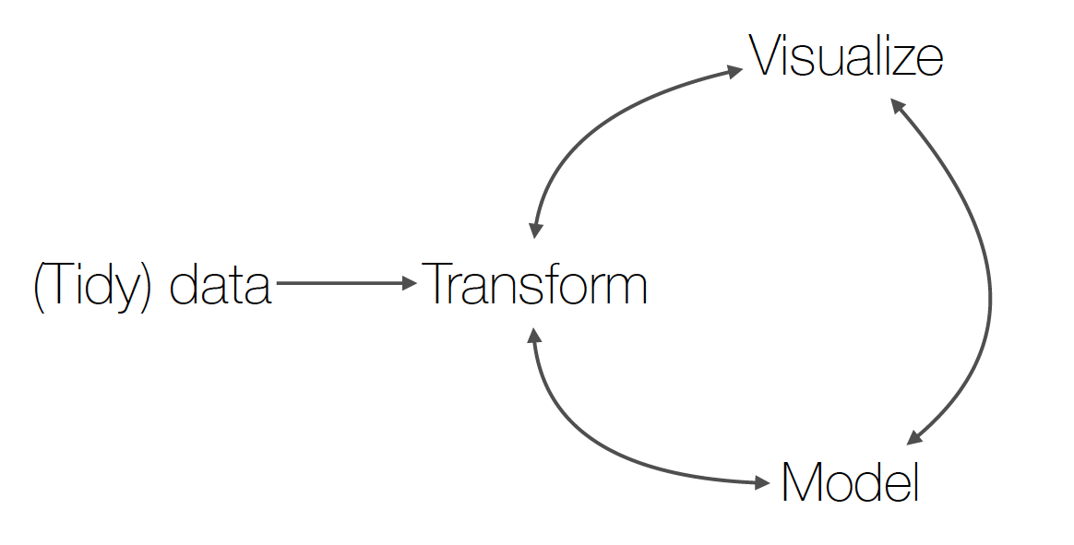
The data analysis cycle
Modified from Hadley Wickham...borrowed from Sean Anderson

Slide 5
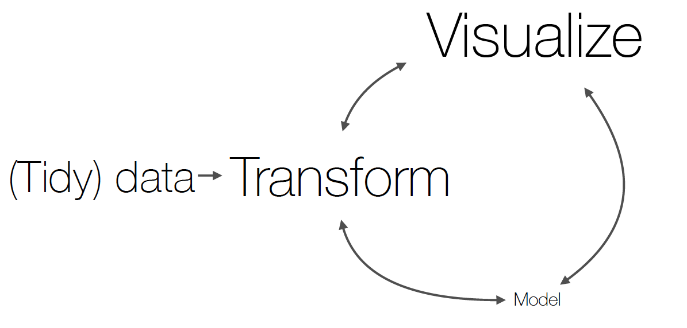
The data analysis cycle
Modified from Hadley Wickham...borrowed from Sean Anderson

