Slide 1
MBE 2017 R workshop
Luis Malpica Cruz
PhD Candidate
E2O Research Group - SFU

Slide 2
Needed software and codes
R (https://www.r-project.org/)
R Studio (https://www.rstudio.com/products/rstudio/download/)
*Desktop version...the free one
Download file from:
https://github.com/lmalpica/Rworkshop_MBE2017.git

Slide 3
Schedule
Today:
Intro to R, tidy data, show of R
Next day:
Stats in R, plotting in R

Slide 4
Intro to R
What is R?
Why not P...Q...or S?

Slide 5
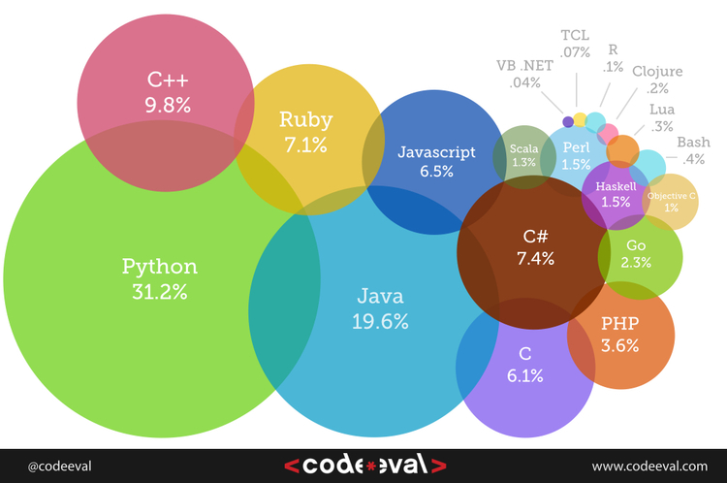
Intro to R
An open source programming language and software environment for statistical computing and graphics that is supported by the R Foundation for Statistical Computing.
Wikipedia 2017

Slide 6

But why???

Slide 7

But why???
Open, shared, and reproducible research!!!

Slide 8

Intro to R
“R is free but not cheap” (Carl Schwarz)
Please, ask away!

Slide 9


Hands on approach!
STOP!
HELP!
GO!

