Slide 1
Realizzare un emulatore di videogiochi
Lorenzo Mancini
EuroPython 2011 – Florence
lmancini@develer.com

Slide 2
Our plan
Give some emulation background
Introduce the canonic 80's video game model
Write an emulator from scratch

Slide 3
Emulation 101
What is an emulator?
  Software/hardware imitating a system
  Accuracy/speed compromise
  “Perfect” emulation – possible?
What are emulators useful for?
  Preservation of existing software
  Existing software restyling
  Compatibility layer

Slide 4
Practical applications
Nintendo's Virtual Console ($66M 2010)
Printers (HP LaserJet)
  As compatibility layer
VMWare's VMTools ($100M 2010)

Slide 5
The overall picture
Interrupts
CPU
Memory
I/O
Graphics
Sound

Slide 6
CPU
CPU
Defines an instruction set
  Can execute programs
The CPU has a state
  Program counter
  Registers
Opcodes and cycles
Often an off-the-shelf component
PC
R1
R2
Rn

Slide 7
Memory
Heterogeneous storage
  Instructions (program)
  Data
Addressable
R/W access from CPU
Memory
P
D

Slide 8
Emulation approaches
Interpreted
  Read and execute instructions one by one
  The CPU is simulated
Dynamic recompilation
  On-the-fly translation for target
  Uses target's CPU (less overhead)
Let's start with the interpreted approach

Slide 9
The emulator core
Fetch-decode-execute loop
for _ in range(cycles_to_execute):
# Fetch
opcode = memory[PC]
# Decode
instruction = decode(opcode)
# Execute
execute(instruction)
PC += 1

Slide 10
Graphics / Sound
Graphic subsystem
  Can be as simple as a video buffer
  Can be as complicated as a GPU
Sound subsystem
They offload the CPU
Often they're custom components
Graphics
Sound

Slide 11
I/O, interrupts, timers
Three related concepts
I/O and the world outside
  How does one check for input data?
Interrupts vs. polling
Timers
I/O
Interrupts

Slide 12
A complete emulator loop
while running:
# Fetch-decode-execute
executeCPU(n_cycles)
# Do we need to generate interrupts?
generateInterrupts()
# Update machine status
updateVideo()
updateSound()
updateTimers()
# synchronize according to n_cycles
sync()

Slide 13
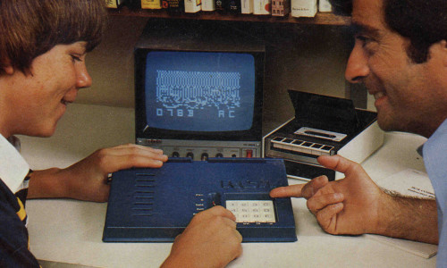
Introducing the Chip-8
A video game VM for hobbyists machines
In a sense, the original Chip-8 was itself an emulator!

Slide 14
Chip-8 tech sheet
CPU
  16 data registers (8 bit), 1 address register (16 bit)
Memory
  4kb RAM (minus 200 bytes actually)
Graphics
  64x32 pixels screen, monochrome, sprite-based
Input: hex keyboard
Timers: delay and sound
No interrupts!

Slide 15
Our target

