Slide 1
UEFI
Unified Extensible Firmware Interface
Laura Maño Archilla
https://github.com/lmanoarchilla
Notes:
Hello ! i am Laura i am a computer engineer, first of all sorry for my english (vallecas style), this is my first talk in english, and i am going to talk about UEFI, I want to clarify concepts about this topic, my interest about that begins in my final project degree, two years ago a started to learn how to do boot apps, and how to do a bootloader and i see that is a lot of information, so complex, all in english and not accessible for all.
But now we have and open standard and every body can do a compliment uefi app . I will start with the definitions, explaining the more interesting data structure, some of implementations, and some extra

Slide 2
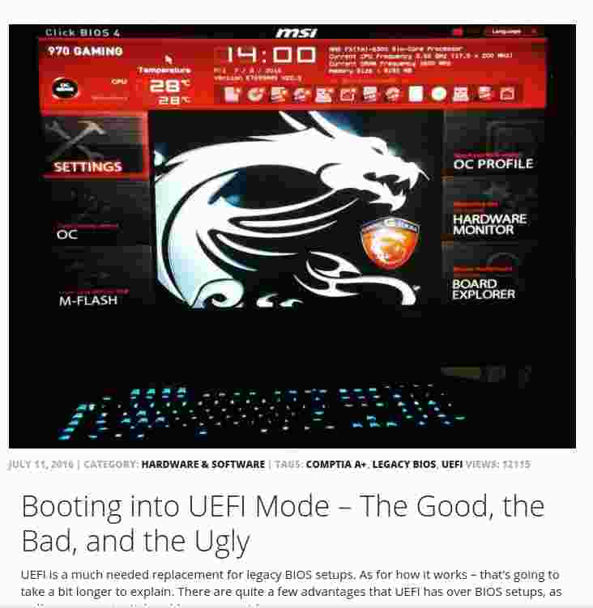
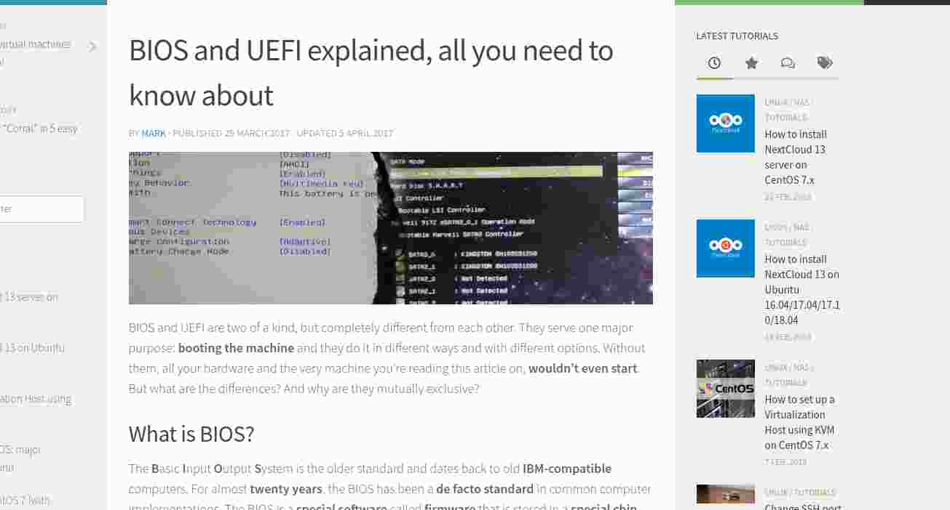
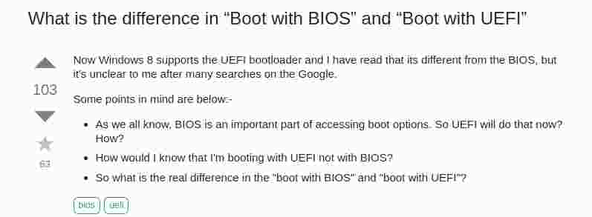

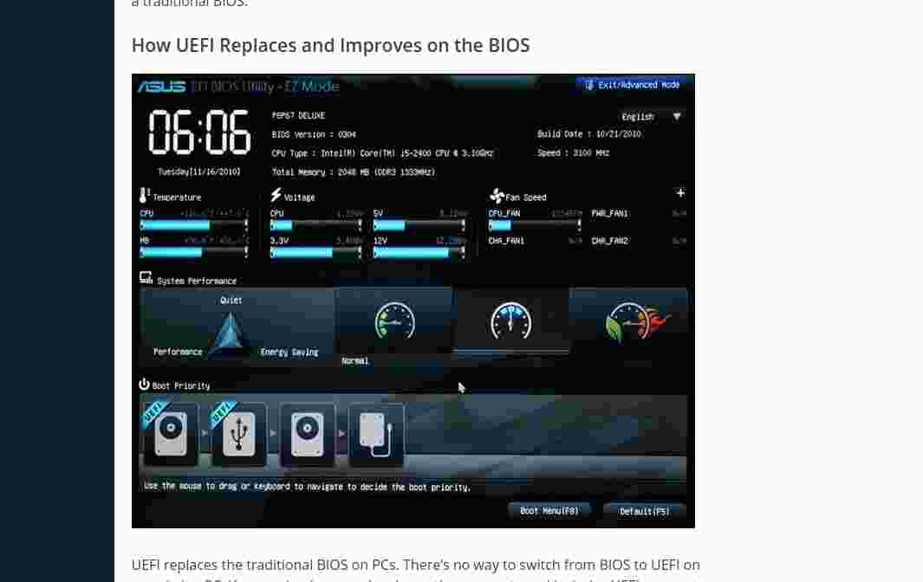
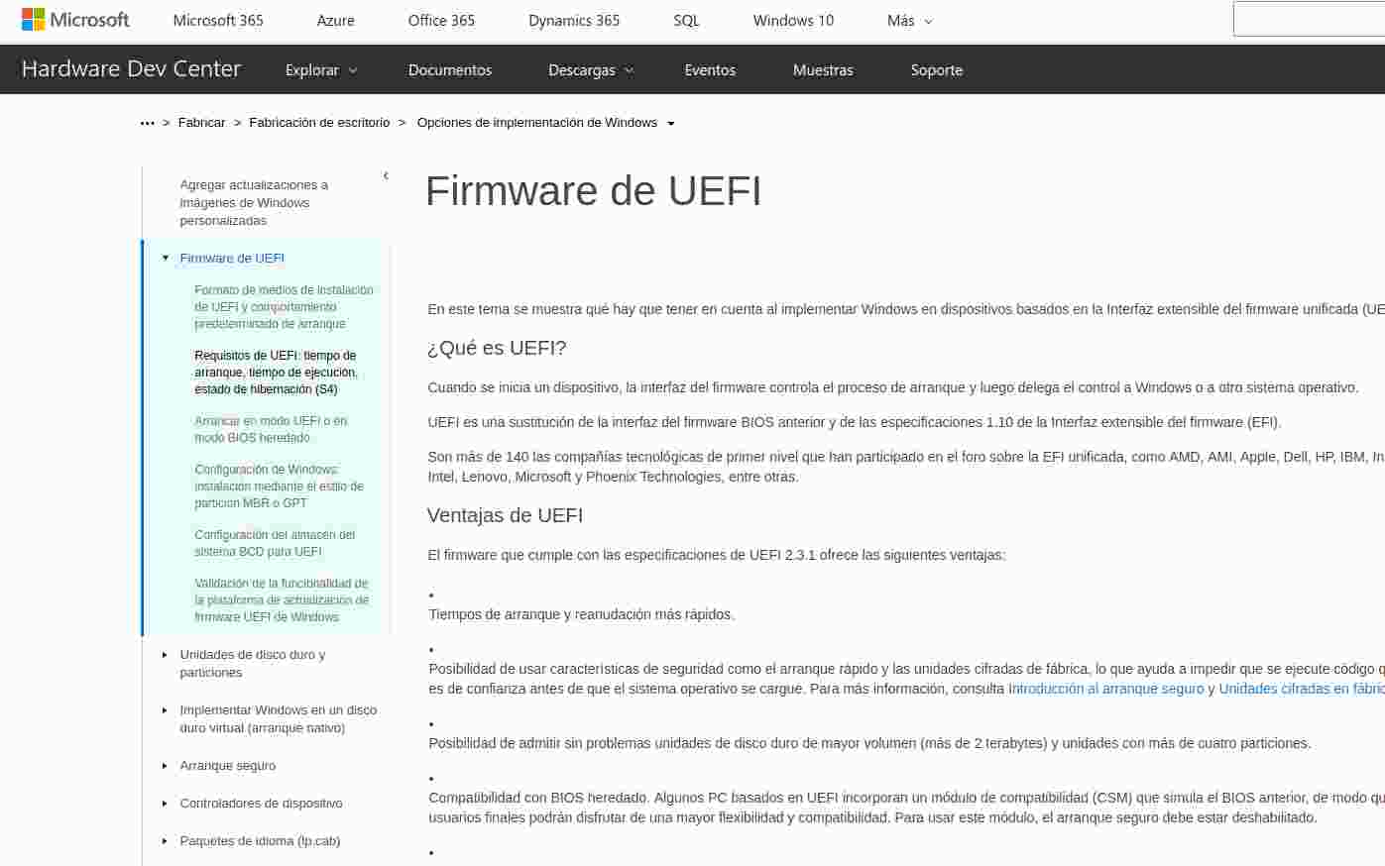
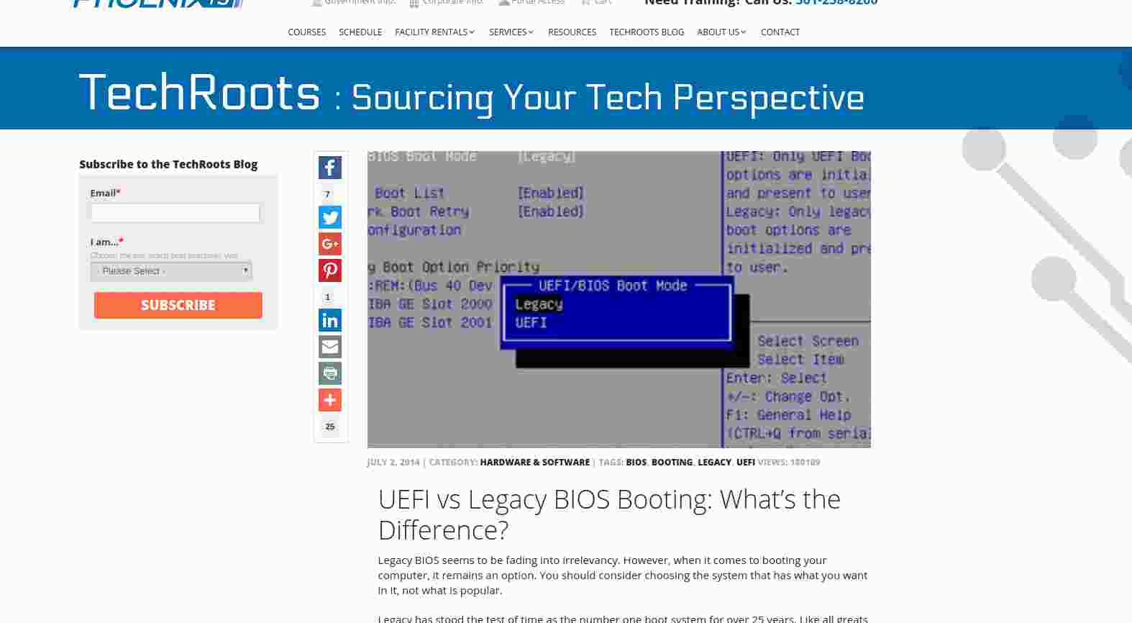
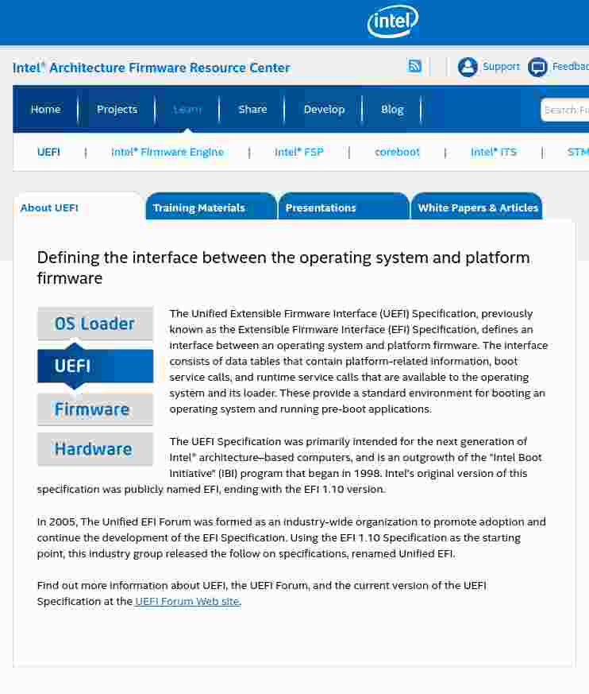
What the hell is UEFI?
Notes:
In the last years we were listened the word UEFI, but what is that? Is the new Bios? is a chip? Is new demon Intel-WIndows sotfware?
Uefi is only a specification that describes an interface between OS and platform firmware (AKA BIOS)
The interface have data tables with platform-relates information, boot and runtime services calls that are avaible to the operating system and it's loader.
It defines a set of of interfaces and structures that platform firmware must implement.
Uefi wants to be a standard enviroment for booting and pre-OS , where we can run pre-os apps
It was made by Intel for create a new form of booting for the Itanium procesor, it was called IBI (Intel boot initiative). In june of 2004 (two thousand and four) the foundation code was released, it was named Tiano, this code was evolved in to the framework EDK, EDKII and actually under the TianoCore community.

Slide 3
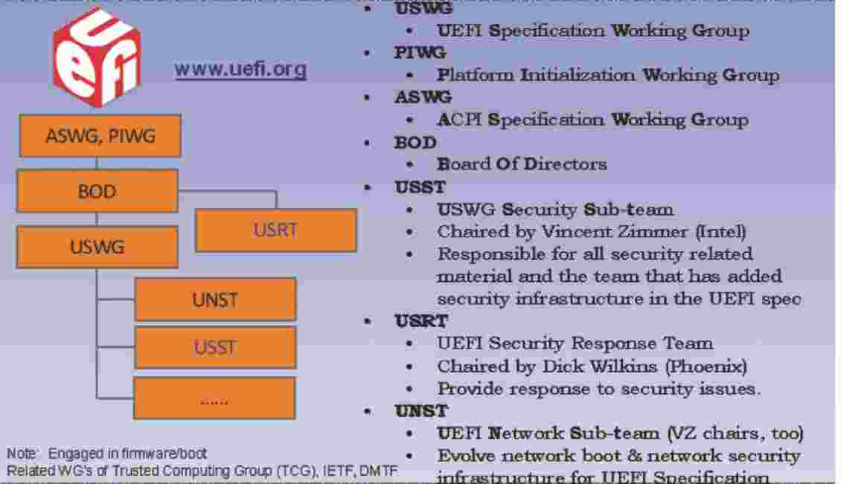
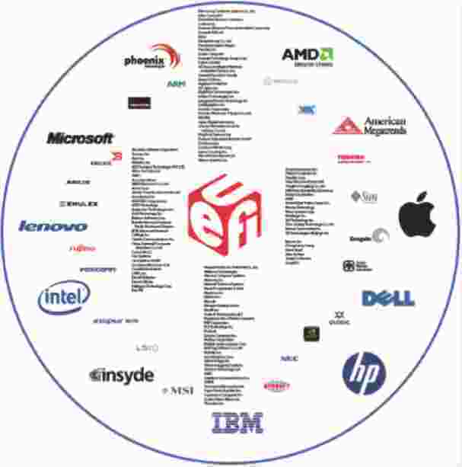
UEFI FORUM
Notes:
Uefi it is based originally in in EFI Especcificatíon published by Intel, this was contributed for the UEfi forum for evolve to UEFI.
The UEfi Forum is formed by tech companies to maintain and evolve the specificaciton, worlwide adoption and promotion of UEFI spec.

Slide 4
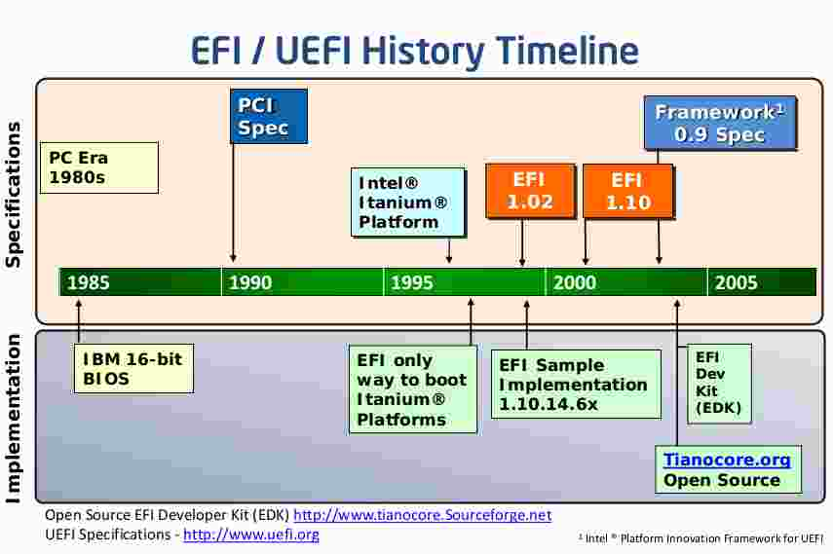
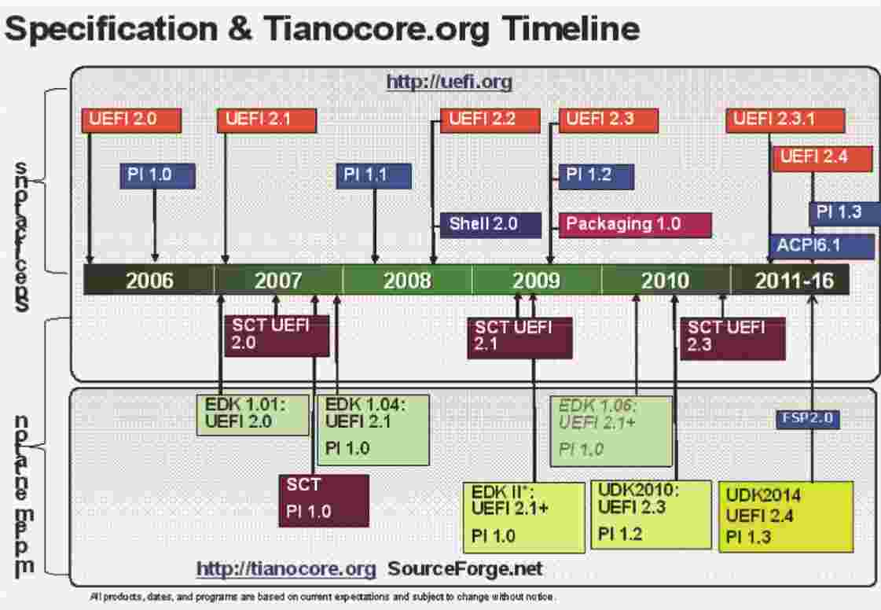
A little bit of history
Notes:
Explicación

Slide 5
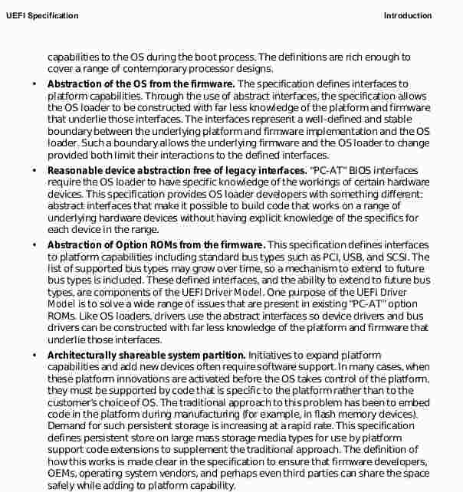
What UEFI spec says about itself
Abstraction
Compatibility
Scalable
Open
Extensible
Standard
Code reuse
High level programing
Notes:
- Coherent, scalable platform enviroment: every new device require FW developers a lot of work to link the new capabilities of th device with the actual SW and often requires changes in the OS, the spec wants to define a complete solution for the FW to describe all pLatform features and surface platform capabilities.
- Abstraction of the OS from the FW: the spec defines a set of interfaces for the platform capabilities. When the bootloader use these interfaces it have less knowledge about the platform and firmware., and both can change independently of each other
- Reasonable device abstraction free of legacy interfaces: bis
- Abstraction of Option ROMs from the firmware: they create a driver model , this is another interface for the bus types and to extend it.
- Architecturally shareable system partition: the spec defines persistent store on large mass storage media types for use by platform support code extensions to supplement the traditional approach.
- The specification defines an open, extensible interface that lends itself to the creation of platform “drivers.
- Avoids redefining interfaces and structures
- Compatibility by design

Slide 6
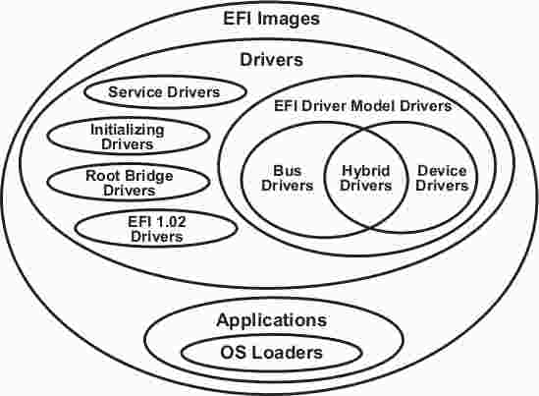
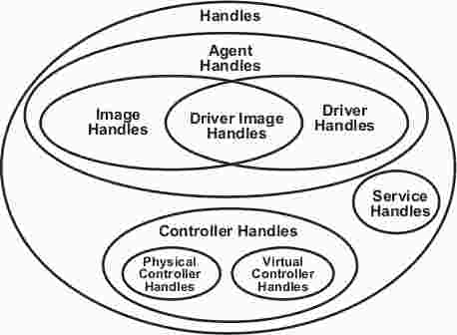
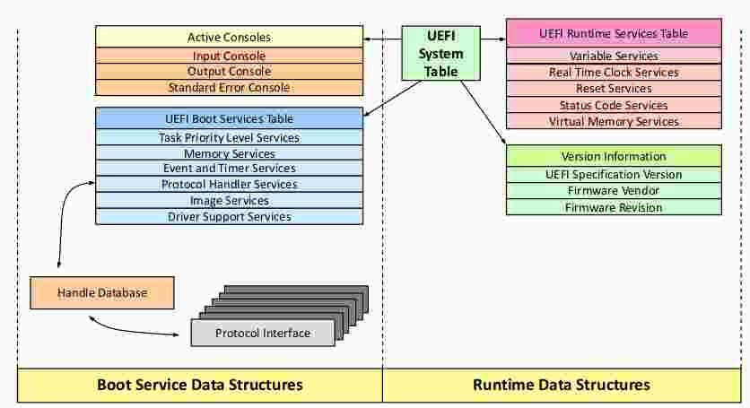
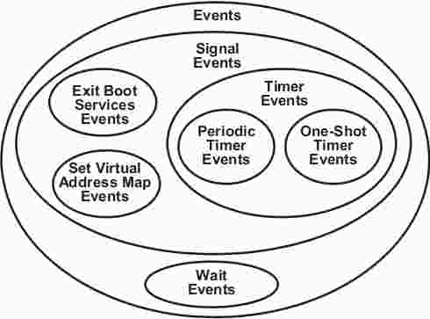
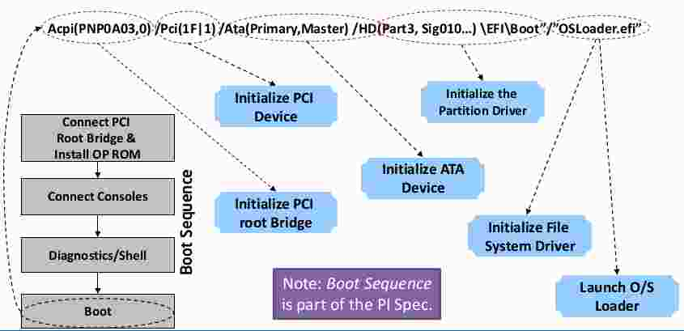
Basic UEFI Architecture
Notes:
- UEFI system table:primary data structure with data information and function calls to interface with the systems
- Handle database and protocols: data structure in which callable interfaces are registered
- Uefi images: executable content
- Events: UEFI does not support interrupts. instead uefi support polled drivers
- Device path: data structure in which device information is stored (Path, bus, partition, important files in it)
- objects: all the things in Uefi interface

Slide 7
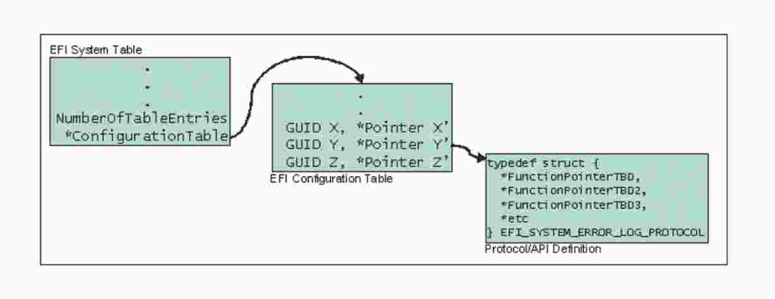
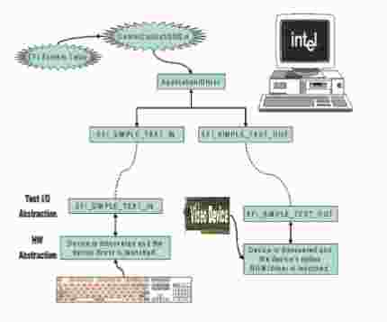
UEFI System table
Notes:
System table: it has pointer to another tables, to the services
Boot services and runtime services, these are minimum services that UEFI spec establishes,
Boot services: have a minimal set of services for boot a OS like memory allocation services, events, timer, handler services (install, locate, openprotocol, locate handler), image services, (load, start, unload...) and the most important Exitbootservices.
Runtime services: the most important services are, variables services, and virtual adresing.
Protocols services: extra services created by developers
Uefi Define a pointer for directly use of a console in the system table for interact with the user, this console is transform in a really complex shell in EDKII implementation. we can interact with our firmware more than a menu but in propietary implements , it isnt avaible

Slide 8
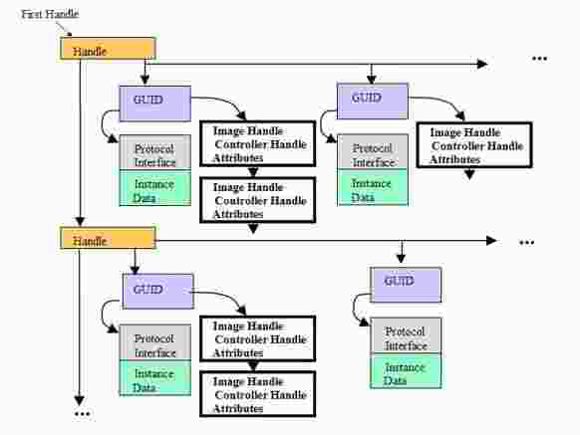
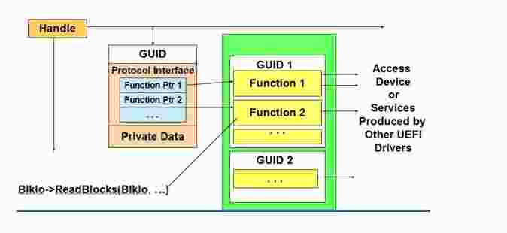
Handle database & Protocols
Notes:
Handle database: is a collection of protocols, one handle have related protocols, but one protocol inst have more than one.
Protocols: is another data structure with it can be empty or contain , services, data, drivers, applications, path.. etc. these protocols can have and callable interfaces .they have a unique Guid each one.
This information can be accesed by any executable image in the UEFI system.
Protocols and handles are accesible by services in the system table. Is it not harcoded

Slide 9
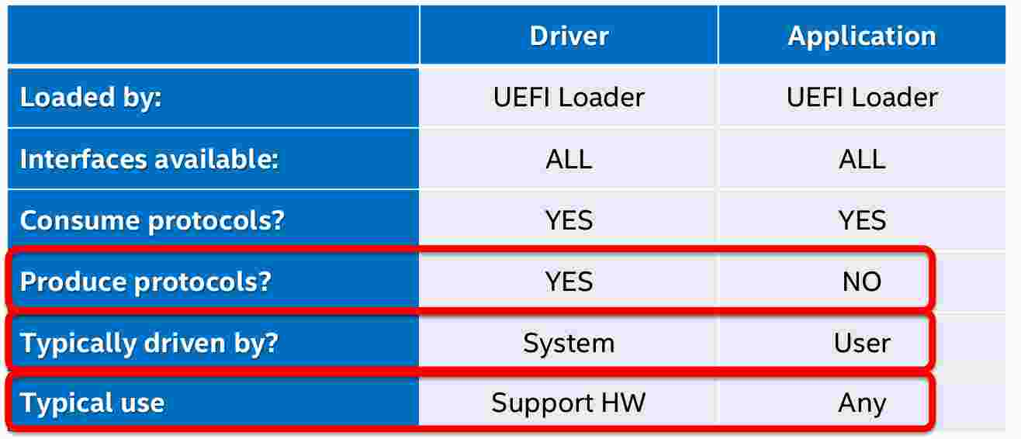
Images : APPS & drivers
Notes:
Images: are all executables things in UEFI, a pointer of the handle created by the loader application and the system table is given like a parameter in the app, the UEFI images can be loaded and relocated anywhere in the system memory
apps: their memory and state is erased in the exit
BS drivers: their memory and state is erased when the boot loader gi8ve the control to the system
RT drivers: memory and state persist throughout the evolution of the machine. they can be invoked by the OS

Slide 10

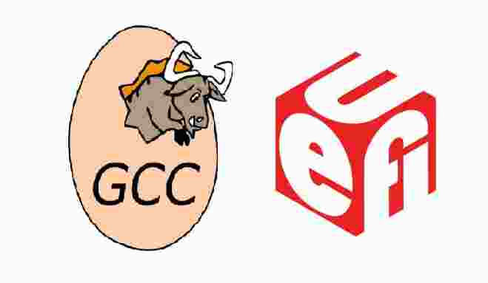
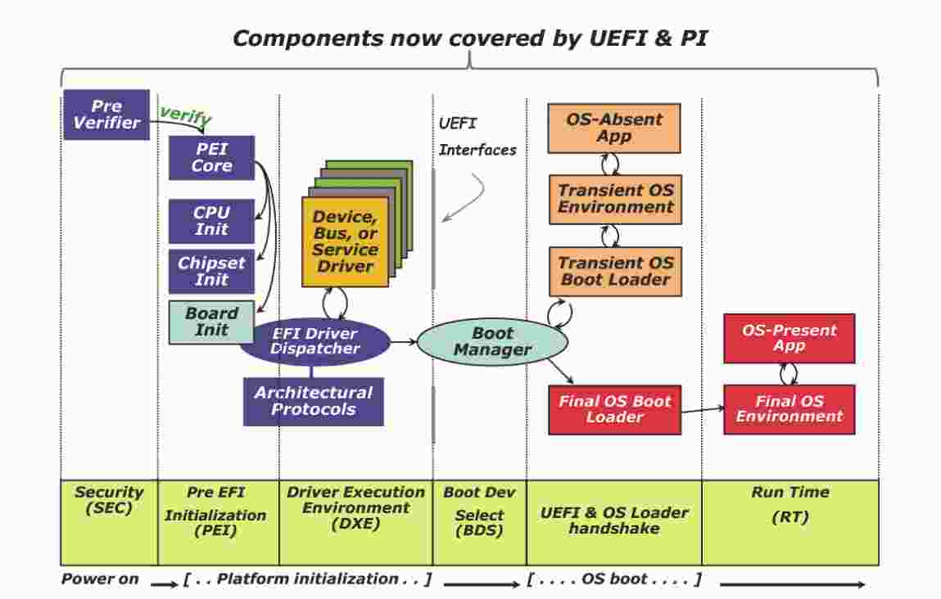
Open Implementations
Notes:
Implementaciones-
We have two free implementations, accesible with relative documentation about it, there are more but isn't for comercial purposes.
-GNU-EFI: is a gnu toolchain for build applications that can run in UEFI enviroment.
https://sourceforge.net/projects/gnu-efi/
GNU-EFI is widely use for programsthat helps format and create bootable USB flash drives, like rufus, refit, Tails, Clover
-EDKII: is framework implemented based in PI spec, it build all of the Firmware and UEFI boot. everybody can clone theri repository, and do all process or a part, it is formed in modules and packages.

Slide 11

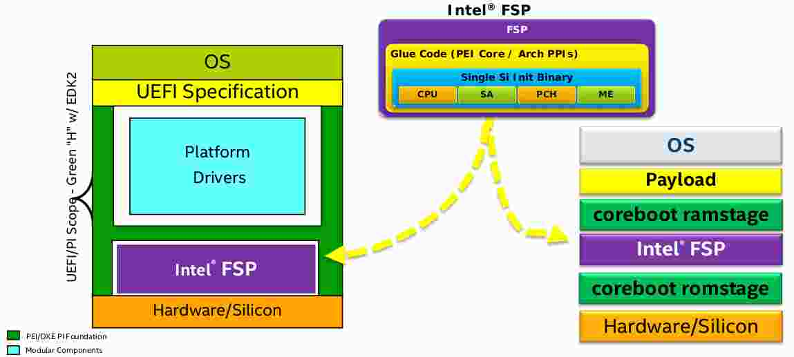
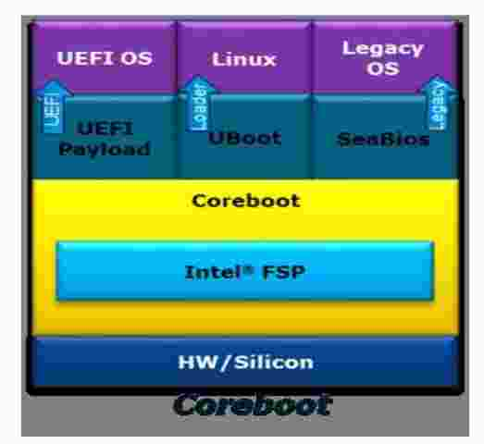

More open implementations
Notes:
coreboot is a little minimal code for initializing hardware, its need a payload for boot an OS (it is more than bootloader neither like other payloads)
Libreboot is a is a coreboot distribution (distro) with proprietary software removed, intended to be a free (libre) ‘BIOS’ replacement for your computer and as a payload a grub Loader in the most case.
Coreboot assumes every bootloader you want , even someone compliment with UEFI. Coreboot It does not have the media drivers and isnt provide services required by an OS, in that case UEFI payload provides UEFI services on top of coreboot that allows UEFI OS boot
Intel FSP , Intel® Firmware Support Package (Intel® FSP) components, provides silicon initialization ingredients, in the image we can see in the case of we have an intel processor we need this package for the initialization.

Slide 12
Extras and links
http://uefi.org/
http://www.tianocore.org/
https://firmware.intel.com/learn/uefi/about-uefi
https://wiki.osdev.org/UEFI
https://www.coreboot.org/
https://msdn.microsoft.com/es-es/library/windows/hardware/dn938339%28v=vs.85%29.aspx
Notes:
Emulator: i don't talk about emulation of code, because it is enough with UEfi, but for say something, bochs is not an option, qemu only can emulate apps and drivers, edk II offers a “UEFI bios” for emulate GNU-EFI or EDKII apps. In EDK II too we have a variety of platform simulator. It is maybe a Qemu under that.
Debug-
This talk begins with a Pekeinfo’s talk in H-con, it is about reversing firmwares, we want to add extra content for this talk but we haven't any time to do it, but we encourage to do an assembly here in faquin, about this topic or another related.
I can put slides and slides of links but I recommend that for begin.

