Slide 1

Breast Cancer Prediction with Machine Learning
This project aims to develop a robust cancer prediction model using machine learning techniques
THE outcome of the research is a model , trained to accurately predict the outcome (malignant vs benign) - based on tumor features from the dataset described below

Slide 2

Breast Cancer Prediction with Machine Learning
About this project About the dataset
Data preprocessing
Exploratory analysis
Data cleansing
Feature engineering
Model training and tuning
FINAL TIPS & TAKEAWAYS

Slide 3
About this project
Code is available HERE: https://github.com/lmanov1/CancerPrediction
The project consists of several notebooks (5) that cover different aspects of the model development process
Each notebook can be run separately. It will read an output of a previous Notebook , and save its work by the end for the next one to use
For example, 5_modeltraining.ipynb will read a pickle saved by 4_FeatureEngeneering.ipynb , and save the work as a FinalModelScores.xlsx
All intermediate data saved in ‘intermidiatedata’ folder.in addition, All files zipped available for download here: https://drive.google.com/drive/folders/1299AaXpzSqLtmCmHTQCcWJqcGHFNtYBD?usp=drive_link
Best to run with Jupiter and not colab

Slide 4
About the dataset
The Breast Cancer Wisconsin (Diagnostic) Dataset was created by Dr. William H. Wolberg, W. Nick Street, and Olvi L. Mangasarian.
This dataset is widely used in machine learning and medical research for breast cancer diagnosis
THE dataset is a collection of data regarding breast cancer tumors
It contains features computed from digitized images of fine needle aspirates (FNA) of breast masses
These samples were taken from patients with solid breast masses
Features were computed from these digitized images, focusing on the characteristics of cell nuclei
List of features can be found Appendix A
For each of original 10 features originating from the digitized image , there are three computed values
mean
standard error (se)
greatest value (worst - mean value of three largest values)
Finally, there are total 30 features in a dataset
Each instance in the dataset is labeled as either benign or malignant, facilitating binary classification tasks
Original Dataset is available at the UCA Machine Learning Repository at:
https://archive.ics.uci.edu/ml/datasets/Breast+Cancer+Wisconsin+(Diagnostic)

Slide 5
1. Data preparation
There is a single table with a single binary categorial feature
Rest of features are continuous
No text
Dropped ‘Unnamed: 32’ feature , as it contain no data
Dropped ‘id’ feature – where all values are unique so cannot be used for classification
Flat file saved as IntermidiateData/1_Flat_Cancer_Data.pkl

Slide 6
2. Explanatory data analysis
consider
Data protocol files saved under the DataProtocol folder
Automated reports with AutoViz – different plots saved under AutoVizPlots folder 10 features are highly correlated with its counterparts (no surprises as all computed/engineered from the physical ones)
Highly correlated features (multicollinearity) will be addressed during the feature selection stage.
Descriptive statistics and visualization per feature data type (categorial, continuous) , describe target value
Converting categorial ‘diagnosis’ to string. There are 2 classes here – benign or malignant
Out of the dataset observations - 63% benign , 47% malignant. Technically, data is not imbalanced.
Among the continuous features, while some are nearly exponentially distributed, others are are nearly normal distributed , with majority of them right-skewed , with some outliers. Consider to use technics that are not assume normal distribution
There are some features that tends to have bigger values when diagnosis is ‘malignant’. On the other hand , there are some that do not show such tendency so it will be possible dropped during feature selection stage
While grouped by diagnosis , t-test statistics of the feature groups groups are statistically significant , meaning the 2 groups has different distributions (means) and thus can be classified by diagnosis. This fact is then thoroughly visualized with histplots and boxplots
No missing data in the dataset
Final data frame saved as IntermidiateData/ 2_EDA_Cancer_Data.pkl

Slide 7
3. Data cleansing
consider
Continuous features visualization – see previous slide . All 30 continuous features are float64 , and the target is dummy (currently int64)
Outliers – visualization with boxplots. As seen previously , not all features are normally distributed , thus using IQR for out liers detection.
Compute correlations to a target feature before and after dropping outliers (spearman , same reason as previously) . Visualizing differences
Compute distributions before and after dropping outliers . Visualizing differences
There are no outliers in the dataset that change distribution but not correlation – thus no need to drop outliers
No missing values - visualization
Final data frame saved as IntermidiateData/3_Final_Cancer_Data.pkl

Slide 8
4. Feature engineering and features selection
consider
Most features on dataset are engineered and preprocessed , there is nothing obvious to construct.
Correlations are visualized in EDA previously
Label encode target variable: B = 0 , M = 1
Examine with unsupervised model to understand if the 2 classes can be efficiently separated , so that classification task can be done on the dataset. Using Kmean, OneClassSVM, GaussianMixture. Best silhouette score – to GaussianMixture (0.79)
Feature selection – finally feature selection done based on number of tests , both Univariate and Multivariate
Univariate tests
paired t_test - compare 2 groups (observations grouped by outcome classes) and find out whether there is a significant difference in paired measurements (p < 0.05). 5 features doesn’t have significant differences. (As seen with histplots in EDA previously) – drop it , reducing to 26 features
k-best 15 features selection using chi2,f_classif, f_regression – each returns a slightly different list of best 15 features
Multivariate tests on 26 features with number of regression models (8) including Lasso and Ridge, etc. Choosing features selected by at least 5 models. Resulting in same 26 features
Choosing features where there is a maximum interception between the list of features created by the different tests (which is an interception between the multivariate list and the kbest with chi2 ) , resulting in 9 (15) features
Final data frame saved as IntermidiateData/4_FeatureEngeneering_Cancer_Data.pkl

Slide 9
5. Model selection and fine tuning
consider
Splitting the data. As Data set is very small , data splitting proportions has huge impact on final models results, to the extent when just dropping dev split for good will improve model performance dramatically. Cross-validation technique used with gridSearch can compensate for absence of a dev set to a certain extent
Choosing best classification metrics : most valued metrics will be 'recall’ since we are interested in minimizing false negatives (i.e. interested in predicting positive class precisely as a false negative penalty is very high ). As we also interested in maximizing true negatives , finally we can use ‘f1’ score
Hyperparameters tuning: 7 different classifier models were examined , hyperparameters tuning on each included GridSearchCV and cross-validation (with k-fold)
Model selection – predicting on best estimator for each model returned with GridSearch and choosing best performing model.As we are interested
Basic models tuning with GridSearchCV and cross-validation on train set reveals that SVM has best f1 and recall scores , without overfitting
Fine tuning selected SVM model
Stratification policies on grid search and data split in general degrade performance of chosen model. Same goes for fold number.
Scaling data improve SVM performance
Examined differed parameters to a SVM gridSearch
Final data frame saved as IntermidiateData/5_FinalEvaluationScores.xlsx

Slide 10
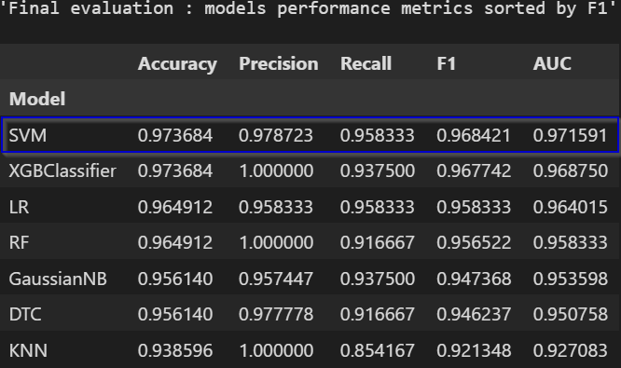
FINAL TIPS & TAKEAWAYS

Slide 11
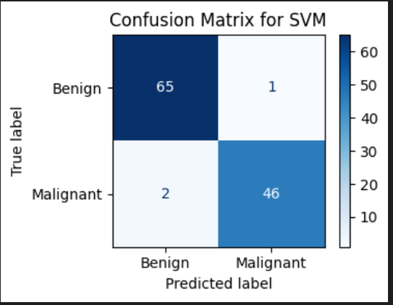
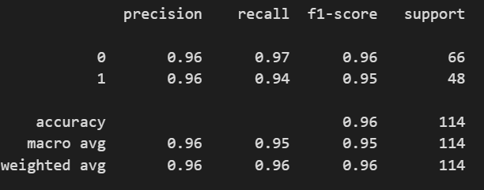
FINAL TIPS & TAKEAWAYS

Slide 12
FINAL TIPS & TAKEAWAYS
Consistent rehearsal
Strengthen your familiarity
Refine delivery style
Pacing, tone, and emphasis
Timing and transitions
Aim for seamless, professional delivery
Practice audience
Enlist colleagues to listen & provide feedback
Seek feedback
Reflect on performance
Explore new techniques
Set personal goals
Iterate and adapt

Slide 13
Appendix A – characteristics of a Breast Cancer Wisconsin (diagnostic) dataset
Number of Instances: 569
Number of Attributes: 30 numerical attributes used for prediction, along with a class label.
Class Distribution: 212 – Malignant, 357 – Benign
REAL FEATURES DERIVED FROM DIGITIZED IMAGES OF TUMORS
a) radius (mean of distances from center to points on the perimeter)
b) texture (standard deviation of gray-scale values)
c) perimeter
d) area
e) smoothness (local variation in radius lengths)
f) compactness (perimeter^2 / area - 1.0)
g) concavity (severity of concave portions of the contour)
h) concave points (number of concave portions of the contour)
i) symmetry
j) fractal dimension ("coastline approximation" - 1) Breast Cancer Wisconsin (Diagnostic) Dataset - GeeksforGeeks
Classes | 2
Samples per class | 212(M),357(B)
Samples total | 569
Dimensionality | 30
Features | real, positive

Slide 14

THANK YOU
Lidia Manov
BIU17 Sep 2024
peru12003@gmail.com
https://github.com/lmanov1/CancerPrediction

