Slide 1

Breast Cancer Prediction with Machine Learning
This project aims to develop a robust cancer prediction model using machine learning techniques
The outcome of the above research is a model , trained to accurately predict the outcome (malignant vs benign) - based on tumor features from the dataset described below

Slide 2

Breast Cancer Prediction with Machine Learning
About this project About the dataset
Data preprocessing
Exploratory analysis
Data cleansing
Feature engineering
Model training and tuning
Conclusions and summary

Slide 3
About this project
Code is available HERE: https://github.com/lmanov1/cancerprediction
The project consists of five notebooks that cover different aspects of the model development process
Each notebook can be run separately. It will read an output of a previous notebook , and save its work by the end for the next one to use
For example, “5_ModelTraining.Ipynb” will read a pickle saved by 4_FeatureEngineering.Ipynb” , and save the work as “Intermidiatedata/FinalModelScores.xlsx”
All intermediate data saved by all the notebooks in ‘IntermidiateData’ folder. In addition, all intermediate files available for download zipped , here: https://drive.Google.Com/drive/folders/1299aaxpzsqltmcmhtqccwjqcghfntybd?Usp=drive_link
Best to run with Jupiter and not colab

Slide 4
About the dataset
The Breast Cancer Wisconsin (Diagnostic) Dataset was created by Dr. William H. Wolberg, W. Nick Street, and Olvi L. Mangasarian.
This dataset is widely used in machine learning and medical research for breast cancer diagnosis
THE dataset is a collection of data regarding breast cancer tumors
These samples were taken from patients with solid breast masses
Features were computed from these digitized images of fine needle aspirates (FNA) of breast masses, focusing on the characteristics of cell nuclei
List of features can be found Appendix A
For each of original 10 features originating from the digitized image , there are three computed values
mean
standard error (se)
greatest value (worst - mean value of three largest values)
Finally, there are total 30 features in a dataset
Each instance in the dataset is labeled as either benign or malignant, facilitating binary classification tasks
Original Dataset is available at the UCA Machine Learning Repository at:
https://archive.ics.uci.edu/ml/datasets/Breast+Cancer+Wisconsin+(Diagnostic)

Slide 5
1. Data preparation
There is a single table with a single binary categorial feature - diagnosis (benign/malignant)
Rest of features are continuous
No text
Dropped ‘Unnamed: 32’ feature , as it contain no data
Dropped ‘id’ feature – where all values are unique so cannot be used for classification
Replaced spaces with underscore in feature names
Flat file saved as IntermidiateData/1_Flat_Cancer_Data.pkl

Slide 6
2. Exploratory data analysis
Data protocol files saved under the DataProtocol folder
Automated reports with AutoViz – different plots saved under AutoVizPlots folder 10 features are highly correlated with its counterparts (no surprises as all computed/engineered from the physical ones)
Highly correlated features (multicollinearity) will be addressed during the feature selection stage.
Descriptive statistics and visualization per feature data type (categorial, continuous) , describe target value
Converting categorial ‘diagnosis’ to string. There are 2 classes here – benign or malignant
Out of the dataset observations - 63% benign , 47% malignant. Technically, data is not imbalanced.
Among the continuous features, while some are nearly exponentially distributed, others are are nearly normal distributed , with majority of them right-skewed , with some outliers -> consider to use technics that are not assume normal distribution
There are some features that tends to have bigger values when diagnosis is ‘malignant’. On the other hand , there are some that do not show such tendency so it will be possible dropped during feature selection stage
While grouped by diagnosis , t-test statistics of the feature groups groups are statistically significant , meaning the 2 groups has different distributions (means) and thus can be classified by diagnosis. This fact is then thoroughly visualized with histplots and boxplots
No missing data in the dataset
Final data frame saved as IntermidiateData/ 2_EDA_Cancer_Data.pkl

Slide 7
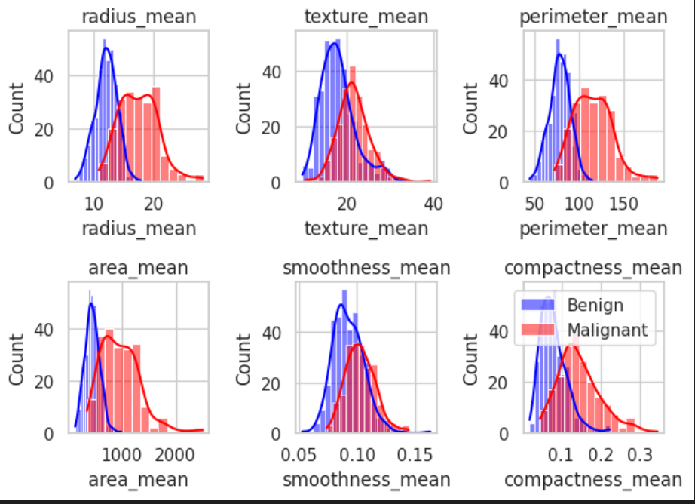
2. Explanatory data analysis
The best image from the EDA about this dataset , demonstrating a potential for classification , at least on part of features of the dataset

Slide 8
3. Data cleansing
Continuous features visualization – see previous slide . All 30 continuous features are float64 , and the target is dummy
Outliers – visualization with boxplots. As seen previously , not all features are normally distributed , thus using IQR for out liers detection.
Compute correlations to a target feature before and after dropping outliers (spearman , same reason as previously) . Visualizing differences
Compute distributions before and after dropping outliers . Visualizing differences
There are no outliers in the dataset that change distribution but not correlation – thus no need to drop outliers
No missing values - visualization
Final data frame saved as IntermidiateData/3_Final_Cancer_Data.pkl

Slide 9
4. Feature engineering and features selection
Stratification policies on grid search and data split in general degrade performance of chosen model. Same goes for increasing folds number.
Scaling data improves SVM performance
Removing columns with high correlations to each other (treat multicollinearity) – did not improved performance . Option to try – dimensionality reduction with PCA
the list of features created by the different tests (most close to k-best with chi2 resulting list) , resulting in the 15 final features
Final data frame saved as IntermidiateData/4_FeatureEngeneering_Cancer_Data.pkl

Slide 10
4. Feature engineering and features selection
Most features on the dataset are engineered and preprocessed, there is nothing obvious to construct
Correlations were visualized in EDA previously
Label encode target variable: B = 0 , M = 1
Perform examination with unsupervised model to determine if the two classes can be efficiently separated, so that supervised classification can be done on the dataset.
Using Kmean, OneClassSVM, GaussianMixture. Best silhouette score – to GaussianMixture (0.79)
Features selection – final features selection based on multiple tests, both Univariate and Multivariate, as described below
Univariate tests
paired t_test - compare 2 groups (observations grouped by outcome classes) and find out whether there is a significant difference in paired measurements (p < 0.05) of features. 5 features found to not have statistically significant differences. (As seen with histplots in EDA previously) – those 5 where dropped, reducing dataset to 26 features
k-best 15 features selection using chi2,f_classif, f_regression methods – each returns a slightly different list of best 15 features
Multivariate tests on 26 features with number of regression models (8) including Lasso and Ridge, etc. Then choosing the features selected by at least 5 different models. Resulted in same 26 features – no recommendation to drop additional features.
Finally choosing features where there is a maximum interception between the list of features created by the different tests (most close to k-best with chi2 resulting list) , resulting in the 15 final features

Slide 11
5. Model selection and fine tuning
Splitting the data: as the data set is very small , data splitting proportions have huge impact on the results, to the extent when just dropping a dev split for good will improve model performance dramatically. Cross-validation technique used with grid search can compensate for absence of a dev set to a certain extent
Choosing the best classification metrics: the best metrics will be ‘recall’, since we are interested in minimizing false negatives (i.e. interested in predicting positive class precisely as a false negative penalty is very high). As we are also interested in maximizing true negatives, finally we can use ‘f1’ score
Hyperparameters tuning: 7 different classifier models were examined, the hyperparameters tuning on each included grid search with cross-validation (k-fold)
Model evaluation process: predicting on the test set with the best estimator per examined model (best estimators fitted with best chosen parameters as returned by a grid search), and then choosing the best performing model(s) according to the classification reports
The SVM classifier has the best f1 and recall scores and without overfitting, especially on a positive label in classification report, compared to all other examined models. Next following was XGBClassifier model.
SVM with recall (on malignant label) of 96% and f1 (on malignant label) of 97%
XGBClassifier with recall (on malignant label) of 96% and f1 (on malignant label) of 98%
Results after fine tuning on selected SVM and XGBClassifier models
Using extended set of grid parameters to grid search with cross-validation and custom refit function that returns best estimator that corresponds to a custom scoring method. The best estimator is the fastest model, chosen from all the results that reached minimal recall value (threshold of 0.9), and within a single standard deviation of the best of those, by f1 metrics value.
Final data frame saved as IntermidiateData/5_FinalEvaluationScores.xlxs

Slide 12
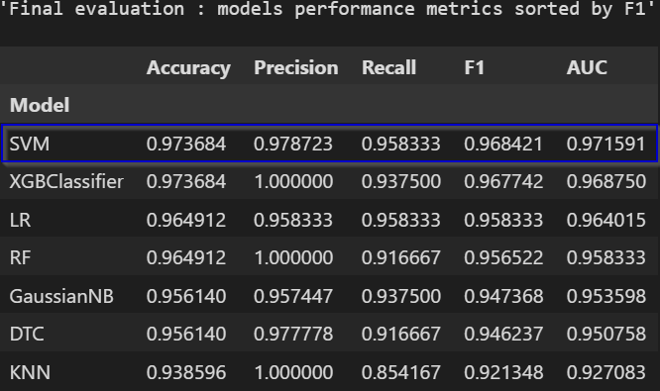
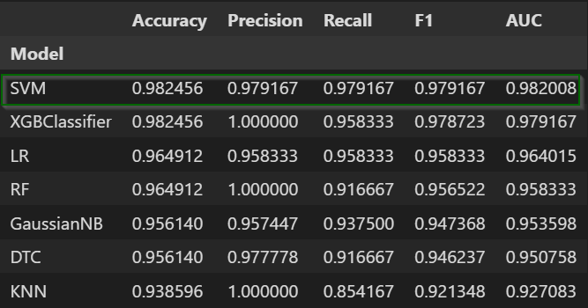
Best model is SVC but let’s give a chance to XGBoost too, to see how fine tuning can improve relevant scores of the both models

Slide 13


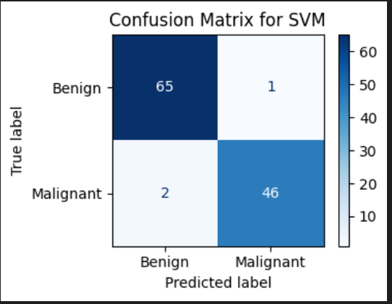
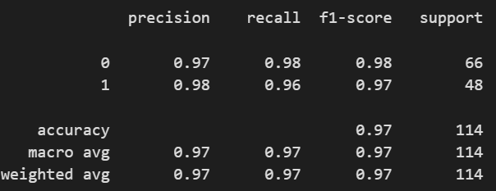
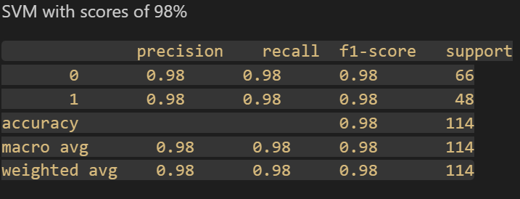

Validation
Fine tuning

Slide 14
Conclusions and summary
Breast cancer diagnosis can be predicted with roughly 98% of accuracy , precision , f1 and recall, using original 30 histological tumor characteristics
While precision (positive classifications) is important , still a penalty on false positives is low compared to a false negative (missed cancer). This is why most important metrics to use are recall and f1 (as a harmonic average of recall and precision)
Machine learning algorithm that performed best is SVM - support vector machine, followed by extra boost classifier
The most predictive 15 features found with the procedure described in Feature Selection slide are
radius_mean radius_se perimeter_mean
area_se area_worst concavity_mean
compactness_worst perimeter_se perimeter_worst
concave points_worst radius_worst texture_worst
texture_mean concavity_worst area_mean

Slide 15
Appendix A – characteristics of a Breast Cancer Wisconsin (diagnostic) dataset
Number of Instances: 569
Number of Attributes: 30 numerical attributes used for prediction, along with a class label.
Class Distribution: 212 – Malignant, 357 – Benign
REAL FEATURES DERIVED FROM DIGITIZED IMAGES OF TUMORS
a) radius (mean of distances from center to points on the perimeter)
b) texture (standard deviation of gray-scale values)
c) perimeter
d) area
e) smoothness (local variation in radius lengths)
f) compactness (perimeter^2 / area - 1.0)
g) concavity (severity of concave portions of the contour)
h) concave points (number of concave portions of the contour)
i) symmetry
j) fractal dimension ("coastline approximation" - 1) Origin: Breast Cancer Wisconsin (Diagnostic) Dataset - GeeksforGeeks
Classes | 2
Samples per class | 212(M),357(B)
Samples total | 569
Dimensionality | 30
Features | real, positive

Slide 16

THANK YOU
Lidia Manov
Bar Ilan University BIU17 Sep 2024 – ML module project
peru12003@gmail.com
https://github.com/lmanov1/CancerPrediction

