Slide 1
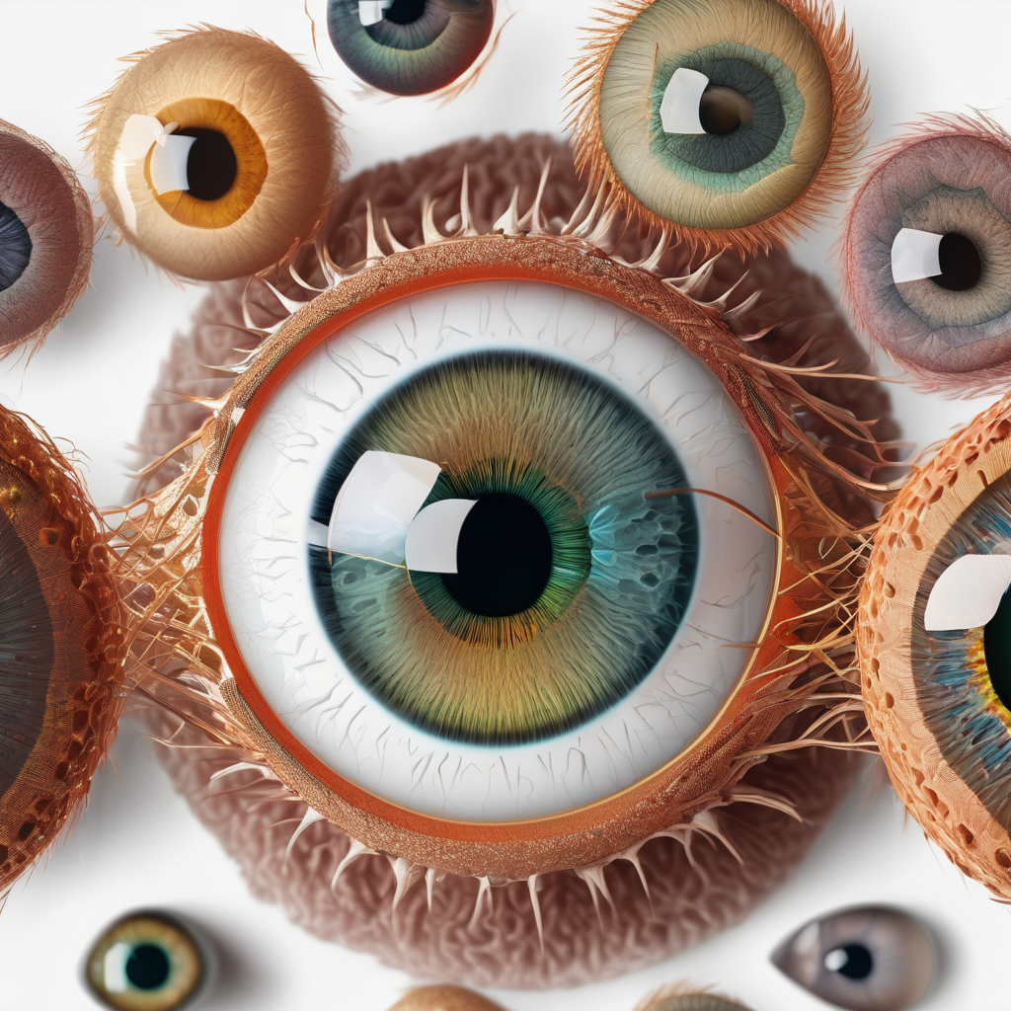
Diabetic Retinopathy Stage Prediction With Deep Learning
A Single-Model Approach to Medical Image Classification

Slide 2
A Single-Model Approach to Medical Image Classification
Brief problem statement
Accurate and efficient Diabetic Retinopathy (DR) stage classification is crucial for timely intervention and improved patient outcomes. Early and accurate diagnosis is critical for preventing vision loss.
Project goals
Develop a high-performing deep learning model for DR stage classification, achieving high accuracy, precision, recall, and F1-score. Evaluate the model's performance thoroughly, and analyze the results for potential improvements

Slide 3
What is Diabetic Retinopathy?
A complication of diabetes that affects the eyes, damaging the blood vessels in the retina.
Stages:
0 - No DR
1 - Mild
2 - Moderate 3 - Severe 4 - Proliferative DR
Early detection is crucial in preventing vision loss and managing DR effectively
AI systems make DR screening more accessible, especially in remote or underserved areas
Automation through AI can accurately identify early signs of diabetic Retinopathy (DR)
How AI can help

Slide 4

Process Flow
Data Ingestion
Kaggle API
Data Preprocessing
FastAI
Model Training
EfficientNet-B7
Model Deployment
Hugging Face
DR Stage Prediction

Slide 5
Detailed Overview
Utilized to streamline data preprocessing with ImageBlock for image handling and CategoryBlock for label management
Data ingestion
Acquired image data and corresponding
DR stage labels from the Kaggle API
Preprocessing pipeline
Standardized image sizes and applied
augmentations to enhance model
robustness
Addressed class imbalance through
weighted random sampling
Model training flow
Fine-tune a pre-trained EfficientNet-B7 model using FastAI and the Adam optimizer
Optimize hyperparameters (learning rate, batch size) for maximum performance
Deployment pipeline
Deployed the trained model to Hugging
Face Spaces for efficient prediction of
DR stages on new input images

Slide 6








Technology Stack
Python
FastAI/PyTorch ecosystem
Kaggle datasets
Deployment: Hugging Face Spaces
Poetry for dependency management

Slide 7
Data Pipeline
Start
2015 Diabetic Retinopathy Detection Dataset
APTOS 2019 Blindness Detection Dataset
Data Combining and Merging
Data Augmentation (Resize to 460, Random Cropping, Rotation, Flipping, etc.)
Train-Validation Split (80/20%)
Model Training Input (Training and Validation DataLoaders)
Weighted Random Sampling (based on class counts)
End

Slide 8
Source Datasets
The data used comprises two datasets:
2015 Diabetic Retinopathy Detection This dataset provides a substantial number of retinal images labeled with DR severity
APTOS 2019 Blindness Detection
This additional dataset supplements the 2015 dataset, offering further data diversity and increased sample size

Slide 9
Solving class imbalance
A significant challenge was the class imbalance present in the combined dataset.
To mitigate this, weighted random sampling was incorporated into the data loading process, assigning higher weights to samples from under-represented classes.
This ensured that minority classes received sufficient attention during training, improving overall model performance.

Slide 10
Data Augmentation Pipeline
Image resizing strategy: 224*224
Augmentation Techniques: To improve model robustness, we applied a set of image augmentations using the FastAI library‘s aug_transforms function with a target size of 224x224 pixels.
These augmentations included:
Random cropping and resizing
Random rotations and flips
Potentially other augmentations (e.g., brightness, contrast, warp)
Validation Split: A 20% holdout validation set was employed to evaluate model performance and prevent overfitting

Slide 11
Why EfficientNet-B7
What is EfficientNet-B7 Model
EfficientNet-B7 is a convolutional neural network (CNN) belonging to the EfficientNet family, known for its high accuracy and efficiency. It's a scaled-up version of EfficientNet-B0, which employs a compound coefficient scaling method to simultaneously scale width, depth, and resolution, resulting in improved performance
EfficientNet-B7 was chosen for its high accuracy on image classification tasks and its relatively efficient computational requirements compared to other state-of-the-art architectures, making it suitable for training on our dataset with reasonable resources.

Slide 12
Potential Model Evaluation
The goal was to identify the model best suited for our dataset and task.
The following table summarizes the performance of each architecture, considering accuracy, precision, recall, and Loss.
parameters |  |  | Loss | Accuracy | Precision | Recall | model
optimizer | Batch size | Epochs
Adam | 32 | 10 | 0.823414 | 0.741495 | 0.902679 | 0.65 | VGG16
Adam | 32 | 5 | 0.90186 | 0.72669 | 0.849109 | 0.6 | ResNet18
 | 32 | 5 | 0.878353 | 0.741495 | 0.902679 | 0.7 | Custom CNN
Adam | 32 | 10 | 0.560641 | 0.771331 | 0.622444 | 0.658213 | resnet50
Adam | 16 | 10 | 0.2 | 0.90186 | 0.849109 | 0.6 | EfficientNet-B7

Slide 13
Transfer Learning and Pre-training
Transfer learning enhances model efficiency by using knowledge from pre-training on a large dataset, like ImageNet, and adapting it for a specific task such as diabetic retinopathy (DR) stage classification, using a smaller dataset.
This approach accelerates training and improves performance, especially with limited data.

Slide 14
Transfer Learning Fine-tuning
Freezing Initial Layers: We trained only the later layers, adapting them to DR image characteristics.
Unfreezing Layers:
Learning Rate Schedule: The one-cycle policy in FastAI, dynamically adjusted the learning rate, starting high and gradually decreasing.
Learning Rate Selection: A learning rate of 0.001 was chosen for fine-tuning based on experimentation or common EfficientNet practices.
Batch Size Optimization: We used a batch size of 8, balancing memory usage and training efficiency.

Slide 15
Results
The model achieved an accuracy of 84.37% after 10 epochs of training.
Overall, the model demonstrated good performance on the Diabetic Retinopathy classification task.
Accuracy | Train Loss | Valid Loss | Precision (Macro) | Recall (Macro) | F1-Score (Macro) | Epoch
0.811784 | 0.60698 | 0.5001 | 0.817514 | 0.821177 | 0.736758 | 1
0.824059 | 0.545057 | 0.480848 | 0.834892 | 0.830024 | 0.748473 | 2
0.834697 | 0.500495 | 0.456291 | 0.84283 | 0.840053 | 0.76152 | 3
0.819149 | 0.537604 | 0.452147 | 0.829414 | 0.827641 | 0.742236 | 4
0.819967 | 0.554973 | 0.46342 | 0.830296 | 0.825523 | 0.747064 | 5
0.822422 | 0.530102 | 0.443685 | 0.828316 | 0.83367 | 0.745598 | 6
0.823241 | 0.496922 | 0.450625 | 0.831087 | 0.832579 | 0.754593 | 7
0.823241 | 0.486911 | 0.438388 | 0.831318 | 0.831251 | 0.748425 | 8
0.835516 | 0.459466 | 0.436297 | 0.841744 | 0.842935 | 0.766008 | 9
0.843699 | 0.492729 | 0.411323 | 0.848036 | 0.851373 | 0.781848 | 10

Slide 16
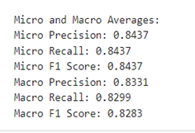
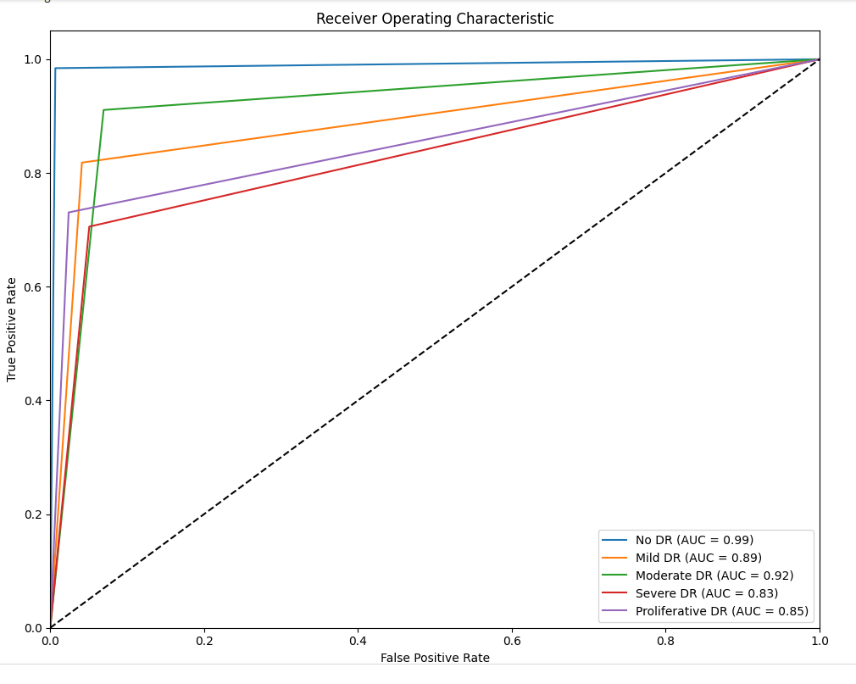
Key Metrics Overview
The model demonstrates strong performance on diabetic retinopathy stage classification, achieving high accuracy and F1-score

Slide 17
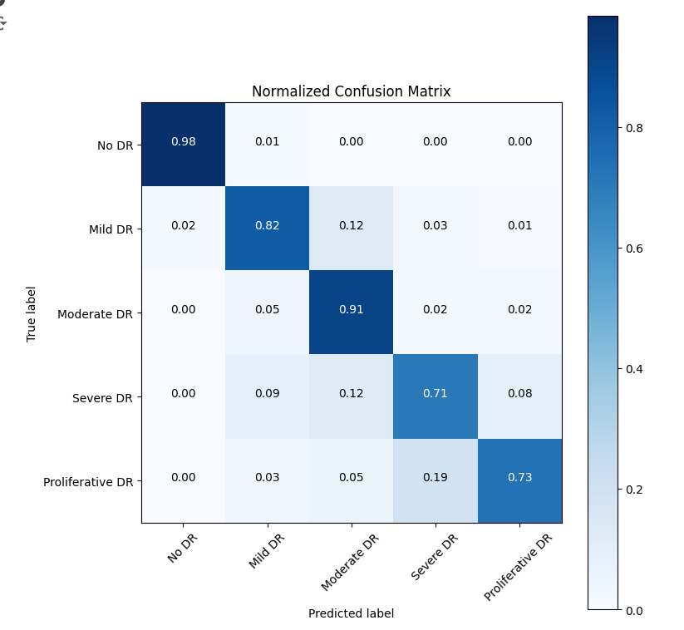
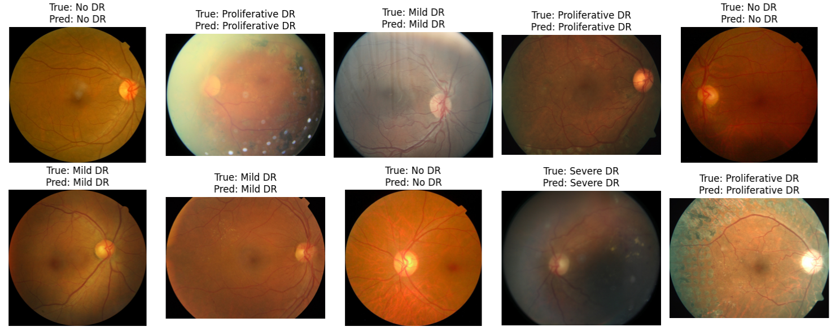
Class level Performance

Slide 18

Deployment & User Interface
Deployment: Deployed as a Gradio web application. This allows easy access and interaction regardless of the user's location or system.
User Interface (UI) Design: Intuitive Gradio-based interface designed for ease of use. Two tabs: Single Image Prediction and Model Analysis.
Single Image Prediction Tab: Users upload retinal fundus images via a simple image upload, getting a prediction of Diabetic Retinopathy severity with class probabilities.
Model Analysis Tab: Enables users to perform a comprehensive model validation, displaying metrics (Precision, Recall, F1-score, Accuracy, AUC), confusion matrices, etc. This analysis provides insights into the model's overall performance and potential areas for improvement.

Slide 19

Hugging Face Integration
Model Versioning and Storage: The trained model is stored and versioned on Hugging Face Hub. This ensures consistent access to a specific model version.
Deployment Platform: The Gradio app is deployed via Hugging Face Spaces, providing a readily available, hosted environment.

Slide 20
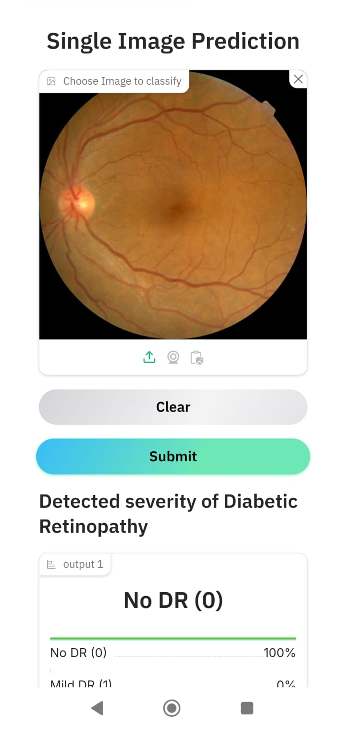
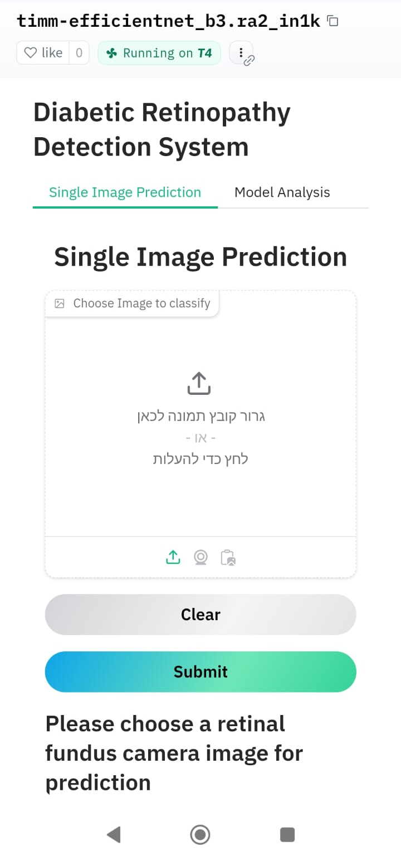
User application
Single Image Prediction Workflow:
User uploads a retinal image.
Model makes a prediction.
Results are displayed as text (severity level) and probabilities for each DR stage.
Model Analysis Workflow:
The user initiates a model analysis.
The system performs the analysis.
Results are presented clearly including: Classification report, Confusion Matrix, ROC-AUC curve.

Slide 21
Conclusions
Successfully developed a deep learning model for classifying diabetic retinopathy stages.
Achieved 84.37% accuracy and a macro-averaged F1-score of 82.83%.
Deployed a user-friendly web application via Hugging Face Spaces for easy access to predictions.
Emphasized the importance of addressing class imbalance through techniques like weighted random sampling.
Successfully utilized transfer learning (EfficientNet-B7) to improve model efficiency and accuracy.
Project achievements
Key technical insights

Slide 22
Challenges we faced and how we managed
Three different platforms – Windows , Linux and Mac to support Different python versions , different development environments.
First we kept a free-style phase – for everybody to learn and research and provide useful ideas. Requirement documents were created. Readme files in GitHub describing code structure , features and how to run https://github.com/lmanov1/DL_DiabeticRetinopathyStagePrediction/tree/main
Starting from this point and on – subsequent results synchronization was done via shared drive location: in shared document , including pre-agreed set of metrics for unified comparison criteria and notebooks
Widely agreed code kept in GitHub, features development managed in branches and with follow up using GitHub issues and conversations.
As training is very heavy – subsequent models were run on AWS Jupiter machine as most of us have no GPU or not enough memory resources @ dev environment.
The results and performance evaluation are kept in shared document in drive. Multiple meetings kept , multiple hands-on sessions to solve problems

Slide 23
Stretch features
LLM Assistant Integration
Integrate an LLM assistant to act as a virtual doctor.
Implement functionalities for anamnesis, analysis, and providing recommendations.
Additional Disease Classification
Extend the model to classify other eye diseases like cataracts and glaucoma.
Adjust the label set and retrain the model accordingly.

Slide 24
Side research done by team members
Features that team implemented but was not merged into main branch
Fine tuning with Lr find
Custom (accumulating) recall and f1 as fast ai’s learner metrics for loss function
Keras models , mapping keras models to torch format with ONNX
Upscaling images with Optuna
Web application (EU uploading images for inference remotely), as an addition to a Hagging Face space for inference and evaluation
Class weighs also for learner’s loss function
Configuration and argparser for different options like class weigths handling (yes/no) , used dataset , explicit model to load, evaluation or training modes , model format to use , so on
Custom data preprocessing pipeline with sharpen/denoise/Laplacian sharpen/high_pass_filter/enhance_contrast/adjust_gamma/clam

Slide 25
# Define the DataBlock
dblock = DataBlock(
blocks=(ImageBlock,CategoryBlock),
get_items=get_image_files,
splitter=RandomSplitter(valid_pct=0.2, seed=42),
get_y=parent_label,
item_tfms=Resize(460),
batch_tfms=aug_transforms(size=224)
)
path = Path('data/train19')
dls = dblock.dataloaders(path, bs=8, num_workers=0)

Slide 26
class EarlyStopping:
def __init__(self, patience=5, min_delta=0.0):
self.patience = patience
self.min_delta = min_delta
self.counter = 0
self.best_loss = float('inf')
self.stopped_epoch = 0
def __call__(self, val_loss):
if self.best_loss - val_loss > self.min_delta:
self.best_loss = val_loss
self.counter = 0 # improvement
else:
self.counter += 1 # no improvement
if self.counter >= self.patience:
self.stopped_epoch = self.counter
return True # Stop training
return False # Continue training

Slide 27
# Replace with your actual class distribution
class_counts = [1805, 1311, 1000, 1000, 1000]
class_weights = [1.0 / count for count in class_counts]
class_weights = torch.tensor(class_weights, dtype=torch.float32)
def get_sample_weights(dls, class_weights):
sample_weights = []
for idx in range(len(dls.train_ds)):
label = dls.train_ds[idx][1] # Get the label of each sample
sample_weights.append(class_weights[label])
return torch.tensor(sample_weights, dtype=torch.float32)
# Compute sample weights
sample_weights = get_sample_weights(dls, class_weights)
weighted_sampler = torch.utils.data.WeightedRandomSampler(
weights=sample_weights,
num_samples=len(sample_weights), # Number of samples in an epoch
replacement=True # Sampling with replacement
)
# Replace the default train DataLoader's sampler
dls.train.loader = torch.utils.data.DataLoader(
dls.train_ds,
batch_size=8,
sampler=weighted_sampler,
num_workers=0
)

Slide 28
class PretrainedEyeDiseaseClassifier(nn.Module, CustomModelMethods):
def __init__(self, num_classes=5, retrained_model='vgg16'):
nn.Module.__init__(self)
CustomModelMethods.__init__(self)
self.num_ftrs = None
if pretrained_model == 'efficientnet-b7':
self.model =
EfficientNet.from_pretrained('efficientnet-b7')
self.num_ftrs = self.model._fc.in_features
self.model._fc = nn.Linear(self.num_ftrs,
num_classes)
else:
raise ValueError("Unsupported pretrained model”).
def forward(self, x):
x = self.model(x) # Pass input through the model
return x # Return the output from the model
def set_num_classes(self, num_classes):
if isinstance(self.model, EfficientNet):
self.model._fc = nn.Linear(self.num_ftrs, num_classes)

