Slide 1
Diabetic Retinopathy Stage Prediction With Deep Learning

Slide 2
A Multi-Model Approach to Medical Image Classification
Brief problem statement
Project goals

Slide 3
What is Diabetic Retinopathy?
What is Diabetic Retinopathy?
Why automated detection matters
Impact on healthcare delivery
Classification stages (0-4)

Slide 4

Technical Architecture

Slide 5
System Overview
– Data ingestion (Kaggle API)
- Preprocessing pipeline
- Model training flow
- Deployment pipeline (Hugging Face)

Slide 6









Technology Stack
Python
FastAI / PyTorch ecosystem
Datasets: Kaggle
Deployment: Hugging Face Spaces
Poetry for dependency management
Visualizations: TensorBoard

Slide 7

Data Pipeline

Slide 8
Data Processing
Datasets:
2015 Diabetic Retinopathy Detection
APTOS 2019 Blindness Detection
Data cleaning approach
Class distribution visualization

Slide 9
Data Augmentation Pipeline
DataBlock( blocks=(ImageBlock, CategoryBlock), get_x=ColReader(df.columns[0]), get_y=ColReader(df.columns[1]), splitter=RandomSplitter(valid_pct=0.2), item_tfms=Resize(224), batch_tfms=aug_transforms( size=224, min_scale=0.75 ) )
Image resizing strategy (224x224)
Augmentation techniques
Validation split approach (20%)

Slide 10

Model Architecture

Slide 11
Model Evolution
Tested Architectures:
VGG16 & VGG16_bn
ResNet (18, 50, 152)
EfficientNet (B1, B7)

Slide 12
Best Performing Models
[Performance comparison chart showing:]
Model size
Training time
Key metrics
Resource requirements

Slide 13
Transfer Learning Strategy
Pre-training approach
Fine-tuning strategy
Learning rate selection
Batch size optimization

Slide 14
Improvements
Recall improvement strategies
Model optimizations:
Advanced augmentation techniques
Ensemble approaches
Model architecture refinements
Research directions from papers

Slide 15

Results Analysis

Slide 16
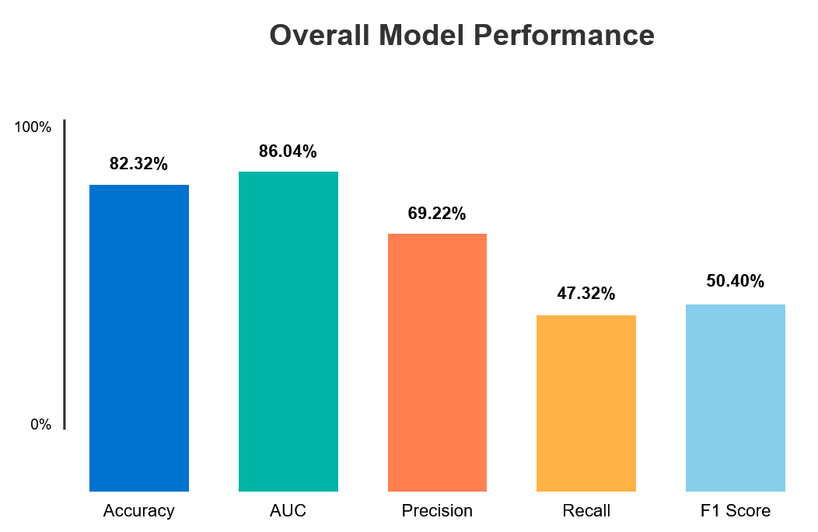
Key Metrics Overview

Slide 17
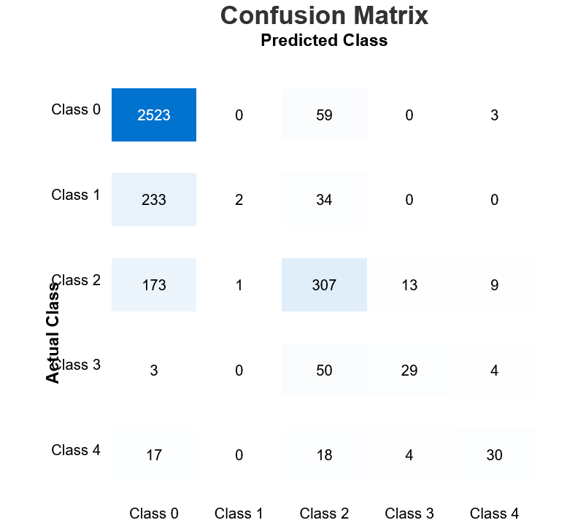
Per-Class Performance
Analysis of class imbalance impact
Identification of challenging classes

Slide 18
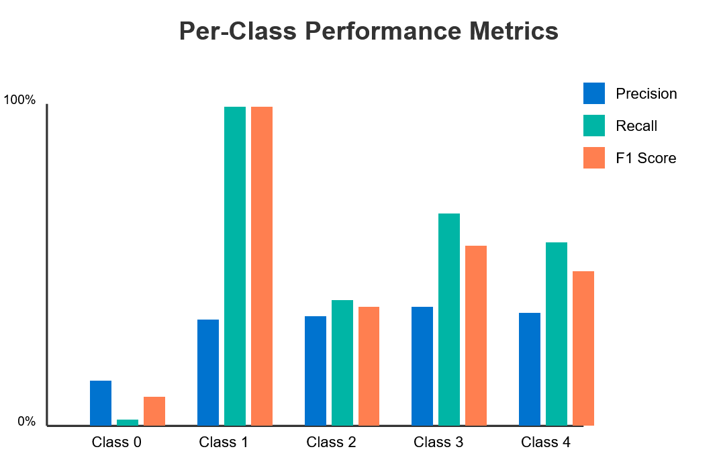
Performance Deep Dive
Error analysis
Impact of data augmentation
Current limitations

Slide 19

Deployment & User Interface

Slide 20
Hugging Face Integration
Deployment architecture
Model serving strategy
API integration points

Slide 21
User Interface
Interface walkthrough
Prediction workflow
Result interpretation
[Screenshots of actual interface]

Slide 22
Conclusion
Project achievements
Key technical insights
Next development phase
Team acknowledgments

Slide 23
Design Elements
Color Scheme:
Primary: Medical blue (#0073CF)
Secondary: Cool gray (#F5F7FA)
Accent: Teal (#00B5A5)
Warning/Important: Coral (#FF7F50)
Typography:
Headers: Roboto Bold
Body: Open Sans Regular
Code: JetBrains Mono
Visual Elements:
Consistent iconography
Clean data visualizations
Minimalist slide transitions
Clear spacing hierarchy

