Slide 1
PROPOSAL · FOR REVIEW — VP, BUSINESS INTELLIGENCE
A forecast that pays for the schedule it writes
Month-ahead attendance forecasting for the labor lock, week-ahead for adjustments and ad spend — phase-gated, measured against our own incumbent before operations changes anything.
Working demo + full production guide in repo: github.com/lmansf/Attendance-Projections

Slide 2



THE DECISION PROBLEM
Labor locks a month out — on a 947 miss.
Labor budgets commit ~30 days out
The zoo plans rosters and labor for ~300 employees a month ahead — so the model's headline horizon is month-ahead, matching that lock.
What a 947-guest average miss costs, daily
±29%
Adjustments and ad spend at ~7 days
average error rate — measured, not guessed
Weekly schedule tweaks and media buys key on a week-ahead forecast; promos need soft days flagged early enough to act.
~95 staff-hours
Today's miss is measured, and it is large
planned against the wrong number every day — roughly twelve 8-hour shifts (at ~10 guests served per scalable staff-hour, our one estimated input)
Against our own 10/2017–7/2026 history, current projections average a 947-guest daily miss (MAE) — a 29% error on a 3,285-guest average day.
Attendance Forecasting — BI review · 2

Slide 3
THE VALUE, IN OUR NUMBERS
Halving the miss: ~$98k–$163k a year.
Assumption | Value | Status
Average daily attendance | 3,285 | measured, from ticketing
Incumbent MAE | 947 guests | measured, 10/2017–7/2026
Model MAE (target) | 450 guests | target — Phase 0 validates
Guests / scalable staff-hour | 10 | estimate — to confirm
Loaded cost / staff-hour | $18 | $15 wage + ~20% load
Operating days / year | 364 | open year-round
Capture rate | 30–50% | min shifts, fixed posts
Forecast horizon | month-ahead | matches the labor lock
497
fewer mis-forecast guests per day (947 → 450)
~50 hrs
staff-hours re-aimed daily (÷ 10 guests/staff-hour)
$895 / day
at the $18 loaded rate
~$326k / yr
gross misallocation removed (× 364 days)
$98k–$163k / yr
captured at a 30–50% scheduling capture rate — every row above is a live slider in the Power BI what-if.
A range, never a point: the incumbent side is measured; Phase 0 validates the model side on nine seasons of our own data.
Attendance Forecasting — BI review · 3

Slide 4
NET OF COSTS
Break-even ~month 14 in the mid case.
~$50k build
8–12 person-weeks, existing team; DuckDB path, one small VM
~$16k / yr run
0.1 FTE + Power BI Pro. US zoo: NWS weather is $0; no flight-schedule feed unless the backtest earns it
Break-even ~month 14
mid case (~$130k/yr captured, net of run cost)
Even the conservative case pays back
~month 23 if the model only closes a third of the gap — and if it can't beat 947 at all, Phase 0 kills it for ~$8k, not $50k
Attendance Forecasting — BI review · 4

Slide 5
THE ASK
Fund Phase 0 and shadow. Nothing else, yet.
0 · POC
1 · SHADOW
2 · ASSISTED
3 · INTEGRATED
wks 1–4
mo 2–5
mo 5–8
mo 9+
Backtest on our own ticketing extract. Go / no-go for ~$8k of time.
Daily forecasts logged and scored. Ops changes nothing. Gates signed before it starts.
Planners see the report at schedule lock, adjust freely, overrides logged.
Template seeded from the forecast; manager keeps override; reversion gates active.
The kill point is priced. Gates missed in shadow → stop; sunk cost is engineering time only, and operations never changed a thing. Funding today covers Phase 0 + shadow; the schedule template is not touched until the system beats our incumbent on our own data, at margins we sign in advance.
Attendance Forecasting — BI review · 5

Slide 6
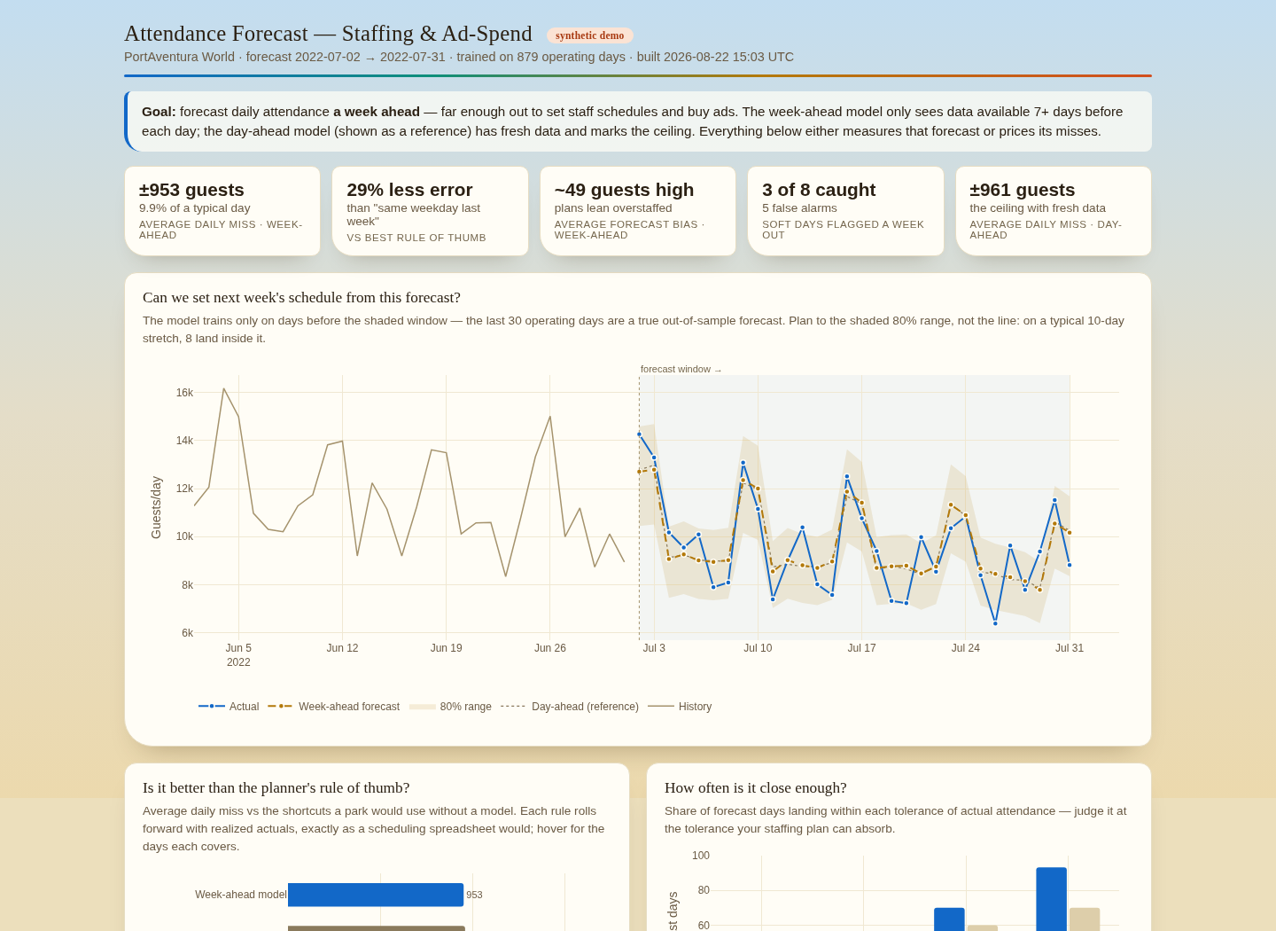



DE-RISKED
This is not a cold start.
A working demo is live
The dashboard exists end-to-end today: month-, week-, and day-ahead forecasts vs actual, an 80% planning band, and a labor-budget panel priced at the month-ahead lock.
The model earned its seat
An equal-weight LightGBM + Ridge + random-forest blend, picked by a reproducible 17-candidate backtest (single command; a neural net and 5 other families lost).
The production path is written
A 6-chapter guide in the repo: warehouse DDL, leakage-firewall feature contract, monitoring thresholds, and the Power BI DAX for every panel — reviewed for accuracy, coherence, and exec scrutiny.
Attendance Forecasting — BI review · 6

Slide 7






FOR THE BI TEAM SPECIFICALLY
It lands in our stack, not beside it.
Power BI native
Import mode, 1–2 refreshes/day
PostgreSQL or DuckDB
Star schema + written DAX, incl. what-if sliders for guests/staff-hour and loaded rate
Pro licensing is enough; no DirectQuery, no gateway on the DuckDB/parquet path
Single-digit MB per park-year; raw → staging → marts, idempotent loads
No guest PII, by design
One small VM
Append-only forecast history
Aggregate counts only — fast security review, no DPIA, low vendor-risk tier
The entire pipeline; scheduled jobs with quality gates and a fallback forecast
“What did we tell ops last Tuesday?” is a query, not an argument
Attendance Forecasting — BI review · 7

Slide 8
WHAT WE ARE NOT CLAIMING
The caveats, before anyone else finds them.
The model's side is provisional
The incumbent MAE (947) is measured on our own history; the 450 target is not yet — the demo runs on synthetic data. Phase 0 validates the model on our nine seasons before gates are set.
Year 1 is still cash-negative
Benefits start ~month 9; mid-case break-even lands early in year 2. If Phase 0 says the 450 target is fantasy, we stop at the kill point having spent engineering time only.
The best feature arrives late
Advance-booking snapshots start accumulating on day one and mature around month 10; shadow is judged without them, and the model only improves after the gates pass.
Month-ahead is the hardest horizon
No weather is knowable 30 days out, so the month-ahead model runs on calendar, seasonality, bookings, and flight schedules alone — its MAE will sit above the week-ahead model's. The 450 target is judged at this horizon because that is where labor locks.
Regime breaks happen
A closure or a viral season breaks any model. Built in: drift monitoring, a same-weekday fallback that always publishes, and band logic that discards broken-regime history.
Attendance Forecasting — BI review · 8

Slide 9
THE DECISION TODAY
Approve Phase 0: four weeks, our own data, a go/no-go with evidence.
One ticketing extract — 10/2017 to 7/2026, nearly nine seasons of daily admissions; no integrations, no vendors
The existing backtest re-run on our numbers: model vs our rule of thumb, out-of-fold
Output: a measured accuracy delta and a re-priced ROI table — then, and only then, the shadow decision
Demo, guide, and this deck: github.com/lmansf/Attendance-Projections · docs/production-guide

