Slide 1
PHS 651 / LECTURE 01
Introduction
Advanced Regression Methods for Population Health
Lu Mao, PhD
Department of Biostatistics and Medical Informatics
University of Wisconsin-Madison
SPRING 2019

Slide 2
Introduction
Longitudinal Studies: Studies in which individuals are measured repeatedly through time.
This course will cover the analysis and interpretation of results from longitudinal studies.
Emphasis will be on model development, use of statistical software, and interpretation of results.
Theoretical basis for results mentioned but not developed.
No calculus or matrix algebra is assumed.
PHS 651 / Lecture 01
2 / 29

Slide 3
Why collecting longitudinal data?
The primary goal of a longitudinal study is to characterize the change in response over time and to study the factors that influence change
What is wrong with cross-sectional study?
  Correlation not causation
  No temporal trend for response
Exposure
Outcome
PHS 651 / Lecture 01
3 / 29

Slide 4
Why collecting longitudinal data?
For temporal trend in response, why not taking multiple cross-sectional samples at different time points?
  Systematic difference between cohorts
  Between-individual variability
  No info on individual-level trajectory
  Cost
  By comparing responses at different time points from the same subject, longitudinal analysis removes systematic and random difference between individuals, provides direct info on individual-level trajectory, and reduces study cost
PHS 651 / Lecture 01
4 / 29

Slide 5
Longitudinal data structure
A typical longitudinal study design:
  In some studies, not all subjects are measured at the same time points
  Some subjects may dropout during study
Baseline
Time 1
Time 2
……
Time p
Outcome
Exposure
Outcome
Outcome
……
Outcome
PHS 651 / Lecture 01
5 / 29

Slide 6
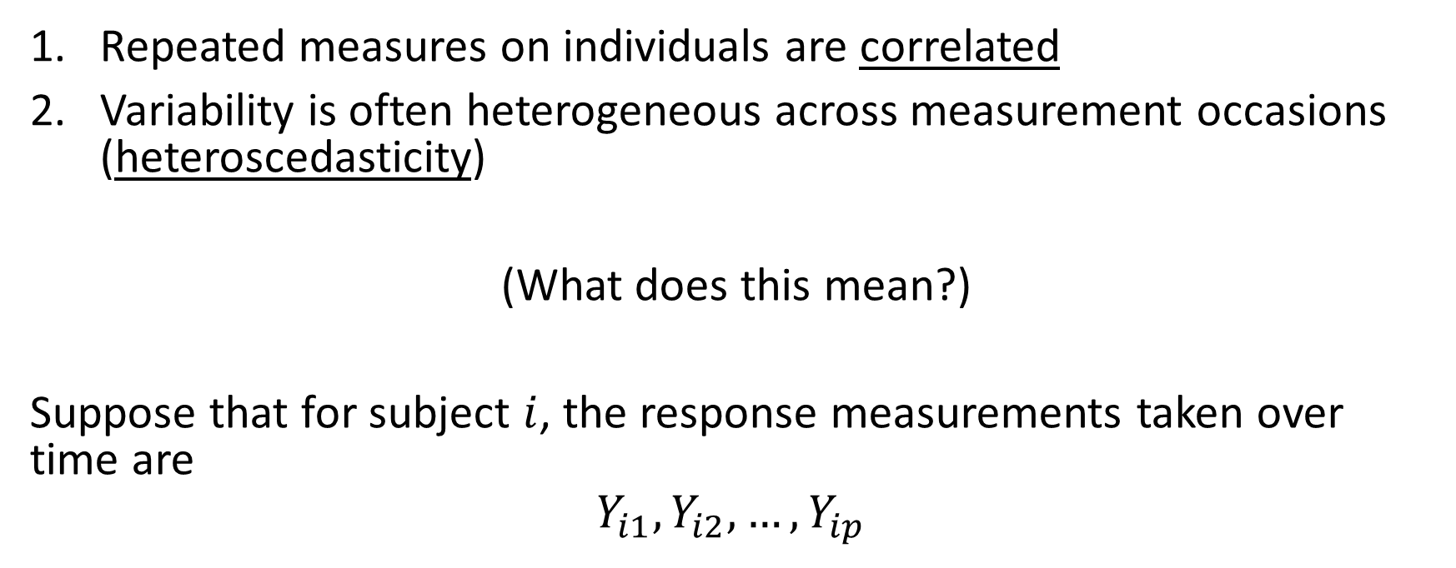
Complications of longitudinal data
Repeated measures on individuals are correlated
Variability is often heterogeneous across measurement occasions (heteroscedasticity)
(What does this mean?)
Suppose that for subject $i$, the response measurements taken over time are
$$Y_{i1}, Y_{i2},…,Y_{ip}$$
PHS 651 / Lecture 01
6 / 29

Slide 7
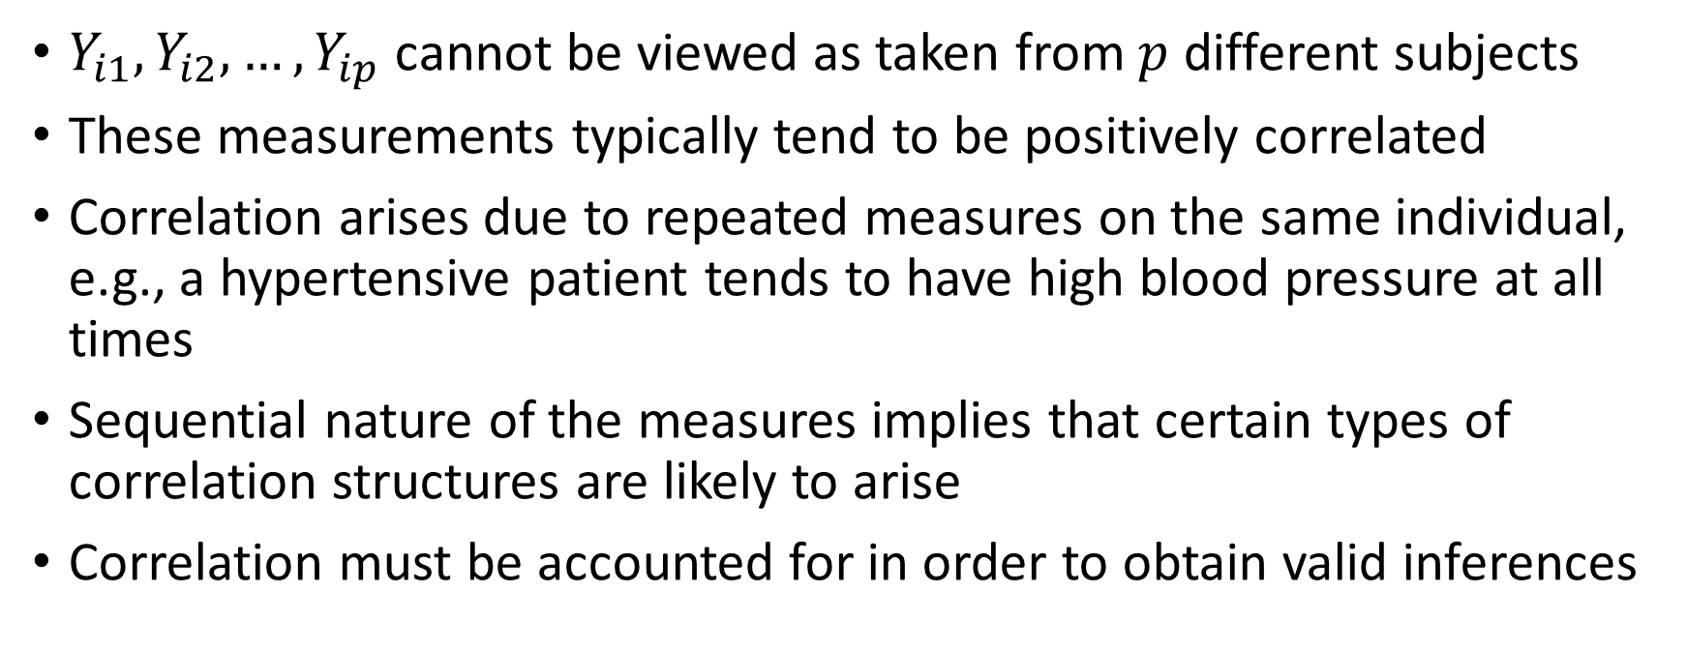
Complications of longitudinal data - Correlation
$Y_{i1}, Y_{i2},…,Y_{ip}$cannot be viewed as taken from $p$ different subjects
These measurements typically tend to be positively correlated
Correlation arises due to repeated measures on the same individual, e.g., a hypertensive patient tends to have high blood pressure at all times
Sequential nature of the measures implies that certain types of correlation structures are likely to arise
Correlation must be accounted for in order to obtain valid inferences
PHS 651 / Lecture 01
7 / 29

Slide 8
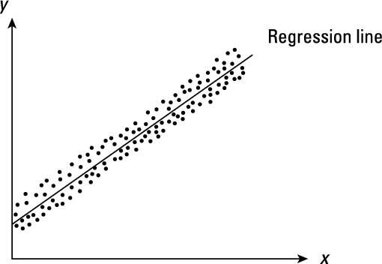
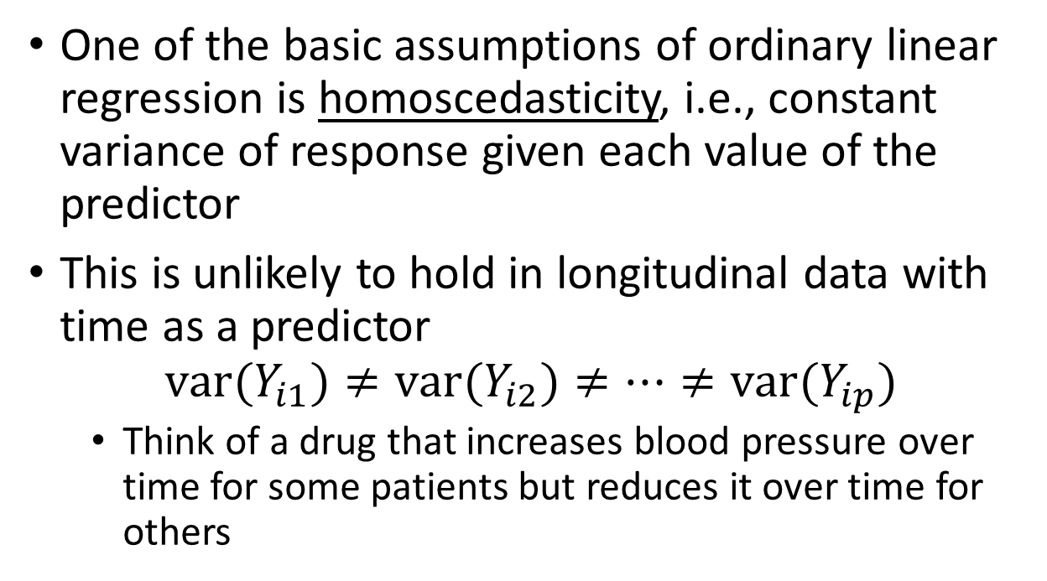
Complications of longitudinal data - Heteroscedasticity
One of the basic assumptions of ordinary linear regression is homoscedasticity, i.e., constant variance of response given each value of the predictor
This is unlikely to hold in longitudinal data with time as a predictor
$${var(Y}_{i1})≠{var(Y}_{i2})≠…≠{var(Y}_{ip})$$
  Think of a drug that increases blood pressure over time for some patients but reduces it over time for others
PHS 651 / Lecture 01
8 / 29

Slide 9
Relation to Correlated Data
Correlated data commonly arise in many applications.
Longitudinal Studies: designs in which the outcome variable is measured repeatedly over time.
Repeated Measures Studies: somewhat older terminology applied to special set of longitudinal designs characterized by measurement at a common set of occasions (usually in an experimental setting under diﬀerent conditions or treatments).
This course will emphasize methods for analyzing and interpreting the results from longitudinal studies.
PHS 651 / Lecture 01
9 / 29

Slide 10
Example 1: Treatment of Lead-Exposed Children Trial
Exposure to lead during infancy is associated with substantial deﬁcits in tests of cognitive ability
Chelation treatment of children with high lead levels usually requires injections and hospitalization
A new agent, Succimer, can be given orally
Randomized trial examining changes in blood lead level during course of treatment
100 children randomized to placebo or Succimer
Measures of blood lead level at baseline, 1, 4 and 6 weeks
PHS 651 / Lecture 01
10 / 29

Slide 11
Example 1: Treatment of Lead-Exposed Children Trial
PHS 651 / Lecture 01
11 / 29

Slide 12
Example 1: Treatment of Lead-Exposed Children Trial
PHS 651 / Lecture 01
12 / 29

Slide 13
Example 1: Treatment of Lead-Exposed Children Trial
PHS 651 / Lecture 01
13 / 29

Slide 14
Example 2: Six Cities Study of Air Pollution and Health
Longitudinal study designed to characterize lung function growth in children and adolescents.
Most children were enrolled between the ages of six and seven and measurements were obtained annually until graduation from high school.
Focus on a randomly selected subset of the 300 female participants living in Topeka, Kansas.
Response variable: Volume of air exhaled in the ﬁrst second of spirometry manoeuvre, FEV1.
PHS 651 / Lecture 01
14 / 29

Slide 15
Example 2: Six Cities Study of Air Pollution and Health
PHS 651 / Lecture 01
15 / 29

Slide 16
Example 2: Six Cities Study of Air Pollution and Health
PHS 651 / Lecture 01
16 / 29

Slide 17
Example 3: Inﬂuence of Menarche on Changes in Body Fat
Prospective study on body fat accretion in a cohort of 162 girls from the MIT Growth and Development Study.
At start of study, all the girls were pre-menarcheal and non-obese
All girls were followed over time according to a schedule of annual measurements until four years after menarche.
The ﬁnal measurement was scheduled on the fourth anniversary of their reported date of menarche.
At each examination, a measure of body fatness was obtained based on bioelectric impedance analysis.
PHS 651 / Lecture 01
17 / 29

Slide 18
Example 3: Inﬂuence of Menarche on Changes in Body Fat
PHS 651 / Lecture 01
18 / 29

Slide 19
Example 3: Inﬂuence of Menarche on Changes in Body Fat
Consider an analysis of the changes in percent body fat before and after menarche.
For the purposes of these analyses “time” is coded as time since menarche and can be positive or negative.
Note: measurement protocol is the same for all girls.
Study design is almost “balanced” if timing of measurement is deﬁned as time since baseline measurement.
It is inherently unbalanced when timing of measurements is deﬁned as time since a girl experienced menarche.
PHS 651 / Lecture 01
19 / 29

Slide 20
Example 3: Inﬂuence of Menarche on Changes in Body Fat
PHS 651 / Lecture 01
20 / 29

Slide 21
Example 4: Oral Treatment of Toenail Infection
Randomized, double-blind, parallel-group, multicenter study of 294 patients comparing 2 oral treatments (denoted A and B) for toenail infection.
Outcome variable: Binary variable indicating presence of onycholysis (separation of the nail plate from the nail bed).
Patients evaluated for degree of onycholysis (separation of the nail plate from the nail-bed) at baseline (week 0) and at weeks 4, 8, 12, 24, 36, and 48.
Interested in the rate of decline of the proportion of patients with onycholysis over time and the eﬀects of treatment on that rate.
PHS 651 / Lecture 01
21 / 29

Slide 22
Example 5: Clinical Trial of Anti-Epileptic Drug Progabide
Randomized, placebo-controlled study of treatment of epilepticseizures with progabide.
Patients were randomized to treatment with progabide, or to placebo in addition to standard therapy.
Outcome variable: Count of number of seizures.
Measurement schedule: Baseline measurement during 8 weeks prior to randomization. Four measurements during consecutive two-week intervals.
Sample size: 28 epileptics on placebo; 31 epileptics on progabide.
PHS 651 / Lecture 01
22 / 29

Slide 23
Example 5: Clinical Trial of Anti-Epileptic Drug Progabide
PHS 651 / Lecture 01
23 / 29

Slide 24
Terminology
Individuals/Subjects: Participants in a longitudinal study are referred to as individuals or subjects.
Occasions: In a longitudinal study individuals are measured repeatedly at diﬀerent occasions or times.
The number of repeated observations, and their timing, can vary widely from one longitudinal study to another.
When number and timing of the repeated measurements are the same for all individuals, study design is said to be “balanced” over time.
Note: Designs can be balanced, although studies may have incompleteness in data collection.
PHS 651 / Lecture 01
24 / 29

Slide 25
Features of Longitudinal Data
In longitudinal studies the outcome variable can be:
  continuous (e.g., blood lead levels)
  binary (e.g., presence/absence of onycholysis)
  count (e.g., number of epileptic seizures)
The data set can be incomplete (missing data/dropout).
Subjects may be measured at diﬀerent occasions (e.g., due to mistimed measurements).
In this course we will develop a set of statistical tools that can handle all of these cases.
Emphasis on concepts, model building, software, and interpretation.
PHS 651 / Lecture 01
25 / 29

Slide 26
Organization of Course
Introduction
  Review of Ordinary Regression/One-Way ANOVA/Matrix algebra
  Descriptive statistics
  Visualization of longitudinal data
Linear Models for Longitudinal Data
  Outcome: Continuous (unbalanced and incomplete) data
  Class of models: Linear models
  Software: PROC MIXED in SAS
PHS 651 / Lecture 01
26 / 29

Slide 27
Organization of Course
Generalized Linear Models (GLM) for Longitudinal Data
  Outcome: Continuous, binary, count
  Class of models: Generalized linear models (GLM; e.g. logistic regression, Poisson regression)
  GLM for non-longitudinal data
  Two approaches to GLM with longitudinal data
    Population-level inference: Generalized Estimating Equations (GEE)
    Subject-level inference: Generalized linear mixed models (GLMM)
  Accounting for missing data/dropout in each approach
  Software: PROC GENMOD/NLMIXED in SAS
PHS 651 / Lecture 01
27 / 29

Slide 28
Organization of Course
Multilevel Models
  Outcome and regression model: All kinds
  Methods for ﬁtting mixed models to multilevel data
  Example: Longitudinal data for each subject, while subjects are clustered by location
  Software: PROC MIXED in SAS, using multiple RANDOM statement
PHS 651 / Lecture 01
28 / 29

Slide 29
Background Assumed
Samples and populations
Population values: parameters (Greek); Sample values: estimates
Variables:
  Y : Outcome, response, dependent variable;
  X: Covariates, independent variables
Regression Models
Have some basic knowledge of
  Inference: Estimation, testing, and conﬁdence intervals
  Multiple linear regression/ANOVA
  Logistic regression
No calculus or matrix algebra is assumed
PHS 651 / Lecture 01
29 / 29

