Slide 1
PHS 651 / LECTURE 02
Linear Regression, Maximum Likelihood, and ANOVA
Advanced Regression Methods for Population Health
Lu Mao, PhD
Department of Biostatistics and Medical Informatics
University of Wisconsin-Madison
SPRING 2019

Slide 2
Outline
As background for our future study of longitudinal data, we review the following
  Standard linear regression model for independent observations.
  Maximum likelihood (ML) and least squares estimation.
  Vector and matrix notation and algebra.
  Analysis of variance (ANOVA) and its connection with linear regression.
PHS 651 / Lecture 02
2 / 35

Slide 3
Linear regression
Consider a cross-sectional data set of 300 measurements of the logarithm of FEV1, age, and logarithm of height of children living in Topeka, Kansas.
We will ﬁt a model describing how the value of log(FEV1) varies linearly with age and log(height).
The children varied in age from 6 to 18 years.
We will ﬁt a multiple linear regression model, estimate the regression coeﬃcients for age and log(height), and test the hypothesis that these coeﬃcients are not signiﬁcantly diﬀerent from 0.
PHS 651 / Lecture 02
3 / 35

Slide 4
Linear regression
Structure of the six-cities data
PHS 651 / Lecture 02
4 / 35

Slide 5
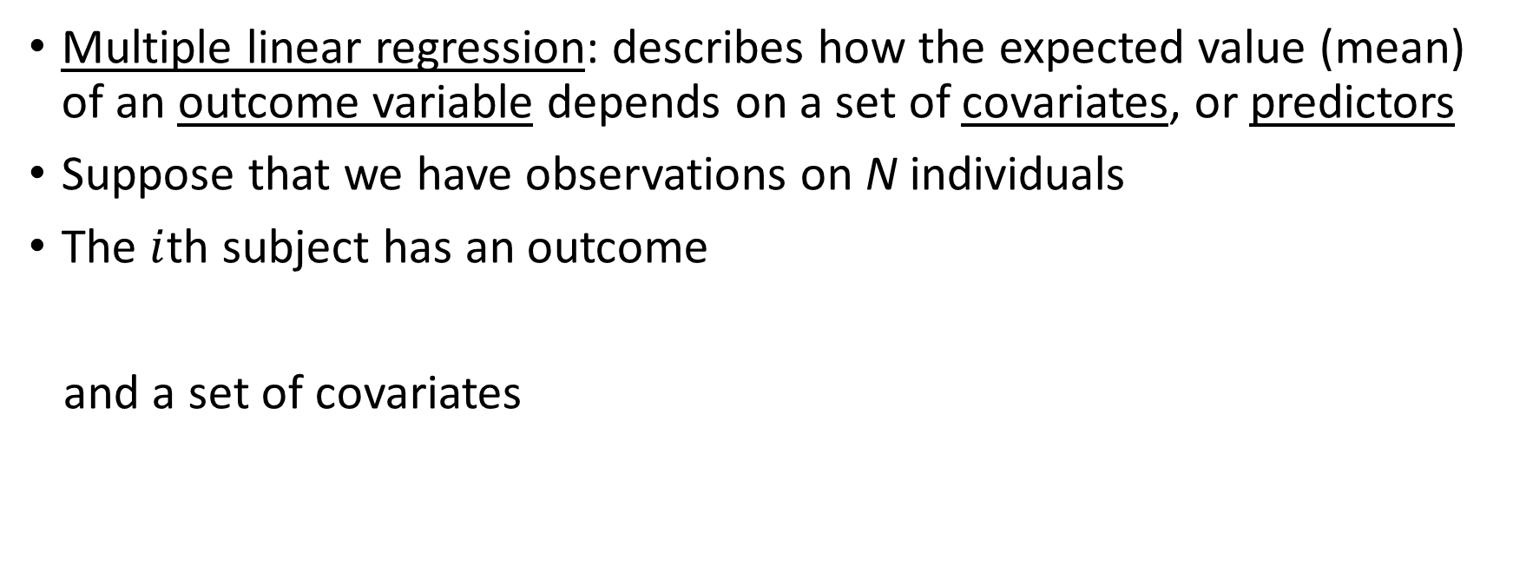
Linear regression
Multiple linear regression: describes how the expected value (mean) of an outcome variable depends on a set of covariates, or predictors
Suppose that we have observations on N individuals
The $i$th subject has an outcome
and a set of covariates
PHS 651 / Lecture 02
5 / 35

Slide 6
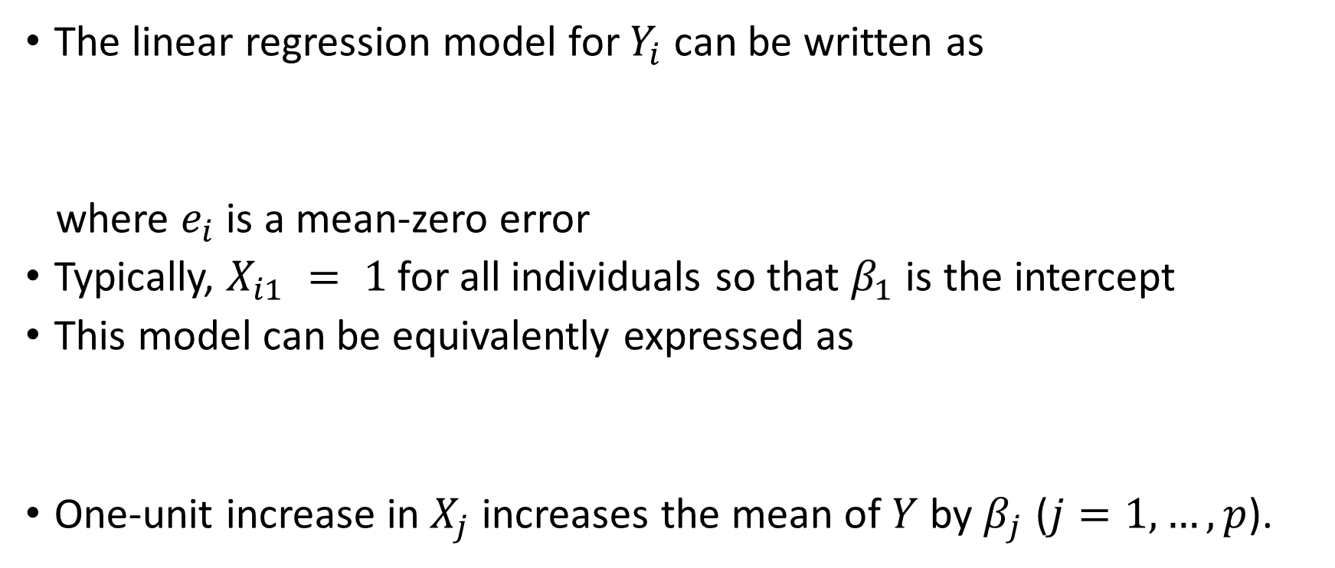
Linear regression
The linear regression model for $Y_{i}$ can be written as
where $e_{i}$ is a mean-zero error
Typically, $X_{i1} = 1$for all individuals so that $β_{1}$ is the intercept
This model can be equivalently expressed as
One-unit increase in $X_{j}$ increases the mean of $Y$ by $β_{j}$ ($j=1,…, p$).
PHS 651 / Lecture 02
6 / 35

Slide 7
Assumptions of multiple linear regression
PHS 651 / Lecture 02
7 / 35

Slide 8
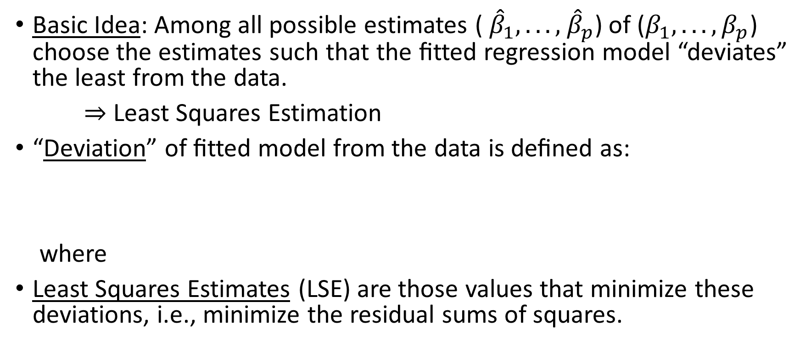
Estimation in linear regression
Basic Idea: Among all possible estimates (${ \hat{β}}_{1}, . . . ,{ \hat{β}}_{p}$) of ($β_{1}, . . . , β_{p}$) choose the estimates such that the ﬁtted regression model “deviates” the least from the data.
⇒ Least Squares Estimation
“Deviation” of ﬁtted model from the data is deﬁned as:
where
Least Squares Estimates (LSE) are those values that minimize these deviations, i.e., minimize the residual sums of squares.
PHS 651 / Lecture 02
8 / 35

Slide 9
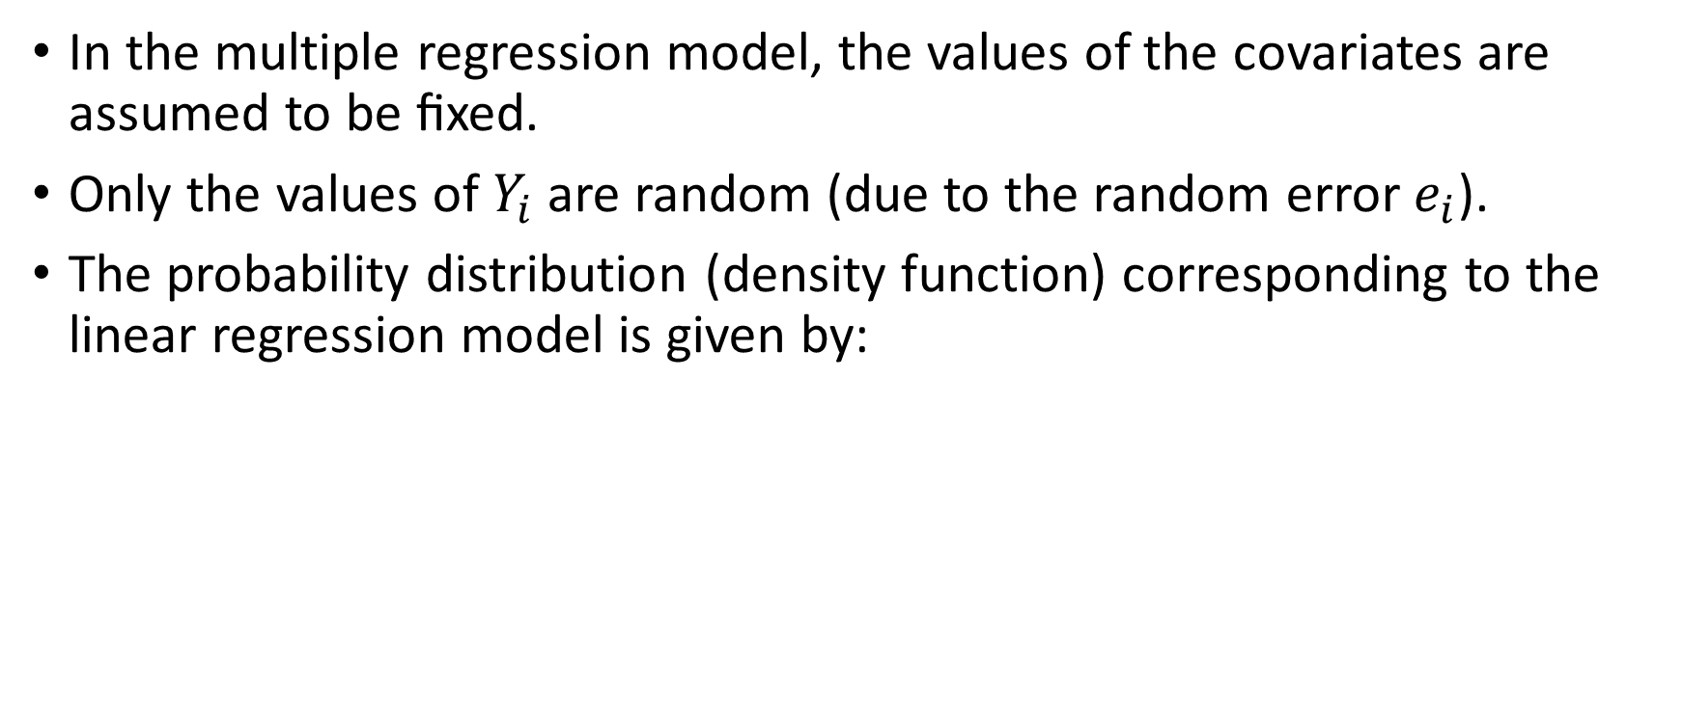
Maximum Likelihood Estimation
In the multiple regression model, the values of the covariates are assumed to be ﬁxed.
Only the values of $Y_{i}$ are random (due to the random error $e_{i}$).
The probability distribution (density function) corresponding to the linear regression model is given by:
PHS 651 / Lecture 02
9 / 35

Slide 10
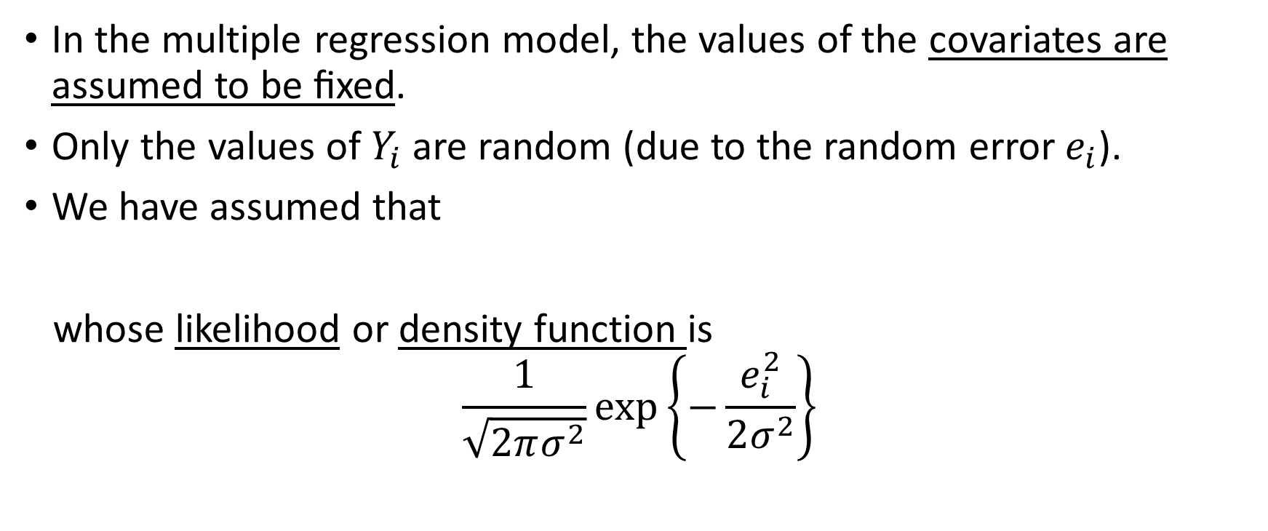
Maximum Likelihood Estimation
In the multiple regression model, the values of the covariates are assumed to be ﬁxed.
Only the values of $Y_{i}$ are random (due to the random error $e_{i}$).
We have assumed that
whose likelihood or density function is
$$\frac{1}{\sqrt{2πσ^{2}}}exp\left\{−\frac{e_{i}^{2}}{2σ^{2}}\right\}$$
PHS 651 / Lecture 02
10 / 35

Slide 11
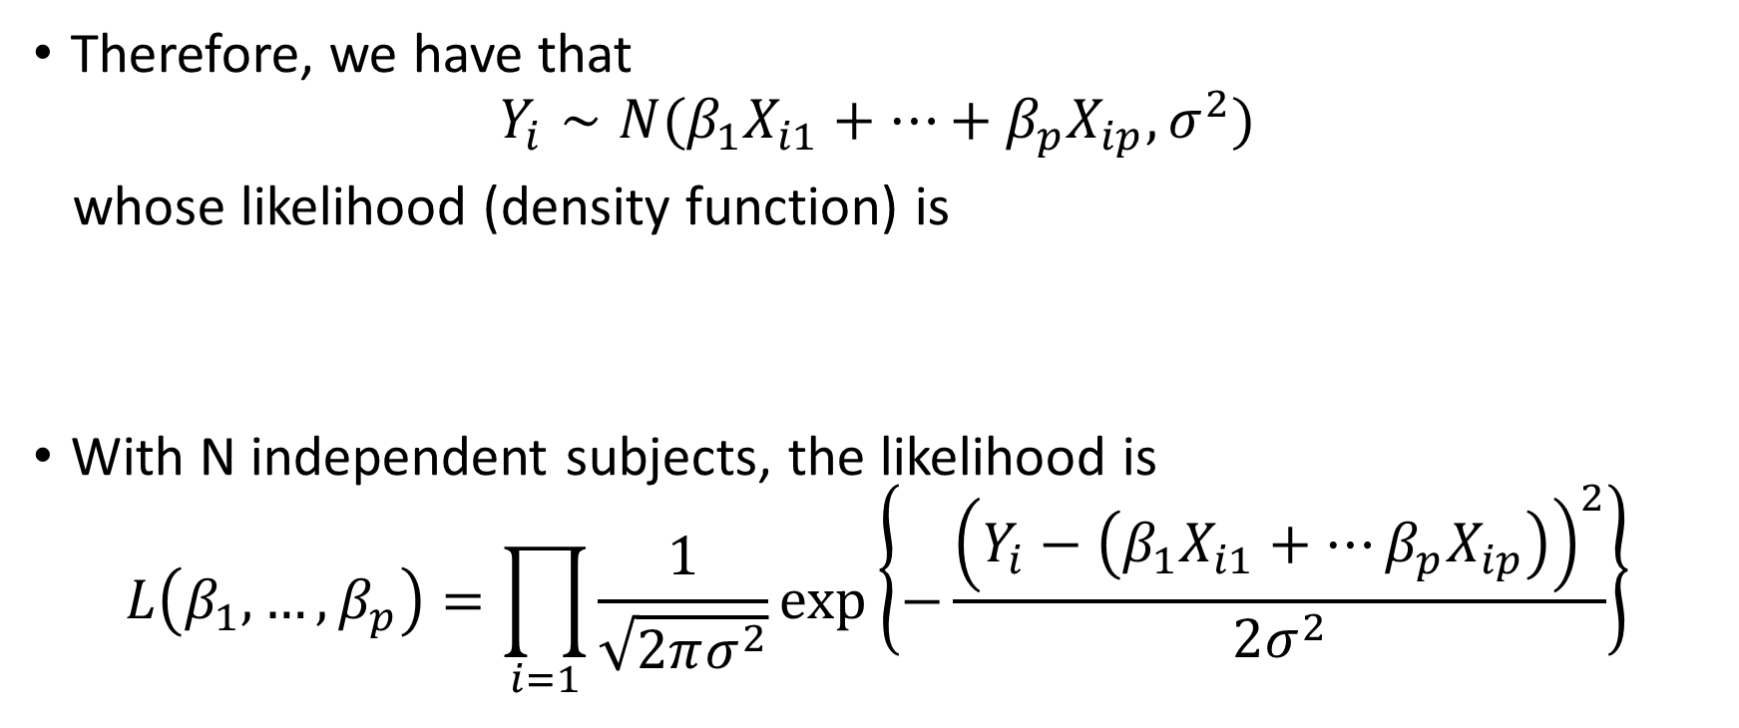
Maximum Likelihood Estimation
Therefore, we have that
$$Y_{i}∼N(β_{1}X_{i1}+…+β_{p}X_{ip},σ^{2})$$
whose likelihood (density function) is
With N independent subjects, the likelihood is
$$L\left(β_{1},…,β_{p}\right)=\prod_{i=1}{\frac{1}{\sqrt{2πσ^{2}}}exp\left\{−\frac{{\left(Y_{i}−\left(β_{1}X_{i1}+…β_{p}X_{ip}\right)\right)}^{2}}{2σ^{2}}\right\}}$$
PHS 651 / Lecture 02
11 / 35

Slide 12
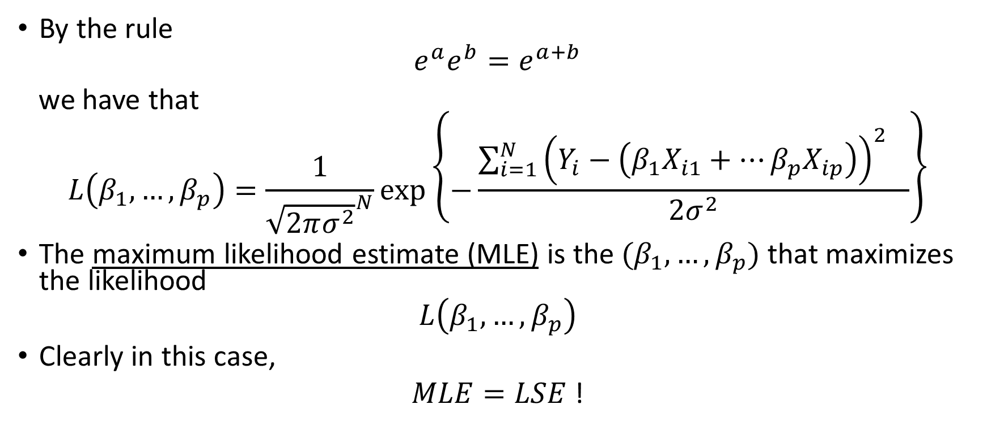
Maximum Likelihood Estimation
By the rule
$$e^{a}e^{b}=e^{a+b}$$
we have that
$$L\left(β_{1},…,β_{p}\right)=\frac{1}{{\sqrt{2πσ^{2}}}^{N}}exp\left\{−\frac{{\sum_{i=1}^{N}{{\left(Y_{i}−\left(β_{1}X_{i1}+…β_{p}X_{ip}\right)\right)}^{2}}}^{}}{2σ^{2}}\right\}$$
The maximum likelihood estimate (MLE) is the $(β_{1},…,β_{p})$ that maximizes the likelihood
$$L\left(β_{1},…,β_{p}\right)$$
Clearly in this case,
$MLE=LSE$ !
PHS 651 / Lecture 02
12 / 35

Slide 13
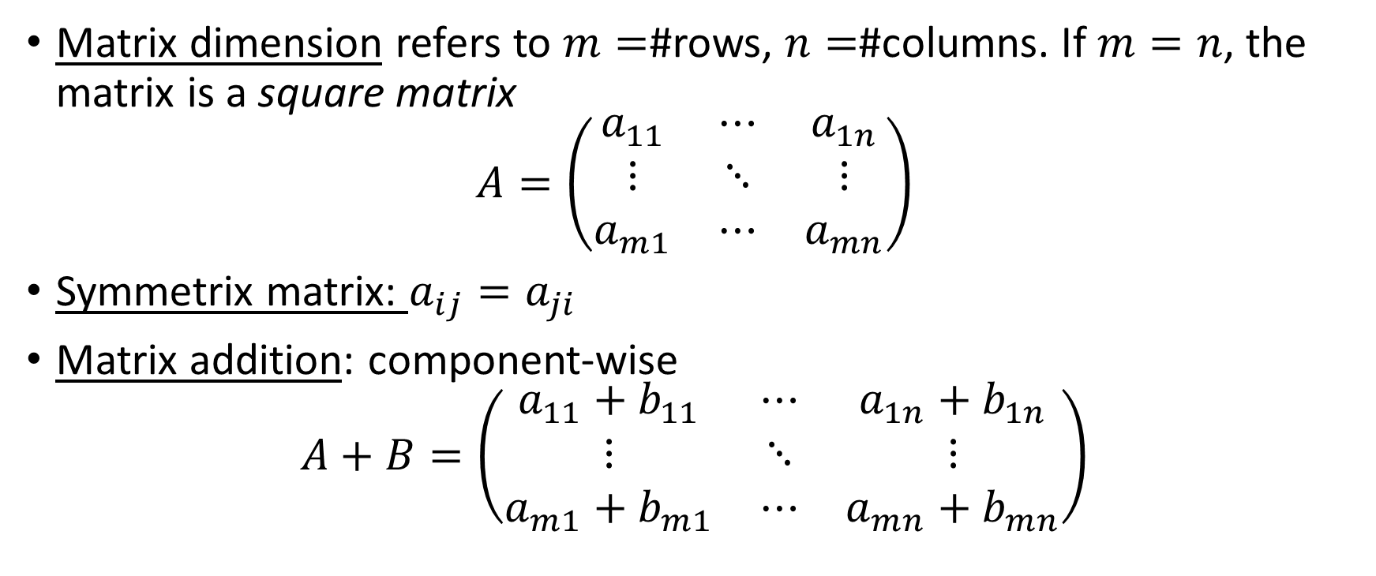
Matrix and vector
Matrix dimensionrefers to $m=$#rows, $n=$#columns. If $m=n$, the matrix is a square matrix
$$A=\left(\begin{matrix}a_{11} & ⋯ & a_{1n} \\ ⋮ & ⋱ & ⋮ \\ a_{m1} & ⋯ & a_{mn}\end{matrix}\right)$$
Symmetrix matrix: $a_{ij}=a_{ji}$
Matrix addition: component-wise
$$A+B=\left(\begin{matrix}a_{11}+b_{11} & ⋯ & a_{1n}+b_{1n} \\ ⋮ & ⋱ & ⋮ \\ a_{m1}+b_{m1} & ⋯ & a_{mn}+b_{mn}\end{matrix}\right)$$
PHS 651 / Lecture 02
13 / 35

Slide 14
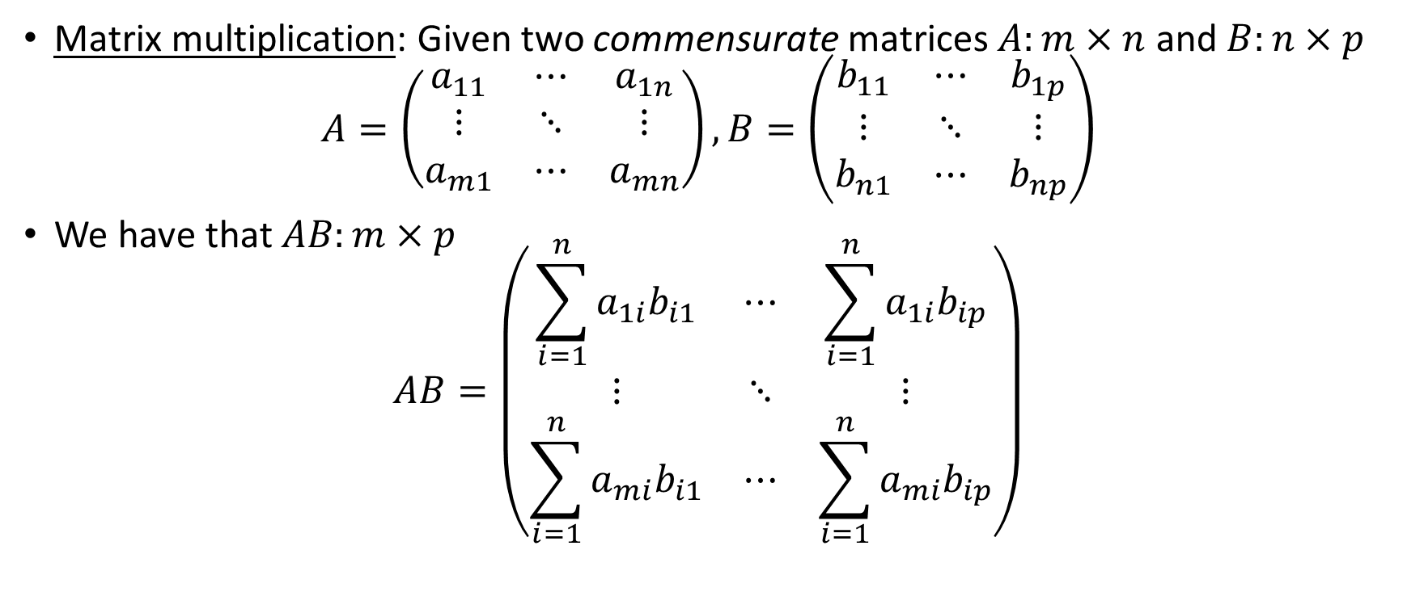
Matrix and vector
Matrix multiplication: Given two commensurate matrices $A:m×n$ and $B:n×p$
$$A=\left(\begin{matrix}a_{11} & ⋯ & a_{1n} \\ ⋮ & ⋱ & ⋮ \\ a_{m1} & ⋯ & a_{mn}\end{matrix}\right), B=\left(\begin{matrix}b_{11} & ⋯ & b_{1p} \\ ⋮ & ⋱ & ⋮ \\ b_{n1} & ⋯ & b_{np}\end{matrix}\right)$$
We have that $AB:m×p$
$$AB=\left(\begin{matrix}\sum_{i=1}^{n}{a_{1i}b_{i1}} & ⋯ & \sum_{i=1}^{n}{a_{1i}b_{ip}} \\ ⋮ & ⋱ & ⋮ \\ \sum_{i=1}^{n}{a_{mi}b_{i1}} & ⋯ & \sum_{i=1}^{n}{a_{mi}b_{ip}}\end{matrix}\right)$$
PHS 651 / Lecture 02
14 / 35

Slide 15

Matrix and vector
That is, the $(kj)$th element of $AB$ is
$$(A{B)}_{kj}=\sum_{i=1}^{n}{a_{ki}b_{ij}}$$
Exercise
$$A=\left(\begin{matrix}1 & 3 \\ 2 & 4\end{matrix}\right), B=\left(\begin{matrix}4 & 2 \\ 3 & 1\end{matrix}\right)$$
$AB=$?
PHS 651 / Lecture 02
15 / 35

Slide 16
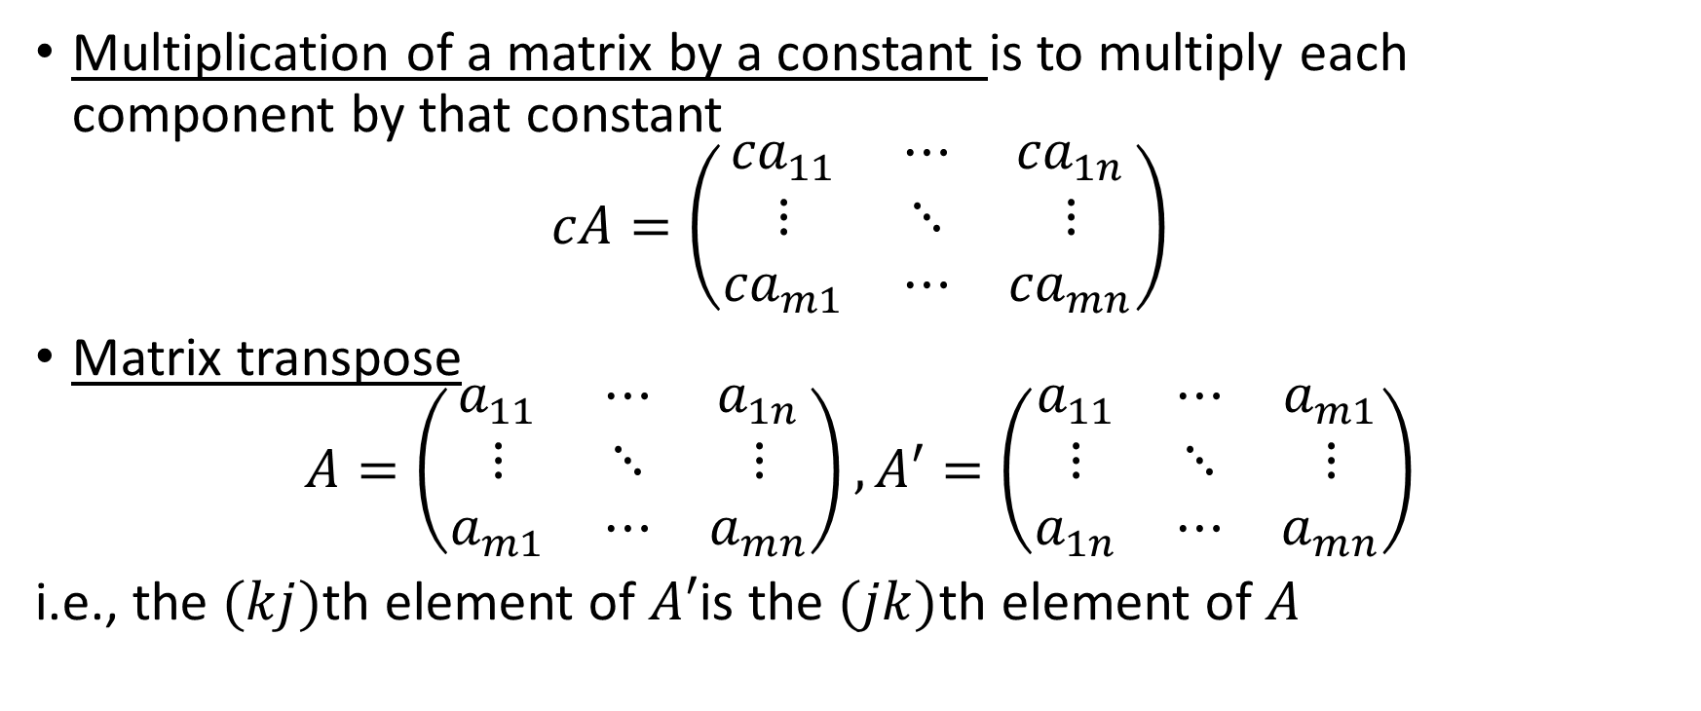
Matrix and vector
Multiplication of a matrix by a constant is to multiply each component by that constant
$$cA=\left(\begin{matrix}{ca}_{11} & ⋯ & {ca}_{1n} \\ ⋮ & ⋱ & ⋮ \\ {ca}_{m1} & ⋯ & {ca}_{mn}\end{matrix}\right)$$
Matrix transpose
$$A=\left(\begin{matrix}a_{11} & ⋯ & a_{1n} \\ ⋮ & ⋱ & ⋮ \\ a_{m1} & ⋯ & a_{mn}\end{matrix}\right),A′=\left(\begin{matrix}a_{11} & ⋯ & a_{m1} \\ ⋮ & ⋱ & ⋮ \\ a_{1n} & ⋯ & a_{mn}\end{matrix}\right)$$
i.e., the $(kj)$th element of $A′$is the $(jk)$th element of $A$
PHS 651 / Lecture 02
16 / 35

Slide 17
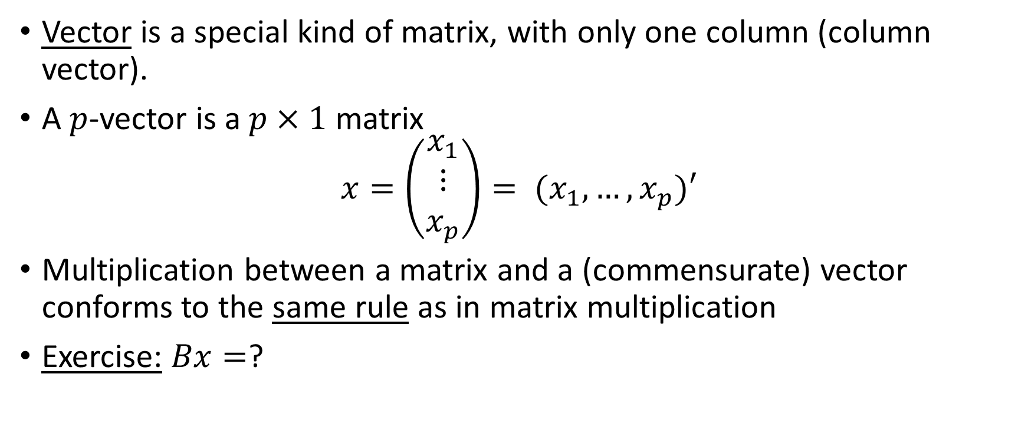
Matrix and vector
Vector is a special kind of matrix, with only one column (column vector).
A $p$-vector is a $p×1$ matrix
$$x=\left(\begin{matrix}x_{1} \\ ⋮ \\ x_{p}\end{matrix}\right)= (x_{1},…,x_{p})′$$
Multiplication between a matrix and a (commensurate) vector conforms to the same rule as in matrix multiplication
Exercise:$Bx=$?
PHS 651 / Lecture 02
17 / 35

Slide 18
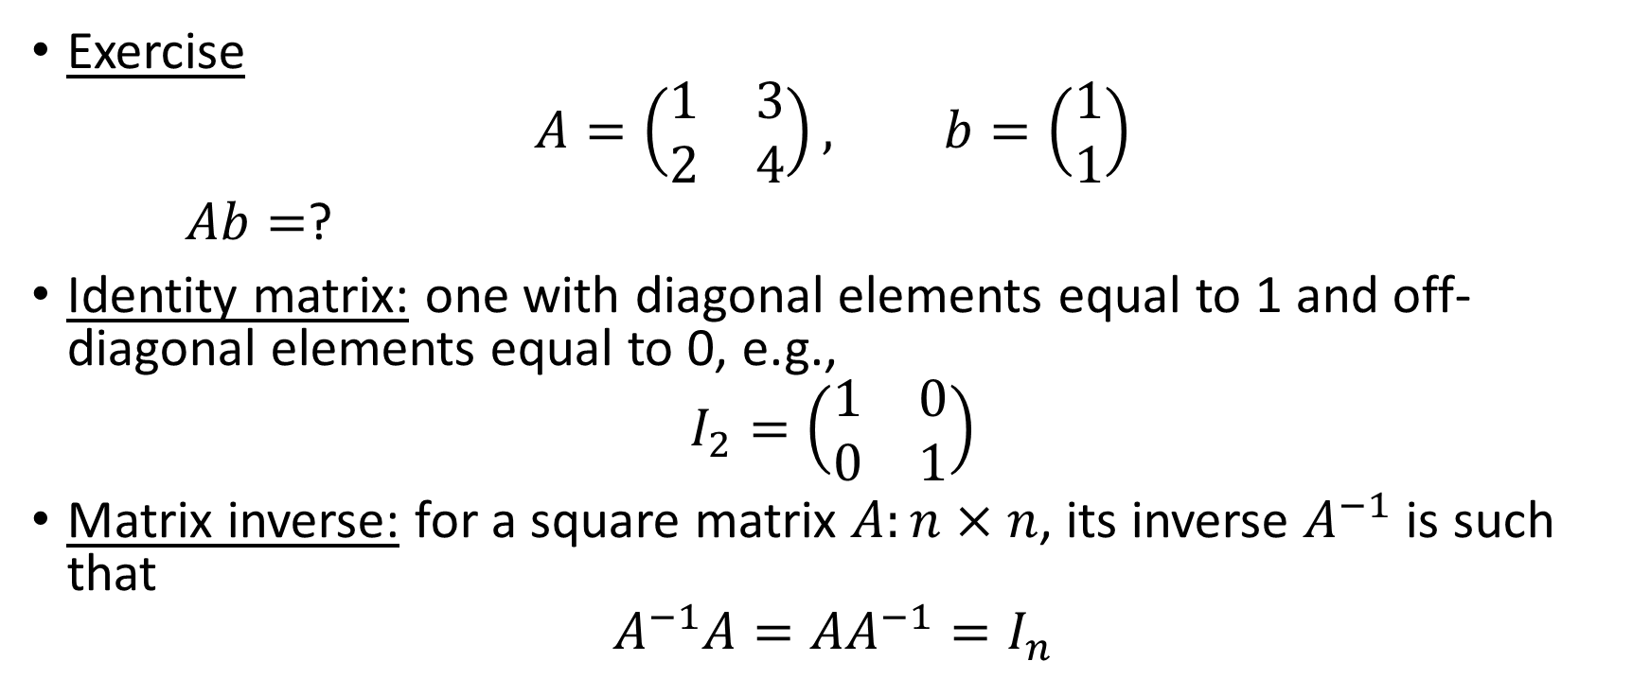
Matrix and vector
Exercise
$$A=\left(\begin{matrix}1 & 3 \\ 2 & 4\end{matrix}\right), b=\left(\begin{matrix}1 \\ 1\end{matrix}\right)$$
$Ab=$?
Identity matrix: one with diagonal elements equal to 1 and off-diagonal elements equal to 0, e.g.,
$$I_{2}=\left(\begin{matrix}1 & 0 \\ 0 & 1\end{matrix}\right)$$
Matrix inverse: for a square matrix $A:n×n$, its inverse $A^{−1}$ is such that
$$A^{−1}A=AA^{−1}=I_{n}$$
PHS 651 / Lecture 02
18 / 35

Slide 19
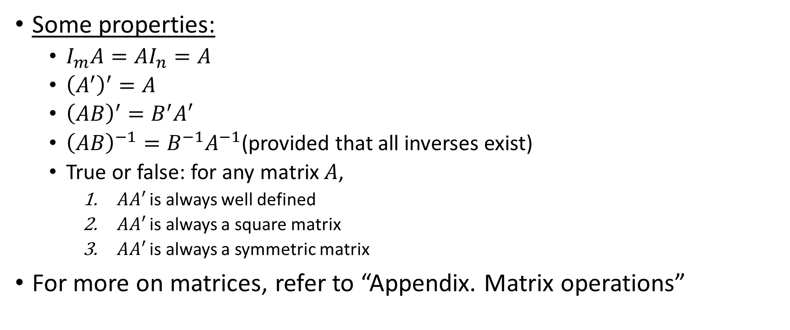
Matrix and vector
Some properties:
  $I_{m}A=AI_{n}=A$
  ${\left(A^{′}\right)}^{′}=A$
  ${\left(AB\right)}^{′}=B^{′}A′$
  ${\left(AB\right)}^{−1}=B^{−1}A^{−1}$(provided that all inverses exist)
  True or false: for any matrix $A$,
    $AA′$ is always well defined
    $AA′$ is always a square matrix
    $AA′$ is always a symmetric matrix
For more on matrices, refer to “Appendix. Matrix operations”
PHS 651 / Lecture 02
19 / 35

Slide 20
Linear regression in matrix form
PHS 651 / Lecture 02
20 / 35

Slide 21

Linear regression in matrix form
If we write
$$Y={\left(Y_{1},…, Y_{n}\right)}^{T}$$
and
$$X={\left(X_{1},…, X_{n}\right)}^{T}$$
$$e={\left(e_{1},…, e_{n}\right)}^{T}$$
Then
$$Y=Xβ+e$$
PHS 651 / Lecture 02
21 / 35

Slide 22
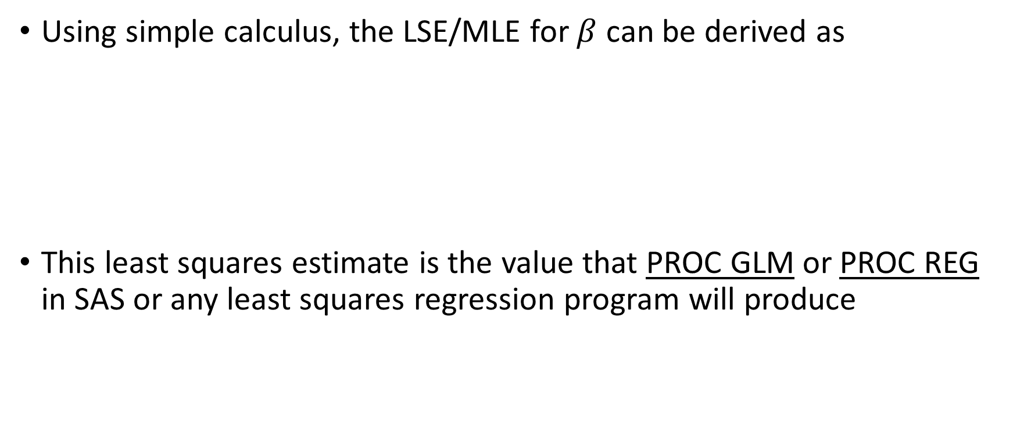

Linear regression in matrix form
Using simple calculus, the LSE/MLE for $β$ can be derived as
This least squares estimate is the value that PROC GLM or PROC REG in SAS or any least squares regression program will produce
$${{=(X}^{′}X) }^{−1}X^{′}Y$$
PHS 651 / Lecture 02
22 / 35

Slide 23
Properties of LSE
PHS 651 / Lecture 02
23 / 35

Slide 24
Regression using PROC GLM in SAS
/* read in data from file topeka.txt */
DATA topeka;
INFILE ’g\shared\bio226\topeka.txt’;
INPUT id height age logfev;
loght = log(height); /*define a new variable*/
RUN;
/* analysis */
PROC GLM DATA=topeka;
MODEL logfev = age loght;
RUN;
PHS 651 / Lecture 02
24 / 35

Slide 25
Regression using PROC GLM in SAS
PHS 651 / Lecture 02
25 / 35

Slide 26
Interpretation of regression results
PHS 651 / Lecture 02
26 / 35

Slide 27
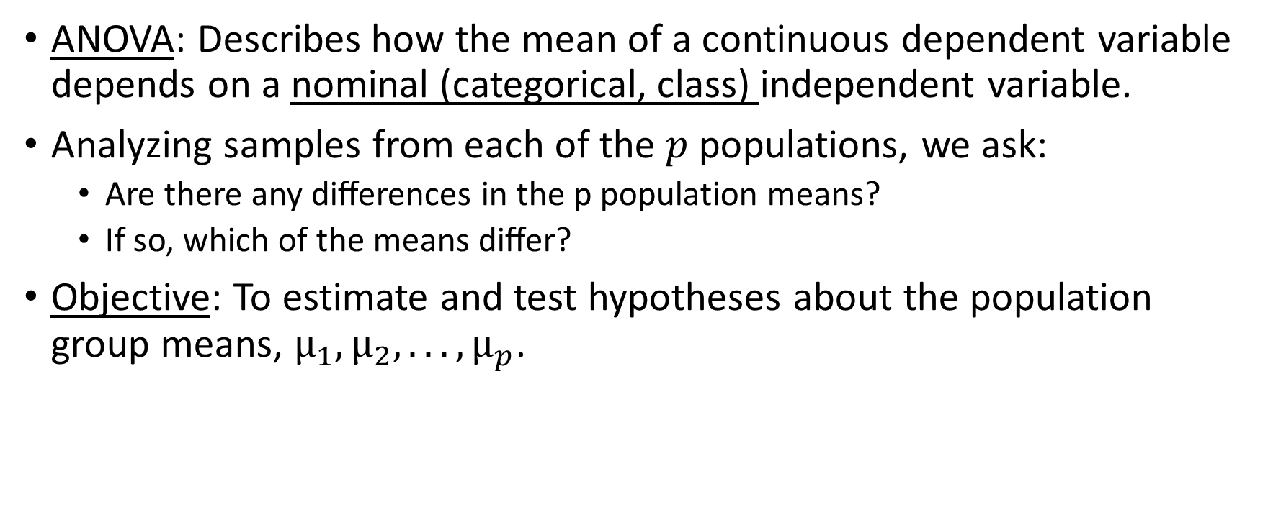
Analysis of variance (ANOVA)
ANOVA: Describes how the mean of a continuous dependent variable depends on a nominal (categorical, class) independent variable.
Analyzing samples from each of the $p$ populations, we ask:
  Are there any diﬀerences in the p population means?
  If so, which of the means diﬀer?
Objective: To estimate and test hypotheses about the population group means, $µ_{1}, µ_{2}, . . . , µ_{p}$.
PHS 651 / Lecture 02
27 / 35

Slide 28
Example: Dosages of four cardiotoxic drugs at death of infused guinea pigs
Evaluating potencies of four cardiac treatments
Observe dosage at which animals (guinea pigs) die for each treatment
10 guinea pigs per treatment (40 observations in all)
Assess any diﬀerences in toxicity of four treatments, i.e., diﬀerences in mean dosage required to kill animal
PHS 651 / Lecture 02
28 / 35

Slide 29
Example: Dosages of four cardiotoxic drugs at death of infused guinea pigs
/* read in data from file tox.txt */
DATA toxic;
  INFILE ’g:\shared\bio226\tox.txt’;
  INPUT y drug;
RUN;
/* analysis */
PROC GLM DATA=toxic;
  CLASS drug;
  MODEL y=drug;
RUN;
PHS 651 / Lecture 02
29 / 35

Slide 30
Example: Dosages of four cardiotoxic drugs at death of infused guinea pigs
PHS 651 / Lecture 02
30 / 35

Slide 31
Relationship between ANOVA and regression
Essentially identical, although often obscured by diﬀerences in terminology.
The ANOVA model can be represented as a multiple regression model with dummy (or indicator) variables.
⇒ A multiple regression analysis with dummy-variable coded factors will yield the same results as an ANOVA.
PHS 651 / Lecture 02
31 / 35

Slide 32
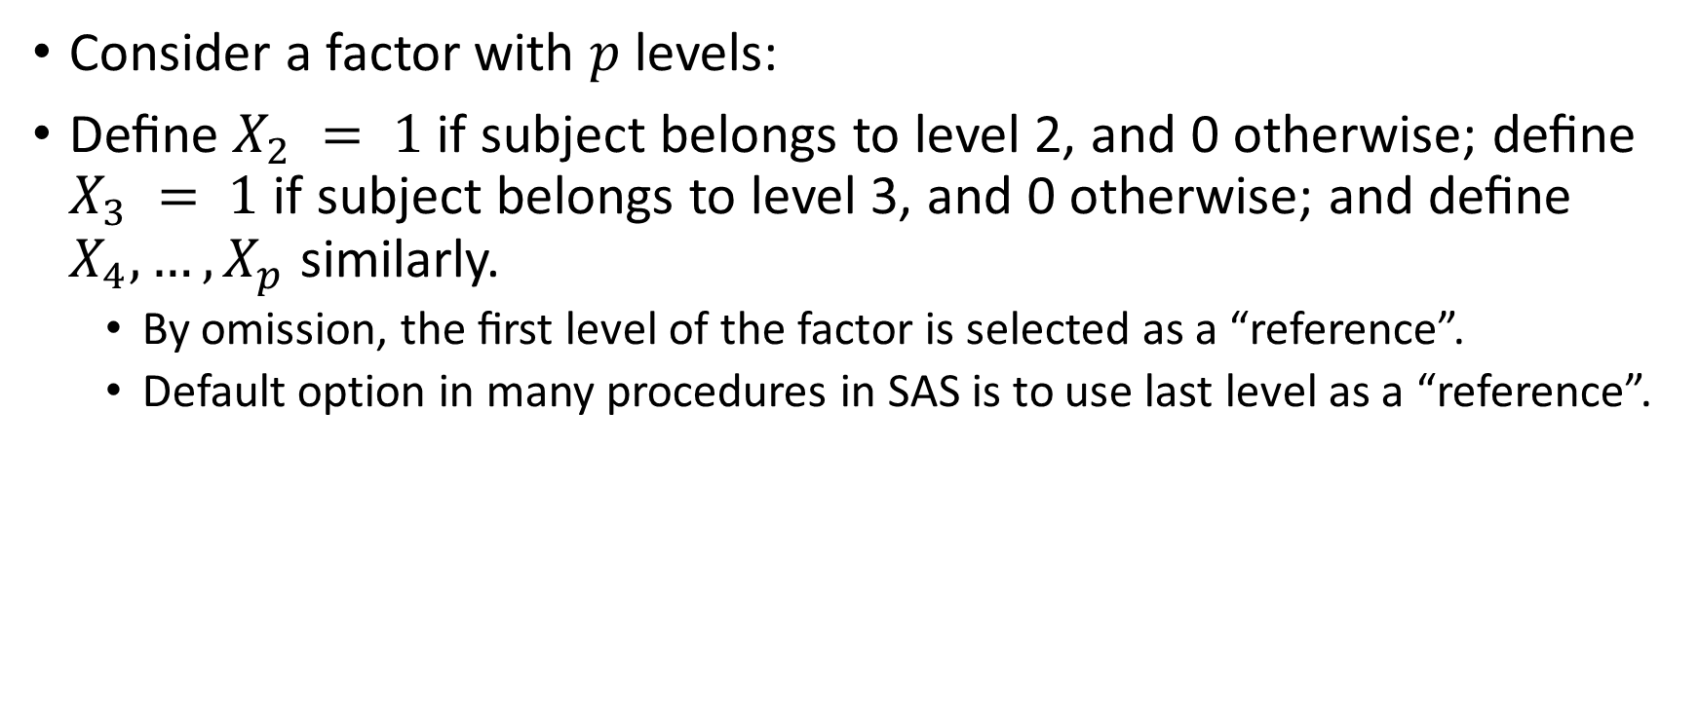
Relationship between ANOVA and regression
Consider a factor with $p$ levels:
Deﬁne $X_{2} = 1$if subject belongs to level 2, and 0 otherwise; deﬁne $X_{3} = 1$ if subject belongs to level 3, and 0 otherwise; and deﬁne $X_{4}, …, X_{p}$ similarly.
  By omission, the ﬁrst level of the factor is selected as a “reference”.
  Default option in many procedures in SAS is to use last level as a “reference”.
PHS 651 / Lecture 02
32 / 35

Slide 33
Relationship between ANOVA and regression
This leads to a simple way of representing the ANOVA model
Note
Or
PHS 651 / Lecture 02
33 / 35

Slide 34
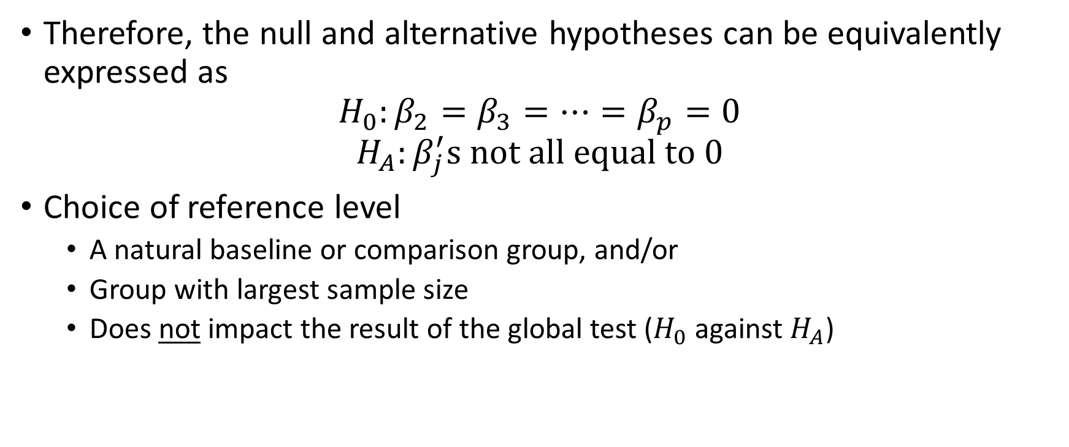
Relationship between ANOVA and regression
Therefore, the null and alternative hypotheses can be equivalently expressed as
$$H_{0}:β_{2}=β_{3}=…=β_{p}=0$$
$$H_{A}:β_{j}^{′}s not all equal to 0$$
Choice of reference level
  A natural baseline or comparison group, and/or
  Group with largest sample size
  Does not impact the result of the global test ($H_{0}$ against $H_{A}$)
PHS 651 / Lecture 02
34 / 35

Slide 35
Relationship between ANOVA and regression
The regression representation of ANOVA is more attractive because:
  It can handle balanced (i.e., equal cell sizes) and unbalanced data in a seamless fashion.
  In addition to the usual ANOVA table summaries, it provides other useful and interpretable results, e.g., estimates of eﬀects and standard errors.
  Generalizations of ANOVA to include continuous predictors (and interactions among nominal and continuous predictors) are straightforward.
PHS 651 / Lecture 02
35 / 35

