Slide 1
PHS 651 / LECTURE 03
Descriptive and Graphical Analysis Using SAS
Advanced Regression Methods for Population Health
Lu Mao, PhD
Department of Biostatistics and Medical Informatics
University of Wisconsin-Madison
SPRING 2019

Slide 2
Outline
Notation and formats of longitudinal data
Quantities of interest: mean, variance-covariance matrix, correlation
Descriptive analysis of the Treatment of Lead-Exposed Children (TLC) Trial using SAS
PHS 651 / Lecture 03
2 / 25

Slide 3
The longitudinal data
Objective:to characterize the change in response over time and the factors that influence change.
Individuals/Subjects: Participants in a longitudinal study are referred
to as individuals or subjects.
Occasions: Individuals are measured repeatedly at different occasions or times.
Balanced: When number and timing of the repeated measurements are the same for all individuals
PHS 651 / Lecture 03
3 / 25

Slide 4
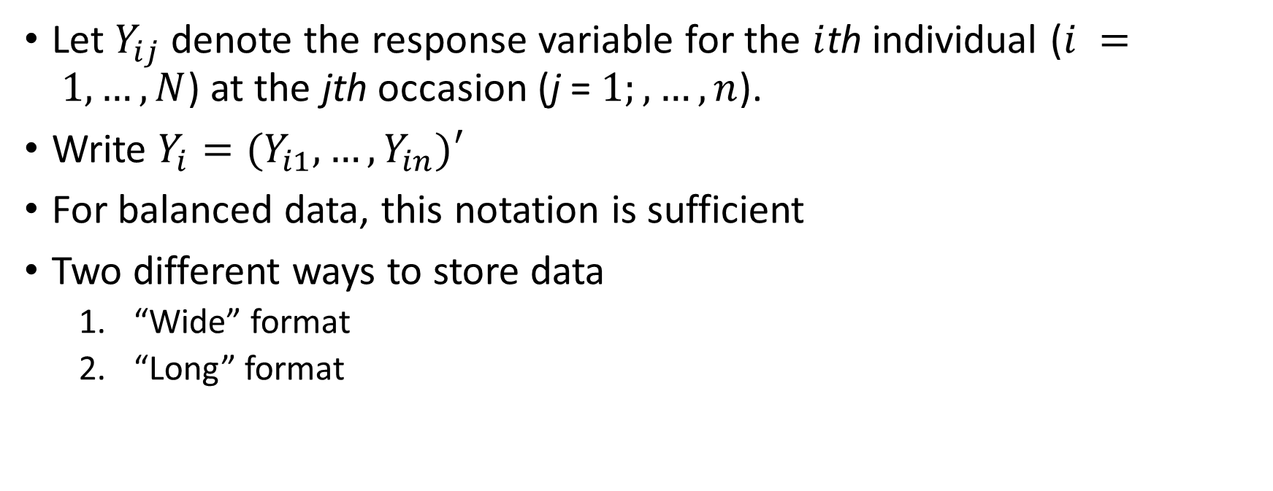
The longitudinal data
Let $Y_{ij}$denote the response variable for the $i$thindividual ($i = 1,…, N$) at the jthoccasion (j = $1;,…, n$).
Write $Y_{i}=(Y_{i1},…, Y_{in})′$
For balanced data, this notation is sufficient
Two different ways to store data
  “Wide” format
  “Long” format
PHS 651 / Lecture 03
4 / 25

Slide 5
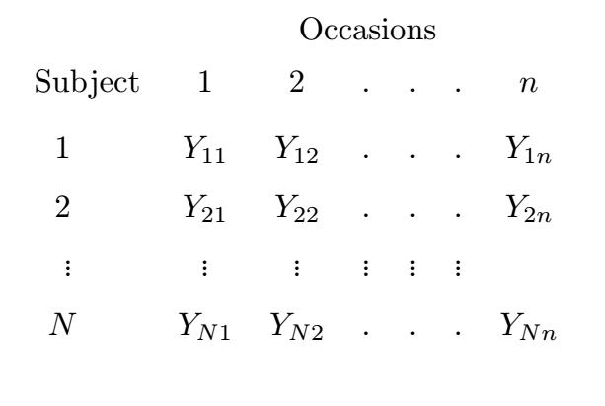

The wide format
  Rows: individuals; Columns: occasions.
  In matrix notation
  $$\left(\begin{matrix}Y_{1}′ \\ ⋮ \\ Y_{N}′\end{matrix}\right)$$

Slide 6
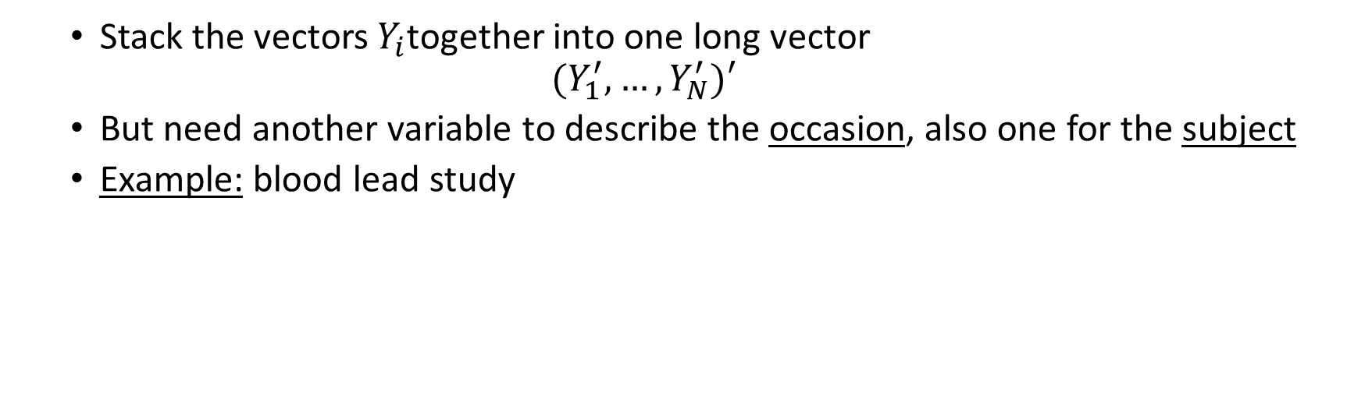
The long format
  Stack the vectors $Y_{i}$together into one long vector
  $$(Y_{1}^{′},…,Y_{N}^{′})′$$
  But need another variable to describe the occasion, also one for the subject
  Example: blood lead study
id | group | response | time
1 | P | 30.8 | 0
1 | P | 26.9 | 1
1 | P | 25.8 | 4
1 | P | 23.8 | 6
2 | A | 26.5 | 0
2 | A | 14.8 | 1
2 | A | 19.5 | 4
2 | A | 21.0 | 6
3 | A | 25.8 | 0
3 | A | 23.0 | 1
PHS 651 / Lecture 03
6 / 25

Slide 7
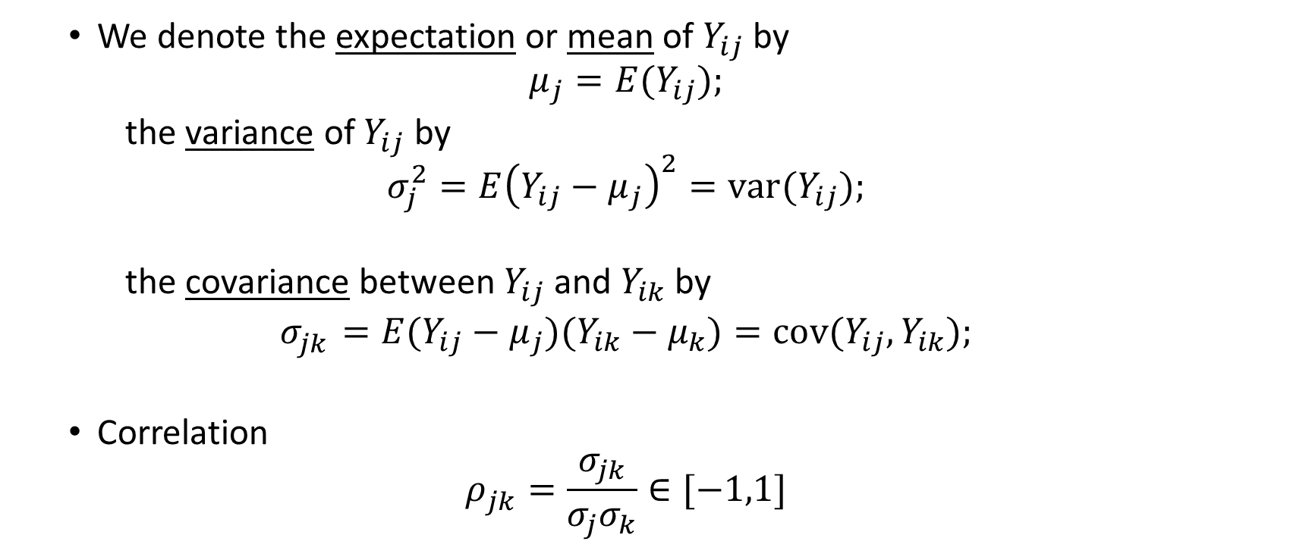
The longitudinal data
  We denote the expectation or mean of $Y_{ij}$by
  $μ_{j}=E(Y_{ij});$
  the variance of $Y_{ij}$ by
  $$σ_{j}^{2}=E{\left(Y_{ij}−μ_{j}\right)}^{2}=var(Y_{ij});$$
  the covariance between $Y_{ij}$ and $Y_{ik}$ by
  $$σ_{jk}^{}=E(Y_{ij}−μ_{j})(Y_{ik}−μ_{k})=cov(Y_{ij}, Y_{ik});$$
  Correlation
  $$ρ_{jk}^{}=\frac{σ_{jk}}{σ_{j}σ_{k}}∈[−1,1]$$
Target of inference
PHS 651 / Lecture 03
7 / 25

Slide 8
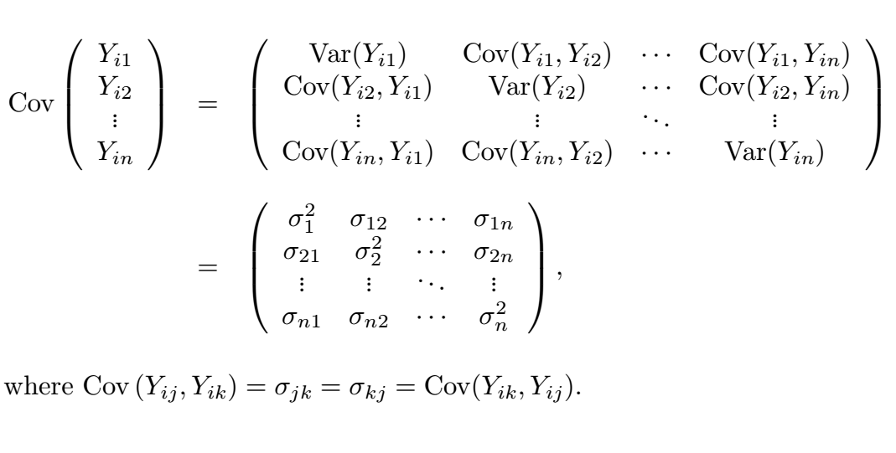

The longitudinal data
  Covariance matrix $cov\left(Y_{i}\right),$
PHS 651 / Lecture 03
8 / 25

Slide 9
Descriptive analysis – TLC study
Treatment of Lead-Exposed Children (TLC) Trial
100 children exposed to lead were randomized into succimer and placebo groups, each N=50
Data consist of 4 repeated measurements of blood lead levels obtained at baseline (or week 0), weeks 1, 4, and 6.
Data file: “tlc-data.txt”
Code file: “lecture3.sas”
PHS 651 / Lecture 03
9 / 25

Slide 10
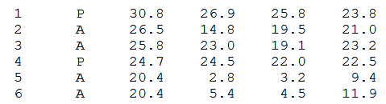
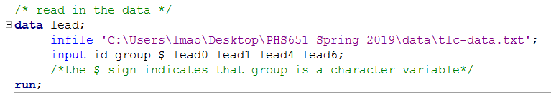
Descriptive analysis – TLC study
Raw data:
Read the data file into SAS
PHS 651 / Lecture 03
10 / 25

Slide 11
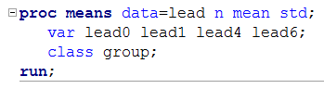
Descriptive analysis
Summarize the baseline characteristics and response over time by treatment group
For continuous variables, use proc means
Request means and standard deviation (can also do quantiles p25, p75, etc.)
The var statement specifies the variable you want to analyze
The class statement specifies the strata
PHS 651 / Lecture 03
11 / 25

Slide 12
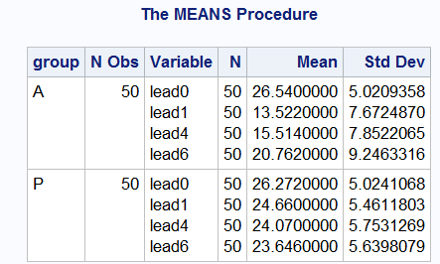
Descriptive analysis
PROC MEANS output:
DO NOT COPY/PASTE this!
PHS 651 / Lecture 03
12 / 25

Slide 13
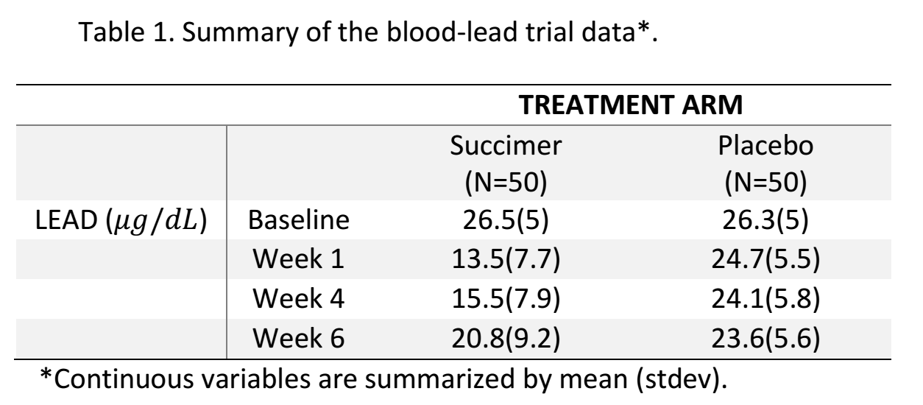
Descriptive analysis – Table 1
Summarize the baseline characteristics and response over time by treatment group
PHS 651 / Lecture 03
13 / 25

Slide 14
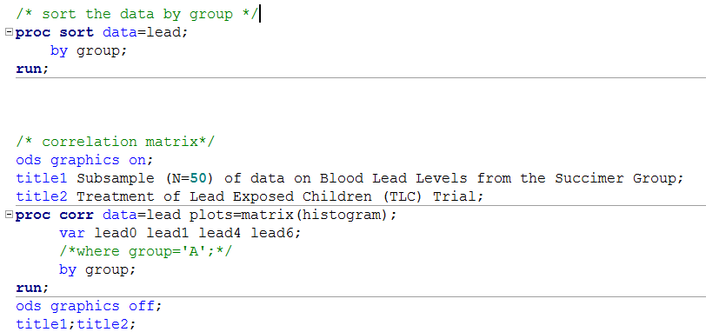
Descriptive analysis – Correlation
Correlation among the four repeated measures can be examined by constructing a scatterplot of each pair using PROC CORR
Needed to show plots
The main title and sub-title. Reset them after procedures
This option requests a scatterplot matrix with histograms in the diagonal
PHS 651 / Lecture 03
14 / 25

Slide 15
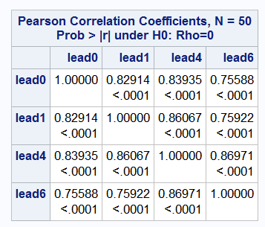
Descriptive analysis – Correlation
For the placebo group
PHS 651 / Lecture 03
15 / 25

Slide 16
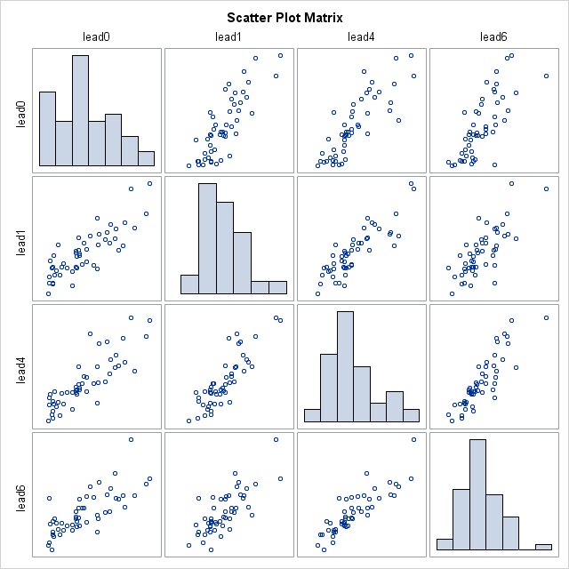
Descriptive analysis – Correlation
Correlations are all positive and tend to decrease with increasing time separation.
PHS 651 / Lecture 03
16 / 25

Slide 17
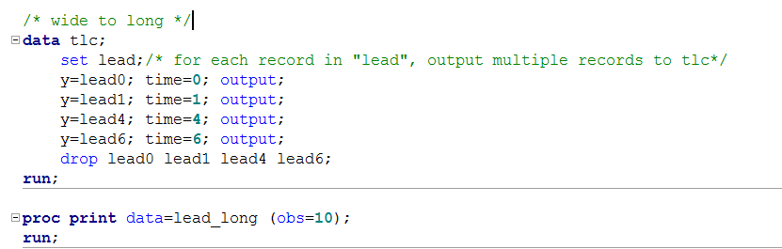
Descriptive analysis – “Wide” to “Long”
Transform the “wide” dataset to “long” dataset
Specifies the number of records to print
PHS 651 / Lecture 03
17 / 25

Slide 18
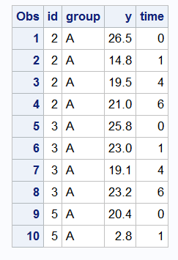
Descriptive analysis – “Wide” to “Long”
PHS 651 / Lecture 03
18 / 25

Slide 19
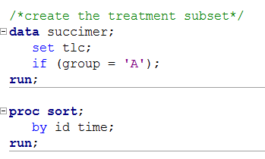
Descriptive analysis – Time plots
Two kinds of time plots
  Individual trajectories
  Mean trajectories
We demonstrate both on the treatment group
PHS 651 / Lecture 03
19 / 25

Slide 20
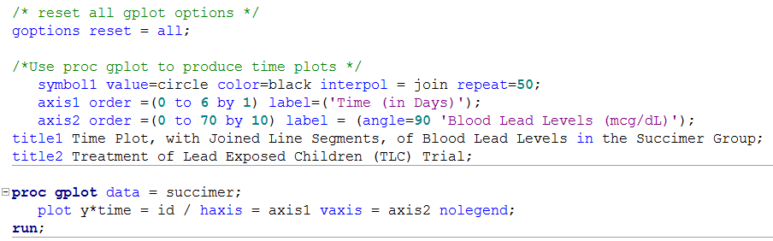
Descriptive analysis – Time plots
Use PROC GPLOT to create these graphics
How the data points are shown and how they are connected
Range, grid size, and label for axis
Weeks)');
“y*x”: plot y as a function of x
“=id”: group variable; data points within the same group use the same symbol

Slide 21
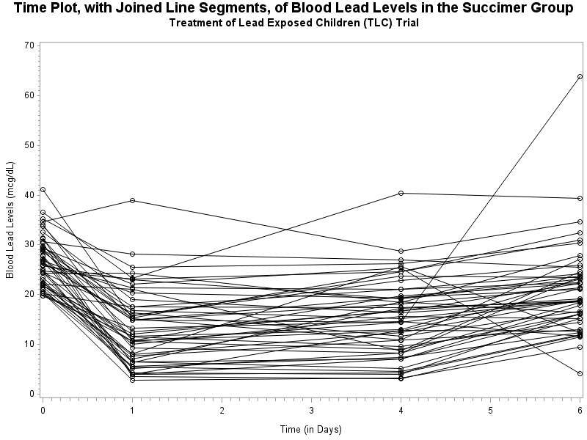
Descriptive analysis – Time plots
Time (in Weeks)

Slide 22
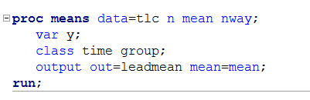
Descriptive analysis – Time plots
Mean plot: first compute the means using PROC MEANS and then output the results
The nway options requests that statistics be computed within each level of the combination of class variables.
Specify the variable name for the mean statistic
Output the results to SAS dataset “leadmean”
PHS 651 / Lecture 03
22 / 25

Slide 23
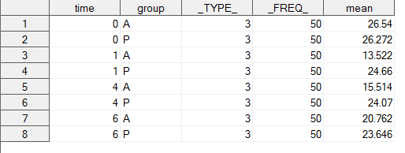
Descriptive analysis – Time plots
Leadmean
PHS 651 / Lecture 03
23 / 25

Slide 24
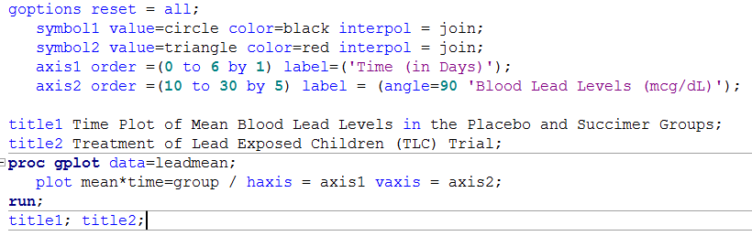
Descriptive analysis – Time plots
Use PROC GPLOT on the Leadmean dataset
The class variable group has two levels, hence two symbol statements.
Weeks)');
PHS 651 / Lecture 03
24 / 25

Slide 25
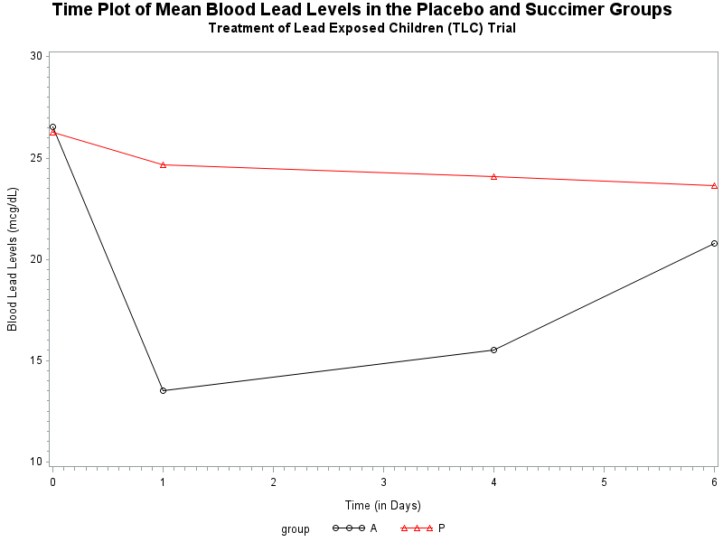
Descriptive analysis – Time plots
Time (in Weeks)
PHS 651 / Lecture 03
25 / 25

