Slide 1
PHS 651 / LECTURE 04
Single-Group Analysis and General Linear Models
Advanced Regression Methods for Population Health
Lu Mao, PhD
Department of Biostatistics and Medical Informatics
University of Wisconsin-Madison
SPRING 2019

Slide 2
Outline
  The impact of correlation in trend analysis
  Single-group trend analysis using PROC MIXED
  Set-up for the general linear model
PHS 651 / Lecture 04
2 / 33

Slide 3
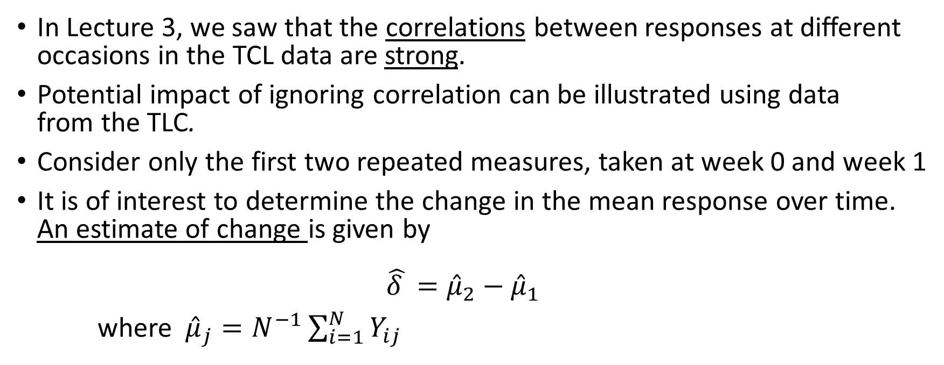
Impact of correlation
In Lecture 3, we saw that the correlations between responses at different occasions in the TCL data are strong.
Potential impact of ignoring correlation can be illustrated using data
from the TLC.
Consider only the first two repeated measures, taken at week 0 and week 1
It is of interest to determine the change in the mean response over time.
An estimate of change is given by
$\hat{δ }={\hat{μ}}_{2}−{\hat{μ}}_{1}$
where ${\hat{μ}}_{j}=N^{−1}\sum_{i=1}^{N}{Y_{ij}}$
PHS 651 / Lecture 04
3 / 33

Slide 4

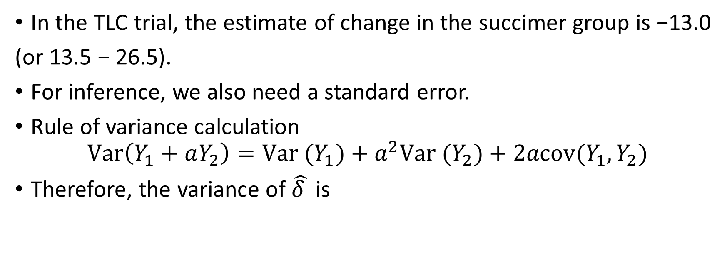
Impact of correlation
In the TLC trial, the estimate of change in the succimer group is −13.0
(or 13.5 − 26.5).
For inference, we also need a standard error.
Rule of variance calculation
$$Var\left(Y_{1}+aY_{2}\right)=Var (Y_{1})+a^{2}Var (Y_{2})+2acov(Y_{1},Y_{2})$$
Therefore, the variance of $\hat{δ }$ is
PHS 651 / Lecture 04
4 / 33

Slide 5


Impact of correlation
Note: Last term, $−2σ_{12}$, accounts for the correlation among the repeated measures.
Substituting estimates of the variances and covariance (obtainable by, say, PROC CORR) into this expression:
PHS 651 / Lecture 04
5 / 33

Slide 6

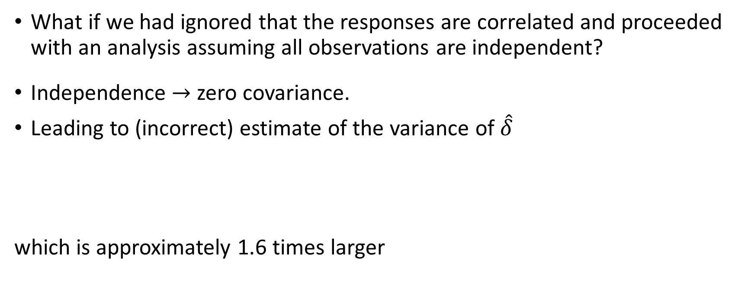
Impact of correlation
What if we had ignored that the responses are correlated and proceeded with an analysis assuming all observations are independent?
Independence zero covariance.
Leading to (incorrect) estimate of the variance of $\hat{δ}$
which is approximately 1.6 times larger
PHS 651 / Lecture 04
6 / 33

Slide 7
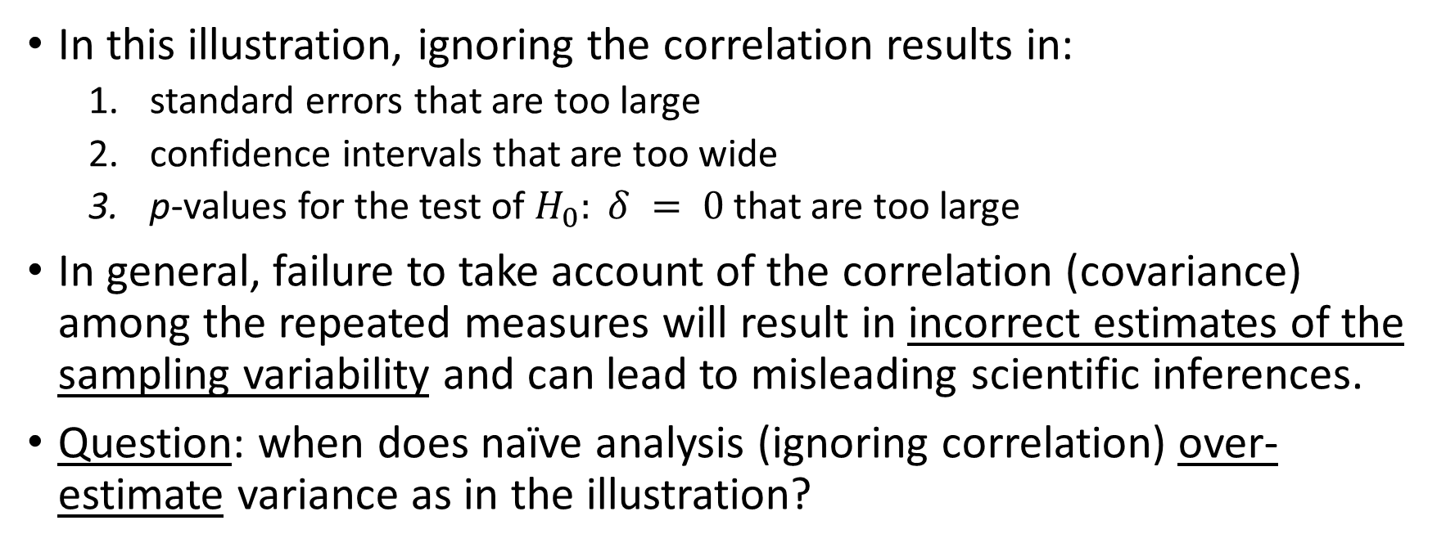
Impact of correlation
In this illustration, ignoring the correlation results in:
  standard errors that are too large
  confidence intervals that are too wide
  p-values for the test of $H_{0}: δ = 0$that are too large
In general, failure to take account of the correlation (covariance) among the repeated measures will result in incorrect estimates of the sampling variabilityand can lead to misleading scientific inferences.
Question: when does naïve analysis (ignoring correlation) over-estimate variance as in the illustration?
PHS 651 / Lecture 04
7 / 33

Slide 8
Impact of correlation
Primary goal of a longitudinal study is to characterize the change in
response over time and the factors that influence change.
Longitudinal data require somewhat more sophisticated statistical
techniques because: (i) repeated measures on the same individual are
usually positively correlated, and (ii) variability is often heterogeneous
across measurement occasions.
Correlation and heterogeneous variability must be accounted for in order to obtain valid inferences about change in response over time.
PHS 651 / Lecture 04
8 / 33

Slide 9
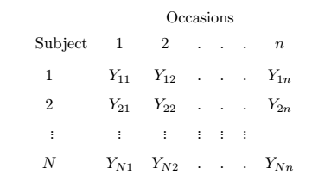
Single-group analysis of trend
Single-Group Repeated Measures Design:
In this design, we have n repeated measures of the response on each of N subjects.
PHS 651 / Lecture 04
9 / 33

Slide 10
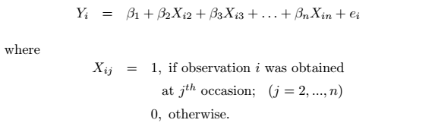

Single-group analysis of trend
Ignoring the subject-wise information, we could order them from 1 to Nnin a vector with elements $Y_{i}$, and write the model as
However, this model needs to be modified to account for the statistical
dependence among repeated observations obtained on the same subject.
PHS 651 / Lecture 04
10 / 33

Slide 11
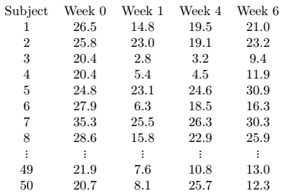
Example: the TLC trial
Consider the data on the 50 children randomized to succimer:
PHS 651 / Lecture 04
11 / 33

Slide 12
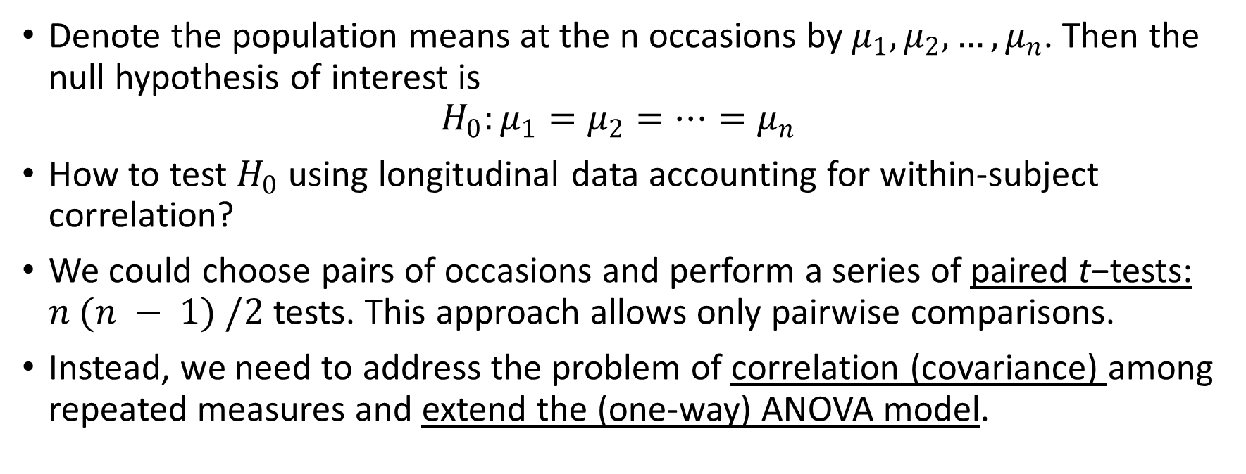
Single-group analysis of trend
Denote the population means at the n occasions by $μ_{1}, μ_{2}, …, μ_{n}$. Then the null hypothesis of interest is
$${H_{0}:μ}_{1}=μ_{2}=…=μ_{n}$$
How to test $H_{0}$ using longitudinal data accounting for within-subject correlation?
We could choose pairs of occasions and perform a series of paired t−tests:$n (n − 1) /2$tests. This approach allows only pairwise comparisons.
Instead, we need to address the problem of correlation (covariance) among repeated measures and extend the (one-way) ANOVA model.
PHS 651 / Lecture 04
12 / 33

Slide 13
Single-group analysis of trend
We allow the repeated measurements on each subject to have an unknown covariance structure.
To do this, we can use the SAS procedure, PROC MIXED, an extension
of PROC GLM which allows clusters of correlated observations.
We will illustrate the use of PROC MIXED using the data from the TLC
trial. Later we will consider the statistical basis for this analysis.
Note: PROC MIXED requires the data be in the long format.
PHS 651 / Lecture 04
13 / 33

Slide 14
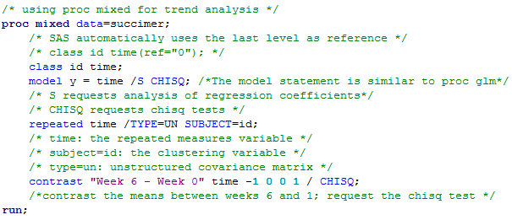
Example: the TLC trial
Suppose that succimer is a SAS dataset for the treatment group in the long format.
PHS 651 / Lecture 04
14 / 33

Slide 15
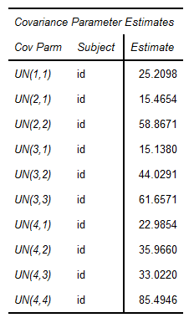
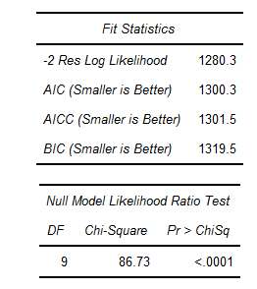
Example: the TLC trial
Estimate of covariance matrix
Model fit statistics
PHS 651 / Lecture 04
15 / 33

Slide 16
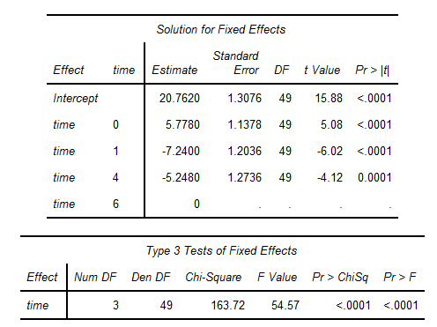
Example: the TLC trial
PHS 651 / Lecture 04
16 / 33

Slide 17
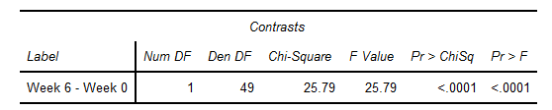

Example: the TLC trial
The contrast between Week 6 and Week 1
Chi-square and F tests are equivalent under large samples
$$χ_{d}=F_{d,∞}$$
In general, Chi-square test is preferred over F test; F test assumes that the response distributions are multivariate normal.
PHS 651 / Lecture 04
17 / 33

Slide 18
Covariance structure
When we estimate the covariance matrix without making any particular
assumption about the covariance structure, we say that we are using an
unrestricted or unstructured covariance matrix.
As we shall see later, it is sometimes advantageous to model the
covariance structure more parsimoniously.
How important is it to take account of the covariance among repeated
measures?
We can address that question by re-analyzing the blood lead level data
under the assumption of independence and homogeneity of variance.
PHS 651 / Lecture 04
18 / 33

Slide 19
Covariance structure
When we estimate the covariance matrix without making any particular
assumption about the covariance structure, we say that we are using an
unrestricted or unstructured covariance matrix.
As we shall see later, it is sometimes advantageous to model the
covariance structure more parsimoniously.
How important is it to take account of the covariance among repeated
measures?
We can address that question by re-analyzing the blood lead level data
under the assumption of independence and homogeneity of variance.
PHS 651 / Lecture 04
19 / 33

Slide 20
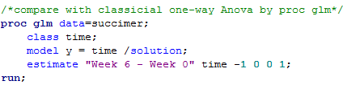
Covariance structure
We re-fit the data by classical ANOVA using PROC GLM
Can obtain same results by deleting the REPEATED statement in PROC MIXED
PHS 651 / Lecture 04
20 / 33

Slide 21
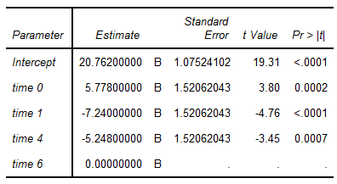
Covariance structure
Independent (and homoscedastic) covariance structure
Unstructured covariance
PHS 651 / Lecture 04
21 / 33

Slide 22
Covariance structure
The estimates of the change in mean from baseline (week 0)
to week 6 are the same in both analyses, i.e., -5:778; but the standard
errors are discernibly different.
The standard error yielded by PROC GLM, 1.52, is not valid since
the procedure has incorrectly assumed that all of the observations are
independent and with homogeneous variance.
The standard error yielded by PROC MIXED, 1.14, is valid since the
procedure has accounted for the covariance among repeated measures in
the analysis.
PHS 651 / Lecture 04
22 / 33

Slide 23
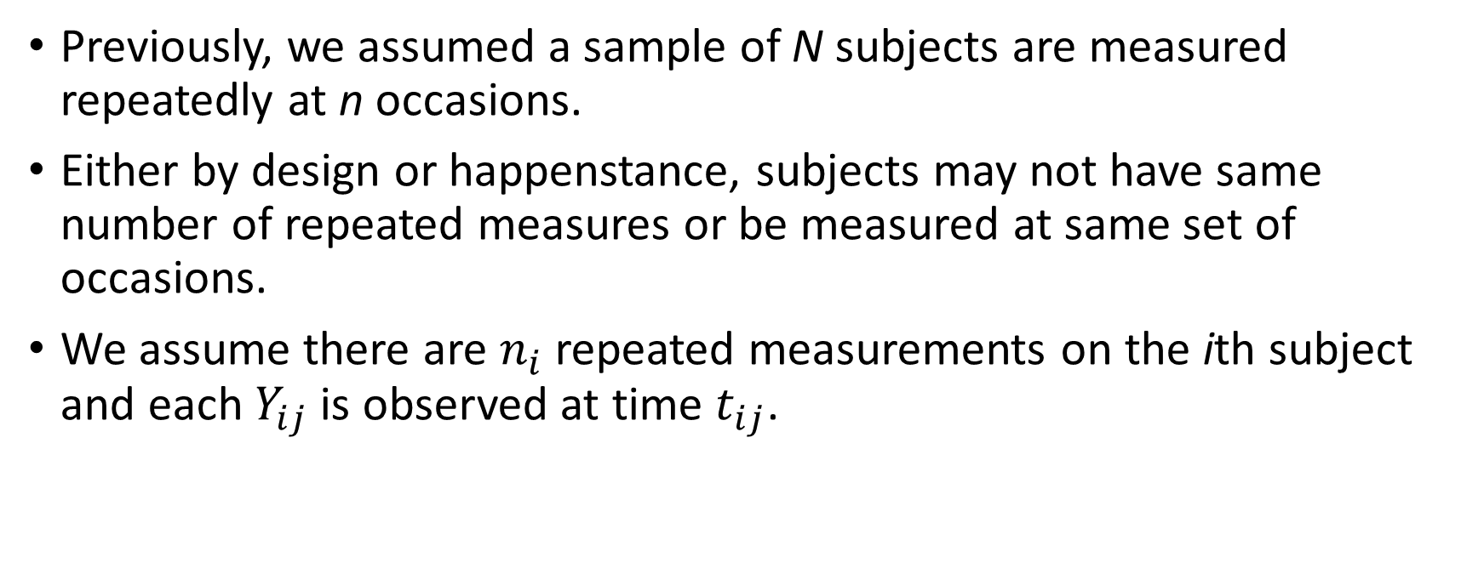
General Linear Model
Previously, we assumed a sample of N subjects are measured repeatedlyat n occasions.
Either by design or happenstance, subjects may not have same number of repeated measures or be measured at same set of occasions.
We assume there are $n_{i}$repeated measurements on the ithsubject and each $Y_{ij}$is observed at time $t_{ij}$.
PHS 651 / Lecture 04
23 / 33

Slide 24
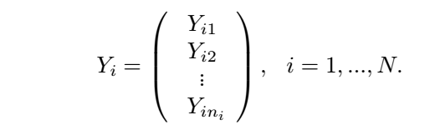
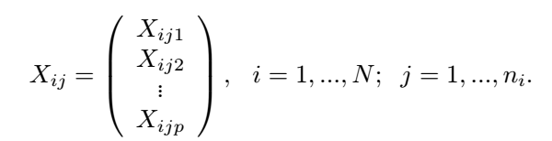

General Linear Model
We can group the response variables for the ithsubject into a $n_{i}$-vector.
Associated with $Y_{ij}$there is a p-vector of covariates
PHS 651 / Lecture 04
24 / 33

Slide 25
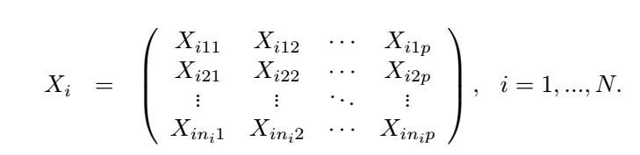
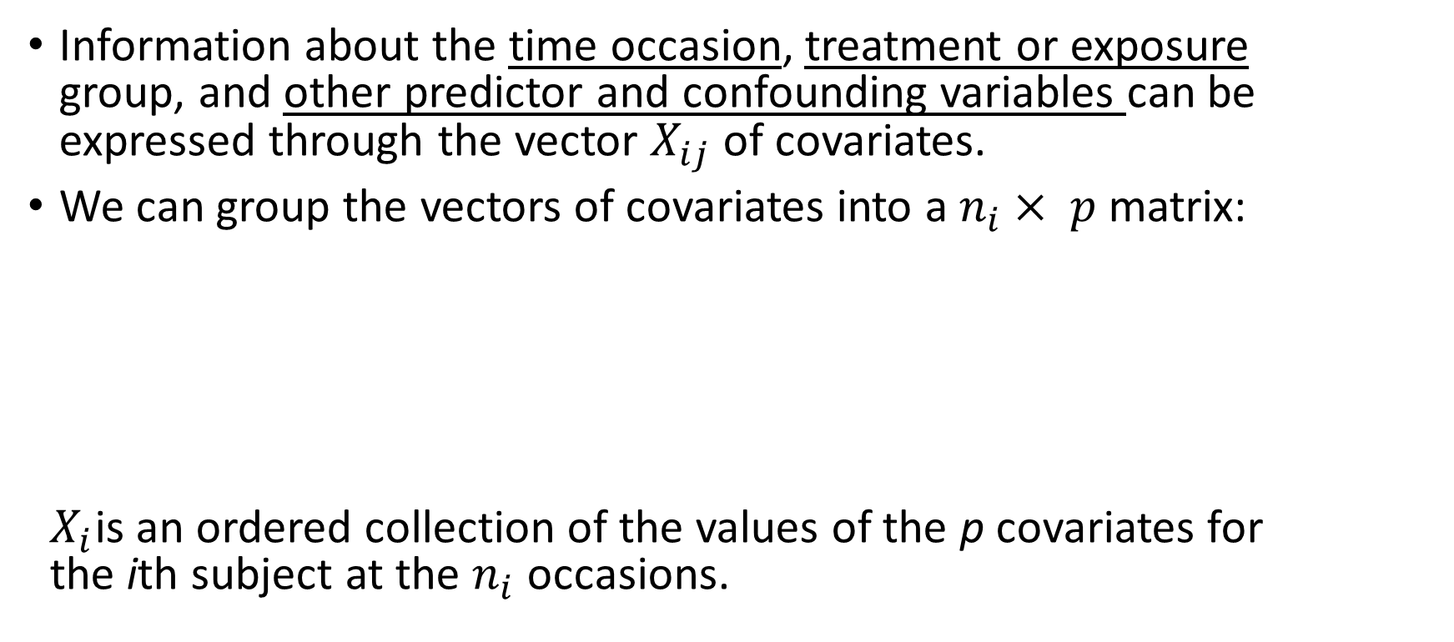
General Linear Model
Information about the time occasion, treatment or exposure
group, and other predictor and confounding variables can be expressed through the vector $X_{ij}$of covariates.
We can group the vectors of covariates into a $n_{i}× p$matrix:
$X_{i}$is an ordered collection of the values of the p covariates for
the ithsubject at the $n_{i}$occasions.
PHS 651 / Lecture 04
25 / 33

Slide 26
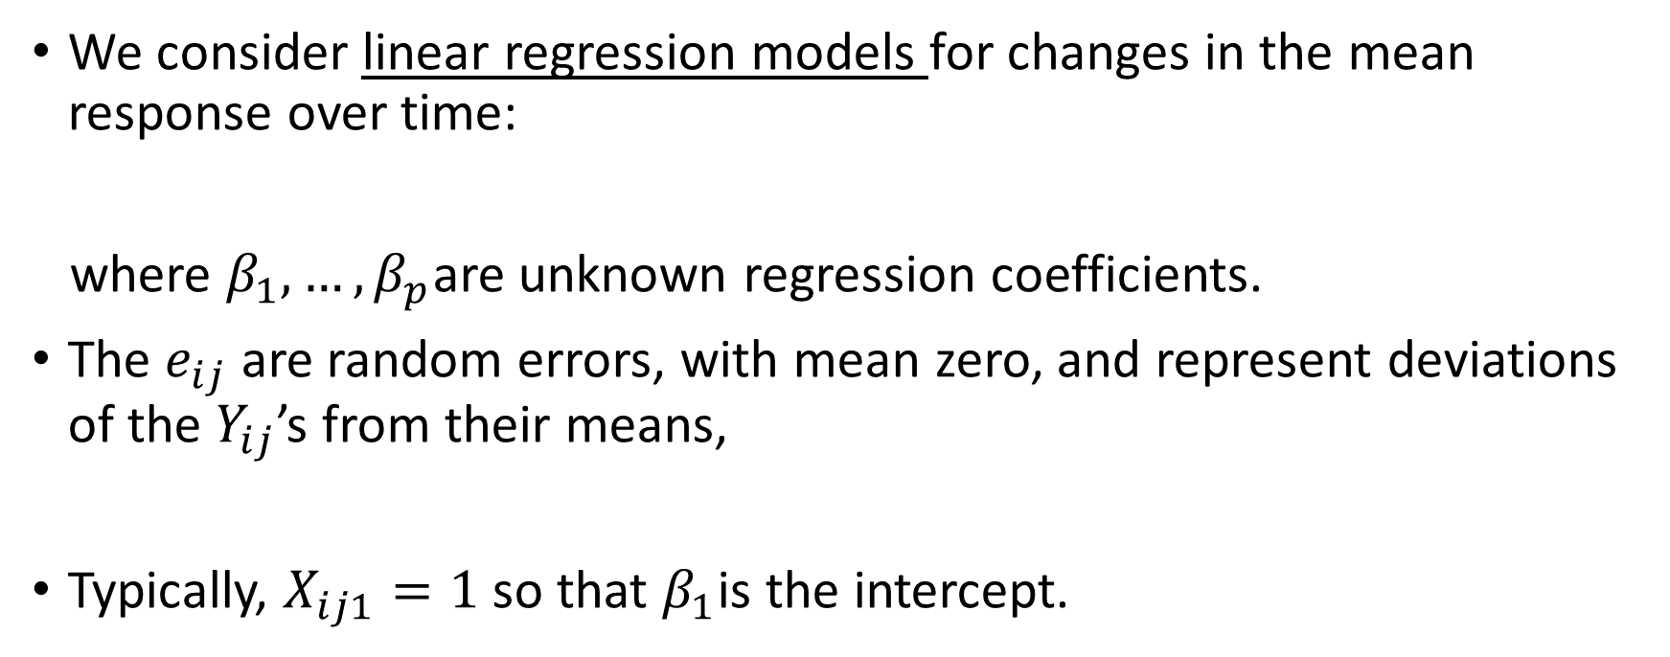
General Linear Model
We consider linear regression models for changes in the mean response over time:
where $β_{1},…,β_{p}$are unknown regression coefficients.
The $e_{ij}$are random errors, with mean zero, and represent deviations of the $Y_{ij}$’s from their means,
Typically, $X_{ij1}=1$ so that $β_{1}$is the intercept.
PHS 651 / Lecture 04
26 / 33

Slide 27
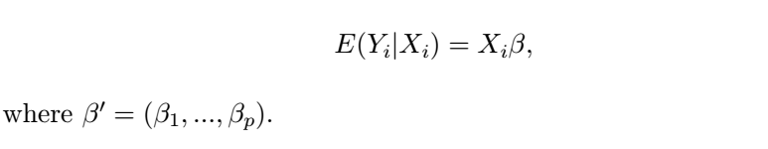

General Linear Model
This model is a general linear model because the $e_{ij}$may be correlated (for the same $i$ with different $j$s)
This mean model can also be represented in vector/matrix notation as:
PHS 651 / Lecture 04
27 / 33

Slide 28
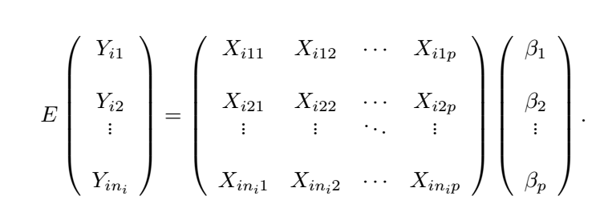
General Linear Model
This is a short hand notation for
PHS 651 / Lecture 04
28 / 33

Slide 29
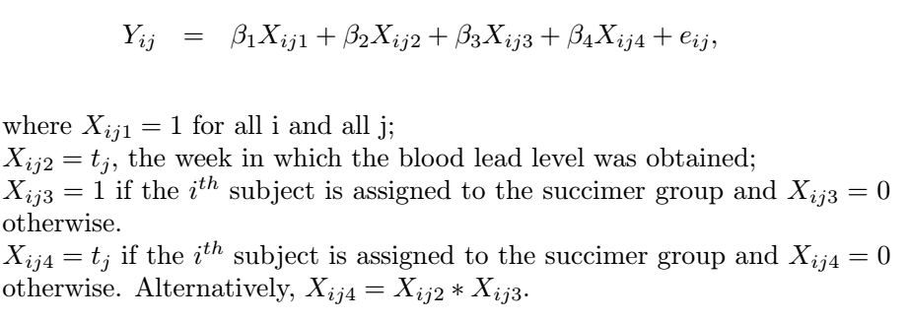
Example: the TLC trial
For illustrative purposes, consider a model that assumes mean blood lead level changes linearly over time, but at a rate that differs by treatment group.
Assume two treatment groups have different intercepts and slopes:
PHS 651 / Lecture 04
29 / 33

Slide 30


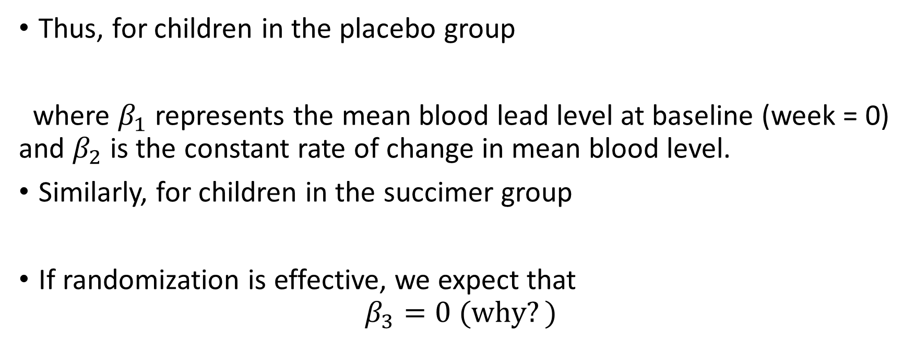
General Linear Model
Thus, for children in the placebo group
where $β_{1}$ represents the mean blood lead level at baseline (week = 0) and $β_{2}$is the constant rate of change in mean blood level.
Similarly, for children in the succimer group
If randomization is effective, we expect that
$β_{3}=0 (why?)$
PHS 651 / Lecture 04
30 / 33

Slide 31
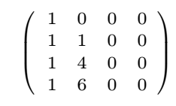
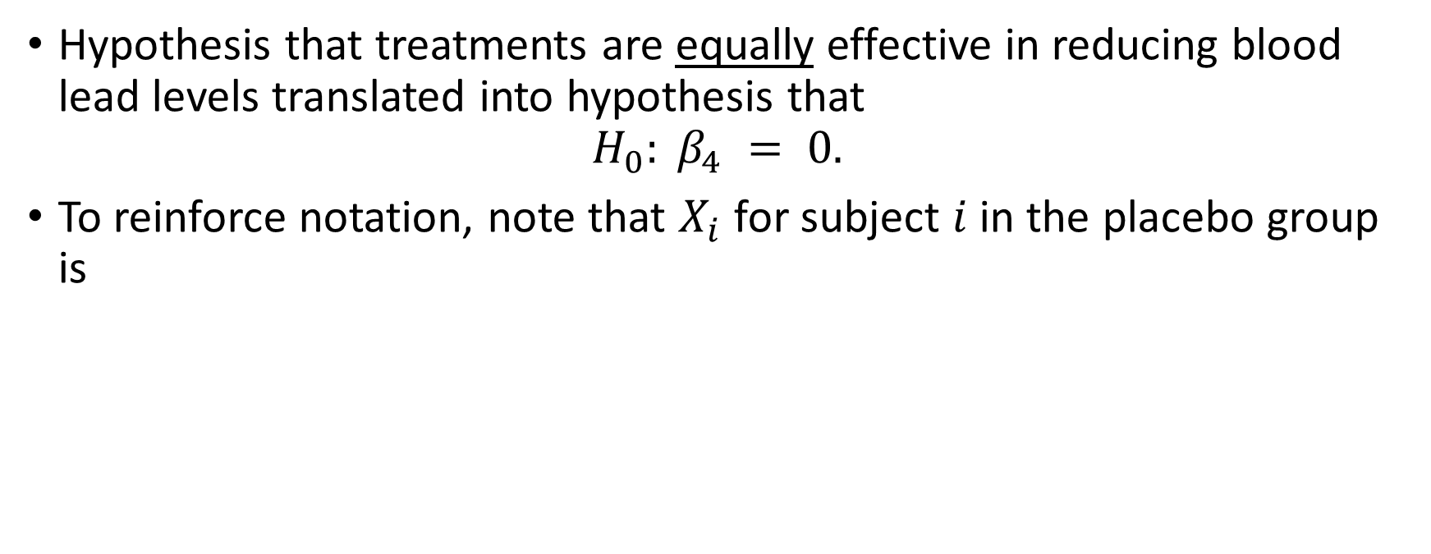
General Linear Model
Hypothesis that treatments are equally effective in reducing blood lead levels translated into hypothesis that
$$H_{0}: β_{4} = 0.$$
To reinforce notation, note that $X_{i}$ for subject $i$ in the placebo group is
PHS 651 / Lecture 04
31 / 33

Slide 32
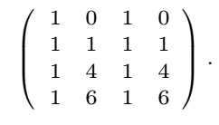

General Linear Model
Similarly, $X_{i}$ for subject $i$ in the treatment group is
So, using vectors and matrices, model for the mean blood lead levels can be represented as
PHS 651 / Lecture 04
32 / 33

Slide 33
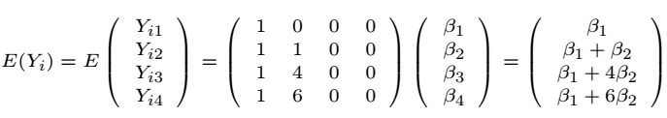
General Linear Model
For example, for the placebo group
What about the treatment group?
PHS 651 / Lecture 04
33 / 33

