Slide 1
PHS 651 / LECTURE 05
Estimation and Inference in the General Linear Model
Advanced Regression Methods for Population Health
Lu Mao, PhD
Department of Biostatistics and Medical Informatics
University of Wisconsin-Madison
SPRING 2019

Slide 2
Outline
  Assumptions of the General Linear Model
  Generalized Least Squares
  Wald test and Likelihood Ratio test
PHS 651 / Lecture 05
2 / 31

Slide 3

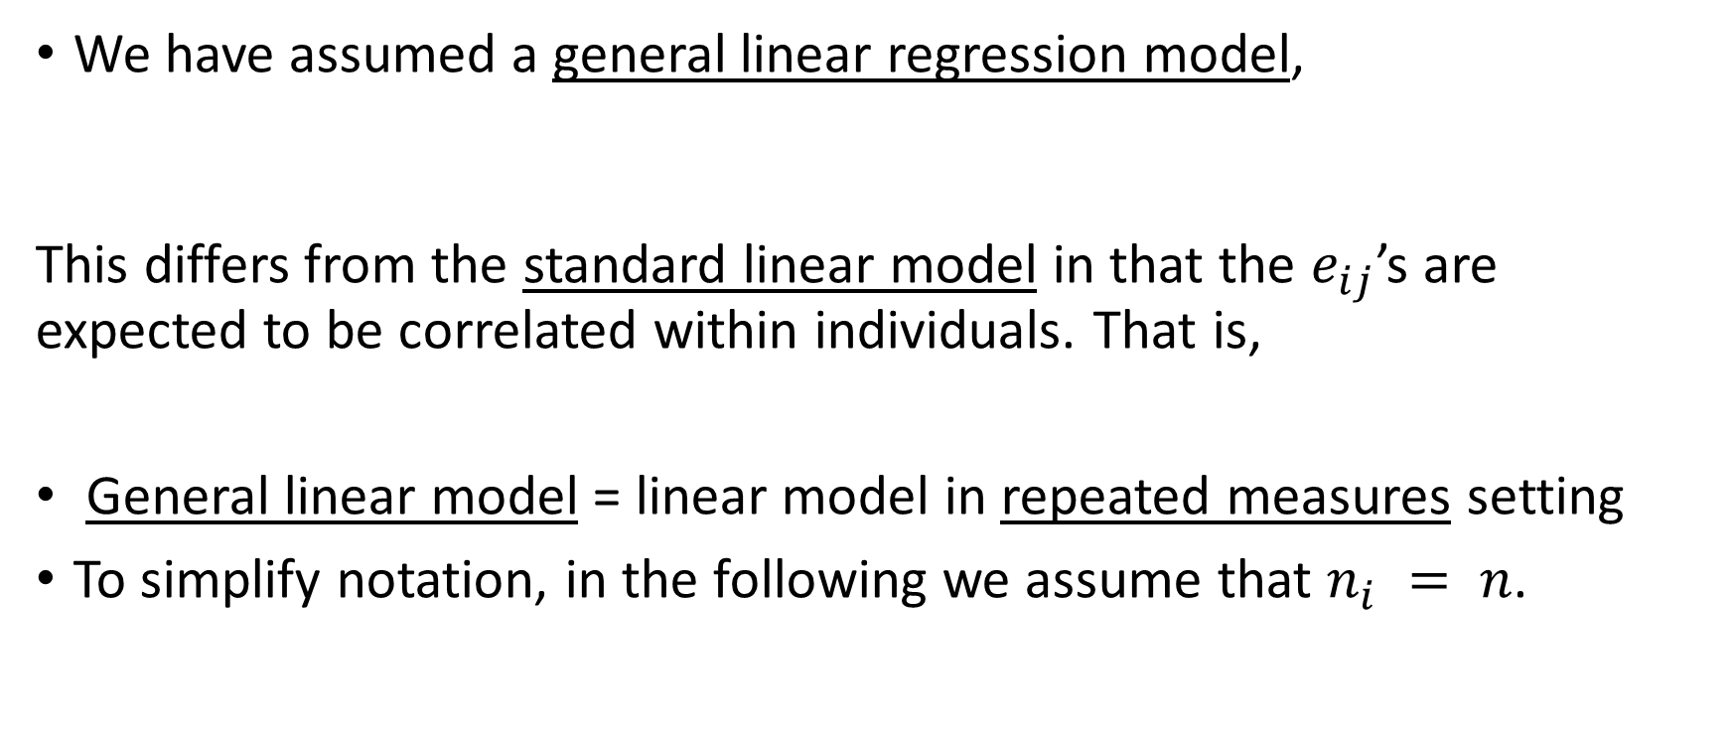
General Linear Model
We have assumed a general linear regression model,
This differs from the standard linear model in that the $e_{ij}$’s are expected to be correlated within individuals. That is,
General linear model = linear model in repeated measures setting
To simplify notation, in the following we assume that $n_{i} = n$.
PHS 651 / Lecture 05
3 / 31

Slide 4
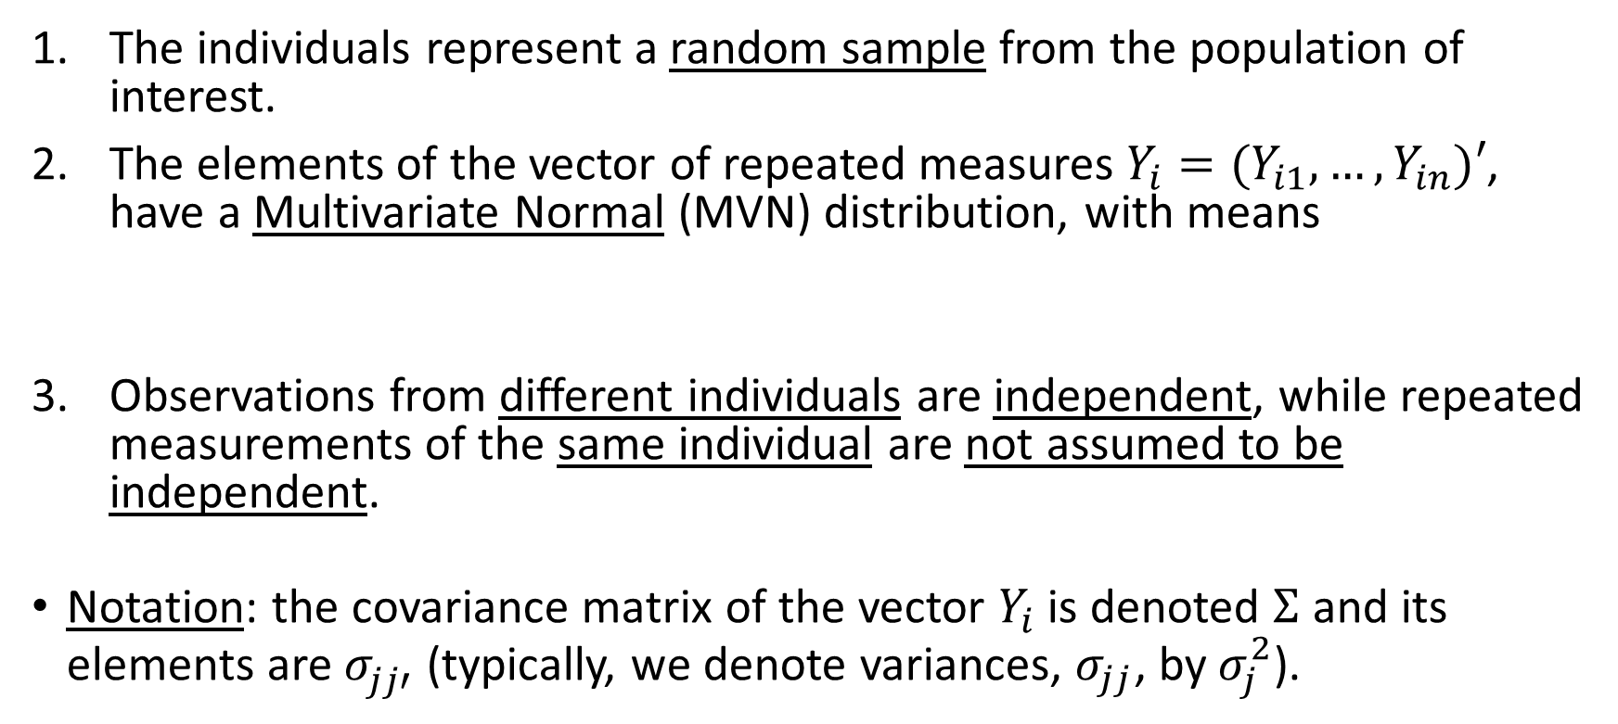
General Linear Model - Assumptions
The individuals represent a random sample from the population of
interest.
The elements of the vector of repeated measures $Y_{i}=(Y_{i1},…, Y_{in})′$, have a Multivariate Normal (MVN) distribution, with means
Observations from different individuals are independent, while repeated
measurements of the same individual are not assumed to be independent.
Notation: the covariance matrix of the vector $Y_{i}$ is denoted $Σ$and its elements are $σ_{jj′}^{}$(typically, we denote variances, $σ_{jj}$, by $σ_{j}^{2}$).
PHS 651 / Lecture 05
4 / 31

Slide 5

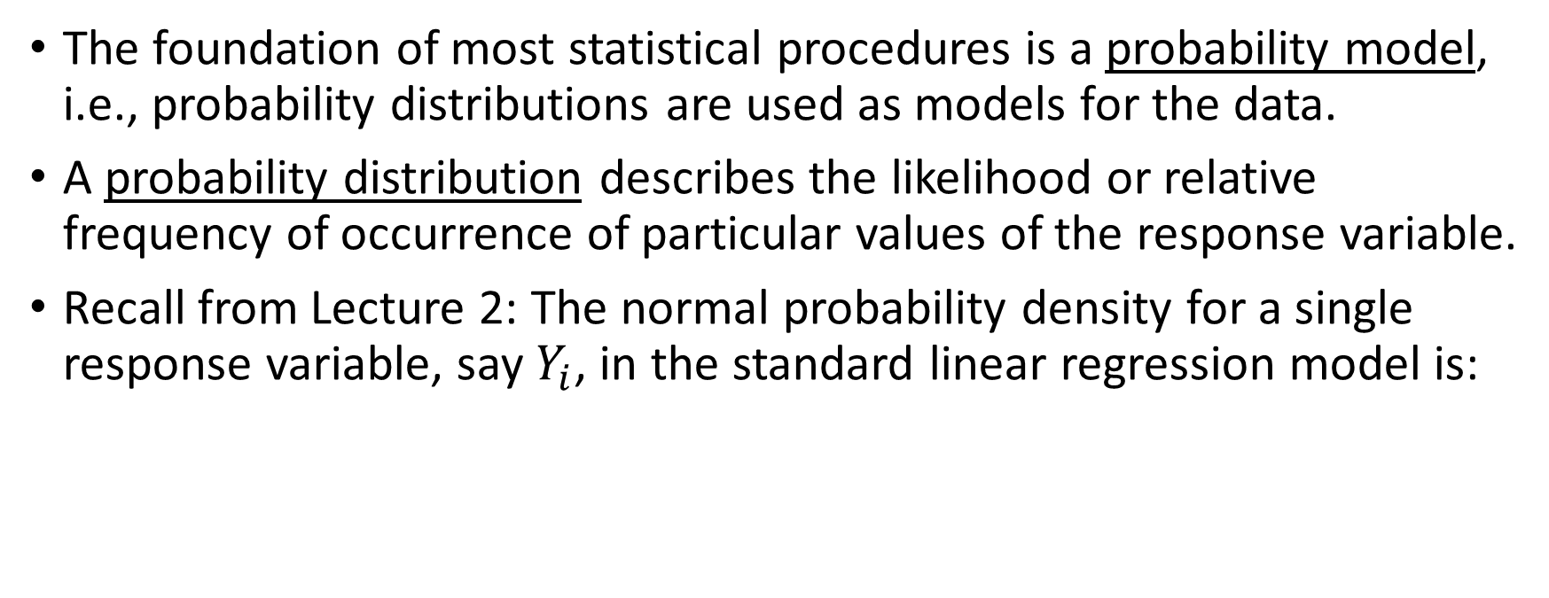
Probability Models
The foundation of most statistical procedures is a probability model, i.e., probability distributions are used as models for the data.
A probability distribution describes the likelihood or relative frequency of occurrence of particular values of the response variable.
Recall from Lecture 2: The normal probability density for a single response variable, say $Y_{i}$, in the standard linear regression model is:
PHS 651 / Lecture 05
5 / 31

Slide 6
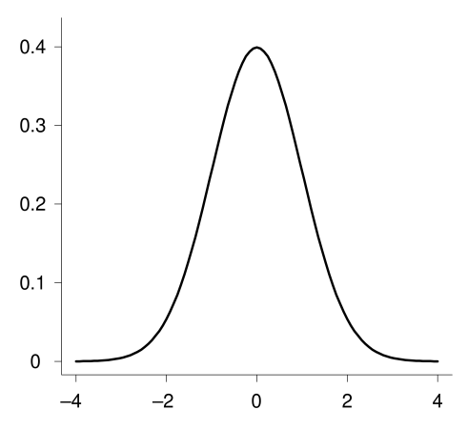

Probability Models
Equivalently, $e_{i}∼N(0, σ^{2})$
PHS 651 / Lecture 05
6 / 31

Slide 7
General Linear Model
With repeated measures we have a vector of response variables and must consider joint probability models for the entire vector of responses.
A joint probability distribution describes the probability or relative
frequency with which the vector of responses takes on a particular set of values.
The Multivariate Normal Distribution is an extension of the Normal
distribution for a single response to a vector of responses.
PHS 651 / Lecture 05
7 / 31

Slide 8
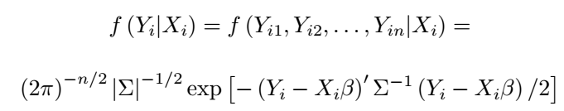
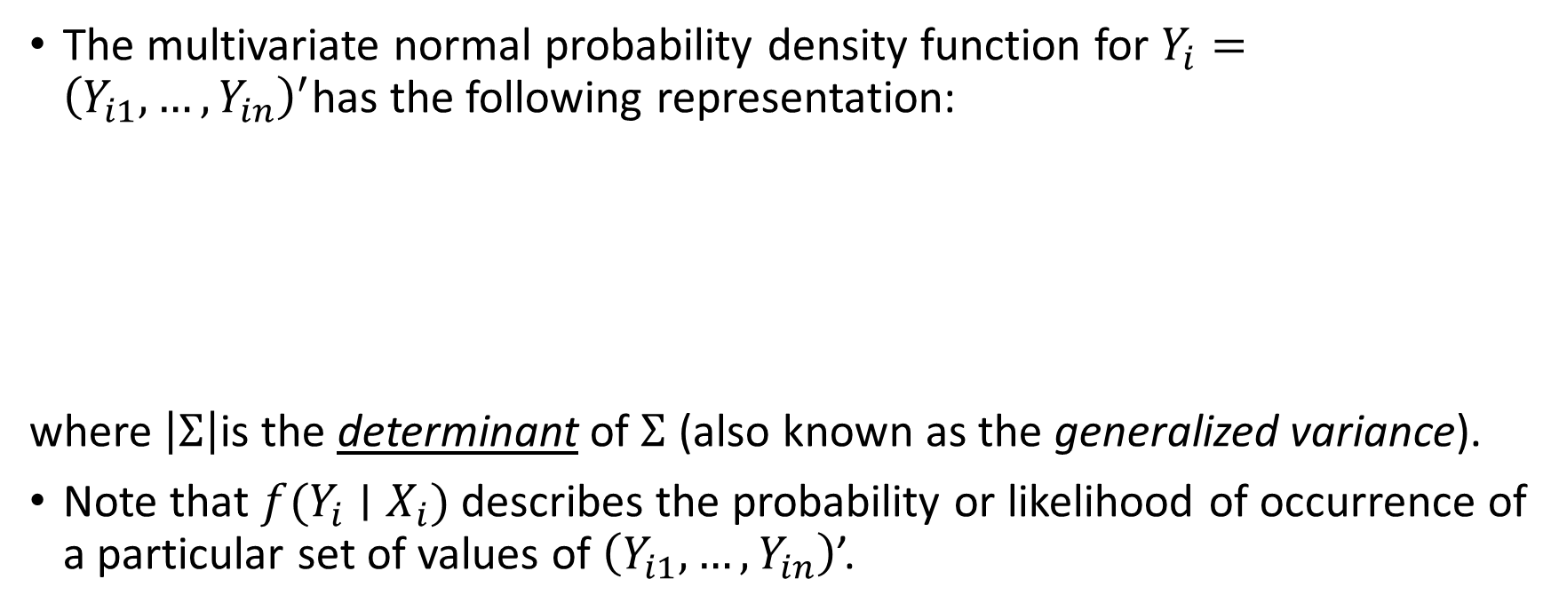
General Linear Model
The multivariate normal probability density function for $Y_{i}={\left(Y_{i1},…, Y_{in}\right)}^{′}$has the following representation:
where $\left|Σ\right|$is the determinantof $Σ$ (also known as the generalized variance).
Note that $f(Y_{i}∣X_{i})$ describes the probability or likelihood ofoccurrence of a particular set of values of $\left(Y_{i1},…, Y_{in}\right)$’.
PHS 651 / Lecture 05
8 / 31

Slide 9

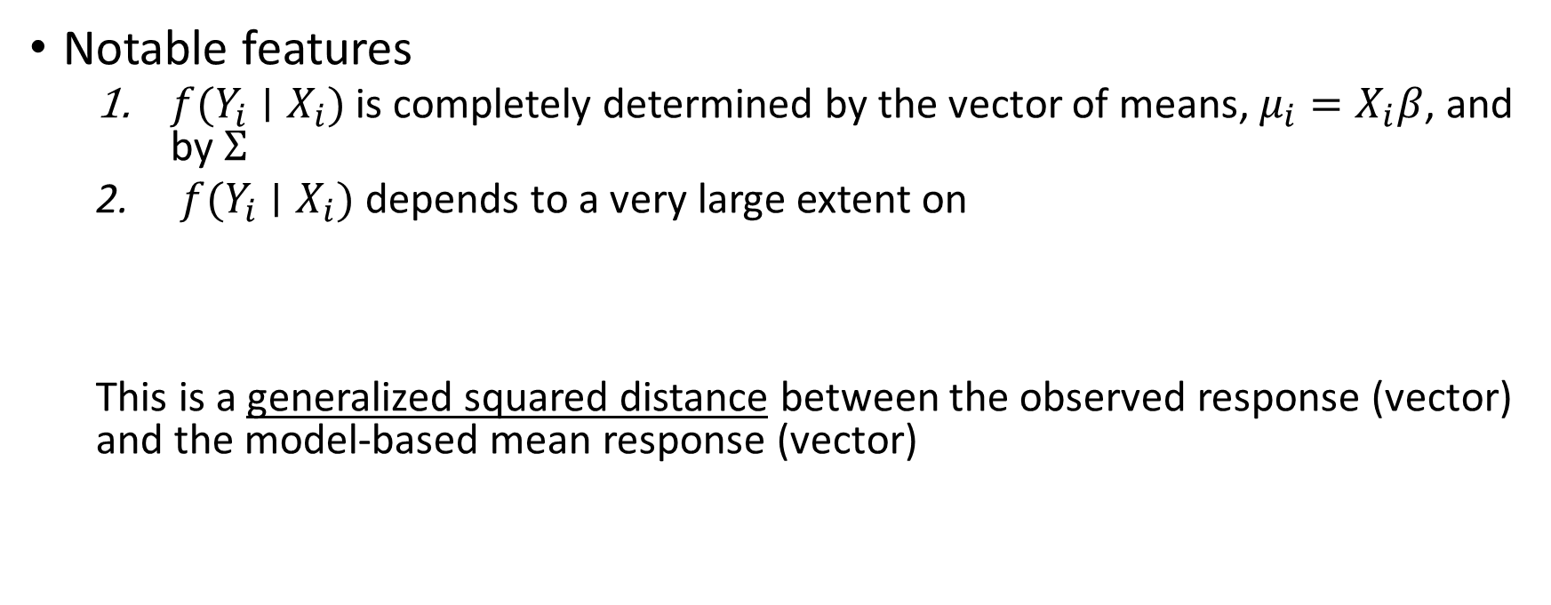
Example: the TLC trial
Notable features
  $f(Y_{i}∣X_{i})$is completely determined by the vector of means, $μ_{i}=X_{i}β$, and by $Σ$
  $f(Y_{i}∣X_{i})$depends to a very large extent on
  This is a generalized squared distance between the observed response (vector) and the model-based mean response (vector)
PHS 651 / Lecture 05
9 / 31

Slide 10
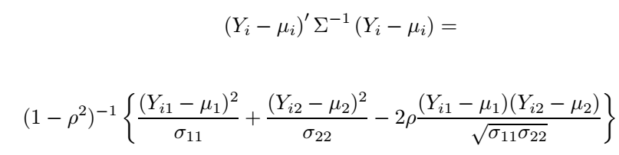
General Linear Model
In the bivariatecase, it can be shown that
This measure of distance
  down-weights deviations from the mean when the variance is large; this
  make intuitive sense because when the variance is larger the information
  is poorer;
  modifies the distance depending on the magnitude of the correlation.
PHS 651 / Lecture 05
10 / 31

Slide 11
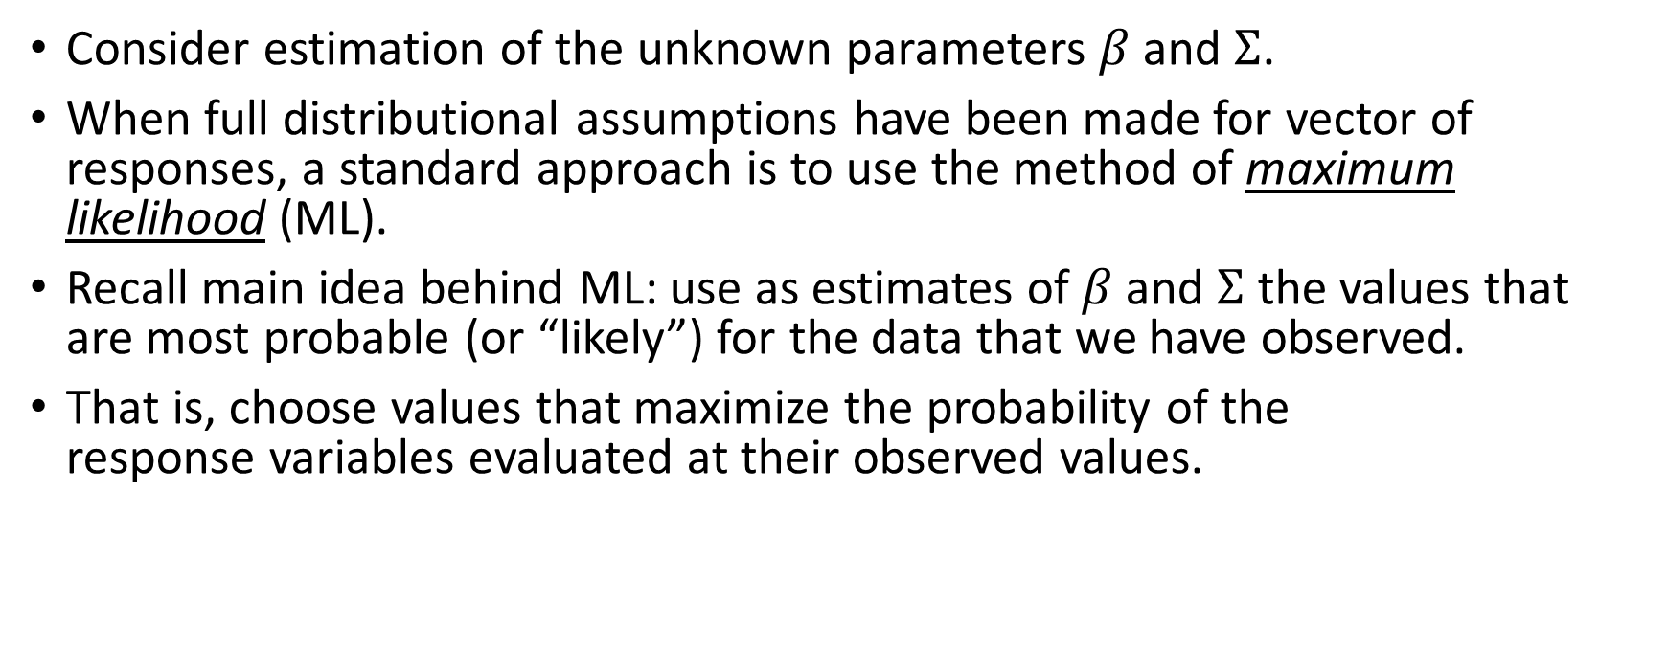
MLE in General Linear Model
Consider estimation of the unknown parameters $β$and $Σ$.
When full distributional assumptions have been made for vector of responses, a standard approach is to use the method of maximum likelihood(ML).
Recall main idea behind ML: use as estimates of $β$and $Σ$ the values that
are most probable (or “likely”) for the data that we have observed.
That is, choose values that maximize the probability of the
response variables evaluated at their observed values.
PHS 651 / Lecture 05
11 / 31

Slide 12
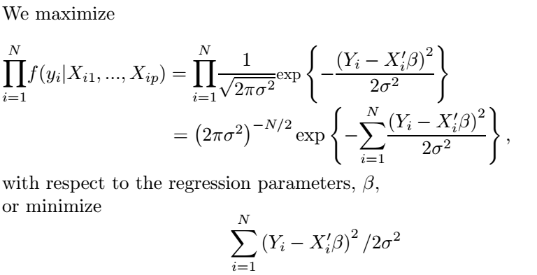
MLE in General Linear Model
For standard linear regression, with independent observations, the likelihood is the product of the individual univariate normal densities.
PHS 651 / Lecture 05
12 / 31

Slide 13
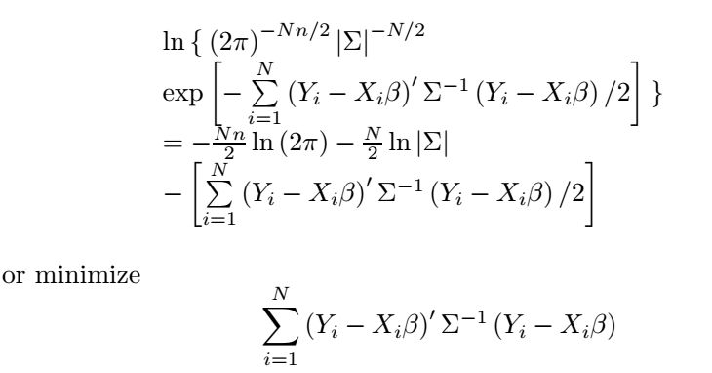

MLE in General Linear Model
For standard linear regression, with independent observations, the likelihood is the product of the individual univariate normal densities.
Given that $Y_{i}={\left(Y_{i1},…, Y_{in}\right)}^{′}$are assumed to have a multivariate
normal distribution, we must maximize the following log-likelihood

Slide 14
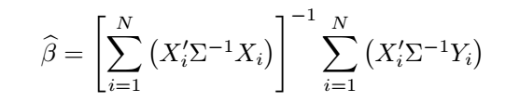
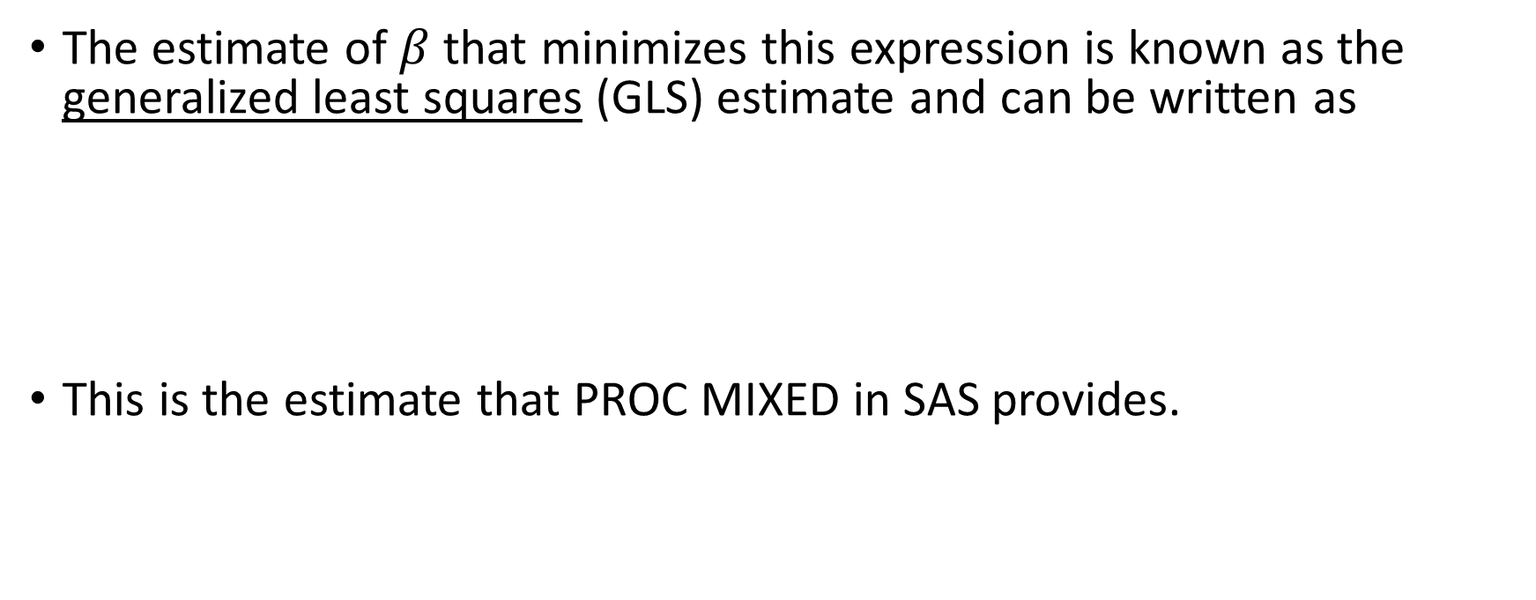
MLE in General Linear Model
The estimate of $β$that minimizes this expression is known as the
generalized least squares (GLS) estimate and can be written as
This is the estimate that PROC MIXED in SAS provides.
PHS 651 / Lecture 05
14 / 31

Slide 15
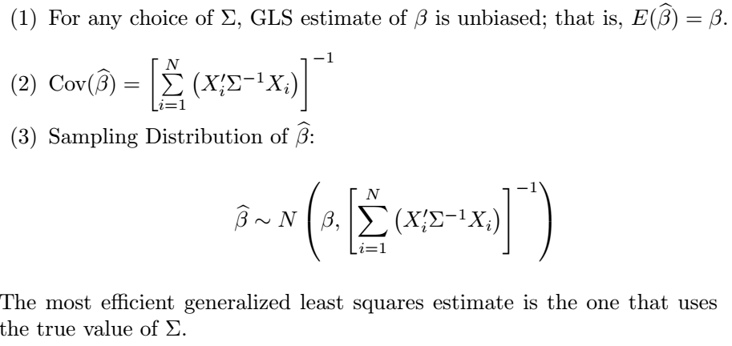
MLE in General Linear Model
PHS 651 / Lecture 05
15 / 31

Slide 16
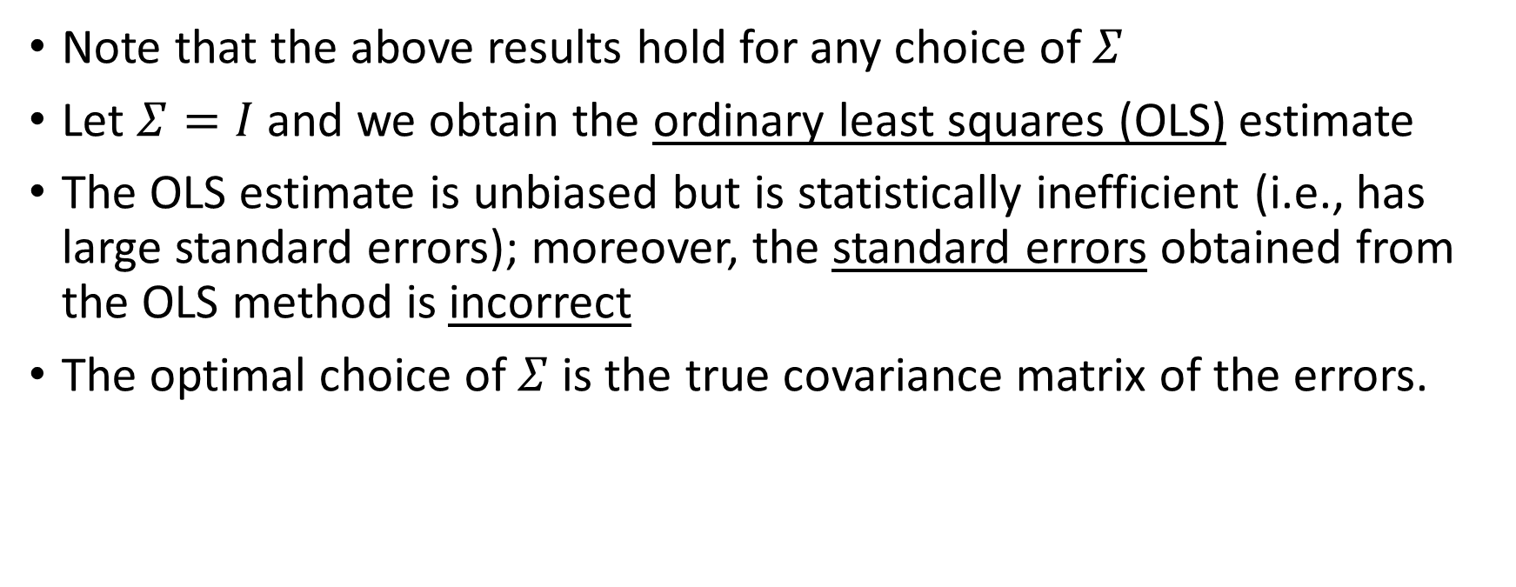
A Word on Ordinary Least Squares
Note that the above results hold for any choice of $Σ$
Let $Σ=I$ and we obtain the ordinary least squares (OLS) estimate
The OLS estimate is unbiased but is statistically inefficient (i.e., has large standard errors); moreover, the standard errors obtained from the OLS method is incorrect
The optimal choice of $Σ$ is the true covariance matrix of the errors.
PHS 651 / Lecture 05
16 / 31

Slide 17
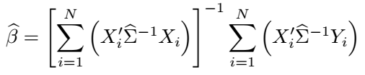
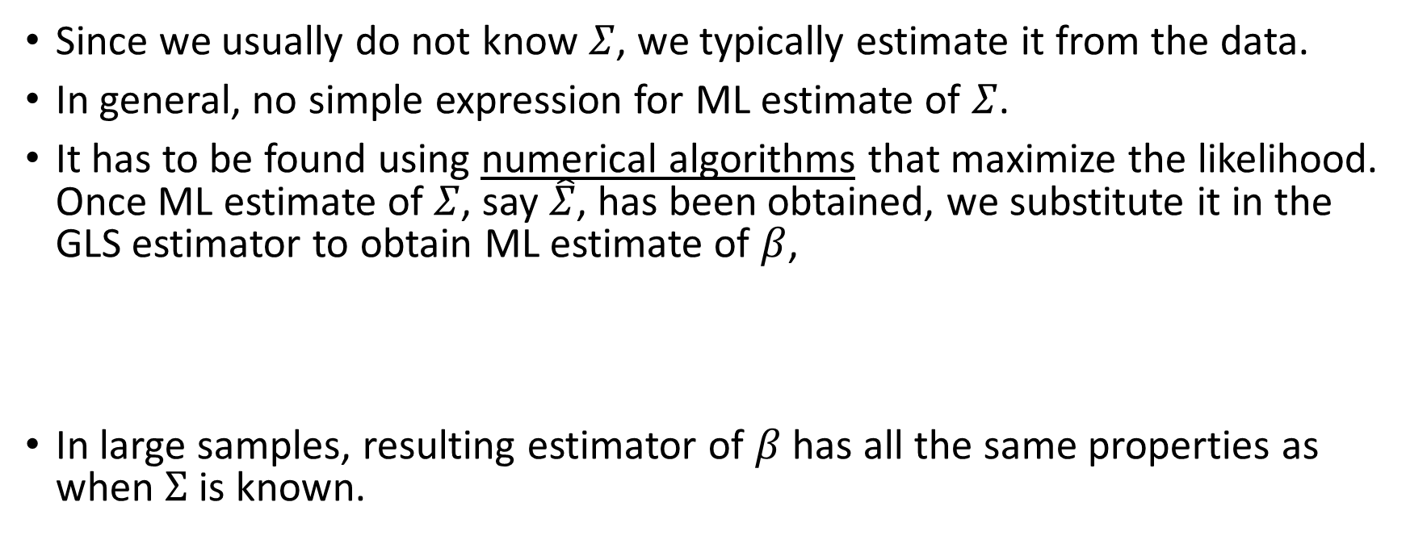
MLE in General Linear Model
Since we usually do not know $Σ$, we typically estimate it from the data.
In general, no simple expression for ML estimate of $Σ$.
It has to be found using numerical algorithms that maximize the likelihood.
Once ML estimate of $Σ$, say $\hat{Σ}$, has been obtained, we substitute it in the
GLS estimator to obtain ML estimate of $β$,
In large samples, resulting estimator of $β$has all the same properties as
when $Σ$ is known.
PHS 651 / Lecture 05
17 / 31

Slide 18
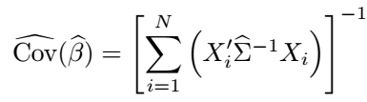
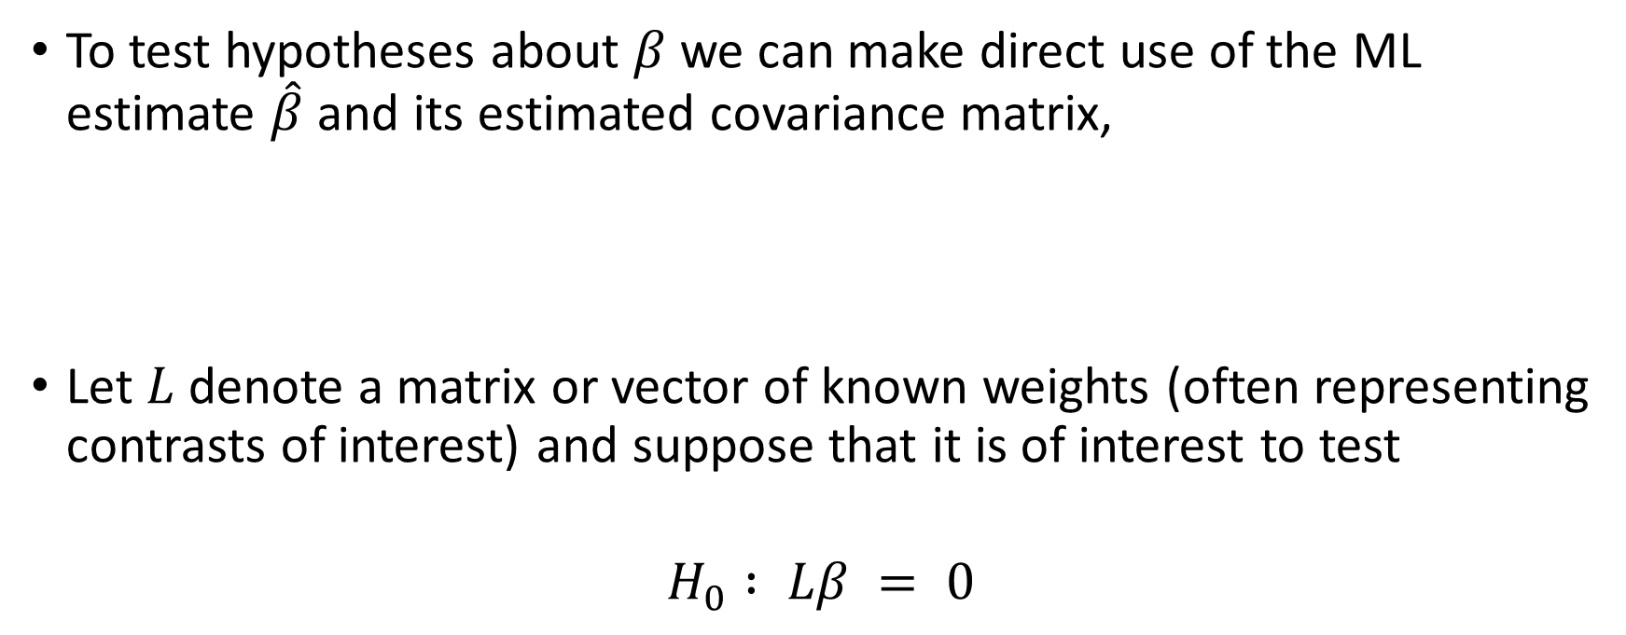
Inference in General Linear Model
To test hypotheses about $β$we can make direct use of the ML estimate $\hat{β}$and its estimated covariance matrix,
Let $L$denote a matrix or vector of known weights (often representing
contrasts of interest) and suppose that it is of interest to test
$$H_{0} : Lβ = 0$$
PHS 651 / Lecture 05
18 / 31

Slide 19
Inference in General Linear Model
To test hypotheses about $β$we can make direct use of the ML estimate $\hat{β}$and its estimated covariance matrix,
Let $L$denote a matrix or vector of known weights (often representing
contrasts of interest) and suppose that it is of interest to test
$$H_{0} : Lβ = 0$$
PHS 651 / Lecture 05
19 / 31

Slide 20
Inference in General Linear Model
To test hypotheses about $β$we can make direct use of the ML estimate $\hat{β}$and its estimated covariance matrix,
Let $L$denote a matrix or vector of known weights (often representing
contrasts of interest) and suppose that it is of interest to test
$$H_{0} : Lβ = 0$$
PHS 651 / Lecture 05
20 / 31

Slide 21

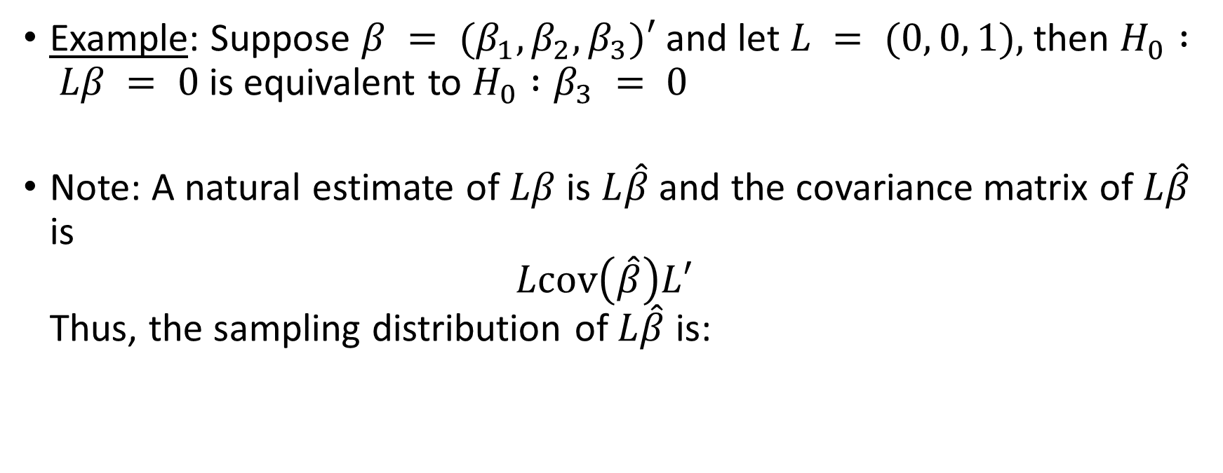
Inference in General Linear Model
Example: Suppose $β = (β_{1}, β_{2}, β_{3})′$and let $L = (0, 0, 1),$then $H_{0} : Lβ = 0$is equivalent to $H_{0} :β_{3} = 0$
Note: A natural estimate of $Lβ$is $L\hat{β}$ and the covariance matrix of $L\hat{β}$ is
$Lcov\left(\hat{β}\right)L′$
Thus, the sampling distribution of $L\hat{β}$ is:
PHS 651 / Lecture 05
21 / 31

Slide 22
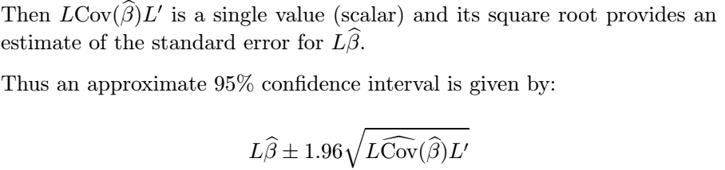

Wald Test
Case 1: Suppose that $L$is a single row vector.
PHS 651 / Lecture 05
22 / 31

Slide 23
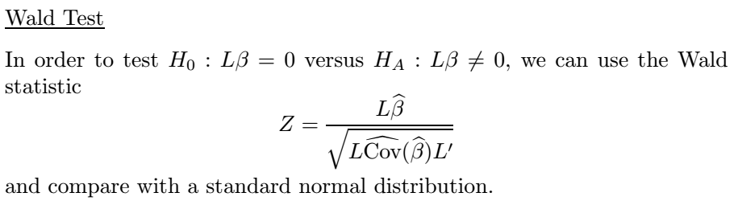
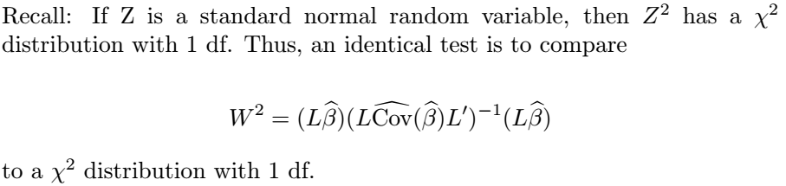
Wald Test
PHS 651 / Lecture 05
23 / 31

Slide 24


Wald Test
Example: Suppose $β = (β_{1}, β_{2}, β_{3})′$and we want to test
$$H_{0}: β_{1}=β_{2}=β_{3}$$
Then we can let
So $H_{0}$ is equivalent to$Lβ = 0.$
PHS 651 / Lecture 05
24 / 31

Slide 25

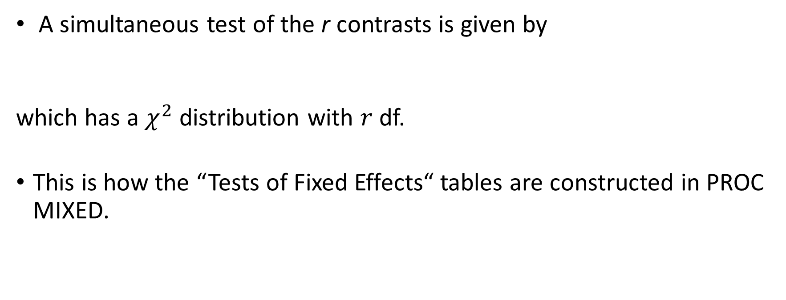
Wald Test
A simultaneous test of the r contrasts is given by
which has a $χ^{2}$ distribution with $r$df.
This is how the “Tests of Fixed Effects“ tables are constructed in PROC MIXED.
PHS 651 / Lecture 05
25 / 31

Slide 26
Likelihood Ratio Test
Suppose that we are interested in comparing two nested models, a “full” model and a “reduced” model.
Nested Models: When one model (the “reduced" model) is a special case of the other (the“full" model), the reduced model is said to be nested within the full model.
The “reduced” model typically arises by constraining the parameters in the “full” model
PHS 651 / Lecture 05
26 / 31

Slide 27
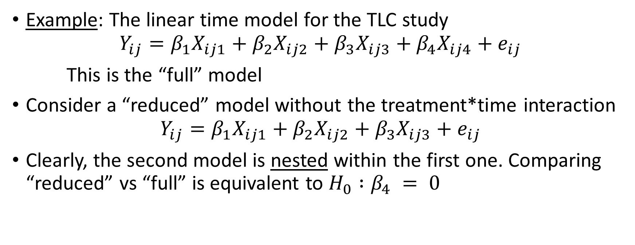
Likelihood Ratio Test
Example: The linear time model for the TLC study
$$Y_{ij}=β_{1}X_{ij1}+β_{2}X_{ij2}+β_{3}X_{ij3}+β_{4}X_{ij4}+e_{ij}$$
This is the “full” model
Consider a “reduced” model without the treatment*time interaction
$$Y_{ij}=β_{1}X_{ij1}+β_{2}X_{ij2}+β_{3}X_{ij3}+e_{ij}$$
Clearly, the second model is nested within the first one. Comparing “reduced” vs “full” is equivalent to $H_{0} :β_{4} = 0$
PHS 651 / Lecture 05
27 / 31

Slide 28
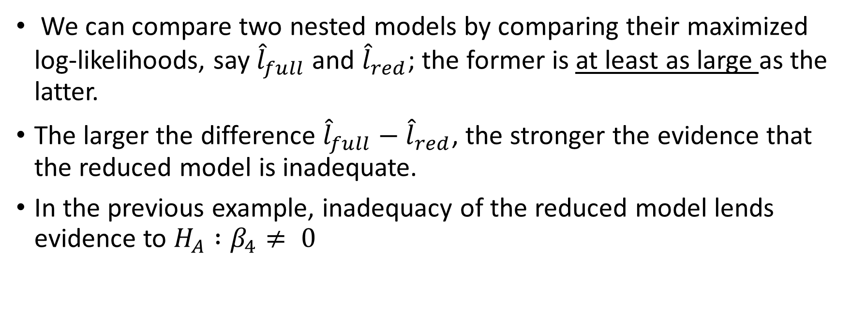
Likelihood Ratio Test
We can compare two nested models by comparing their maximized log-likelihoods, say ${\hat{l}}_{full}$ and ${\hat{l}}_{red}$; the former is at least as large as the latter.
The larger the difference ${\hat{l}}_{full}−{\hat{l}}_{red}$, the stronger the evidence that
the reduced model is inadequate.
In the previous example, inadequacy of the reduced model lends evidence to $H_{A} :β_{4}≠ 0$
PHS 651 / Lecture 05
28 / 31

Slide 29
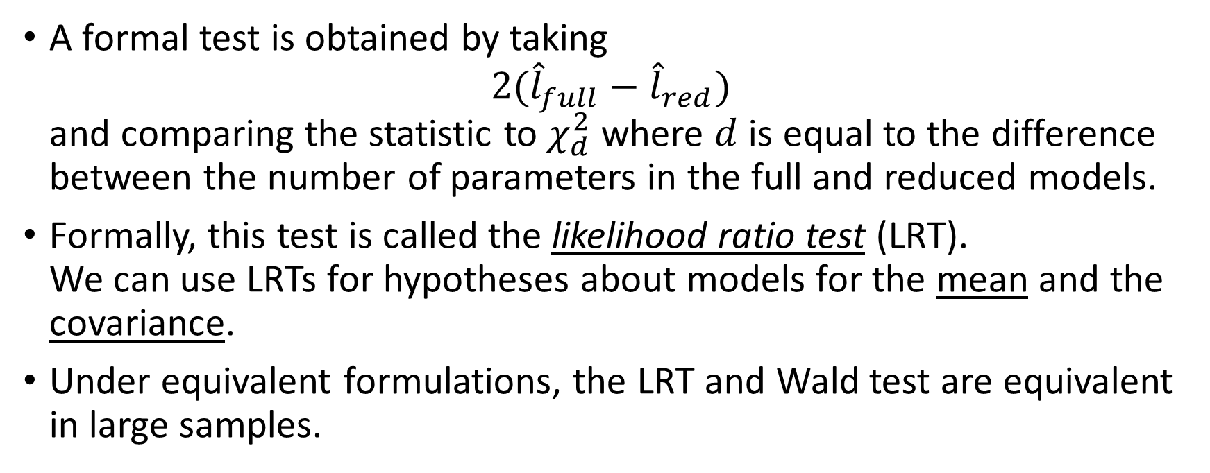
Likelihood Ratio Test
A formal test is obtained by taking
$2({\hat{l}}_{full}−{\hat{l}}_{red})$
and comparing the statistic to $χ_{d}^{2}$ where $d$ is equal to the difference between the number of parameters in the full and reduced models.
Formally, this test is called the likelihood ratio test(LRT).
We can use LRTs for hypotheses about models for the mean and the
covariance.
Under equivalent formulations, the LRT and Wald test are equivalent in large samples.
PHS 651 / Lecture 05
29 / 31

Slide 30
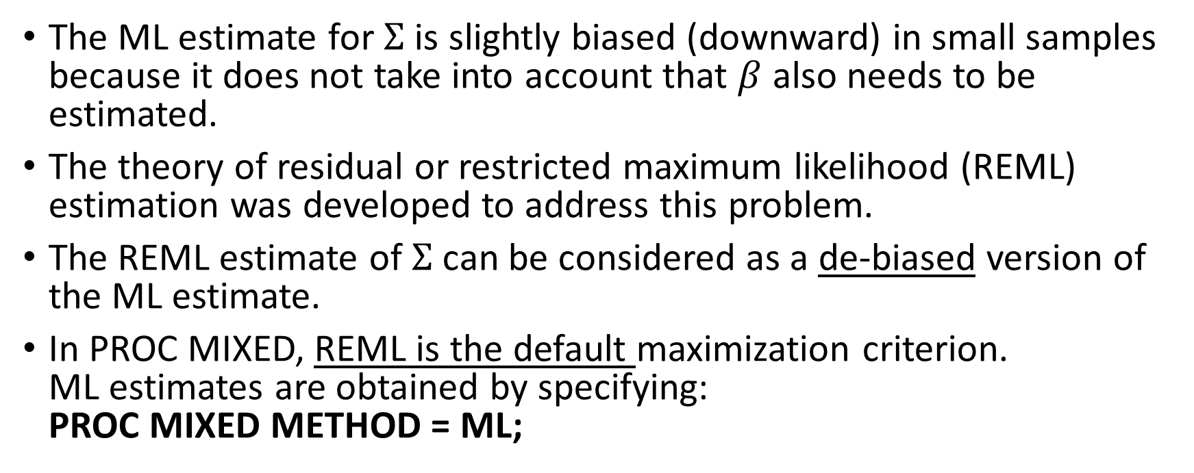
A Word on REML
The ML estimate for $Σ$ is slightly biased (downward) in small samples because it does not take into account that $β$ also needs to be estimated.
The theory of residual or restricted maximum likelihood (REML) estimation was developed to address this problem.
The REML estimate of $Σ$ can be considered as a de-biased version of the ML estimate.
In PROC MIXED, REML is the default maximization criterion.
ML estimates are obtained by specifying:
PROC MIXED METHOD = ML;
PHS 651 / Lecture 05
30 / 31

Slide 31
A Word on REML
Note: The residual maximum likelihood (REML) can be used to compare different models for the covariance structure.
However, it should not be used to compare different mean models
To test hypotheses in the mean model (on regression coefficients), one must use the ML approach (by specifying the method=ML in PROC MIXED).
PHS 651 / Lecture 05
31 / 31

