Slide 1
PHS 651 / LECTURE 06
Analysis of Response Profiles
Advanced Regression Methods for Population Health
Lu Mao, PhD
Department of Biostatistics and Medical Informatics
University of Wisconsin-Madison
SPRING 2019

Slide 2
Outline
  Mean response profiles and covariance models
  Tests of group, time, and group-by-time effects
  Analysis of the TLC trial using PROC MIXED
PHS 651 / Lecture 06
2 / 24

Slide 3
Modeling of Longitudinal Data
Two aspects to longitudinal data need to be modelled:
  Mean response over time (of primary interest)
  Covariance among repeated measures
For now, we consider models that jointly specify models for the mean and covariance.
Later on, we will consider approaches that focus only on the mean model without specifying a covariance model
PHS 651 / Lecture 06
3 / 24

Slide 4
Modeling of Longitudinal Data
Mean model
  Analysis of response profiles (saturated model)
  Parametric or semi-parametric curves
Covariance model
  Unstructured or arbitrary pattern of covariance
  Covariance pattern models
  Random effects covariance structure
PHS 651 / Lecture 06
4 / 24

Slide 5
Analysis of Response Profiles
Response profile: the sequence of responses over time
Compare groups of subjects in terms of mean response profiles.
Useful for balanced longitudinal designs and when there is a single categorical covariate (for treatment or exposure groups).
Analysis of response profiles can be extended to handle more than a single group factor.
Analysis of response profiles can also handle missing response data.
PHS 651 / Lecture 06
5 / 24

Slide 6
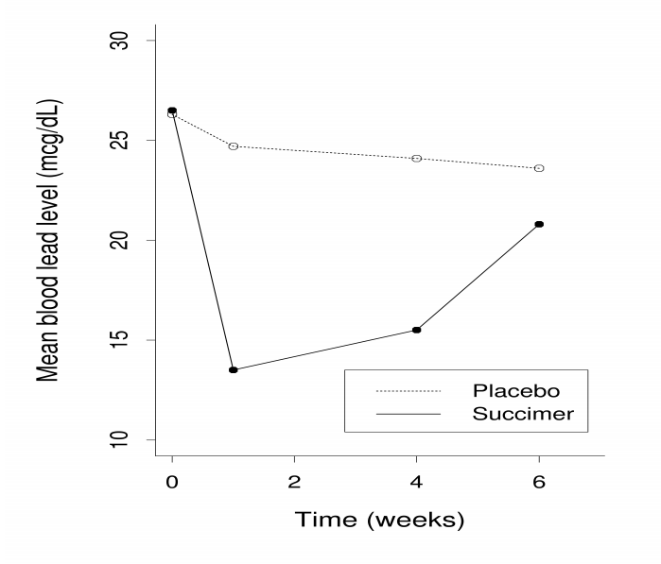
Example: the TLC Trial
PHS 651 / Lecture 06
6 / 24

Slide 7
Analysis of Response Profiles
Three main questions concerning response profiles:
  Are the mean response profiles similar in shape between the groups, in the sense that the mean response profiles are parallel?
  This is a question that concerns the group × time interaction effect;
  Assuming mean response profiles are parallel, are the means constant
  over time, in the sense that the mean response profiles are flat?
  This is a question that concerns the time effect.
  Assuming mean response profiles are parallel, are they also at the same level in the sense that the mean response profiles
  for the groups coincide?
  This is a questions that concerns the group effect;
PHS 651 / Lecture 06
7 / 24

Slide 8
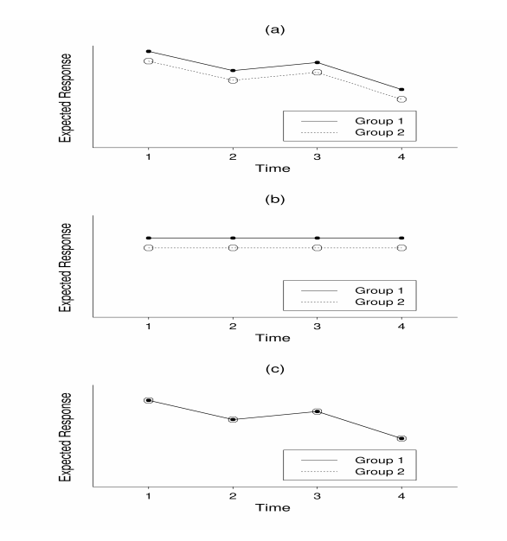
Analysis of Response Profiles
Three hypotheses:
No group × time interaction
No time effect
No group effect
For most studies, main interest lies in (a).

Slide 9
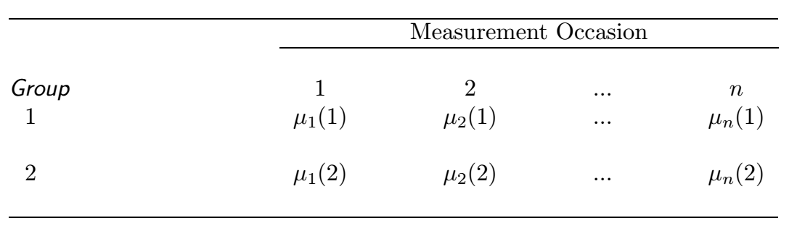
Analysis of Response Profiles
Mean response profile over time in two groups
PHS 651 / Lecture 06
9 / 24

Slide 10
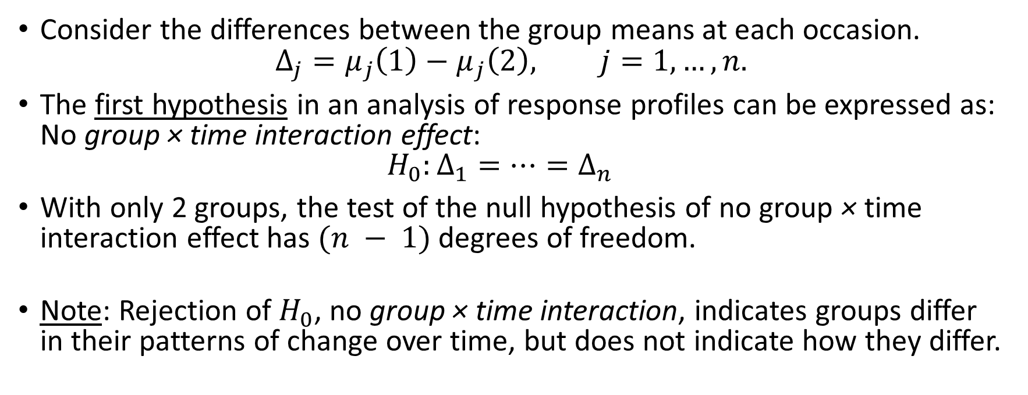
Analysis of Response Profiles
Consider the differences between the group means at each occasion.
$Δ_{j}=μ_{j}\left(1\right)−μ_{j}\left(2\right), j=1,…, n.$
The first hypothesis in an analysis of response profiles can be expressed as:
No group × time interaction effect:
$H_{0}:Δ_{1}=⋯=Δ_{n}$
With only 2 groups, the test of the null hypothesis of no group × time
interaction effect has $(n − 1)$degrees of freedom.
Note: Rejection of $H_{0}$, no group × time interaction, indicates groups differ
in their patterns of change over time, but does not indicate how they differ.
PHS 651 / Lecture 06
10 / 24

Slide 11
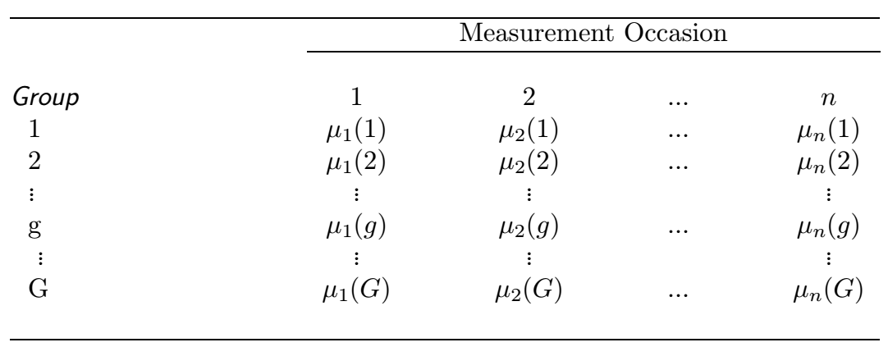

Analysis of Response Profiles
Mean response profile over time in $G$ groups
PHS 651 / Lecture 06
11 / 24

Slide 12
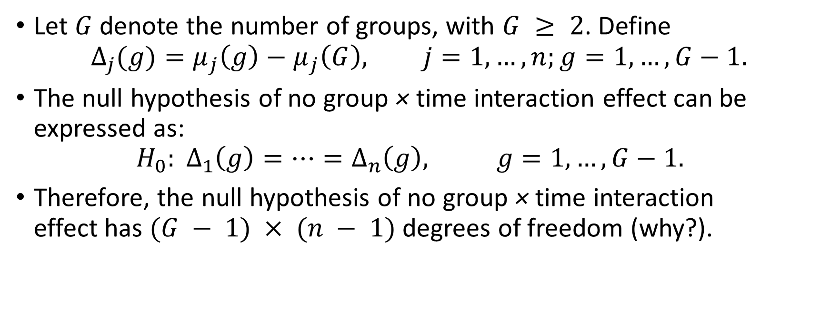
Analysis of Response Profiles
Let $G$denote the number of groups, with $G ≥ 2$. Define
$$Δ_{j}(g)=μ_{j}\left(g\right)−μ_{j}\left(G\right), j=1,…, n;g=1,…, G−1.$$
Thenull hypothesis of no group × time interaction effect can be expressed as:
${H_{0}: Δ}_{1}\left(g\right)=…=Δ_{n}\left(g\right), g=1,…, G−1.$
Therefore, the null hypothesis of no group × time interaction
effect has $(G − 1) × (n − 1)$degrees of freedom (why?).
PHS 651 / Lecture 06
12 / 24

Slide 13
Remark on Baseline Response
Baseline response is treated the same as follow-up (post-randomization) responses.
Alternative methods to adjust for baseline conditions:
  Subtract baseline from each subsequent observation and analyze
  differences
  Use baseline as a covariate
These methods may be more intuitive, and occasionally more efficient, but they do not work well under missing baseline response.
PHS 651 / Lecture 06
13 / 24

Slide 14
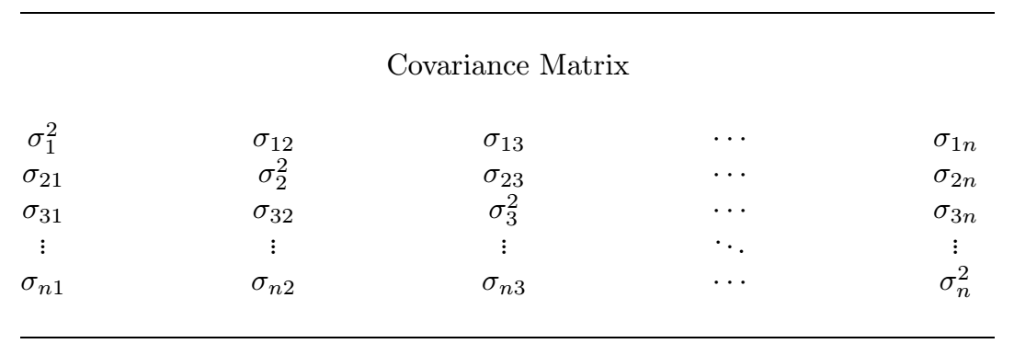
Covariance Model
Typically, unstructured covariance is used.
PHS 651 / Lecture 06
14 / 24

Slide 15
Analysis of Response Profiles
In summary, analysis of response profiles can be specified as a regression model with categorical covariatesfor both group and time.
The global test of the null hypothesis of parallel profiles translates into a hypothesis concerning regression coefficients for the group × time interaction being equal to zero.
Beyond testing the null hypothesis of parallel profiles, the estimated
regression coefficients have meaningful interpretations.
PHS 651 / Lecture 06
15 / 24

Slide 16
Case Study: the TLC Trial
We use PROC MIXED to analyze response profiles between the two treatments (succimer vs placebo) in the TCL trial.
Recall that PROC MIXED requires that the data be in the “long” format.
In the TLC Trial there are two groups (placebo and succimer) and four
measurement occasions (week 0, 1, 4, 6).
PHS 651 / Lecture 06
16 / 24

Slide 17
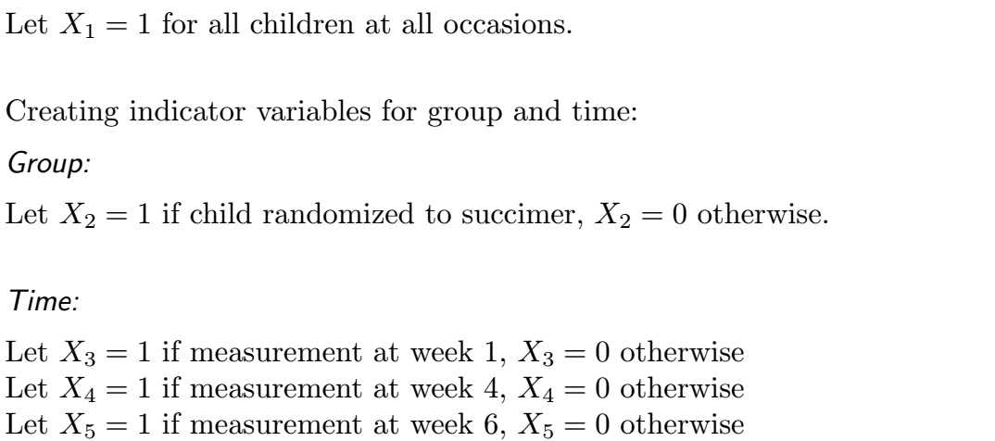

Case Study: the TLC Trial
Suppressing the subscript $ij$
PHS 651 / Lecture 06
17 / 24

Slide 18
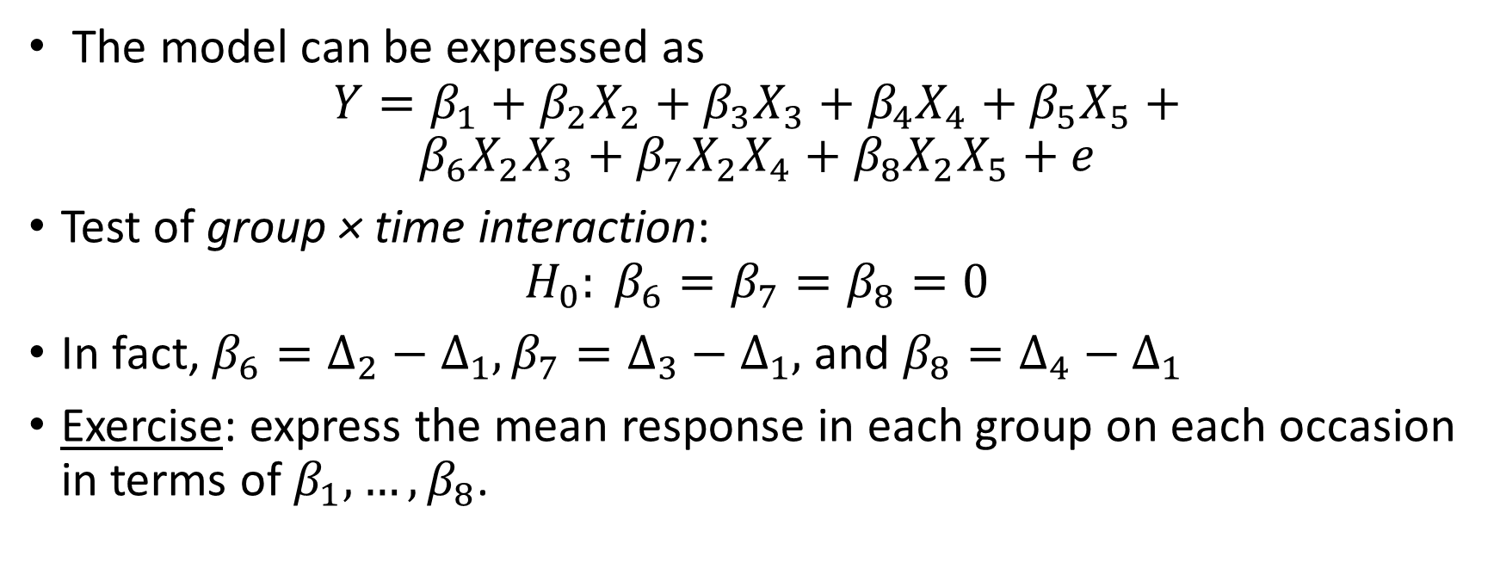
Case Study: the TLC Trial
The model can be expressed as
$$Y=β_{1}+β_{2}X_{2}+β_{3}X_{3}+β_{4}X_{4}+β_{5}X_{5}+$$
$$β_{6}X_{2}X_{3}+β_{7}X_{2}X_{4}+β_{8}X_{2}X_{5}+e$$
Test of group × time interaction:
$$H_{0}: β_{6}=β_{7}=β_{8}=0$$
In fact, $β_{6}=Δ_{2}−Δ_{1},β_{7}=Δ_{3}−Δ_{1},$ and $β_{8}=Δ_{4}−Δ_{1}$
Exercise: express the mean response in each group on each occasion in terms of $β_{1},…, β_{8}$.
PHS 651 / Lecture 06
18 / 24

Slide 19
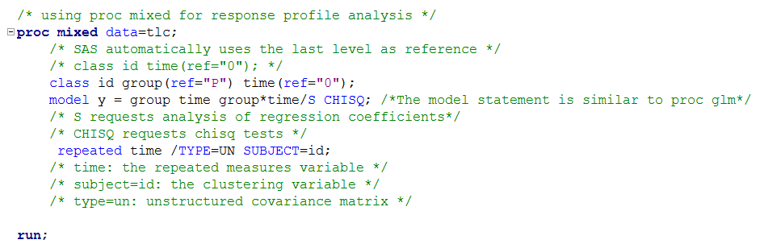
Case Study: the TLC Trial
PHS 651 / Lecture 06
19 / 24

Slide 20
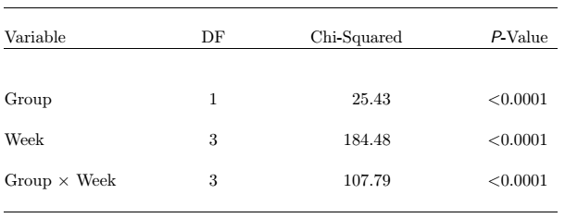
Case Study: the TLC Trial
Wald tests of (fixed) effects
The test of the group × time interaction yields a Wald statistic of 107.79 with 3 degrees of freedom (p < 0.0001), indicating that there is a significant difference in the mean response pattern over time between the two treatment groups.
PHS 651 / Lecture 06
20 / 24

Slide 21
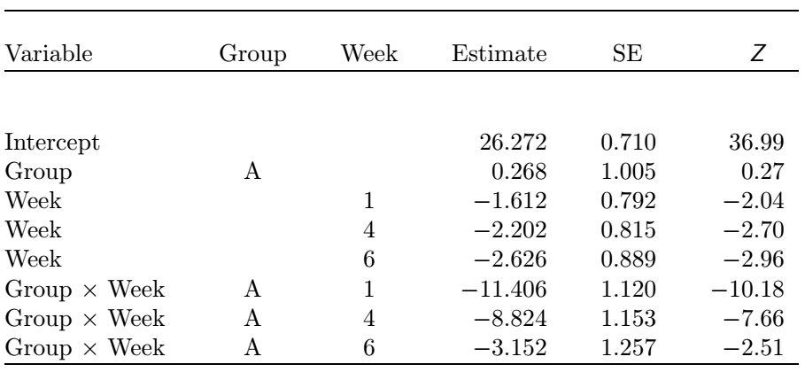








Case Study: the TLC Trial
Estimated regression coefficients and standard errors based on
analysis of response profiles of the blood lead level data.
$$β_{1}$$
$$β_{2}$$
$$β_{3}$$
$$β_{4}$$
$$β_{5}$$
$$β_{6}$$
$$β_{7}$$
$$β_{8}$$
PHS 651 / Lecture 06
21 / 24

Slide 22
Summary
Analysis of response profiles is essentially a two-way ANOVA with
repeated measures and can be framed as a linear regression with
correlated observations.
Extensions beyond the usual profile analysis:
1. Adjust for baseline covariates
2. Time contrasts
3. Area-under-the-curve-analyses
PHS 651 / Lecture 06
22 / 24

Slide 23
Summary
Strengths:
  Allows arbitrary patterns in the mean response over time (no time trend assumed) and arbitrary patterns in the covariance.
  Analysis is robust in that misspecification of models for mean and covariance are minimal.
  Can accommodate an arbitrary pattern of missingness.
Drawbacks:
  Requires that the longitudinal design be balanced.
  “Saturated” model, number of free parameters grows rapidly with the number of occasions, may be less efficient
PHS 651 / Lecture 06
23 / 24

Slide 24

Homework 1 (Due Feb 27)
For the TLC trial considered, express the mean response in each group on each occasion in terms of the regression coefficients $β_{1},…, β_{8}.$
Problem 5.1 of FLW (pp 141).
  Instruction: provide coherent, readable answers to each question, supplemented by (well formatted) tables and figures when appropriate. Append (annotated) code to the end of your solutions.
Treatment | Week 0 | Week 1 | Week 4 | Week 6
Succimer
Placebo
PHS 651 / Lecture 06
24 / 24

