Slide 1
PHS 651 / LECTURE 07
More on Analysis of Response Profiles
Advanced Regression Methods for Population Health
Lu Mao, PhD
Department of Biostatistics and Medical Informatics
University of Wisconsin-Madison
SPRING 2019

Slide 2
Outline
  Single degree-of-freedom contrasts
  Alternative ways to adjust for baseline response
PHS 651 / Lecture 07
2 / 24

Slide 3
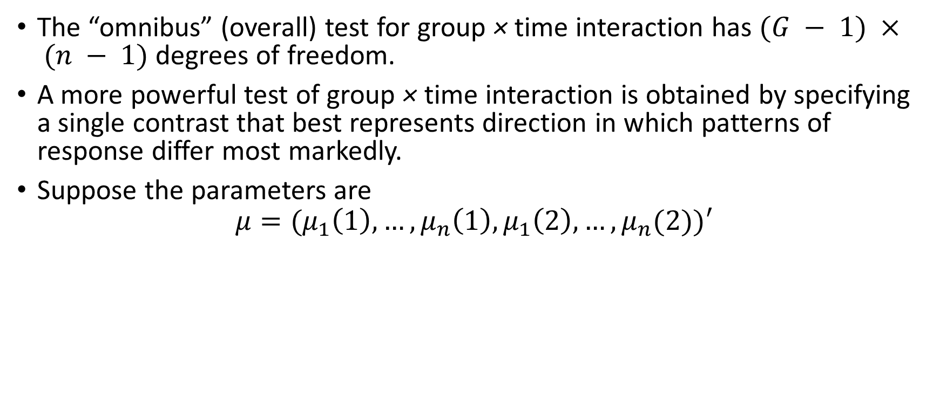
Single DF Contrasts
The “omnibus” (overall) test for group × time interaction has $(G − 1) × (n − 1)$ degrees of freedom.
A more powerful test of group × timeinteraction is obtained by specifying a single contrast that best represents direction in which patterns of response differ most markedly.
Suppose the parameters are
$$μ=(μ_{1}\left(1\right),…, μ_{n}\left(1\right), μ_{1}\left(2\right),…, μ_{n}(2))′$$
PHS 651 / Lecture 07
3 / 24

Slide 4
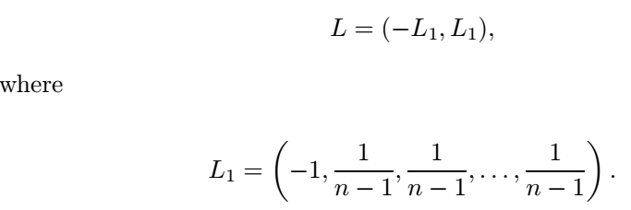
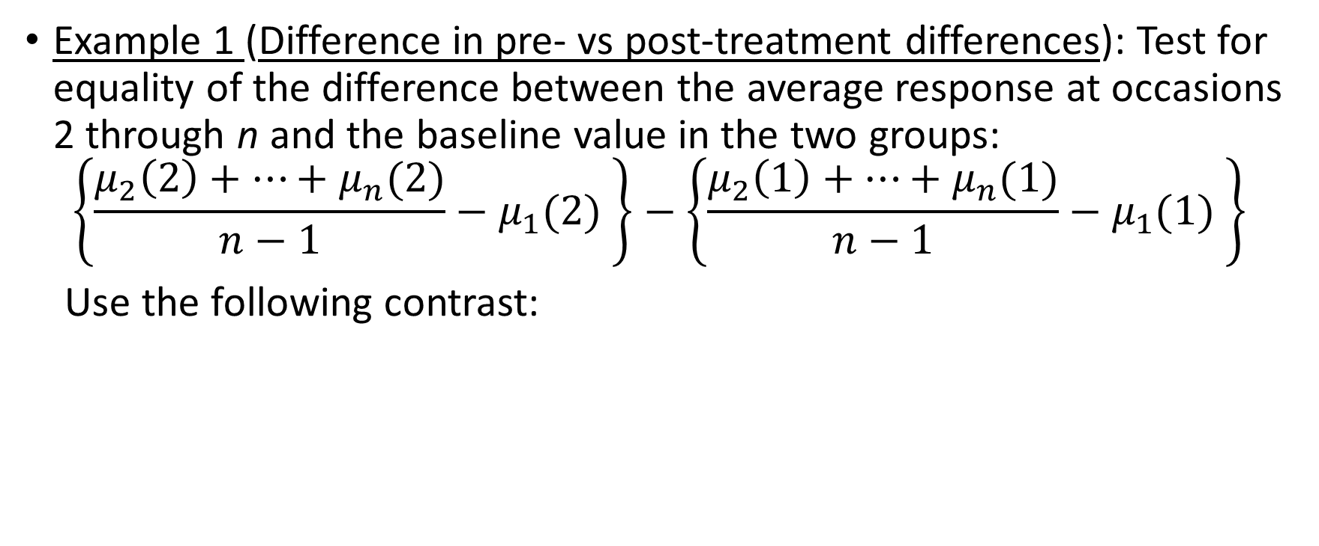
Single DF Contrasts
Example 1 (Difference in pre- vs post-treatment differences): Test for equality of the difference between the average response at occasions 2 through n and the baseline value in the two groups:
$$\left\{\frac{μ_{2}\left(2\right)+⋯+μ_{n}(2)}{n−1}−μ_{1}(2) \right\}−\left\{\frac{μ_{2}\left(1\right)+⋯+μ_{n}(1)}{n−1}−μ_{1}(1) \right\}$$
Use the following contrast:
PHS 651 / Lecture 07
4 / 24

Slide 5
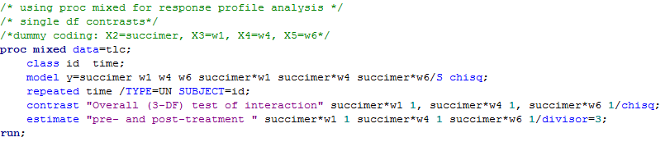

Single DF Contrasts
Example 1: in the TLC example, this 1-df contrast can be equivalently expressed (in terms of $β$) as $(β_{6}+β_{7}+β_{8})/3$.
PHS 651 / Lecture 07
5 / 24

Slide 6
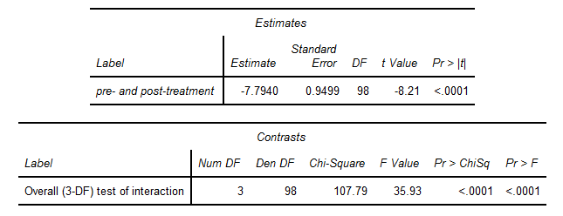
Single DF Contrasts
Example 1: Output
PHS 651 / Lecture 07
6 / 24

Slide 7
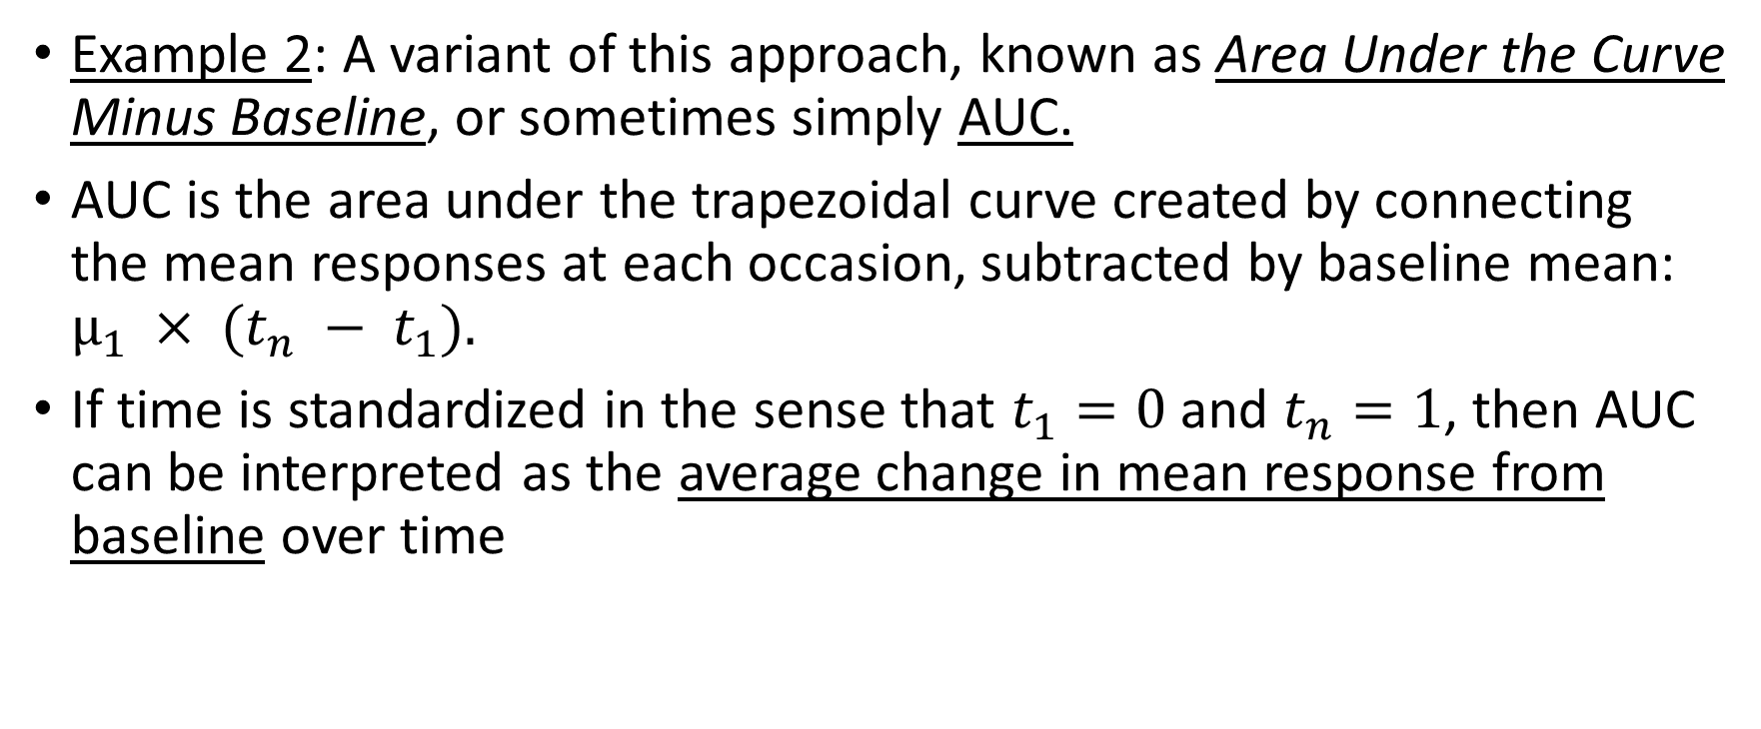
Single DF Contrasts
Example 2: A variant of this approach, known as Area Under the Curve
Minus Baseline, or sometimes simply AUC.
AUC is the area under the trapezoidal curve created by connecting the mean responses at each occasion, subtracted by baseline mean: $µ_{1} × (t_{n} − t_{1}).$
If time is standardized in the sense that $t_{1}=0$ and $t_{n}=1$, then AUC can be interpreted as the average change in mean response from baseline over time
PHS 651 / Lecture 07
7 / 24

Slide 8
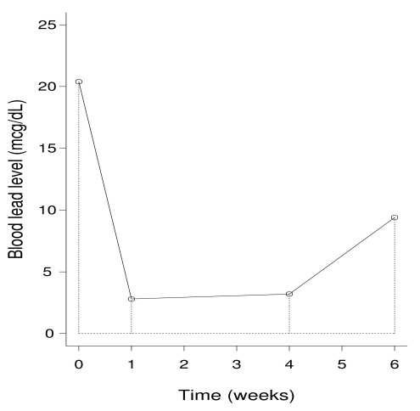
Single DF Contrasts
PHS 651 / Lecture 07
8 / 24

Slide 9

Single DF Contrasts
Example 2: In the TLC example, the AUC is
$$\frac{1}{2}t_{2}\left(μ_{2}−μ_{1}\right)+\frac{1}{2}\left(t_{3}−t_{2}\right)\left(μ_{3}−μ_{1}+μ_{2}−μ_{1}\right)+\frac{1}{2}(t_{4}−t_{3})(μ_{4}−μ_{1}+μ_{3}−μ_{1})$$
So the difference in AUC between succimer and placebo is
$$\frac{1}{2}t_{2}\left(Δ_{2}−Δ_{1}\right)+\frac{1}{2}\left(t_{3}−t_{2}\right)\left(Δ_{3}−Δ_{1}+Δ_{2}−Δ_{1}\right)+\frac{1}{2}(t_{4}−t_{3})(Δ_{4}−Δ_{1}+Δ_{3}−Δ_{1})$$
PHS 651 / Lecture 07
9 / 24

Slide 10

Single DF Contrasts
Example 2: Use the fact that $β_{6}=Δ_{2}−Δ_{1},β_{7}=Δ_{3}−Δ_{1},$ and $β_{8}=Δ_{4}−Δ_{1}$.
The difference in AUC is
$$\frac{1}{2}t_{2}β_{6}+\frac{1}{2}\left(t_{3}−t_{2}\right)\left(β_{7}+β_{6}\right)+\frac{1}{2}\left(t_{4}−t_{3}\right)\left(β_{8}+β_{7}\right)$$
$$=\frac{1}{2}t_{3}β_{6}+\frac{1}{2}\left(t_{4}−t_{2}\right)β_{7}+\frac{1}{2}\left(t_{4}−t_{3}\right)β_{8}$$
$$=\frac{1}{3}β_{6}+\frac{5}{12}β_{7}+\frac{1}{6}β_{8}$$
with $t_{2}=\frac{1}{6},t_{3}=\frac{2}{3}, t_{4}=1.$
PHS 651 / Lecture 07
10 / 24

Slide 11
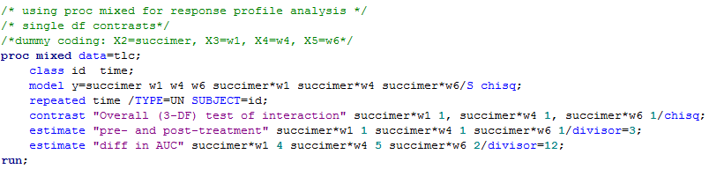
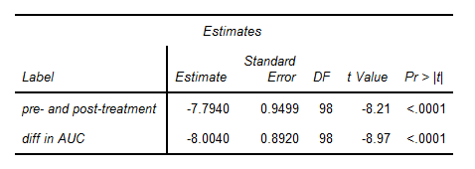
Single DF Contrasts
Example 2:
PHS 651 / Lecture 07
11 / 24

Slide 12
Adjustment for Baseline Response
In previous analysis, we treat baseline response as a component of the response profile, and consider the difference in the change pattern between groups
This is a natural paradigm to adjust for baseline response, and works for both randomized and observational studies.
Here we consider two alternative ways to adjust for baseline response
  Subtraction
  As covariate
PHS 651 / Lecture 07
12 / 24

Slide 13
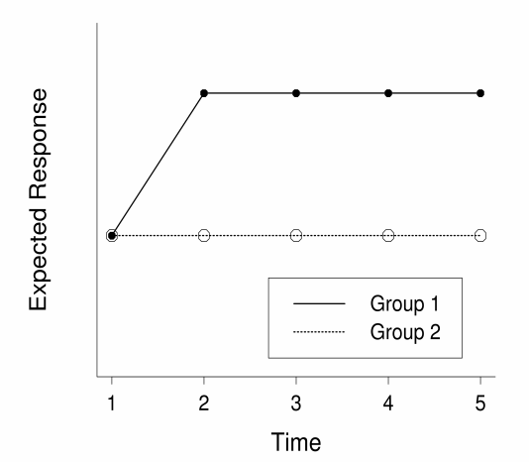
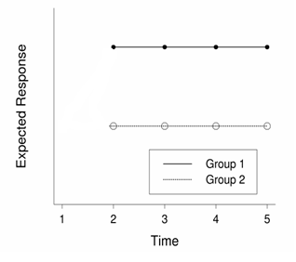

Adjustment for Baseline Response
If each post-treatment response is subtracted by the baseline response, we are dealing with a $n−1$ vector of changes in response.
To study the treatment effect, we need to directly assess the equality of mean changes between groups, not parallelism.

Slide 14
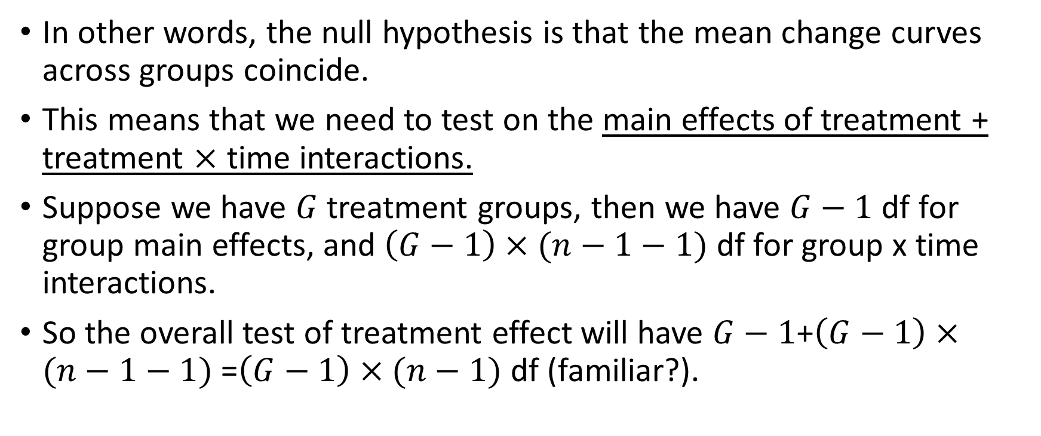
Adjustment for Baseline Response
In other words, the null hypothesis is that the mean change curves across groups coincide.
This means that we need to test on the main effects of treatment + treatment $×$ time interactions.
Suppose we have $G$ treatment groups, then we have $G−1$df for group main effects, and $\left(G−1\right)×(n−1−1)$df for group x time interactions.
So the overall test of treatment effect will have $G−1$+$\left(G−1\right)×(n−1−1)$=$\left(G−1\right)×(n−1)$df (familiar?).
PHS 651 / Lecture 07
14 / 24

Slide 15
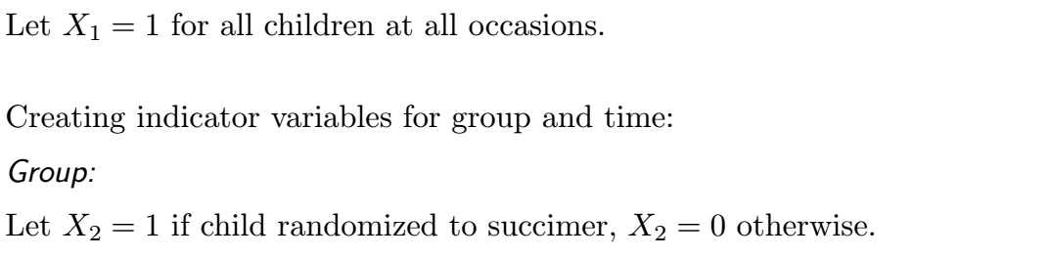

Case Study: the TLC Trial
Suppressing the subscript $ij$
Time: $X_{3}=1$ for week 4, $X_{3}=0$ otherwise.
$X_{4}=1$ for week 6, $X_{4}=0$ otherwise.
So the reference level is week 1.
PHS 651 / Lecture 07
15 / 24

Slide 16
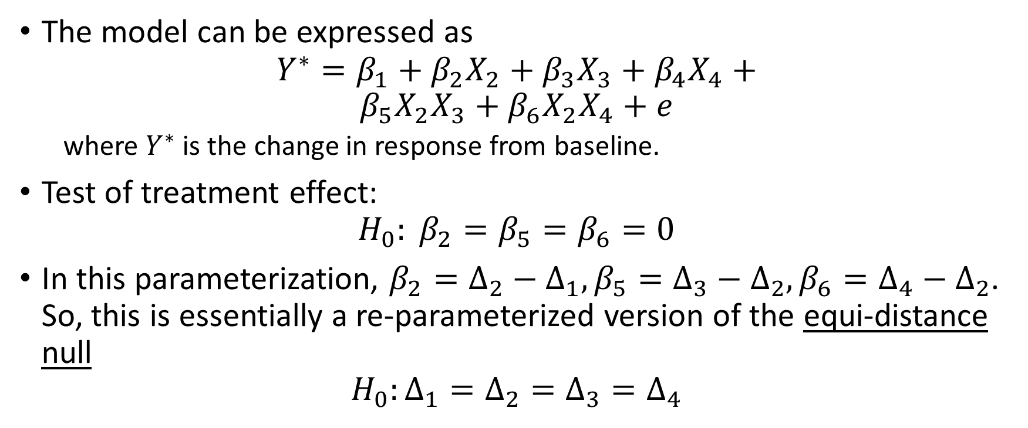
Case Study: the TLC Trial
The model can be expressed as
$$Y^{∗}=β_{1}+β_{2}X_{2}+β_{3}X_{3}+β_{4}X_{4}+$$
$$β_{5}X_{2}X_{3}+β_{6}X_{2}X_{4}+e$$
  where $Y^{∗}$ is the change in response from baseline.
Test of treatment effect:
$$H_{0}: β_{2}=β_{5}=β_{6}=0$$
In this parameterization, $β_{2}=Δ_{2}−Δ_{1}, β_{5}=Δ_{3}−Δ_{2}, β_{6}=Δ_{4}−Δ_{2}$. So, this is essentially a re-parameterized version of the equi-distance null
$$H_{0}:Δ_{1}=Δ_{2}=Δ_{3}=Δ_{4}$$
PHS 651 / Lecture 07
16 / 24

Slide 17
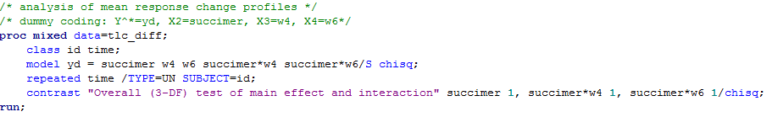
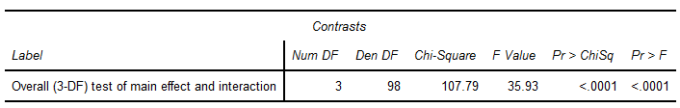
Case Study: the TLC Trial
Without covariates in addition to time and group, the analysis of response change profiles is equivalent to the analysis of response profiles.
PHS 651 / Lecture 07
17 / 24

Slide 18
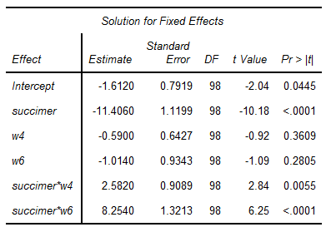






Case Study: the TLC Trial
$$β_{1}$$
$$β_{2}$$
$$β_{3}$$
$$β_{4}$$
$$β_{5}$$
$$β_{6}$$
PHS 651 / Lecture 07
18 / 24

Slide 19
Adjustment for Baseline Response
Now, consider the other alternative: inclusion of baseline response as a covariate.
In a baseline-response-adjusted regression model, inference is made on subjects having the same baseline response.
Therefore, the null hypothesis is, again, the equality of responses between groups, not parallelism
So, hypothesis testing of treatment effect will also be based on the main effects and interactions jointly.
PHS 651 / Lecture 07
19 / 24

Slide 20

Case Study: the TLC Trial
Suppressing the subscript $ij$
Time: $X_{3}=1$ for week 4, $X_{3}=0$ otherwise.
$X_{4}=1$ for week 6, $X_{4}=0$ otherwise.
Baseline response: $X_{5}=$Baseline response
PHS 651 / Lecture 07
20 / 24

Slide 21
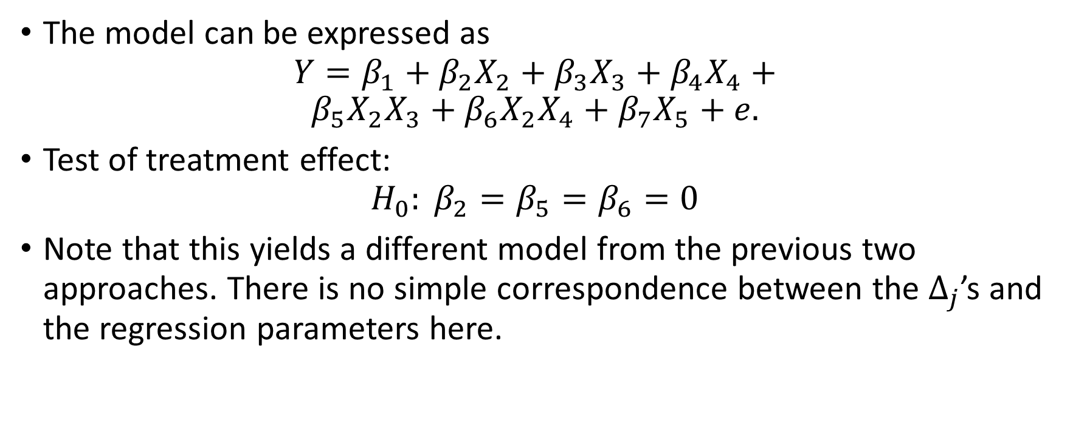
Case Study: the TLC Trial
The model can be expressed as
$$Y=β_{1}+β_{2}X_{2}+β_{3}X_{3}+β_{4}X_{4}+$$
$$β_{5}X_{2}X_{3}+β_{6}X_{2}X_{4}+β_{7}X_{5}+e.$$
Test of treatment effect:
$$H_{0}: β_{2}=β_{5}=β_{6}=0$$
Note that this yields a different model from the previous two approaches. There is no simple correspondence between the $Δ_{j}$’s and the regression parameters here.
PHS 651 / Lecture 07
21 / 24

Slide 22
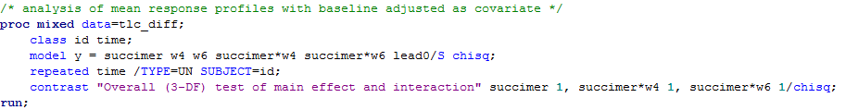
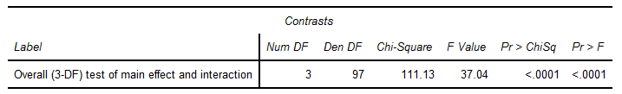
Case Study: the TLC Trial
The test statistic is not numerically identical to that from the previous two approaches, but is comparable (111.13 vs 107.79).
PHS 651 / Lecture 07
22 / 24

Slide 23
Adjustment for Baseline Response
This approach can be extended to incorporate other baseline characteristics such as age, race, gender, etc.
Compared with the first two approaches, it is the least robust because it involves extra assumptions on the relationship between post-treatment and baseline responses.
Therefore, the first two approaches are recommended.
PHS 651 / Lecture 07
23 / 24

Slide 24
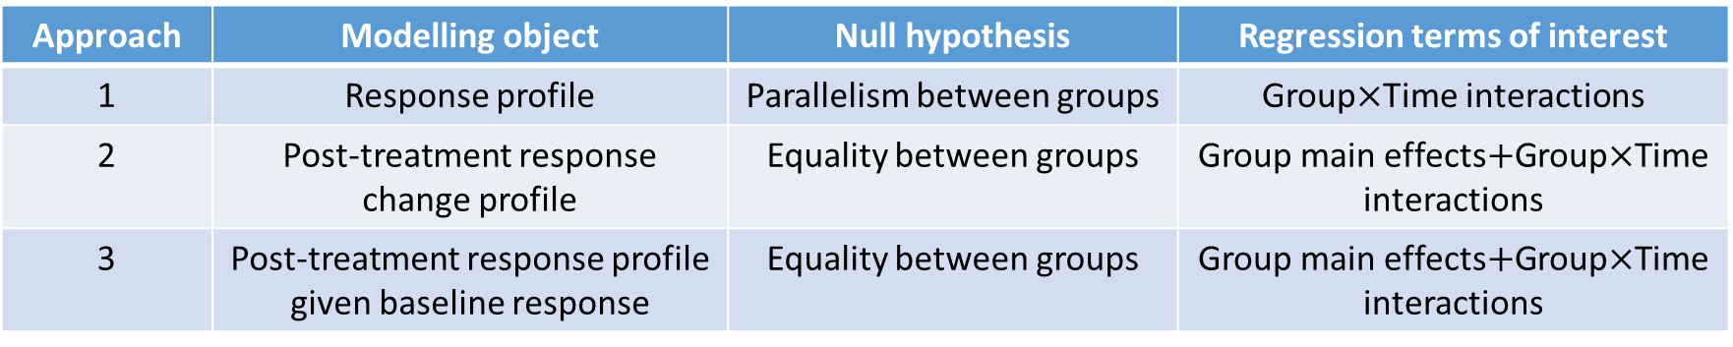
Adjustment for Baseline Response
Approach | Modelling object | Null hypothesis | Regression terms of interest
1 | Response profile | Parallelism between groups | Group$×$Time interactions
2 | Post-treatment response change profile | Equality between groups | Group main effects$+$Group$×$Time interactions
3 | Post-treatment response profile given baseline response | Equality between groups | Group main effects$+$Group$×$Time interactions
PHS 651 / Lecture 07
24 / 24

