Slide 1
PHS 651 / LECTURE 08
Modeling the Mean: Parametric Curves
Advanced Regression Methods for Population Health
Lu Mao, PhD
Department of Biostatistics and Medical Informatics
University of Wisconsin-Madison
SPRING 2019

Slide 2
Outline
  The mean model: polynomial curves, linear splines, and constant effect models
  Examples: Lung Health Study and TCL Trial
PHS 651 / Lecture 08
2 / 28

Slide 3
Modelling the Mean: Parametric Curves
Fitting parametric or semi-parametric curves to longitudinal data can be justified on substantive and statisticalgrounds.
Substantively, in many studies true underlying mean response process
changes over time in a relatively smooth, monotonically increasing/decreasing pattern.
Fitting parsimonious models for mean response results in statistical tests of covariate effects (e.g., treatment × time interactions) with greater power than in analysis of response profiles.
PHS 651 / Lecture 08
3 / 28

Slide 4
Modelling the Mean: Linear Curves
Simplest possible curve for describing changes in the mean response over time is a straight line.
Slope has direct interpretation in terms of a constant rate of change in mean response for a single unit change in time.
Consider two-group study comparing treatment and control, where changes in mean response are approximately linear:
PHS 651 / Lecture 08
4 / 28

Slide 5


Modelling the Mean: Linear Curves
In this model, the mean response in the control group is
and that in the treatment group is
Thus, each group’s mean response is assumed to change linearly over time .
PHS 651 / Lecture 08
5 / 28

Slide 6
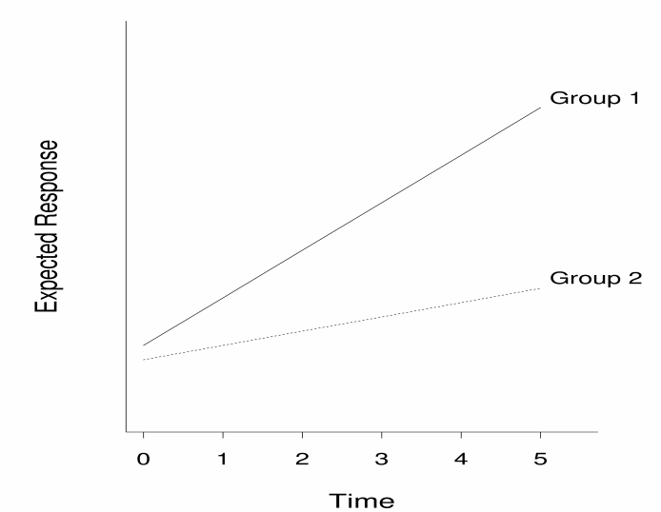
Modelling the Mean: Linear Curves
PHS 651 / Lecture 08
6 / 28

Slide 7
Modelling the Mean: Quadratic Curves
When changes in the mean response over time are not linear, higher-order polynomial terms can be considered.
For example, if the means are monotonically increasing or decreasing over the course of the study, but in a curvilinear way, a model with quadratic termscan be considered.
In a quadratic trend model the rate of change in the mean response is not constant but depends on time.
Rate of change must be expressed in terms of two parameters.
PHS 651 / Lecture 08
7 / 28

Slide 8
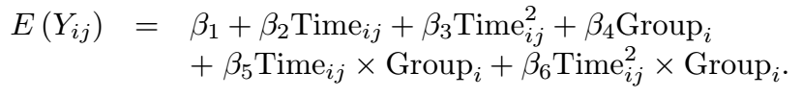

Modelling the Mean: Quadratic Curves
Consider two-group study example:
In this model, the mean response in the control group is
and that in the treatment group is
PHS 651 / Lecture 08
8 / 28

Slide 9
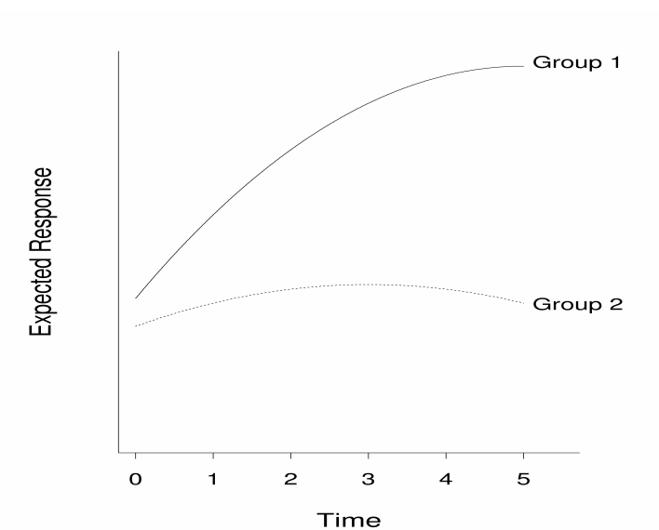

Modelling the Mean: Quadratic Curves
The mean response changes at different rate, depending on $Time_{ij}$
Rate of change in control group is $β_{2}+2β_{3}Time_{ij};$ that in control group is $β_{2}+β_{5}+2(β_{3}+β_{6})Time_{ij}$.
PHS 651 / Lecture 08
9 / 28

Slide 10
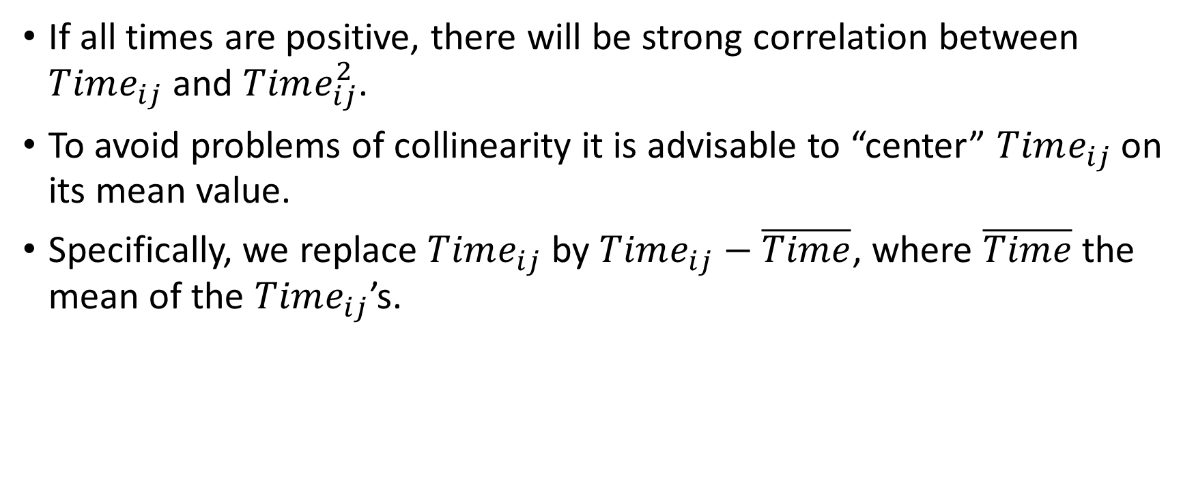
Modelling the Mean: Quadratic Curves
If all times are positive, there will be strong correlation between $Time_{ij}$ and $Time_{ij}^{2}$.
To avoid problems of collinearity it is advisable to “center” $Time_{ij}$on its mean value.
Specifically, we replace $Time_{ij}$by $Time_{ij}−\overline{Time}$, where $\overline{Time}$ the mean of the $Time_{ij}$’s.
PHS 651 / Lecture 08
10 / 28

Slide 11
Modelling the Mean: Linear Splines
Another way to extend the linear curve is to have a sequence of joined line segments that produces a piecewise linear pattern.
Such linear spline models provide a flexible way to accommodate many non-linear trends that cannot be approximated by simple polynomials in time.
Basic idea: Divide time axis into series of segments and consider piecewise linear trends, having different slopes but joined at fixed times. Locations where lines are tied together are known as “knots”.
PHS 651 / Lecture 08
11 / 28

Slide 12
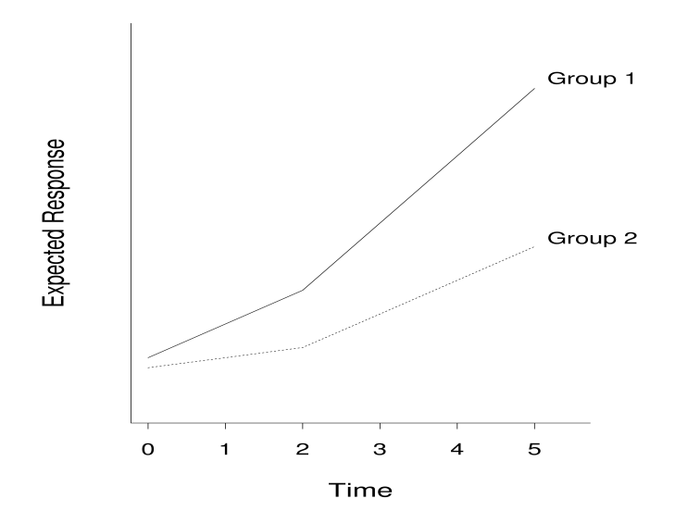
Modelling the Mean: Linear Splines
Also called a “broken-stick” model
PHS 651 / Lecture 08
12 / 28

Slide 13
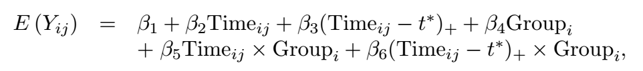
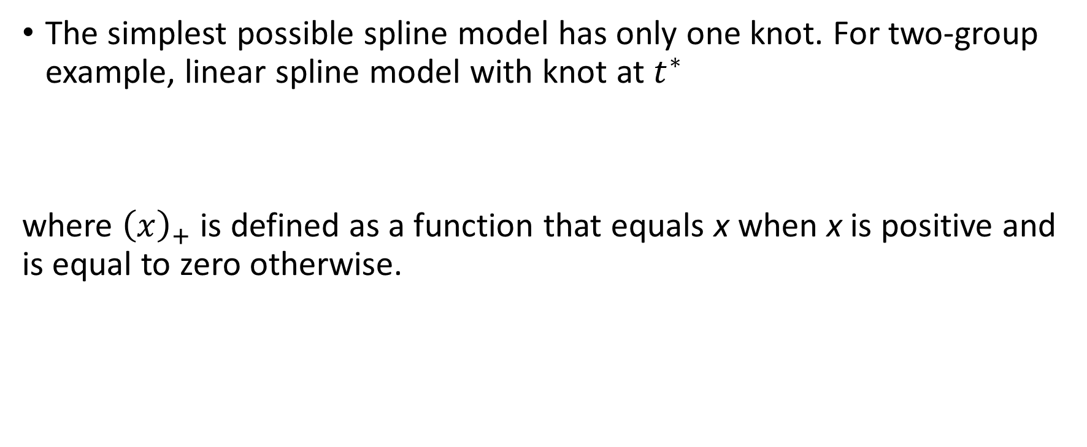
Modelling the Mean: Linear Splines
The simplest possible spline model has only one knot. For two-group example, linear spline model with knot at $t^{∗}$
where ${\left(x\right)}_{+}$is defined as a function that equals x when x is positive and isequal to zero otherwise.
PHS 651 / Lecture 08
13 / 28

Slide 14
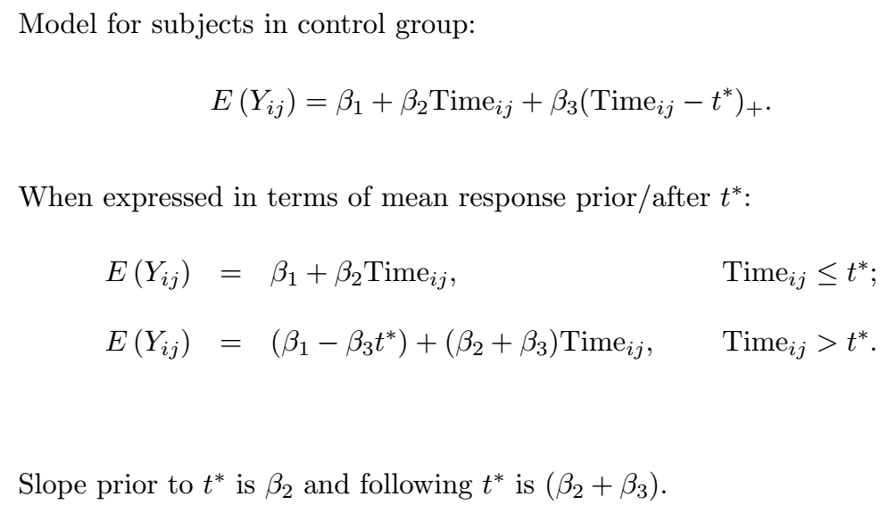
Modelling the Mean: Linear Splines

Slide 15
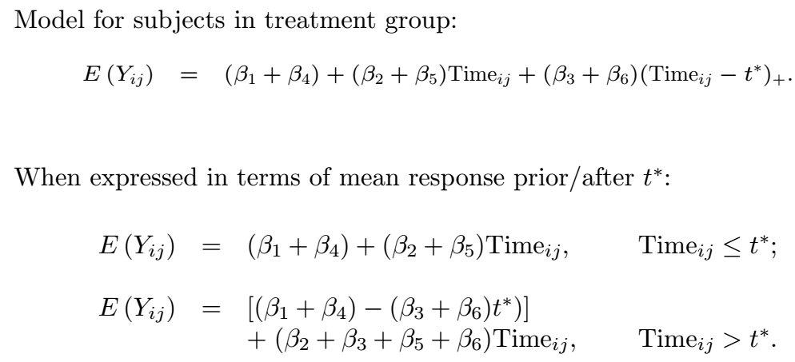
Modelling the Mean: Linear Splines
PHS 651 / Lecture 08
15 / 28

Slide 16
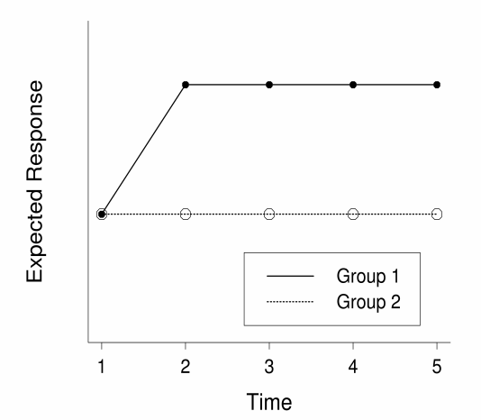
Modelling the Mean: Linear Splines
In Lecture 7, we saw a simple model like this:
PHS 651 / Lecture 08
16 / 28

Slide 17

Modelling the Mean: Linear Splines
To fit such a model, we can create a new variable for time:
$Post_time_{ij}$= 0 if baseline ($Time_{ij}$= 0),
$Post_time_{ij}$= 1 if post-baseline ($Time_{ij}$ > 0).
Then, in two group setting, the model is:
PHS 651 / Lecture 08
17 / 28

Slide 18
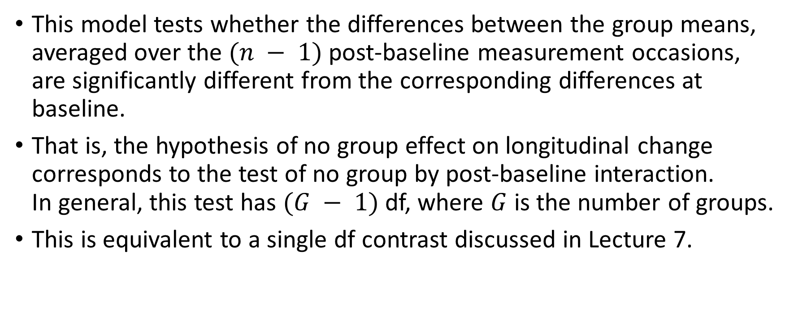
Modelling the Mean: Linear Splines
This model tests whether the differences between the group means, averaged over the $(n − 1)$post-baseline measurement occasions, are significantly different from the corresponding differences at baseline.
That is, the hypothesis of no group effect on longitudinal change
corresponds to the test of no group by post-baseline interaction.
In general, this test has $(G − 1)$df, where $G$is the number of groups.
This is equivalent to a single df contrast discussed in Lecture 7.
PHS 651 / Lecture 08
18 / 28

Slide 19
Case Studies: Lung Disease Study
Epidemiologic study on prevalence of and risk factors for chronic obstructive lung disease.
Sample participated in follow-up surveys approximately every 3 years for
up to 21 years.
Pulmonary function was determined by spirometry: FEV1.
We focus on a subset of 133 residents aged 36 or older at their entry into
the study and whose smoking status did not change over the 19 years of
follow-up.
Each study participant was either a current or former smoker.
PHS 651 / Lecture 08
19 / 28

Slide 20
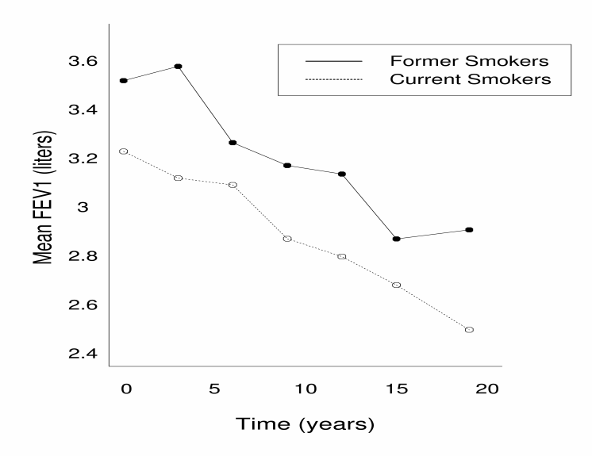
Case Studies: Lung Disease Study
PHS 651 / Lecture 08
20 / 28

Slide 21
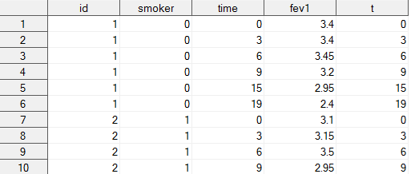
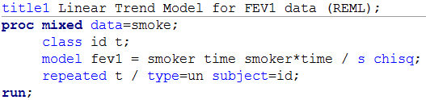
Case Studies: Lung Disease Study
First, consider a linear trend in the mean response over time.
We assume an unstructured covariance matrix.
PHS 651 / Lecture 08
21 / 28

Slide 22

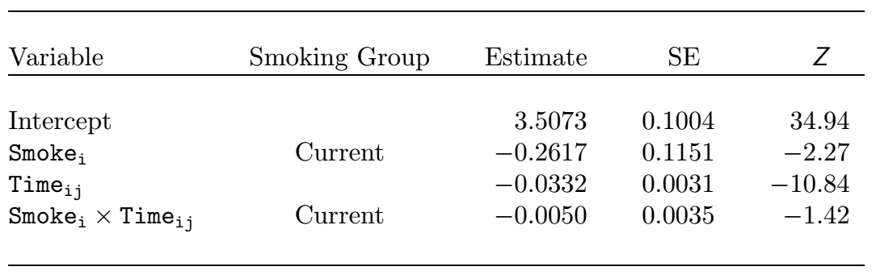
Case Studies: Lung Disease Study
The mean response for former smokers is
  and that for current smokers is
PHS 651 / Lecture 08
22 / 28

Slide 23
Case Studies: Lung Disease Study
Thus, both groups have a significant decline in mean FEV1 over time,
with no discernible difference between the exposure groups in the (constant) rate of change (interaction term in the model).
Is the rate of change constant over time?
Adequacy of linear trend model can be assessed by including higher-order polynomial trends.
We fit a “full” model by including the quadratic term, and compare the log-likelihood with that from the “reduced” model, i.e., the linear trend model.
PHS 651 / Lecture 08
23 / 28

Slide 24
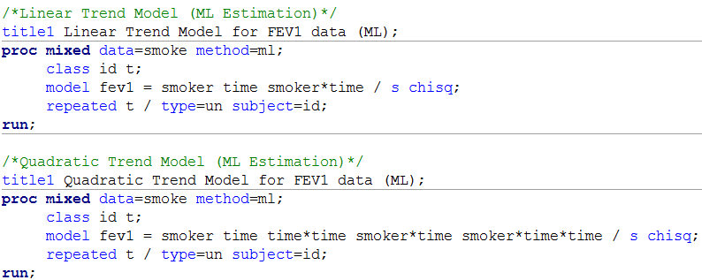
Case Studies: Lung Disease Study
PHS 651 / Lecture 08
24 / 28

Slide 25
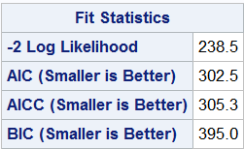
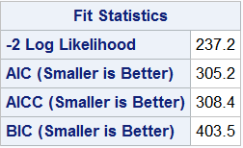
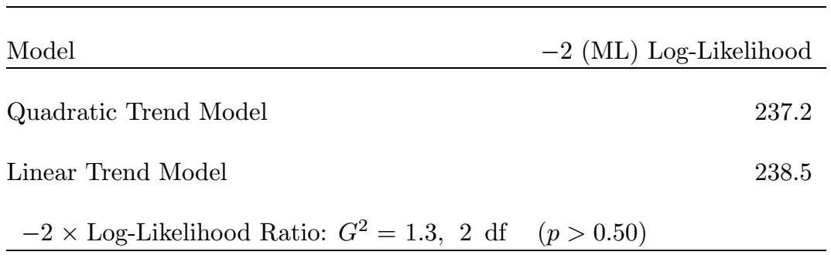
Case Studies: Lung Disease Study
Linear
Quadratic
PHS 651 / Lecture 08
25 / 28

Slide 26
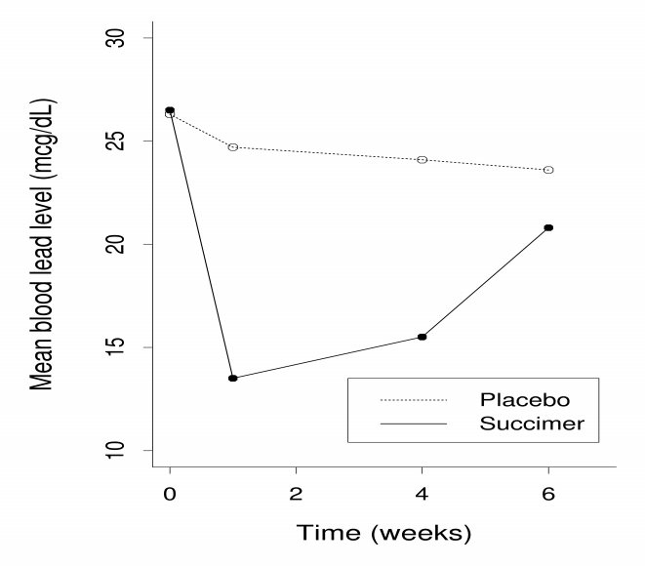
Case Studies: The TLC Trial
PHS 651 / Lecture 08
26 / 28

Slide 27
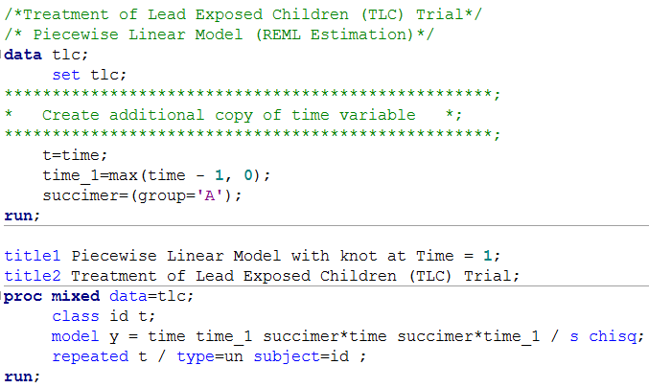
Case Studies: The TLC Trial
PHS 651 / Lecture 08
27 / 28

Slide 28
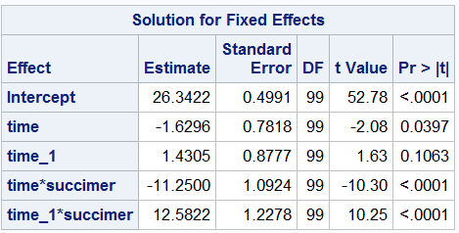
Case Studies: The TLC Trial
The interaction terms are highly significant, indicating difference in the pattern of change between the two arms.
Can construct 2 df joint test of interactions using the CONTRAST statement in PROC MIXED.
PHS 651 / Lecture 08
28 / 28

