Slide 1
PHS 651 / LECTURE 09
Modeling the Covariance
Advanced Regression Methods for Population Health
Lu Mao, PhD
Department of Biostatistics and Medical Informatics
University of Wisconsin-Madison
SPRING 2019

Slide 2
Outline
  Different covariance pattern models
  Choice of covariance pattern models
  An Example with Exercise Therapy Trial
PHS 651 / Lecture 09
2 / 33

Slide 3
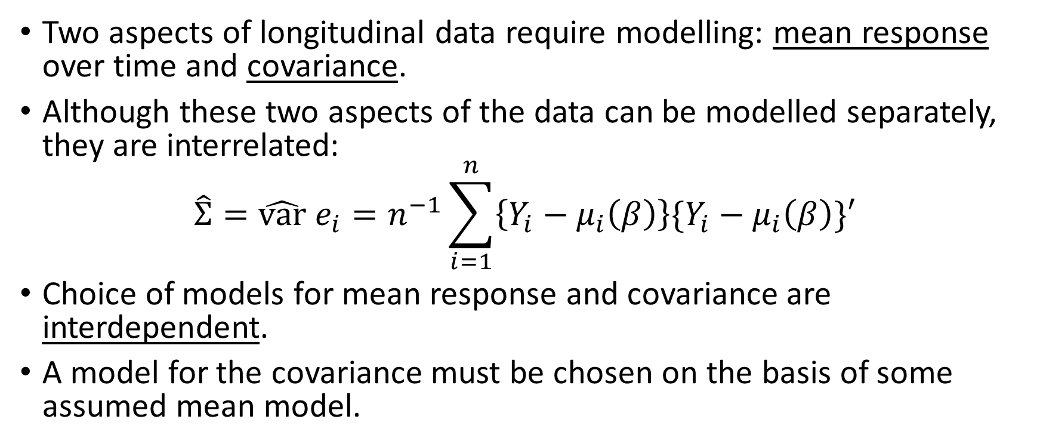
Modelling the Covariance
Two aspects of longitudinal data require modelling: mean response over time and covariance.
Although these two aspects of the data can be modelled separately, they are interrelated:
$$\hat{Σ}=\hat{var} e_{i}=n^{−1}\sum_{i=1}^{n}{\left\{Y_{i}−μ_{i}\left(β\right)\right\}\{Y_{i}−μ_{i}\left(β\right)\}′}$$
Choice of models for mean response and covariance are interdependent.
A model for the covariance must be chosen on the basis of some assumed mean model.
PHS 651 / Lecture 09
3 / 33

Slide 4
Modelling the Covariance
Three broad approaches can be distinguished:
  Unstructured covariance (“saturated” model)
  Covariance pattern models
  Random effects covariance structure
PHS 651 / Lecture 09
4 / 33

Slide 5
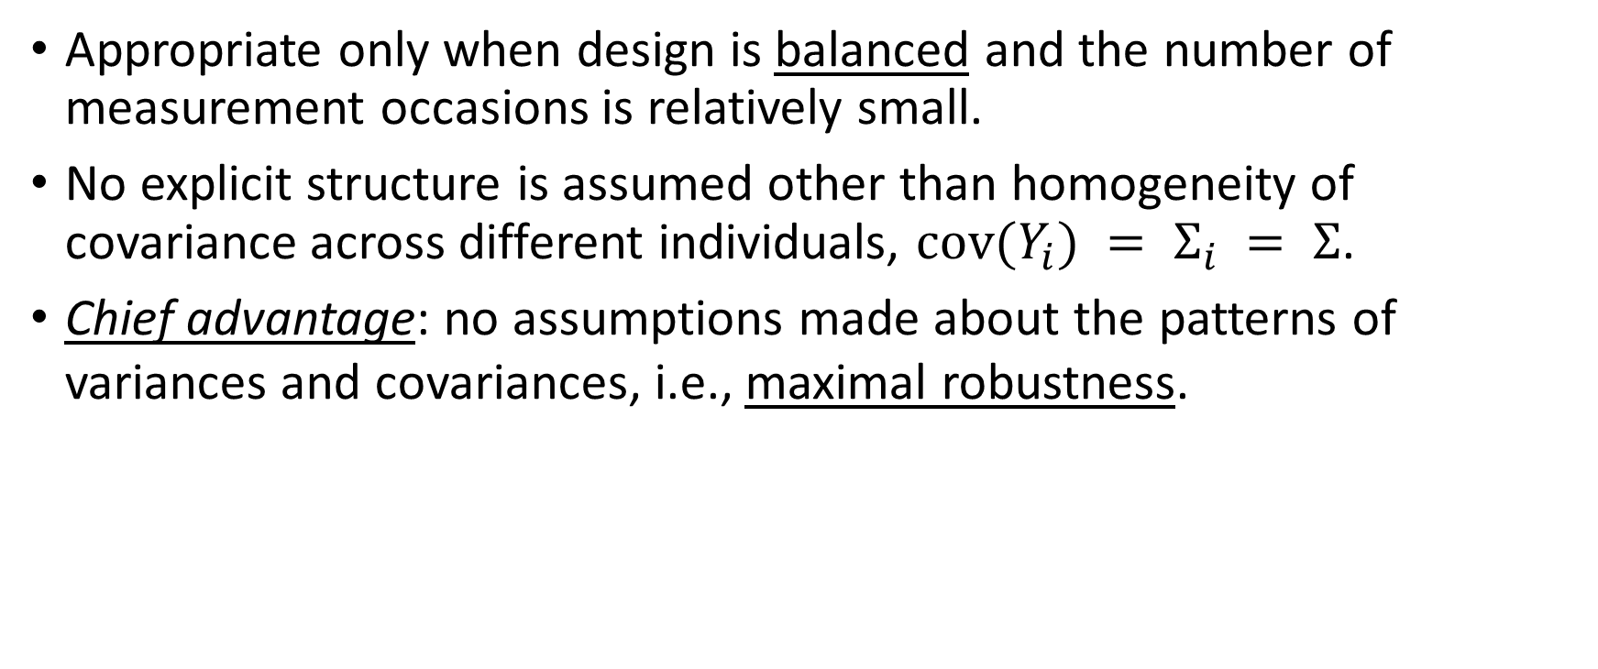
Unstructured Covariance
Appropriate only when design is balancedand the number of measurement occasions is relatively small.
No explicit structure is assumed other than homogeneity of covariance across different individuals, $cov(Y_{i}) = Σ_{i} = Σ$.
Chief advantage: no assumptions made about the patterns of variances and covariances, i.e., maximal robustness.
PHS 651 / Lecture 09
5 / 33

Slide 6
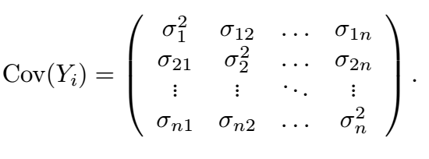

Unstructured Covariance
With $n$measurement occasions, unstructured covariance matrix has
$q=n(n+1)/2$parameters.
That is, $n$ variances plus $\left(\begin{matrix}n \\ 2\end{matrix} \right)=n(n−1)/2$covariances.
PHS 651 / Lecture 09
6 / 33

Slide 7
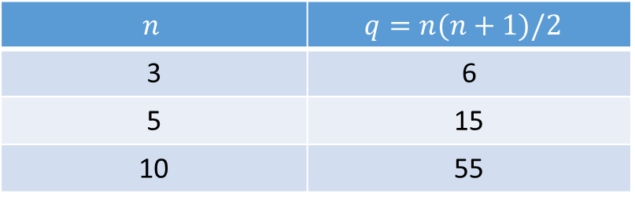
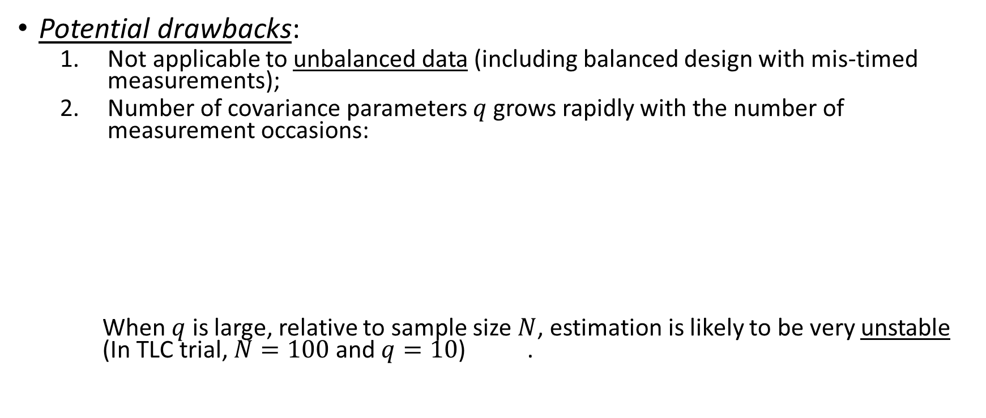
Unstructured Covariance
Potential drawbacks:
  Not applicable to unbalanced data (including balanced design with mis-timed measurements);
  Number of covariance parameters $q$grows rapidly with the number of
  measurement occasions:
When $q$ is large, relative to sample size $N$, estimation is likely to be very unstable (In TLC trial, $N=100$ and $q=10$) .
$$n$$ | $$q=n(n+1)/2$$
3 | 6
5 | 15
10 | 55
PHS 651 / Lecture 09
7 / 33

Slide 8
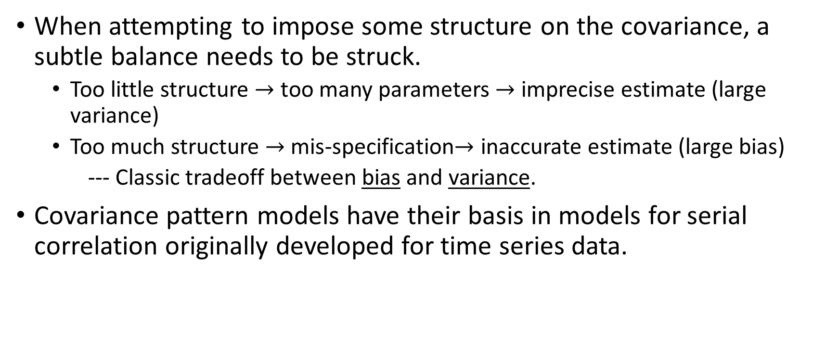
Covariance Pattern Models
When attempting to impose some structure on the covariance, a subtle balance needs to be struck.
  Too little structure $→$ too many parameters $→$ imprecise estimate (large variance)
  Too much structure $→$ mis-specification$→$inaccurate estimate (large bias)
  --- Classic tradeoff between bias and variance.
Covariance pattern models have their basis in models for serial correlation originally developed for time series data.
PHS 651 / Lecture 09
8 / 33

Slide 9
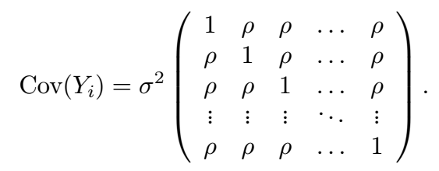

Covariance Pattern Models – Compound Symmetry
Compound symmetry (CS) assumes variance is constant across occasions, say $σ^{2}$, and$Corr(Y_{ij}, Y_{ik}) =ρ$for all $j$and $k$.
Parsimonious: $q=2$ parameters regardless of $n$.
Strong assumptions (measurements are exchangeable), usually not valid with longitudinal data.
PHS 651 / Lecture 09
9 / 33

Slide 10
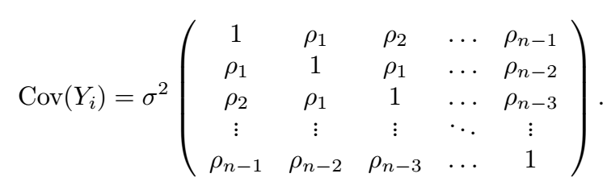
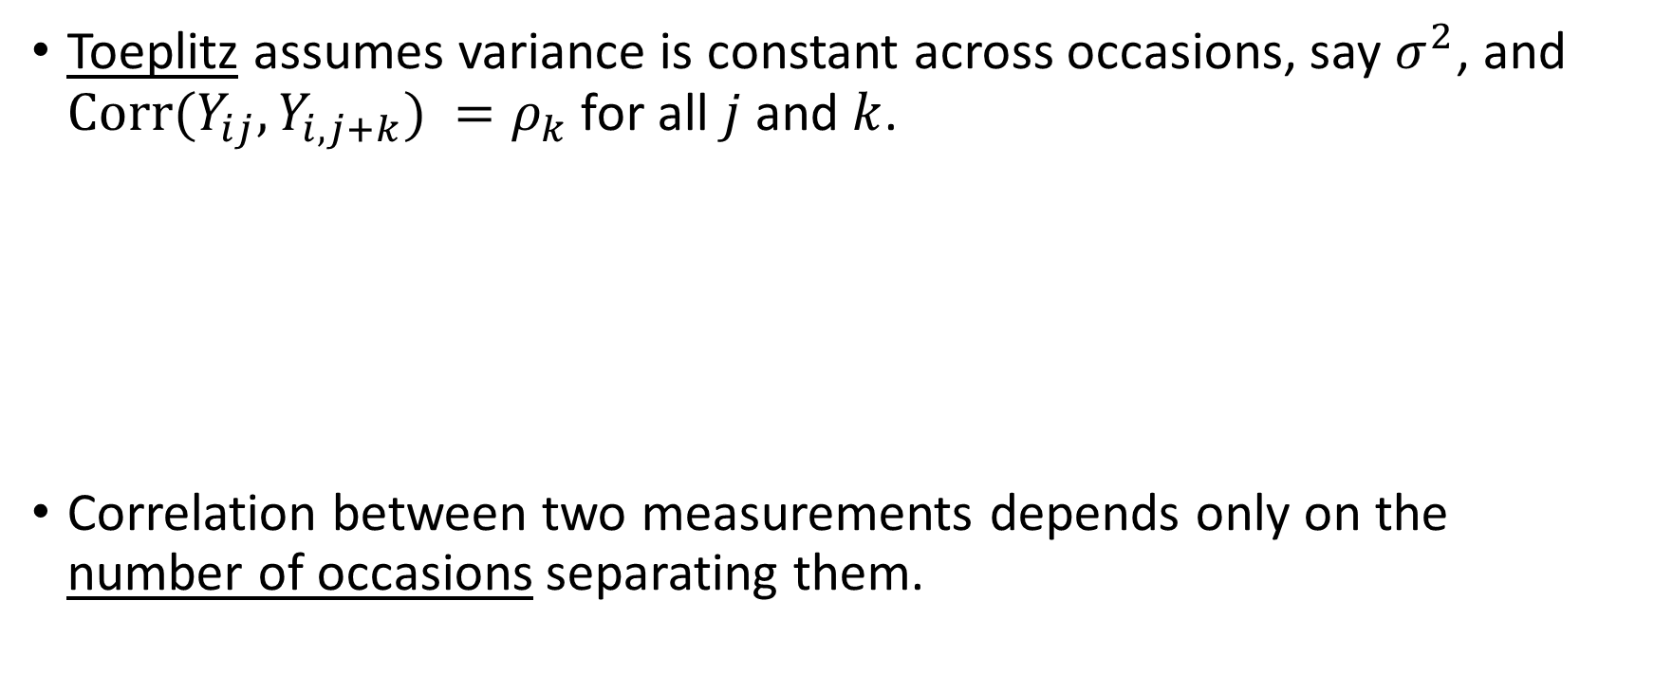
Covariance Pattern Models – Toeplitz
Toeplitzassumes variance is constant across occasions, say $σ^{2}$, and
$Corr(Y_{ij}, Y_{i,j+k}) =ρ_{k}$for all $j$and $k$.
Correlation between two measurements depends only on the number of occasions separating them.
PHS 651 / Lecture 09
10 / 33

Slide 11
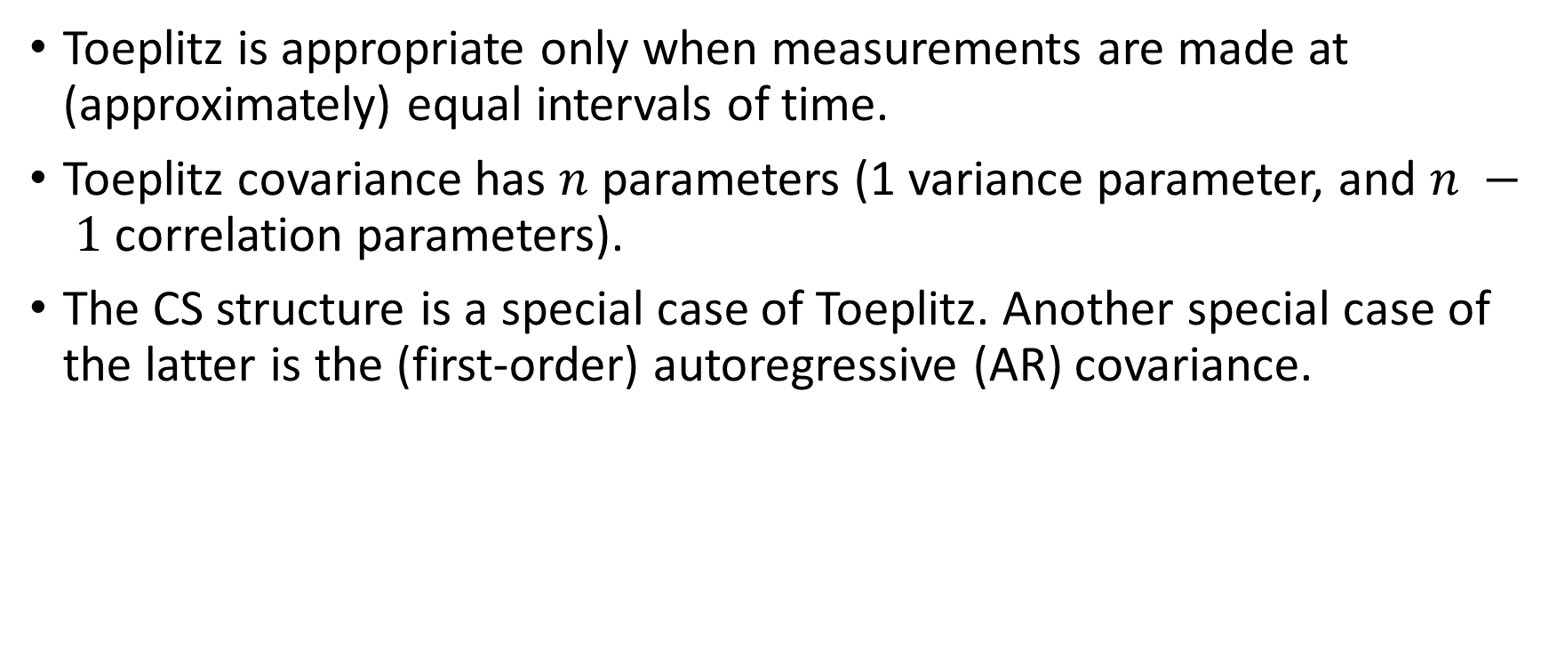
Covariance Pattern Models – Toeplitz
Toeplitz is appropriate only when measurements are made at (approximately) equal intervals of time.
Toeplitz covariance has $n$parameters (1 variance parameter, and $n − 1$correlation parameters).
The CS structure is a special case ofToeplitz. Another special case of the latter is the (first-order) autoregressive (AR) covariance.
PHS 651 / Lecture 09
11 / 33

Slide 12
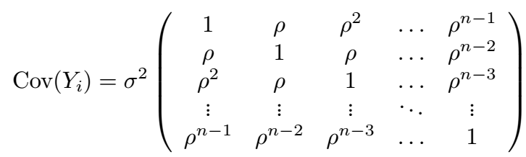
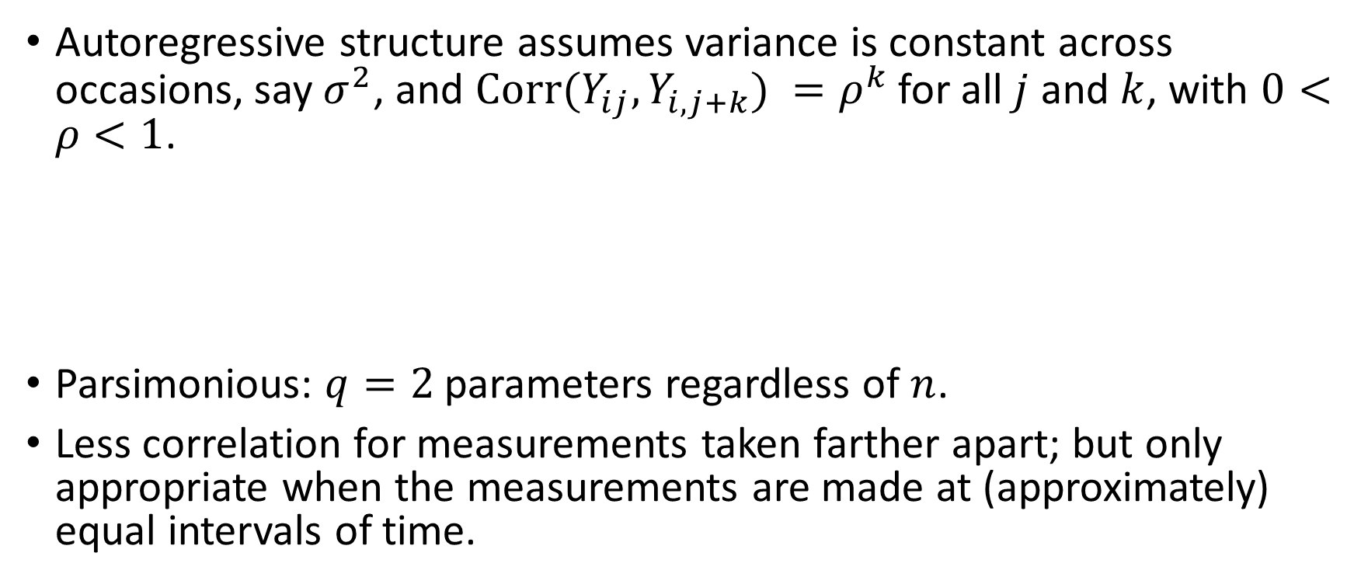
Covariance Pattern Models – AR
Autoregressive structure assumes variance is constant across occasions, say $σ^{2}$, and$Corr(Y_{ij}, Y_{i,j+k}) =ρ^{k}$for all $j$and $k$, with $0<ρ<1$.
Parsimonious: $q=2$ parameters regardless of $n$.
Less correlation for measurements taken farther apart; but only appropriate when the measurements are made at (approximately) equal intervals of time.
PHS 651 / Lecture 09
12 / 33

Slide 13
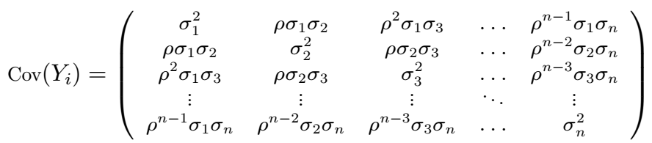
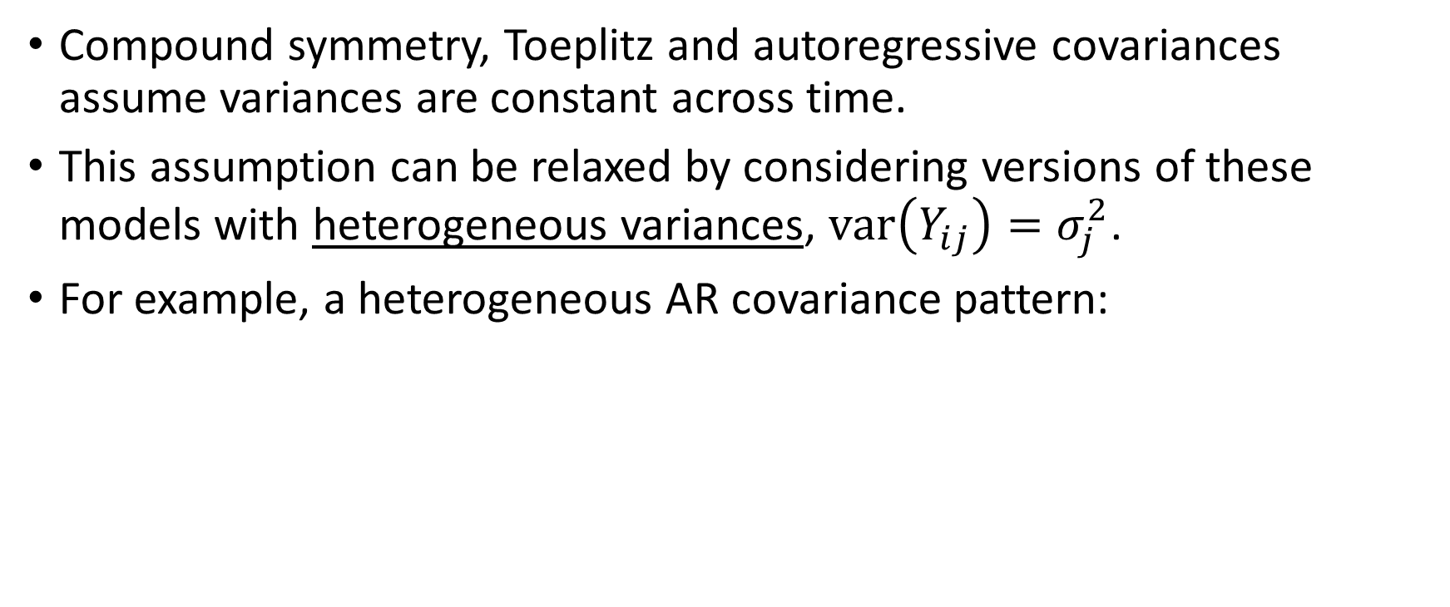
Covariance Pattern Models – Heteroscedastic versions
Compound symmetry, Toeplitz and autoregressive covariancesassume variances are constant across time.
This assumption can be relaxed by considering versions of these models with heterogeneous variances, $var\left(Y_{ij}\right)=σ_{j}^{2}$.
For example, a heterogeneous AR covariance pattern:
PHS 651 / Lecture 09
13 / 33

Slide 14
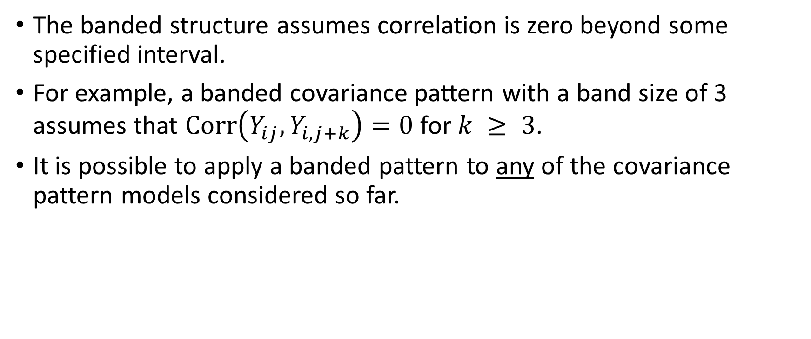
Covariance Pattern Models – Banded
The banded structure assumes correlation is zero beyond some specified interval.
For example, a banded covariance pattern with a band size of 3 assumes that $Corr\left(Y_{ij}, Y_{i,j+k}\right)=0$for $k ≥ 3$.
It is possible to apply a banded pattern to any of the covariance pattern models considered so far.
PHS 651 / Lecture 09
14 / 33

Slide 15
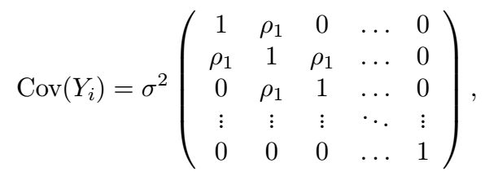
Covariance Pattern Models – Banded
A banded Toeplitz covariance pattern with a band size of 2 is given by
Banding assumes that correlation decays to zero with increasing time separation.
PHS 651 / Lecture 09
15 / 33

Slide 16

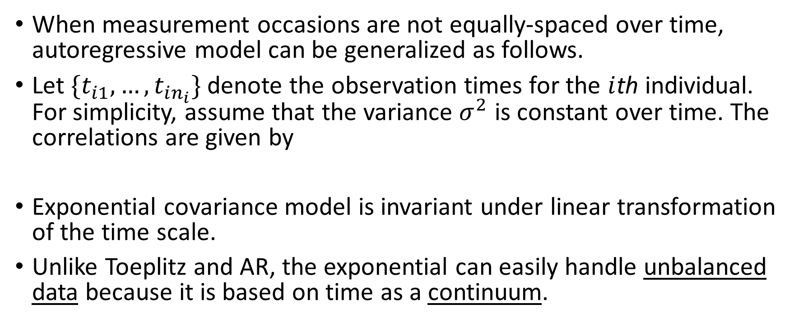
Covariance Pattern Models – Exponential
When measurement occasions are not equally-spaced over time,
autoregressive model can be generalized as follows.
Let $\{t_{i1},…,t_{in_{i}}\}$ denote the observation times for the $i$thindividual. For simplicity, assume that the variance $σ^{2}$is constant over time. The correlations are given by
Exponential covariance model is invariant under linear transformation of the time scale.
Unlike Toeplitz and AR, the exponential can easily handle unbalanced data because it is based on time as a continuum.
PHS 651 / Lecture 09
16 / 33

Slide 17
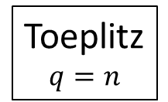
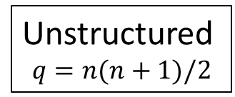



Relationships between the Covariance Models
Compound Symmetry
$$q=2$$
Covariance constant
Unstructured
$$q=n(n+1)/2$$
Covariance depends only on separation
Toeplitz
$$q=n$$
Exponential decay
Autoregressive
$$q=2$$
Decays to zero
Banded (size $d$)
$$q=?$$
PHS 651 / Lecture 09
17 / 33

Slide 18
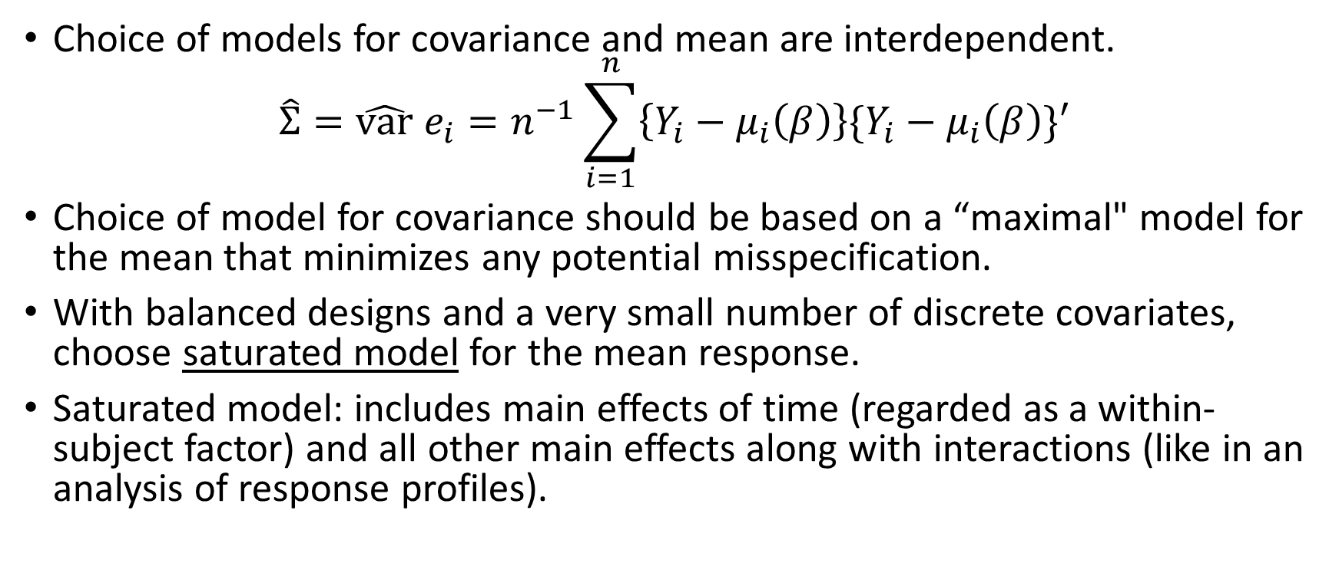
Choice among Covariance Pattern Models
Choice of models for covariance and mean are interdependent.
$$\hat{Σ}=\hat{var} e_{i}=n^{−1}\sum_{i=1}^{n}{\left\{Y_{i}−μ_{i}\left(β\right)\right\}\{Y_{i}−μ_{i}\left(β\right)\}′}$$
Choice of model for covariance should be based on a “maximal" model for
the mean that minimizes any potential misspecification.
With balanced designs and a very small number of discrete covariates,
choose saturated modelfor the mean response.
Saturated model: includes main effects of time (regarded as a within-subject factor) and all other main effects along with interactions (like in an analysis of response profiles).
PHS 651 / Lecture 09
18 / 33

Slide 19
Choice among Covariance Pattern Models
Maximal mean model should be in a certain sense the most elaborate model for the mean response that we would consider from a subject-matter point of view.
Once maximal model has been chosen, residual variation and covariation can be used to select appropriate model for covariance.
For nested covariance pattern models, a likelihood ratio test statistic can be constructed that compares “full” and “reduced" models.
PHS 651 / Lecture 09
19 / 33

Slide 20
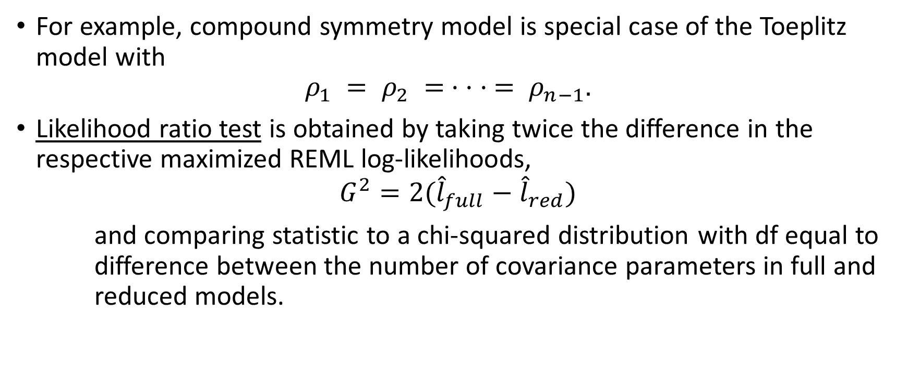
Choice among Covariance Pattern Models
For example, compound symmetry model is special case of the Toeplitz model with
$ρ_{1} = ρ_{2} = · · · = ρ_{n−1}.$
Likelihood ratio test is obtained by taking twice the difference in the
respective maximized REML log-likelihoods,
$$G^{2}=2({\hat{l}}_{full}−{\hat{l}}_{red})$$
and comparing statistic to a chi-squared distribution with df equal to
difference between the number of covariance parameters in full and reducedmodels.
PHS 651 / Lecture 09
20 / 33

Slide 21
Choice among Covariance Pattern Models
To compare non-nested model, an alternative approach is the Akaike
Information Criterion (AIC).
According to the AIC, given a set of competing models for the covariance, one should select the model that minimizes
Note that a larger number of parameters is penalized in the interest of a parsimonious model.
PHS 651 / Lecture 09
21 / 33

Slide 22
Example: Exercise Therapy Trial
Subjects were assigned to one of two weightlifting programs to increase muscle strength.
  treatment 1: number of repetitions of the exercises was increased as
  subjects became stronger.
  treatment 2: number of repetitions was held constant but amount ofweight was increased as subjects became stronger.
Measurements of body strength were taken at baseline and on days 2, 4, 6, 8, 10, and 12.
We focus only on measures of strength obtained at baseline (or day 0)
and on days 4, 6, 8, and 12.
PHS 651 / Lecture 09
22 / 33

Slide 23
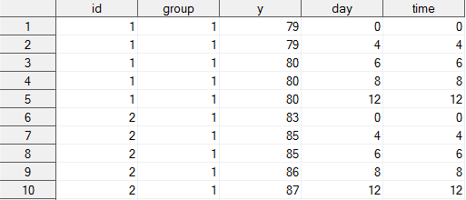
Example: Exercise Therapy Trial
Before considering models for the covariance, it is necessary to choose a maximal (saturated) model for the mean response.
PHS 651 / Lecture 09
23 / 33

Slide 24
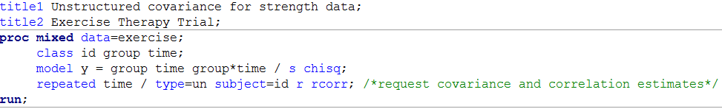
Example: Exercise Therapy Trial
First, we consider an unstructured covariance matrix.
PHS 651 / Lecture 09
24 / 33

Slide 25
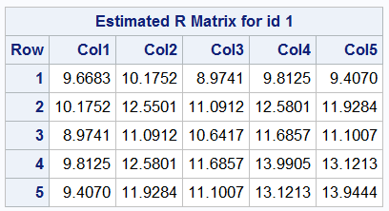
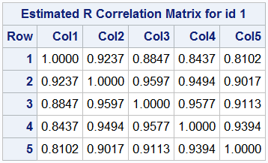
Example: Exercise Therapy Trial
The variance appears to be larger by the end of the study when
compared to the variance at baseline.
Correlations decrease as the time separation between the repeated measures increases.
PHS 651 / Lecture 09
25 / 33

Slide 26
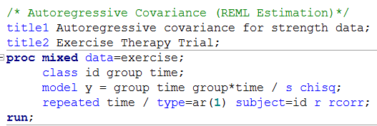
Example: Exercise Therapy Trial
Despite apparent increase in variance over time, we consider a homogenous autoregressivemodel for the correlation.
Heterogeneous autoregressive model can be specified using type=ARH(1) (See SAS documentation for a list of options for covariance structure).
PHS 651 / Lecture 09
26 / 33

Slide 27
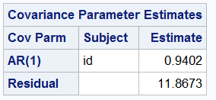

Example: Exercise Therapy Trial
This results in the following estimates of the variance and correlation
parameters, ${\hat{σ}}^{2}= 11.87$and $\hat{ρ}= 0.94$.
This model was fit primarily for illustrative purposes; the model is not very appropriate as data are unequally spaced over time.
PHS 651 / Lecture 09
27 / 33

Slide 28
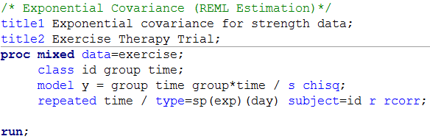

Example: Exercise Therapy Trial
Instead, consider exponential model for the covariance, where
  for $t_{i} = (0, 4, 6, 8, 12)$for all subjects. s
sp(exp): Spatial structure by exponential rule;
day: quantitative variable of time
PHS 651 / Lecture 09
28 / 33

Slide 29
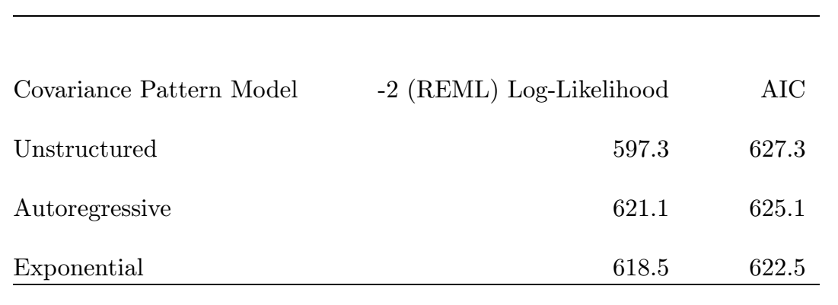
Example: Exercise Therapy Trial
There is a hierarchy among the models: autoregressive and exponential are both nested within unstructured.
The autoregressive and exponential models are not nested but have the same number of parameters.
PHS 651 / Lecture 09
29 / 33

Slide 30
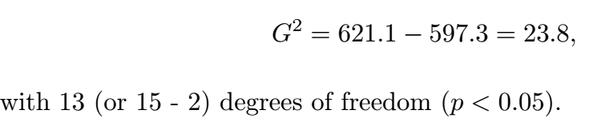
Example: Exercise Therapy Trial
Any comparison between these two models can be made directly in terms of their maximized log-likelihoods.
LRT comparing autoregressive vs unstructured covariance,
There is evidence that the autoregressive model does not provide an
adequate fit to the covariance.
PHS 651 / Lecture 09
30 / 33

Slide 31
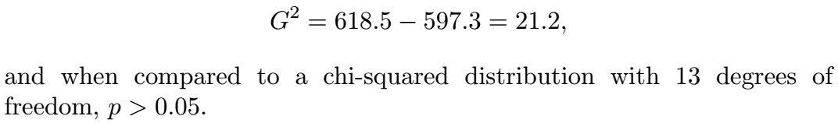
Example: Exercise Therapy Trial
LRT comparing exponential vs unstructured covariance, yields
Exponential covariance provides an adequate fit to the data.
Also, in terms of AIC, the exponential model minimizes this criterion.
PHS 651 / Lecture 09
31 / 33

Slide 32
Summary of Covariance Pattern Models
Covariance pattern models attempt to characterize the covariance with a
relatively small number of parameters.
However, many models (e.g., autoregressive, Toeplitz, and banded)
appropriate only when repeated measurements are obtained at equal
intervals and cannot handle irregularly timed measurements.
While there is a large selection of models for correlations, choice of models
for variances is limited.
They are not well-suited for modelling data from inherently unbalanced
longitudinal designs.
PHS 651 / Lecture 09
32 / 33

Slide 33
HW2 (Due Mar 13)
Problem 6.1 of FLW
Problem 7.1 (7.1.1—7.1.4) of FLW
PHS 651 / Lecture 09
33 / 33

