Slide 1
PHS 651 / LECTURE 10
Linear Mixed Effects Models
Advanced Regression Methods for Population Health
Lu Mao, PhD
Department of Biostatistics and Medical Informatics
University of Wisconsin-Madison
SPRING 2019

Slide 2
Outline
  Features of mixed effects models
  Random intercept and random slope models
  An Example with Exercise Therapy Trial
PHS 651 / Lecture 10
2 / 32

Slide 3
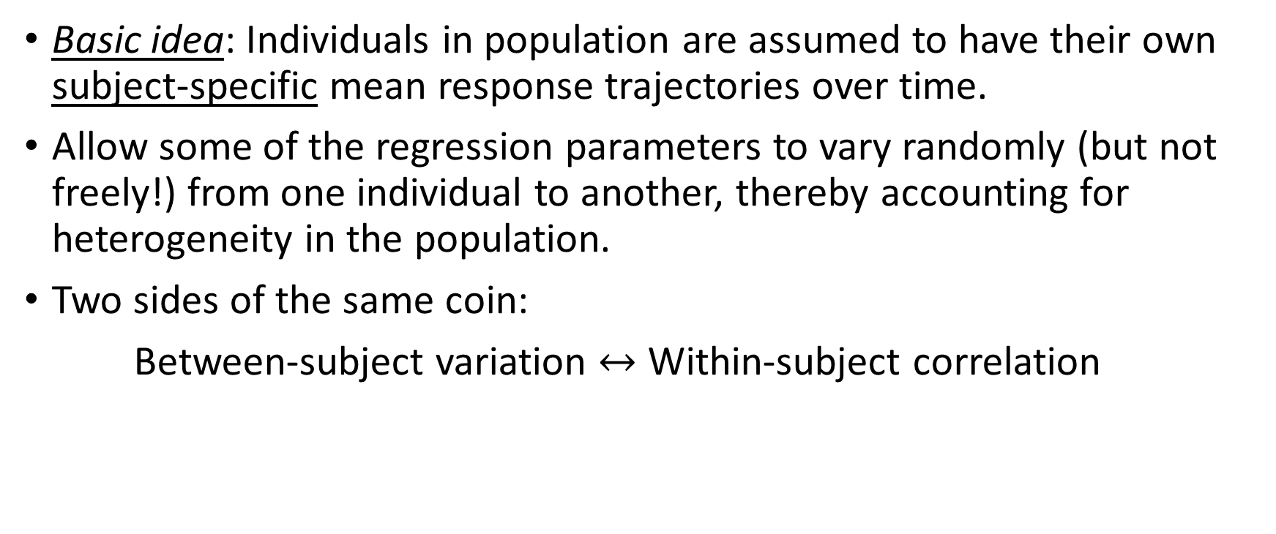
Mixed Effects Models
Basic idea: Individuals in population are assumed to have their own subject-specificmean response trajectories over time.
Allow some of the regression parameters to vary randomly (but not freely!) from one individual to another, thereby accounting forheterogeneity in the population.
Two sides of the same coin:
Between-subject variation $↔$ Within-subject correlation
PHS 651 / Lecture 10
3 / 32

Slide 4
Mixed Effects Models
Distinctive feature: mean response modelled as a combination of population characteristics (fixed effects) assumed to be shared by all individuals, and subject-specific effects (random effects) that are unique to a particular individual.
  Fixed effects: target of inference;
  Random effects: a construct to account for between-subject heterogeneity.
The term mixeddenotes that model contains both fixed and random effects.
PHS 651 / Lecture 10
4 / 32

Slide 5

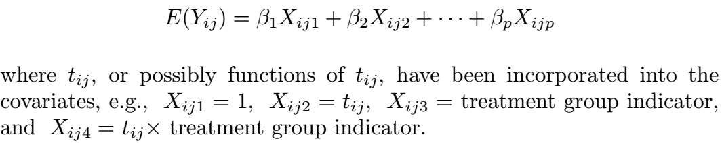
Mixed Effects Models – Random intercept
The mean response can be modelled by a familiar regression model. For example, with a linear trend over time, we may have
With additional covariates, this can be written more generally
PHS 651 / Lecture 10
5 / 32

Slide 6

Mixed Effects Models – Random intercept
One traditional approach for handling the covariance among repeated
measures is to assume that it arises from a random subject effect.
That is, each subject is assumed to have an (unobserved) underlying level of response which persists across all of his/her repeated measurements.
This subject effect is treated as random and the model becomes
PHS 651 / Lecture 10
6 / 32

Slide 7
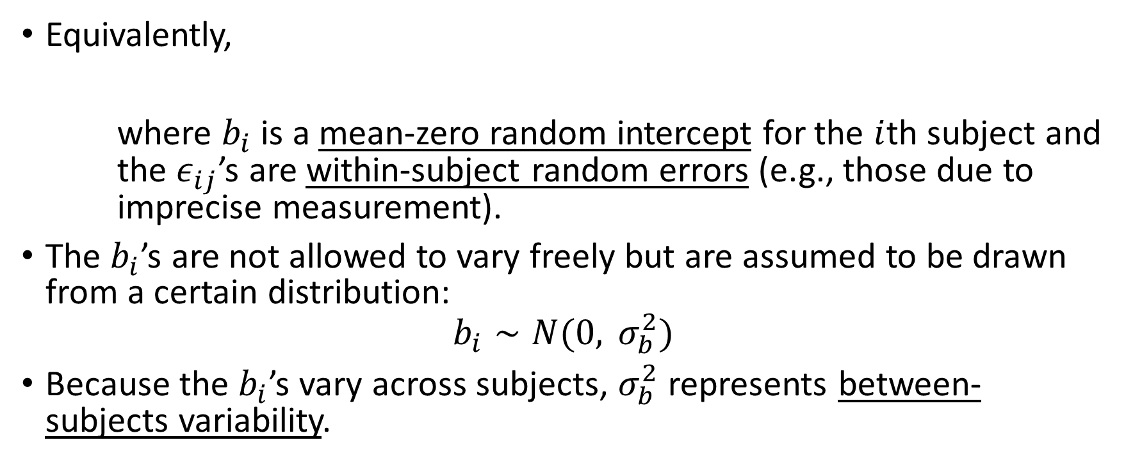
Mixed Effects Models – Random intercept
Equivalently,
where $b_{i}$ is a mean-zero random intercept for the $i$th subject and the $ε_{ij}$’s are within-subject random errors (e.g., those due to imprecise measurement).
The $b_{i}$’s are not allowed to vary freely but are assumed to be drawn from a certain distribution:
$$b_{i}∼N(0, σ_{b}^{2})$$
Because the $b_{i}$’s vary across subjects, $σ_{b}^{2}$ represents between-subjects variability.
PHS 651 / Lecture 10
7 / 32

Slide 8
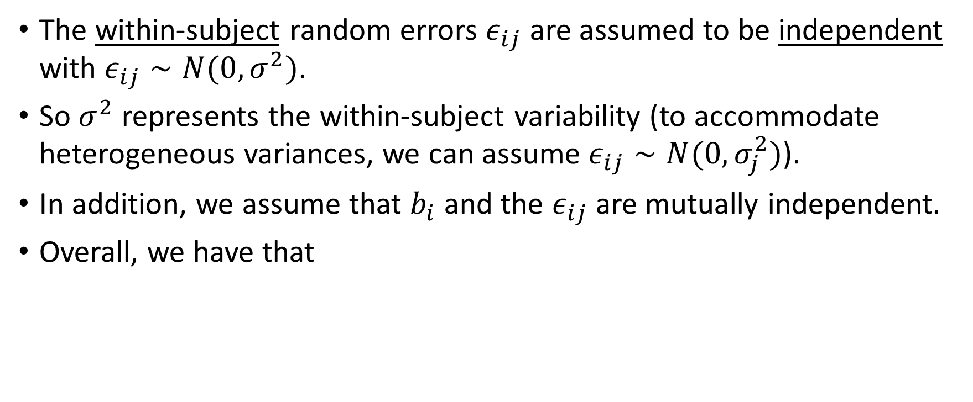
Mixed Effects Models – Random intercept
The within-subjectrandom errors $ε_{ij}$ are assumed to be independent with $ε_{ij}∼N(0, σ^{2})$.
So $σ^{2}$ represents the within-subject variability (to accommodate heterogeneous variances, we can assume $ε_{ij}∼N(0, σ_{j}^{2})$).
In addition, we assume that $b_{i}$ and the $ε_{ij}$ are mutually independent.
Overall, we have that
PHS 651 / Lecture 10
8 / 32

Slide 9

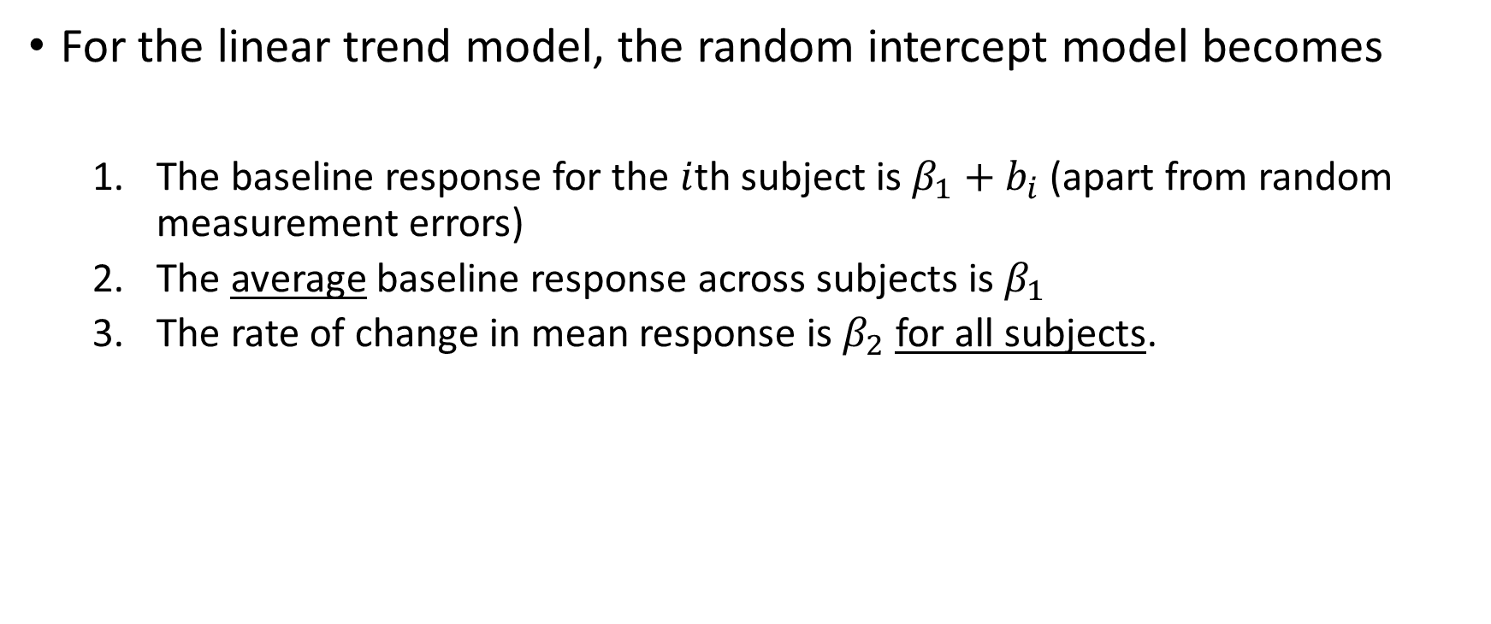
Mixed Effects Models – Random intercept
For the linear trend model, the random intercept model becomes
  The baseline response for the $i$th subject is $β_{1}+b_{i}$ (apart from random measurement errors)
  The average baseline response across subjects is $β_{1}$
  The rate of change in mean response is $β_{2}$for all subjects.
PHS 651 / Lecture 10
9 / 32

Slide 10
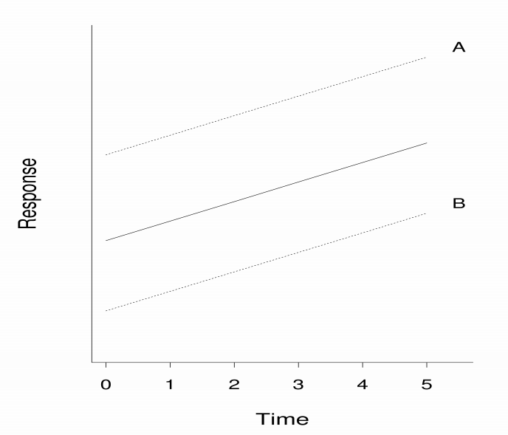
Mixed Effects Models – Random intercept
The true response curves for two randomly selected subjects A and B.
PHS 651 / Lecture 10
10 / 32

Slide 11
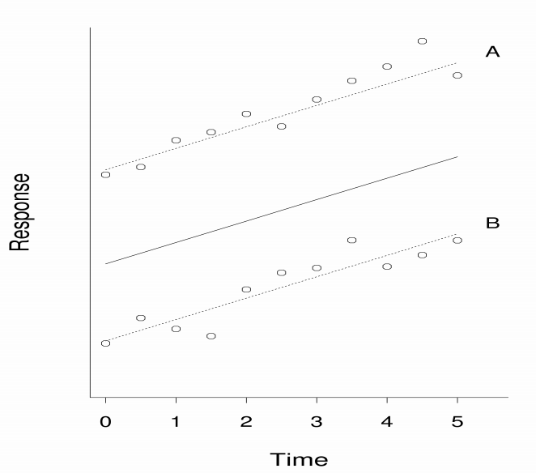
Mixed Effects Models – Random intercept
The observed responses for two randomly selected subjects A and B, incorporating measurement errors.

Slide 12
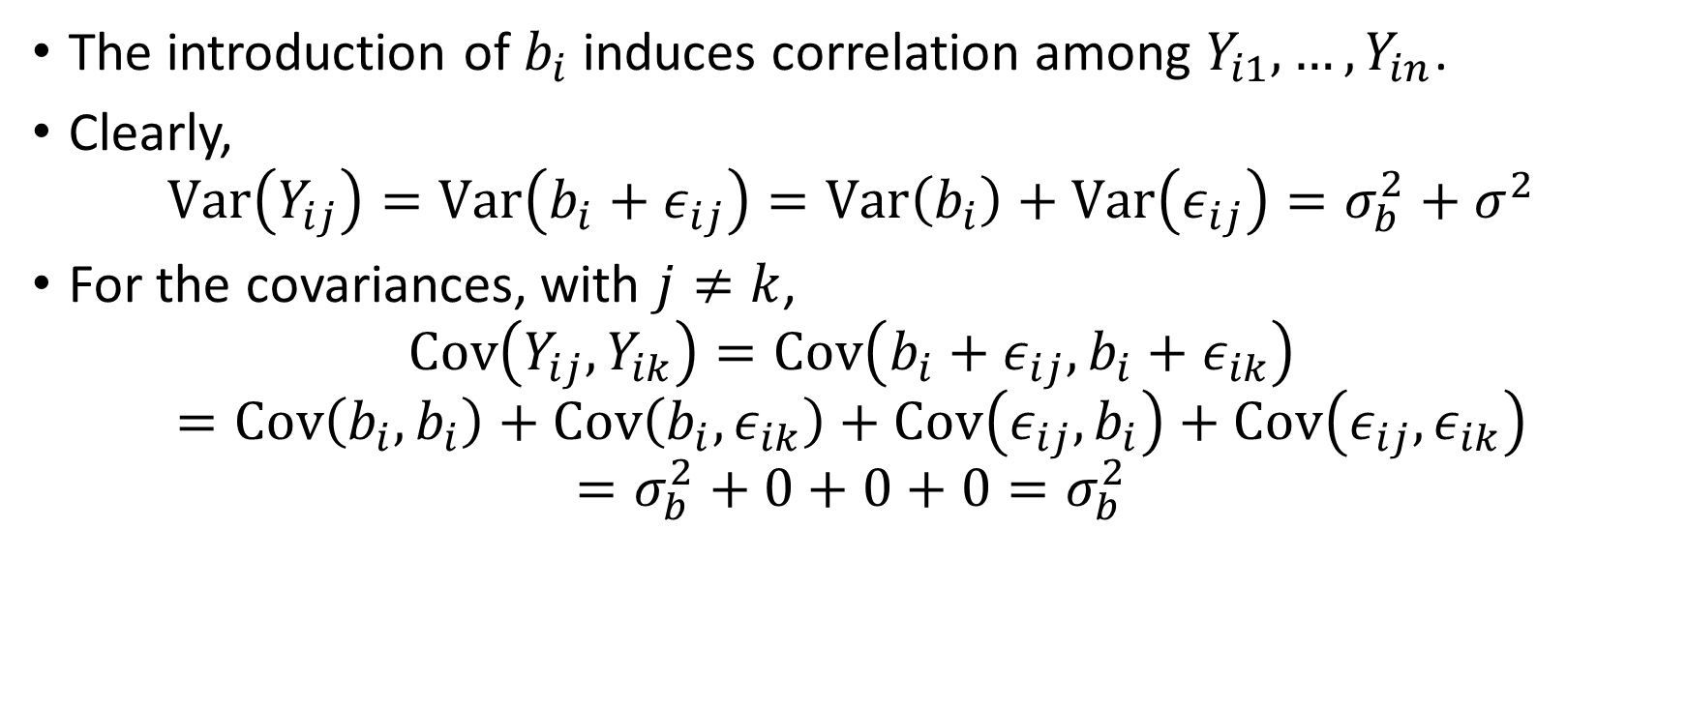
Mixed Effects Models – Random intercept
The introduction of $b_{i}$ induces correlation among $Y_{i1},…, Y_{in}$.
Clearly,
$$Var\left(Y_{ij}\right)=Var\left(b_{i}+ε_{ij}\right)=Var\left(b_{i}\right)+Var\left(ε_{ij}\right)=σ_{b}^{2}+σ^{2}$$
For the covariances, with $j≠k$,
$$Cov\left(Y_{ij}, Y_{ik}\right)=Cov\left(b_{i}+ε_{ij},b_{i}+ε_{ik}\right)$$
$$=Cov\left(b_{i},b_{i}\right)+Cov\left(b_{i},ε_{ik}\right)+Cov\left(ε_{ij},b_{i}\right)+Cov\left(ε_{ij},ε_{ik}\right)$$
$$=σ_{b}^{2}+0+0+0=σ_{b}^{2}$$
PHS 651 / Lecture 10
12 / 32

Slide 13
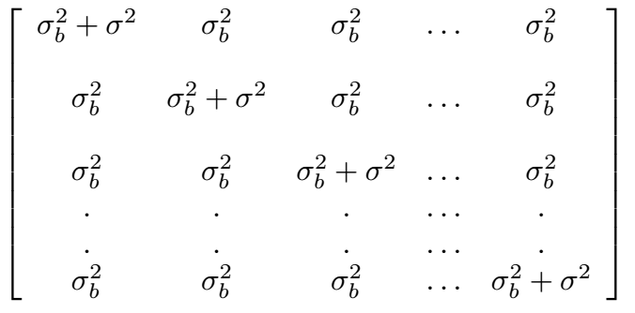

Mixed Effects Models – Random intercept
The covariance matrix of $Y_{i1},…, Y_{in}$has the compound symmetry form:
PHS 651 / Lecture 10
13 / 32

Slide 14
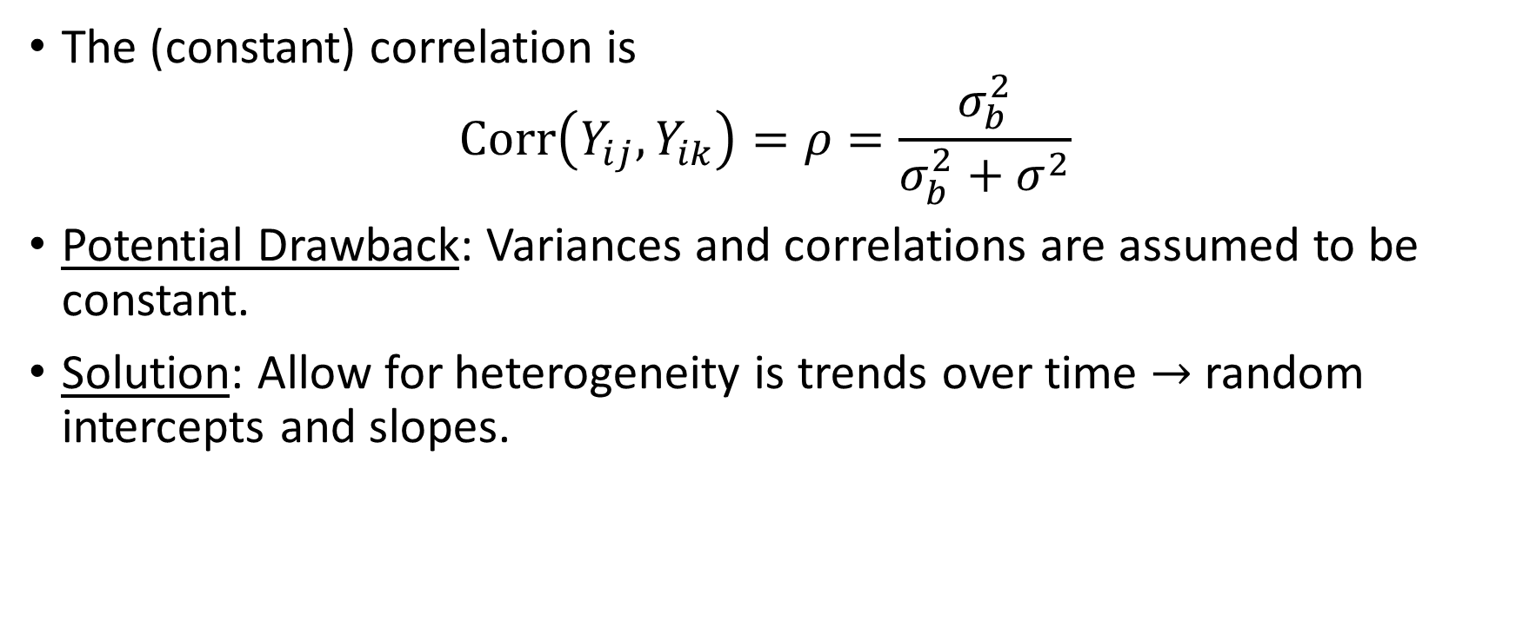
Mixed Effects Models – Random intercept
The (constant) correlation is
$$Corr\left(Y_{ij}, Y_{ik}\right)=ρ=\frac{σ_{b}^{2}}{σ_{b}^{2}+σ^{2}}$$
Potential Drawback: Variances and correlations are assumed to be constant.
Solution: Allow for heterogeneity is trends over time $→$ random intercepts and slopes.
PHS 651 / Lecture 10
14 / 32

Slide 15
Mixed Effects Models – Randomintercept and slopes
Consider a model with intercepts and slopes that vary randomly among individuals:
This model posits that individuals vary not only in their baseline level of response but also in terms of their changes in the response over time.
The effects of covariates (e.g., treatments, exposures) can be
incorporated by allowing mean of intercepts and slopes to depend on
covariates.
PHS 651 / Lecture 10
15 / 32

Slide 16
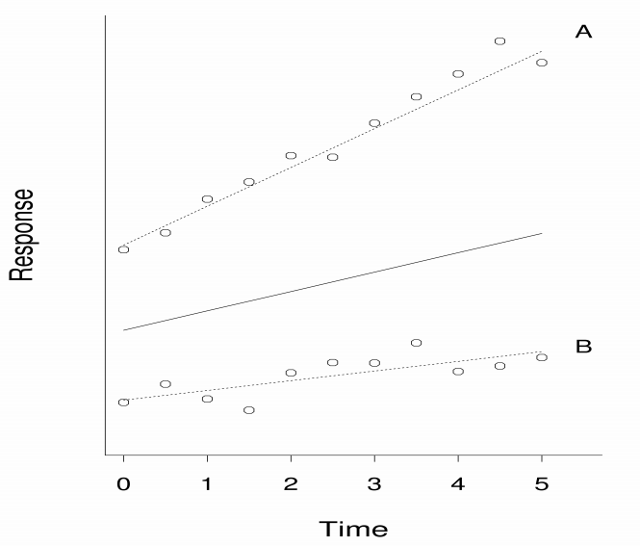
Mixed Effects Models – Randomintercept and slopes
PHS 651 / Lecture 10
16 / 32

Slide 17
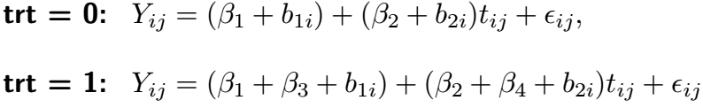

Mixed Effects Models – Randomintercept and slopes
For example, consider two-group study:
The model can be re-expressed as follows for the control group ($trt_{i}=0$) and treatment group ($trt_{i}=1$) respectively:
PHS 651 / Lecture 10
17 / 32

Slide 18
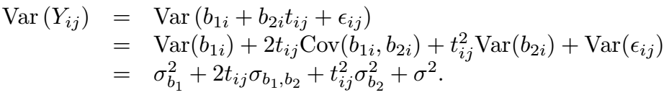
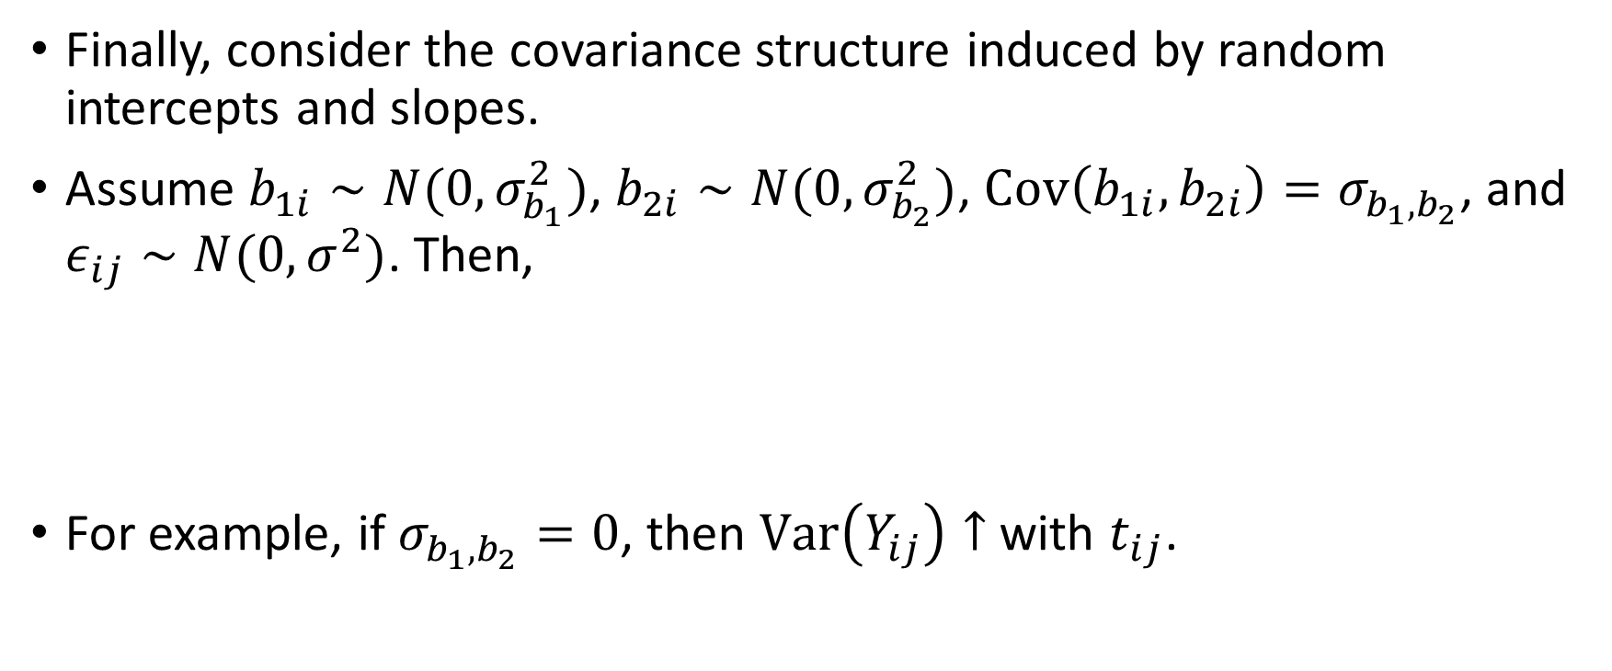
Mixed Effects Models – Randomintercept and slopes
Finally, consider the covariance structure induced by random intercepts and slopes.
Assume $b_{1i}∼N(0,σ_{b_{1}}^{2})$, $b_{2i}∼N(0,σ_{b_{2}}^{2})$, $Cov\left(b_{1i},b_{2i}\right)=σ_{b_{1},b_{2}}$, and $ε_{ij}∼N(0,σ^{2})$. Then,
For example, if $σ_{b_{1},b_{2}}=0$, then $Var\left(Y_{ij}\right)↑$ with $t_{ij}$.
PHS 651 / Lecture 10
18 / 32

Slide 19
Mixed Effects Models – Randomintercept and slopes
Similarly, it can be shown that
Thus, the variances and correlations (covariances) are expressed as explicit functions of time.
Random effects can be applied to any subset of the regression parameters. But typically include only time-varying variables (terms related to time trend).
PHS 651 / Lecture 10
19 / 32

Slide 20


Mixed Effects Models
Using vector notation, the linear mixed effects model can be expressed as
Note: Components of $Z_{ij}$are a subset of the covariate in $X_{ij}.$
For the model considered earlier:
PHS 651 / Lecture 10
20 / 32

Slide 21
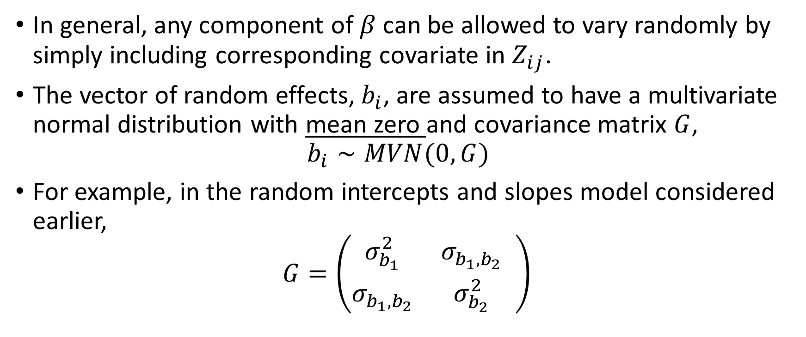
Mixed Effects Models
In general, any component of $β$can be allowed to vary randomly by simply including corresponding covariate in $Z_{ij}$.
The vector of random effects, $b_{i}$, are assumed to have a multivariate normal distribution with mean zero and covariance matrix $G$,
$b_{i}∼MVN(0, G)$
For example, in the random intercepts and slopes model considered earlier,
$$G=\left(\begin{matrix}σ_{b_{1}}^{2} & σ_{b_{1},b_{2}} \\ σ_{b_{1},b_{2}} & σ_{b_{2}}^{2}\end{matrix} \right)$$
PHS 651 / Lecture 10
21 / 32

Slide 22
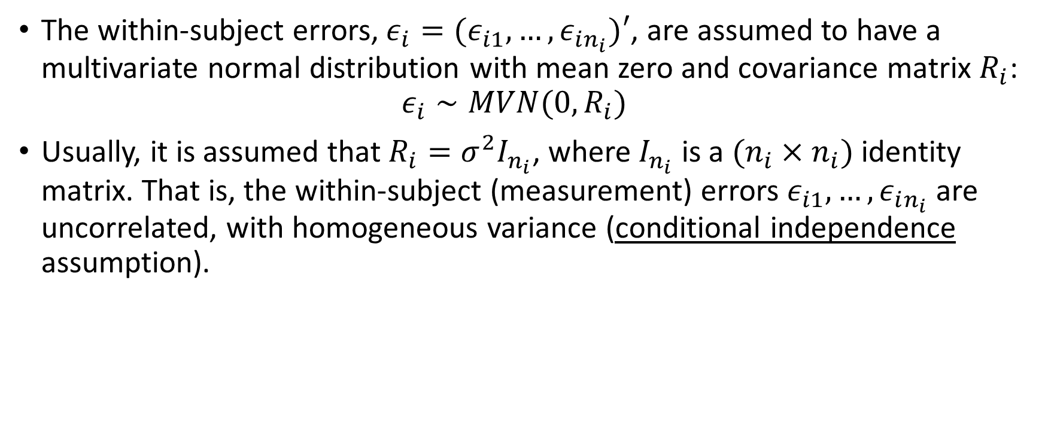
Mixed Effects Models
The within-subject errors,$ε_{i}=(ε_{i1},…, ε_{in_{i}})′$, are assumed to have a multivariate normal distribution with mean zero and covariance matrix $R_{i}$:
$ε_{i}∼MVN(0, R_{i})$
Usually, it is assumed that $R_{i}={σ^{2}I}_{n_{i}}$, where $I_{n_{i}}$is a $(n_{i}×n_{i})$ identity
matrix. That is, the within-subject (measurement) errors $ε_{i1},…, ε_{in_{i}}$ are uncorrelated, with homogeneous variance (conditional independenceassumption).
PHS 651 / Lecture 10
22 / 32

Slide 23
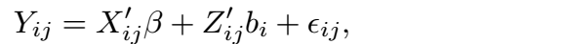


Mixed Effects Models – Conditional and marginal
In the linear mixed effects model,
there is an important distinction between the conditional mean
and the marginal mean
The former describes the mean response for an individual, the latter
describes the mean response averaged over individuals.
PHS 651 / Lecture 10
23 / 32

Slide 24

Mixed Effects Models – Conditional and marginal
PHS 651 / Lecture 10
24 / 32

Slide 25
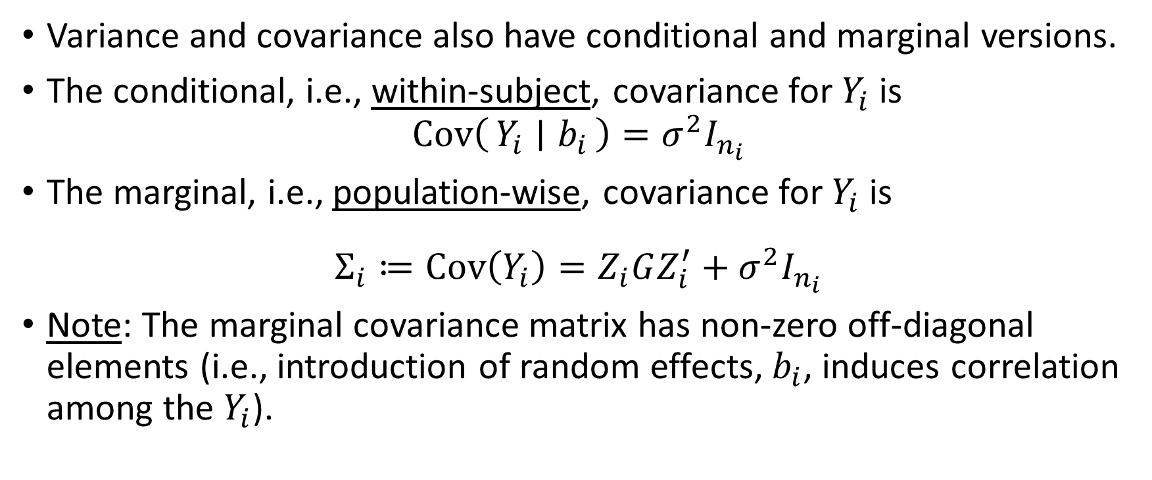
Mixed Effects Models –Conditional and marginal
Variance and covariance also have conditional and marginal versions.
The conditional, i.e., within-subject, covariance for $Y_{i}$ is
$$Cov\left(Y_{i} ∣ b_{i}\right)=σ^{2}I_{n_{i}}$$
The marginal, i.e., population-wise, covariance for $Y_{i}$ is
$$Σ_{i}≔Cov\left(Y_{i}\right)=Z_{i}GZ_{i}^{′}+σ^{2}I_{n_{i}}$$
Note: The marginal covariance matrix has non-zero off-diagonal elements (i.e., introduction of random effects, $b_{i}$, induces correlation among the $Y_{i}$).
PHS 651 / Lecture 10
25 / 32

Slide 26



Mixed Effects Models
Linear Mixed Effects Models vs General Linear Model
In matrix form,
General Linear:
$$Y_{i}=X_{i}β+e_{i}$$
$${Σ_{i}≔Cov(Y}_{i})$$
Linear Mixed Effects:
$$Y_{i}=X_{i}β+Z_{i}b_{i}{+ε}_{i}$$
Mean (fixed effects) model
PHS 651 / Lecture 10
26 / 32

Slide 27
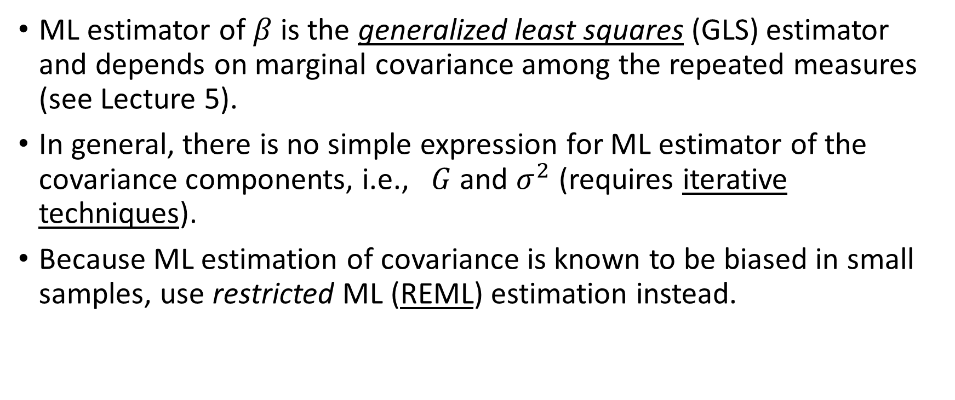
Mixed Effects Models – Estimation
ML estimator of $β$is the generalized least squares(GLS) estimator and depends on marginal covariance among the repeated measures (see Lecture 5).
In general, there is no simple expression for ML estimator of the covariance components, i.e., $G$ and $σ^{2}$ (requires iterative techniques).
Because ML estimation of covariance is known to be biased in small samples, use restricted ML (REML) estimation instead.
PHS 651 / Lecture 10
27 / 32

Slide 28
Example: Exercise Therapy Trial
Subjects were assigned to one of two weightlifting programs to increase muscle strength.
  treatment 1: number of repetitions of the exercises was increased as
  subjects became stronger.
  treatment 2: number of repetitions was held constant but amount of weight was increased as subjects became stronger.
Measurements of body strength were taken at baseline and on days 2, 4, 6, 8, 10, and 12.
We focus only on measures of strength obtained at baseline (or day 0)
and on days 4, 6, 8, and 12.
PHS 651 / Lecture 10
28 / 32

Slide 29
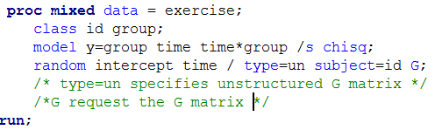
Example: Exercise Therapy Trial
Consider a linear trend model with intercepts and slopes that vary randomly among subjects.
PHS 651 / Lecture 10
29 / 32

Slide 30
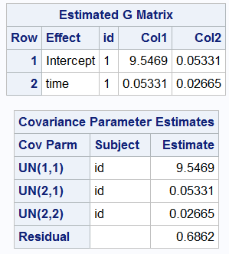
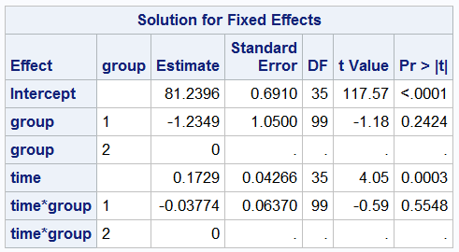
Example: Exercise Therapy Trial
PHS 651 / Lecture 10
30 / 32

Slide 31
Example: Exercise Therapy Trial
Based on the estimates of the fixed effects:
  the constant rate of increase in strength in group 1 is 0.173 per day
  the constant rate of increase in strength in group 2 is 0.135 (0.173 – 0.038) per day
  the difference between these two rates, – 0.038 (SE = 0.064) is not statistically significant
There does not appear to be differences between the two groups in their pattern of increase in strength.
PHS 651 / Lecture 10
31 / 32

Slide 32
Example: Exercise Therapy Trial
Based on the estimates of the fixed effects:
  the constant rate of increase in strength in group 1 is 0.173 per day
  the constant rate of increase in strength in group 2 is 0.135 (0.173 – 0.038) per day
  the difference between these two rates, – 0.038 (SE = 0.064) is not statistically significant
There does not appear to be differences between the two groups in their pattern of increase in strength.
PHS 651 / Lecture 10
32 / 32

