Slide 1
PHS 651 / LECTURE 11
Prediction in Mixed Effects Models
Advanced Regression Methods for Population Health
Lu Mao, PhD
Department of Biostatistics and Medical Informatics
University of Wisconsin-Madison
SPRING 2019

Slide 2
Outline
  Rationale for prediction of random effects
  The shrinkage estimator
  An Example with Exercise Therapy Trial
  An Example with MIT Growth and Development Study
PHS 651 / Lecture 11
2 / 27

Slide 3



Conditional and Marginal Means
Recall that in the linear mixed effects model,
we can distinguish between the conditional mean,
and the marginal mean,
The former describes the mean response for an individual, the latter
describes the mean response averaged over individuals.
PHS 651 / Lecture 11
3 / 27

Slide 4


Conditional and Marginal Means
Consider the (single-group) random intercepts and slopes model,
In this model, the conditional mean for an individualis
The marginal mean averaged over individualsis
PHS 651 / Lecture 11
4 / 27

Slide 5
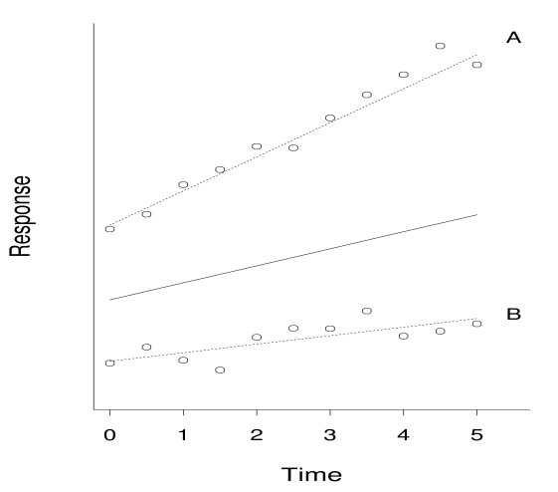
Conditional and Marginal Means
PHS 651 / Lecture 11
5 / 27

Slide 6
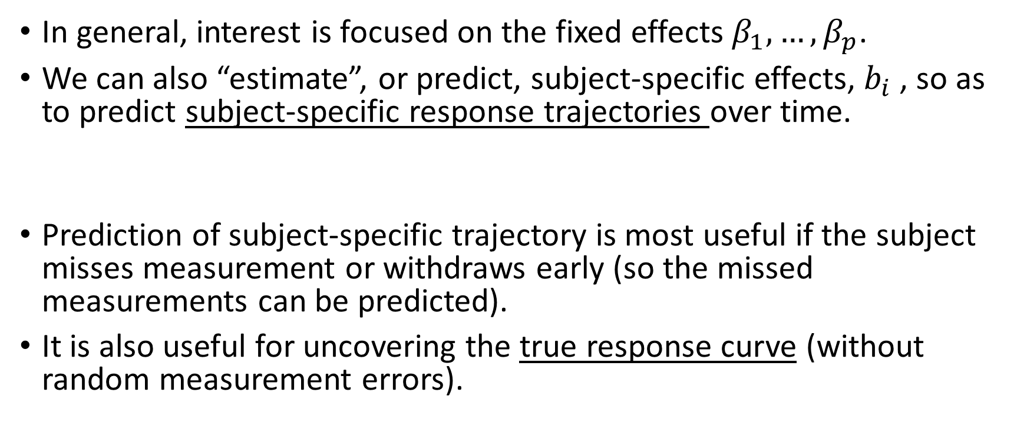
Prediction of Random Effects
In general, interest is focused on the fixed effects $β_{1},…, β_{p}$.
We can also “estimate”, or predict, subject-specific effects, $b_{i}$, so as to predictsubject-specific response trajectories over time.
Prediction of subject-specific trajectory is most useful if the subject misses measurement or withdraws early (so the missed measurements can be predicted).
It is also useful for uncovering the true response curve (without random measurement errors).
PHS 651 / Lecture 11
6 / 27

Slide 7
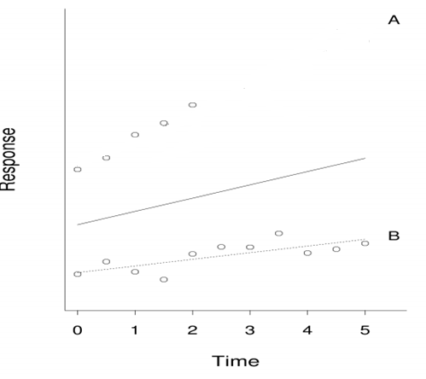
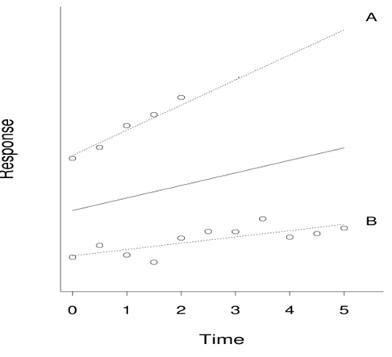
Prediction of Random Effects
PHS 651 / Lecture 11
7 / 27

Slide 8
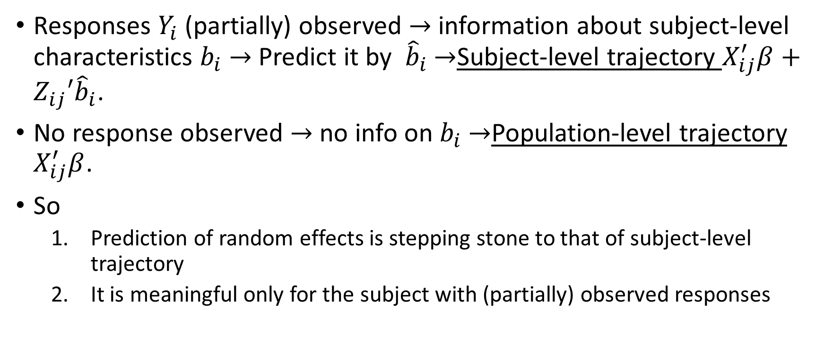
Prediction of Random Effects
Responses $Y_{i}$ (partially) observed $→$ information about subject-level characteristics $b_{i}$$→$ Predict it by ${\hat{b}}_{i}$$→$Subject-level trajectory $X_{ij}^{′}β+Z_{ij}′{\hat{b}}_{i}$.
No response observed$→$ no info on $b_{i}$$→$Population-level trajectory $X_{ij}^{′}β$.
So
  Prediction of random effects is stepping stone to that of subject-level trajectory
  It is meaningful only for the subject with (partially) observed responses
PHS 651 / Lecture 11
8 / 27

Slide 9

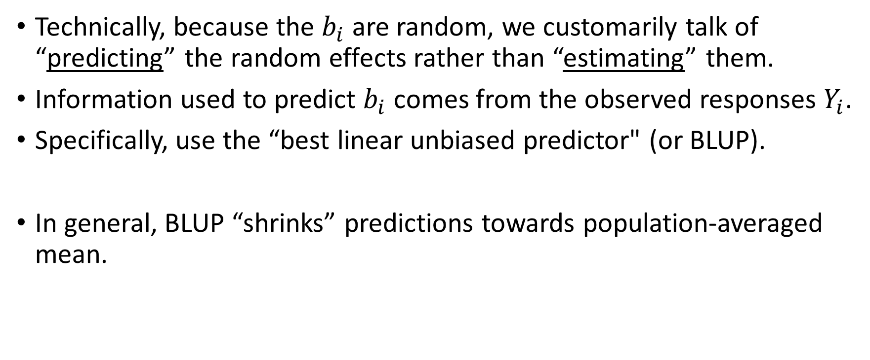
Prediction of Random Effects
Technically, because the $b_{i}$are random, we customarily talk of “predicting” the random effects rather than “estimating” them.
Information used to predict $b_{i}$ comes from the observed responses $Y_{i}$.
Specifically, use the “best linear unbiased predictor" (or BLUP).
In general, BLUP “shrinks” predictions towards population-averaged mean.
PHS 651 / Lecture 11
9 / 27

Slide 10
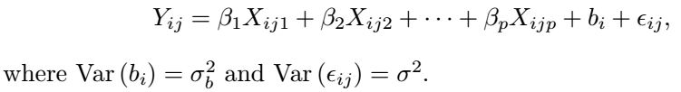
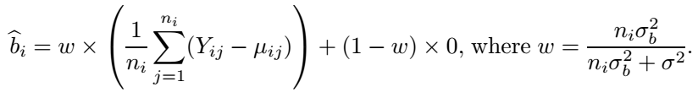
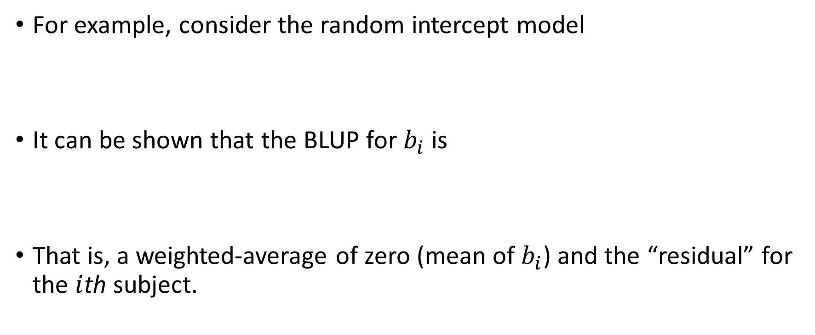
Prediction of Random Effects
For example, consider the random intercept model
It can be shown that the BLUP for $b_{i}$ is
That is, a weighted-average of zero (mean of $b_{i}$) and the “residual” for the $i$thsubject.
PHS 651 / Lecture 11
10 / 27

Slide 11
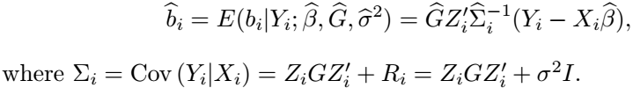
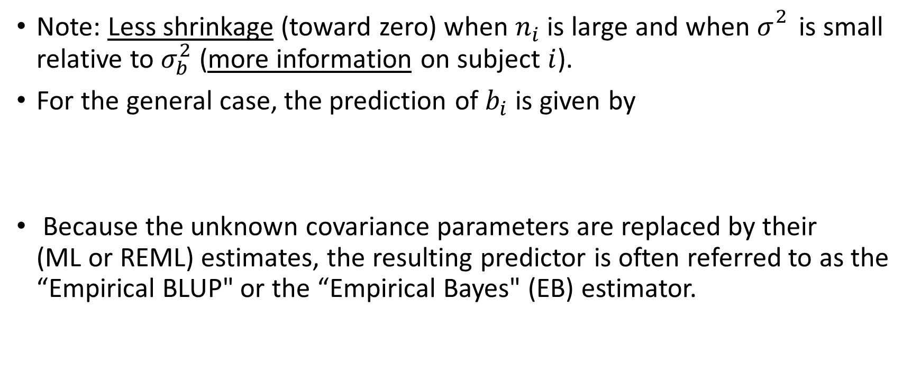
Prediction of Random Effects
Note: Less shrinkage (toward zero) when $n_{i}$is large and when $σ_{}^{2}$ is small relative to $σ_{b}^{2}$ (more information on subject $i$).
For the general case, the prediction of $b_{i}$is given by
Because the unknown covariance parameters are replaced by their
(ML or REML) estimates, the resulting predictor is often referred to as the
“Empirical BLUP" or the “Empirical Bayes" (EB) estimator.
PHS 651 / Lecture 11
11 / 27

Slide 12
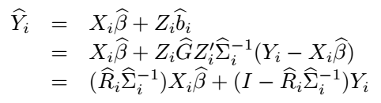
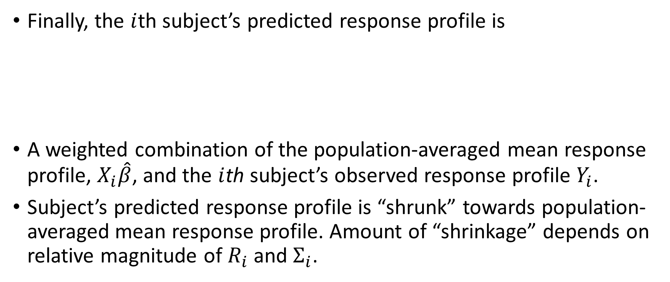
Prediction of Random Effects
Finally, the $i$thsubject’s predicted response profile is
A weighted combination of the population-averaged mean response profile, $X_{i}\hat{β}$, and the $i$thsubject’s observed response profile $Y_{i}$.
Subject’s predicted response profile is “shrunk” towards population-averaged mean response profile. Amount of “shrinkage” depends on relative magnitude of $R_{i}$and $Σ_{i}$.
PHS 651 / Lecture 11
12 / 27

Slide 13


Prediction of Random Effects
When within-subject variability is large relative to between-subject
variability, more weight is given to $X_{i}β$, the population-averaged mean response profile (more “shrinkage”).
PHS 651 / Lecture 11
13 / 27

Slide 14
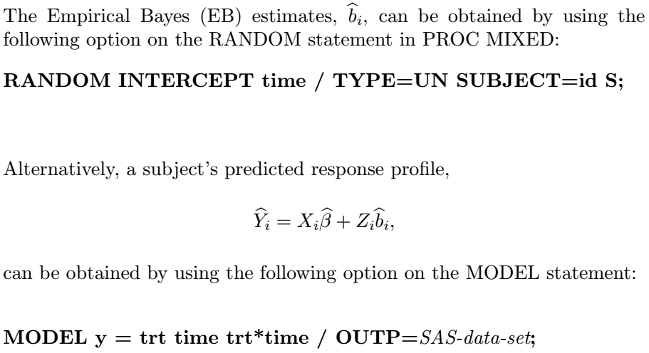
Prediction of Random Effects
PHS 651 / Lecture 11
14 / 27

Slide 15
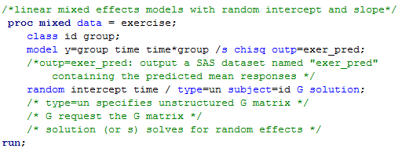
Example: Exercise Therapy Trial
Consider the same model studied in Lecture 10
PHS 651 / Lecture 11
15 / 27

Slide 16
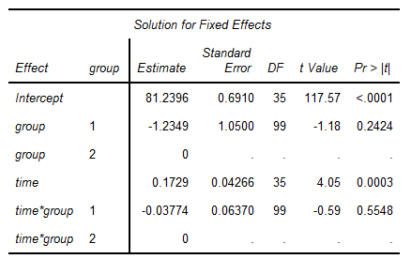
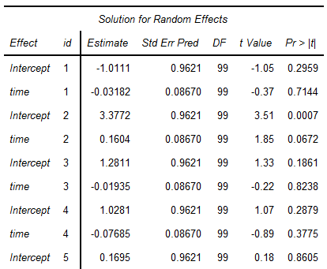
Example: Exercise Therapy Trial
PHS 651 / Lecture 11
16 / 27

Slide 17
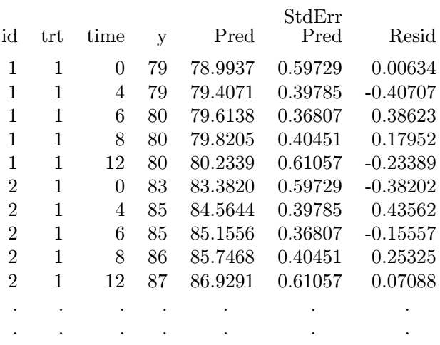
Example: Exercise Therapy Trial
PHS 651 / Lecture 11
17 / 27

Slide 18
Example: Influence of Menarche on Body Fat
Prospective study on body fat accretion in a cohort of 162 girls from the
MIT Growth and Development Study.
At start of study, all the girls were pre-menarcheal and non-obese.
They were followed over time according to a schedule of annual
measurements until four years after menarche.
The final measurement was scheduled on the fourth anniversary of their
reported date of menarche.
At each examination, a measure of body fatness was obtained based on
bioelectric impedance analysis.
PHS 651 / Lecture 11
18 / 27

Slide 19
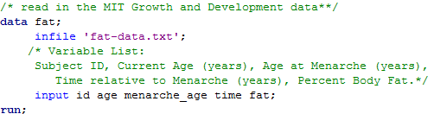
Example: Influence of Menarche on Body Fat
Consider an analysis of the changes in percent body fat before and after menarche.
Time is coded as time since menarche and can be positive or negative, making the data inherently unbalanced.
PHS 651 / Lecture 11
19 / 27

Slide 20
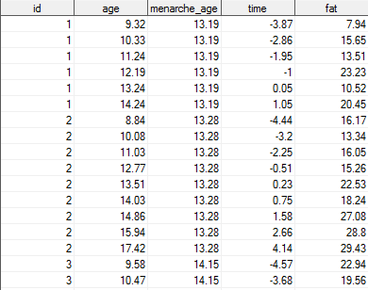
Example: Influence of Menarche on Body Fat
PHS 651 / Lecture 11
20 / 27

Slide 21
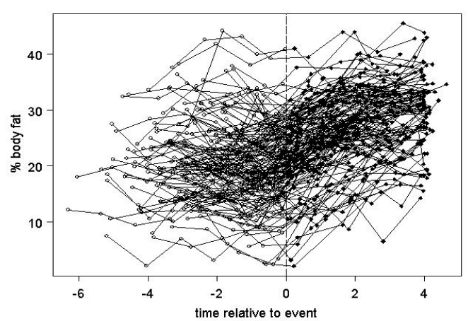
Example: Influence of Menarche on Body Fat
PHS 651 / Lecture 11
21 / 27

Slide 22
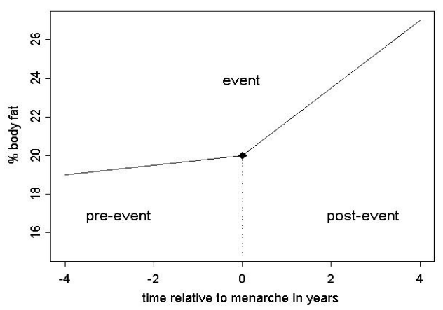
Example: Influence of Menarche on Body Fat
The null hypothesis is that the pattern of change in percent body fat remains the same before and after menarche.
The simplest way to test the null hypothesis is to use a piecewise linear model, with a knot at time zero (time of menarche).

Slide 23
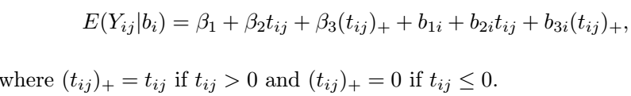
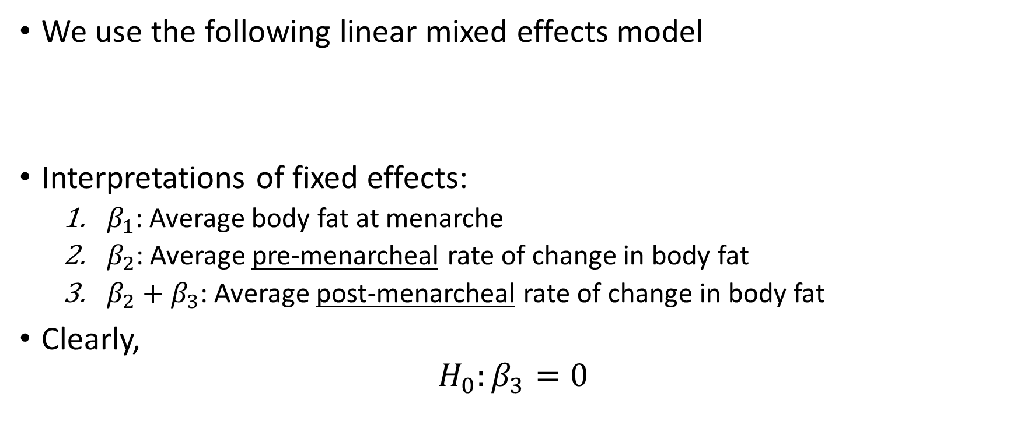
Example: Influence of Menarche on Body Fat
We use the following linear mixed effects model
Interpretations of fixed effects:
  $β_{1}$: Average body fat at menarche
  $β_{2}$: Average pre-menarcheal rate of change in body fat
  $β_{2}+β_{3}$: Average post-menarchealrate of change in body fat
Clearly,
$$H_{0}:β_{3}=0$$
PHS 651 / Lecture 11
23 / 27

Slide 24
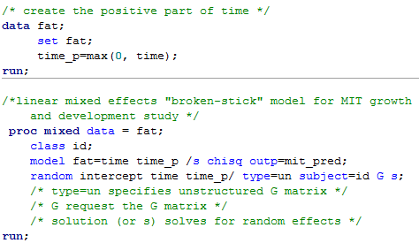
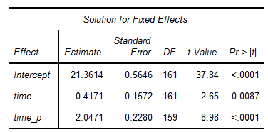
Example: Influence of Menarche on Body Fat
PHS 651 / Lecture 11
24 / 27

Slide 25
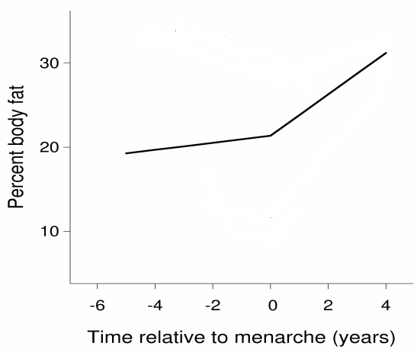
Example: Influence of Menarche on Body Fat
PHS 651 / Lecture 11
25 / 27

Slide 26
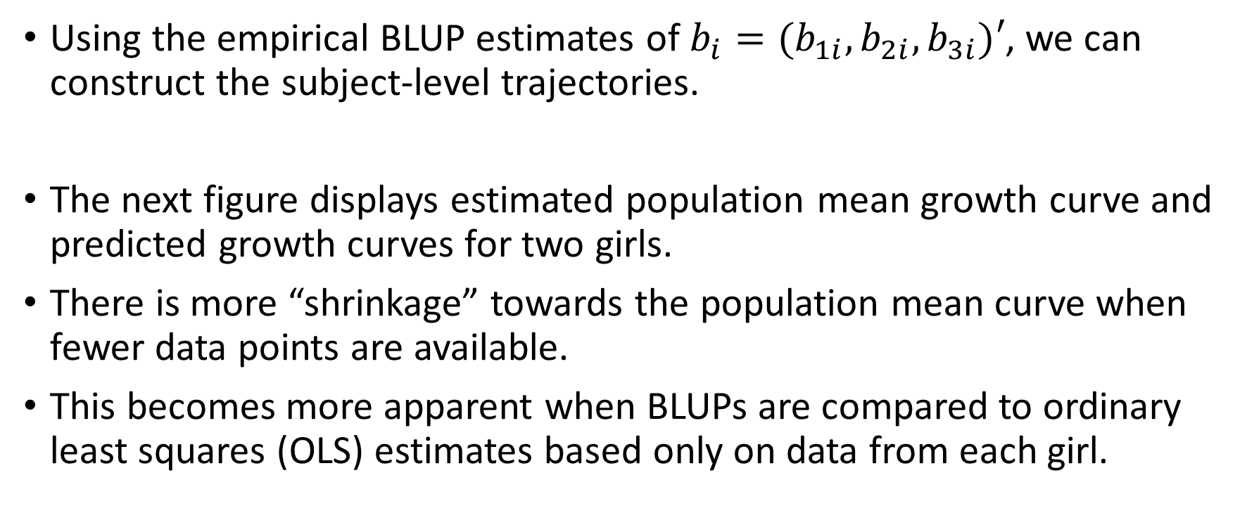
Example: Influence of Menarche on Body Fat
Using the empirical BLUP estimates of $b_{i}=(b_{1i}, b_{2i}, b_{3i})′$, we can construct the subject-level trajectories.
The next figure displays estimated population mean growth curve and predicted growth curves for two girls.
There is more “shrinkage” towards the population mean curve when fewer data points are available.
This becomes more apparent when BLUPs are compared to ordinary least squares (OLS) estimates based only on data from each girl.
PHS 651 / Lecture 11
26 / 27

Slide 27
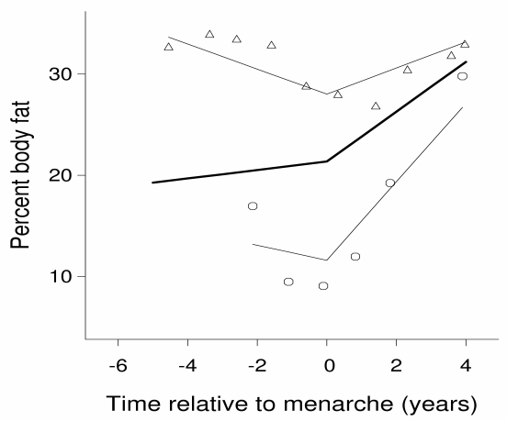
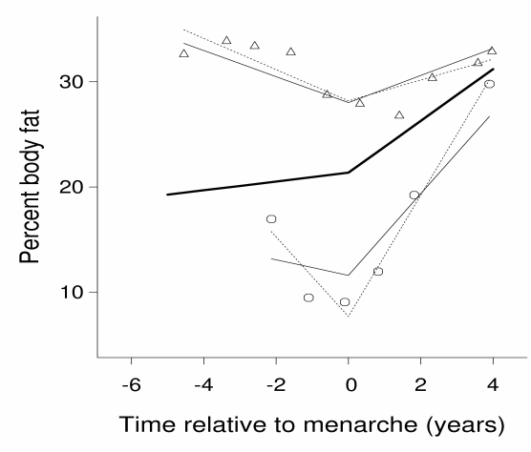
Example: Influence of Menarche on Body Fat
PHS 651 / Lecture 11
27 / 27

