Slide 1
PHS 651 / LECTURE 12
Design of Longitudinal Studies
Advanced Regression Methods for Population Health
Lu Mao, PhD
Department of Biostatistics and Medical Informatics
University of Wisconsin-Madison
SPRING 2019

Slide 2
Outline
  Type I, Type II errors and power
  Sample size calculation for a univariate response
  Sample size calculation for longitudinal studies
  An example
PHS 651 / Lecture 12
2 / 27

Slide 3
Sample Size and Power
Investigators typically ask the following question:
“How large should my study be to test my hypothesis?”
Straightforward with only a single, univariate response: the size of a study = sample size.
For a longitudinal study, the question of size is more complex,
e.g., number of subjects, duration of study, frequency and spacing of
repeated measurements on the subjects.
We first review sample size/power formulas for a univariate response.
PHS 651 / Lecture 12
3 / 27

Slide 4
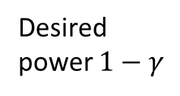


Sample Size and Power
Statistical power: the probability that the test will reject the null hypothesis under the alternative hypothesis (typically desired at the levels of 80% or 90%).
Sample size is calculated based on the alternative hypothesis (under a hypothesized effect size) and the desired power.
Effect size $δ$
Sample size $n$
Desired power $1−γ$
PHS 651 / Lecture 12
4 / 27

Slide 5
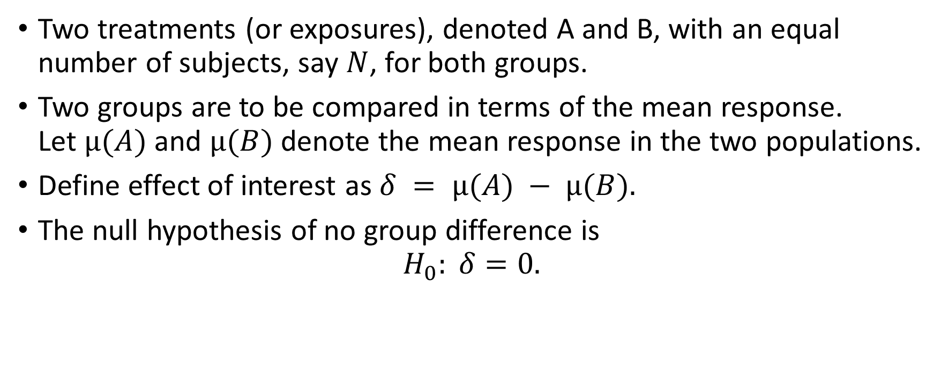
Sample Size for a Univariate Response
Two treatments (or exposures), denoted A and B, with an equal number of subjects, say $N$, for both groups.
Two groups are to be compared in terms of the mean response.
Let $µ(A)$and $µ(B)$denote the mean response in the two populations.
Define effect of interest as $δ = µ(A) − µ(B).$
The null hypothesis of no group difference is
$H_{0}: δ=0.$
PHS 651 / Lecture 12
5 / 27

Slide 6
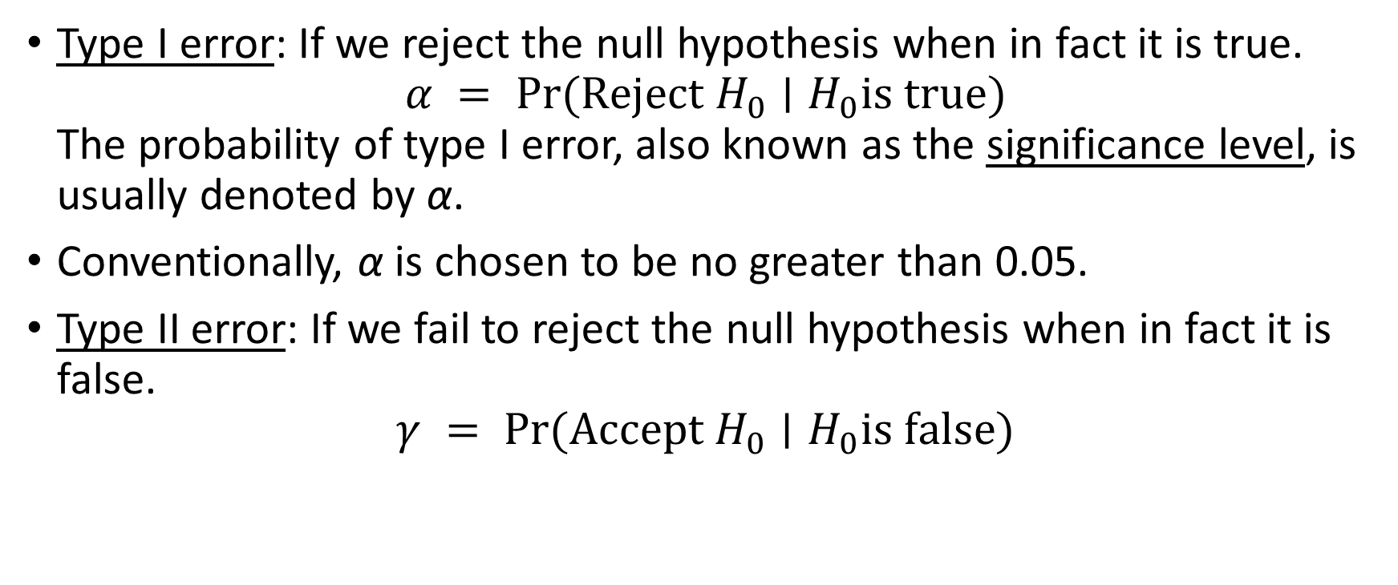
Type I and Type II Errors
Type I error: If we reject the null hypothesis when in fact it is true.
$α = Pr⁡(Reject H_{0}∣H_{0}is true)$
The probability of type I error, also known as the significance level, is
usually denoted by α.
Conventionally, α is chosen to be no greater than 0.05.
Type II error: If we fail to reject the null hypothesis when in fact it is false.
$$γ = Pr⁡(Accept H_{0}∣H_{0}is false)$$
PHS 651 / Lecture 12
6 / 27

Slide 7

Two-Group Sample Size Formula
Note: $γ$necessarily depends upon the particular choice of value for $δ ≠ 0$ under the alternative hypothesis.
Finally, power of test is
$$power = 1 − γ =\operatorname{Pr}\left(Reject H_{0} ∣ H_{0} is false\right).$$
PHS 651 / Lecture 12
7 / 27

Slide 8
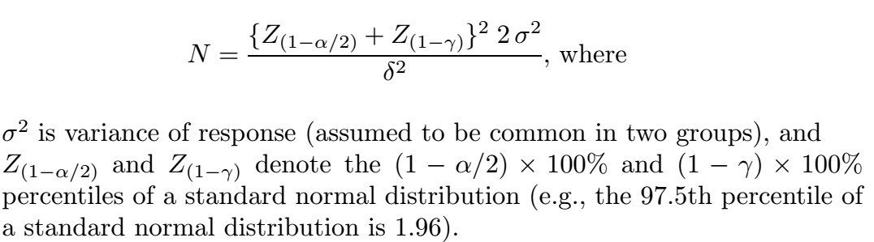

Two-Group Sample Size Formula
For two group comparison, a formula for approximate sample size in each group, $N$, is
PHS 651 / Lecture 12
8 / 27

Slide 9
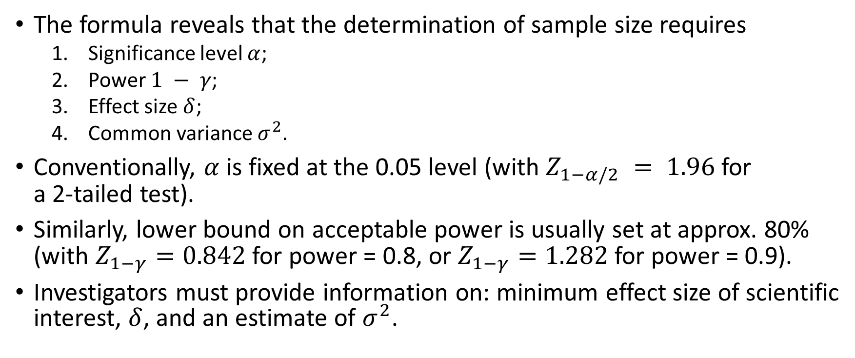
Two-Group Sample Size Formula
The formula reveals that the determination of sample size requires
  Significance level $α$;
  Power $1 − γ$;
  Effect size $δ$;
  Common variance $σ^{2}$.
Conventionally, $α$is fixed at the 0.05 level (with $Z_{1−α/2} = 1.96$for
a 2-tailed test).
Similarly, lower bound on acceptable power is usually set at approx. 80%
(with $Z_{1−γ}=0.842$for power = 0.8, or $Z_{1−γ}=1.282$for power = 0.9).
Investigators must provide information on: minimum effect size of scientific
interest, $δ$, and an estimate of $σ^{2}$.
PHS 651 / Lecture 12
9 / 27

Slide 10
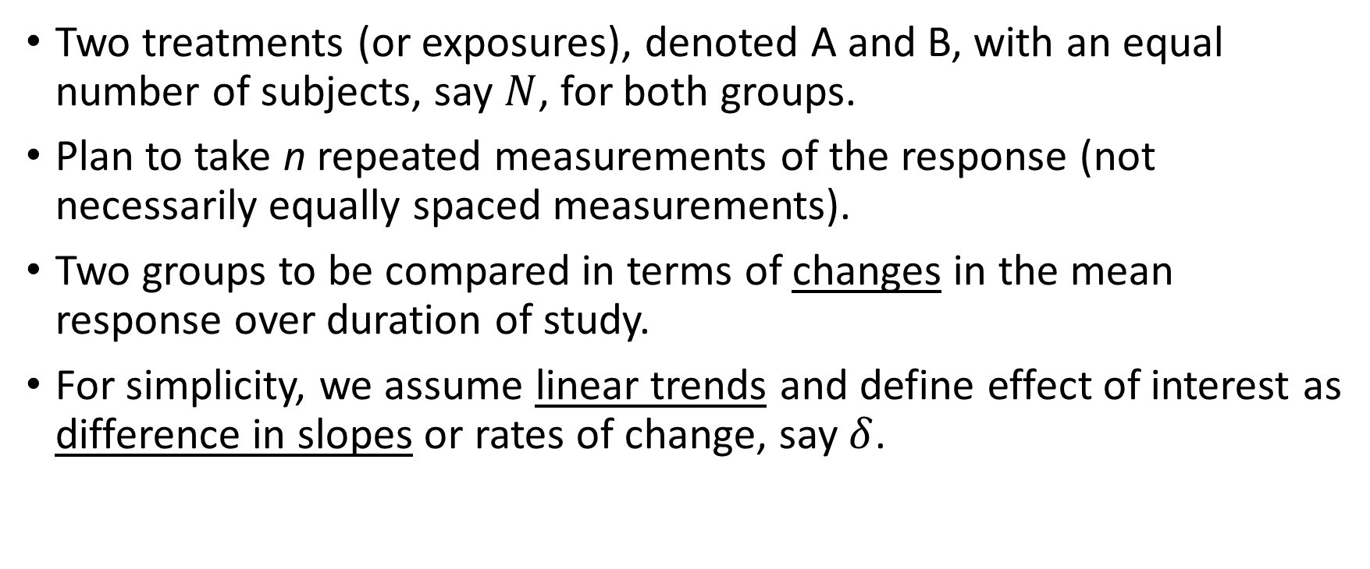
Sample Size for Longitudinal Response
Two treatments (or exposures), denoted A and B, with an equal number of subjects, say $N$, for both groups.
Plan to take n repeated measurements of the response (not necessarily equally spaced measurements).
Two groups to be compared in terms of changes in the mean response over duration of study.
For simplicity, we assume linear trends and define effect of interest as
difference in slopes or rates of change, say $δ$.
PHS 651 / Lecture 12
10 / 27

Slide 11
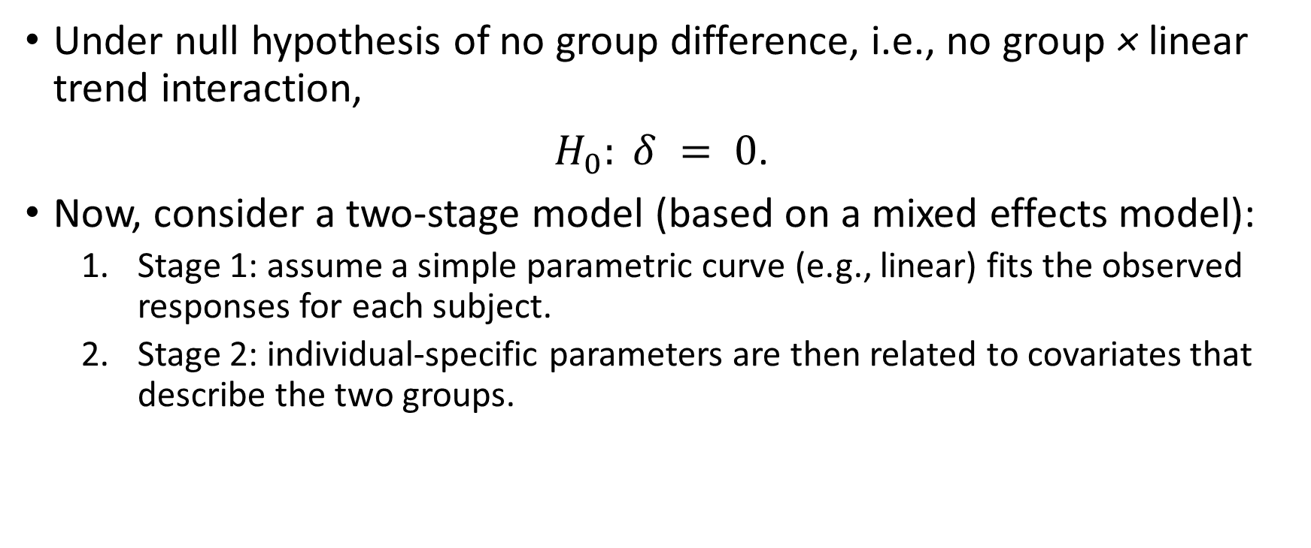
Sample Size for Longitudinal Response
Under null hypothesis of no group difference, i.e., no group × linear trend interaction,
$H_{0}: δ = 0$.
Now, consider a two-stage model (based on a mixed effects model):
  Stage 1: assume a simple parametric curve (e.g., linear) fits the observed
  responses for each subject.
  Stage 2: individual-specific parameters are then related to covariates that
  describe the two groups.
PHS 651 / Lecture 12
11 / 27

Slide 12
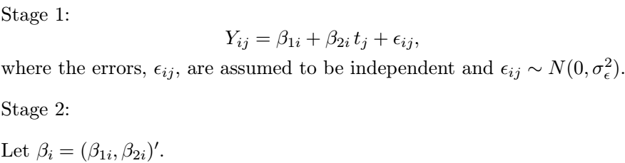
Sample Size for Longitudinal Response
PHS 651 / Lecture 12
12 / 27

Slide 13
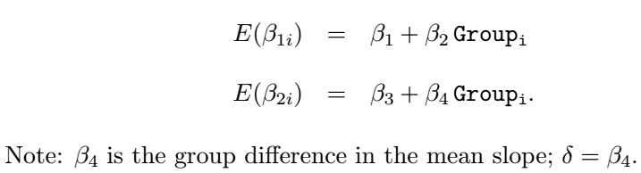

Sample Size for Longitudinal Response
Allow the mean of $β_{i}$(i.e., the mean intercept and slope) to depend on group,
PHS 651 / Lecture 12
13 / 27

Slide 14
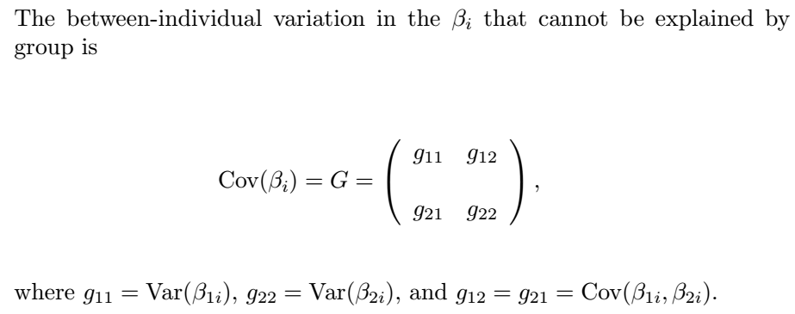
Sample Size for Longitudinal Response
PHS 651 / Lecture 12
14 / 27

Slide 15

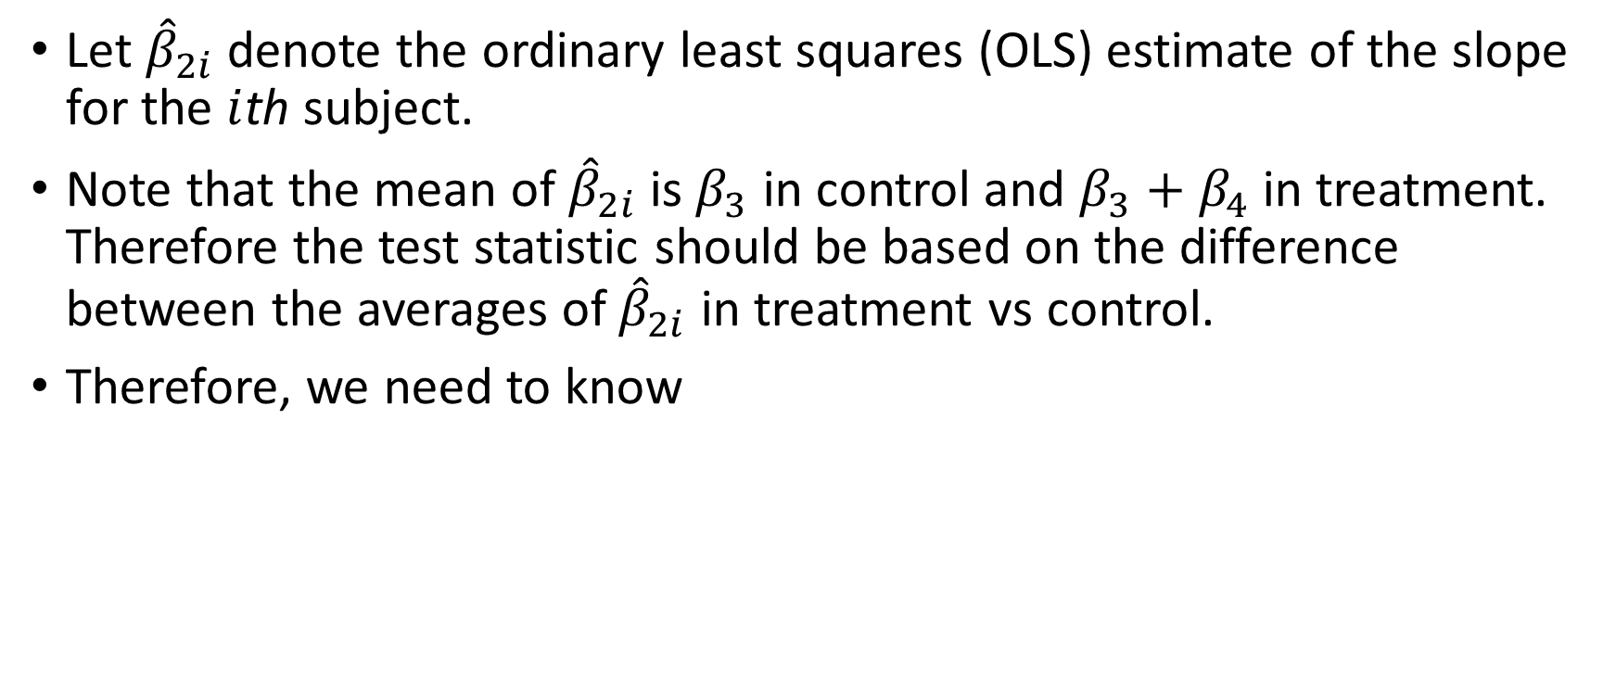
Sample Size for Longitudinal Response
Let ${\hat{β}}_{2i}$denote the ordinary least squares (OLS) estimate of the slope for the $i$thsubject.
Note that the mean of ${\hat{β}}_{2i}$ is $β_{3}$ in control and $β_{3}+β_{4}$ in treatment. Therefore the test statistic should be based on the difference between the averages of ${\hat{β}}_{2i}$ in treatment vs control.
Therefore, we need to know
PHS 651 / Lecture 12
15 / 27

Slide 16
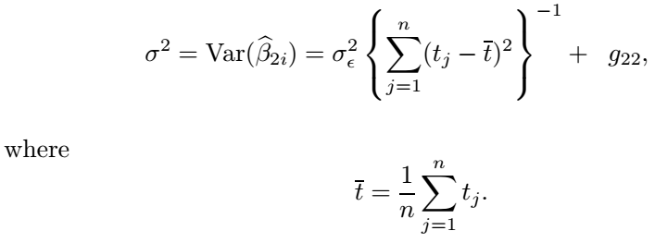

Sample Size for Longitudinal Response
Recall: Each subject is measured at common set of occasions $t_{1},…, t_{n}$.
The variance of ${\hat{β}}_{2i}$ is given by
PHS 651 / Lecture 12
16 / 27

Slide 17
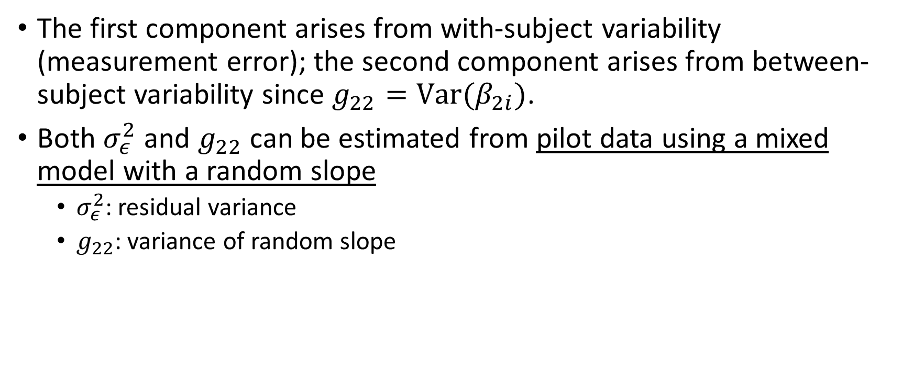
Sample Size for Longitudinal Response
The first component arises from with-subjectvariability (measurement error); the second component arises from between-subject variability since $g_{22}=Var(β_{2i})$.
Both $σ_{ε}^{2}$ and $g_{22}$ can be estimated from pilot data using a mixed model with a random slope
  $σ_{ε}^{2}$: residual variance
  $g_{22}$: variance of random slope
PHS 651 / Lecture 12
17 / 27

Slide 18
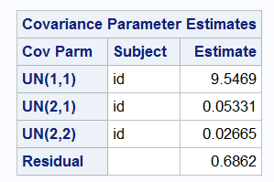


Sample Size for Longitudinal Response
Example: Suppose we want to plan another trial similar to the Exercise Therapy Trialstudied in Lecture 10.
Recall that we obtained the following estimates for the covariance parameters based on a linear-trend mixed effects model:
$$g_{22}$$
$$σ_{ε}^{2}$$
PHS 651 / Lecture 12
18 / 27

Slide 19
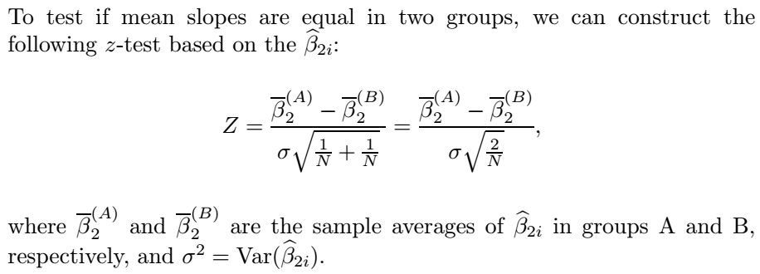
Sample Size for Longitudinal Response
PHS 651 / Lecture 12
19 / 27

Slide 20

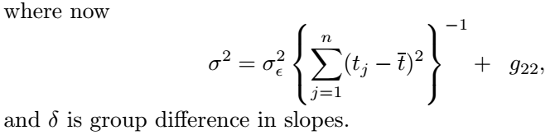

Sample Size for Longitudinal Response
Given estimates of $g_{22}$, the between-subject variability in slopes, and of $σ_{ε}^{2}$, the within-subject variability, the sample size can be determined from
PHS 651 / Lecture 12
20 / 27

Slide 21
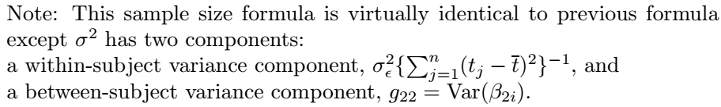
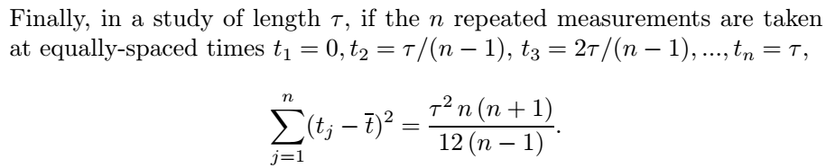
Sample Size for Longitudinal Response
PHS 651 / Lecture 12
21 / 27

Slide 22
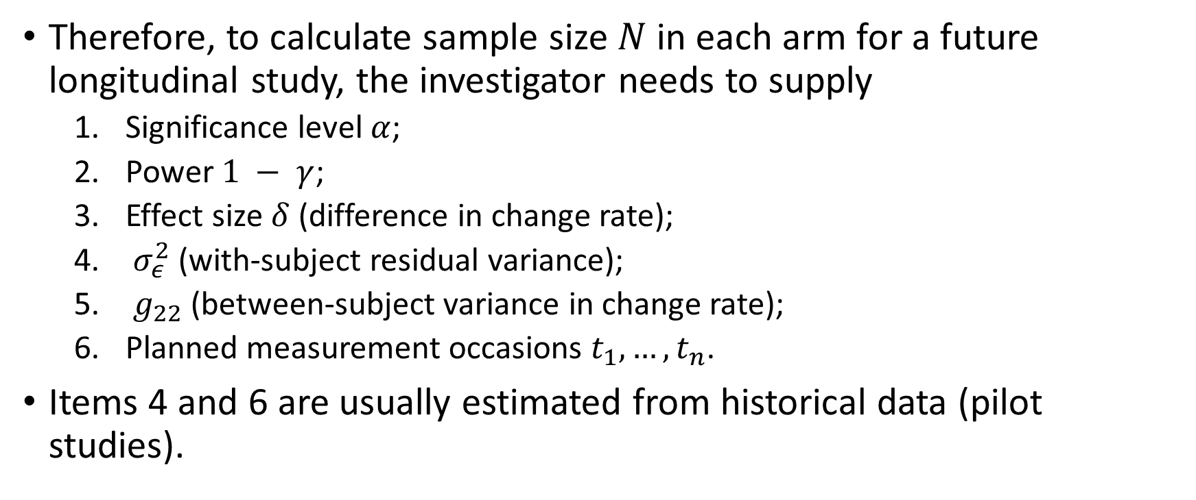
Sample Size for Longitudinal Response
Therefore, to calculate sample size $N$ in each arm for a future longitudinal study, the investigator needs to supply
  Significance level $α$;
  Power $1 − γ$;
  Effect size $δ$ (difference in change rate);
  $σ_{ε}^{2}$ (with-subject residual variance);
  $g_{22}$ (between-subject variance in change rate);
  Planned measurement occasions $t_{1},…, t_{n}$.
Items 4 and 6 are usually estimated from historical data (pilot studies).
PHS 651 / Lecture 12
22 / 27

Slide 23
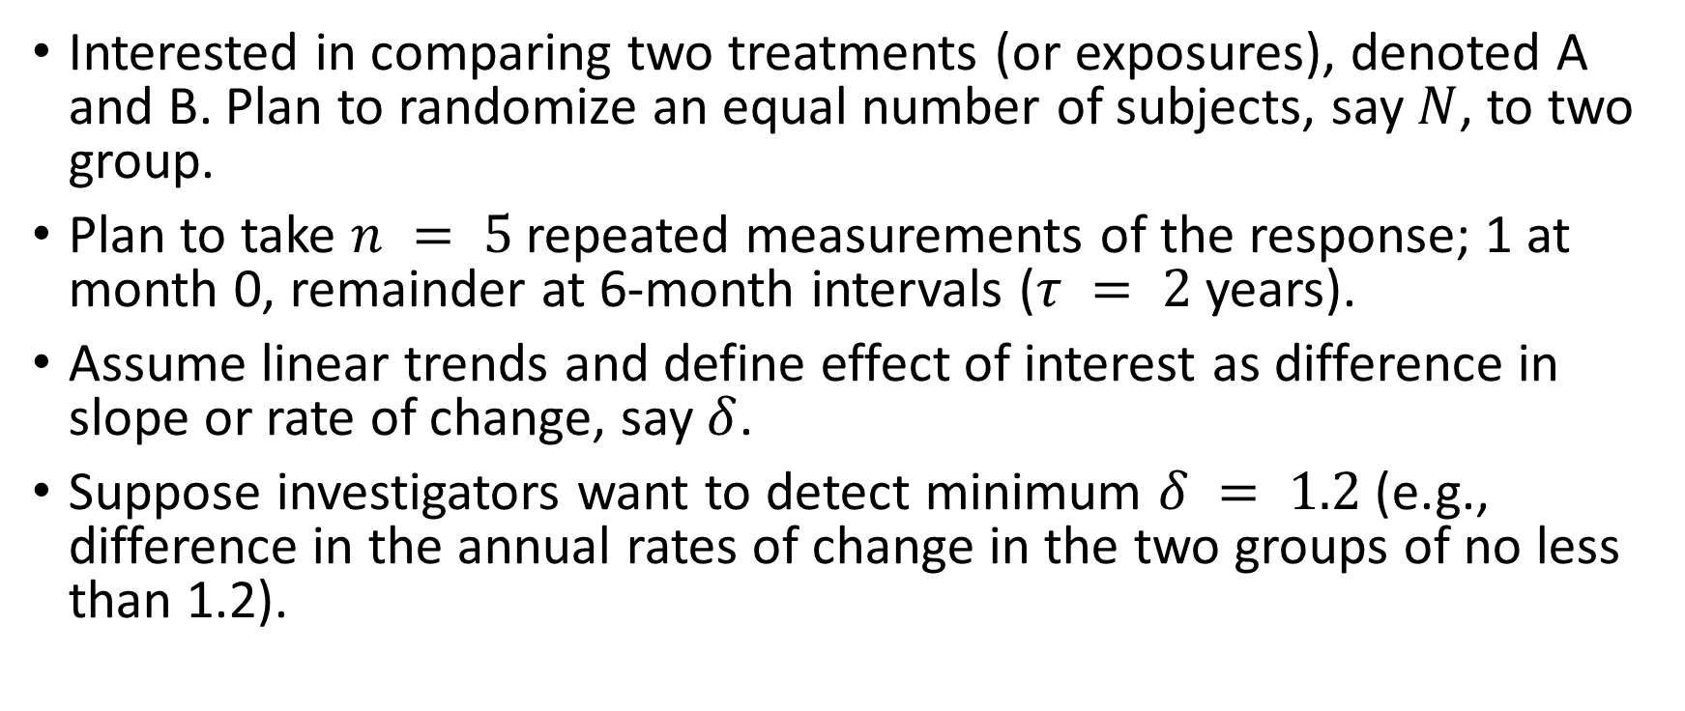
A Toy Example
Interested in comparing two treatments (or exposures), denoted A and B. Plan to randomize an equal number of subjects, say $N$, to two group.
Plan to take $n = 5$repeated measurements of the response; 1 at month 0, remainder at 6-month intervals ($τ = 2$years).
Assume linear trends and define effect of interest as difference in slope or rate of change, say $δ$.
Suppose investigators want to detect minimum $δ = 1.2$(e.g., difference in the annual rates of change in the two groups of no less than 1.2).
PHS 651 / Lecture 12
23 / 27

Slide 24
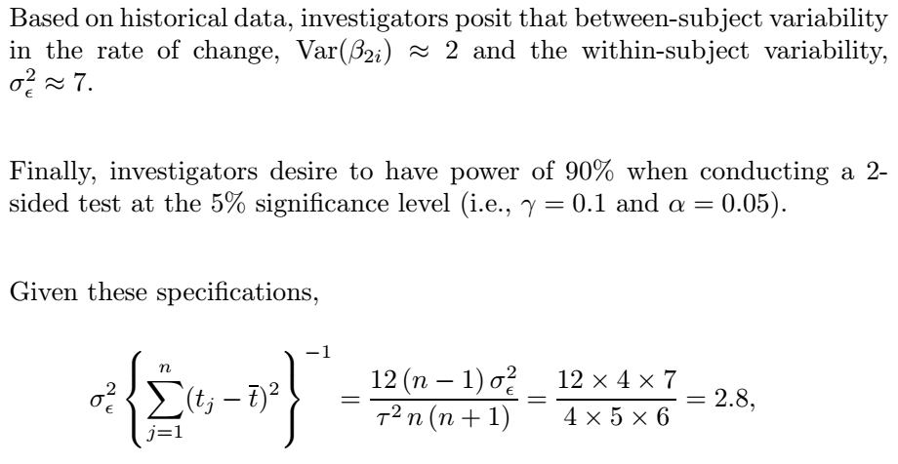
A Toy Example

Slide 25
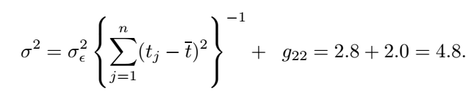

A Toy Example
Therefore,
The sample size needed in each group is
Thus, to ensure power of at least 90%, investigators will need to enroll atotal of 142 subjects, randomizing an equal number (71) to each group.
PHS 651 / Lecture 12
25 / 27

Slide 26
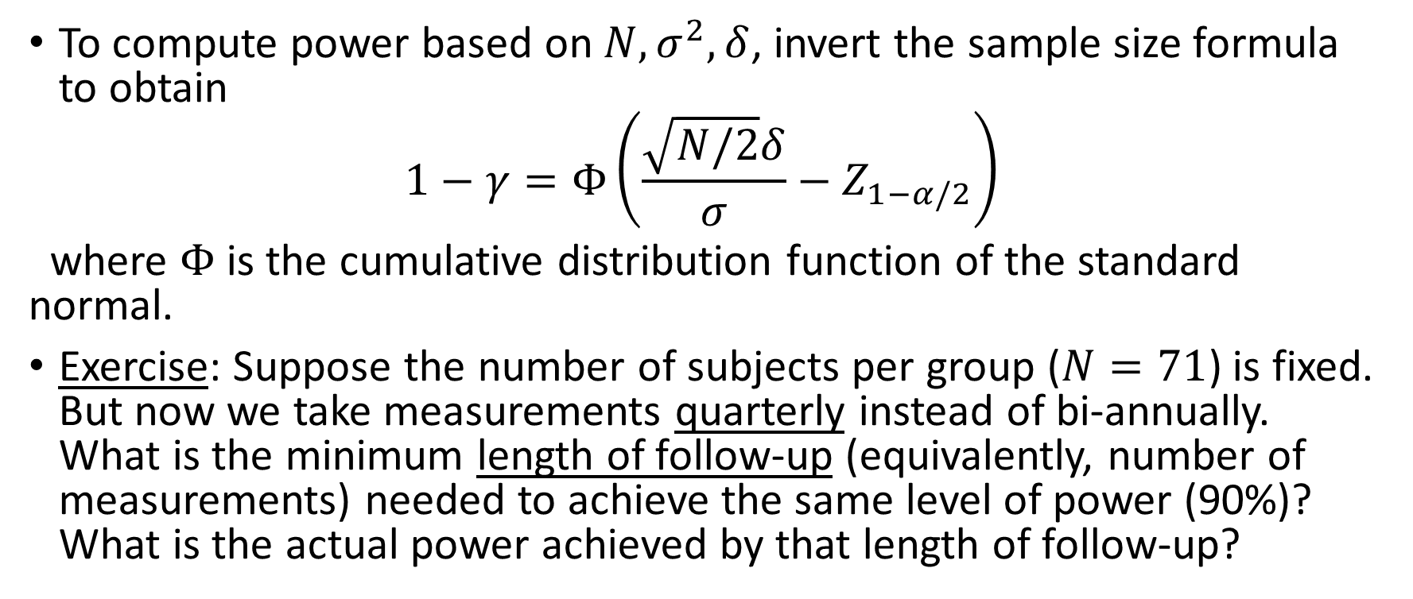
A Toy Example
To compute power based on $N, σ^{2}, δ$, invert the sample size formula to obtain
$$1−γ=Φ\left(\frac{\sqrt{N/2}δ}{σ}−Z_{1−α/2}\right)$$
where $Φ$ is the cumulative distribution function of the standard normal.
Exercise: Suppose the number of subjects per group ($N=71$) is fixed. But now we take measurements quarterly instead of bi-annually. What is the minimum length of follow-up (equivalently, number of measurements) needed to achieve the same level of power (90%)? What is the actual power achieved by that length of follow-up?
PHS 651 / Lecture 12
26 / 27

Slide 27
HW3 (Due Mar 27)
Problem 8.1 of FLW
Exercise in Lecture 12.
PHS 651 / Lecture 12
27 / 27

