Slide 1
PHS 651 / LECTURE 13
Residual Analysis and Diagnostics
Advanced Regression Methods for Population Health
Lu Mao, PhD
Department of Biostatistics and Medical Informatics
University of Wisconsin-Madison
SPRING 2019

Slide 2
Outline
  The idea of residual analysis to assess model adequacy
  Cholesky transformation of the residuals
  An Example with the MIT Growth Study
PHS 651 / Lecture 13
2 / 26

Slide 3
Residual Analysis
The analysis of longitudinal data is not complete without examination of the residuals.
The residuals are defined as the difference between the observed responses and the estimated ones based on the model.
Basic idea: if the model adequately captures the systematic trend of the response, then the residuals should exhibit no systematic pattern, i.e., they should be scattered fairly randomly around zero.
PHS 651 / Lecture 13
3 / 26

Slide 4
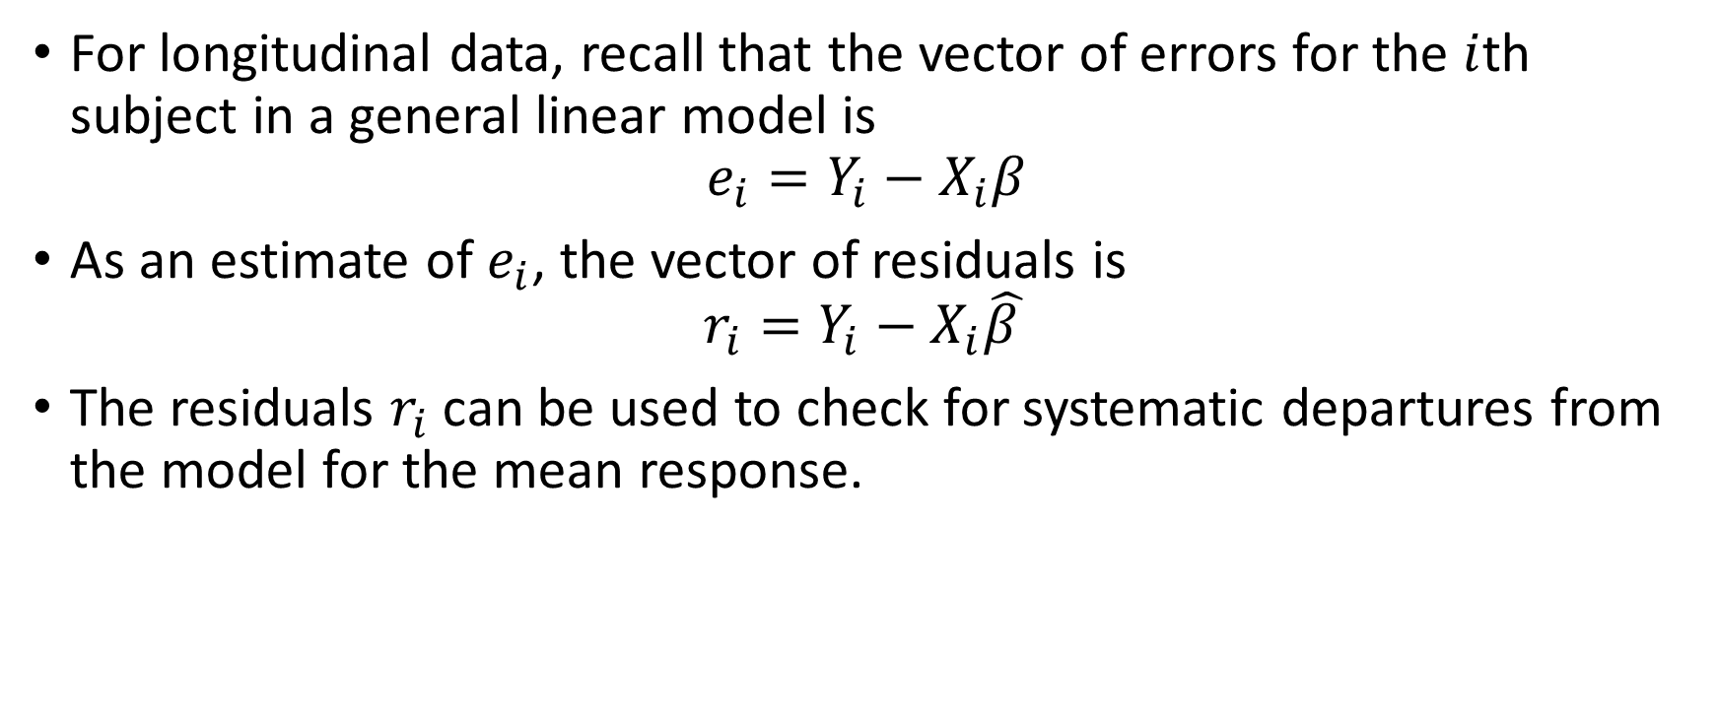
Residual Analysis
For longitudinal data, recall that the vector of errors for the $i$th subject in a general linear model is
$$e_{i}=Y_{i}−X_{i}β$$
As an estimate of $e_{i}$, the vector of residuals is
$$r_{i}=Y_{i}−X_{i}\hat{β }$$
The residuals $r_{i}$ can be used to check for systematic departures from the model for the mean response.
PHS 651 / Lecture 13
4 / 26

Slide 5
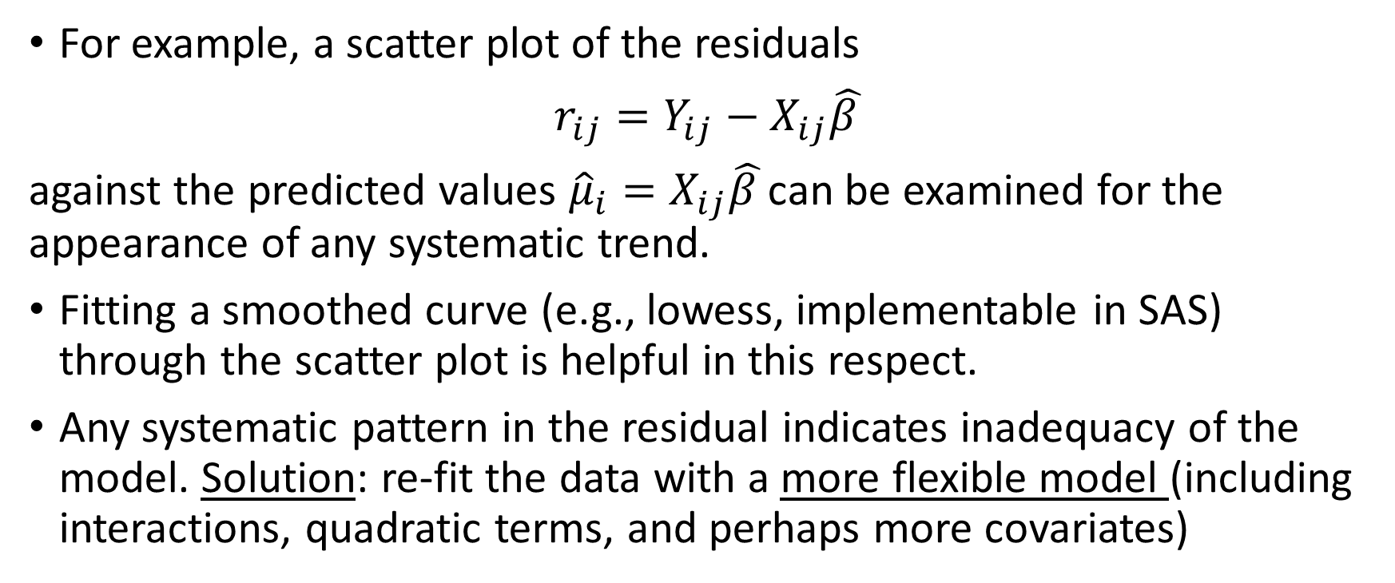
Residual vs Predicted Response
For example, a scatter plot of the residuals
$r_{ij}=Y_{ij}−X_{ij}\hat{β }$
against the predicted values ${{\hat{μ}}_{i}=X}_{ij}\hat{β }$can be examined for the appearance of any systematic trend.
Fitting a smoothed curve (e.g., lowess, implementable in SAS) through the scatter plot is helpful in this respect.
Any systematic pattern in the residual indicates inadequacy of the model. Solution: re-fit the data with a more flexible model (including interactions, quadratic terms, and perhaps more covariates)
PHS 651 / Lecture 13
5 / 26

Slide 6
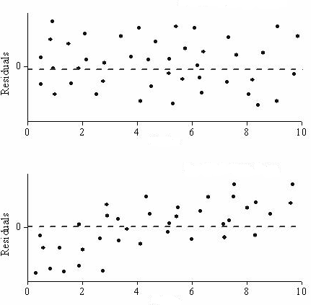
Residual vs Predicted Response
Good
No good
PHS 651 / Lecture 13
6 / 26

Slide 7
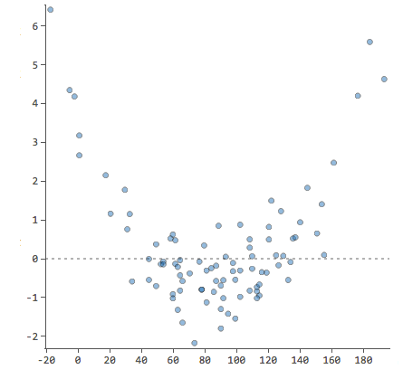
Residual vs Predictor
Similar scatter plots of the residuals against a particular covariate (e.g., time) can be examined for systematic trend.
Such a trend may indicate omission of a quadratic term or need for transformation of the covariate.
Add a quadratic term!
PHS 651 / Lecture 13
7 / 26

Slide 8
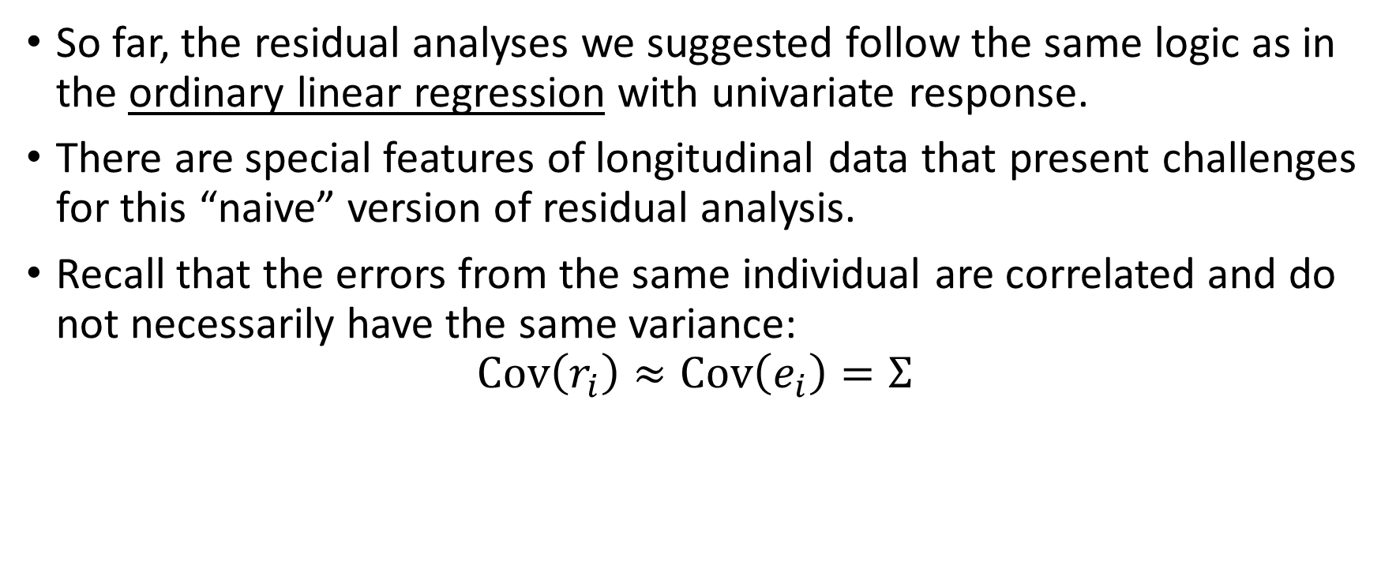
Issues with Longitudinal Data
So far, the residual analyses we suggested follow the same logic as in the ordinary linear regression with univariate response.
There are special features of longitudinal data that present challenges for this “naive” version of residual analysis.
Recall that the errors from the same individual are correlated and do not necessarily have the same variance:
$$Cov\left(r_{i}\right)≈Cov\left(e_{i}\right)=Σ$$
PHS 651 / Lecture 13
8 / 26

Slide 9
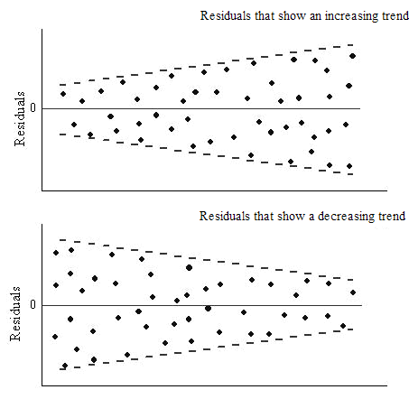
Issues with Longitudinal Data
Two implications:
  Residual vs predicted response/covariate may not have a constant range (homoscedasticity may not hold)
Bad in OLR
Need not be bad in longitudinal analysis
PHS 651 / Lecture 13
9 / 26

Slide 10
Issues with Longitudinal Data
  Because of correlation among residuals, residuals may be correlated with covariates so that a pattern in residual vs predictor plot will show even when the model is adequate.
Solution: “De-correlate” the residuals so that they mimic those from an OLR.
This is done by transforming the residuals via Cholesky decomposition.
PHS 651 / Lecture 13
10 / 26

Slide 11
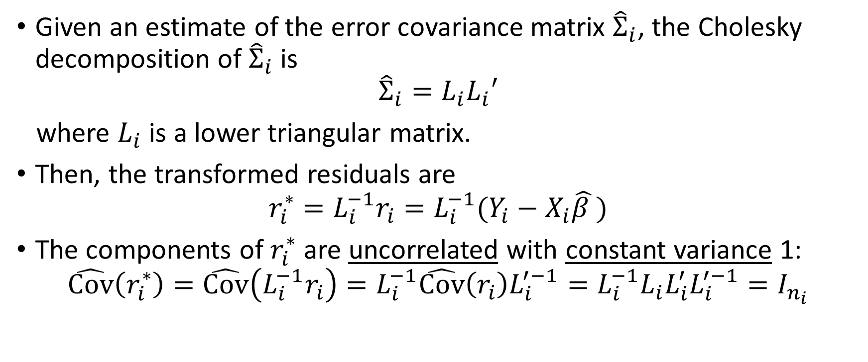
Transformed Residuals
Given an estimate of the error covariance matrix ${\hat{Σ}}_{i}$, the Cholesky decomposition of ${\hat{Σ}}_{i}$ is
$${\hat{Σ}}_{i}=L_{i}L_{i}′$$
where $L_{i}$ is a lower triangular matrix.
Then, the transformed residuals are
$$r_{i}^{∗}=L_{i}^{−1}r_{i}=L_{i}^{−1}(Y_{i}−X_{i}\hat{β })$$
The components of $r_{i}^{∗}$ are uncorrelated with constant variance 1:
$\hat{Cov}\left(r_{i}^{∗}\right)=\hat{Cov}\left(L_{i}^{−1}r_{i}\right)=L_{i}^{−1}\hat{Cov}\left(r_{i}\right)L_{i}^{′−1}=L_{i}^{−1}L_{i}L_{i}^{′}L_{i}^{′−1}=I_{n_{i}}$
PHS 651 / Lecture 13
11 / 26

Slide 12
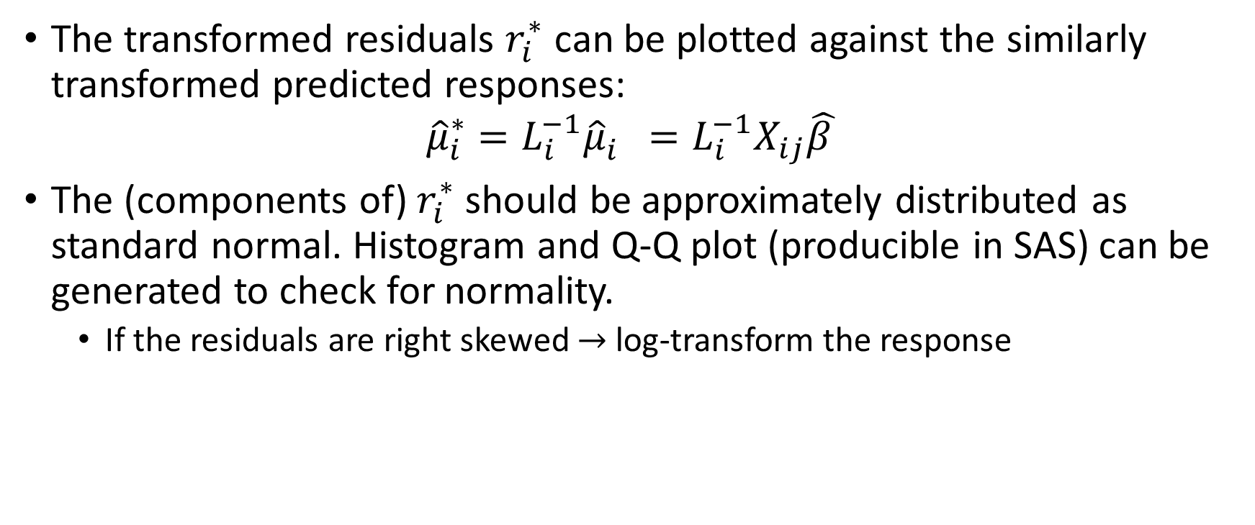
Transformed Residuals
The transformed residuals$r_{i}^{∗}$ can be plotted against the similarly transformed predicted responses:
$${{\hat{μ}}_{i}^{∗}=L_{i}^{−1}{\hat{μ}}_{i}^{}=L_{i}^{−1}X}_{ij}\hat{β }$$
The (components of) $r_{i}^{∗}$ should be approximately distributed as standard normal. Histogram and Q-Q plot (producible in SAS) can be generated to check for normality.
  If the residuals are right skewed $→$ log-transform the response
PHS 651 / Lecture 13
12 / 26

Slide 13
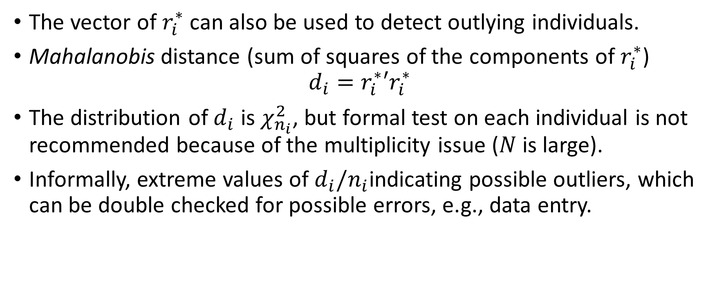
Transformed Residuals
The vector of $r_{i}^{∗}$ can also be used to detect outlying individuals.
Mahalanobis distance (sum of squares of the components of $r_{i}^{∗}$)
$$d_{i}=r_{i}^{∗}′r_{i}^{∗}$$
The distribution of $d_{i}$ is $χ_{n_{i}}^{2}$, but formal test on each individual is not recommended because of the multiplicity issue ($N$ is large).
Informally, extreme values of $d_{i}/n_{i}$indicating possible outliers, which can be double checked for possible errors, e.g., data entry.
PHS 651 / Lecture 13
13 / 26

Slide 14
Example: Influence of Menarche on Body Fat
Prospective study on body fat accretion in a cohort of 162 girls from the
MIT Growth and Development Study.
At start of study, all the girls were pre-menarcheal and non-obese.
They were followed over time according to a schedule of annual
measurements until four years after menarche.
The final measurement was scheduled on the fourth anniversary of their
reported date of menarche.
At each examination, a measure of body fatness was obtained based on
bioelectric impedance analysis.
PHS 651 / Lecture 13
14 / 26

Slide 15
Example: Influence of Menarche on Body Fat
Prospective study on body fat accretion in a cohort of 162 girls from the
MIT Growth and Development Study.
At start of study, all the girls were pre-menarcheal and non-obese.
They were followed over time according to a schedule of annual
measurements until four years after menarche.
The final measurement was scheduled on the fourth anniversary of their
reported date of menarche.
At each examination, a measure of body fatness was obtained based on
bioelectric impedance analysis.
PHS 651 / Lecture 13
15 / 26

Slide 16
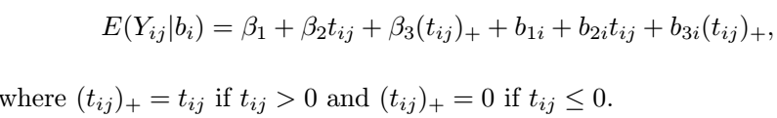
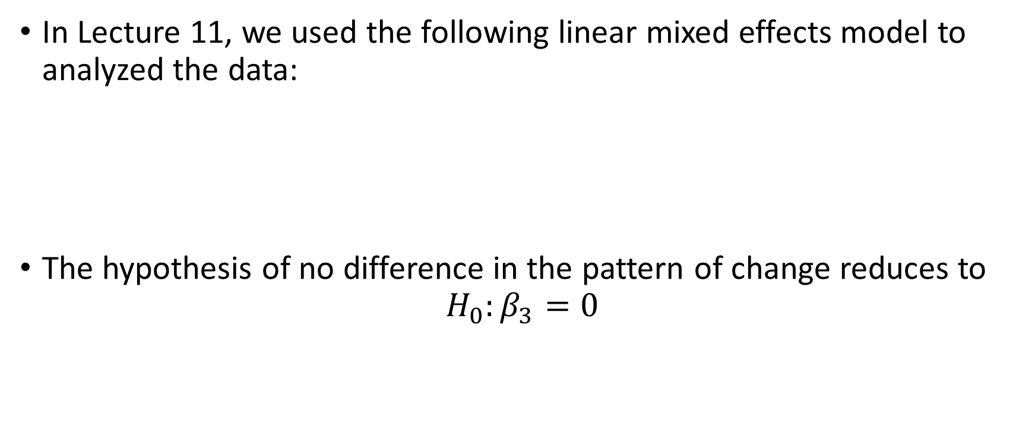
Example: Influence of Menarche on Body Fat
In Lecture 11, we used the following linear mixed effects model to analyzed the data:
The hypothesis of no difference in the pattern of change reduces to
$$H_{0}:β_{3}=0$$
PHS 651 / Lecture 13
16 / 26

Slide 17
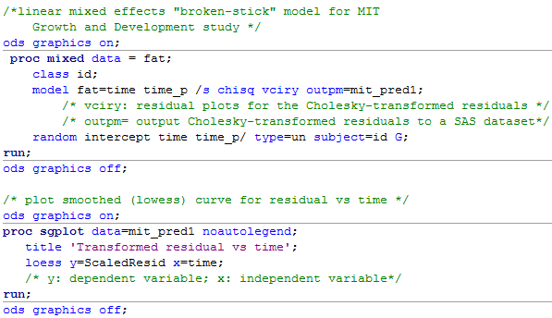
Example: Influence of Menarche on Body Fat
PHS 651 / Lecture 13
17 / 26

Slide 18
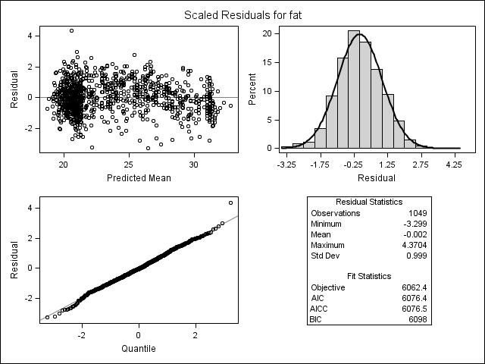
Example: Influence of Menarche on Body Fat
PHS 651 / Lecture 13
18 / 26

Slide 19
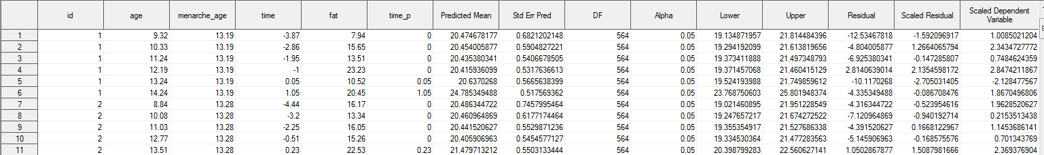

Example: Influence of Menarche on Body Fat
SAS dataset mitpred1
$$r_{i} r_{i}^{∗} {\hat{μ}}_{i}^{∗}$$
PHS 651 / Lecture 13
19 / 26

Slide 20
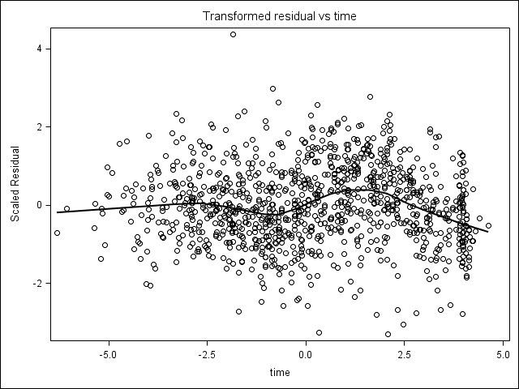
Example: Influence of Menarche on Body Fat
Quite some curvature post-menarche…
PHS 651 / Lecture 13
20 / 26

Slide 21
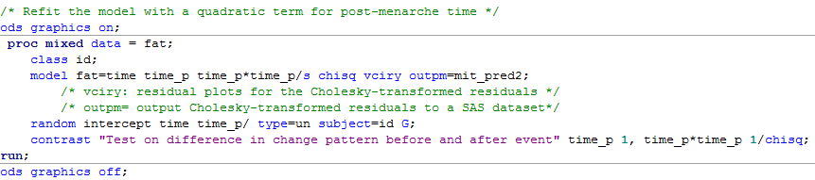
Example: Influence of Menarche on Body Fat
Refit the data with a quadratic term for post-event time.
PHS 651 / Lecture 13
21 / 26

Slide 22
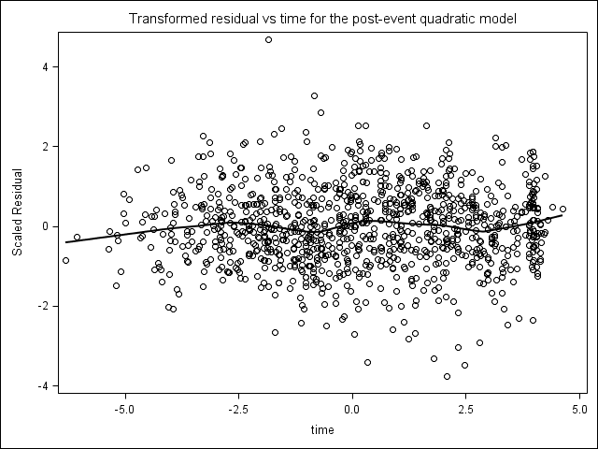
Example: Influence of Menarche on Body Fat
Better?
PHS 651 / Lecture 13
22 / 26

Slide 23
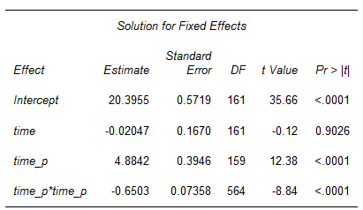
Example: Influence of Menarche on Body Fat
Does adding post-event quadratic term significantly improve the fit?
An LRT should yield similar results.
PHS 651 / Lecture 13
23 / 26

Slide 24
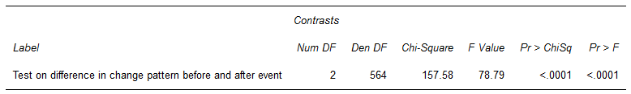
Example: Influence of Menarche on Body Fat
Test on the null hypothesis of no difference in the pattern of change between pre- and post-menarche times: 2-df test on the linear and quadratic post-menarche terms.
PHS 651 / Lecture 13
24 / 26

Slide 25
Summary
A simplified procedure for (transformed) residual analysis
  Plot histogram (or Q-Q plot) to check for normality (transform the response so that the residuals are approximately normal)
  Plot residual vs predicted to see if there is a systematic pattern; if yes, include additional terms in the model and re-fit the data.
  Plot residual vs time/other covariates to see which covariates should be transformed or need additional terms; include additional terms if necessary.
  Conduct a formal test to compare the original model and the model with additional terms.
PHS 651 / Lecture 13
25 / 26

Slide 26
Summary
Residual analysis for model diagnostics is more of an art than a science.
For more discussion, refer to Chapter 10 of FLW.
PHS 651 / Lecture 13
26 / 26

