Slide 1
PHS 651 / LECTURE 14
Generalized Linear Models for Longitudinal Data
Advanced Regression Methods for Population Health
Lu Mao, PhD
Department of Biostatistics and Medical Informatics
University of Wisconsin-Madison
SPRING 2019

Slide 2
Outline
  Longitudinal binary and count outcomes
  The toenail and epilepsy trials
  Review of logistic regression
  Review of Poisson regression
PHS 651 / Lecture 14
2 / 13

Slide 3
Oral Treatment of Toenail Infection
Randomized, double-blind, parallel-group, multicenter study of 294 patients comparing 2 oral treatments (denoted A and B) for toe-nail infection.
Outcome variable: Binary variable indicating presence of onycholysis
(separation of the nail plate from the nail bed).
Patients evaluated for onycholysis(separation of the nail plate
from the nail-bed) at baseline (week 0) and at weeks 4, 8, 12, 24, 36, and 48.
Interested in the rate of decline of the proportion of patients with
onycholysis over time and the effects of treatment on that rate.
PHS 651 / Lecture 14
3 / 13

Slide 4
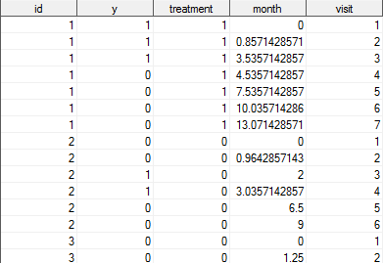
Oral Treatment of Toenail Infection
PHS 651 / Lecture 14
4 / 13

Slide 5
Clinical trial of anti-epileptic drug progabide
Randomized, placebo-controlled study of treatment of epileptic seizures with progabide.
Patients were randomized to treatment with progabide, or to placebo in addition to standard therapy.
Outcome variable: Count of number of seizures
Measurement schedule: Baseline measurement during 8 weeks prior to randomization. Four measurements at two-week intervals during follow-up.
Sample size: 28 epileptics on placebo; 31 epileptics on progabide
PHS 651 / Lecture 14
5 / 13

Slide 6
Clinical trial of anti-epileptic drug progabide
PHS 651 / Lecture 14
6 / 13

Slide 7
Generalized Linear Models
Generalized linear models (GLM)are a class of regression models that extend the standard linear regression model to accommodate non-continuous outcomes:
  Linear regression for continuous data
  Logistic regression for binary data
  Log-linear/Poisson regression models for count data
We consider application of GLM to longitudinal data.
First, we review logistic and Poisson regression models for a single response.
PHS 651 / Lecture 14
7 / 13

Slide 8

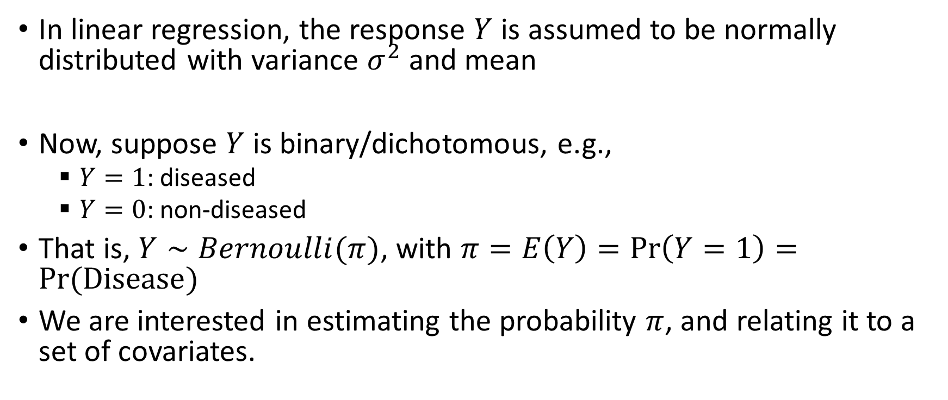
Review: Logistic Regression
In linear regression, the response $Y$ is assumed to be normally distributed with variance $σ^{2}$and mean
Now, suppose $Y$ is binary/dichotomous, e.g.,
  $Y=1$: diseased
  $Y=0$: non-diseased
That is, $Y∼Bernoulli(π)$, with $π=E\left(Y\right)=\operatorname{Pr}\left(Y=1\right)=Pr⁡(Disease)$
We are interested in estimating the probability $π$, and relating it to a set of covariates.
PHS 651 / Lecture 14
8 / 13

Slide 9

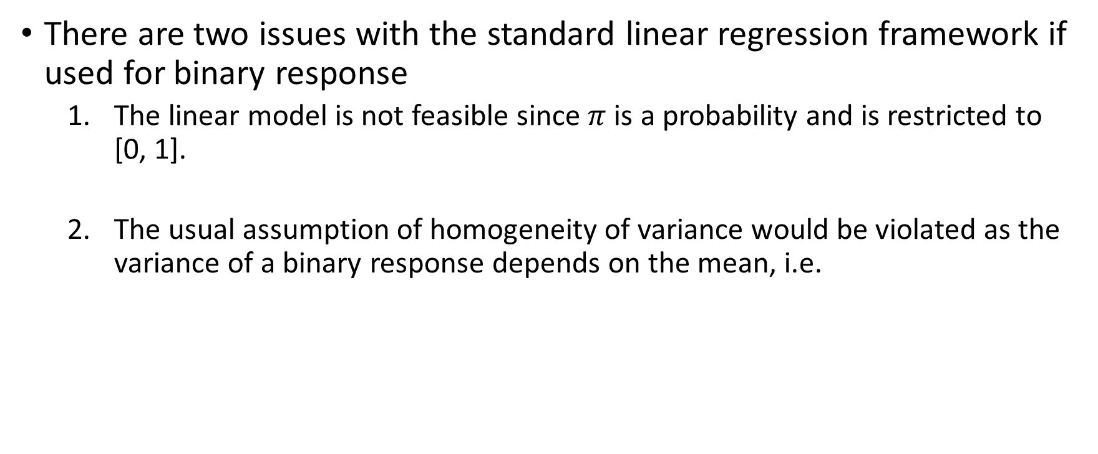
Review: Logistic Regression
There are two issues with the standard linear regression framework if used for binary response
  The linear model is not feasible since $π$is a probability and is restricted to [0, 1].
  The usual assumption of homogeneity of variance would be violatedas the variance of a binary response depends on the mean, i.e.
PHS 651 / Lecture 14
9 / 13

Slide 10
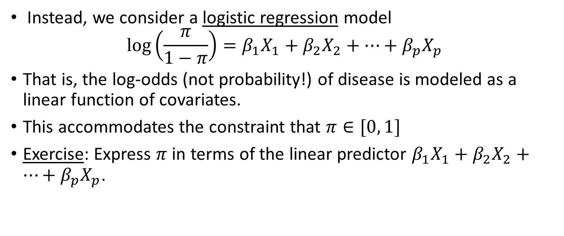
Review: Logistic Regression
Instead, we consider a logistic regression model
$$\log\left(\frac{π}{1−π}\right)=β_{1}X_{1}+β_{2}X_{2}+…+β_{p}X_{p}$$
That is, the log-odds (not probability!) of disease is modeled as a linear function of covariates.
This accommodates the constraint that $π∈[0, 1]$
Exercise: Express $π$ in terms of the linear predictor $β_{1}X_{1}+β_{2}X_{2}+…+β_{p}X_{p}$.
PHS 651 / Lecture 14
10 / 13

Slide 11
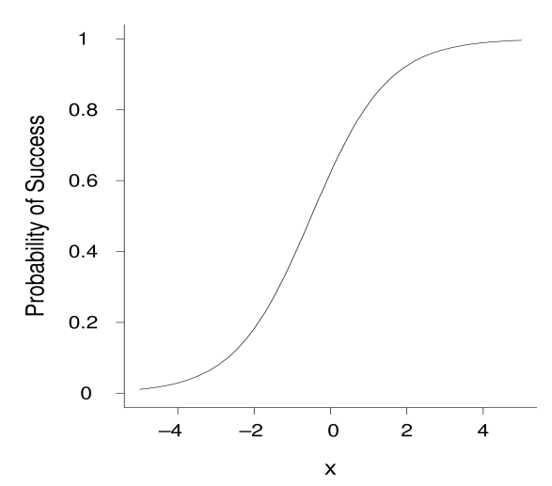
Review: Logistic Regression

Slide 12
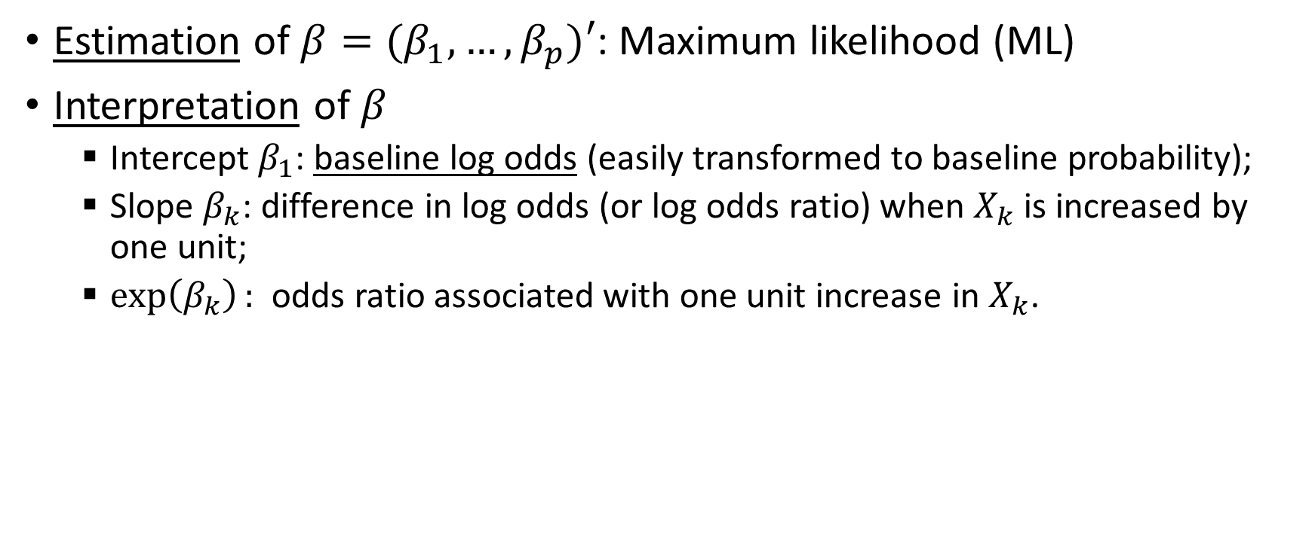
Review: Logistic Regression
Estimation of $β=(β_{1},…,β_{p})′$: Maximum likelihood (ML)
Interpretationof $β$
  Intercept $β_{1}$: baseline log odds (easily transformed to baseline probability);
  Slope $β_{k}$: difference in log odds (or log odds ratio) when $X_{k}$ is increased by one unit;
  $\exp\left(β_{k}\right):$ odds ratio associated with one unit increase in $X_{k}$.
PHS 651 / Lecture 14
12 / 13

Slide 13
Review: Poisson Regression
In Poisson regression, the response variable is a count (e.g. number of cases of a disease in a given period of time).
The Poisson distribution provides the basis of likelihood-based inference.
Often the counts may be expressed as rates. That is, the count or absolute number of events is normalized by the underlying size of population or length of follow-up for better comparison.
PHS 651 / Lecture 14
13 / 13

