Slide 1
PHS 651 / LECTURE 15
Marginal Models: Generalized Estimating Equations
Advanced Regression Methods for Population Health
Lu Mao, PhD
Department of Biostatistics and Medical Informatics
University of Wisconsin-Madison
SPRING 2019

Slide 2
Outline
  Overview of three approaches to GLM for longitudinal data
  Marginal models by Generalized Estimating Equations (GEE)
  GEE by PROC GENMOD
  An Example with the Toenail Trial
PHS 651 / Lecture 15
2 / 18

Slide 3
GLM for Longitudinal Data
There are three main approaches to analyzing longitudinal responses.
These approaches can be considered extensions of generalized linear models to correlated data, with emphasis on discrete response data, e.g., count data or binary responses.
  Marginal Models (Generalized Estimating Equations, or GEE)
  Mixed Effects Models (Generalized Linear Mixed Effects Models, or GLIMIX)
  Transitional Models
PHS 651 / Lecture 15
3 / 18

Slide 4
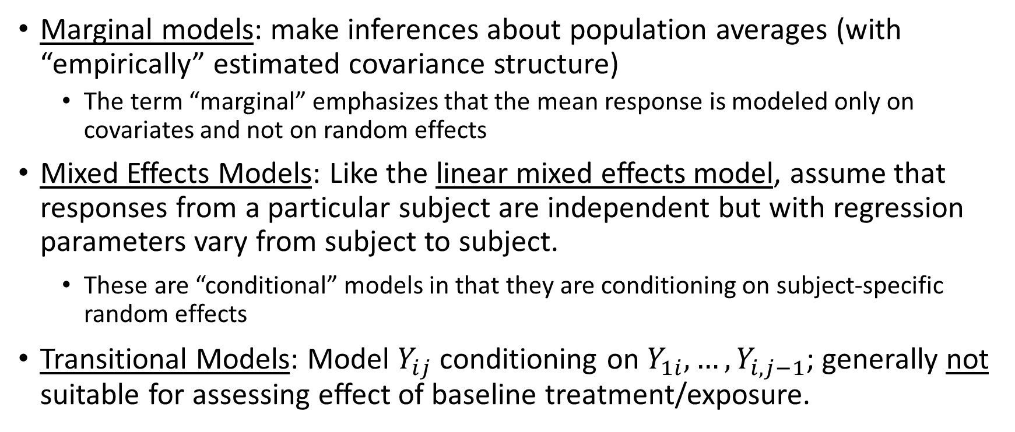
GLM for Longitudinal Data
Marginal models: make inferences about population averages (with “empirically” estimated covariance structure)
  The term “marginal” emphasizes that the mean response is modeled only on covariates and not on random effects
Mixed Effects Models: Like the linear mixed effects model, assume that responses from a particular subject are independent but with regression parameters vary from subject to subject.
    These are “conditional” models in that they are conditioning on subject-specific random effects
  Transitional Models: Model $Y_{ij}$ conditioning on $Y_{1i}, …, Y_{i,j−1}$; generally not suitable for assessing effect of baseline treatment/exposure.
PHS 651 / Lecture 15
4 / 18

Slide 5
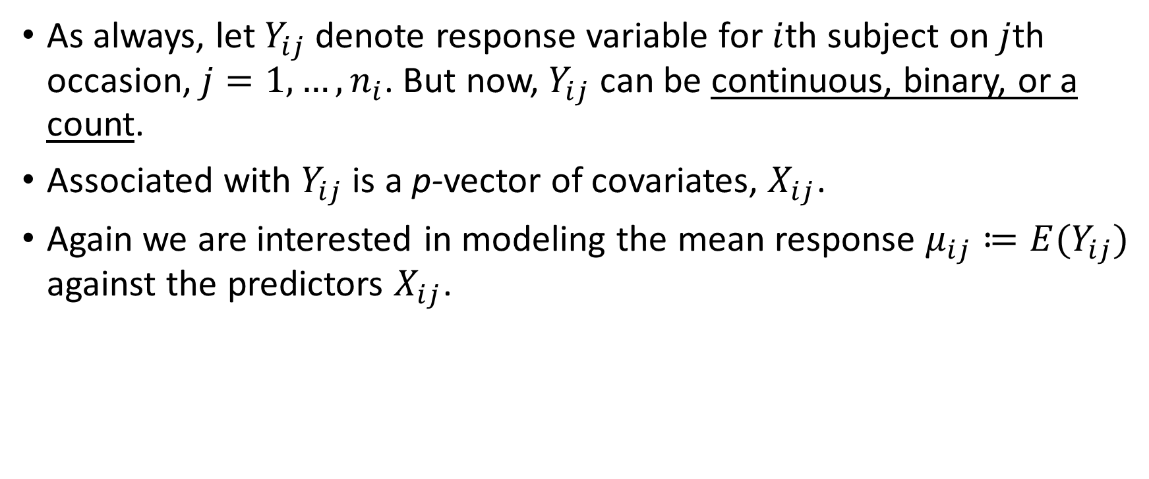
Marginal GLM
As always, let $Y_{ij}$denote response variable for $i$thsubject on $j$thoccasion, $j=1,…, n_{i}$. But now, $Y_{ij}$can be continuous, binary, or a count.
Associated with $Y_{ij}$ is a p-vector of covariates, $X_{ij}$.
Again we are interested in modeling the mean response $μ_{ij}≔E(Y_{ij})$ against the predictors $X_{ij}$.
PHS 651 / Lecture 15
5 / 18

Slide 6
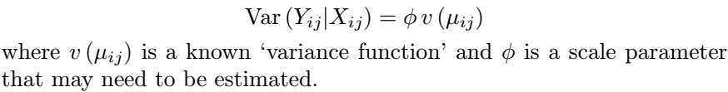

Marginal GLM
As in the GLM for univariate response, we specify that the mean response depends on the covariates through a known link function $g$:
The variance of $Y_{ij}$depends on the marginal mean according to
PHS 651 / Lecture 15
6 / 18

Slide 7
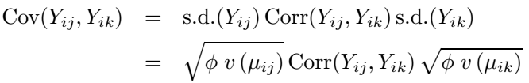
Difficulty in Specifying Covariance
So far, the GLM for longitudinal data is not much different from that for univariate response.
The difficulty with longitudinal data lies in the specification of a covariance/correlation structure.
For non-normal response (e.g., binary, count), the correlations, like the variances, are constrained by the means.
PHS 651 / Lecture 15
7 / 18

Slide 8
Difficulty in Specifying Covariance
For instance, for binary response, the correlations must satisfy certain inequalities determined by the marginal probabilities.
These constraints are likely to cause difficulties for modelling of the association.
With binary response, this difficulty can be partially circumvented by using the odds ratio (instead of correlation) as the measure of association.
PHS 651 / Lecture 15
8 / 18

Slide 9
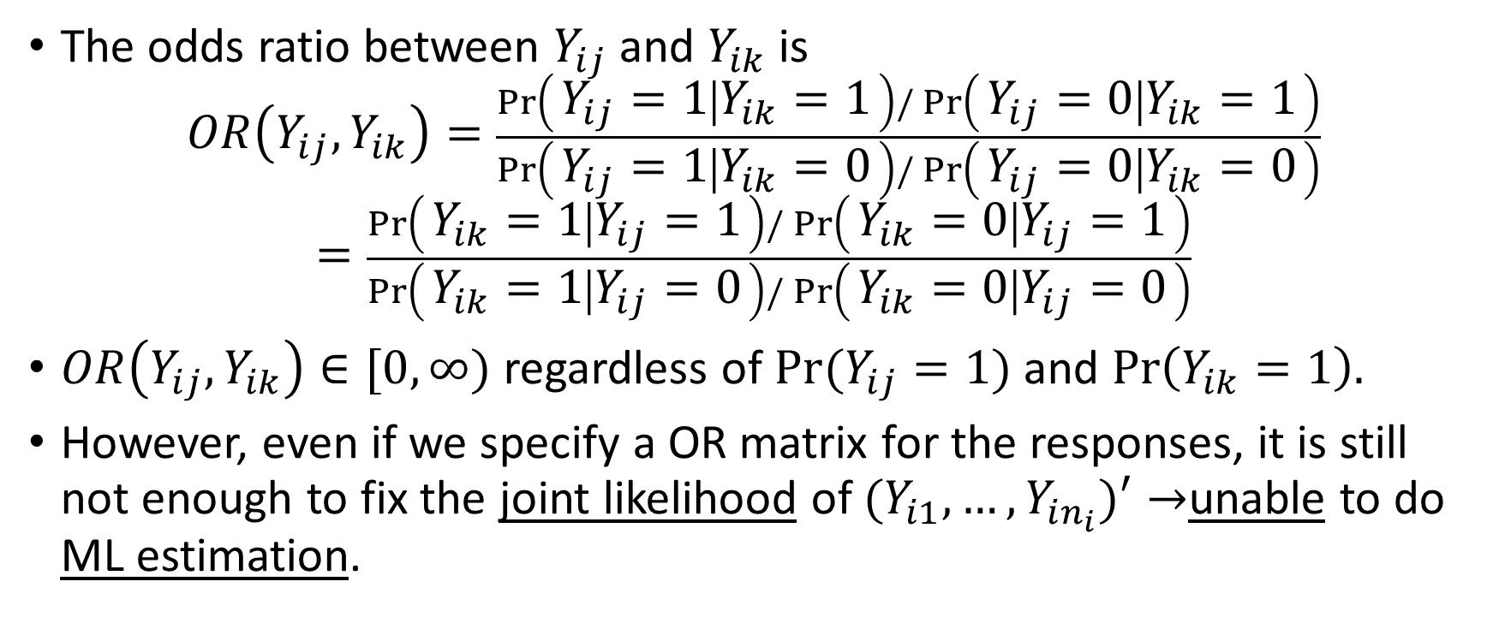
Difficulty in Specifying Covariance
The odds ratio between $Y_{ij}$ and $Y_{ik}$ is
$$OR\left(Y_{ij},Y_{ik}\right)=\frac{\operatorname{Pr}\left(Y_{ij}=1 ∣ Y_{ik}=1\right)/\operatorname{Pr}\left(Y_{ij}=0 ∣ Y_{ik}=1\right)}{\operatorname{Pr}\left(Y_{ij}=1 ∣ Y_{ik}=0\right)/\operatorname{Pr}\left(Y_{ij}=0 ∣ Y_{ik}=0\right)}$$
$$=\frac{\operatorname{Pr}\left(Y_{ik}=1 ∣ Y_{ij}=1\right)/\operatorname{Pr}\left(Y_{ik}=0 ∣ Y_{ij}=1\right)}{\operatorname{Pr}\left(Y_{ik}=1 ∣ Y_{ij}=0\right)/\operatorname{Pr}\left(Y_{ik}=0 ∣ Y_{ij}=0\right)}$$
$OR\left(Y_{ij},Y_{ik}\right)∈[0,∞)$ regardless of $Pr(Y_{ij}=1)$ and $Pr\left(Y_{ik}=1\right).$
However, even if we specify a OR matrix for the responses, it is still not enough to fix the joint likelihood of $(Y_{i1},…,Y_{in_{i}})′→$unable to do ML estimation.
PHS 651 / Lecture 15
9 / 18

Slide 10
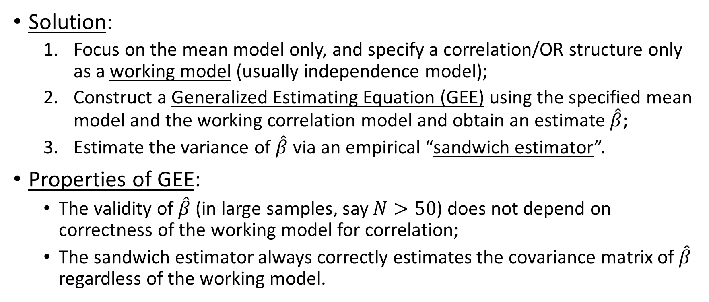
Generalized Estimating Equations
Solution:
  Focus on the mean model only, and specify a correlation/OR structure only as a working model (usually independence model);
  Construct a Generalized Estimating Equation (GEE) using the specified mean model and the working correlation model and obtain an estimate $\hat{β}$;
  Estimate the variance of $\hat{β}$ via an empirical “sandwich estimator”.
Properties of GEE:
  The validity of $\hat{β}$(in large samples, say $N>50$) does not depend on correctness of the working model for correlation;
  The sandwich estimator always correctly estimates the covariance matrix of $\hat{β}$regardless of the working model.
PHS 651 / Lecture 15
10 / 18

Slide 11
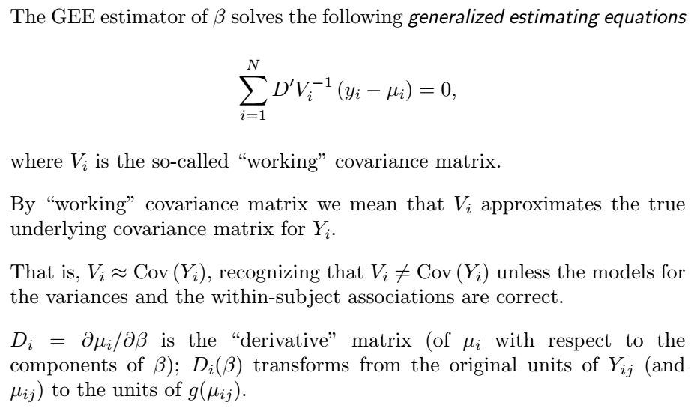
*Details about the GEE
PHS 651 / Lecture 15
11 / 18

Slide 12
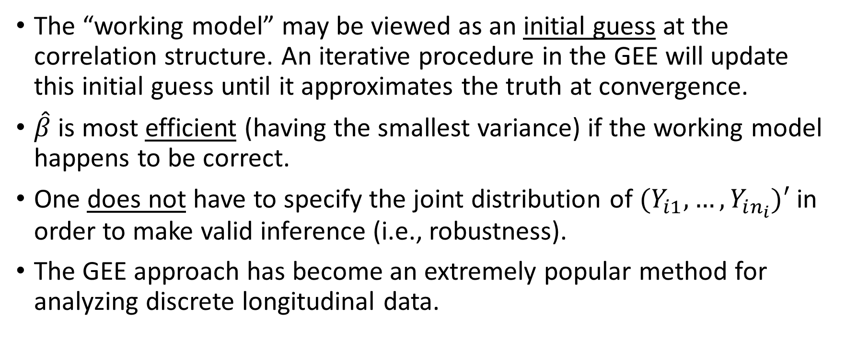
Advantages of GEE
The “working model” may be viewed as an initial guess at the correlation structure. An iterative procedure in the GEE will update this initial guess until it approximates the truth at convergence.
$\hat{β}$is most efficient (having the smallest variance) if the working model happens to be correct.
One does not have to specify the joint distribution of $(Y_{i1},…,Y_{in_{i}})′$ in order to make valid inference (i.e., robustness).
The GEE approach has become an extremely popular method for analyzing discrete longitudinal data.
PHS 651 / Lecture 15
12 / 18

Slide 13
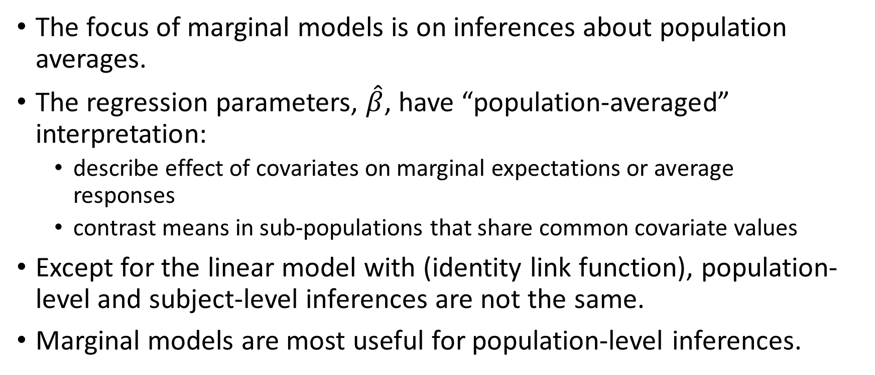
Interpretations of Marginal Models
The focus of marginal models is on inferences about population averages.
The regression parameters, $\hat{β}$, have “population-averaged” interpretation:
  describe effect of covariates on marginal expectations or average
  responses
  contrast means in sub-populations that share common covariate values
Except for the linear model with (identity link function), population-level and subject-level inferences are not the same.
Marginal models are most useful for population-level inferences.
PHS 651 / Lecture 15
13 / 18

Slide 14
GEE in SAS
PROC GENMOD in SAS can fit generalizedlinear models to a single response.
It can also implement the GEE approach using a REPEATED statement (similar to PROC MIXED but the there a few differences in the syntax).
PROC GENMOD, as with almost all software for longitudinal analyses, requires that the dataset be in the “long” format.
PHS 651 / Lecture 15
14 / 18

Slide 15
GEE in SAS
For example, the code for a GEE logistic regression looks like this:
PROC GENMOD DESCENDING;
CLASS id group time;
MODEL y=group time group*time / DIST=BINOMIAL LINK=LOGIT;
REPEATED SUBJECT=id / WITHIN=time TYPE=IND;
RUN;
Two differences with PROC MIXED:
“SUBJECT=“ follows the REPEATED statement immediately, not after “/”;
The class variable for time occasion is specified by the option “WITHIN=“;
If this statement were from PROC MIXED, it would have been
REPEATED time / SUBJECT=idTYPE=IND;
PHS 651 / Lecture 15
15 / 18

Slide 16
Oral Treatment of Toenail Infection
Randomized, double-blind, parallel-group, multicenter study of 294 patients comparing 2 oral treatments (denoted A and B) for toe-nail infection.
Outcome variable: Binary variable indicating presence of onycholysis
(separation of the nail plate from the nail bed).
Patients evaluated for onycholysisat baseline (week 0) and at weeks 4, 8, 12, 24, 36, and 48.
Interested in the rate of decline of the proportion of patients with
onycholysis over time and the effects of treatment on that rate.
PHS 651 / Lecture 15
16 / 18

Slide 17
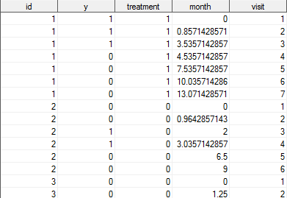
Oral Treatment of Toenail Infection
PHS 651 / Lecture 15
17 / 18

Slide 18
Oral Treatment of Toenail Infection
PHS 651 / Lecture 15
18 / 18

