Slide 1
PHS 651 / LECTURE 16
Case Studies of Marginal Models
Advanced Regression Methods for Population Health
Lu Mao, PhD
Department of Biostatistics and Medical Informatics
University of Wisconsin-Madison
SPRING 2019

Slide 2
Outline
  Multinomial regression
  Proportional odds modeland application to an arthritis trial
  Log-linear model and application to a leprosy trial
PHS 651 / Lecture 16
2 / 23

Slide 3
Categorical Response
In biomedical investigations, the response variable is frequently categorical (with more than two levels)
These responses may be ordinal (i.e., ordered) or nominal (i.e., without an inherent order)
  Different sub-types of disease
  Tumor grade
  Arthritis Categorical Scale
PHS 651 / Lecture 16
3 / 23

Slide 4
Example: An Arthritis Trial
A randomized, double-blind trial comparing auranofin therapy (3 mg of oral gold, twice daily) and placebo for the treatment of rheumatoid arthritis on 303 patients.
The outcome variable is a global impression scale (Arthritis Categorical Scale) measured at baseline (month 0), month 2, month 4, and month 6.
This is a self-assessment of a patient's current arthritis, measured on a 5-level ordinal scale: (1) very good, (2) good, (3) fair, (4) poor, and (5) very poor.
PHS 651 / Lecture 16
4 / 23

Slide 5
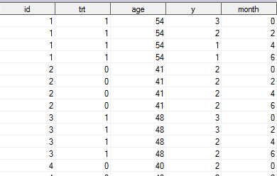
Example: An Arthritis Trial
PHS 651 / Lecture 16
5 / 23

Slide 6
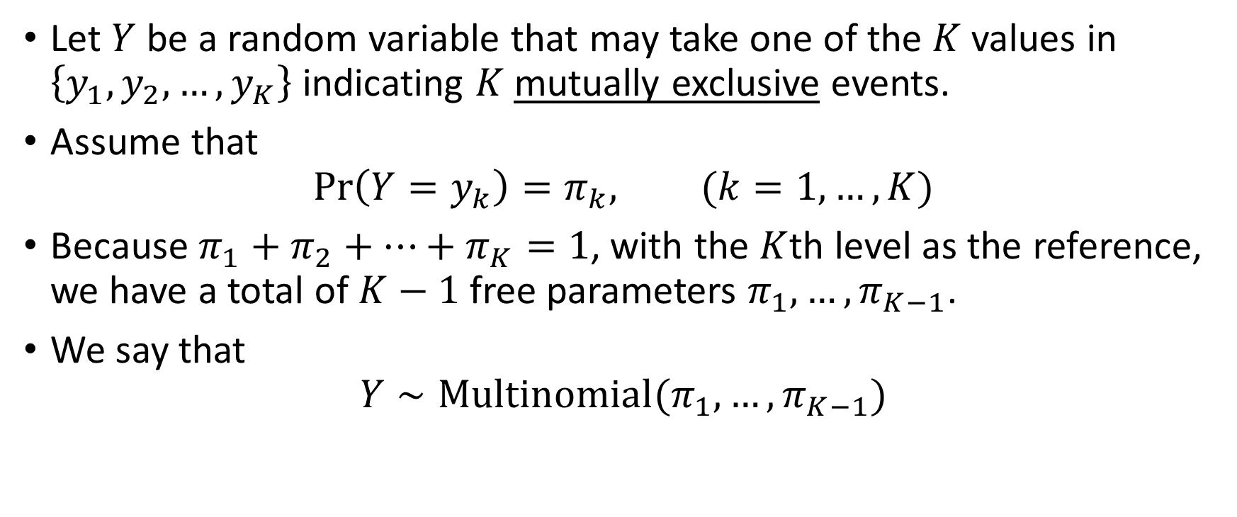
The Multinomial Distribution
Let $Y$ be a random variable that may take one of the $K$ values in $\left\{y_{1},y_{2},…, y_{K}\right\}$ indicating $K$mutually exclusive events.
Assume that
$$\operatorname{Pr}\left(Y=y_{k}\right)=π_{k}, (k=1,…, K)$$
Because $π_{1}+π_{2}+⋯+π_{K}=1$, with the $K$th level as the reference, we have a total of $K−1$ free parameters $π_{1},…, π_{K−1}$.
We say that
$$Y∼Multinomial{(π}_{1},…, π_{K−1})$$
PHS 651 / Lecture 16
6 / 23

Slide 7
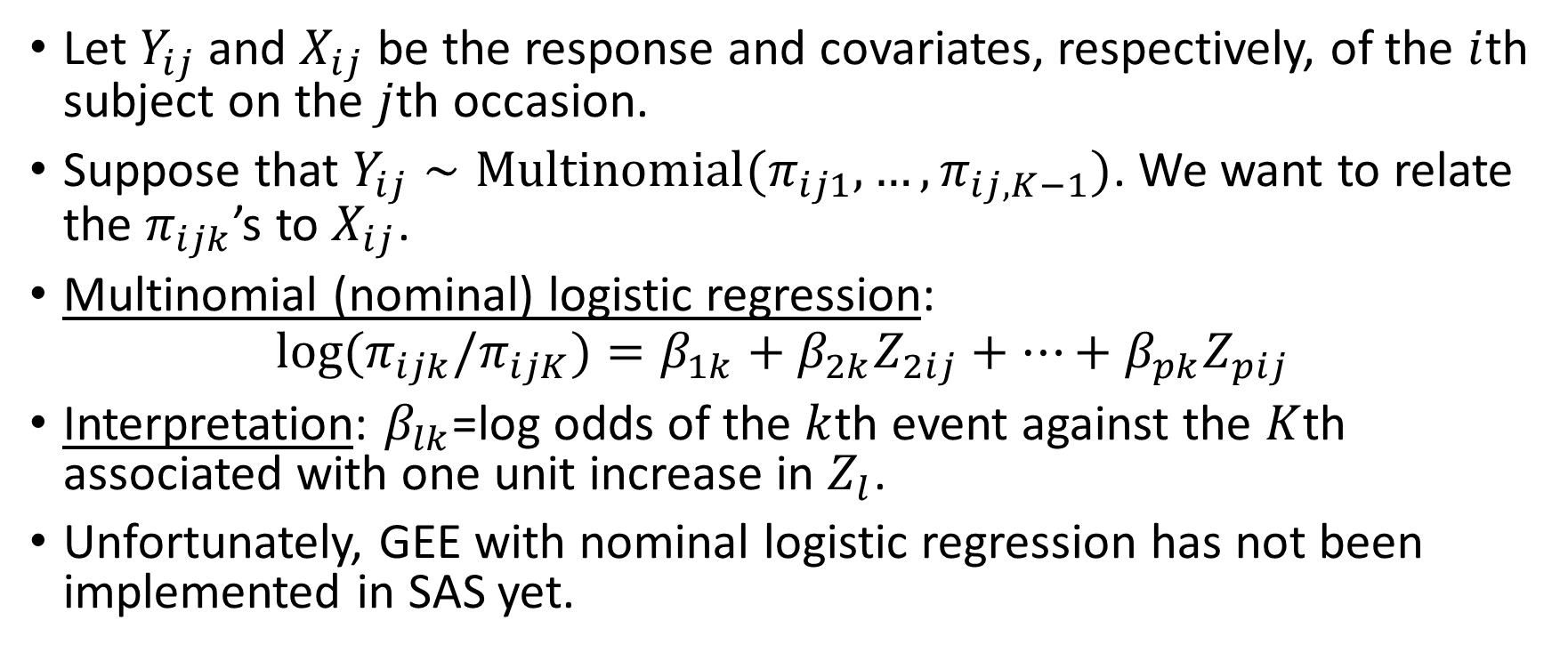
Multinomial Logistic Regression
Let $Y_{ij}$ and $X_{ij}$ be the response and covariates, respectively, of the $i$th subject on the $j$th occasion.
Suppose that $Y_{ij}∼Multinomial{(π}_{ij1},…, π_{ij,K−1})$. We want to relate the $π_{ijk}$’s to $X_{ij}$.
Multinomial (nominal) logistic regression:
$$\log{{(π}_{ijk}/π_{ijK})}=β_{1k}+β_{2k}Z_{2ij}+⋯+β_{pk}Z_{pij}$$
Interpretation: $β_{lk}$=log odds of the $k$th event against the $K$thassociated with one unit increase in $Z_{l}$.
Unfortunately, GEE with nominal logistic regression has not been implemented in SAS yet.
PHS 651 / Lecture 16
7 / 23

Slide 8
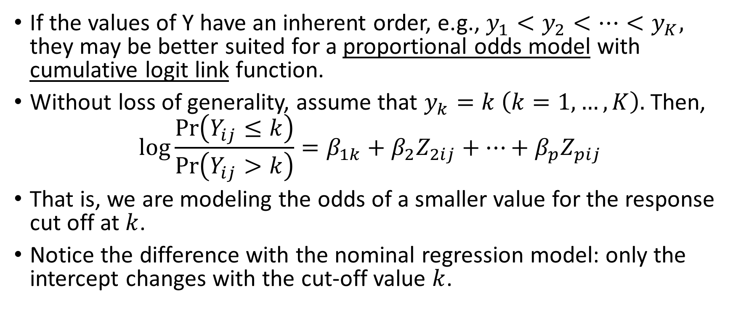
Ordinal Logistic Regression
If the values of Y have an inherent order, e.g., $y_{1}<y_{2}<⋯<y_{K},$ they may be better suited for a proportional odds modelwith cumulative logit link function.
Without loss of generality, assume that $y_{k}=k \left(k=1,…, K\right).$ Then,
$$\log{\frac{\operatorname{Pr}\left(Y_{ij}≤k\right)}{\operatorname{Pr}\left(Y_{ij}>k\right)}}=β_{1k}+β_{2}Z_{2ij}+⋯+β_{p}Z_{pij}$$
That is, we are modeling the odds of a smaller value for the response cut off at $k$.
Notice the difference with the nominal regression model: only the intercept changes with the cut-off value $k$.
PHS 651 / Lecture 16
8 / 23

Slide 9
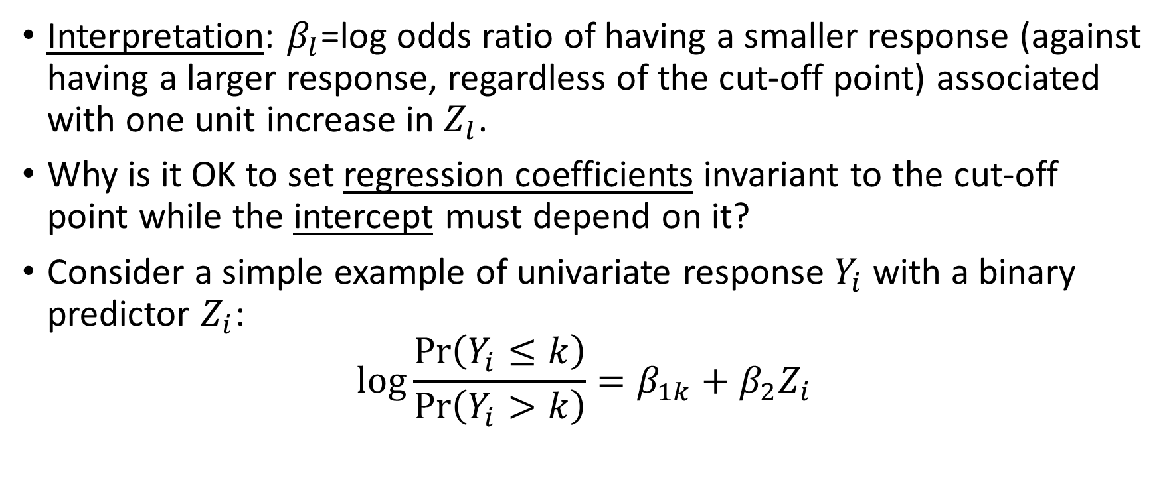
Ordinal Logistic Regression
Interpretation: $β_{l}$=log odds ratio of having a smaller response (against having a larger response, regardless of the cut-off point) associated with one unit increase in $Z_{l}$.
Why is it OK to set regression coefficients invariant to the cut-off point while the intercept must depend on it?
Consider a simple example of univariate response $Y_{i}$ with a binary predictor $Z_{i}$:
$$\log{\frac{\operatorname{Pr}\left(Y_{i}≤k\right)}{\operatorname{Pr}\left(Y_{i}>k\right)}}=β_{1k}+β_{2}Z_{i}$$
PHS 651 / Lecture 16
9 / 23

Slide 10
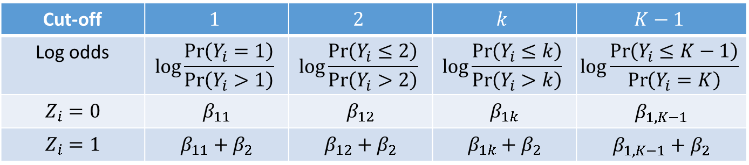
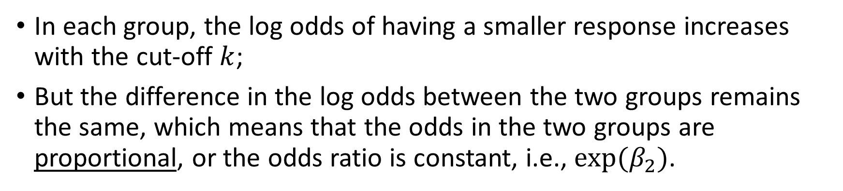
Ordinal Logistic Regression
Cut-off | $$1$$ | $$2$$ | $$k$$ | $$K−1$$
Log odds | $$\log{\frac{\operatorname{Pr}\left(Y_{i}=1\right)}{\operatorname{Pr}\left(Y_{i}>1\right)}}$$ | $$\log{\frac{\operatorname{Pr}\left(Y_{i}≤2\right)}{\operatorname{Pr}\left(Y_{i}>2\right)}}$$ | $$\log{\frac{\operatorname{Pr}\left(Y_{i}≤k\right)}{\operatorname{Pr}\left(Y_{i}>k\right)}}$$ | $$\log{\frac{\operatorname{Pr}\left(Y_{i}≤K−1\right)}{\operatorname{Pr}\left(Y_{i}=K\right)}}$$
$$Z_{i}=0$$ | $$β_{11}$$ | $$β_{12}$$ | $$β_{1k}$$ | $$β_{1,K−1}$$
$$Z_{i}=1$$ | $$β_{11}+β_{2}$$ | $$β_{12}+β_{2}$$ | $$β_{1k}+β_{2}$$ | $$β_{1,K−1}+β_{2}$$
In each group, the log odds of having a smaller response increases with the cut-off $k$;
But the difference in the log odds between the two groups remains the same, which means that the odds in the two groups are proportional, or the odds ratio is constant, i.e., $exp⁡(β_{2})$.
PHS 651 / Lecture 16
10 / 23

Slide 11
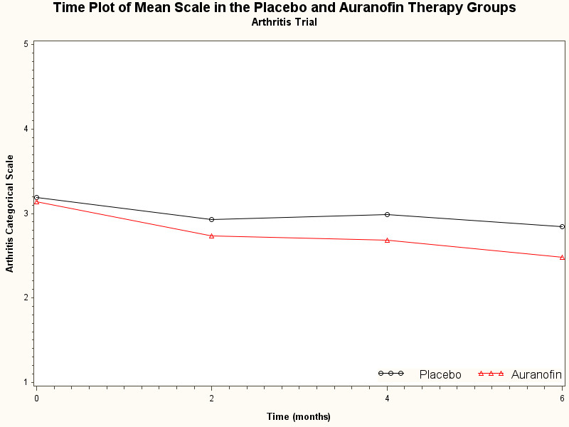
Example: An Arthritis Trial
PHS 651 / Lecture 16
11 / 23

Slide 12
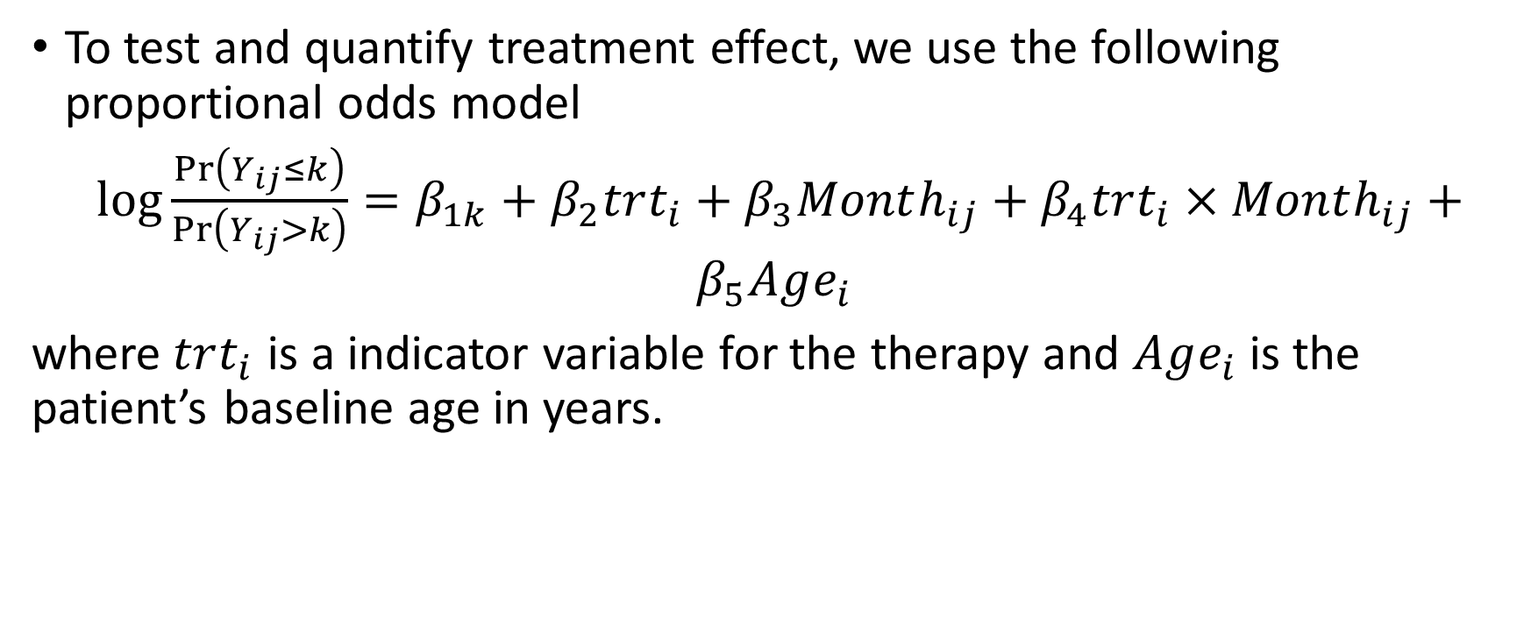
Example: An Arthritis Trial
To test and quantify treatment effect, we use the following proportional odds model
$\log{\frac{\operatorname{Pr}\left(Y_{ij}≤k\right)}{\operatorname{Pr}\left(Y_{ij}>k\right)}}=β_{1k}+β_{2}trt_{i}+β_{3}Month_{ij}+β_{4}trt_{i}×Month_{ij}+β_{5}Age_{i}$
where$trt_{i}$ is a indicator variable for the therapy and $Age_{i}$ is the patient’s baseline age in years.
PHS 651 / Lecture 16
12 / 23

Slide 13
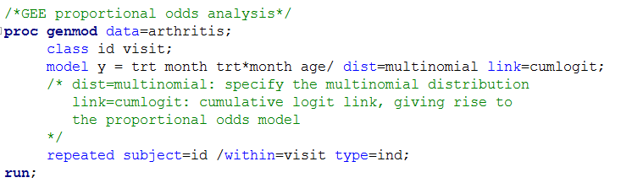
Example: An Arthritis Trial
PROC GENMOD is modeling the probabilities of levels of y having LOWER Ordered Values in the response profile table.
PHS 651 / Lecture 16
13 / 23

Slide 14
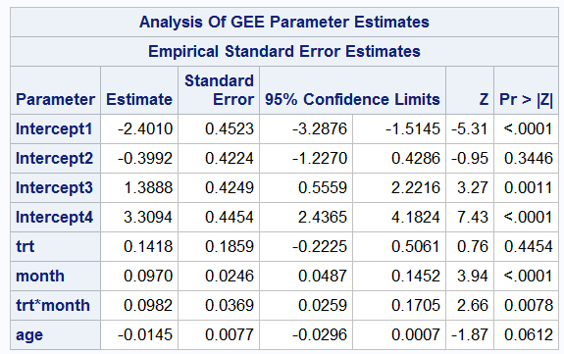
Example: An Arthritis Trial
PHS 651 / Lecture 16
14 / 23

Slide 15
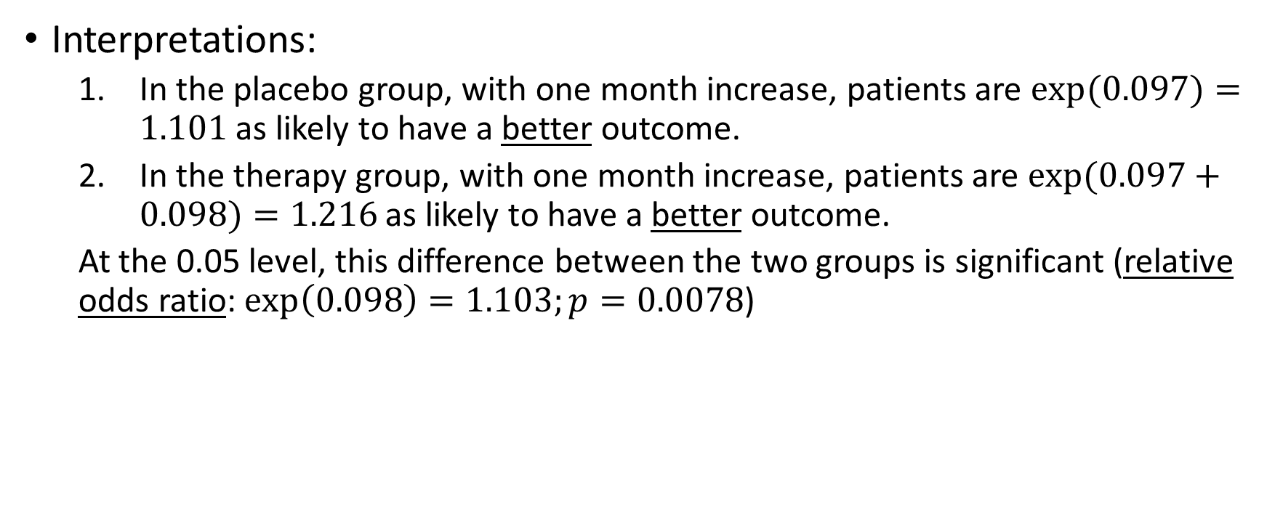
Example: An Arthritis Trial
Interpretations:
  In the placebo group, with one month increase, patients are $exp⁡(0.097)=1.101$ as likely to have a better outcome.
  In the therapy group, with one month increase, patients are $exp⁡(0.097+0.098)=1.216$ as likely to have a better outcome.
  At the 0.05 level, this difference between the two groups is significant (relative odds ratio: $\exp\left(0.098\right)=1.103;p=0.0078$)
PHS 651 / Lecture 16
15 / 23

Slide 16
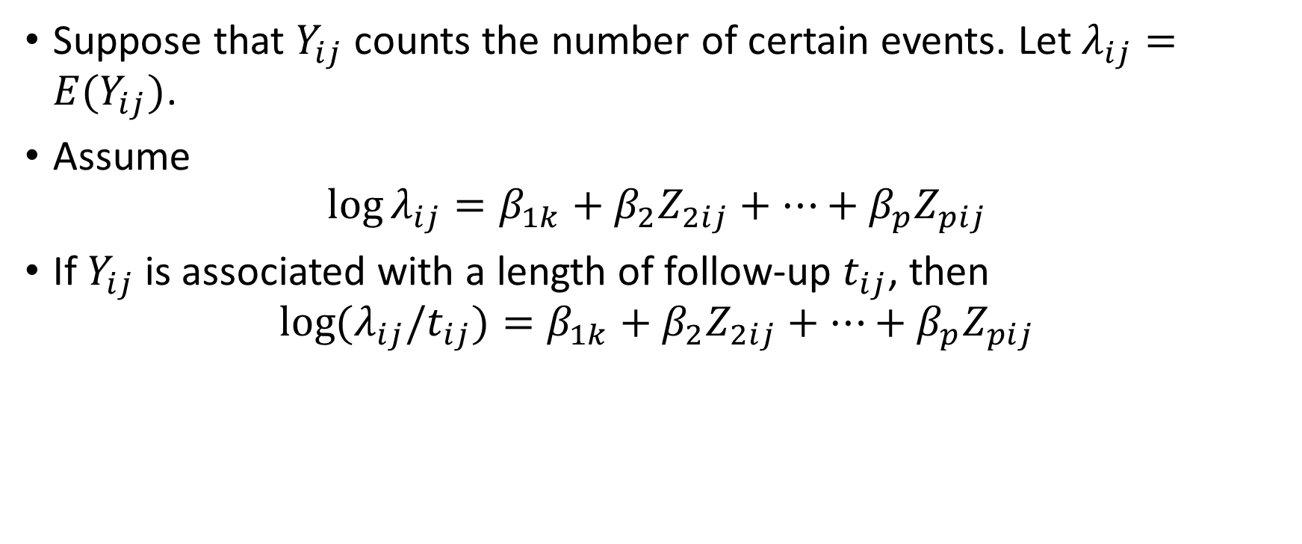
Log-Linear Models for Count Response
Suppose that $Y_{ij}$ counts the number of certain events. Let $λ_{ij}=E(Y_{ij})$.
Assume
$$\log{λ_{ij}}=β_{1k}+β_{2}Z_{2ij}+⋯+β_{p}Z_{pij}$$
If $Y_{ij}$ is associated with a length of follow-up $t_{ij}$, then
$$\log{{(λ}_{ij}/t_{ij})}=β_{1k}+β_{2}Z_{2ij}+⋯+β_{p}Z_{pij}$$
PHS 651 / Lecture 16
16 / 23

Slide 17
Clinical Trial of Antibiotics for Leprosy
Placebo-controlled clinical trial of 30 patients with leprosy at the Eversley Childs Sanitorium in the Philippines.
Participants were randomized to either of two antibiotics (denoted treatment drug A and B) or to a placebo (denoted treatment drug C).
Baseline data on number of leprosy bacilli at 6 sites of body were recorded.
After several months of treatment, number of bacilli were recorded a second time.
Outcome: Total count of number of leprosy bacilli at 6 sites.
PHS 651 / Lecture 16
17 / 23

Slide 18
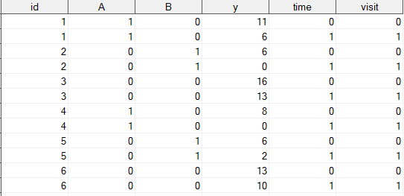
Clinical Trial of Antibiotics for Leprosy
PHS 651 / Lecture 16
18 / 23

Slide 19
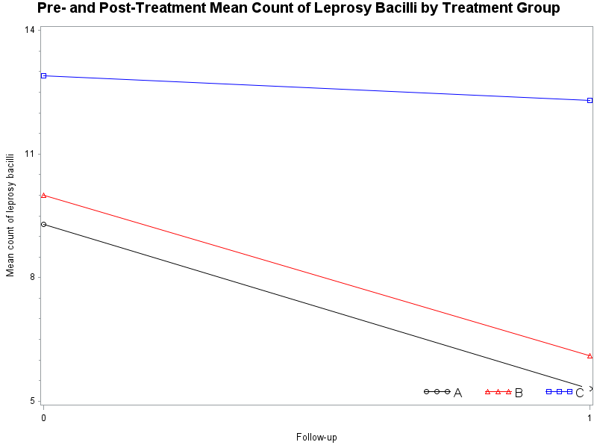
Clinical Trial of Antibiotics for Leprosy
PHS 651 / Lecture 16
19 / 23

Slide 20
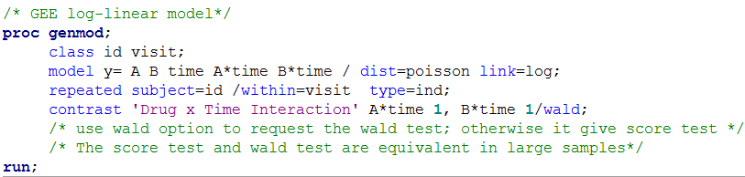
Clinical Trial of Antibiotics for Leprosy
PHS 651 / Lecture 16
20 / 23

Slide 21
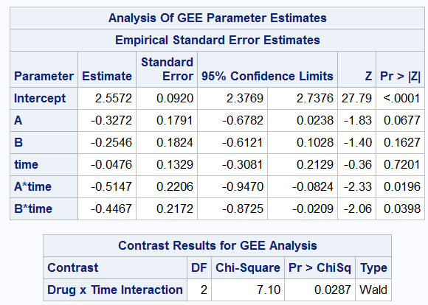
Clinical Trial of Antibiotics for Leprosy
PHS 651 / Lecture 16
21 / 23

Slide 22
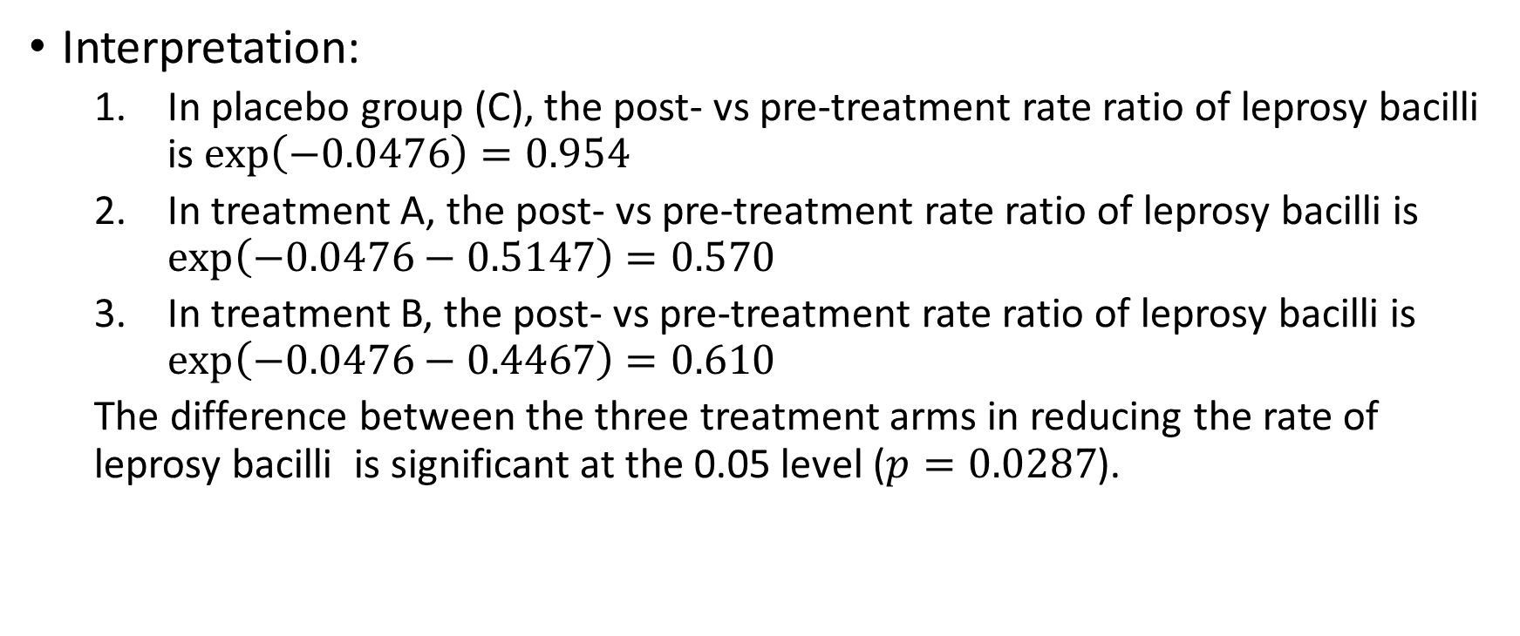
Clinical Trial of Antibiotics for Leprosy
Interpretation:
  In placebo group (C), the post- vs pre-treatment rate ratio of leprosy bacilliis $\exp\left(−0.0476\right)=0.954$
  In treatment A, the post- vs pre-treatment rate ratio of leprosy bacilli is $\exp\left(−0.0476−0.5147\right)=0.570$
  In treatment B, the post- vs pre-treatment rate ratio of leprosy bacilliis $\exp\left(−0.0476−0.4467\right)=0.610$
  The difference between the three treatment arms in reducing the rate of leprosy bacilli is significant at the 0.05 level ($p=0.0287$).
PHS 651 / Lecture 16
22 / 23

Slide 23
Summary
Response | Model | PROC GENMOD
Nominal multinomial | Mutinomial logistic | NA*
Ordinal multinomial | Proportional odds | Dist=multinomial link=cumlogit
Count | Log-linear | Dist=Poisson link=log
* A new procedure PROC GEE may implement it in the near future.
PHS 651 / Lecture 16
23 / 23

