Slide 1
PHS 651 / LECTURE 17
Generalized Linear Mixed Effects Models
Advanced Regression Methods for Population Health
Lu Mao, PhD
Department of Biostatistics and Medical Informatics
University of Wisconsin-Madison
SPRING 2019

Slide 2
Outline
  Subject-Level Models and Interpretations
  PROC GLIMMIX in SAS
  Examples with Binary and Count Responses
PHS 651 / Lecture 17
2 / 15

Slide 3
Generalized Linear Mixed Models
So far, we have discussed marginal modelsfor longitudinal data.
Next, we consider a second type of extension, generalized linear mixed models (GLMM), which extend the conceptual approach of the linear mixed effects model (Lectures 10 & 11).
We also highlight their greater degree of conceptual and analytic complexity relative to marginal models.
PHS 651 / Lecture 17
3 / 15

Slide 4
Generalized Linear Mixed Models
As in the linear mixed effects models, a subset of the regression coefficients (e.g., intercepts and slopes) in the GLMM are assumed to vary across individuals according to some distribution (multivariate normal).
Then, conditional on the random effects, it is assumed that the responses for a single individual are independent observations from a distribution belonging to the exponential family.
The subject-level random effects account for the heterogeneity in the population and induce correlation among measurements within each subject.
PHS 651 / Lecture 17
4 / 15

Slide 5

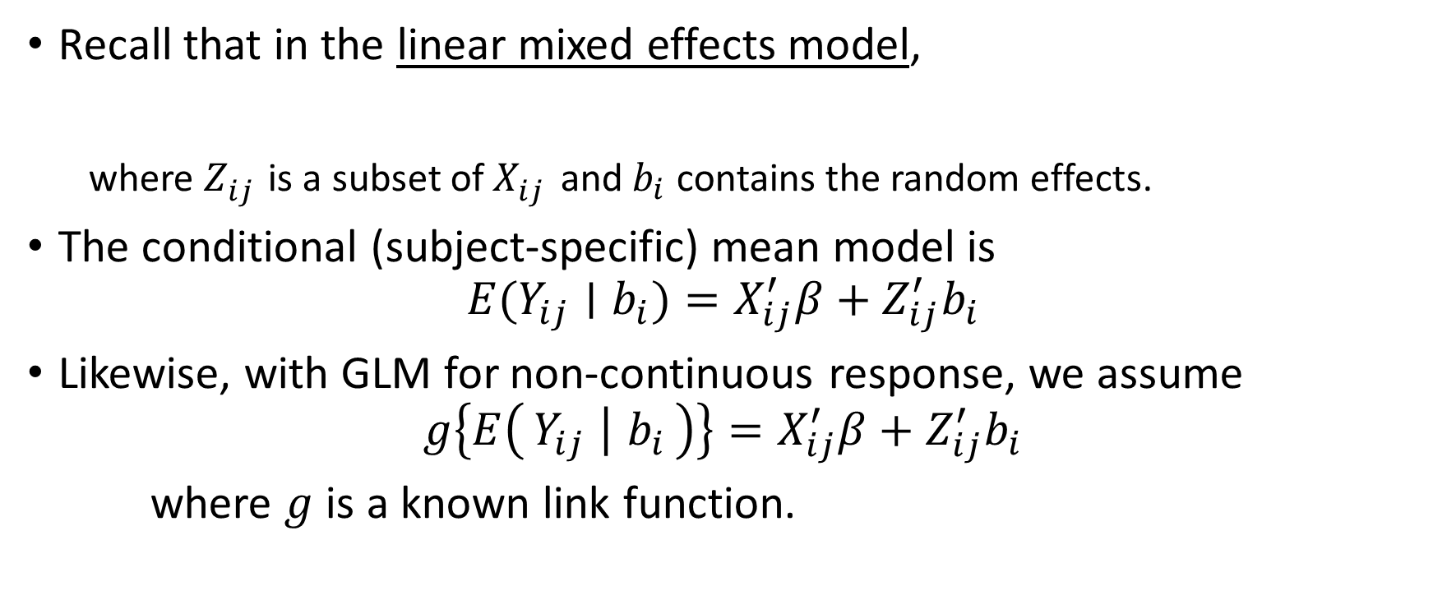
Generalized Linear Mixed Models
Recall that in the linear mixed effects model,
  where $Z_{ij}^{}$ is a subset of $X_{ij}^{}$ and $b_{i}$ contains the random effects.
The conditional (subject-specific) mean model is
$$E(Y_{ij}∣b_{i})=X_{ij}^{′}β+Z_{ij}^{′}b_{i}$$
Likewise, with GLM for non-continuous response, we assume
$$g\left\{E\left(Y_{ij} ∣ b_{i}\right)\right\}=X_{ij}^{′}β+Z_{ij}^{′}b_{i}$$
where $g$ is a known link function.
$$Y_{ij}=X_{ij}^{′}β+Z_{ij}^{′}b_{i}{+ε}_{i}$$
PHS 651 / Lecture 17
5 / 15

Slide 6
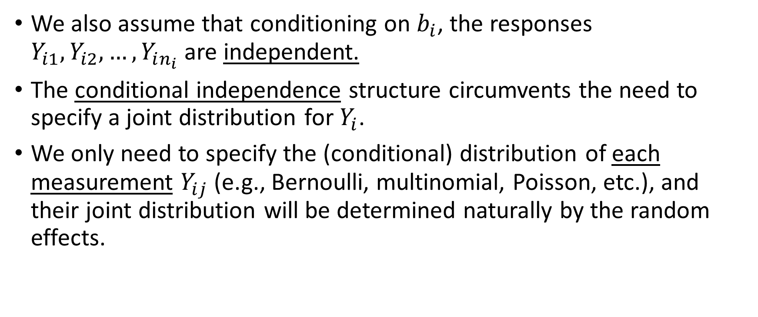
Generalized Linear Mixed Models
We also assume that conditioning on $b_{i}$, the responses $Y_{i1},Y_{i2},…, Y_{in_{i}}$ are independent.
The conditional independence structure circumvents the need to specify a joint distribution for $Y_{i}$.
We only need to specify the (conditional) distribution of each measurement$Y_{ij}$ (e.g., Bernoulli, multinomial, Poisson, etc.), and their joint distribution will be determined naturally by the random effects.
PHS 651 / Lecture 17
6 / 15

Slide 7
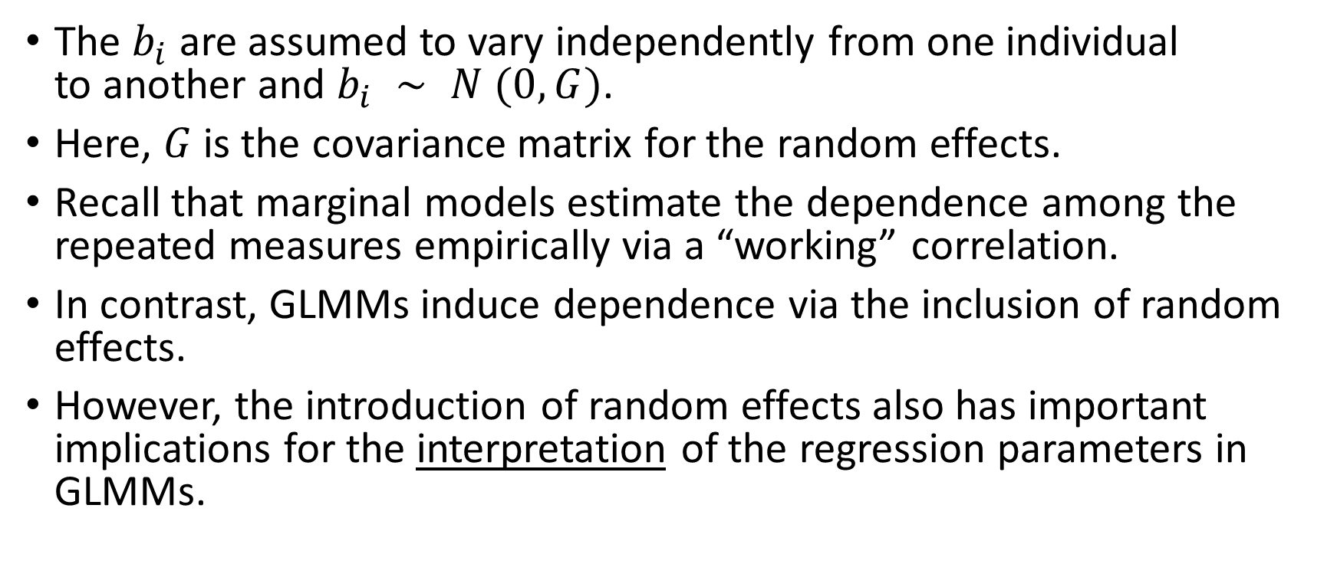
Generalized Linear Mixed Models
The $b_{i}$are assumed to vary independently from one individual
to another and $b_{i} ∼ N (0, G)$.
Here, $G$is the covariance matrix for the random effects.
Recall that marginal models estimate the dependenceamong the repeated measures empirically via a “working” correlation.
In contrast, GLMMs induce dependence via the inclusion of random effects.
However, the introduction of random effects also has important implications for the interpretation of the regression parameters in GLMMs.
PHS 651 / Lecture 17
7 / 15

Slide 8
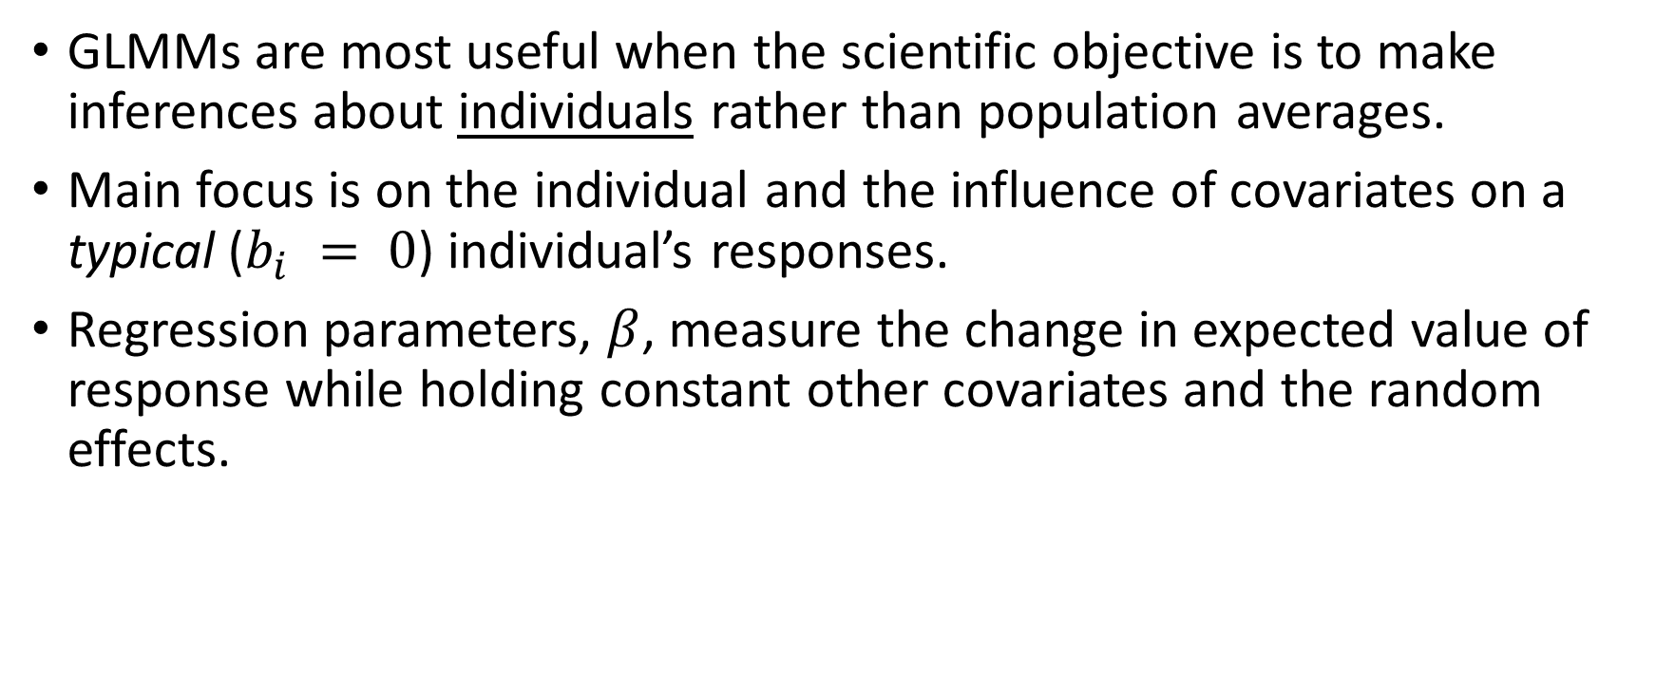
Interpretation of Fixed Effects in GLMM
GLMMs are most useful when the scientific objective is to make inferences about individuals rather than population averages.
Main focus is on the individual and the influence of covariates on a typical ($b_{i} = 0$) individual’s responses.
Regression parameters, $β$, measure the change in expected value of response while holding constant other covariates and the random effects.
PHS 651 / Lecture 17
8 / 15

Slide 9
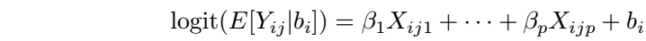
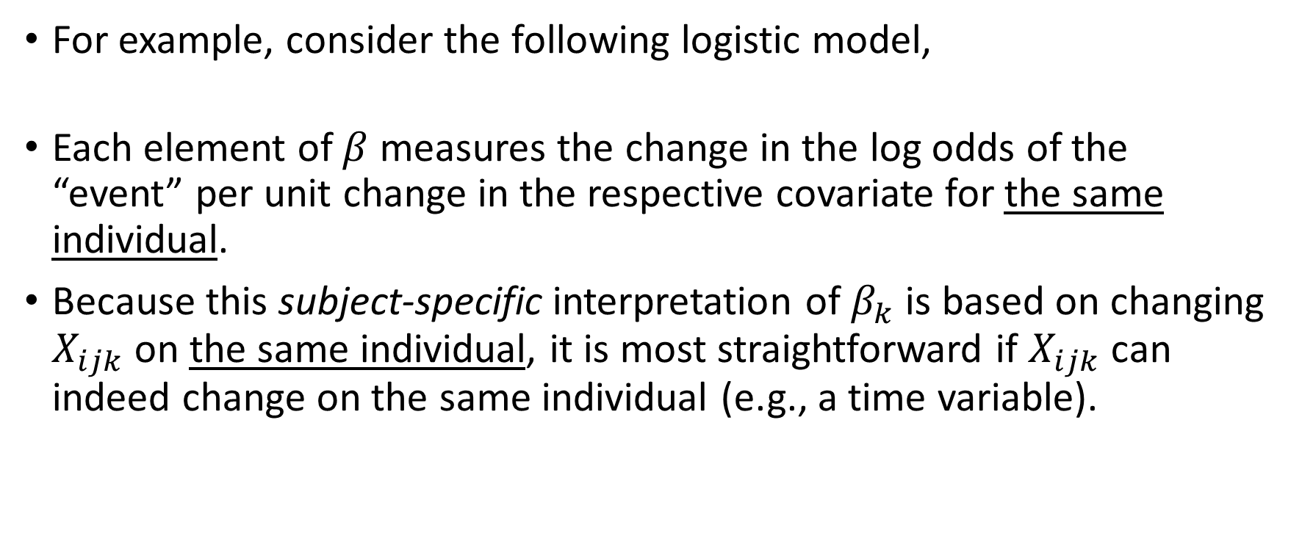
Interpretation of Fixed Effects in GLMM
For example, consider the following logistic model,
Each element of $β$measures the change in the log odds of the “event” per unit change in the respective covariate for the same individual.
Because this subject-specific interpretation of $β_{k}$is based on changing $X_{ijk}$ on the same individual, it is most straightforward if $X_{ijk}$ can indeed change on the same individual (e.g., a time variable).
PHS 651 / Lecture 17
9 / 15

Slide 10
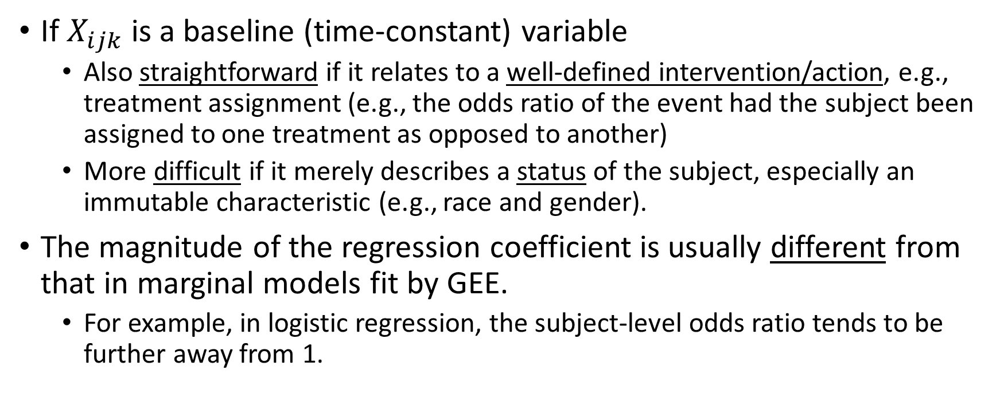
Interpretation of Fixed Effects in GLMM
If $X_{ijk}$ is a baseline (time-constant) variable
  Also straightforward if it relates to a well-defined intervention/action, e.g., treatment assignment (e.g., the odds ratio of the event had the subject been assigned to one treatment as opposed to another)
  More difficult if it merely describes a status of the subject, especially an immutable characteristic (e.g., race and gender).
The magnitude of the regression coefficient is usually differentfrom that in marginal models fit by GEE.
  For example, in logistic regression, the subject-level odds ratio tends to be further away from 1.
PHS 651 / Lecture 17
10 / 15

Slide 11
Interpretation of Fixed Effects in GLMM
For some (but not all) link functions,
PHS 651 / Lecture 17
11 / 15

Slide 12

Estimation in GLMM
ML estimation of $β$(and possibly $φ$) and $G$based on the marginallikelihood of the $Y_{i}$’s.
In general, it requires numerical or Monte Carlo integration techniques that can be computationally quite intensive (usually much more so than a GEE counterpart).
PHS 651 / Lecture 17
12 / 15

Slide 13
Oral Treatment of Toenail Infection
Randomized, double-blind, parallel-group, multicenter study of 294 patients comparing 2 oral treatments (denoted A and B) for toe-nail infection.
Outcome variable: Binary variable indicating presence of onycholysis
(separation of the nail plate from the nail bed).
Patients evaluated for onycholysis(separation of the nail plate
from the nail-bed) at baseline (week 0) and at weeks 4, 8, 12, 24, 36, and 48.
Interested in the rate of decline of the proportion of patients with
onycholysis over time and the effects of treatment on that rate.
PHS 651 / Lecture 17
13 / 15

Slide 14
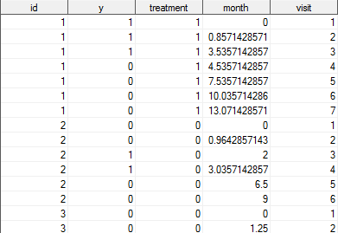
Oral Treatment of Toenail Infection
PHS 651 / Lecture 17
14 / 15

Slide 15
Estimation in GLMM
PHS 651 / Lecture 17
15 / 15

