Slide 1
PHS 651 / LECTURE 18
Contrasting GLMM and GEE
Advanced Regression Methods for Population Health
Lu Mao, PhD
Department of Biostatistics and Medical Informatics
University of Wisconsin-Madison
SPRING 2019

Slide 2
Outline
  Difference between marginal models and GLMM
  A case study with count data
  A case study with a cross-over trial
PHS 651 / Lecture 18
2 / 26

Slide 3
Marginal Models and GLMM
So far, we have discussed two main extensions of GLM:
  Marginal Models (by GEE)
  Generalized Linear Mixed Models
There are important distinctions between these two broad classes of models that go beyond simple differences in approaches for accounting for the within-subject association.
These two classes of models have somewhat different targets of inference and address subtly different questions regarding longitudinal change in the response.
PHS 651 / Lecture 18
3 / 26

Slide 4


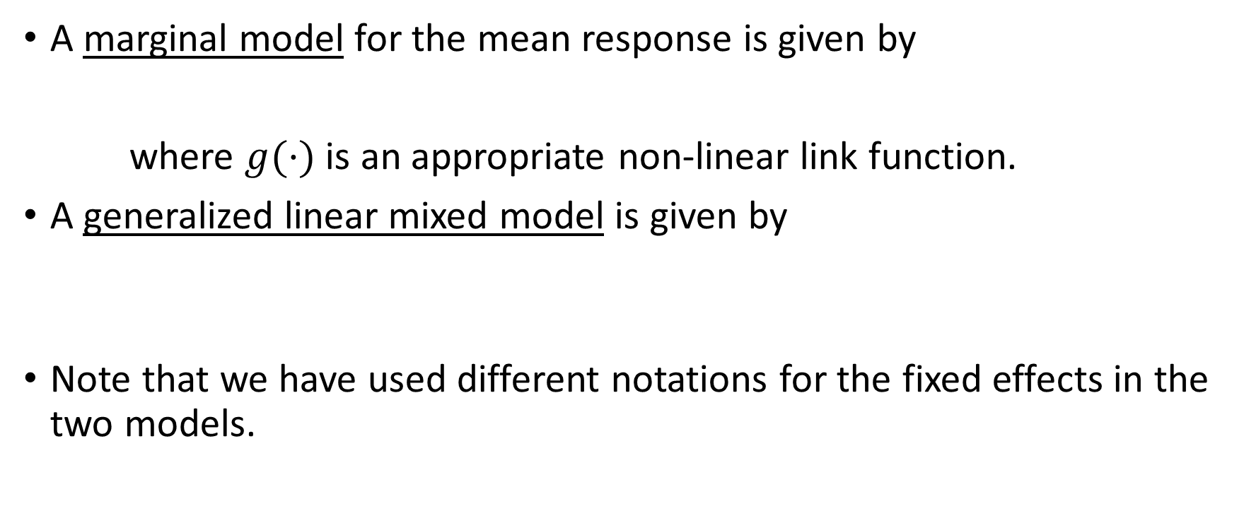
Marginal Models and GLMM
A marginal modelfor the mean response is given by
where $g(·)$is an appropriate non-linear link function.
A generalized linear mixed modelis given by
Note that we have used different notations for the fixed effects in the two models.
PHS 651 / Lecture 18
4 / 26

Slide 5
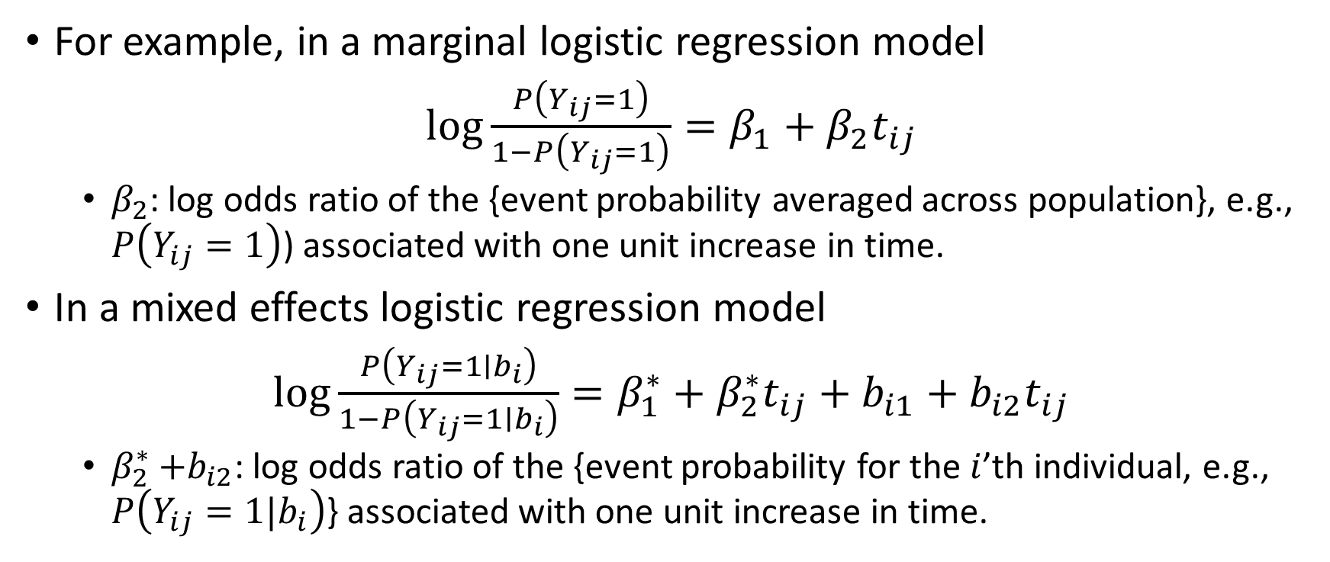
Marginal Models and GLMM
For example, in a marginal logistic regression model
$\log{\frac{P\left(Y_{ij}=1\right)}{1−P\left(Y_{ij}=1\right)}}=β_{1}+β_{2}t_{ij}$
  $β_{2}$: log odds ratio of the {event probability averaged across population}, e.g., $P\left(Y_{ij}=1\right)$) associated with one unit increase in time.
In a mixed effects logistic regression model
$\log{\frac{P\left(Y_{ij}=1∣b_{i}\right)}{1−P\left(Y_{ij}=1∣b_{i}\right)}}=β_{1}^{∗}+β_{2}^{∗}t_{ij}+b_{i1}+b_{i2}t_{ij}$
  $β_{2}^{∗}{+b}_{i2}$: log odds ratio of the {event probability for the $i$’th individual, e.g., $P\left(Y_{ij}=1|b_{i}\right)$} associated with one unit increase in time.
PHS 651 / Lecture 18
5 / 26

Slide 6
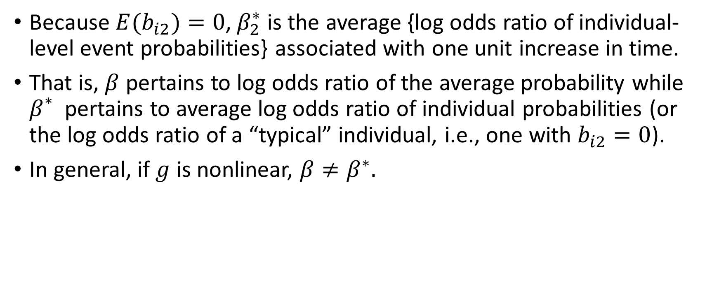
Marginal Models and GLMM
Because ${E(b}_{i2})=0$, $β_{2}^{∗}$ is the average {log odds ratio of individual-level event probabilities} associated with one unit increase in time.
That is, $β$ pertains to log odds ratio of the average probability while $β_{}^{∗}$ pertains to average log odds ratio of individual probabilities (or the log odds ratio of a “typical” individual, i.e., one with $b_{i2}=0$).
In general, if $g$ is nonlinear, $β≠β^{∗}.$
PHS 651 / Lecture 18
6 / 26

Slide 7
Marginal Models and GLMM
 | GEE | GLMM
Interpretation | Population-level | Subject-level
How to account for correlation | Empirical estimation | Via specification of random effects
Assumptions | Weak assumptions, more robust (correlation structure, over-dispersion) | Strong assumptions, less robust
Sample size needed | Moderately big (e.g., >50) | Works with smaller sample sizes provided that the entire model is correctly specified
Computational burden | Light | Heavy
Can do subject-level prediction? | No | Yes
PHS 651 / Lecture 18
7 / 26

Slide 8
Case Study: Analysis of Over-dispersed Count Data
One of the advantages of GEE is that it automatically accounts for over-dispersion when used to analyze count data.
This is because the variances are estimated empirically rather than under the constraints of the Poisson distribution.
In PROC GENMOD, specify the modelseoption in the REPEATED statement to obtain an estimate of the over-dispersion parameter when standard errors (se) are estimated under the Poisson model.
But always use the empirically estimatedse’s, not the model-based ones.
PHS 651 / Lecture 18
8 / 26

Slide 9
Case Study: Analysis of Over-dispersed Count Data
Placebo-controlled clinical trial of 30 patients with leprosy at the Eversley Childs Sanitorium in the Philippines.
Participants were randomized to either of two antibiotics (denoted treatment drug A and B) or to a placebo (denoted treatment drug C).
Baseline data on number of leprosy bacilli at 6 sites of body were recorded.
After several months of treatment, number of bacilli were recorded a second time.
Outcome: Total count of number of leprosy bacilli at 6 sites.
PHS 651 / Lecture 18
9 / 26

Slide 10
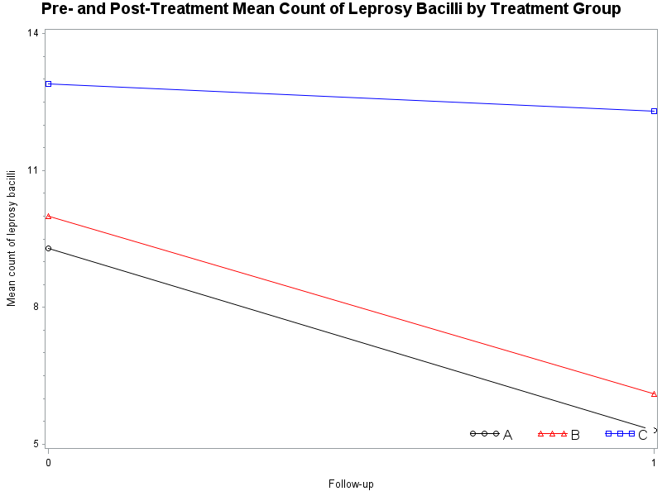
Case Study: Analysis of Over-dispersed Count Data
PHS 651 / Lecture 18
10 / 26

Slide 11
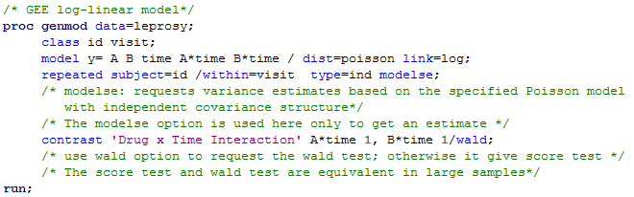
Case Study: Analysis of Over-dispersed Count Data
PHS 651 / Lecture 18
11 / 26

Slide 12
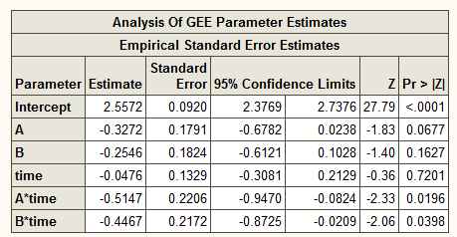
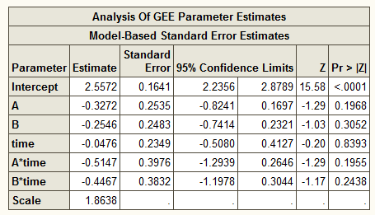
Case Study: Analysis of Over-dispersed Count Data
Use results in this table Look only at the scale parameter here parameter
Dispersion is 1.86 times that predicted by the (independent) Poisson model.
This over-dispersion is accounted for in the empirical standard errors.
PHS 651 / Lecture 18
12 / 26

Slide 13
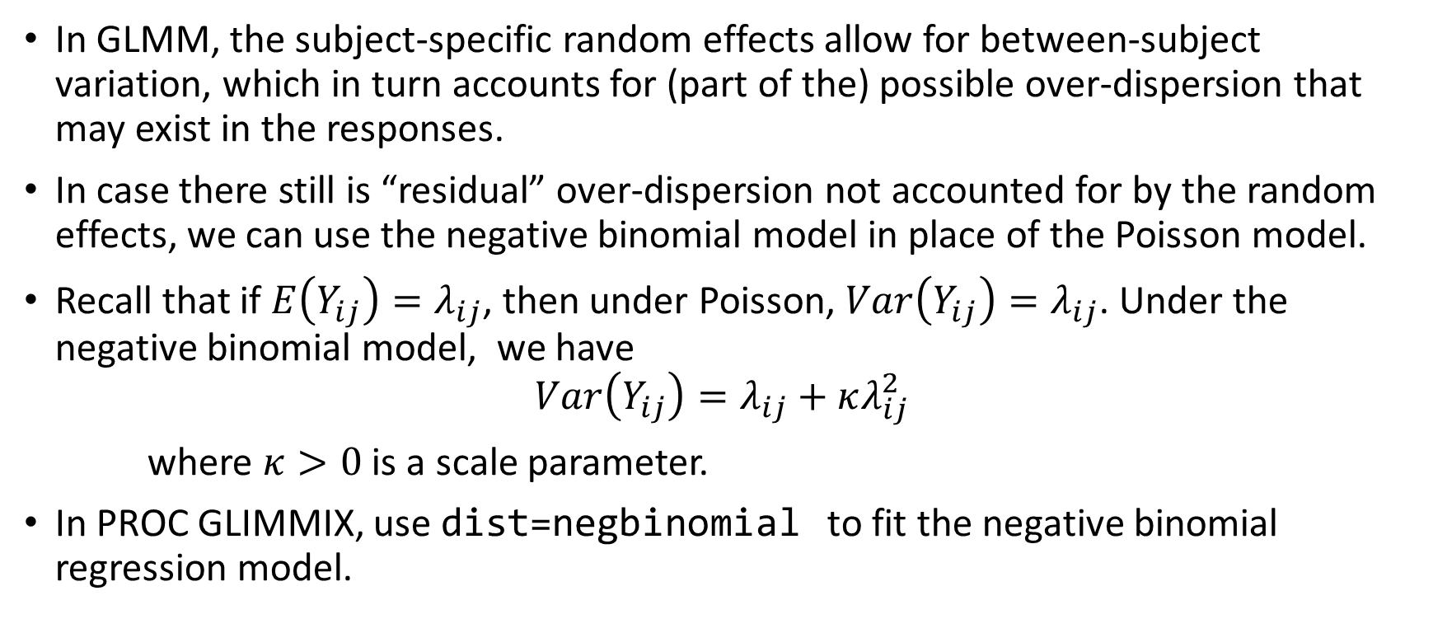
Case Study: Analysis of Over-dispersed Count Data
In GLMM, the subject-specific random effects allow for between-subject variation, which in turn accounts for (part of the) possible over-dispersion that may exist in the responses.
In case there still is “residual” over-dispersion not accounted for by the random effects, we can use the negative binomial model in place of the Poisson model.
Recall that if $E\left(Y_{ij}\right)=λ_{ij}$, then under Poisson, $Var\left(Y_{ij}\right)=λ_{ij}$. Under the negative binomial model, we have
$$Var\left(Y_{ij}\right)=λ_{ij}+κλ_{ij}^{2}$$
where $κ>0$ is a scale parameter.
In PROC GLIMMIX, use dist=negbinomialto fit the negative binomial regression model.
PHS 651 / Lecture 18
13 / 26

Slide 14
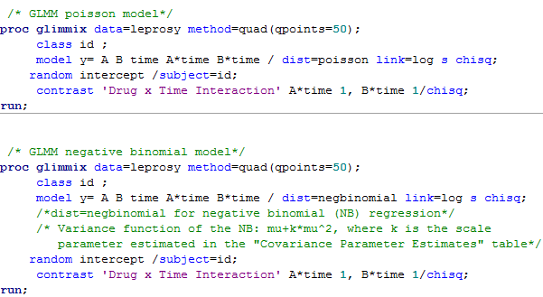
Case Study: Analysis of Over-dispersed Count Data
PHS 651 / Lecture 18
14 / 26

Slide 15
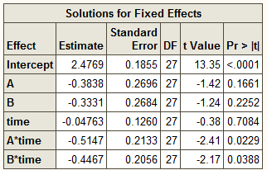
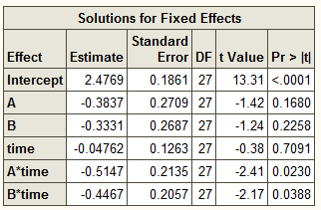
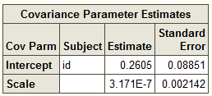

Case Study: Analysis of Over-dispersed Count Data
GLMM Poisson regression results:
GLMM negative binomial regression results:
This is an estimate of our $κ$
PHS 651 / Lecture 18
15 / 26

Slide 16
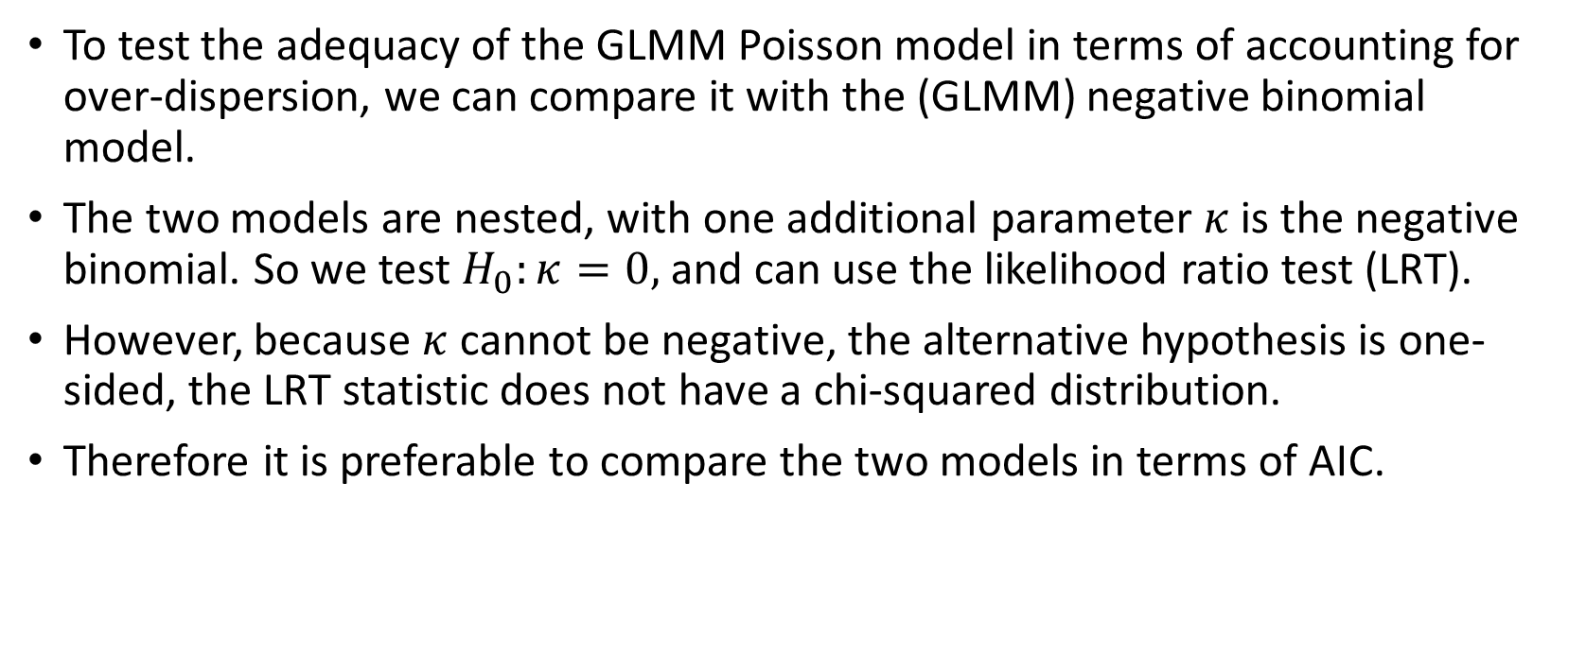
Case Study: Analysis of Over-dispersed Count Data
To test the adequacy of the GLMM Poisson model in terms of accounting for over-dispersion, we can compare it with the (GLMM) negative binomial model.
The two models are nested, with one additional parameter $κ$ is the negative binomial. So we test $H_{0}:κ=0,$ and can use the likelihood ratio test (LRT).
However, because $κ$ cannot be negative, the alternative hypothesis is one-sided, the LRT statistic does not have a chi-squared distribution.
Therefore it is preferable to compare the two models in terms of AIC.
PHS 651 / Lecture 18
16 / 26

Slide 17
Case Study: Analysis of Over-dispersed Count Data
 | GLMM Poisson | GLMM Negative Binomial
-2 Log Likelihood | 349.86 | 349.86
AIC (smaller is better) | 363.86 | 365.86
Clearly, the GLMM Poisson model is adequate in terms of accounting for over-dispersion with reference to the negative binomial model.
PHS 651 / Lecture 18
17 / 26

Slide 18
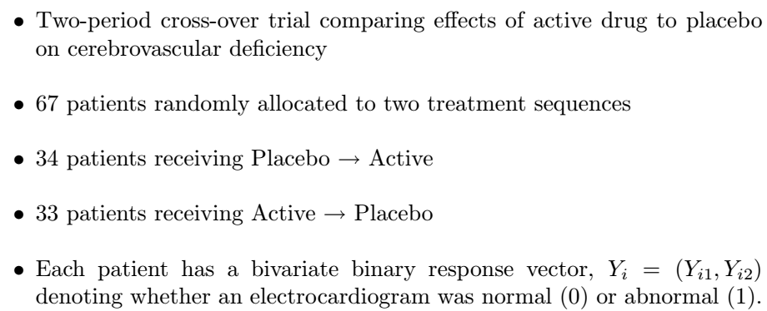
Case Study: A Cross-Over Trial
PHS 651 / Lecture 18
18 / 26

Slide 19
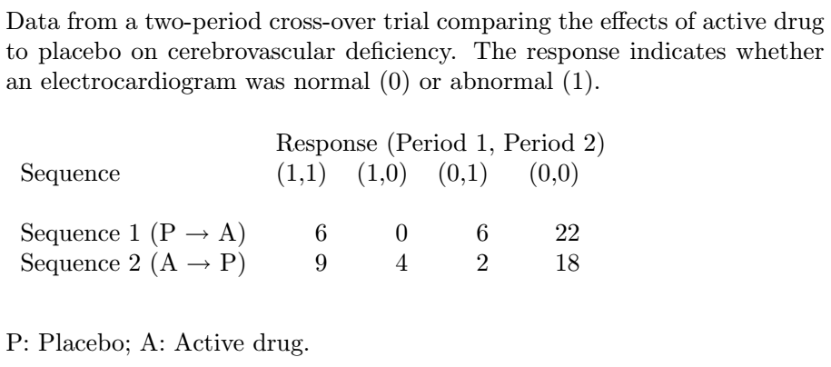
Case Study: A Cross-Over Trial
PHS 651 / Lecture 18
19 / 26

Slide 20
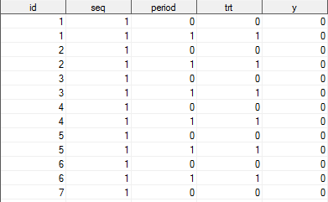
Case Study: A Cross-Over Trial
Variable List: ID, Seq(1=Placebo-->Active, 2=Active-->Placebo), Period (0=Period 1, 1=Period 2), TRT (0=Placebo, 1=Active Drug), ECG Response (0=Normal, 1=Abnormal).
PHS 651 / Lecture 18
20 / 26

Slide 21
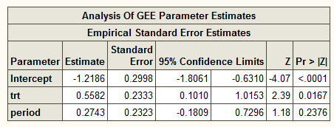
Case Study: A Cross-Over Trial
First, we use a marginal logistic regression model
Note that because treatment is time-varying, we assess the main effect of treatment rather than its interaction with time.
PHS 651 / Lecture 18
21 / 26

Slide 22
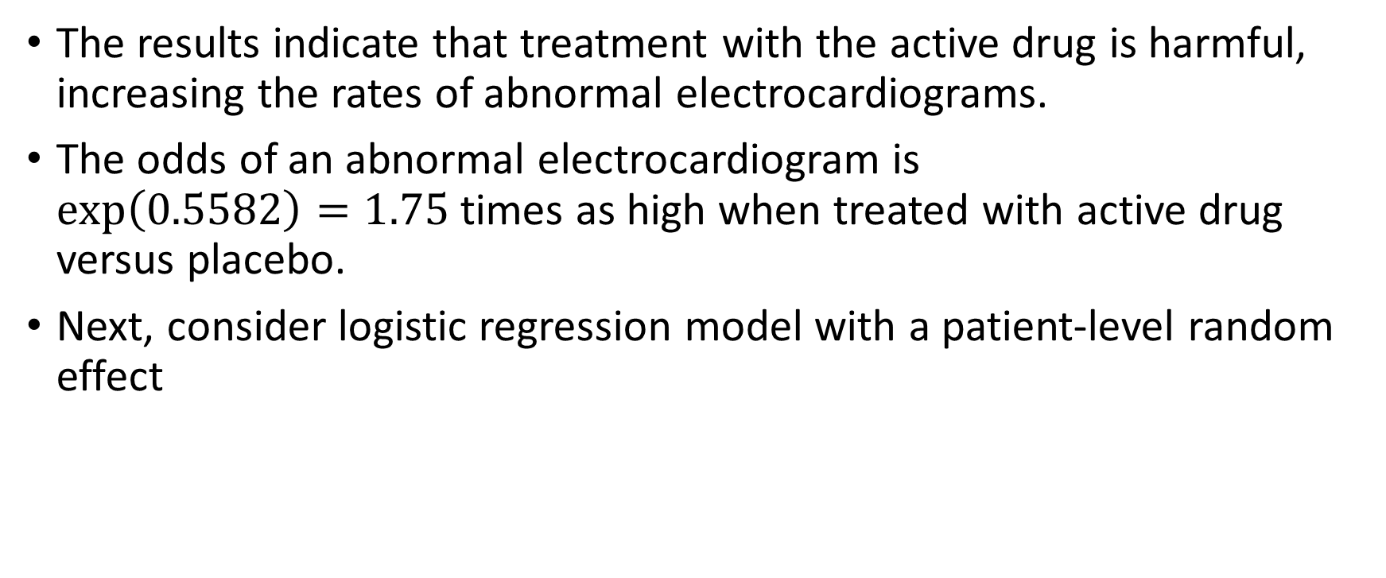
Case Study: A Cross-Over Trial
The results indicate that treatment with the active drug is harmful,
increasing the rates of abnormal electrocardiograms.
The odds of an abnormal electrocardiogram is $\exp\left(0.5582\right)=1.75$times as high when treated with active drug versus placebo.
Next, consider logistic regression model with a patient-level random effect
PHS 651 / Lecture 18
22 / 26

Slide 23
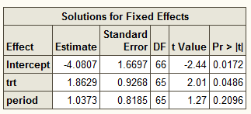

Case Study: A Cross-Over Trial
The results also indicate that treatment with the active drug increases the patient-specific risk of an abnormal electrocardiogram.
In particular, a patient’s odds of an abnormal electrocardiogram is $\exp\left(1.8629\right)=6.44$ times high when treated with active drug than when treated with the placebo.
PHS 651 / Lecture 18
23 / 26

Slide 24
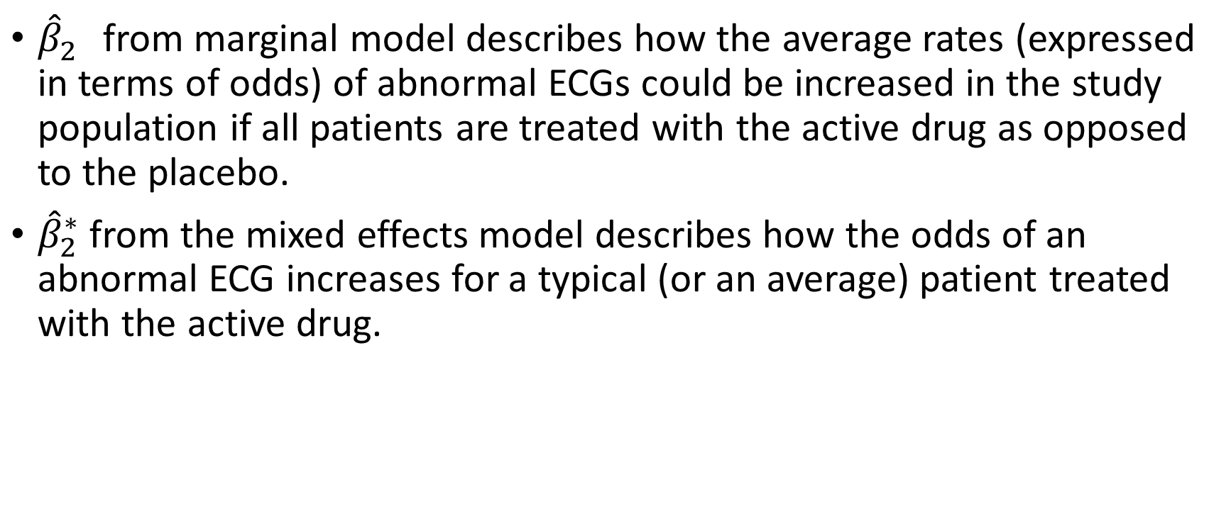
Case Study: A Cross-Over Trial
${\hat{β}}_{2}^{}$ from marginal model describes how the average rates (expressed in terms of odds) of abnormal ECGs could be increased in the study population if all patients are treated with the active drugas opposed to the placebo.
${\hat{β}}_{2}^{∗}$ from the mixed effects model describes how the odds of an abnormal ECG increases for a typical (or an average) patient treated with the active drug.
PHS 651 / Lecture 18
24 / 26

Slide 25
Summary
Unlike linear models, longitudinal analysis of categorical data raises many
subtle issues.
Different models for categorical outcomes can give discernibly different
results.
The choice and meaning of longitudinal models for categorical outcomes
require somewhat greater care.
With different targets of inference, different models for categorical outcomes address subtly different questions regarding longitudinal change.
PHS 651 / Lecture 18
25 / 26

Slide 26
Summary
Choice among models?
  Should be primarily guided by specific scientific question of interest
  May also consider robustness (in covariance structure, over-dispersion), efficiency, sample size, computational issues, etc.
PHS 651 / Lecture 18
26 / 26

