Slide 1
PHS 651 / LECTURE 19
Missing Data and Multiple Imputation
Advanced Regression Methods for Population Health
Lu Mao, PhD
Department of Biostatistics and Medical Informatics
University of Wisconsin-Madison
SPRING 2019

Slide 2
Outline
  Missing data mechanisms and corresponding methods
  Multiple imputation by PROC MI
  An Example with the TLC trial
PHS 651 / Lecture 19
2 / 33

Slide 3
Missing Data in Longitudinal Studies
In longitudinal studies in health sciences, missing data are the norm rather than the exception.
Missing data problem is more serious in longitudinal data than in cross-sectional data.
  Missingness can occur at any of the measurement occasions;
  Attrition/Dropout: patient withdraws before end of study.
PHS 651 / Lecture 19
3 / 33

Slide 4
Missing Data in Longitudinal Studies
Missing data have important implications in longitudinal analysis
  Data become unbalanced;
  Information loss;
  Bias due to informative missingness/dropout. For instance, if greater values tend to be missing, then the available data tend to be smaller than representative of the target population.
If the reason a response is unobserved has to do with its underlying value, then bias may be introduced in the available data.
Whenever data are missing, we must carefully consider why they are missing.
PHS 651 / Lecture 19
4 / 33

Slide 5
Reason for Missingness
Example: Six Cities Study of Air Pollution.
Longitudinal study designed to characterize lung function growth in children and adolescents.
Most children were enrolled between the ages of six and seven and measurements were obtained annually until graduation from high school.
Response variable: Volume of air exhaled in the ﬁrst second of spirometry manoeuvre, FEV1.
Due to late entry or loss-to-follow-up, number of measurements varied from 1 to 12.
PHS 651 / Lecture 19
5 / 33

Slide 6
Reason for Missingness
The main reason for late entry or drop-out is moving in and out of a school district.
If a child changed the school district because of employment relocation of the parents, then missing measurement can be thought of as unrelated to the child’s lung function.
If a child moved out because of deteriorating respiratory health (possibly due to poor air quality of the district), then missingness is related to the response, i.e., lung function, and the available data are a biased sample of the underlying population.
PHS 651 / Lecture 19
6 / 33

Slide 7
Missing Data in Longitudinal Studies
Therefore, the reasons for missing data, often referred to as missing data mechanism, must be carefully examined.
Missing data mechanism:
  Missing Completely at Random (MCAR): missingness does not depend on observed or unobserved responses (a flip of a coin);
  Missing at Random (MAR): missingness depends on observed responses but not unobserved ones;
  Not Missing at Random (NMAR): missingness depends on unobserved responses.
Severity: MCAR<MAR<NMAR
PHS 651 / Lecture 19
7 / 33

Slide 8
Missing Data in Longitudinal Studies
Usually the missingness mechanism is not under the controlled of the investigator and is not understood with certainty.
Instead, assumptions are made about the missing data mechanism.
Assumptions on missing data mechanism are derived from substantive knowledge (cf. the Six-Cities Study).
When reporting analysis results based on data with missingness, we should state explicitly the assumption made on the missing data mechanism.
PHS 651 / Lecture 19
8 / 33

Slide 9
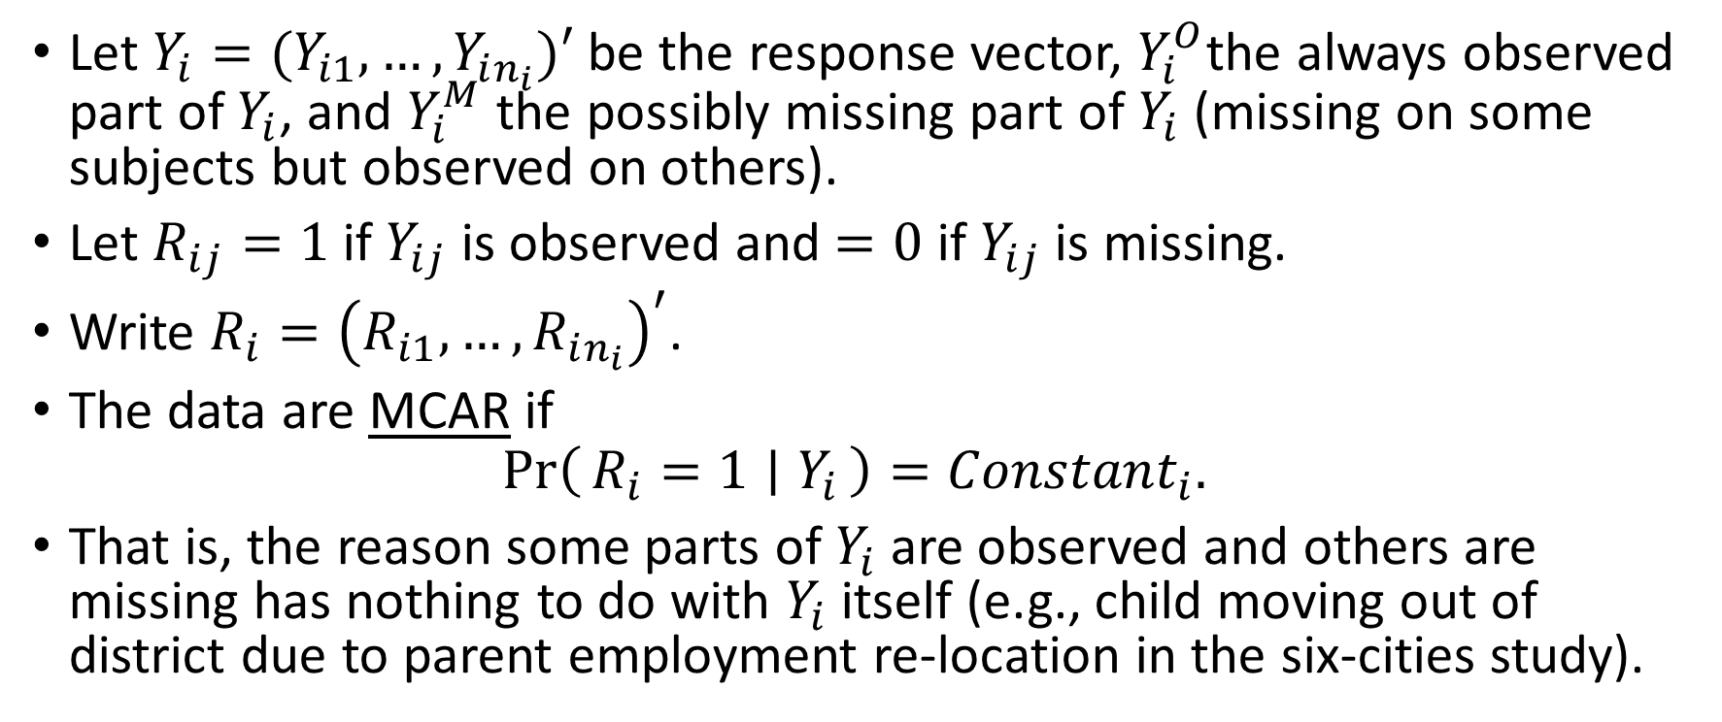
Missing Data Mechanisms
Let $Y_{i}=(Y_{i1},…, Y_{in_{i}})′$ be the response vector, $Y_{i}^{O}$the always observed part of $Y_{i}$, and $Y_{i}^{M}$ the possibly missing part of $Y_{i}$ (missing on some subjects but observed on others).
Let $R_{ij}=1$ if $Y_{ij}$ is observed and $=0$ if $Y_{ij}$ is missing.
Write $R_{i}={\left(R_{i1},…, R_{in_{i}}\right)}^{′}$.
The data are MCAR if
$$\operatorname{Pr}\left(R_{i}=1 ∣ Y_{i}\right)={Constant}_{i}.$$
That is, the reason some parts of $Y_{i}$ are observed and others are missing has nothing to do with $Y_{i}$ itself (e.g., child moving out of district due to parent employment re-location in the six-cities study).
PHS 651 / Lecture 19
9 / 33

Slide 10
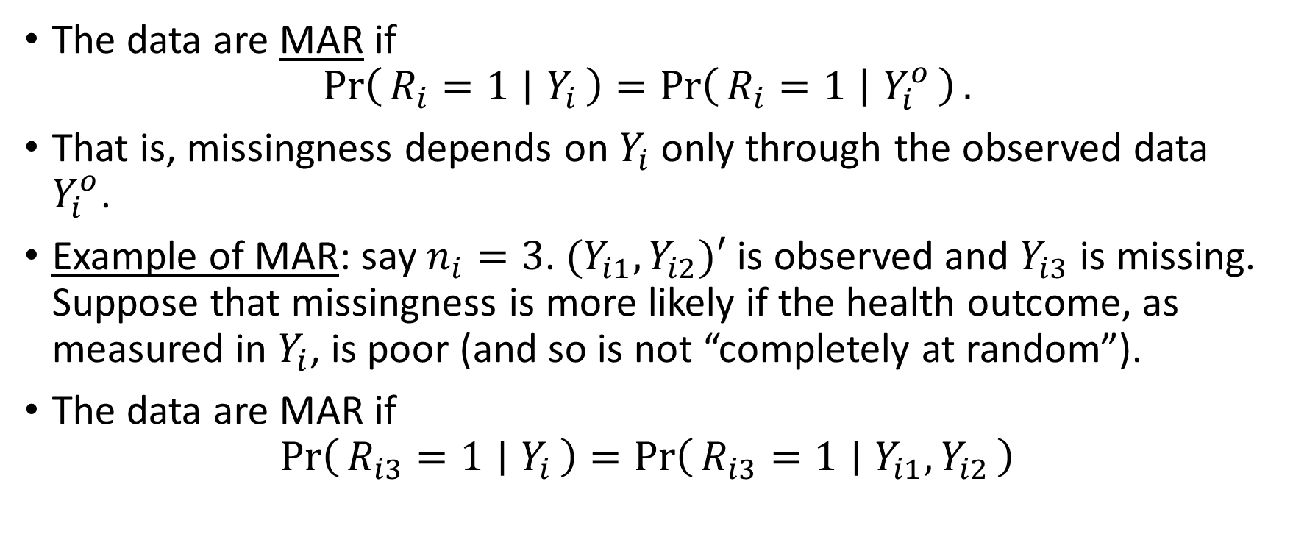
Missing Data Mechanisms
The data are MAR if
$$\operatorname{Pr}\left(R_{i}=1 ∣ Y_{i}\right)=\operatorname{Pr}\left(R_{i}=1 ∣ Y_{i}^{o}\right).$$
That is, missingness depends on $Y_{i}$ only through the observed data $Y_{i}^{o}$.
Example of MAR: say $n_{i}=3$. ${(Y}_{i1}, Y_{i2})′$ is observed and $Y_{i3}$ is missing. Suppose that missingness is more likely if the health outcome, as measured in $Y_{i}$, is poor (and so is not “completely at random”).
The data are MAR if
$$\operatorname{Pr}\left(R_{i3}=1 ∣ Y_{i}\right)=\operatorname{Pr}\left(R_{i3}=1 ∣ Y_{i1}, Y_{i2}\right)$$
PHS 651 / Lecture 19
10 / 33

Slide 11
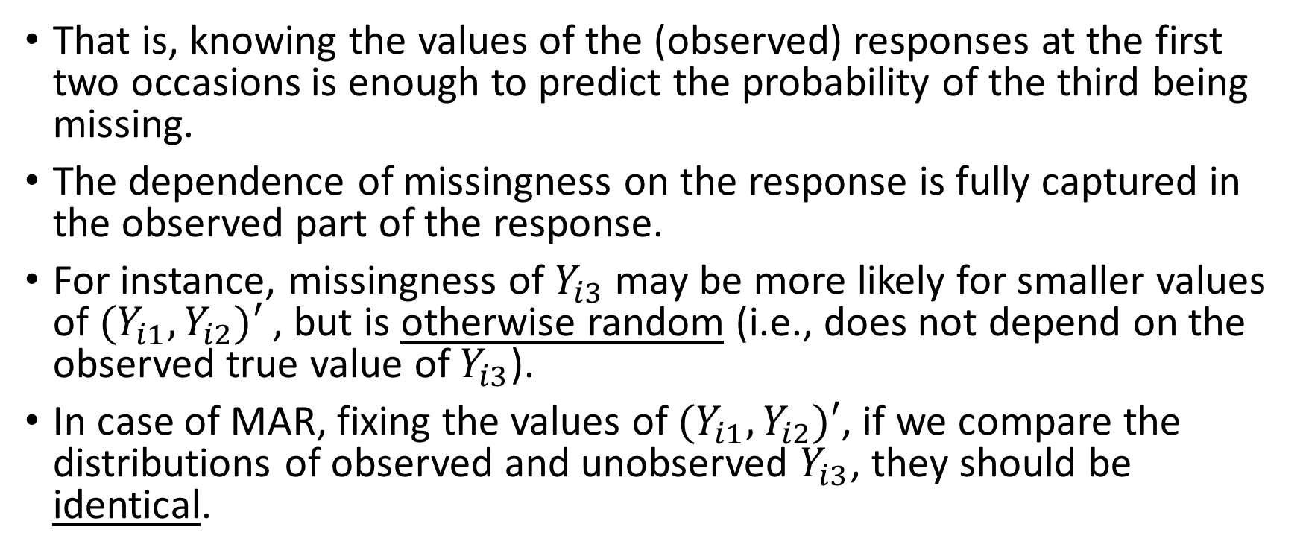
Missing Data Mechanisms
That is, knowing the values of the (observed) responses at the first two occasions is enough to predict the probability of the third being missing.
The dependence of missingness on the response is fully captured in the observed part of the response.
For instance, missingness of $Y_{i3}$ may be more likely for smaller values of ${(Y}_{i1}, Y_{i2})′$, but is otherwise random (i.e., does not depend on the observed true value of $Y_{i3}$).
In case of MAR, fixing the values of ${(Y}_{i1}, Y_{i2})′$, if we compare the distributions of observed and unobserved $Y_{i3}$, they should be identical.
PHS 651 / Lecture 19
11 / 33

Slide 12
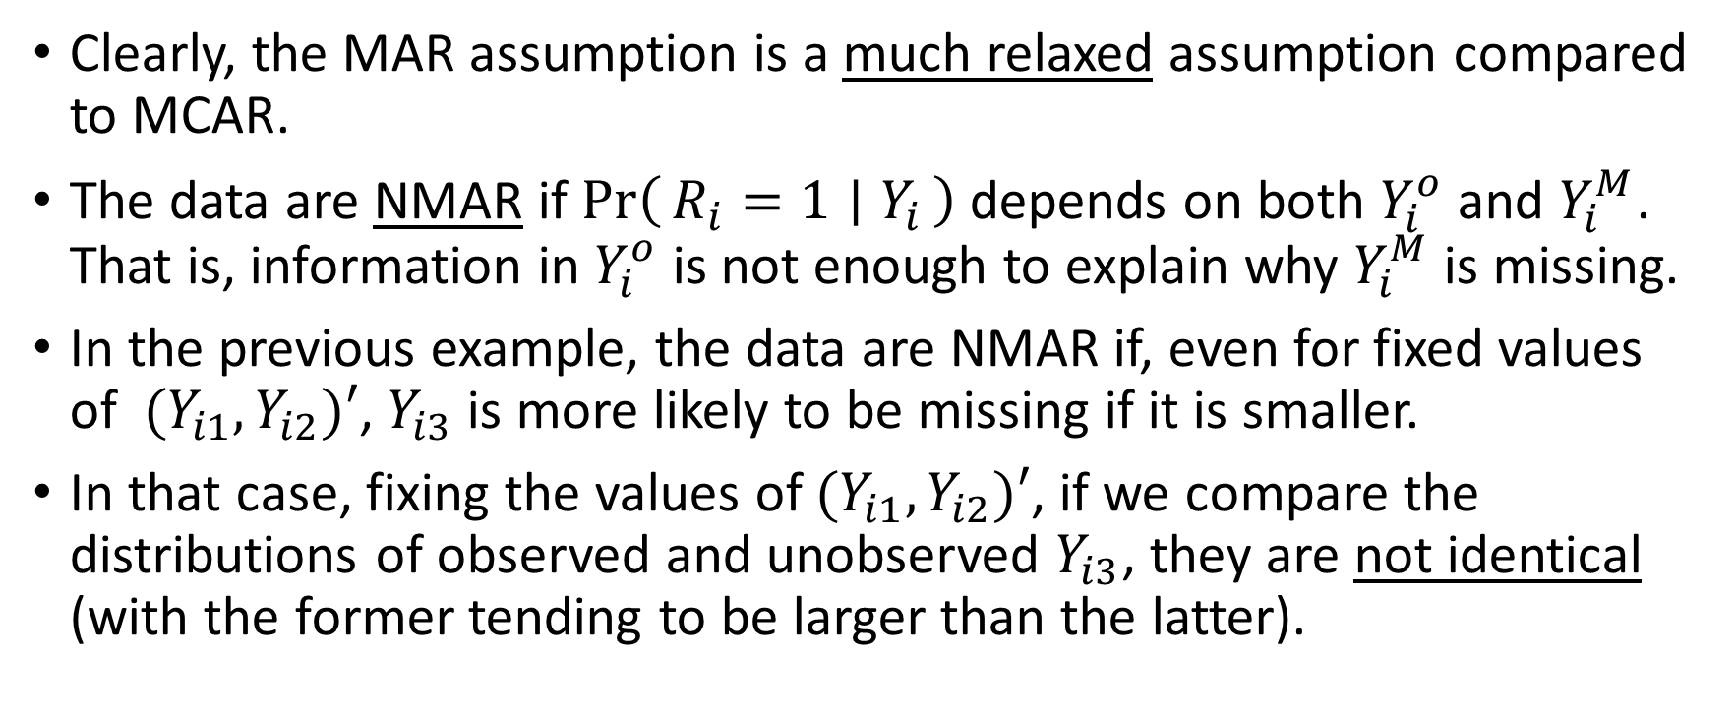
Missing Data Mechanisms
Clearly, the MAR assumption is a much relaxed assumption compared to MCAR.
The data are NMAR if $\operatorname{Pr}\left(R_{i}=1 ∣ Y_{i}\right)$ depends on both $Y_{i}^{o}$ and $Y_{i}^{M}$. That is, information in $Y_{i}^{o}$ is not enough to explain why $Y_{i}^{M}$ is missing.
In the previous example, the data are NMAR if, even for fixed values of ${(Y}_{i1}, Y_{i2})′$,$Y_{i3}$ is more likely to be missing if it is smaller.
In that case, fixing the values of ${(Y}_{i1}, Y_{i2})′$, if we compare the distributions of observed and unobserved $Y_{i3}$, they are not identical (with the former tending to be larger than the latter).
PHS 651 / Lecture 19
12 / 33

Slide 13
Missing Data Mechanisms
There are specialized statistical techniques for MCAR and MAR data to adjust for missing data.
Analysis of NMAR data generally lead to biased inference.
What is worse, whether the data are MAR or NMAR cannot be identified from the (observed) data.
So, the assumption of MAR needs to be made and justified on substantive grounds.
For valid inference, one should try to collect all variables believed to be associated with any possible missingness, so that the data are MAR if missingness occur.
PHS 651 / Lecture 19
13 / 33

Slide 14
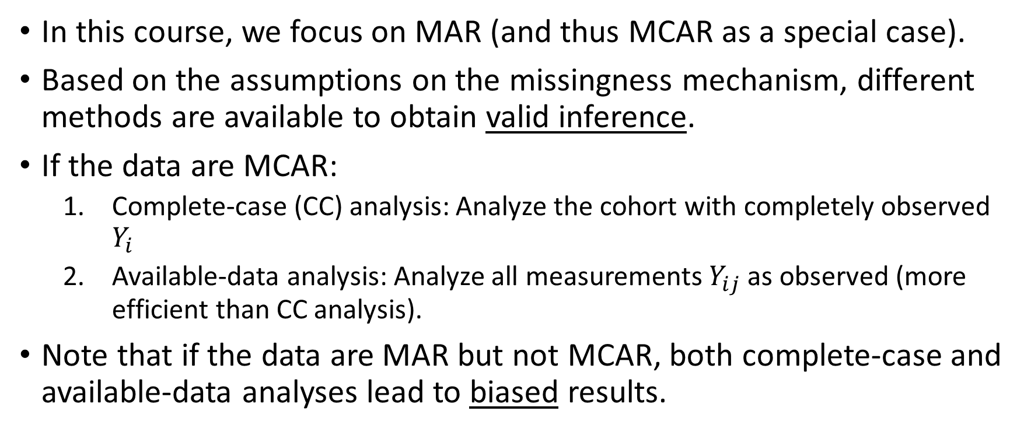
Methods for Missing Data
In this course, we focus on MAR (and thus MCAR as a special case).
Based on the assumptions on the missingness mechanism, different methods are available to obtain valid inference.
If the data are MCAR:
  Complete-case (CC) analysis: Analyze the cohort with completely observed $Y_{i}$
  Available-data analysis: Analyze all measurements $Y_{ij}$ as observed (more efficient than CC analysis).
Note that if the data are MAR but not MCAR, both complete-case and available-data analyses lead to biased results.
PHS 651 / Lecture 19
14 / 33

Slide 15
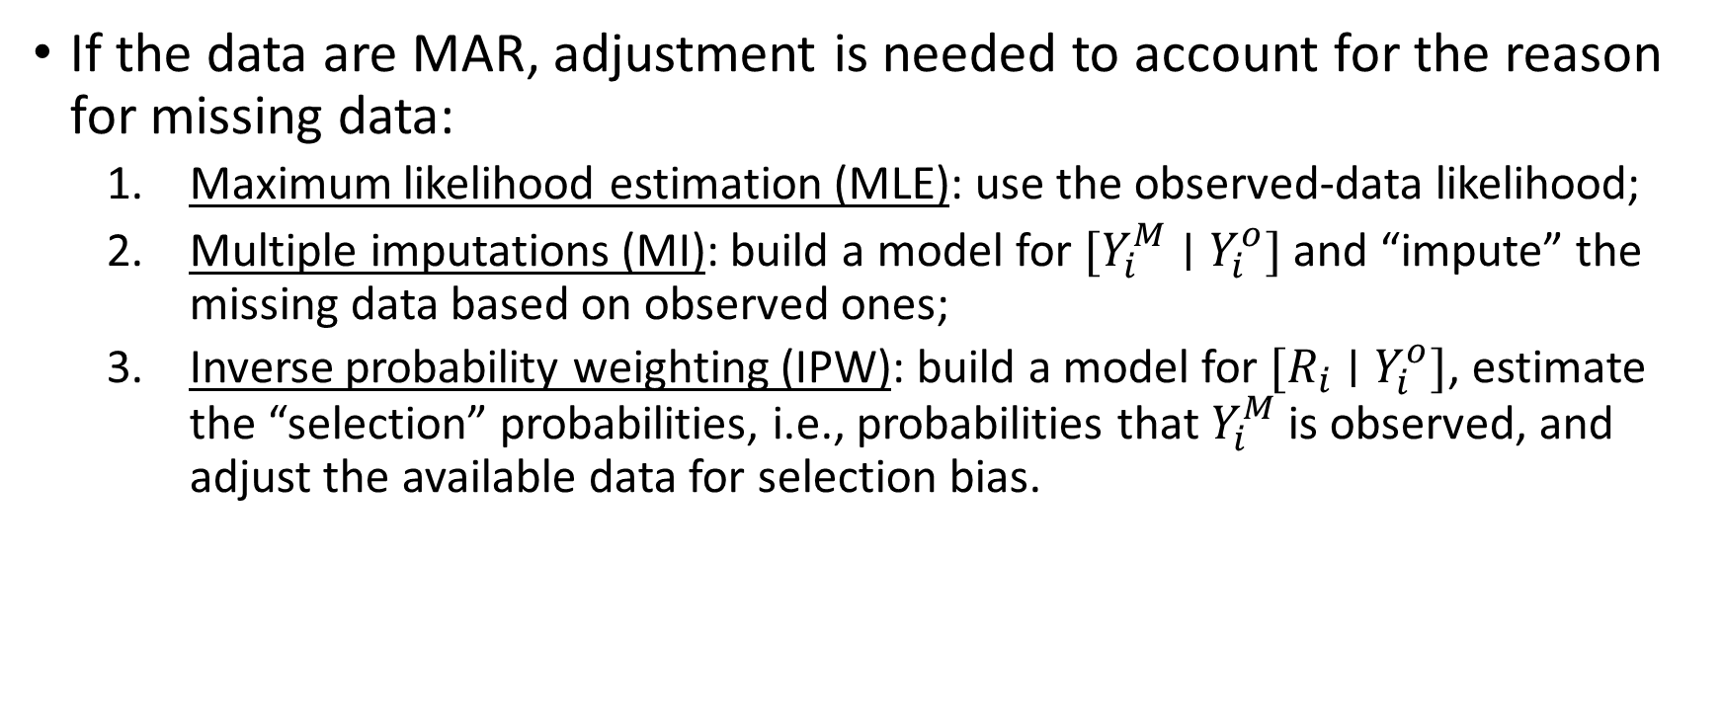
Methods for Missing Data
If the data are MAR, adjustment is needed to account for the reason for missing data:
  Maximum likelihood estimation (MLE): use the observed-data likelihood;
  Multiple imputations (MI): build a model for $[Y_{i}^{M}∣Y_{i}^{o}]$ and “impute” the missing data based on observed ones;
  Inverse probability weighting (IPW): build a model for $[R_{i}∣Y_{i}^{o}]$, estimate the “selection” probabilities, i.e., probabilities that $Y_{i}^{M}$ is observed, and adjust the available data for selection bias.
PHS 651 / Lecture 19
15 / 33

Slide 16
Methods for Missing Data
Default assumption and method by SAS.
Missingness Mechanism | Statistical Methods | SASImplementation
MCAR | Available-Data Analysis | PROC GENMOD (GEE)
MAR | Maximum Likelihood | PROC MIXED/GLIMMIX (Mixed models)
PHS 651 / Lecture 19
16 / 33

Slide 17
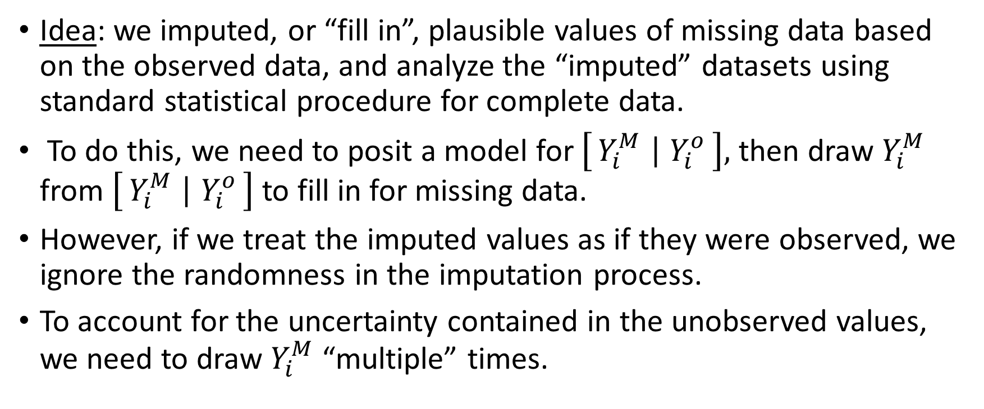
Multiple Imputations
Idea: we imputed, or “fill in”, plausible values of missing data based on the observed data, and analyze the “imputed” datasets using standard statistical procedure for complete data.
To do this, we need to posit a model for $\left[Y_{i}^{M} ∣ Y_{i}^{o}\right],$ then draw $Y_{i}^{M}$ from $\left[Y_{i}^{M} ∣ Y_{i}^{o}\right]$ to fill in for missing data.
However, if we treat the imputed values as if they were observed, we ignore the randomness in the imputation process.
To account for the uncertainty contained in the unobserved values, we need to draw $Y_{i}^{M}$ “multiple” times.
PHS 651 / Lecture 19
17 / 33

Slide 18
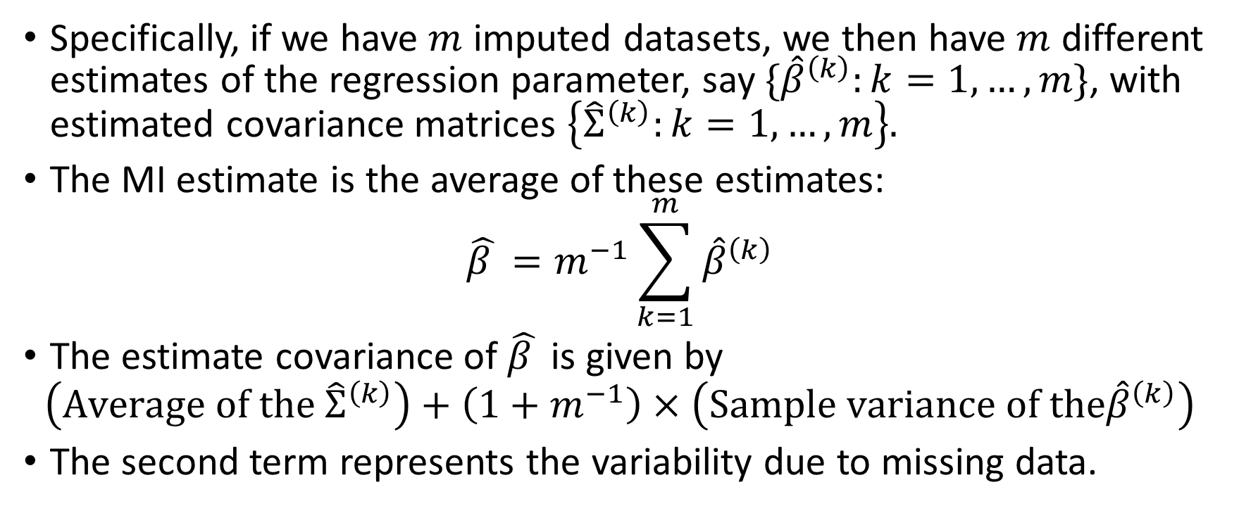
Multiple Imputations
Specifically, if we have $m$ imputed datasets, we then have $m$ different estimates of the regression parameter, say $\{{\hat{β}}^{\left(k\right)}:k=1,…, m\}$, with estimated covariance matrices $\left\{{\hat{Σ}}^{\left(k\right)}:k=1,…, m\right\}.$
The MI estimate is the average of these estimates:
$$\hat{β }=m^{−1}\sum_{k=1}^{m}{{\hat{β}}^{\left(k\right)}}$$
The estimate covariance of $\hat{β }$ is given by
$$\left(Average of the{ \hat{Σ}}^{\left(k\right)}\right)+\left(1+m^{−1}\right)×\left(Sample variance of the{\hat{β}}^{\left(k\right)}\right)$$
The second term represents the variability due to missing data.
PHS 651 / Lecture 19
18 / 33

Slide 19
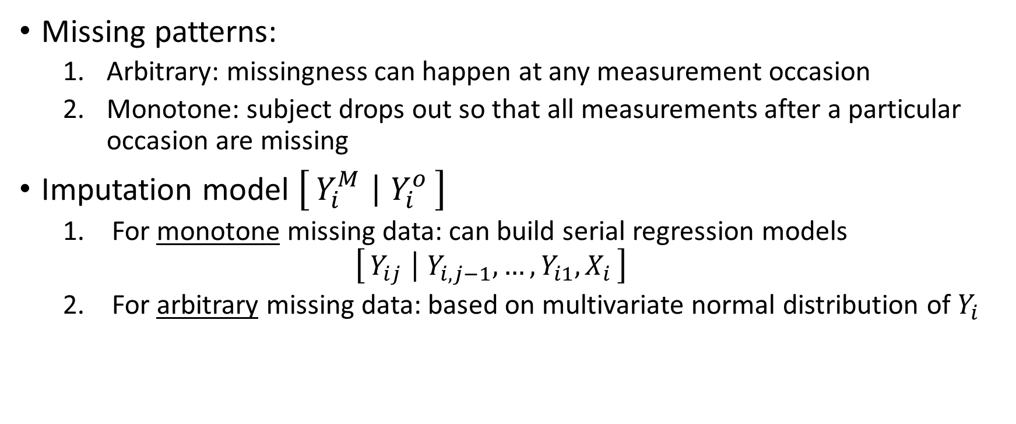
Multiple Imputations
Missing patterns:
  Arbitrary: missingness can happen at any measurement occasion
  Monotone: subject drops out so that all measurements after a particular occasion are missing
Imputation model $\left[Y_{i}^{M} ∣ Y_{i}^{o}\right]$
  For monotone missing data: can build serial regression models
  $$\left[Y_{ij} ∣ Y_{i,j−1},…,Y_{i1}, X_{i}\right]$$
  For arbitrarymissing data: based on multivariate normal distribution of $Y_{i}$
PHS 651 / Lecture 19
19 / 33

Slide 20
Multiple Imputations by PROC MI
First off, to use PROC MI, the data need to be in the “wide” format.
Say, there are missing data in responses y1—y4 with an arbitrary missing pattern.
/* Impute missing values in y1—y4 based on a multivariate normal distribution for each group level; output NIMPUTE=50 imputed datasets in sas file “mifile”.
SEED can be any random integer; specified for reproducibility */
PROC MI DATA=widefile SEED=12345 NIMPUTE=50 OUT=mifile;
VAR group y1 y2 y3 y4;
MCMC NBITER=5000 NITER=500; /* use the Markov Chain Monte Carlo with 5000 burn-in iterations and 500 iterations between imputations */
RUN;
PHS 651 / Lecture 19
20 / 33

Slide 21
Multiple Imputations by PROC MI
For non-continuous responses, one can round the imputed values accordingly.
A more principle approach to imputing non-continuous response is through regression models, but that only works for monotone missing data.
See Section 18.6 of FLW for regression model-based imputation for monotone missing data in PROC MI.
PHS 651 / Lecture 19
21 / 33

Slide 22
Multiple Imputations by PROC MI
After the imputed datasets are generated in the SAS file “mifile”, we use the standard procedure, e.g., PROC GENMOD, to analyze the SAS file by dataset (indicated by variable “_imputation_”).
This usually amounts to adding a “by _imputation_” statement to the standard procedure and output the appropriate parameter estimates table to a SAS file .
Finally, we use PROC MIANALYZE to combine the parameter estimates to obtain the final results.
PHS 651 / Lecture 19
22 / 33

Slide 23
Example: TLC Trial
Treatment of Lead-Exposed Children (TLC) Trial
100 children exposed to lead were randomized into succimer and placebo groups, each N=50
Data consist of 4 repeated measurements of blood lead levels obtained at baseline (or week 0), weeks 1, 4, and 6.
Missing data are artificially created for illustrative purposes.
PHS 651 / Lecture 19
23 / 33

Slide 24
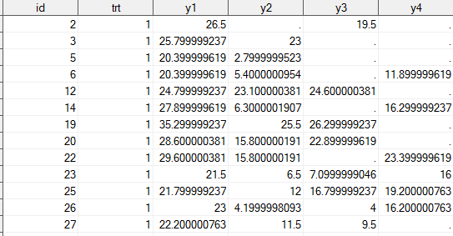
Example: TLC Trial
PHS 651 / Lecture 19
24 / 33

Slide 25
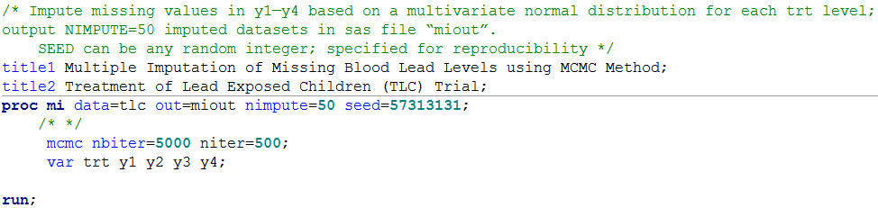
Example: TLC Trial
PHS 651 / Lecture 19
25 / 33

Slide 26
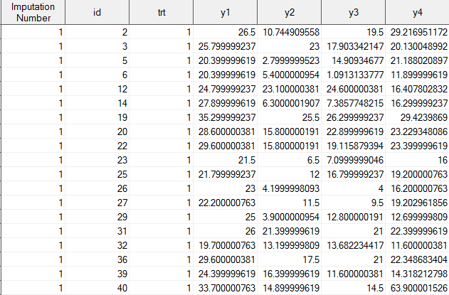
Example: TLC Trial
The multiply-imputed “miout” dataset
PHS 651 / Lecture 19
26 / 33

Slide 27
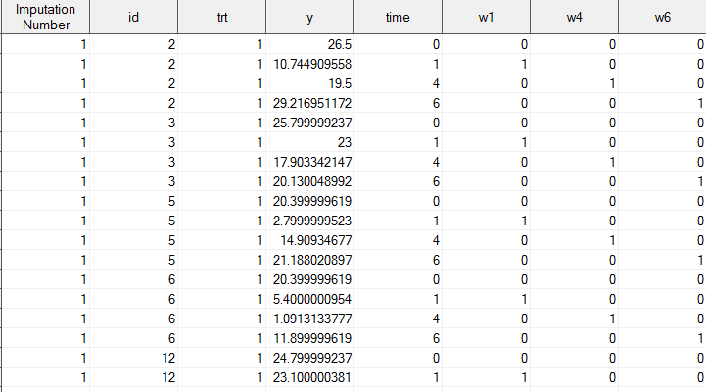
Example: TLC Trial
Then, transform the “miout” dataset to a “long” dataset “milong”.
PHS 651 / Lecture 19
27 / 33

Slide 28
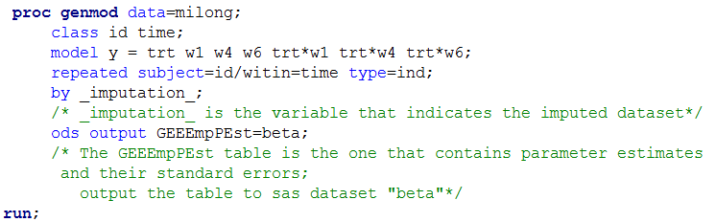
Example: TLC Trial
PHS 651 / Lecture 19
28 / 33

Slide 29
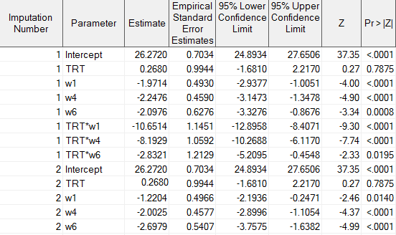
Example: TLC Trial
The “beta” dataset
PHS 651 / Lecture 19
29 / 33

Slide 30
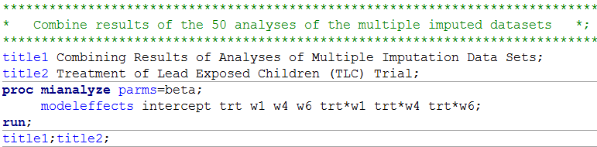
Example: TLC Trial
Anything contained in the “Parameter”
Column in the “beta” dataset.
PHS 651 / Lecture 19
30 / 33

Slide 31
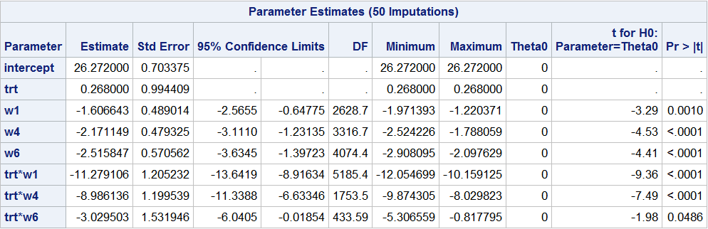
Example: TLC Trial
PHS 651 / Lecture 19
31 / 33

Slide 32
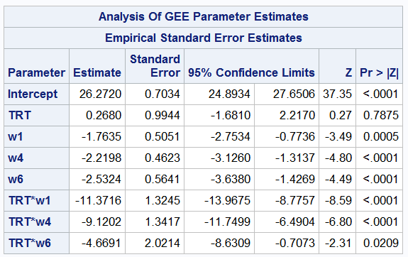
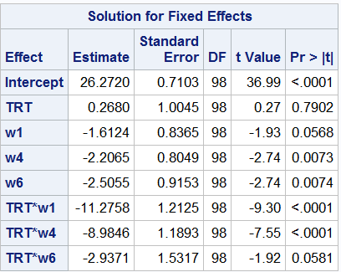
Example: TLC Trial
Available-data analysis by GEE MLE by PROC MIXED
PHS 651 / Lecture 19
32 / 33

Slide 33
Summary
Missing Data Mechanism | Method | SAS Implementation
MCAR | Complete-case/Available data analysis | GEE by PROC GEMOD
MAR | MLE | PROC MIXED/GLIMMIX
 | MI | PROC MI combined with standard procedure (e.g., GENMOD)
 | IPW | ? (Next lecture)
NMAR
PHS 651 / Lecture 19
33 / 33

