Slide 1
PHS 651 / LECTURE 20
Inverse Probability Weighting for Missing Data
Advanced Regression Methods for Population Health
Lu Mao, PhD
Department of Biostatistics and Medical Informatics
University of Wisconsin-Madison
SPRING 2019

Slide 2
Outline
  Inverse weighting and correction of selection bias
  Selection models for monotone missing data
  An Example with the contraceptive trial
PHS 651 / Lecture 20
2 / 24

Slide 3
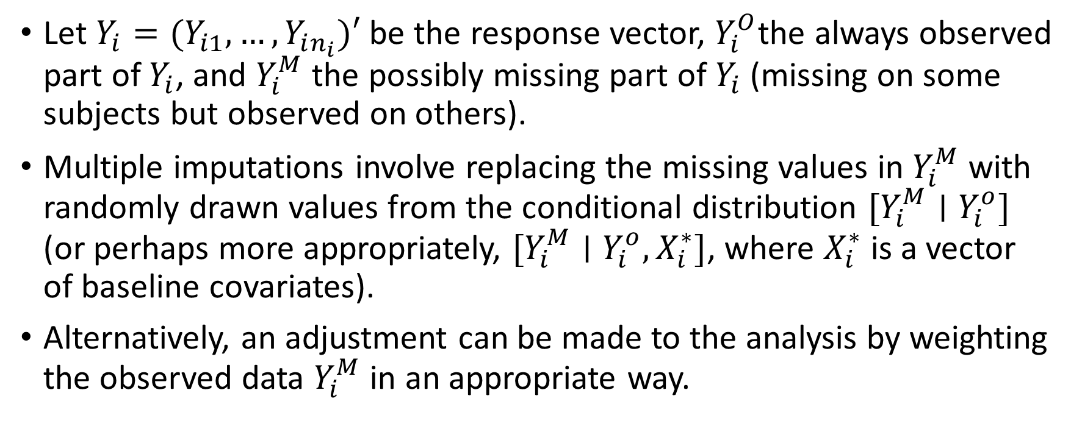
Inverse Probability Weighting for Missing Data
Let $Y_{i}=(Y_{i1},…, Y_{in_{i}})′$ be the response vector, $Y_{i}^{O}$the always observed part of $Y_{i}$, and $Y_{i}^{M}$ the possibly missing part of $Y_{i}$ (missing on some subjects but observed on others).
Multiple imputations involve replacing the missing values in $Y_{i}^{M}$ with randomly drawn values from the conditional distribution $[Y_{i}^{M}∣Y_{i}^{o}]$ (or perhaps more appropriately, $[Y_{i}^{M}∣Y_{i}^{o}, X_{i}^{∗}]$, where $X_{i}^{∗}$ is a vector of baseline covariates).
Alternatively, an adjustment can be made to the analysis by weighting the observed data $Y_{i}^{M}$ in an appropriate way.
PHS 651 / Lecture 20
3 / 24

Slide 4
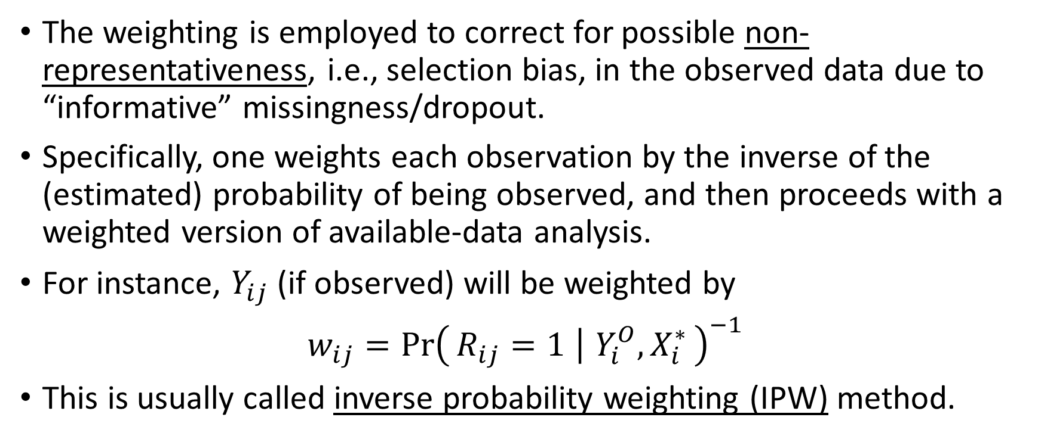
Inverse Probability Weighting for Missing Data
The weighting is employed to correct for possible non-representativeness, i.e., selection bias, in the observed data due to “informative” missingness/dropout.
Specifically, one weights each observation by the inverse of the (estimated) probability of being observed, and then proceeds with a weighted version of available-data analysis.
For instance, $Y_{ij}$ (if observed) will be weighted by
$w_{ij}={\operatorname{Pr}\left(R_{ij}=1 ∣ Y_{i}^{O},X_{i}^{∗}\right)}^{−1}$
This is usually called inverse probability weighting (IPW) method.
PHS 651 / Lecture 20
4 / 24

Slide 5
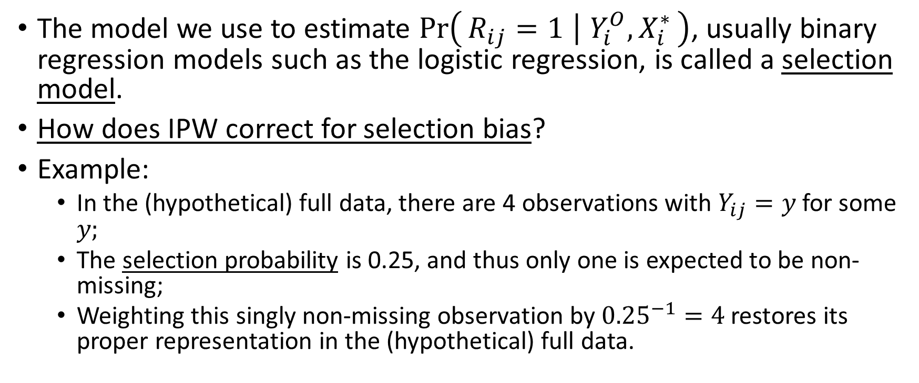
Inverse Probability Weighting for Missing Data
The model we use to estimate $\operatorname{Pr}\left(R_{ij}=1 ∣ Y_{i}^{O},X_{i}^{∗}\right)$, usually binary regression models such as the logistic regression, is called a selection model.
How does IPW correct for selection bias?
Example:
  In the (hypothetical) full data, there are 4 observations with $Y_{ij}=y$ for some $y;$
  The selection probability is 0.25, and thus only one is expected to be non-missing;
  Weighting this singly non-missing observation by ${0.25}^{−1}=4$ restores its proper representation in the (hypothetical) full data.
PHS 651 / Lecture 20
5 / 24

Slide 6
Inverse Probability Weighting for Missing Data
When the joint distribution of the response is specified, a commonly used approach to missing data is the maximum likelihood based on the observed-data likelihood (cf. Lecture 19).
IPW methods are thus most useful when a likelihood-based analysis is not possible due to lack of a specified joint likelihood, e.g., marginal models with GEE.
IPW are more straightforward to implement when missing data are monotone, e.g., due to drop-out/loss to follow-up.
We thus focus on IPW-GEE with monotone missing data.
PHS 651 / Lecture 20
6 / 24

Slide 7
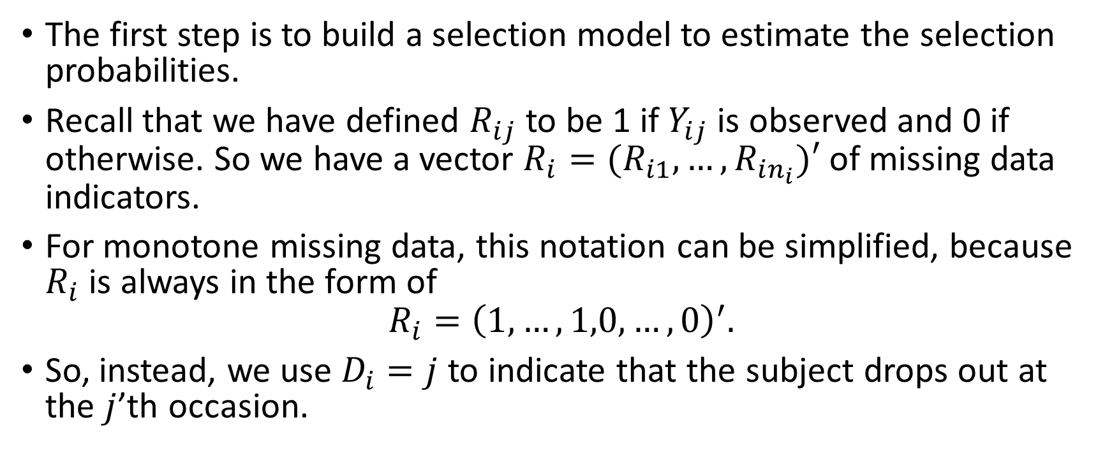
Selection Model for Monotone Missing Data
The first step is to build a selection model to estimate the selection probabilities.
Recall that we have defined $R_{ij}$ to be 1 if $Y_{ij}$ is observed and 0 if otherwise. So we have a vector $R_{i}=(R_{i1},…, R_{in_{i}})′$ of missing data indicators.
For monotone missing data, this notation can be simplified, because $R_{i}$ is always in the form of
$$R_{i}={\left(1,…,1,0,…, 0\right)}^{′}.$$
So, instead, we use $D_{i}=j$ to indicate that the subject drops out at the $j$’th occasion.
PHS 651 / Lecture 20
7 / 24

Slide 8

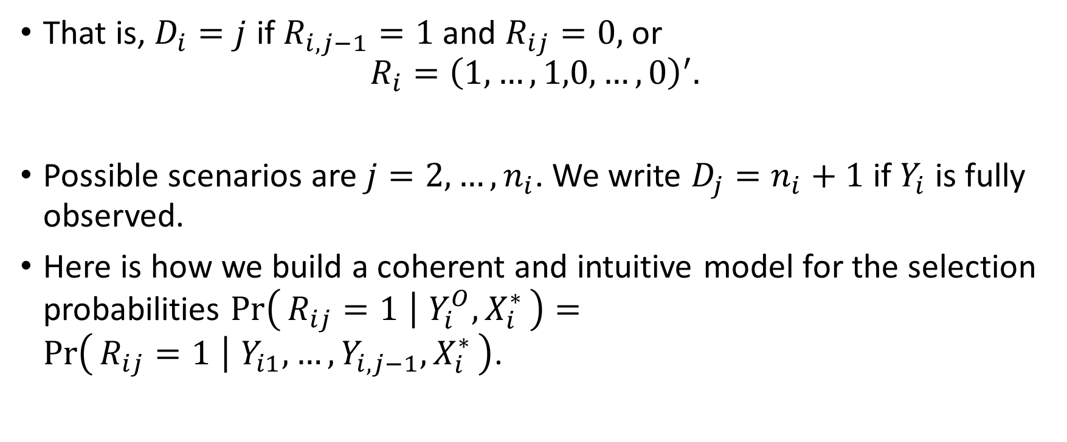
Selection Model for Monotone Missing Data
That is, $D_{i}=j$if $R_{i,j−1}=1$ and $R_{ij}=0,$ or
$$R_{i}={\left(1,…,1,0,…, 0\right)}^{′}.$$
Possible scenarios are $j=2,…, n_{i}$. We write $D_{j}=n_{i}+1$ if $Y_{i}$ is fully observed.
Here is how we build a coherent and intuitive model for the selection probabilities $\operatorname{Pr}\left(R_{ij}=1 ∣ Y_{i}^{O},X_{i}^{∗}\right)=\operatorname{Pr}\left(R_{ij}=1 ∣ Y_{i1},…,Y_{i,j−1},X_{i}^{∗}\right)$.
The $j$’th occasion
PHS 651 / Lecture 20
8 / 24

Slide 9
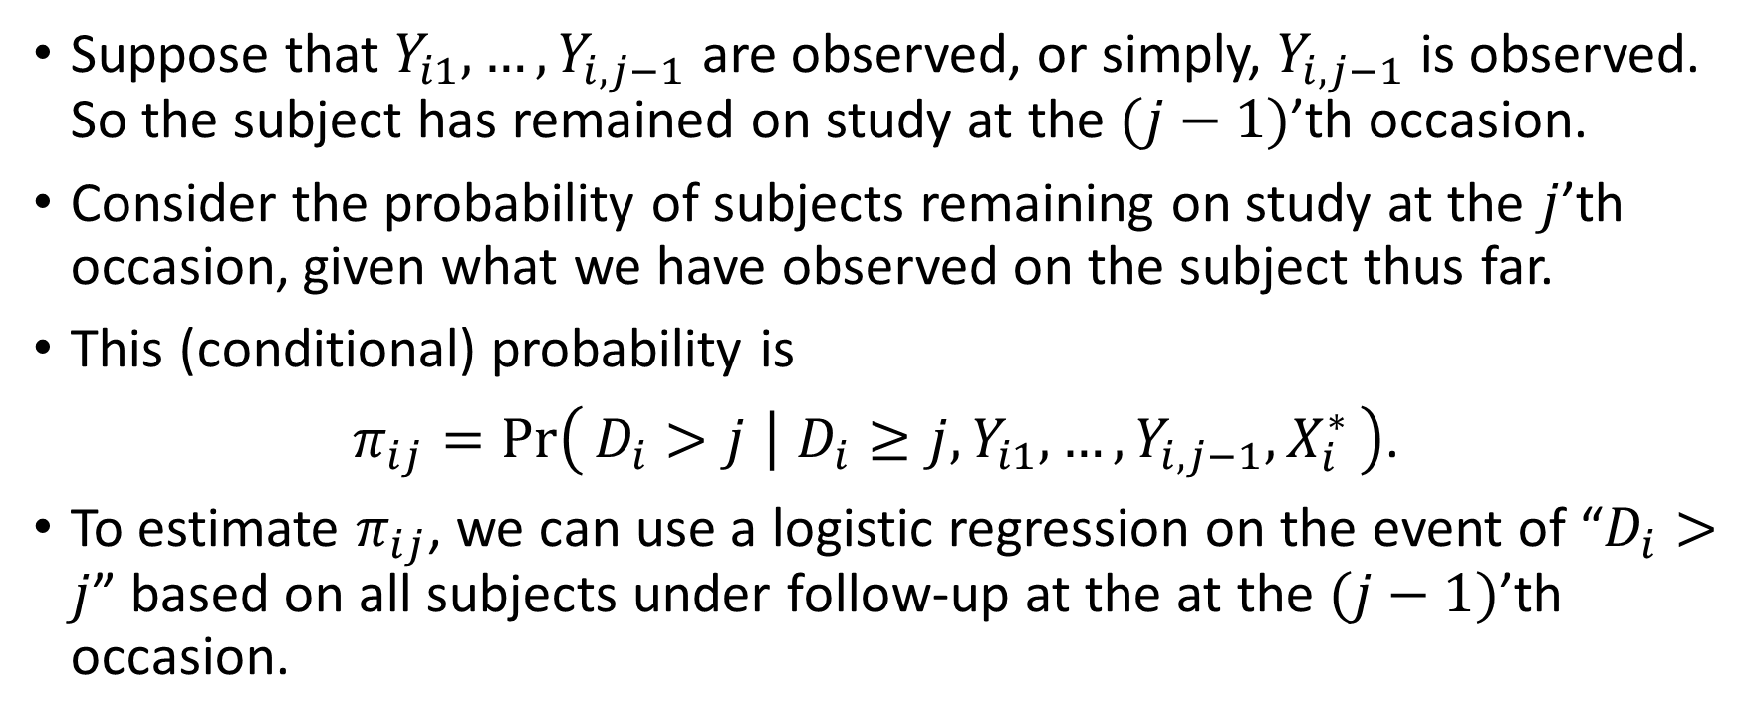
Selection Model for Monotone Missing Data
Suppose that $Y_{i1},…, Y_{i,j−1}$ are observed, or simply, $Y_{i,j−1}$ is observed. So the subject has remained on study at the $(j−1)$’th occasion.
Consider the probability of subjects remaining on study at the $j$’thoccasion, given what we have observed on the subject thus far.
This (conditional) probability is
$π_{ij}=Pr\left(D_{i}>j ∣ D_{i}≥j,Y_{i1},…,Y_{i,j−1},X_{i}^{∗}\right)$.
To estimate $π_{ij}$, we can use a logistic regression on the event of “$D_{i}>j$” based on all subjects under follow-up at the at the $(j−1)$’thoccasion.
PHS 651 / Lecture 20
9 / 24

Slide 10
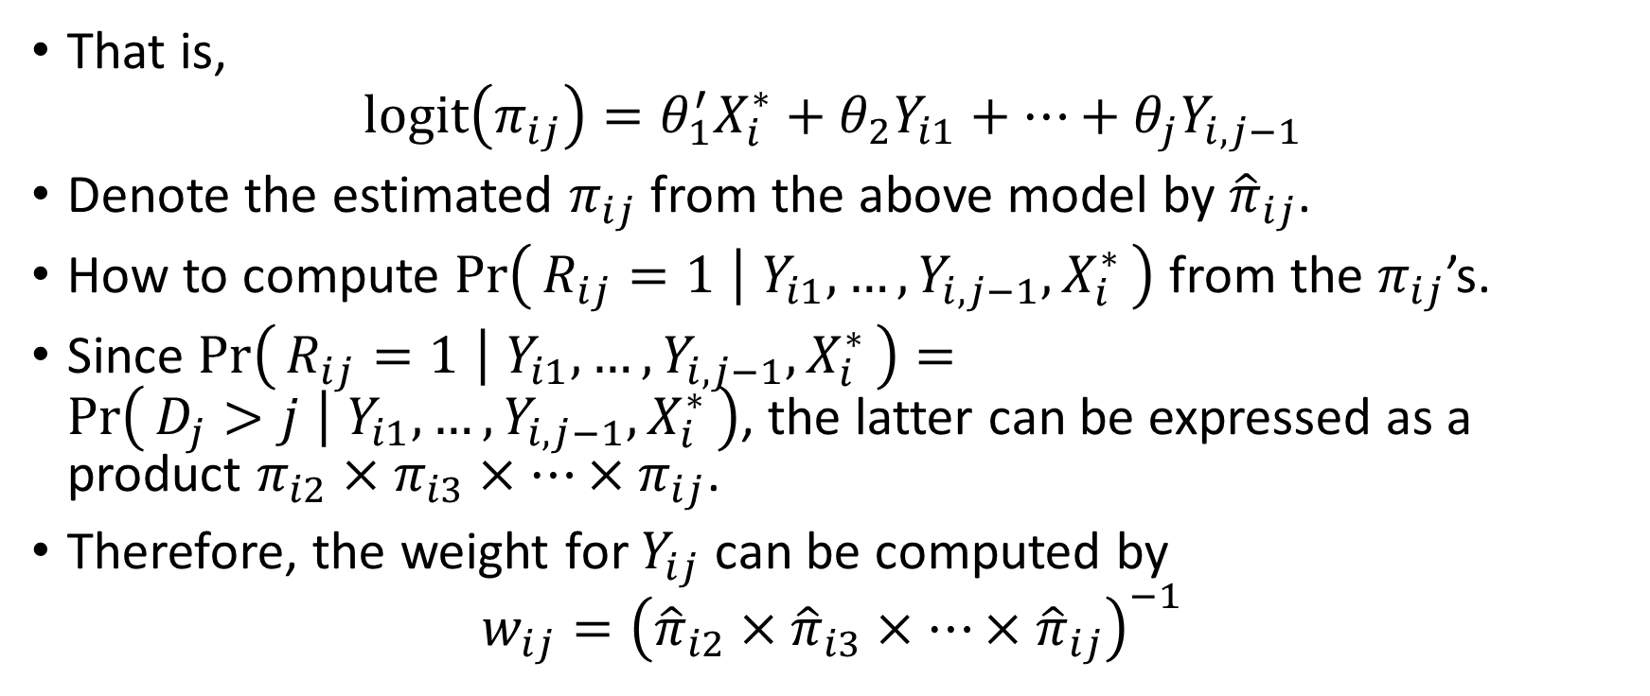
Selection Model for Monotone Missing Data
That is,
$$logit\left(π_{ij}\right)=θ_{1}^{′}X_{i}^{∗}+θ_{2}Y_{i1}+⋯+θ_{j}Y_{i,j−1}$$
Denote the estimated $π_{ij}$ from the above model by ${\hat{π}}_{ij}$.
How to compute $\operatorname{Pr}\left(R_{ij}=1 ∣ Y_{i1},…,Y_{i,j−1},X_{i}^{∗}\right)$ from the $π_{ij}$’s.
Since $\operatorname{Pr}\left(R_{ij}=1 ∣ Y_{i1},…,Y_{i,j−1},X_{i}^{∗}\right)=\operatorname{Pr}\left(D_{j}>j ∣ Y_{i1},…,Y_{i,j−1},X_{i}^{∗}\right)$, the latter can be expressed as a product $π_{i2}×π_{i3}×⋯×π_{ij}$.
Therefore, the weight for $Y_{ij}$ can be computed by
$$w_{ij}={\left({\hat{π}}_{i2}×{\hat{π}}_{i3}×⋯×{\hat{π}}_{ij}\right)}^{−1}$$
PHS 651 / Lecture 20
10 / 24

Slide 11
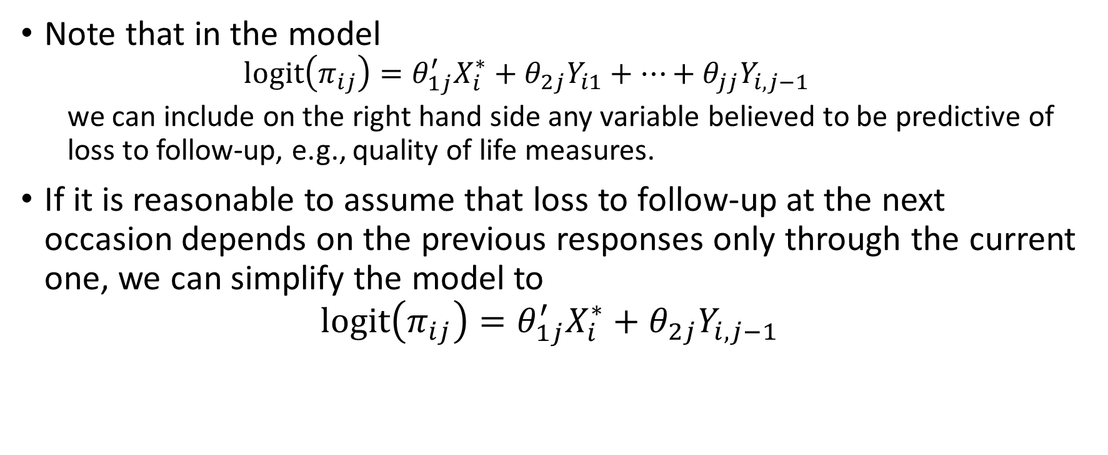
Selection Model for Monotone Missing Data
Note that in the model
  $$logit\left(π_{ij}\right)=θ_{1j}^{′}X_{i}^{∗}+θ_{2j}Y_{i1}+⋯+θ_{jj}Y_{i,j−1}$$
  we can include on the right hand side any variable believed to be predictive of loss to follow-up, e.g., quality of life measures.
If it is reasonable to assume that loss to follow-up at the next occasion depends on the previous responses only through the current one, we can simplify the model to
$$logit\left(π_{ij}\right)=θ_{1j}^{′}X_{i}^{∗}+θ_{2j}Y_{i,j−1}$$
PHS 651 / Lecture 20
11 / 24

Slide 12
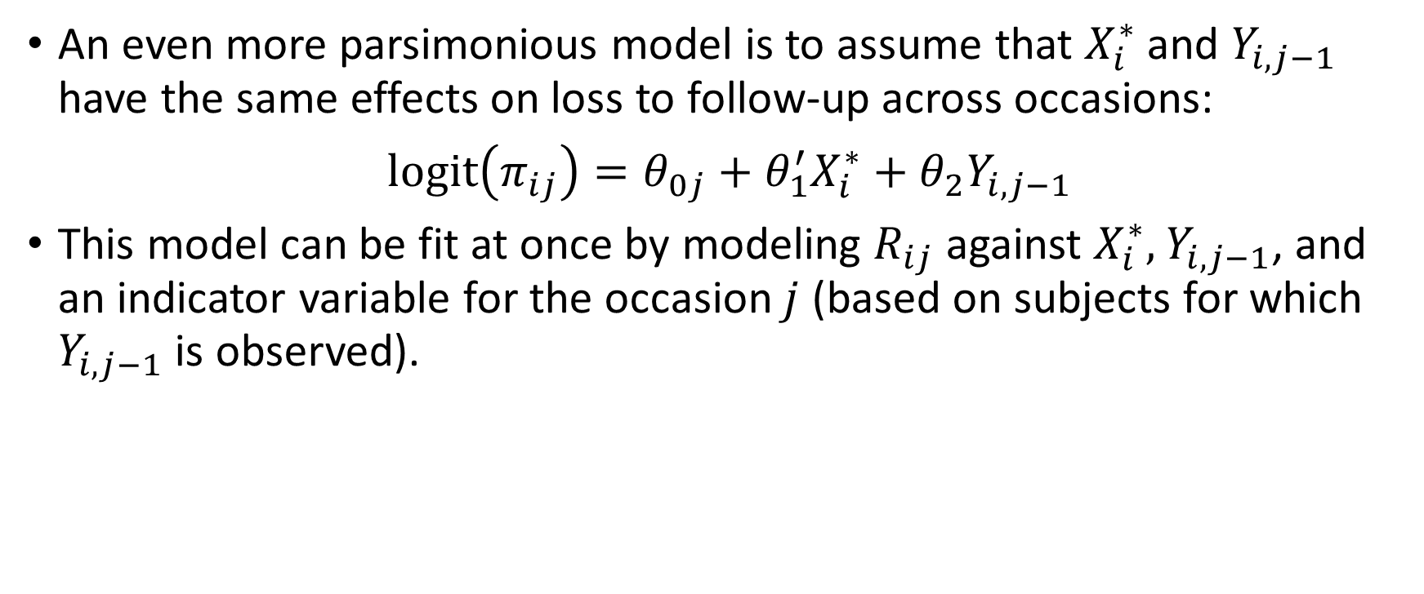
Selection Model for Monotone Missing Data
An even more parsimonious model is to assume that $X_{i}^{∗}$ and $Y_{i,j−1}$ have the same effects on loss to follow-up across occasions:
$logit\left(π_{ij}\right)=θ_{0j}+θ_{1}^{′}X_{i}^{∗}+θ_{2}Y_{i,j−1}$
This model can be fit at once by modeling $R_{ij}$ against $X_{i}^{∗},$$Y_{i,j−1}$, and an indicator variable for the occasion $j$ (based on subjects for which $Y_{i,j−1}$ is observed).
PHS 651 / Lecture 20
12 / 24

Slide 13
Selection Model for Monotone Missing Data
In SAS, here are the typical steps in fitting IPW-GEE with monotone missing data:
  Use a binary regression procedure (e.g., GENMOD) to fit the selection model and output the estimated selection probability to a dataset;
  Merge the output dataset with the original dataset by subject ID and occasion.
  Run PROC GENMOD for the GEE analysis with an additional WEIGHT statement to specify the weight.
PHS 651 / Lecture 20
13 / 24

Slide 14
Example: A Clinical Trial of Contracepting Women
A total of 1151 women received an injection of either 100 mg or 150 mg of depot-medroxyprogesterone acetate (DMPA) as contraceptives on the day of randomization and three additional injections at 90-day intervals.
In clinical trials of modern hormonal contraceptives, pregnancy is exceedingly rare.
Instead, amenorrhea, the absence of menstrual bleeding, is used as the outcome.
Binary response: amenorrhea in the four successive three month intervals.
PHS 651 / Lecture 20
14 / 24

Slide 15
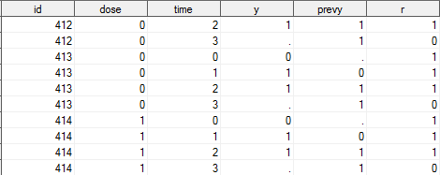
Example: A Clinical Trial of Contracepting Women
More than one third of the women dropped out before the completion of the trial.
Dose: 0=Low,1=High; time: quarter=0,1,2,3; y: Amenorrhea status; prevy= y at previous occasion; r: non-missing indicator.
PHS 651 / Lecture 20
15 / 24

Slide 16
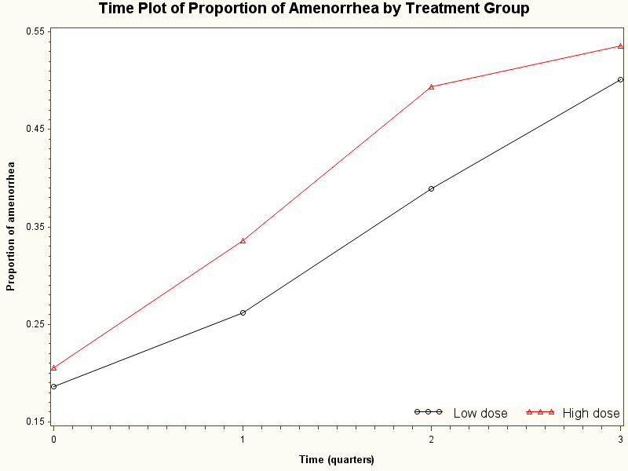
Example: A Clinical Trial of Contracepting Women
PHS 651 / Lecture 20
16 / 24

Slide 17
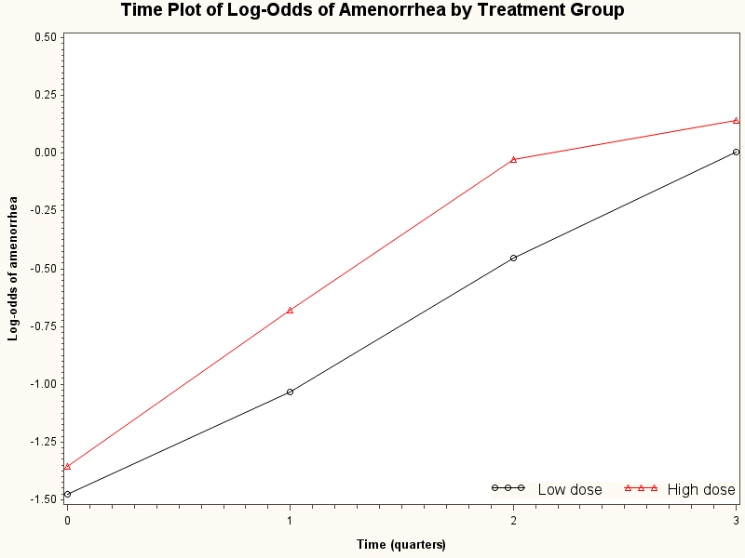
Example: A Clinical Trial of Contracepting Women
PHS 651 / Lecture 20
17 / 24

Slide 18
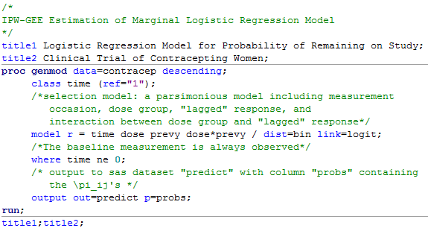

Example: A Clinical Trial of Contracepting Women
First step (1.1): Compute the $π_{ij}$’s.
PHS 651 / Lecture 20
18 / 24

Slide 19
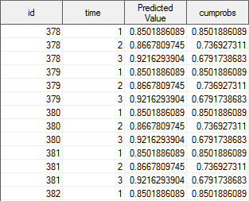
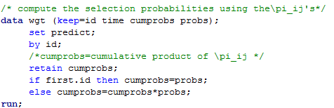

Example: A Clinical Trial of Contracepting Women
First step (1.2): Compute the selection probabilities as cumulative product of the $π_{ij}$’s.
PHS 651 / Lecture 20
19 / 24

Slide 20
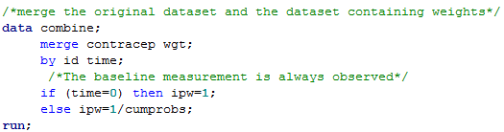
Example: A Clinical Trial of Contracepting Women
Second step (2): Merge the original dataset and the weight dataset by subject id and measurement occasion.
PHS 651 / Lecture 20
20 / 24

Slide 21
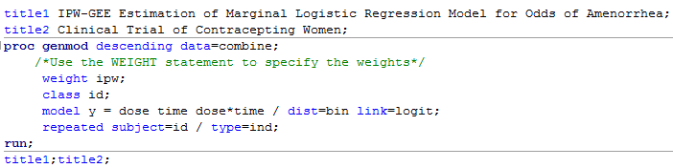
Example: A Clinical Trial of Contracepting Women
Third step (3): Weighted analysis by including the WEIGHT statement in PROC GENMOD.
PHS 651 / Lecture 20
21 / 24

Slide 22
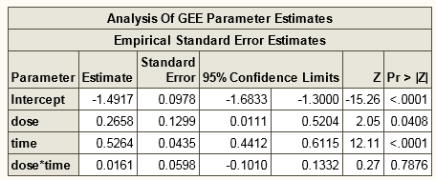
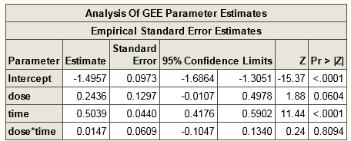
Example: A Clinical Trial of Contracepting Women
IPW-GEE
Unweighted-GEE
If subjects with a higher risk of amenorrhea are more likely to drop-out, the available-data analysis (unweighted GEE) will underestimate the increase in risk over time.
PHS 651 / Lecture 20
22 / 24

Slide 23
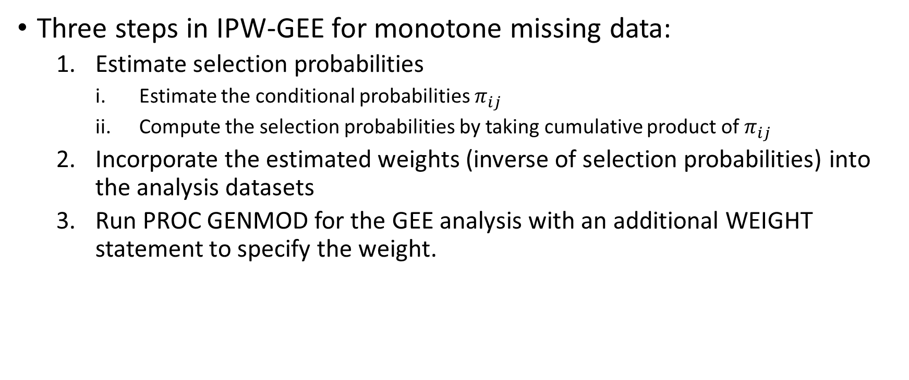
Summary
Three steps in IPW-GEE for monotone missing data:
  Estimate selection probabilities
    Estimate the conditional probabilities $π_{ij}$
    Compute the selection probabilities by taking cumulative product of $π_{ij}$
  Incorporate the estimated weights (inverse of selection probabilities) into the analysis datasets
  Run PROC GENMOD for the GEE analysis with an additional WEIGHT statement to specify the weight.
PHS 651 / Lecture 20
23 / 24

Slide 24
Summary
Missing Data Mechanism | Method | SAS Implementation
MCAR | Complete-case/Available-data analysis | GEE by PROC GEMOD
MAR | MLE | Default in PROC MIXED/GLIMMIX
 | MI | PROC MI combined with standard procedure (e.g., GENMOD)
 | IPW | Standard procedure (e.g., GENMOD) with WEIGHT statement to incorporate selection probabilities computed by binary regressions.
NMAR
PHS 651 / Lecture 20
24 / 24

