Slide 1
PHS 651 / LECTURE 21
Smoothing Longitudinal Data: Semiparametric Regression Models
Advanced Regression Methods for Population Health
Lu Mao, PhD
Department of Biostatistics and Medical Informatics
University of Wisconsin-Madison
SPRING 2019

Slide 2
Outline
  Rationale for semiparametric modeling of longitudinal data
  Penalized splines and their mixed-model representation
  Implementing penalized splines in PROC MIXED
  A study of early pregnancy loss
PHS 651 / Lecture 21
2 / 23

Slide 3
Semiparametric Models for longitudinal Data
So far we have focused on parametric models for longitudinal data.
These models pre-specify the functional relationship between the mean response and covariates (e.g., treatment, time, etc.) and contain a relatively small number of unknown parameters.
Advantages:
  Interpretability
  Efficiency under correct modeling
  Prevention of overfitting
PHS 651 / Lecture 21
3 / 23

Slide 4
Semiparametric Models for longitudinal Data
In some cases, the relationship between a covariate and the response may be too complex to be described in terms of a few regression parameters.
Non-/Semi-parametric models afford greater flexibility by allowing this relationship to be largely determined by the data at hand.
In general, we would like to model the effect of the exposure/treatment parametrically, for better interpretability, while leaving the “nuisance” factors (i.e., those not of primary scientific interest, say, time trend) nonparametric.
PHS 651 / Lecture 21
4 / 23

Slide 5
Semiparametric Models for longitudinal Data
In addition to greater flexibility, semiparametric methods can be useful in preliminary analysis, often guiding the choice of a parametric model that may fit the data well.
We will study semiparametric methods for longitudinal data that do not pre-specify the shape the covariate-response relationship apart from a qualitative “smoothness” assumption.
In particular, we will focus on a class of methods referred to as penalized splines.
PHS 651 / Lecture 21
5 / 23

Slide 6
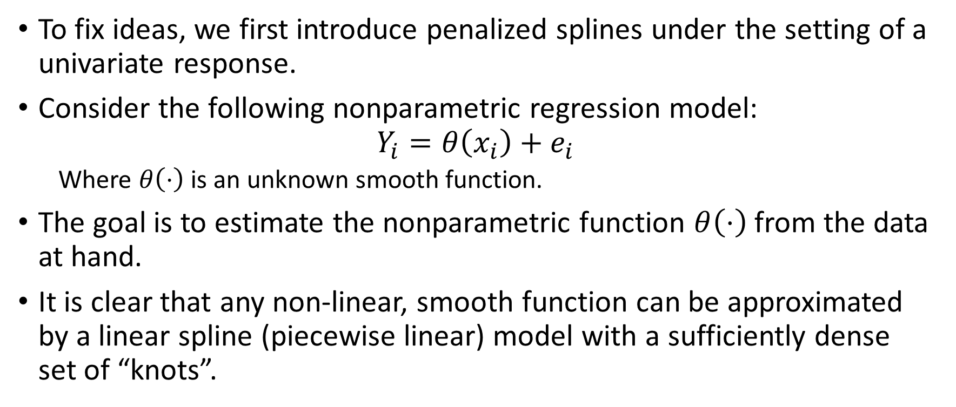
Penalized Splines
To fix ideas, we first introduce penalized splines under the setting of a univariate response.
Consider the following nonparametric regression model:
$$Y_{i}=θ\left(x_{i}\right)+e_{i}$$
  Where $θ\left(⋅\right)$ is an unknown smooth function.
The goal is to estimate the nonparametric function $θ\left(⋅\right)$ from the data at hand.
It is clear that any non-linear, smooth function can be approximated by a linear spline (piecewise linear) model with a sufficiently dense set of “knots”.
PHS 651 / Lecture 21
6 / 23

Slide 7
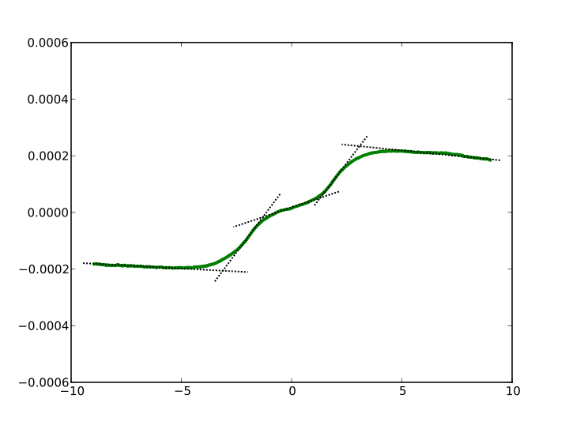
Penalized Splines
PHS 651 / Lecture 21
7 / 23

Slide 8
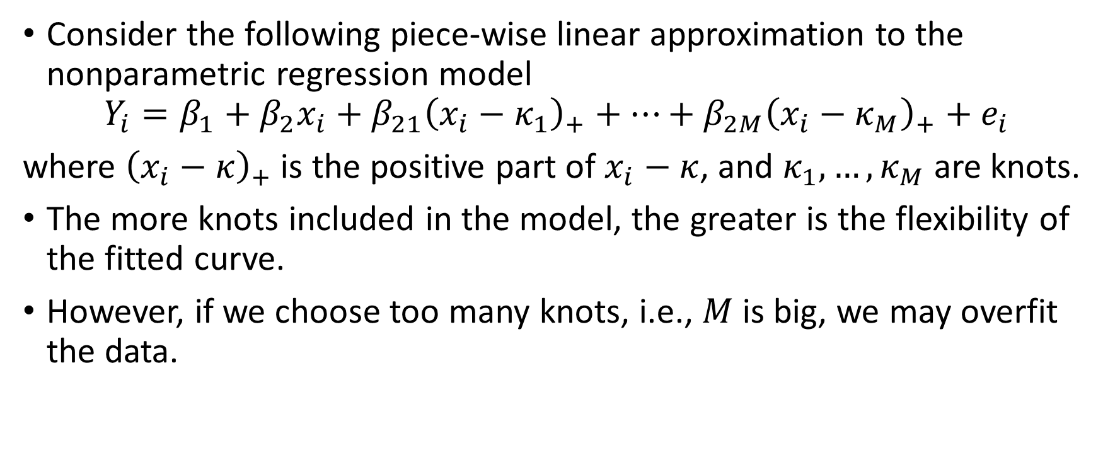
Penalized Splines
Consider the following piece-wise linear approximation to the nonparametric regression model
$$Y_{i}=β_{1}+β_{2}x_{i}+β_{21}{\left(x_{i}−κ_{1}\right)}_{+}+⋯+β_{2M}{\left(x_{i}−κ_{M}\right)}_{+}+e_{i}$$
where ${\left(x_{i}−κ\right)}_{+}$ is the positive part of $x_{i}−κ$, and $κ_{1},…,κ_{M}$ are knots.
The more knots included in the model, the greater is the flexibility of the fitted curve.
However, if we choose too many knots, i.e., $M$ is big, we may overfit the data.
PHS 651 / Lecture 21
8 / 23

Slide 9
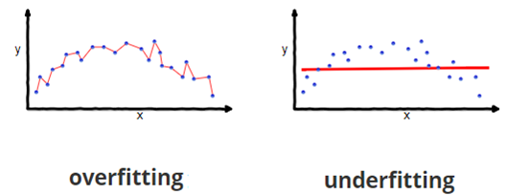
Penalized Splines
We thus face the challenge of striking a balance between the degree of flexibility and “model fit”.
PHS 651 / Lecture 21
9 / 23

Slide 10
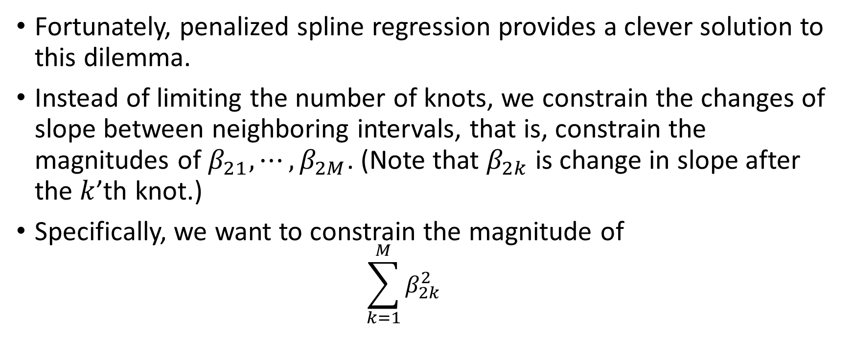
Penalized Splines
Fortunately, penalized spline regression provides a clever solution to this dilemma.
Instead of limiting the number of knots, we constrain the changes of slope between neighboring intervals, that is, constrain the magnitudes of $β_{21},⋯,β_{2M}$. (Note that $β_{2k}$ is change in slope after the $k$’th knot.)
Specifically, we want to constrain the magnitude of
  $${\sum_{k=1}^{M}{β_{2k}^{2}}}_{}$$
PHS 651 / Lecture 21
10 / 23

Slide 11
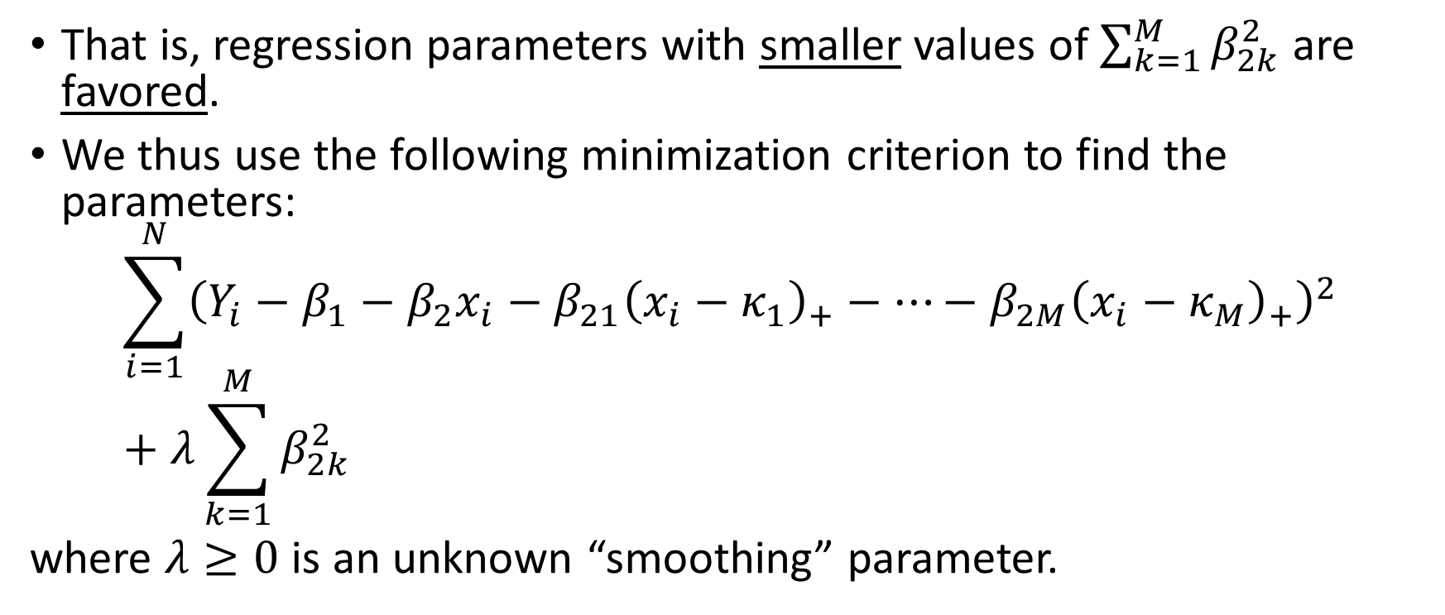
Penalized Splines
That is, regression parameters with smaller values of $\sum_{k=1}^{M}{β_{2k}^{2}}$ are favored.
We thus use the following minimization criterion to find the parameters:
$$\sum_{i=1}^{N}{{\left(Y_{i}−β_{1}−β_{2}x_{i}−β_{21}{\left(x_{i}−κ_{1}\right)}_{+}−⋯−β_{2M}{\left(x_{i}−κ_{M}\right)}_{+}\right)}^{2}}+λ\sum_{k=1}^{M}{β_{2k}^{2}}$$
where $λ≥0$ is an unknown “smoothing” parameter.
PHS 651 / Lecture 21
11 / 23

Slide 12
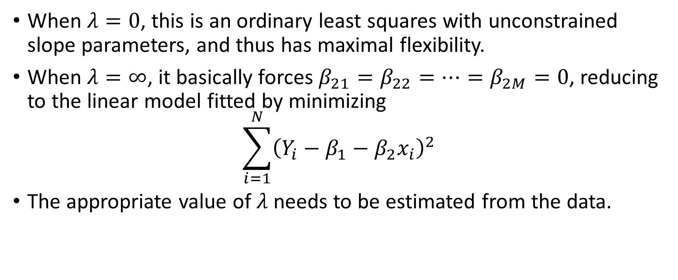
Penalized Splines
When $λ=0$, this is an ordinary least squares with unconstrained slope parameters, and thus has maximal flexibility.
When $λ=∞$, it basically forces $β_{21}=β_{22}=⋯=β_{2M}=0$, reducing to the linear model fitted by minimizing
$$\sum_{i=1}^{N}{{\left(Y_{i}−β_{1}−β_{2}x_{i}\right)}^{2}}$$
The appropriate value of $λ$ needs to be estimated from the data.
PHS 651 / Lecture 21
12 / 23

Slide 13
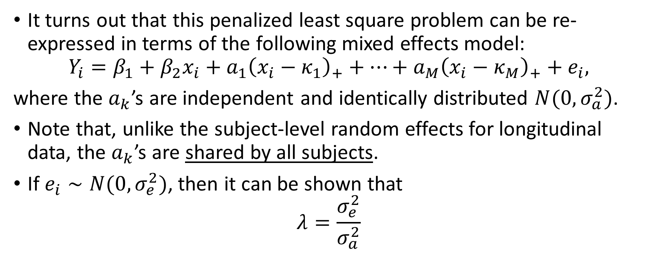
Mixed Model Representation of Penalized Splines
It turns out that this penalized least square problem can be re-expressed in terms of the following mixed effects model:
$$Y_{i}=β_{1}+β_{2}x_{i}+a_{1}{\left(x_{i}−κ_{1}\right)}_{+}+⋯+a_{M}{\left(x_{i}−κ_{M}\right)}_{+}+e_{i},$$
where the $a_{k}$’s are independent and identically distributed $N(0,σ_{a}^{2})$.
Note that, unlike the subject-level random effects for longitudinal data, the $a_{k}$’s are shared by all subjects.
If $e_{i}∼N(0, σ_{e}^{2})$, then it can be shown that
$$λ=\frac{σ_{e}^{2}}{σ_{a}^{2}}$$
PHS 651 / Lecture 21
13 / 23

Slide 14
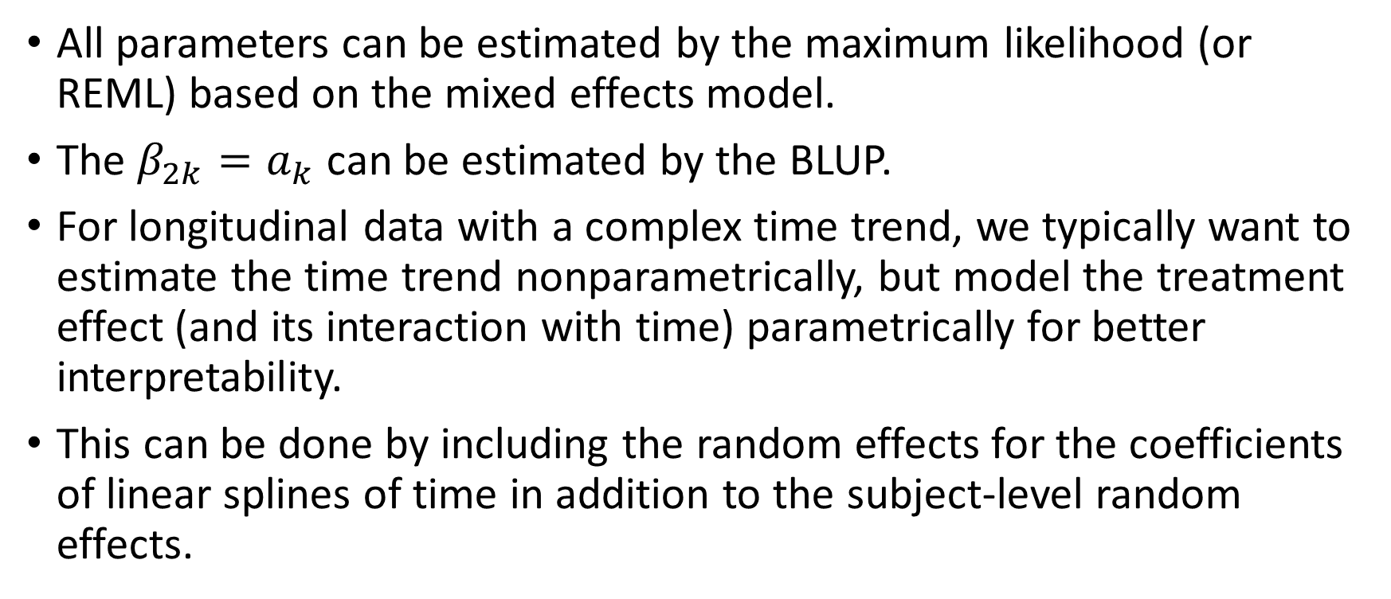
Mixed Model Representation of Penalized Splines
All parameters can be estimated by the maximum likelihood (or REML) based on the mixed effects model.
The $β_{2k}=a_{k}$ can be estimated by the BLUP.
For longitudinal data with a complex time trend, we typically want to estimate the time trend nonparametrically, but model the treatment effect (and its interaction with time) parametrically for better interpretability.
This can be done by including the random effects for the coefficients of linear splines of time in addition to the subject-level random effects.
PHS 651 / Lecture 21
14 / 23

Slide 15

Mixed Model Representation of Penalized Splines
For example,
$$Y_{ij}=β_{1}+β_{2}trt_{i}+β_{3}t_{ij}+β_{4}trt_{i}×t_{ij}+\sum_{k=1}^{M}{a_{k}}{\left(t_{ij}−κ_{k}\right)}_{+}+b_{i1}+b_{i2}t_{ij}+ε_{ij}$$
PHS 651 / Lecture 21
15 / 23

Slide 16
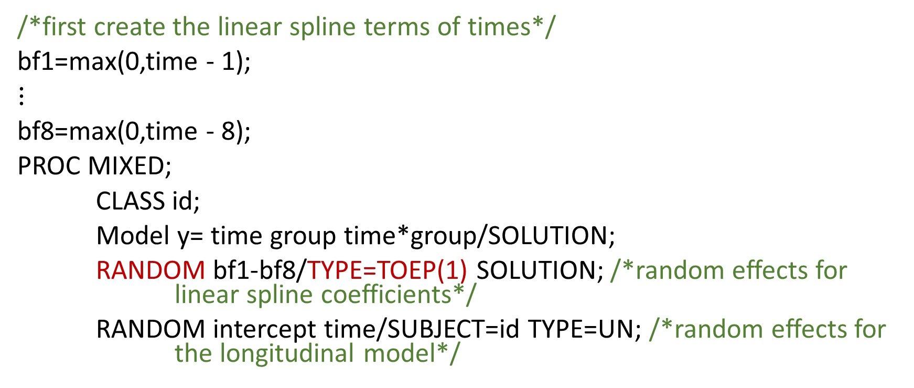
SAS Implementation of Penalized Splines
/*first create the linear spline terms of times*/
bf1=max(0,time - 1);
$⋮$
bf8=max(0,time - 8);
PROC MIXED;
CLASS id;
Model y= time group time*group/SOLUTION;
RANDOM bf1-bf8/TYPE=TOEP(1) SOLUTION; /*random effects for linear spline coefficients*/
RANDOM intercept time/SUBJECT=id TYPE=UN; /*random effects for the longitudinal model*/
PHS 651 / Lecture 21
16 / 23

Slide 17
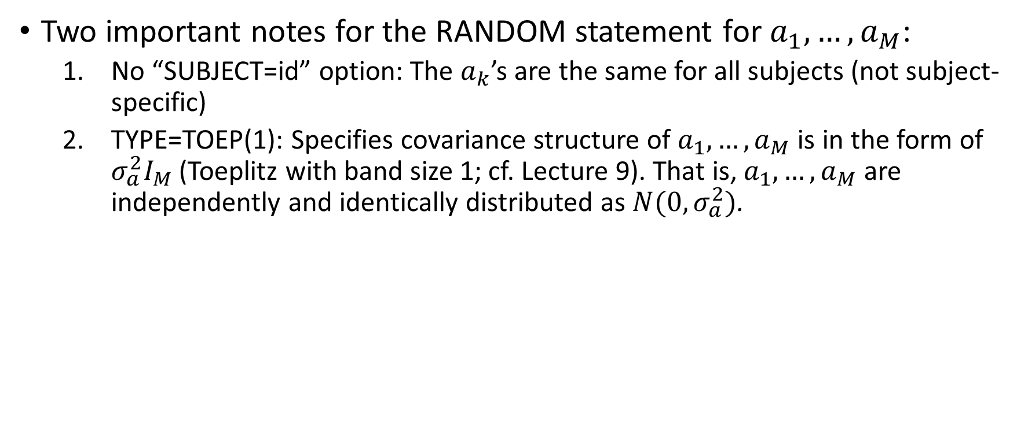
SAS Implementation of Penalized Splines
Two important notes for the RANDOM statement for $a_{1},…, a_{M}$:
  No “SUBJECT=id” option: The $a_{k}$’s are the same for all subjects (not subject-specific)
  TYPE=TOEP(1): Specifies covariance structure of $a_{1},…, a_{M}$ is in the form of $σ_{a}^{2}I_{M}$ (Toeplitz with band size 1; cf. Lecture 9). That is, $a_{1},…, a_{M}$ are independently and identically distributed as $N(0,σ_{a}^{2})$.
PHS 651 / Lecture 21
17 / 23

Slide 18
A Study of Early Pregnancy Loss
A study of early pregnancy loss conducted by the Institute for Toxicology and Environmental Health at the Reproductive Epidemiology Section of the California Department of Health Services.
The data consist of repeated progesterone metabolite (pregnanediol-3-glucuronide, PdG) measures from day -8 to day 15 in the menstrual cycle (day 0 denotes ovulation day) on a sample of 22 conceptive cycles from 22 women and 29 non-conceptive cycles from another 29 women.
Variable List: ID, Group (0=non-conceptive, 1=conceptive), Time (in days), Log PdG
PHS 651 / Lecture 21
18 / 23

Slide 19
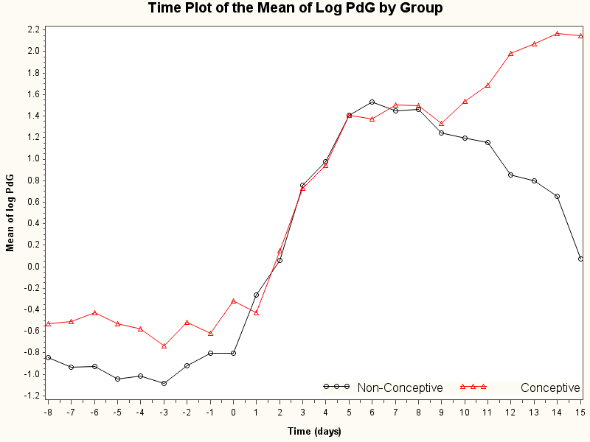
A Study of Early Pregnancy Loss
PHS 651 / Lecture 21
19 / 23

Slide 20
A Study of Early Pregnancy Loss
Two distinctive features:
  The time trends in both groups are highly nonlinear
  The group difference comparing conceptive versus non-conceptive cycles diminishes before around day 7 and widens after.
Modeling solution:
  Include 22 time knots from day -7 through day 14;
  Include a group-time interaction for the main term of time and also for the spline term at day 7.
PHS 651 / Lecture 21
20 / 23

Slide 21
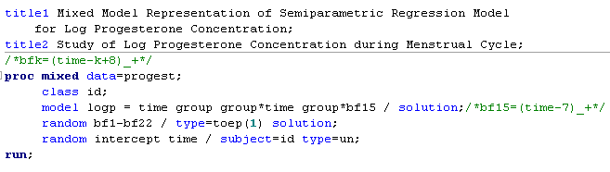
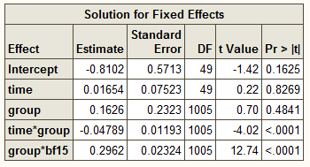
A Study of Early Pregnancy Loss
PHS 651 / Lecture 21
21 / 23

Slide 22
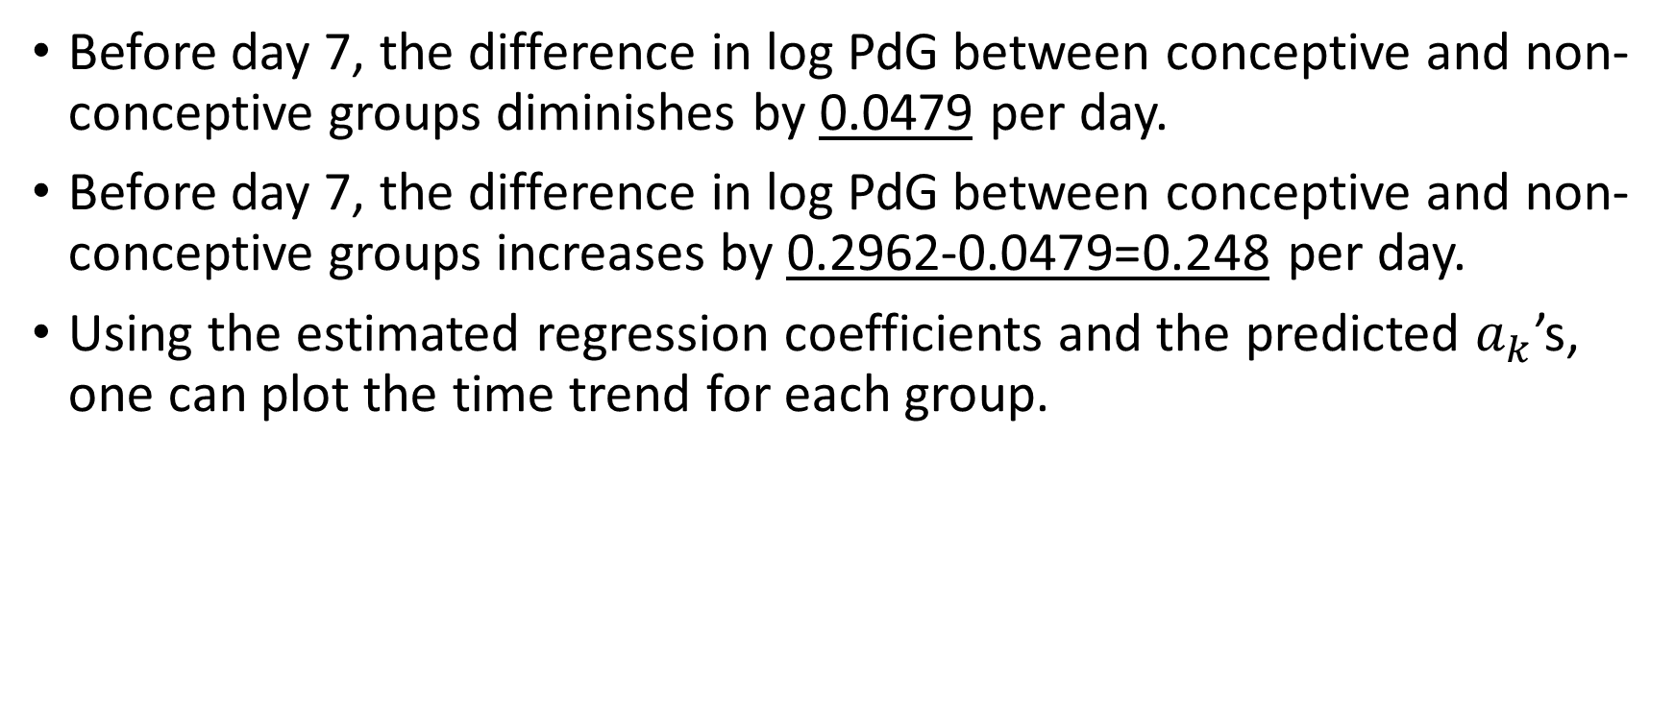
A Study of Early Pregnancy Loss
Before day 7, the difference in log PdG between conceptive and non-conceptive groups diminishes by 0.0479 per day.
After day 7, the difference in log PdG between conceptive and non-conceptive groups increases by 0.2962-0.0479=0.248 per day.
Using the estimated regression coefficients and the predicted $a_{k}$’s, one can plot the time trend for each group.
PHS 651 / Lecture 21
22 / 23

Slide 23
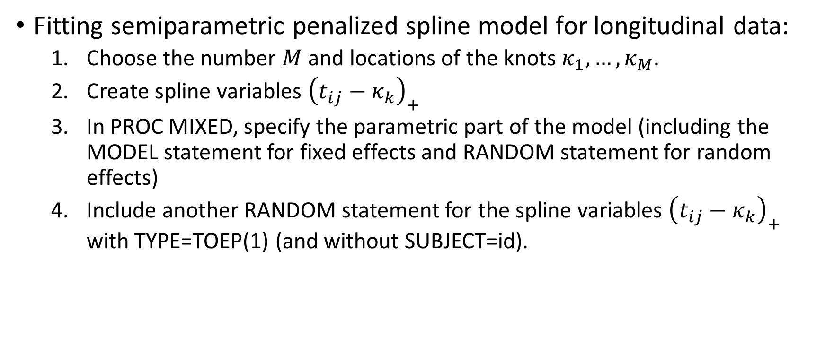
Summary
Fitting semiparametric penalized spline model for longitudinal data:
  Choose the number $M$ and locations of the knots $κ_{1},…, κ_{M}$.
  Create spline variables ${\left(t_{ij}−κ_{k}\right)}_{+}$
  In PROC MIXED, specify the parametric part of the model (including the MODEL statement for fixed effects and RANDOM statement for random effects)
  Include another RANDOM statement for the spline variables ${\left(t_{ij}−κ_{k}\right)}_{+}$ with TYPE=TOEP(1) (and without SUBJECT=id).
PHS 651 / Lecture 21
23 / 23

