Slide 1
PHS 651 / LECTURE 22
Multilevel Models
Advanced Regression Methods for Population Health
Lu Mao, PhD
Department of Biostatistics and Medical Informatics
University of Wisconsin-Madison
SPRING 2019

Slide 2
Outline
  Different types of hierarchical/multilevel data
  Mixed effects models for multilevel data
  SAS implementation of multilevel modeling by PROC MIXED/GLIMMIX
  An example with a behavioral intervention
PHS 651 / Lecture 22
2 / 23

Slide 3
Multilevel Models
So far we have been focusing on the analysis of longitudinal data.
Mixed models can also be used to analyze multilevel data.
Hierarchical or multilevel data arise when there is a clustered/grouped
structure to the data.
Data of this kind frequently arise in the social, behavioral, and health
sciences since individuals can be grouped in so many different ways.
For example, in studies of health services and outcomes, assessments of
quality of care are often obtained from patients who are nested within
different clinics.
PHS 651 / Lecture 22
3 / 23

Slide 4
Multilevel Models
Such data can be regarded as hierarchical/multilevel, with patients referred
to as the level 1 units and clinics the level 2 units.
In this example there are two levels in the data hierarchy and, by convention, the lowest level of the hierarchy is referred to as level 1.
The term “level", as used in this context, signifies the position of a unit of
observation within a hierarchy.
Clustering in multilevel data can be due to a naturally occurring hierarchy
in the target population or a consequence of study design (or sometimes
both).
PHS 651 / Lecture 22
4 / 23

Slide 5
Naturally Occurring Data Hierarchies
Studies of nuclear families: observations on the mother, father, and children (level 1 units) nested within families (level 2 units).
Studies of health services/outcomes: observations on patients (level 1 units) nested within clinics (level 2 units).
Studies of education: observations on children (level 1 units) nested within
classrooms (level 2 units).
Note: Naturally occurring hierarchical data structures can have more than
two levels, e.g., children (level 1 units) nested within classrooms (level 2
units), nested within schools (level 3 units)
PHS 651 / Lecture 22
5 / 23

Slide 6
Clustering as Consequence of Study Design
Longitudinal Studies: the clusters are composed of the repeated
measurements obtained from a single individual at different occasions.The level 1 units are the repeated occasions of
measurement and the level 2 units are the subjects.
Cluster-Randomized Clinical Trials: Groups (level 2 units) of individuals (level 1 units), rather than the individuals themselves, are randomly assigned to different treatments or interventions.
Complex Sample Surveys: Many national surveys use multi-stage
sampling, e.g., NHANES.
PHS 651 / Lecture 22
6 / 23

Slide 7
Multilevel Clustering
Clustering can be due to both study design and naturally occurring
hierarchies in the target population.
Example: Clinical trials conducted in many different centers to ensure sufficient numbers of patients and/or to assess the effectiveness of
the treatment in different settings.
  Level 1: Longitudinal measurements
  Level 2: Patients
  Level 3: Centers
PHS 651 / Lecture 22
7 / 23

Slide 8
Feature of Multilevel Data
A consequence of the clustering is that responses within a cluster are more similar than those in different clusters.
For example, two children selected at random from the same family are
expected to respond more similarly than two children randomly selected
from different families.
The clustering can be expressed in terms of correlation among the
measurements on units within the same cluster.
Statistical models for hierarchical (i.e., multilevel) data must account for the intra-cluster correlationat each level; failure to do so can result in misleading inferences.
PHS 651 / Lecture 22
8 / 23

Slide 9
Feature of Multilevel Data
The dominant approach to analysis of multilevel data is the hierarchical linear model.
The correlation induced by clustering is described by random effects at each level of the hierarchy.
Note: In a multilevel model, the response is obtained at the first level, but covariatescan be measured at any level.
For example, if we are studying BMI for the individual, we can measure individual diets, family attitudes about food and purchasing habits, and community attributes such as the density of fast-food restaurants.
PHS 651 / Lecture 22
9 / 23

Slide 10
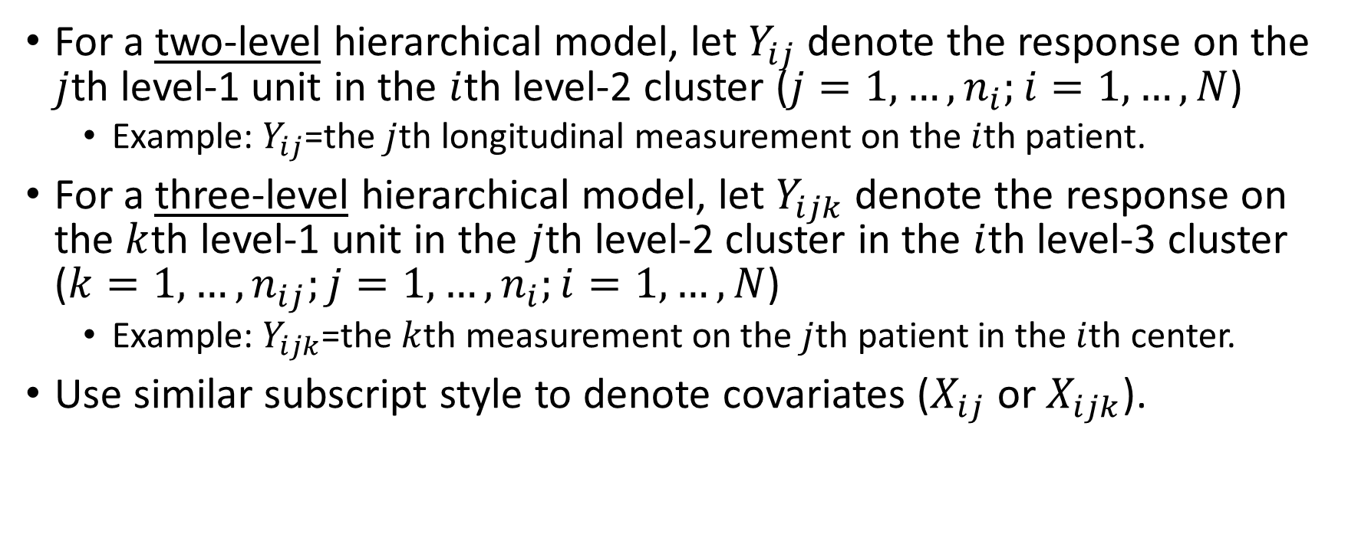
Notation
For a two-level hierarchical model, let $Y_{ij}$ denote the response on the $j$th level-1 unit in the $i$th level-2 cluster ($j=1,…,n_{i};i=1,…, N$)
  Example: $Y_{ij}$=the $j$thlongitudinal measurement on the $i$thpatient.
For a three-level hierarchical model, let $Y_{ijk}$ denote the response on the $k$th level-1 unit in the $j$th level-2 cluster in the $i$th level-3 cluster ($k=1,…,n_{ij};j=1,…,n_{i};i=1,…, N$)
  Example: $Y_{ijk}$=the $k$thmeasurement on the $j$thpatient in the $i$thcenter.
Use similar subscript style to denote covariates ($X_{ij}$ or $X_{ijk}$).
PHS 651 / Lecture 22
10 / 23

Slide 11
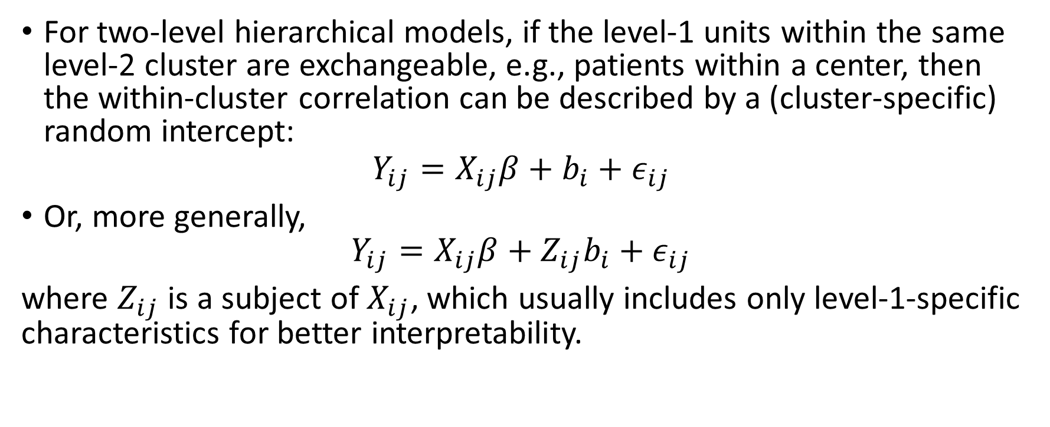
Two-Level Linear Models
For two-level hierarchical models, if the level-1 units within the same level-2 cluster are exchangeable, e.g., patients within a center, then the within-cluster correlation can be described by a (cluster-specific) random intercept:
$$Y_{ij}=X_{ij}β+b_{i}+ε_{ij}$$
Or, more generally,
$Y_{ij}=X_{ij}β+{Z_{ij}b}_{i}+ε_{ij}$
where $Z_{ij}$ is a subject of $X_{ij}$, which usually includes only level-1-specific characteristics for better interpretability.
PHS 651 / Lecture 22
11 / 23

Slide 12
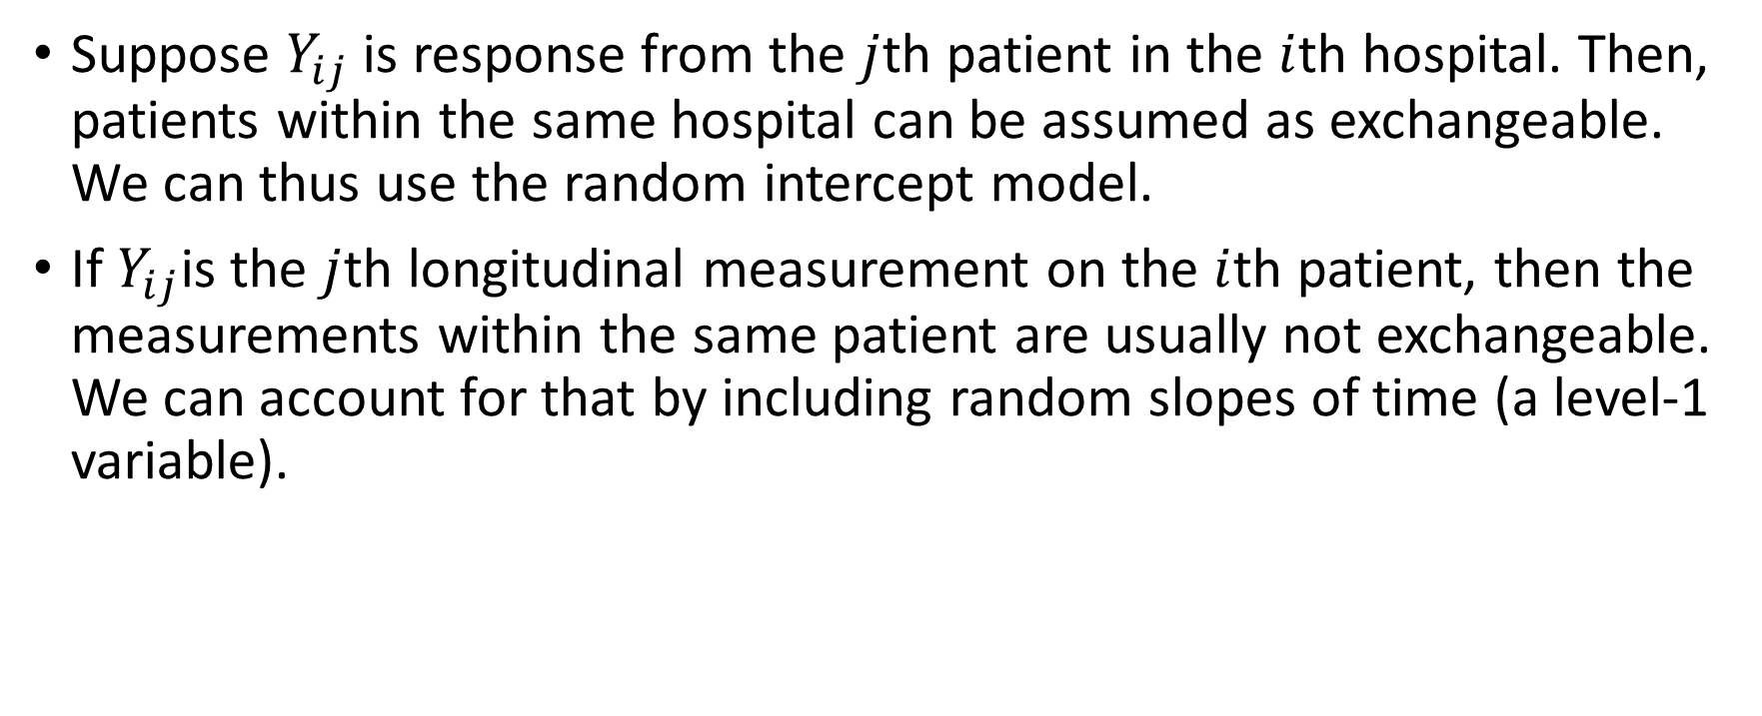
Two-Level Linear Models
Suppose $Y_{ij}$ is response from the $j$thpatient in the $i$thhospital. Then, patients within the same hospital can be assumed as exchangeable. We can thus use the random intercept model.
If $Y_{ij}$is the $j$thlongitudinal measurement on the $i$thpatient, then the measurements within the same patient are usually not exchangeable. We can account for that by including random slopes of time (a level-1 variable).
PHS 651 / Lecture 22
12 / 23

Slide 13
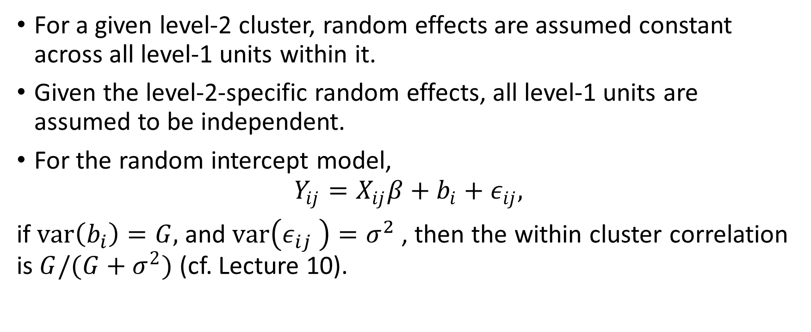
Two-Level Linear Models
For a given level-2 cluster, random effects are assumed constant across all level-1 units within it.
Given the level-2-specific random effects, all level-1 units are assumed to be independent.
For the random intercept model,
$$Y_{ij}=X_{ij}β+b_{i}+ε_{ij},$$
if $var\left(b_{i}\right)=G,$ and $var\left(ε_{ij} \right)=σ^{2}$, then the within cluster correlation is $G/(G+σ^{2})$ (cf. Lecture 10).
PHS 651 / Lecture 22
13 / 23

Slide 14
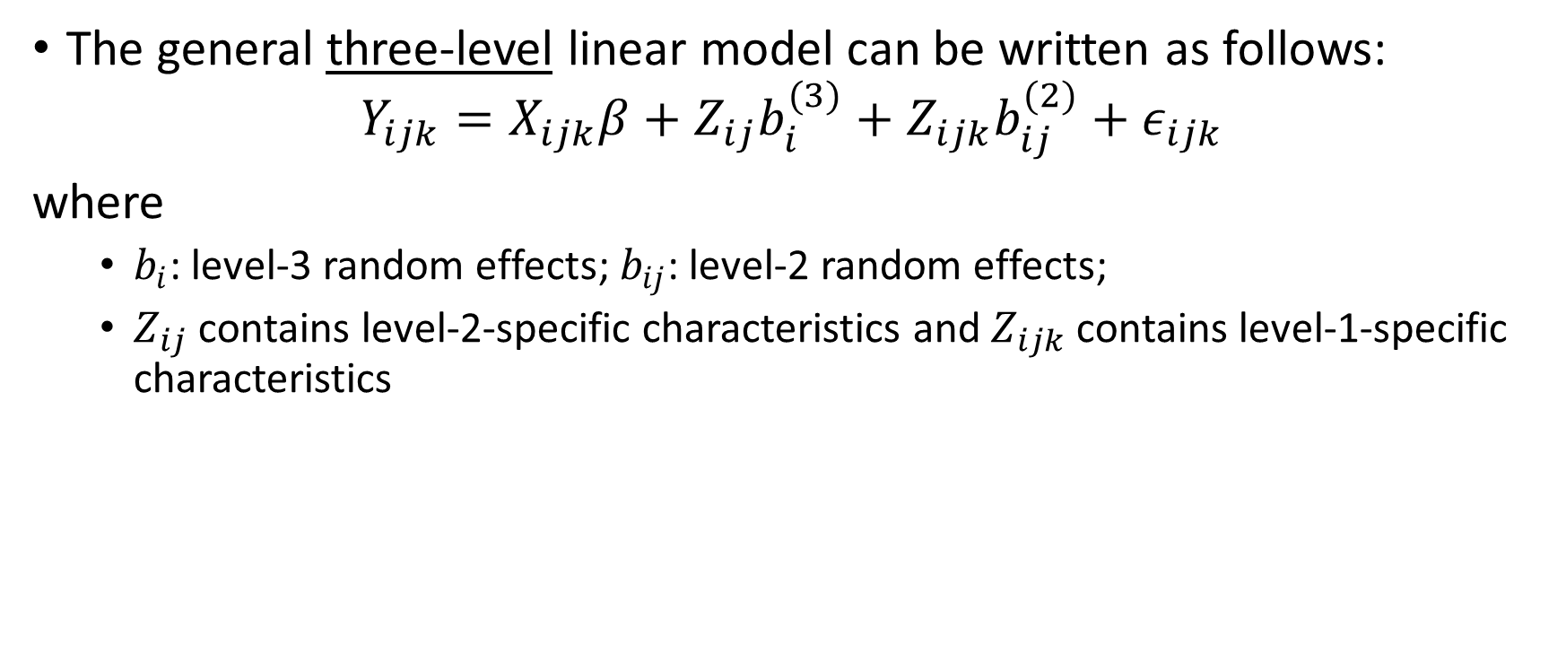
Three-Level Linear Models
The general three-level linear model can be written as follows:
$$Y_{ijk}=X_{ijk}β+{Z_{ij}b}_{i}^{(3)}+Z_{ijk}b_{ij}^{(2)}+ε_{ijk}$$
where
  $b_{i}$: level-3 random effects; $b_{ij}$: level-2 random effects;
  $Z_{ij}$ contains level-2-specific characteristics and $Z_{ijk}$ contains level-1-specific characteristics
PHS 651 / Lecture 22
14 / 23

Slide 15
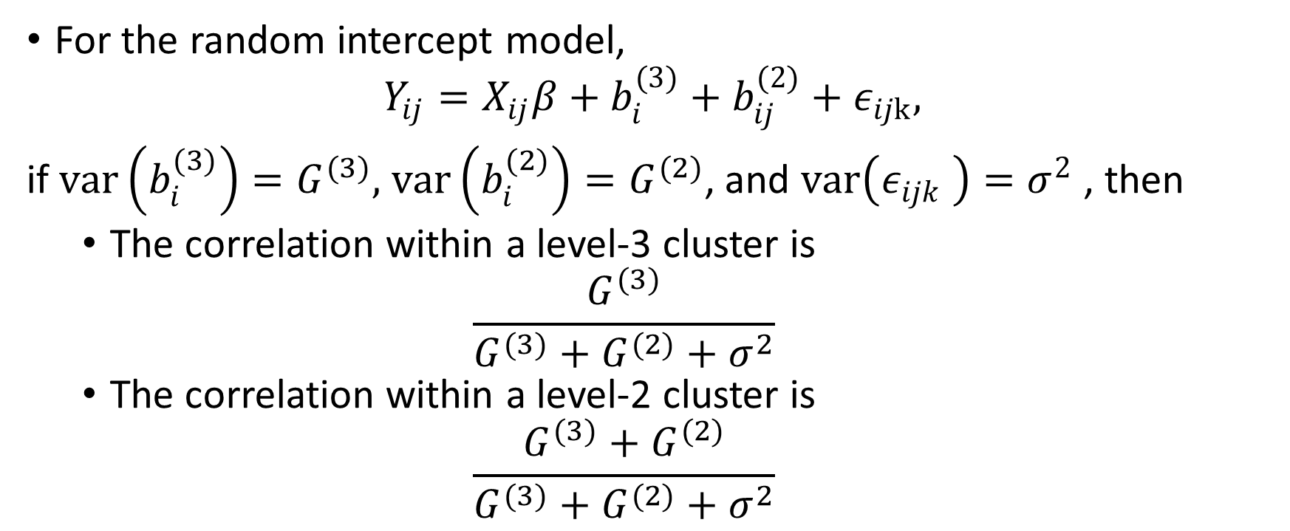
Three-Level Linear Models
For the random intercept model,
$$Y_{ij}=X_{ij}β+b_{i}^{(3)}+b_{ij}^{(2)}+ε_{ijk},$$
if $var\left(b_{i}^{(3)}\right)=G^{(3)},$$var\left(b_{i}^{(2)}\right)=G^{(2)}$, and $var\left(ε_{ijk} \right)=σ^{2}$, then
  The correlation within a level-3 cluster is
  $$\frac{G^{(3)}}{G^{(3)}+G^{(2)}+σ^{2}}$$
  The correlation within a level-2 cluster is
  $$\frac{G^{(3)}+G^{(2)}}{G^{(3)}+G^{(2)}+σ^{2}}$$
PHS 651 / Lecture 22
15 / 23

Slide 16
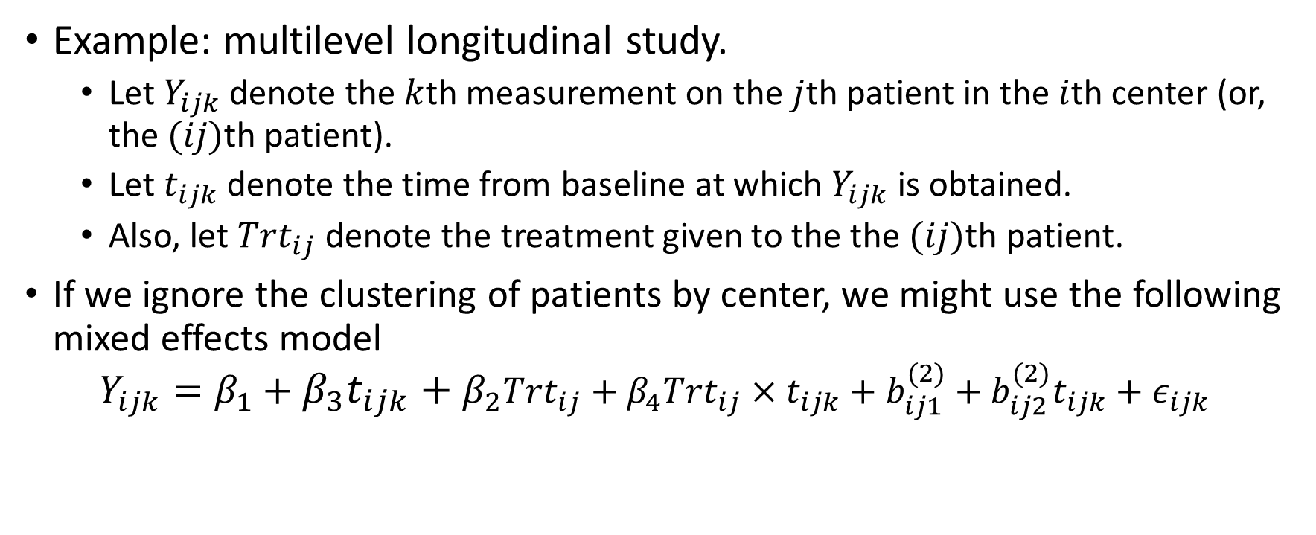
Three-Level Linear Models
Example: multilevel longitudinal study.
  Let $Y_{ijk}$denote the $k$thmeasurement on the $j$thpatient in the $i$thcenter (or, the $(ij)$th patient).
  Let $t_{ijk}$denote the time from baseline at which $Y_{ijk}$is obtained.
  Also, let $Trt_{ij}$denote the treatment given to the the $(ij)$thpatient.
If we ignore the clustering of patients by center, we might use the following mixed effects model
$$Y_{ijk}=β_{1}+{β_{3}t_{ijk}+β}_{2}Trt_{ij}+β_{4}Trt_{ij}×t_{ijk}+b_{ij1}^{(2)}+b_{ij2}^{(2)}t_{ijk}+ε_{ijk}$$
PHS 651 / Lecture 22
16 / 23

Slide 17
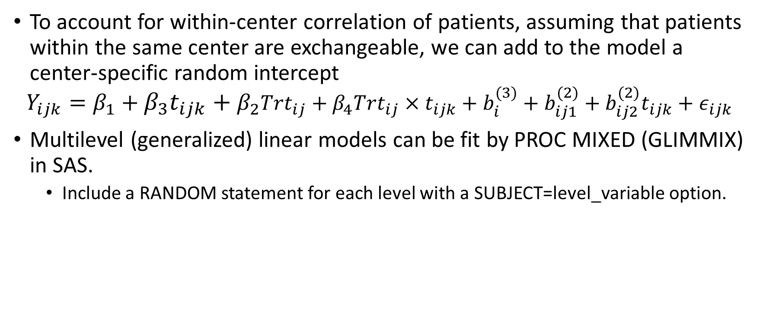
Three-Level Linear Models
To account for within-center correlation of patients, assuming that patients within the same center are exchangeable, we can add to the model a center-specific random intercept
$$Y_{ijk}=β_{1}+{β_{3}t_{ijk}+β}_{2}Trt_{ij}+β_{4}Trt_{ij}×t_{ijk}+b_{i}^{(3)}+b_{ij1}^{(2)}+b_{ij2}^{(2)}t_{ijk}+ε_{ijk}$$
Multilevel (generalized) linear models can be fit by PROC MIXED (GLIMMIX) in SAS.
  Include a RANDOM statement for each level with a SUBJECT=level_variable option.
PHS 651 / Lecture 22
17 / 23

Slide 18
The Television, School, and Family Smoking Prevention and Cessation Program
A randomized study with a 2 by 2 factorial design (4 treatments in total):
  Factor 1: A school-based social-resistance curriculum (CC)
  Factor 2: A television-based prevention program (TV)
We report results for 1,600 seventh graders from 135 classes in 28 schools
in Los Angeles
The response variable, the tobacco and health knowledge scale (THKS),
was administered before and after the intervention.
We consider a linear model for post-intervention THKS, with baseline
THKS as a covariate.
PHS 651 / Lecture 22
18 / 23

Slide 19
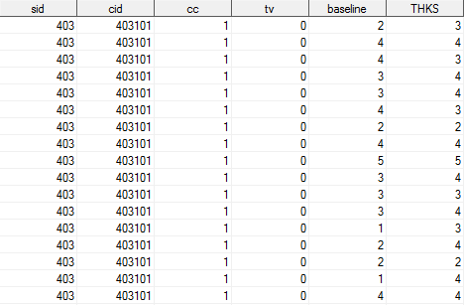
The Television, School, and Family Smoking Prevention and Cessation Program
Variable List: School ID, Class ID, School-based Resistance Curriculum (1=yes,0=no), Television-based Prevention Program (1=yes,0=no), Pre-interventions THKS score, Post-interventions THKS score.

Slide 20
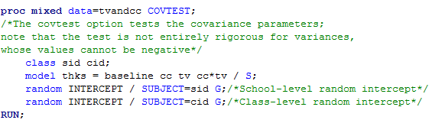
The Television, School, and Family Smoking Prevention and Cessation Program

Slide 21
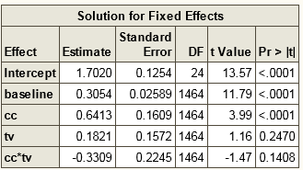
The Television, School, and Family Smoking Prevention and Cessation Program
(CC&non-TV) vs (non-CC&non-TV): 0.6413
(TV&non-CC) vs (non-TV&non-CC): 0.1821
(TV&CC) vs (non-TV&CC): 0.1821-0.3309=-0.1488

Slide 22
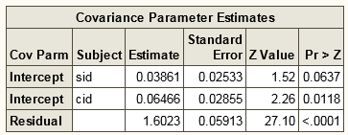
The Television, School, and Family Smoking Prevention and Cessation Program
Within-school correlation: 0.03861/(0.03861+0.06466+1.6023)=0.023
Within-class correlation: (0.03861+0.06466)/(0.03861+0.06466+1.6023)=0.061

Slide 23
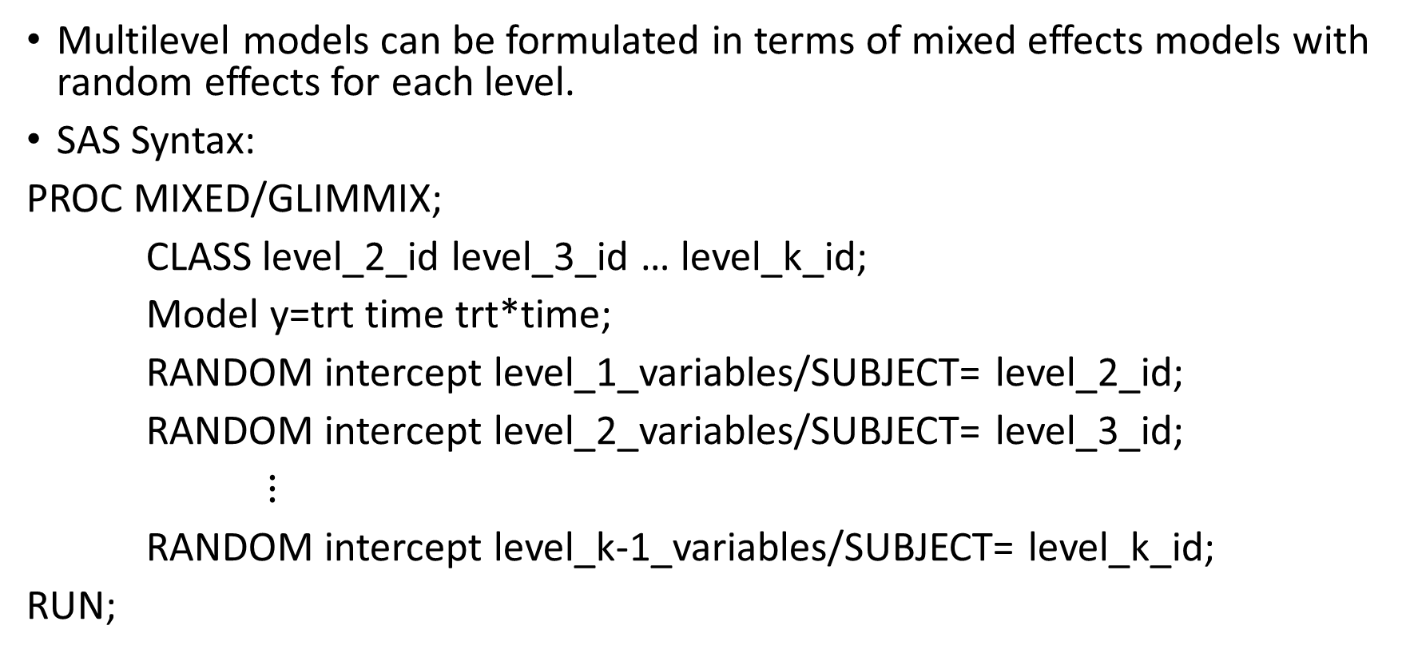
Summary
Multilevel models can be formulated in terms of mixed effects models with random effects for each level.
SAS Syntax:
PROC MIXED/GLIMMIX;
CLASS level_2_id level_3_id … level_k_id;
Model y=trt time trt*time;
RANDOM intercept level_1_variables/SUBJECT=level_2_id;
RANDOM intercept level_2_variables/SUBJECT= level_3_id;
$⋮$
RANDOM intercept level_k-1_variables/SUBJECT= level_k_id;
RUN;

