Slide 1
PHS 651 / LECTURE 23
Special Topic: Repeated-Measures Designs
Advanced Regression Methods for Population Health
Lu Mao, PhD
Department of Biostatistics and Medical Informatics
University of Wisconsin-Madison
SPRING 2019

Slide 2
Outline
  Features of repeated-measures designs
  Mixed effects modeling of randomized block designs
  An Example with a cross-over trial
PHS 651 / Lecture 23
2 / 20

Slide 3
Classical Repeated-Measures Designs
We discuss application of methods for longitudinal data to closely related designs.
One such design is the so-called classical repeated-measures design, where each subject (or “block”) is measured under different conditions, which often correspond to different treatments.
The major interest is not in changes over time but in the difference between circumstances of treatment within the subject.
PHS 651 / Lecture 23
3 / 20

Slide 4
Classical Repeated-Measures Designs
Unlike a longitudinal study, treatment varies within the subject rather than between subjects.
That is, “treatment” in a classical repeated-measures study is analogous to “time” in a longitudinal study. Hence, treatment effect is derived by within-subject contrasts.
Each subject serves as his/her own control
  Free of systematic bias due to between-subject difference (validity)
  Free of between-subject variation (efficiency)
PHS 651 / Lecture 23
4 / 20

Slide 5
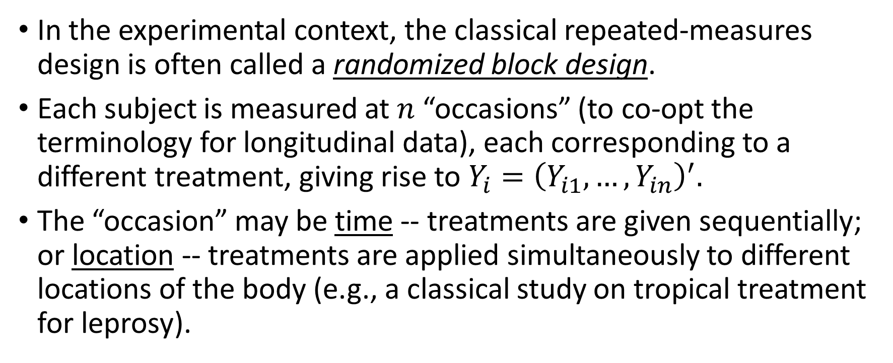
Randomized Block Design
In the experimental context, the classical repeated-measures design is often called a randomized block design.
Each subject is measured at $n$ “occasions” (to co-opt the terminology for longitudinal data), each corresponding to a different treatment, giving rise to $Y_{i}={\left(Y_{i1},…, Y_{in}\right)}^{′}.$
The “occasion” may be time -- treatments are given sequentially; or location -- treatments are applied simultaneously to different locations of the body (e.g., a classical study on tropical treatment for leprosy).
PHS 651 / Lecture 23
5 / 20

Slide 6
Randomized Block Design
Typically, the treatments are randomized to the different “occasions” to eliminate confounding due to systematic difference between the latter.
  Treatments received in random order
  Random assignment of location to treatment
Note that the difference with “cluster randomization” discussed in Lecture 22 is that here randomization is done in the unit (subject/block/cluster) rather than on the unit.
PHS 651 / Lecture 23
6 / 20

Slide 7
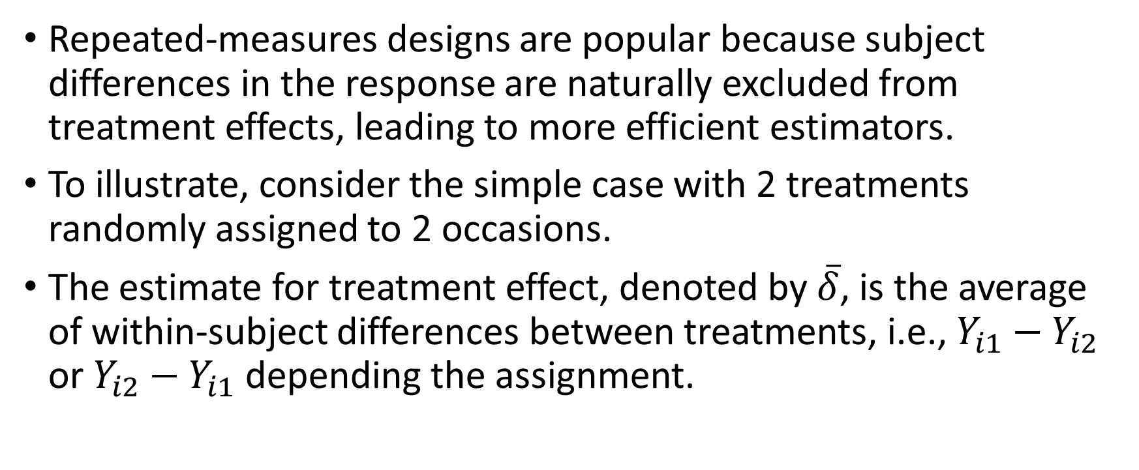
Efficiency Gain in Repeated Measures
Repeated-measures designs are popular because subject differences in the response are naturally excluded from treatment effects, leading to more efficient estimators.
To illustrate, consider the simple case with 2 treatments randomly assigned to 2 occasions.
The estimate for treatment effect, denoted by $\overline{δ}$, is the average of within-subject differences between treatments, i.e., $Y_{i1}−Y_{i2}$ or $Y_{i2}−Y_{i1}$ depending the assignment.
PHS 651 / Lecture 23
7 / 20

Slide 8
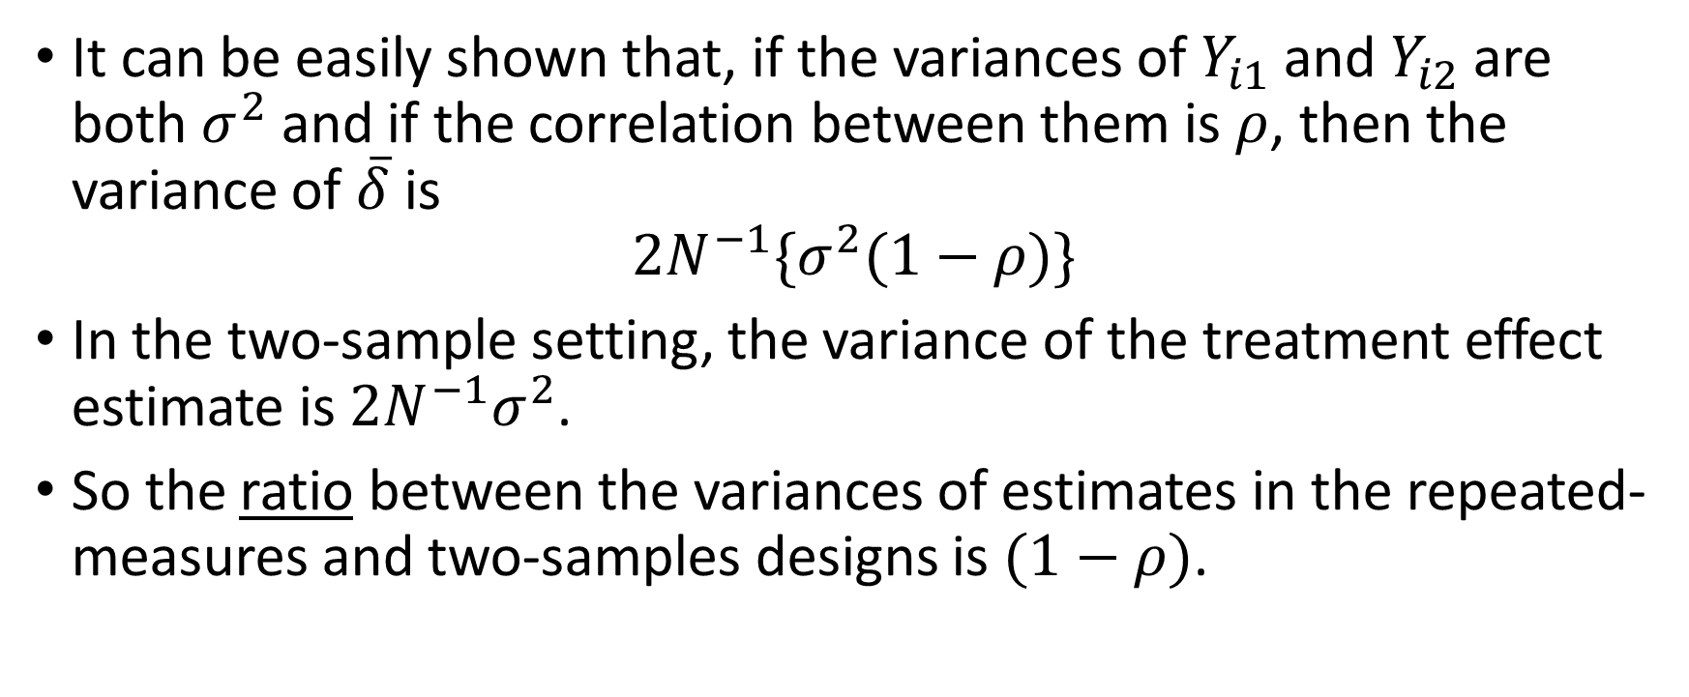
Efficiency Gain in Repeated Measures
It can be easily shown that, if the variances of $Y_{i1}$ and $Y_{i2}$ are both $σ^{2}$ and if the correlation between them is $ρ$, then the variance of $\overline{δ}$ is
$$2N^{−1}\{σ^{2}(1−ρ)\}$$
In the two-sample setting, the variance of the treatment effect estimate is $2N^{−1}σ^{2}$.
So the ratio between the variances of estimates in the repeated-measures and two-samples designs is $(1−ρ)$.
PHS 651 / Lecture 23
8 / 20

Slide 9
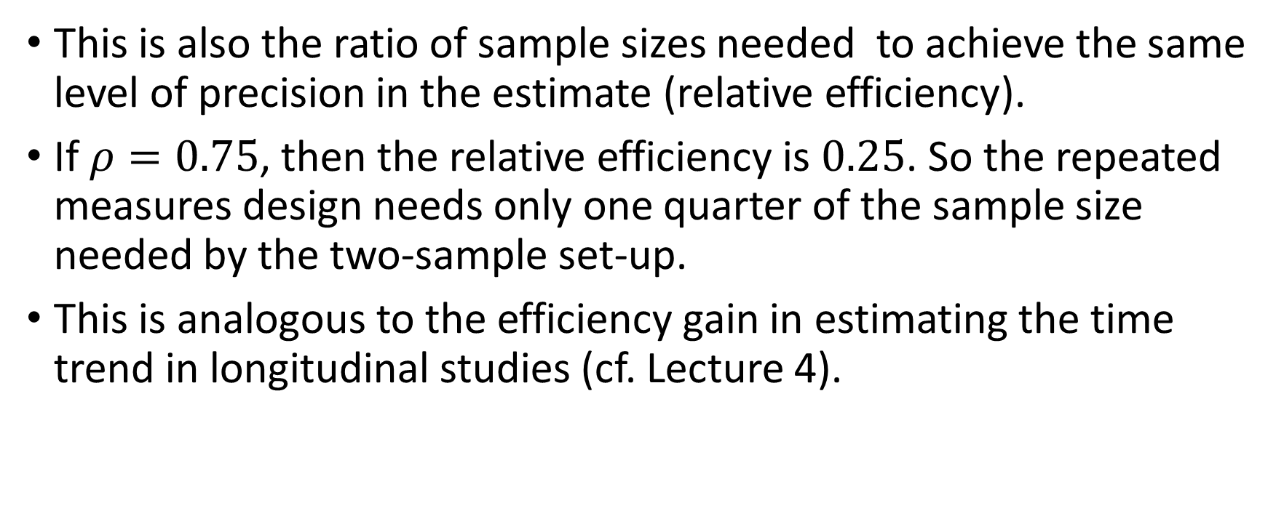
Efficiency Gain in Repeated Measures
This is also the ratio of sample sizes needed to achieve the same level of precision in the estimate (relative efficiency).
If $ρ=0.75$, then the relative efficiency is $0.25$. So the repeated measures design needs only one quarter of the sample size needed by the two-sample set-up.
This is analogous to the efficiency gain in estimating the time trend in longitudinal studies (cf. Lecture 4).
PHS 651 / Lecture 23
9 / 20

Slide 10
Mixed Effects Modeling of Randomized Block Designs
In randomized block designs, because treatments are randomly assigned to occasions, each occasion contains a mixture of different treatments.
Moreover, thanks to randomization, the proportions of treatments are expected to be identical across occasions.
This implies that responses from different occasions are exchangeable, resulting in a compound symmetric covariance structure.
In mixed effects models, this amounts to including a random intercept for the subject/block.
PHS 651 / Lecture 23
10 / 20

Slide 11
An Example with a Cross-Over Trial
The study was designed to compare two active drugs and placebo for relief of tension headache.
The two analgesic drugs were identical in their active ingredients except that one contained caffeine.
The primary comparison of interest was between the two active drugs; the placebo was included for regulatory purposes.
Each subject received only two of the three treatments in a random order.
PHS 651 / Lecture 23
11 / 20

Slide 12
An Example with a Cross-Over Trial
With three treatments and two periods, this is an incomplete randomized block design, i.e., each subject receives an incomplete set of treatments.
There are six possible treatment sequences, AB, BA, AP, PA, BP, PB:
  A, B and P denote the two active drugs and placebo.
In this study the AB and BA sequences were assigned three times as many subjects as the remaining four because of the interest in the A versus B comparison.
PHS 651 / Lecture 23
12 / 20

Slide 13
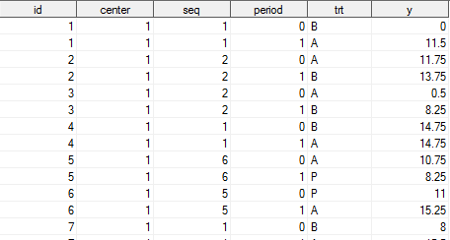
An Example with a Cross-Over Trial
id: Subject id; seq: Sequence of treatments for the subject; period: 0=first, 1=second; trt=A, B, P, indicating treatment received; y: Self-reported pain relief.
PHS 651 / Lecture 23
13 / 20

Slide 14
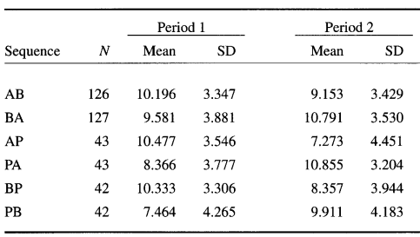
An Example with a Cross-Over Trial
Summary statistics by treatment sequence and period
PHS 651 / Lecture 23
14 / 20

Slide 15
An Example with a Cross-Over Trial
An important issue in cross-over designs is the possibility of carry-over effects.
This means that the treatment taken in the first period may influence that in the second period.
We account for the carry-over effects by including in the model a period term and terms for previous treatments.
We make the simplifying assumption that the carry-over effects depend only on the first treatment and not on second (two-way interactions between first treatment and period).
PHS 651 / Lecture 23
15 / 20

Slide 16
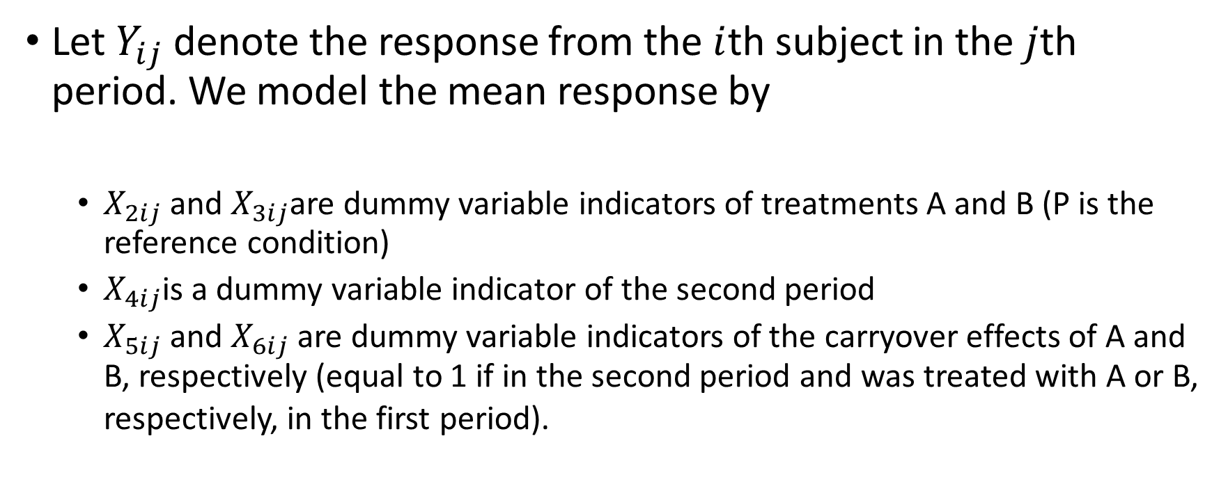
An Example with a Cross-Over Trial
Let $Y_{ij}$ denote the response from the $i$th subject in the $j$thperiod. We model the mean response by
  $X_{2ij}$and $X_{3ij}$are dummy variable indicators of treatments A and B (P is the reference condition)
  $X_{4ij}$is a dummy variable indicator of the second period
  $X_{5ij}$and $X_{6ij}$ are dummy variable indicators of the carryover effects of A and B, respectively (equal to 1 if in the second period and was treated with A or B, respectively, in the first period).
PHS 651 / Lecture 23
16 / 20

Slide 17
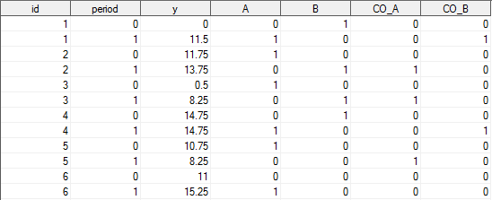

An Example with a Cross-Over Trial
$X_{2ij}$: A; $X_{3ij}$: B; $X_{4ij}$: period; $X_{5ij}$: CO_A; $X_{6ij}$: CO_B.
PHS 651 / Lecture 23
17 / 20

Slide 18
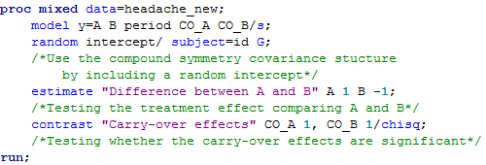

An Example with a Cross-Over Trial
The difference in treatment effect between A and B is $β_{2}−β_{3}$
We use a mixed effects model with a subject-specific random intercept, as justified by the randomized design.
PHS 651 / Lecture 23
18 / 20

Slide 19
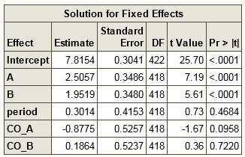
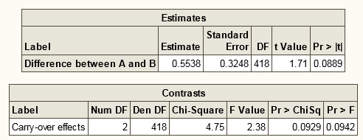
An Example with a Cross-Over Trial
The average difference in pain relief between treatments A and B is 0.5538 (p=0.089).
The test for carry-over effects yields a p value of 0.094. Because of the magnitudes of the estimated carry-over effects, we keep them in the model.
PHS 651 / Lecture 23
19 / 20

Slide 20
Summary
The main difference between classical repeated-measures designs and the longitudinal study designs is that treatment varies within the subject in the former but usually between subjects in the latter.
In the special case of randomized block design, treatments are randomly assigned to different occasions, justifying the use of a within-block (within-subject) random-intercept model.
This can be implemented in SAS procedures PROC MIXED/GLIMMIX the same way as for a random-intercept model for longitudinal data.
PHS 651 / Lecture 23
20 / 20

