Slide 1
PHS 651 / LECTURE 24
Review and Prospects
Advanced Regression Methods for Population Health
Lu Mao, PhD
Department of Biostatistics and Medical Informatics
University of Wisconsin-Madison
SPRING 2019

Slide 2
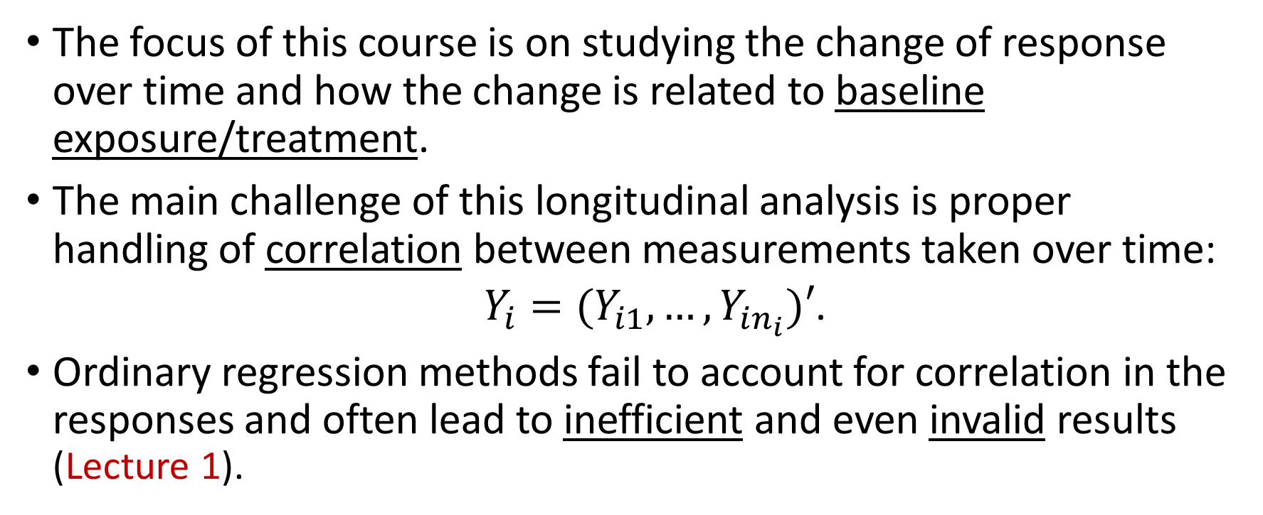
Why PHS 651?
The focus of this course is on studying the change of response over time and how the change is related to baseline exposure/treatment.
The main challenge of this longitudinal analysis is proper handling of correlation between measurements taken over time:
  $Y_{i}=(Y_{i1},…, Y_{in_{i}})′$.
Ordinary regression methods fail to account for correlation in the responses and often lead to inefficient and even invalid results (Lecture 1).
PHS 651 / Lecture 24
2 / 15

Slide 3
Statistical Methods for Longitudinal Data
There are different ways of modeling longitudinal data to account for the correlation structure in the response. All can be viewed as extensions of ordinary linear regression (Lecture 2) or generalized linear regression (GLM; Lecture 14)
We have studied three classes of models for longitudinal model:
  General Linear Models
  Mixed Effects Models
  Marginal Models
PHS 651 / Lecture 24
3 / 15

Slide 4
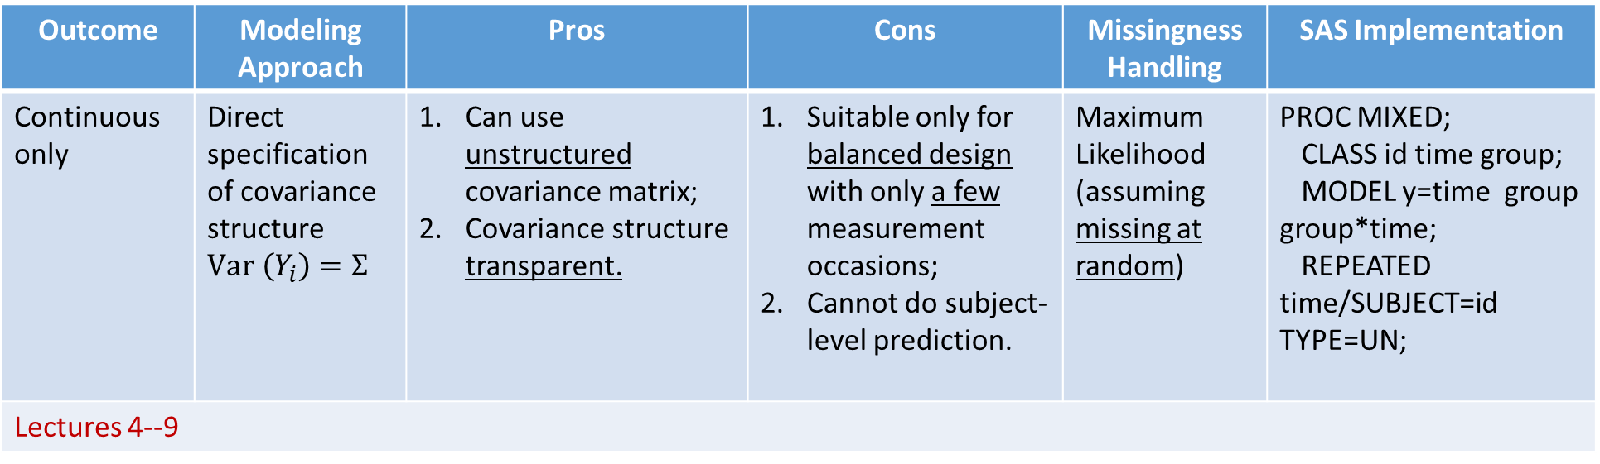
Statistical Methods – General Linear Models
Outcome | Modeling Approach | Pros | Cons | Missingness Handling | SAS Implementation
Continuous only | Direct specification of covariance structure $Var \left(Y_{i}\right)=Σ$ | Can use unstructured covariance matrix; Covariance structuretransparent. | Suitable only for balanced design with only a few measurement occasions; Cannot do subject-level prediction. | Maximum Likelihood (assuming missing at random) | PROC MIXED; CLASS id time group; MODEL y=time group group*time; REPEATED time/SUBJECT=id TYPE=UN;
Lectures 4--9
PHS 651 / Lecture 24
4 / 15

Slide 5
Statistical Methods – Mixed Effects Models
Outcome | Modeling Approach | Pros | Cons | Missingness Handling | SAS Implementation
Continuous/Non-Continuous | Specify subject-level random effects to induce correlation | Subject-level inference; Natural induction of correlation among measurements; Statistically efficient if correctly modeled. | Validity depends on assumed distribution of random effects; May be computationally intensive. | Maximum Likelihood (assuming missing at random) | PROC MIXED/GLIMMIX; CLASS id group; MODEL y=time group group*time/dist=, link=; RANDOM INTERCEPT time/SUBJECT=id TYPE=UN G;
Lectures 10--11, 17--18
PHS 651 / Lecture 24
5 / 15

Slide 6
Statistical Methods – Marginal Models
Outcome | Modeling Approach | Pros | Cons | Missingness Handling | SAS Implementation
Continuous/Non-Continuous | Focus only on the mean model without specifying the correlation | Maximal robustness Computationally simple | Needs the sample size to be fairly large; Cannot do subject-level prediction; Strong assumption on missing data | Available case analysis (assuming missing completely at random) | PROC GENMOD; CLASS id group visit; MODEL y=time group group*time/dist=, link=; REPEATED SUBJECT=id/WITHIN=visit TYPE=IND ;
Lectures 15--16
PHS 651 / Lecture 24
6 / 15

Slide 7
The Importance of Descriptive Analysis
Regardless of the modeling approach, one always summarizes the data descriptively first (Lecture 3).
For longitudinal study, a “Table 1” for descriptive analysis typically contains summary statistics for baseline characteristics of subjects (by treatment).
A time plot for individual or mean responses usually helps to exhibit the main features in the pattern of temporal change and to guide the choice of the analysis model.
PHS 651 / Lecture 24
7 / 15

Slide 8
The Importance of Residual Analysis
Credibility of the analysis results and conclusion drawn thereupon depends on the adequacy of the model.
We have considered model diagnostics in the setting of linear mixed effects model (Lecture 13).
Similar residual plots can be done in PROC GLIMMIX for GLMM and PROC GENMOD for marginal models.
A common sensical way to diagnose model misfit is to overlay the model-based mean trajectories over the empirically estimated ones (perhaps by grouping the data in an appropriate way).
PHS 651 / Lecture 24
8 / 15

Slide 9
Sample Size Calculation for a Longitudinal Study
To design a longitudinal study, we used a linear mixed effects model with a linear time trend and random slopes for sample size calculation (Lecture 12).
Alternatively, one can base sample size on a paired t-test (pre- and post-treatment), which may be an over-simplification of the data and analysis eventually gathered and performed.
Or, one can use simulation based on the model to be used for analysis, which may be computationally demanding.
PHS 651 / Lecture 24
9 / 15

Slide 10
Missing Data in Longitudinal Studies
There are three types of missing data: 1. missing completely at random (MCAR); 2. missing at random (MAR); 3. not missing at random (NMAR).
For longitudinal analysis, the assumption on missing data is usually MAR (MLE for mixed effects models; IPW or multiple imputations for marginal models; Lecture 19--20).
For more on missing data, refer to the book:
Little, Roderick JA, and Donald B. Rubin. Statistical analysis with missing data. 3rd edition, Wiley, 2019.
PHS 651 / Lecture 24
10 / 15

Slide 11
Versatility of the Random Effects Methods
The random effects approach to longitudinal study can also be applied to various other settings (Lectures 21--23)
  Semiparametric regression
  Multilevel data
  Cross-over trials
For a systematic overview of smoothness-based semiparametric models, see the book:
Ruppert, D., Wand, M. P., & Carroll, R. J. (2003). Semiparametric regression. Cambridge University Press.
PHS 651 / Lecture 24
11 / 15

Slide 12
Time-Varying Treatment/Exposure
This course is focused on longitudinal study with time-constant treatment/exposure (with the exception of the menarche study analyzed in Lecture 11)
For such cases, the treatment effects are usually captured by the interactions between time and treatment.
Longitudinal studies with time-varying treatment is a challenging topic. You may refer to this new causal inference book by M. Hernan and J. Robins for a detailed discussion:
https://www.hsph.harvard.edu/miguel-hernan/causal-inference- book/
PHS 651 / Lecture 24
12 / 15

Slide 13
The Objectives of the Course
Are you now able to…
Extend the knowledge of regression analysis beyond ordinary linear models
Understand the features of correlated data and their implications in drawing inference
Construct proper linear and generalized linear models for longitudinal and clustered data
Understand the assumptions needed for estimation and inference
PHS 651 / Lecture 24
13 / 15

Slide 14
The Objectives of the Course
Implement the inference procedures to solve real-world problems using statistical packages such as SAS and R
Use diagnostic tools to assess model fit
Interpret and present the analytic results to answer substantive questions
PHS 651 / Lecture 24
14 / 15

Slide 15
Final Assignment
Please complete course evaluation by Friday (5/3)!
  Thank you for your cooperation!
PHS 651 / Lecture 24
15 / 15

