Slide 1
STGraph is the core component of a sophisticated software architecture aimed at developing models of business games and making them interactively accessible for online players.
The two main stages of the process are then (i) model development and (ii) game management.
In the first stage (model development) the domain expert generates a model by means of STGraph.
STGraph
model
domain expert

Slide 2
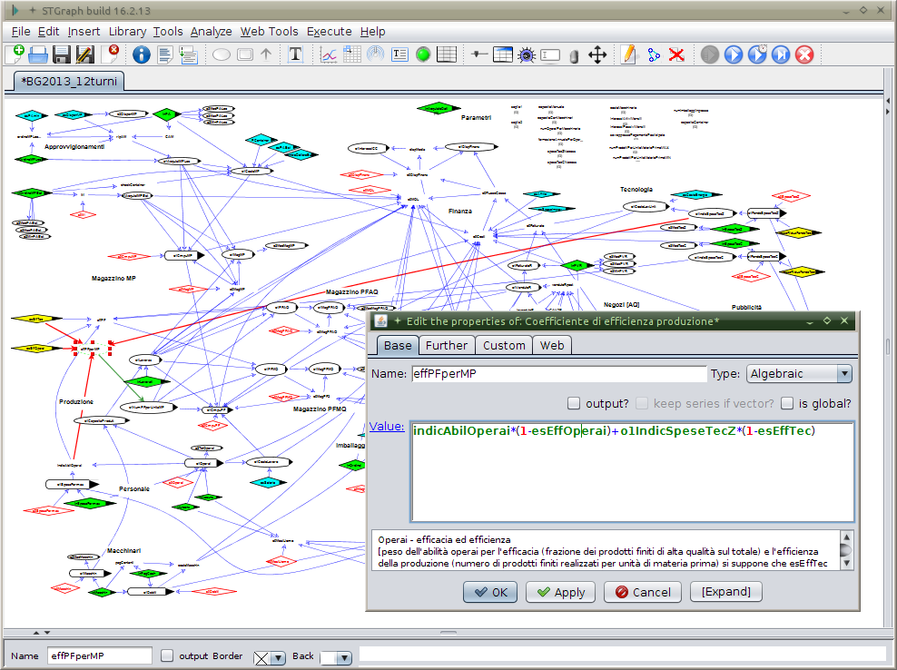
domain expert
The actions in this stage are:
(1) qualitative (drawing of graph) and quantitative (definition of equations) construction of the model;

Slide 3
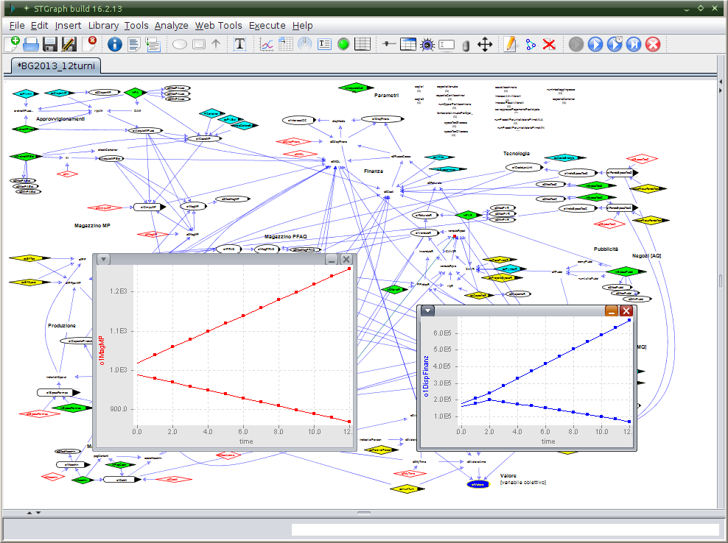
domain expert
(2) testing of the model;

Slide 4
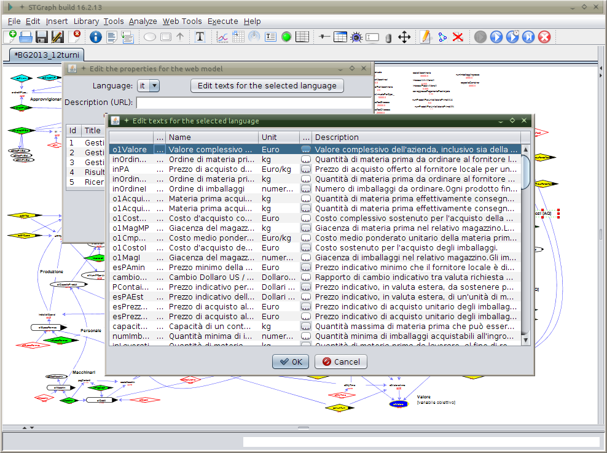
domain expert
(3) contextual writing of the documentation;

Slide 5
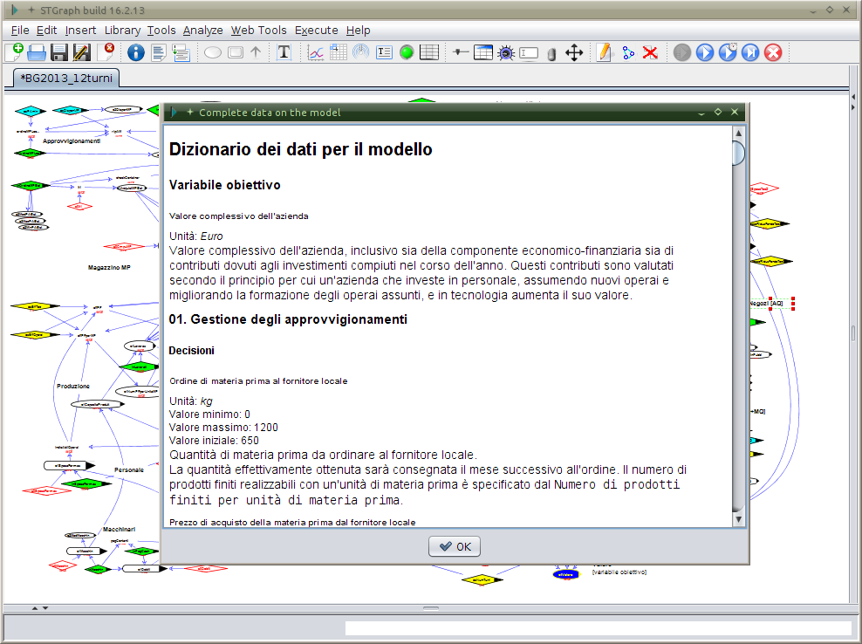
domain expert
(4) automatic generation of documentation files.
All actions of the first stage are performed by means of STGraph, operated as both an interactive editor and a simulation engine.

Slide 6
In the second stage (game setup and management) the domain expert transfers the developed model, stored in an XML file, to the system administrator, who setup one or more games based on that model, by configuring the game-related parameters, in particular the number of players / teams of each game.
The game is finally ready to be played...

Slide 7
system administrator
market manager
browser
browser
web / application server
model
browser
STGraphWeb
STGraph
player
web site
internet
forum
database
management system
browser
player & game
data
player
browser
tutor

