Slide 1
Facial recognition
Lucas Mariétan 06.10.23

Slide 2
Outline
Executive Summary
Introduction
Methodology
Results
Conclusion
Appendix

Slide 3
Executive summary
Convoluted neural networks provide the best performance under the following conditions:
Specialized nets for specific tasks, for example a specialist predicts the position of the nose tip.
Learning rate and momentum linearly dependent on the epochs
Regularization techniques
This work must be seen as an introduction to neural networks, i.e. no extensive research on optimization of parameters.

Slide 4
Introduction
The objective of this task is to predict keypoint positions on face images. This can be used as a building block in several applications, such as:
tracking faces in images and video
analysing facial expressions
detecting dysmorphic facial signs for medical diagnosis
biometrics / face recognition

Slide 5
Methodology - summary
Data from Kaggle challenge Facial Keypoints Detection | Kaggle
Black and white 96x96 face pictures. Training set labeled with up to 15 keypoints location (x and y coordinates).
Convoluted specialists networks
RMSE to evaluate predictions

Slide 6
Methodology - data
Each predicted keypoint is specified by an (x,y) real-valued pair in the space of pixel indices. There are max 15 keypoints per image.
The input image consists of a list of pixels (ordered by row), as integers in (0,255). The images are 96x96 pixels.
Data files
training.csv: list of training 7049 images. Each row contains the (x,y) coordinates for 15 keypoints, and image data as row-ordered list of pixels.
test.csv: list of 1783 test images. Each row contains ImageId and image data as row-ordered list of pixels

Slide 7
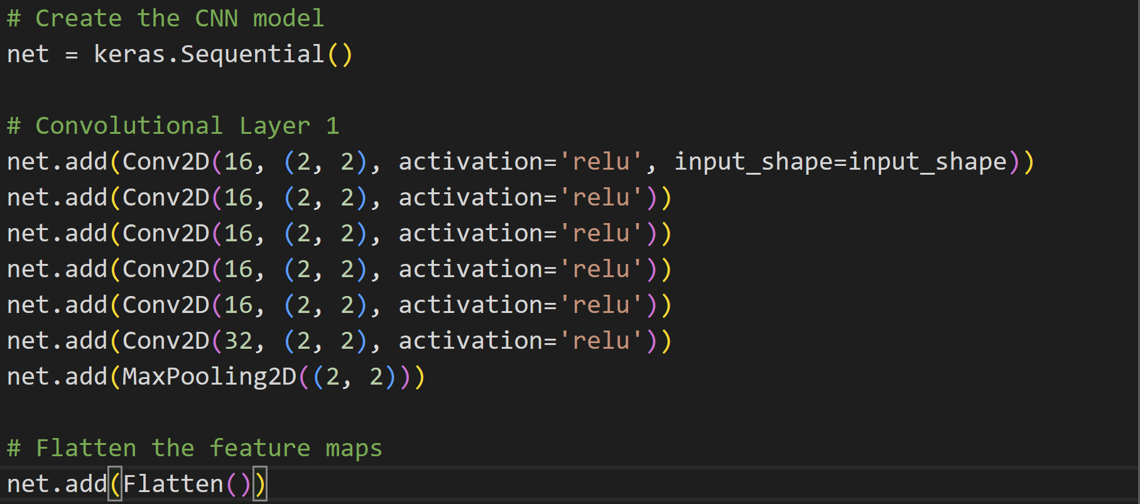
Methodology – Base architecture

Slide 8
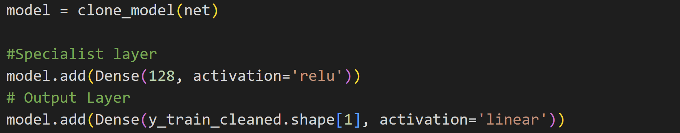
Methodology – Specialized head
Task prediction is divided into specialists, i.e. one model predicts the position of the center of the eyes, another predicts the nose tip etc…
A fully connected layer is added on top of each specialist.
The output layer size depends on the number of keypoints for the corresponding specialist

Slide 9
Methodology - Hyperparameters
Learning rate and momentum decrease, respectively increase linearly with the epoch number.
Random shifting and flipping of images
Adam optimizer with gradient clipping at 1
Early stopping at 60 epochs (could have been smaller)
Batch size = 32
500 epochs

Slide 10
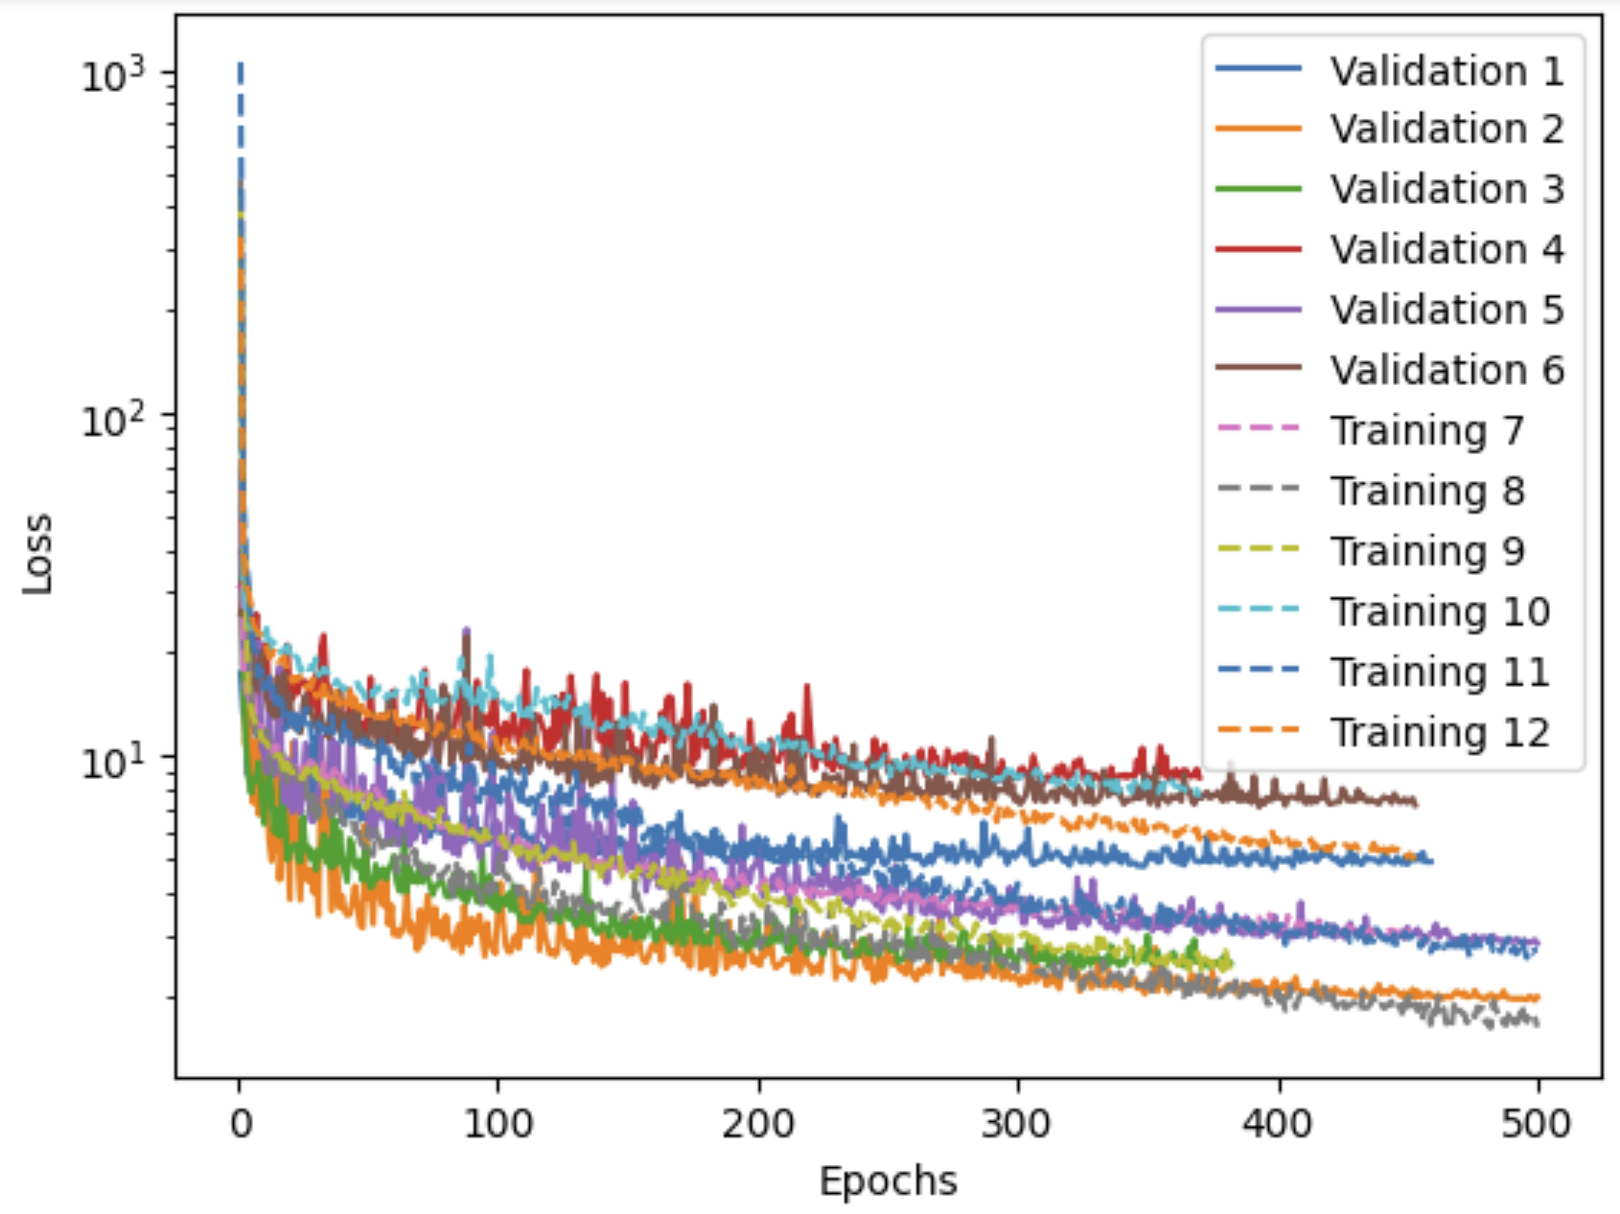
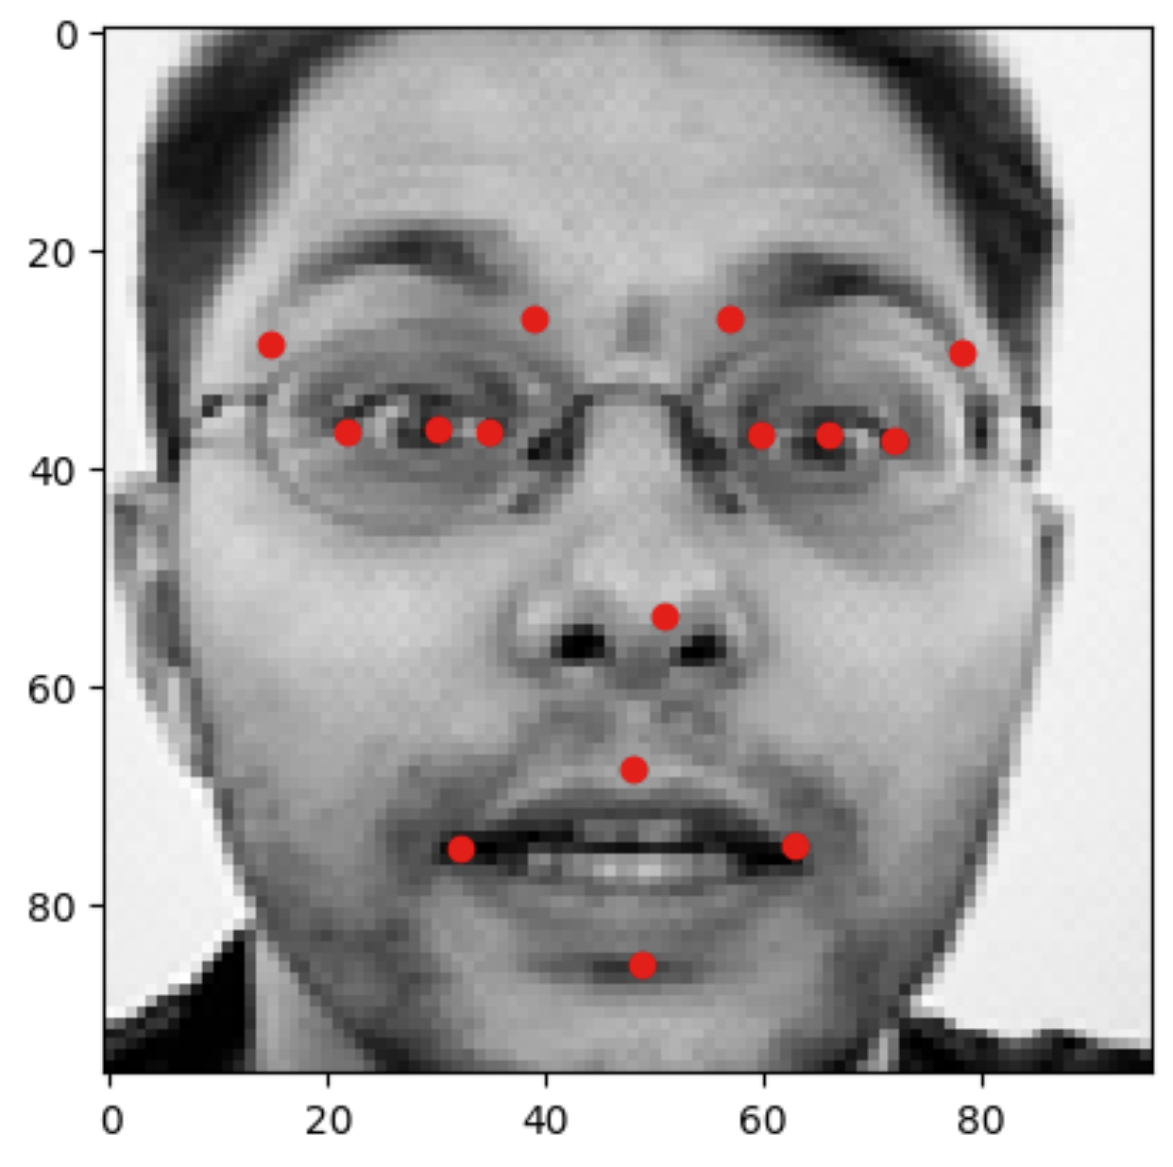
Results
Public score of RMSE = 2.14 on Kaggle (should have kept color code below)

