Slide 1



Hospitality_Dashboard
View in Power BI
Last data refresh:
2/18/2025 5:08:22 PM UTC
Downloaded at:
2/18/2025 5:13:41 PM UTC

Slide 2

Main Page
Notes:
image
No alt text provided
textbox
No alt text provided
image
No alt text provided
textbox
No alt text provided
image
No alt text provided
textbox
No alt text provided
image
No alt text provided
textbox
No alt text provided
actionButton
No alt text provided
actionButton
No alt text provided
actionButton
No alt text provided
shape
No alt text provided
shape
No alt text provided
shape
No alt text provided

Slide 3
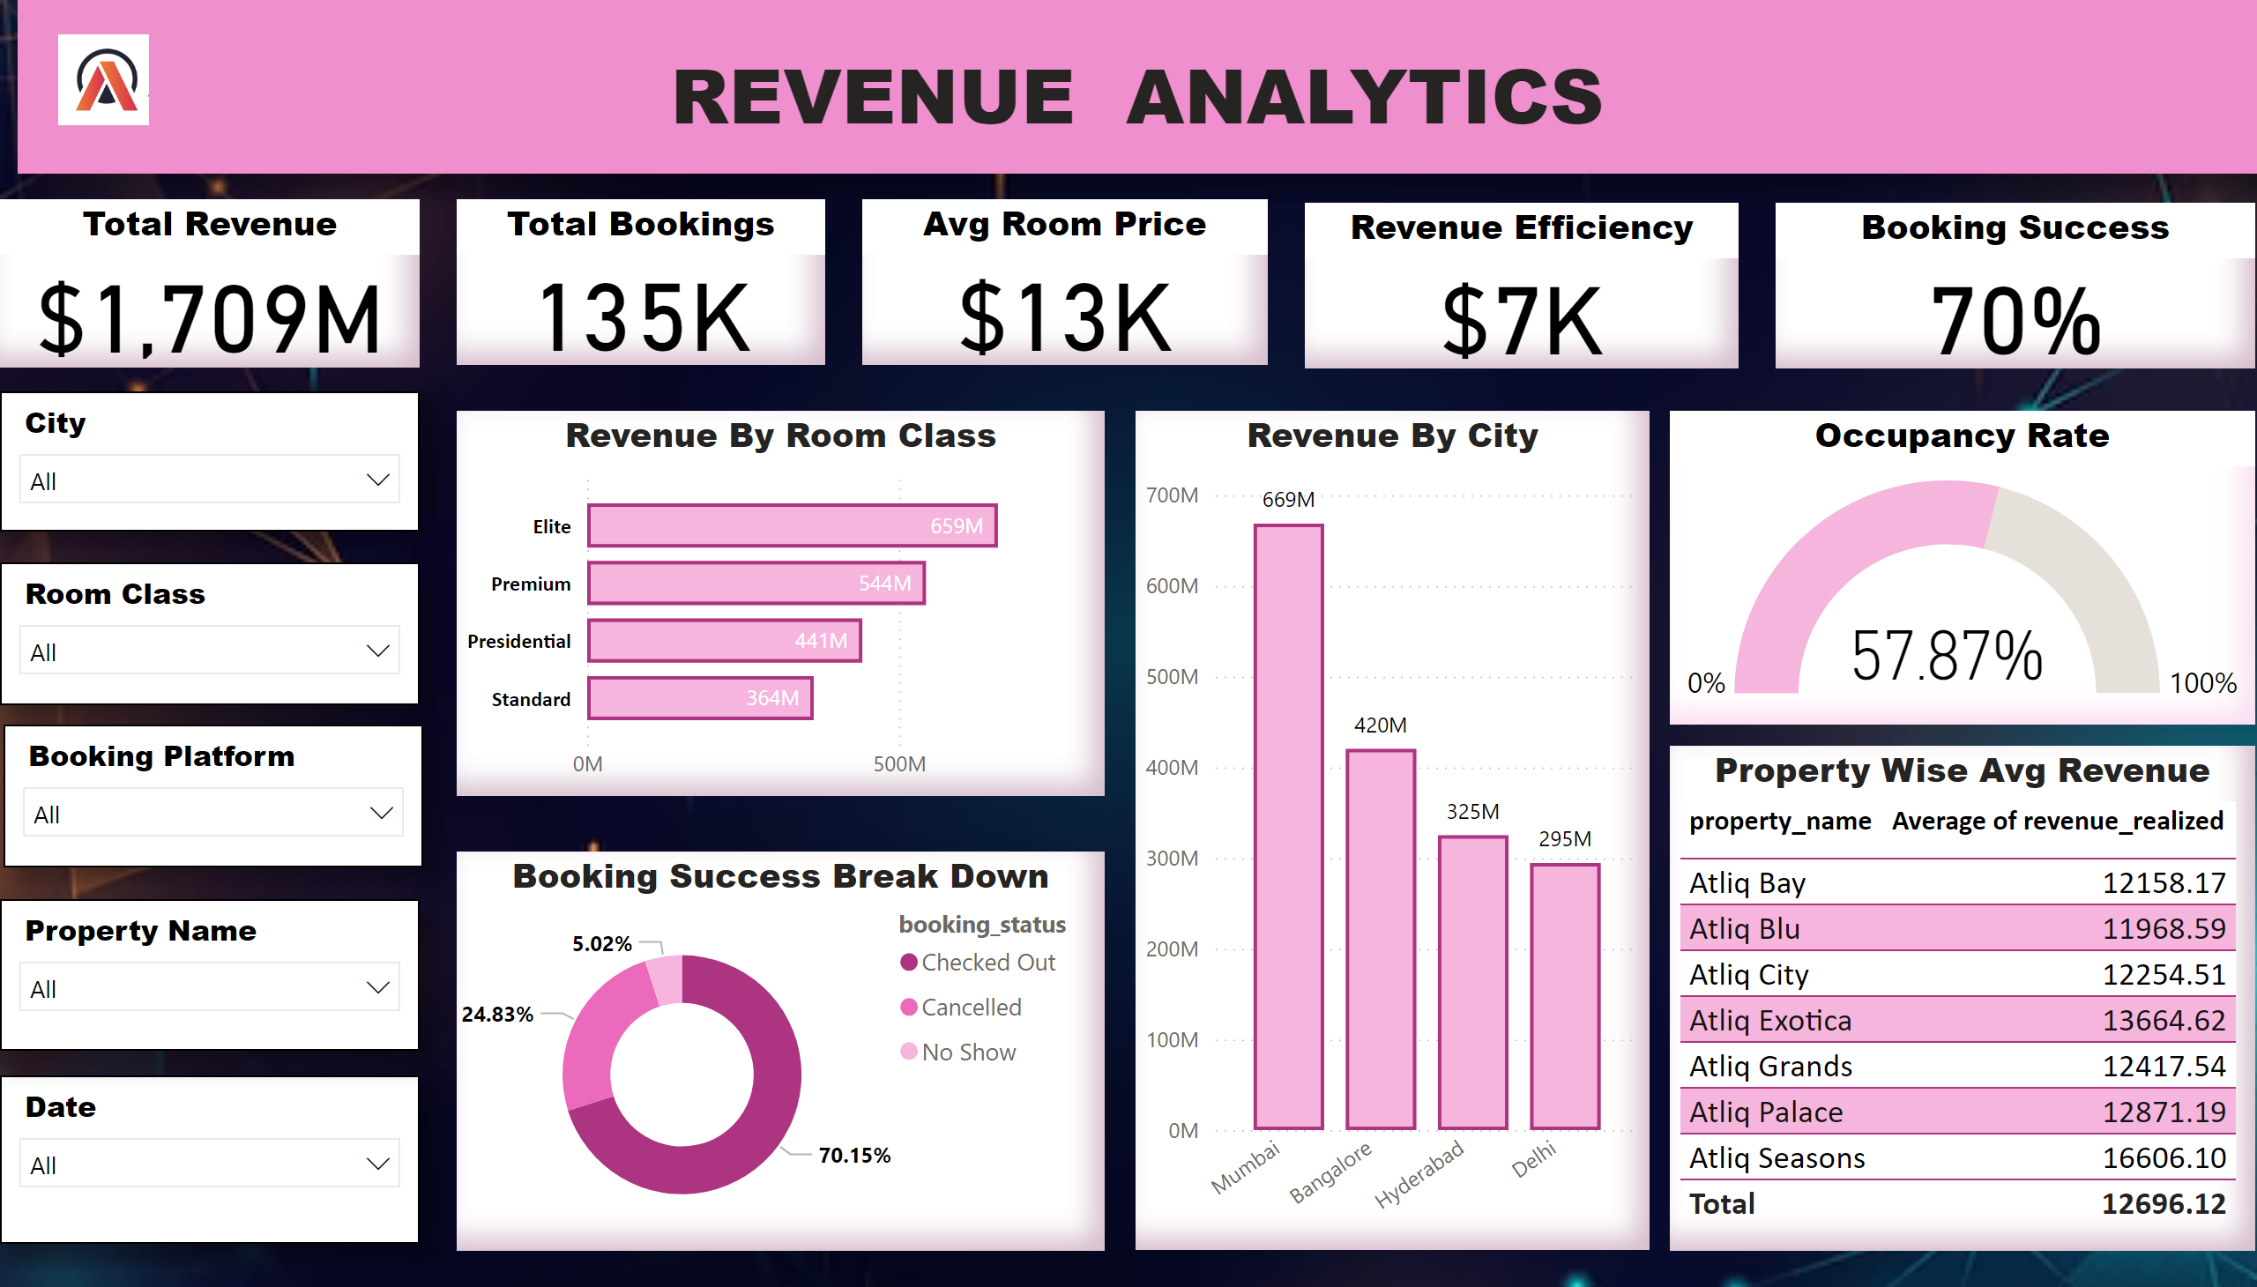
Revenue Analytics
Notes:
textbox
No alt text provided
Total Revenue
No alt text provided
Total Bookings
No alt text provided
Avg Room Price
No alt text provided
slicer
No alt text provided
slicer
No alt text provided
slicer
No alt text provided
slicer
No alt text provided
slicer
No alt text provided
Occupancy Rate
No alt text provided
Revenue Efficiency
No alt text provided
Booking Success
No alt text provided
Booking Success Break Down
No alt text provided
Revenue By Room Class
No alt text provided
Property Wise Avg Revenue
No alt text provided
Revenue By City
No alt text provided
image
No alt text provided

Slide 4
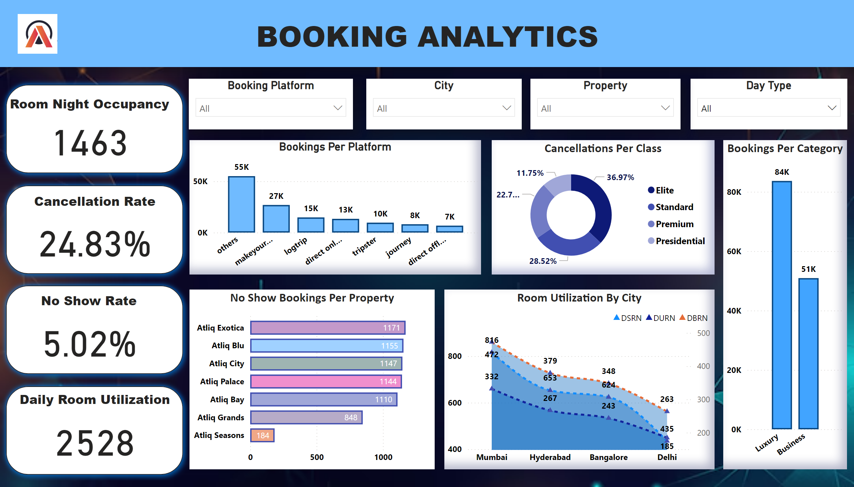
Booking Analytics
Notes:
textbox
No alt text provided
shape
No alt text provided
shape
No alt text provided
shape
No alt text provided
shape
No alt text provided
Room Night Occupancy
No alt text provided
Cancellation Rate
No alt text provided
No Show Rate
No alt text provided
Daily Room Utilization
No alt text provided
Booking Platform
No alt text provided
Day Type
No alt text provided
City
No alt text provided
Property
No alt text provided
Bookings Per Platform
No alt text provided
Cancellations Per Class
No alt text provided
Bookings Per Category
No alt text provided
Room Utilization By City
No alt text provided
No Show Bookings Per Property
No alt text provided
image
No alt text provided

Slide 5
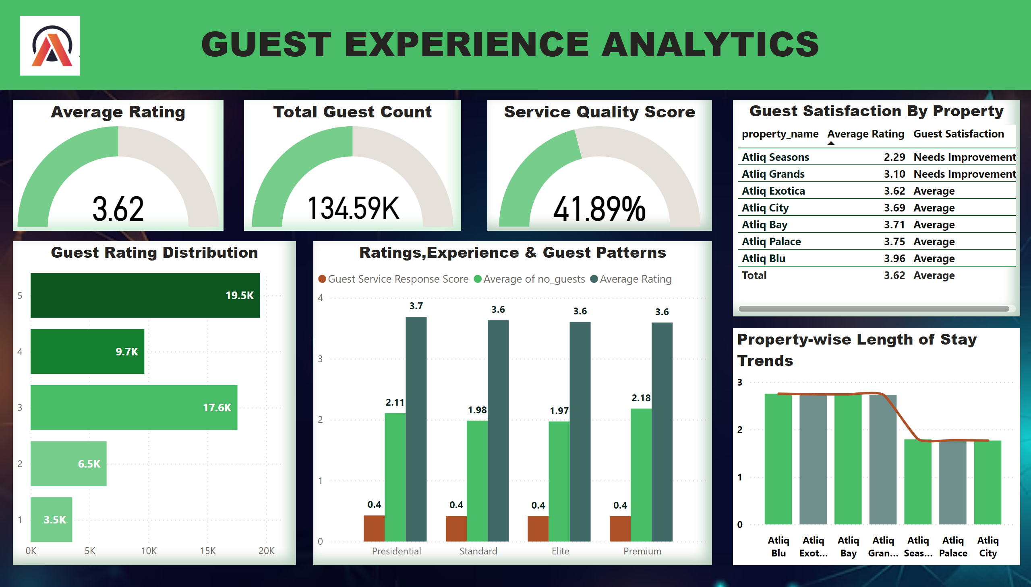
Guest Experience
Notes:
textbox
No alt text provided
Average Rating
No alt text provided
Total Guest Count
No alt text provided
Service Quality Score
No alt text provided
Guest Rating Distribution
No alt text provided
Ratings,Experience & Guest Patterns
No alt text provided
Guest Satisfaction By Property
No alt text provided
Property-wise Length of Stay Trends
No alt text provided
image
No alt text provided

