Slide 1
Voice-Activated Keyword Spotting
Presented by Lenny Marron

Slide 2
agenda
Project overview
System Architecture
Hardware Design (PL)
Conclusion
Software Design (PS)
Interfaces and Peripherals Used
Verification and Testing
Project Demo

Slide 3
Project Overview
Goal:
To detect simple spoken commands such as “on” and “off” using Zybo Z7-10 with audio interface and indicate the detected command using UART or LEDs.

Slide 4

System Architecture
Audio is captured by mic or line-in into DDR memory.
Coverts DMA words into signed 16-bit samples.
Extracts 1 second of audio for KWS code
Verify silence vs speech before computing model

Slide 5
Hardware Design (Programmable Logic)
Buttons use interrupts to captures audio without polling
Audio codec is configured over I2C
Audio samples travel through the I2S/audio stream path
S2MM DMA writes the recording at MEM_BASE_ADDR
DMA interrupts notify the software when recording is complete, before reading

Slide 6
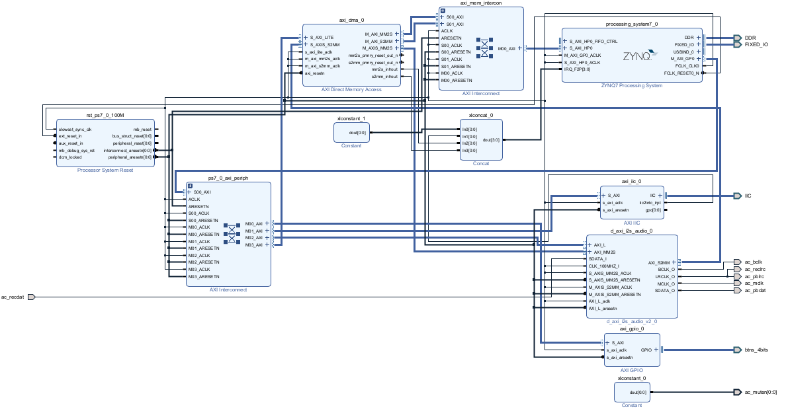
Hardware Design (Programmable Logic)

Slide 7
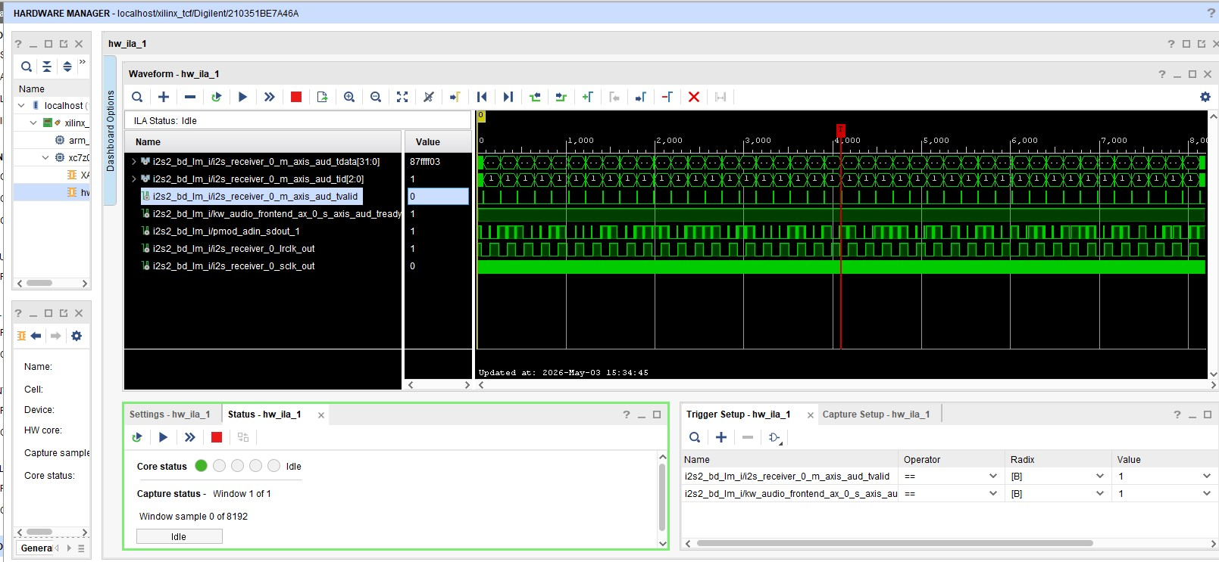
Hardware Design (Programmable Logic)

Slide 8
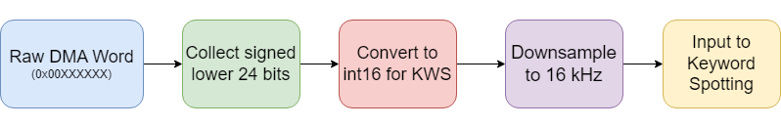
Software Design (Processing System)
Raw DMA word capture and buffer extraction
ConvertDmaAudioToPcm16(): raw 24-bit words to signed PCM
ExtractOneSecond16k_Avg6(): 96 kHz to 16 kHz input window
kws.cc: C++ wrapper ready for TensorFlow Lite Micro integration

Slide 9
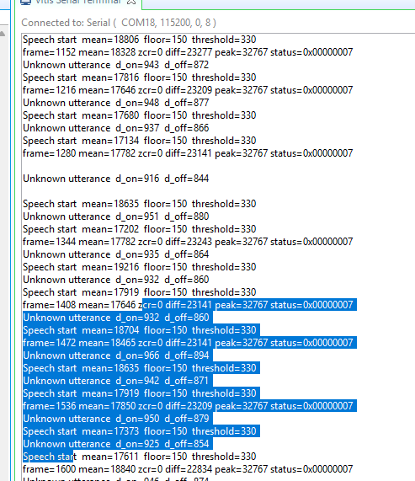
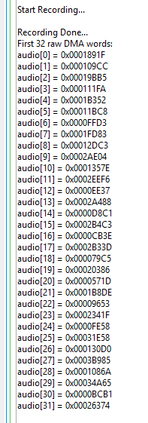
Software Design (Processing System)
System Constantly Polling Without Interrupts
System with Interrupts

Slide 10
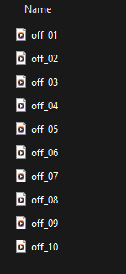
Training model
To create a learning model, the training microphone, distance, and environment needed to be matched, and the keyword required to be spoken in different ways to improve accuracy.
Folder layout

Slide 11
Interfaces and Peripherals Used
Interface / Peripheral
Role in the Project
Audio Codec
Mic/line-in Source via Audio Stream
AXI DMA
S2MM recording
MM2S playback path
AXI GPIO
Used to trigger the start of a recording.
USB-UART
Displays raw samples, KWS input stats, and results.
On-board LEDs
Simple visible response for recognized commands.
Zynq PS / DDR
Stores data at MEM_BASE_ADDR and provides recording buffer

Slide 12
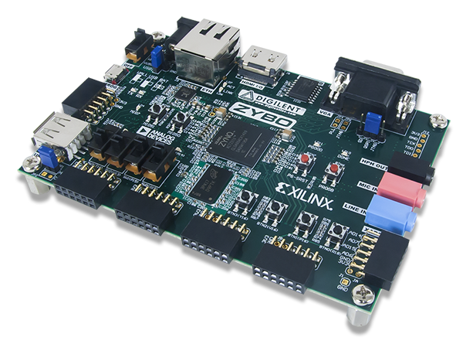
Project Demo

Slide 13
conclusion
This project demonstrates a proof-of-concept audio pipeline from DMA-to-Keyword Spotting on the Zybo. Troubleshooting was separated between hardware and software processing issues by validating each section and integrating one by one. Validated both quiet and speech recordings through UART.

Slide 14
Thank you
May the 4th be with You

