Slide 1

Formal Verification of the MESI Cache Coherence Protocol
Team Cache Me Outside
Luke Marzen
Notes:
2020 27th Asia-Pacific Software Engineering Conference (APSEC)

Slide 2
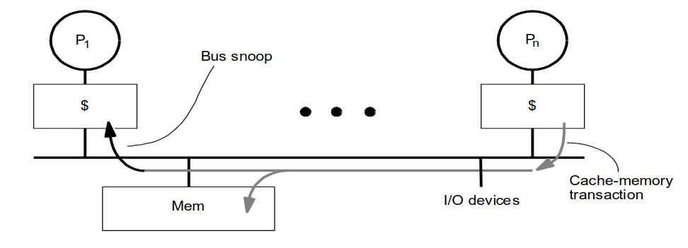
MESI Cache Coherence Protocol
Cache Controller snoops all transactions on the shared bus.

Slide 3
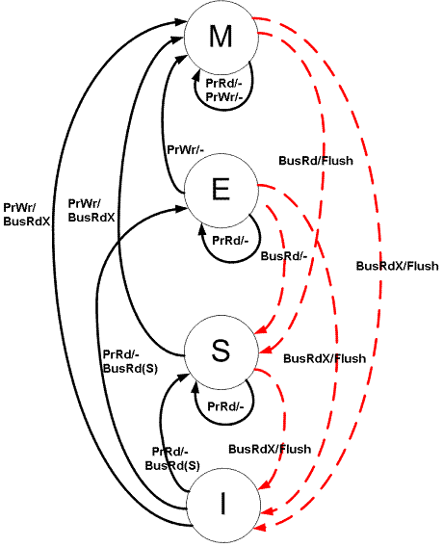
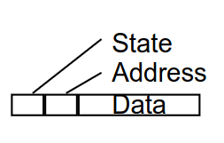
MESI Cache Coherence Protocol
Four State Finite Automata
Modified
Exclusive
Shared
Invalid
Cache Line
Notes:
Modified (M)
The cache line is present only in the current cache, and is dirty - it has been modified (M state) from the value in main memory. The cache is required to write the data back to main memory at some time in the future, before permitting any other read of the (no longer valid) main memory state. The write-back changes the line to the Shared state(S).
Exclusive (E)
The cache line is present only in the current cache, but is clean - it matches main memory. It may be changed to the Shared state at any time, in response to a read request. Alternatively, it may be changed to the Modified state when writing to it.
Shared (S)
Indicates that this cache line may be stored in other caches of the machine and is clean - it matches the main memory. The line may be discarded (changed to the Invalid state) at any time.
Invalid (I)
Indicates that this cache line is invalid (unused)

Slide 4

Formal Verification
Goal: Formally verify the MESI protocol satisfies the properties of a coherent memory system.
Using SPIN.
Promela is particularly strong in expressing concurrent algorithms.

Slide 5
The Model
Parameterized: # of processors, cache size, and memory size
Assumption: Caches are implemented to be symmetric.
Common in real world systems
Greatly simplifies the model
Direct-Mapped Cache
No need to model replacement policies like LRU or FIFO
Main Memory
L1 Cache
L1 Cache
…
Processor 0
Processor N-1
…

Slide 6
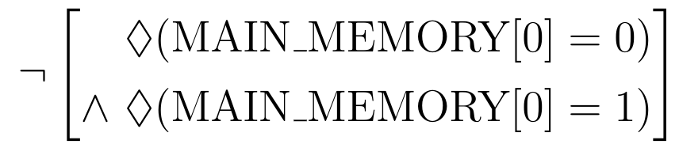
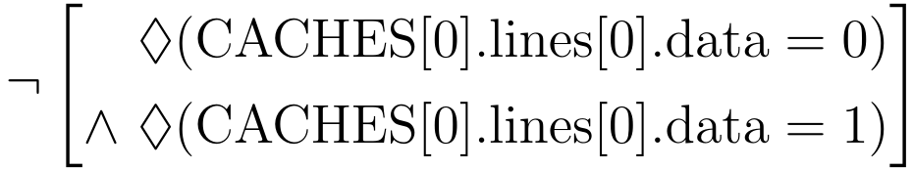
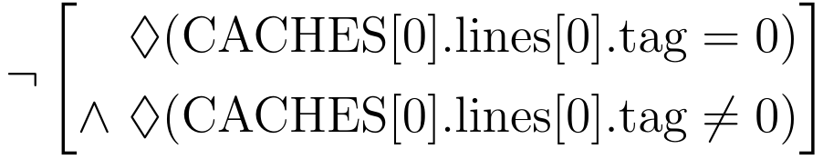
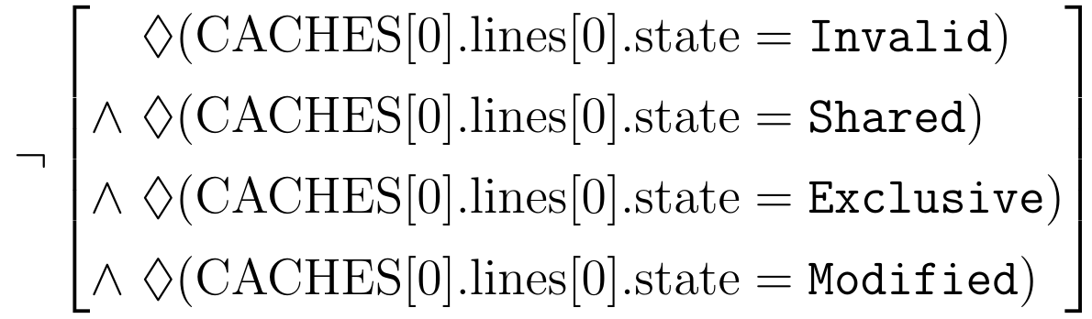
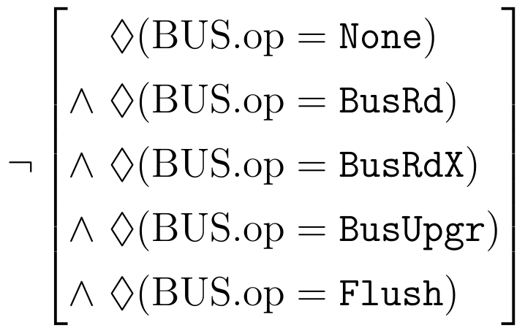
Validation
Goal: Validate that our memory hierarchy model is functional
Negated LTL statements used to prove that desired operations can occur
Assertions used to check that transitions disallowed by MESI cannot occur
Memory can be written to
Cache can be written to
All cacheline states can be reached
All bus operations can occur
Notes:
Before we can assert that our verification is correct it is important to take
steps to validate that the model accurately represents what we are attempting
to verify. To this end, LTL statements have been written which aim to prove
that there exists a trace in which various memory system operations and bus
operations can occur. The statements are all written as negations, so that a
violation of the LTL provides a counter trace that proves the property that
we are aiming to show.

Slide 7
Verification
Verify that the MESI protocol exhibits the coherency principles
LTL safety property that checks that the transitions defined by MESI do not violate coherency
✓
 | M | E | S | I
M | 𐄂 | 𐄂 | 𐄂 | ✓
E | 𐄂 | 𐄂 | 𐄂 | ✓
S | 𐄂 | 𐄂 | ✓ | ✓
I | ✓ | ✓ | ✓ | ✓
Cache 1
Cache 2
State | Tag | Data
M | 0x01 | 0x00
State | Tag | Data
I | 0x01 | 0x01
𐄂
Cache 1
Cache 2
State | Tag | Data
M | 0x00 | 0x00
State | Tag | Data
M | 0x00 | 0x01
Notes:
Before we can assert that our verification is correct it is important to take
steps to validate that the model accurately represents what we are attempting
to verify. To this end, LTL statements have been written which aim to prove
that there exists a trace in which various memory system operations and bus
operations can occur. The statements are all written as negations, so that a
violation of the LTL provides a counter trace that proves the property that
we are aiming to show.

Slide 8
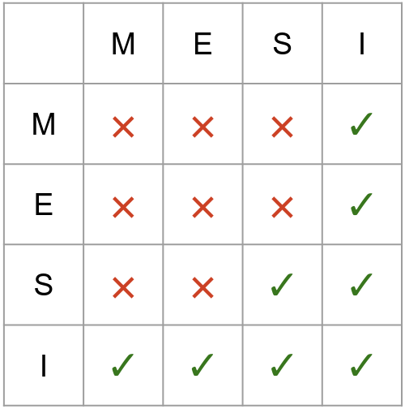
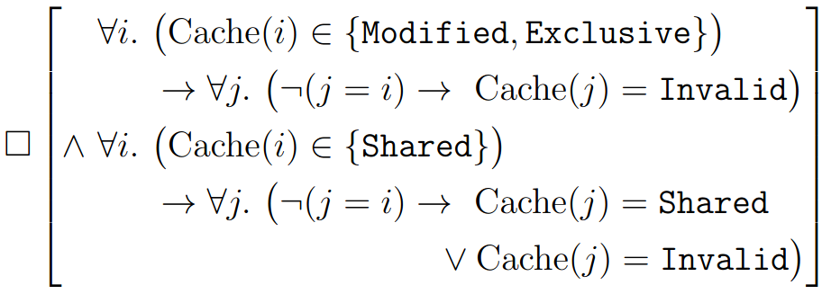
Verification
Verify that the MESI protocol exhibits the coherency principles
LTL safety property that checks that the transitions defined by MESI do not violate coherency
✓
Cache 1
Cache 2
State | Tag | Data
M | 0x01 | 0x00
State | Tag | Data
I | 0x01 | 0x01
𐄂
Cache 1
Cache 2
State | Tag | Data
M | 0x00 | 0x00
State | Tag | Data
S | 0x00 | 0x00
Notes:
Before we can assert that our verification is correct it is important to take
steps to validate that the model accurately represents what we are attempting
to verify. To this end, LTL statements have been written which aim to prove
that there exists a trace in which various memory system operations and bus
operations can occur. The statements are all written as negations, so that a
violation of the LTL provides a counter trace that proves the property that
we are aiming to show.

Slide 9
Selecting Sufficiently Large Structures
How big should memory and each cache be?
Large enough to ensure coverage of all transitions.
Small enough to be checked with SPIN.
Notes:
Infeasible to prove for all the infinite combinations of structure sizes.

Slide 10
Selecting Sufficiently Large Structures
Cache Size and Main Memory
0 < Cache Size < Main Memory
If the cache is >= Main Memory, conflict misses can not occur.
Smallest configuration:
Cache Size = 1
Main Memory = 2
Notes:
Infeasible to prove for all the infinite combinations of structure sizes.

Slide 11
State Space Still TOO LARGE!!!
How to reduce it.
Optimizing Non-Deterministic Selection
Expand select statements to if statements (if bounds known at compile-time)
Reduce with Atomic
Abuse the atomic keyword to reduce statespace without altering the behavior that we are interested in verifying
Deterministic Acknowledgments
Enforce a deterministic ordering for processors to send bus acknowledgements

Slide 12
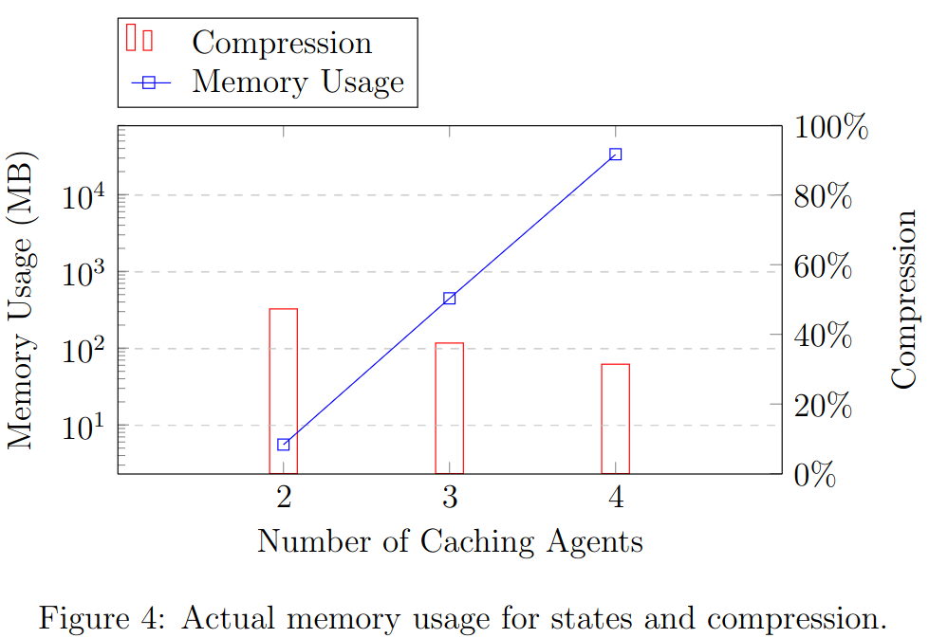
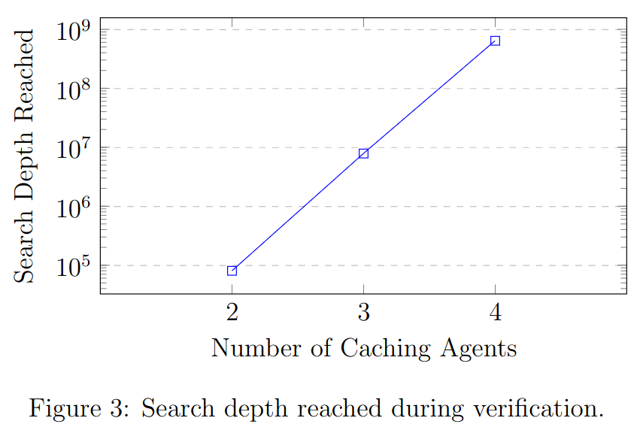
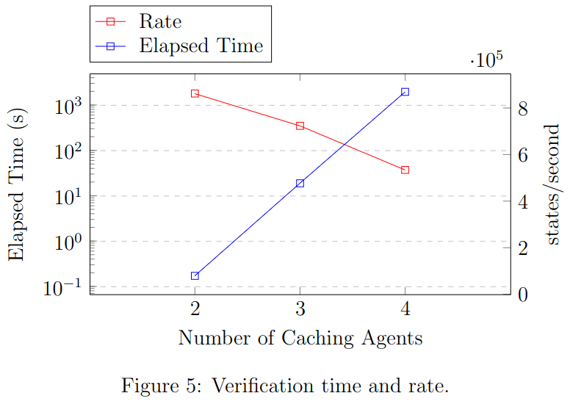
Results
Successfully verified entire statespace for 2-4 processors!
Notes:
Correctness of Memory Management
-Mapping of virtual address to a physical address.
Lemma1 The physical address mapped from the virtual address cannot overflow.
Lemma2 A secure virtual address can be mapped to a secure physical address or to a normal physical address, but a normal virtual address can only be mapped to a normal physical address.
-non-secure transactions cannot modify the sensitive data in secure memory.
Lemma3 Memory write operation that occurs in REE does not modify secure memory
Information Flow Security
Noninterference - means that the actions taken by a lower security process should not affect the actions or information available to the higher security processes. Noninfluence - high-security processes do not interfere with the security of lower-security components or processes, and vice versa.
Nonleakage - means that access control should not be violated.
A strong definition for Noninfluence should also show noninterference and nonleakage

Slide 13
Results
Only partially verified 5 processors
SPIN’s max search depth limited to 1,410,065,408?
Used 700GB of Memory, 18 hours and still did not finish to depth of 1,410,065,408.
Notes:
Correctness of Memory Management
-Mapping of virtual address to a physical address.
Lemma1 The physical address mapped from the virtual address cannot overflow.
Lemma2 A secure virtual address can be mapped to a secure physical address or to a normal physical address, but a normal virtual address can only be mapped to a normal physical address.
-non-secure transactions cannot modify the sensitive data in secure memory.
Lemma3 Memory write operation that occurs in REE does not modify secure memory
Information Flow Security
Noninterference - means that the actions taken by a lower security process should not affect the actions or information available to the higher security processes. Noninfluence - high-security processes do not interfere with the security of lower-security components or processes, and vice versa.
Nonleakage - means that access control should not be violated.
A strong definition for Noninfluence should also show noninterference and nonleakage

Slide 14
Questions?
Main Memory
L1 Cache
L1 Cache
…
Processor 0
Processor N-1
…
Notes:
Page fades in, red pops up. Only this page

Slide 15
Defining a Coherent Memory System
Preserve program order
Coherent view of memory
Write serialization
Notes:
Preserve Program Order: A read by processor P to location X
that follows a write by P to X, with no writes of X by another
processor occurring between the write and the read by P,
always returns the value written by P
2. Coherent view of memory: Read by a processor to location X
that follows a write by another processor to X returns the
written value if the read and write are sufficiently separated in
time and no other writes to X occur between the two
accesses
3. Write serialization: 2 writes to same location by any 2
processors are seen in the same order by all processors

