Slide 1

Formal Verification of the MESI Cache Coherence Protocol
Team Cache Me Outside
Luke Marzen
Notes:
2020 27th Asia-Pacific Software Engineering Conference (APSEC)

Slide 2
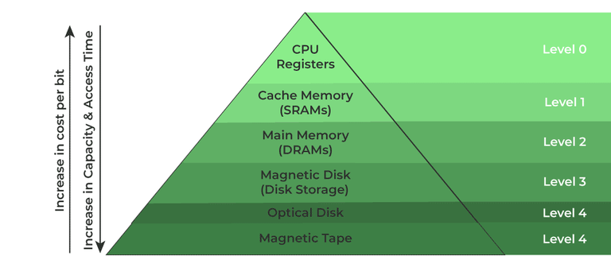
Memory Hierarchy
<1 cycle
2-50 cycles
150 cycles
1-10M cycles
Notes:
Why is this important?
Source https://confidentialcomputing.io/wp-content/uploads/sites/10/2023/03/CCC_outreach_whitepaper_updated_November_2022.pdf

Slide 3
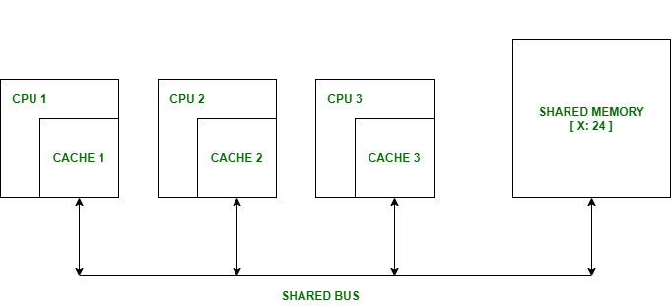
Cache Coherence
Notes:
Arm Exception levels, also known as Exception levels or EL, are a hierarchical privilege and execution mode framework used in Arm architecture-based processors. They help manage and isolate different software components, such as the operating system (OS) and user applications.
Exception levels allow for a structured separation of privilege and facilitate secure and efficient execution of software components with different privilege levels.
Intel and RISCV have their own version of these too. https://developer.arm.com/documentation/102412/0103/Privilege-and-Exception-levels/Exception-levels

Slide 4
Cache Coherence
x=0
Notes:
Arm Exception levels, also known as Exception levels or EL, are a hierarchical privilege and execution mode framework used in Arm architecture-based processors. They help manage and isolate different software components, such as the operating system (OS) and user applications.
Exception levels allow for a structured separation of privilege and facilitate secure and efficient execution of software components with different privilege levels.
Intel and RISCV have their own version of these too. https://developer.arm.com/documentation/102412/0103/Privilege-and-Exception-levels/Exception-levels

Slide 5
Cache Coherence
x=0
x=0
Notes:
Arm Exception levels, also known as Exception levels or EL, are a hierarchical privilege and execution mode framework used in Arm architecture-based processors. They help manage and isolate different software components, such as the operating system (OS) and user applications.
Exception levels allow for a structured separation of privilege and facilitate secure and efficient execution of software components with different privilege levels.
Intel and RISCV have their own version of these too. https://developer.arm.com/documentation/102412/0103/Privilege-and-Exception-levels/Exception-levels

Slide 6
Cache Coherence
x=0
x=0
x=0
Notes:
Arm Exception levels, also known as Exception levels or EL, are a hierarchical privilege and execution mode framework used in Arm architecture-based processors. They help manage and isolate different software components, such as the operating system (OS) and user applications.
Exception levels allow for a structured separation of privilege and facilitate secure and efficient execution of software components with different privilege levels.
Intel and RISCV have their own version of these too. https://developer.arm.com/documentation/102412/0103/Privilege-and-Exception-levels/Exception-levels

Slide 7
Cache Coherence
x=0
x=0 x=5
x=0
Notes:
Arm Exception levels, also known as Exception levels or EL, are a hierarchical privilege and execution mode framework used in Arm architecture-based processors. They help manage and isolate different software components, such as the operating system (OS) and user applications.
Exception levels allow for a structured separation of privilege and facilitate secure and efficient execution of software components with different privilege levels.
Intel and RISCV have their own version of these too. https://developer.arm.com/documentation/102412/0103/Privilege-and-Exception-levels/Exception-levels

Slide 8
Cache Coherence
???
x=0
x=0 x=5
x=0
Notes:
Arm Exception levels, also known as Exception levels or EL, are a hierarchical privilege and execution mode framework used in Arm architecture-based processors. They help manage and isolate different software components, such as the operating system (OS) and user applications.
Exception levels allow for a structured separation of privilege and facilitate secure and efficient execution of software components with different privilege levels.
Intel and RISCV have their own version of these too. https://developer.arm.com/documentation/102412/0103/Privilege-and-Exception-levels/Exception-levels

Slide 9
Defining a Coherent Memory System
Preserve program order
Coherent view of memory
Write serialization
Notes:
Preserve Program Order: A read by processor P to location X
that follows a write by P to X, with no writes of X by another
processor occurring between the write and the read by P,
always returns the value written by P
2. Coherent view of memory: Read by a processor to location X
that follows a write by another processor to X returns the
written value if the read and write are sufficiently separated in
time and no other writes to X occur between the two
accesses
3. Write serialization: 2 writes to same location by any 2
processors are seen in the same order by all processors

Slide 10
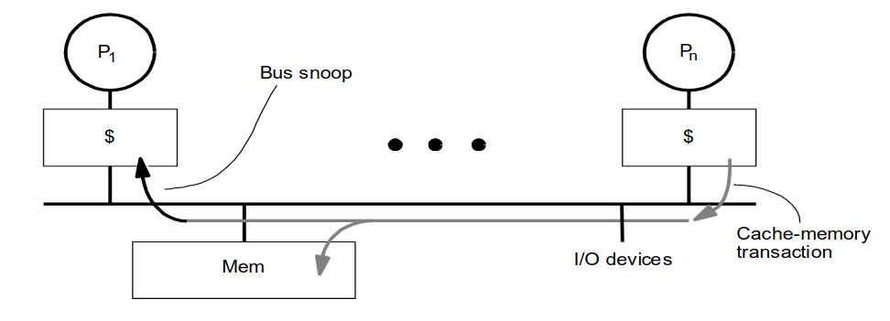
MESI Cache Coherence Protocol
Cache Controller snoops all transactions on the shared bus.

Slide 11
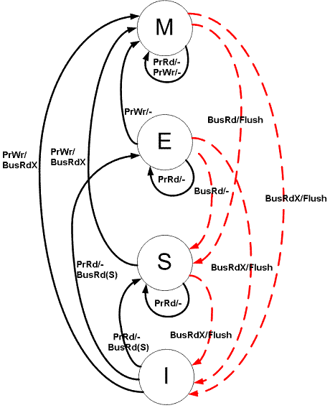
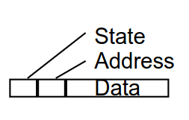
MESI Cache Coherence Protocol
Four State Finite Automata
Modified
Exclusive
Shared
Invalid
Cache Line
Notes:
Modified (M)
The cache line is present only in the current cache, and is dirty - it has been modified (M state) from the value in main memory. The cache is required to write the data back to main memory at some time in the future, before permitting any other read of the (no longer valid) main memory state. The write-back changes the line to the Shared state(S).
Exclusive (E)
The cache line is present only in the current cache, but is clean - it matches main memory. It may be changed to the Shared state at any time, in response to a read request. Alternatively, it may be changed to the Modified state when writing to it.
Shared (S)
Indicates that this cache line may be stored in other caches of the machine and is clean - it matches the main memory. The line may be discarded (changed to the Invalid state) at any time.
Invalid (I)
Indicates that this cache line is invalid (unused)

Slide 12

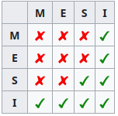
Formal Verification
Goal: Formally verify the MESI protocol satisfies the properties of a coherent memory system.
Using SPIN.
Promela is particularly strong in expressing concurrent algorithms.

Slide 13
Progress
Model is defined in Promela.
Cache controllers + Shared bus.
Partially validated.
Verification LTL formulas written.
Notes:
Correctness of Memory Management
-Mapping of virtual address to a physical address.
Lemma1 The physical address mapped from the virtual address cannot overflow.
Lemma2 A secure virtual address can be mapped to a secure physical address or to a normal physical address, but a normal virtual address can only be mapped to a normal physical address.
-non-secure transactions cannot modify the sensitive data in secure memory.
Lemma3 Memory write operation that occurs in REE does not modify secure memory
Information Flow Security
Noninterference - means that the actions taken by a lower security process should not affect the actions or information available to the higher security processes. Noninfluence - high-security processes do not interfere with the security of lower-security components or processes, and vice versa.
Nonleakage - means that access control should not be violated.
A strong definition for Noninfluence should also show noninterference and nonleakage

Slide 14

Challenges
Statespace explosion.
Greatly reduced by experimenting with techniques I read about online.
Model in nuXmv?
Memory constraints.
Partially resolved by reducing statespace.
Experimented with Compile Options.
Give up and run on HPC with up to 1.5TB of RAM.
Headache to debug long traces.
Skill issue.
Notes:
The hardware needs to correctly implement security
extensions to isolate resources of the secure and normal worlds
the TEE software needs to correctly implement intended functions to
ensure code isolated execution and protect critical data.
The monitor needs to correctly manipulate
the state of the two worlds and to achieve the world switch
without leaking sensitive information of the secure world.
the correct implementation
of both hardware and software is essential to guarantee the
isolation of TEE
This research was motivated by recent security vulnerabilities discovered in some implementations of the arm TrustZone TEE.
This paper attempts verification that arm TrustZone TEE specification satisfies security properties and considers both hardware and software components.

Slide 15
Report Outline
Introduction
Background
Model + Validation
Verification Results
Conclusion
Notes:
Correctness of Memory Management
-Mapping of virtual address to a physical address.
Lemma1 The physical address mapped from the virtual address cannot overflow.
Lemma2 A secure virtual address can be mapped to a secure physical address or to a normal physical address, but a normal virtual address can only be mapped to a normal physical address.
-non-secure transactions cannot modify the sensitive data in secure memory.
Lemma3 Memory write operation that occurs in REE does not modify secure memory
Information Flow Security
Noninterference - means that the actions taken by a lower security process should not affect the actions or information available to the higher security processes. Noninfluence - high-security processes do not interfere with the security of lower-security components or processes, and vice versa.
Nonleakage - means that access control should not be violated.
A strong definition for Noninfluence should also show noninterference and nonleakage

Slide 16
Questions
MESI – Modified, Exclusive, Shared, Invalid.
???
x=0
x=0 x=5
x=0
Notes:
Modified (M)
The cache line is present only in the current cache, and is dirty - it has been modified (M state) from the value in main memory. The cache is required to write the data back to main memory at some time in the future, before permitting any other read of the (no longer valid) main memory state. The write-back changes the line to the Shared state(S).
Exclusive (E)
The cache line is present only in the current cache, but is clean - it matches main memory. It may be changed to the Shared state at any time, in response to a read request. Alternatively, it may be changed to the Modified state when writing to it.
Shared (S)
Indicates that this cache line may be stored in other caches of the machine and is clean - it matches the main memory. The line may be discarded (changed to the Invalid state) at any time.
Invalid (I)
Indicates that this cache line is invalid (unused)

Slide 17
Thank You
Notes:
Page fades in, red pops up. Only this page

