Slide 1
DB
DIGITAL BOOK
Here is where your presentation begins

Slide 2
TABLE OF CONTENTS
01
04
About the Project
Sneak Peek
02
05
Major Requirements
Project Stages
03
06
Project Goals
Our Team
Here you could describe
the topic of the section
Here you could describe
the topic of the section
Here you could describe
the topic of the section
Here you could describe
the topic of the section
Here you could describe
the topic of the section
Here you could describe
the topic of the section

Slide 3
DB
DB
A new application where you get all the ppts of all subjects at one place where they need not send ppts from mails it can easily upload into an application. It can be user-friendly for all the user who uses the application. New features can be integrated into an application from the user requirements.`

Slide 4
WHAT WE ARE WORKING ON
SECURE
ACCESSIBLE
FAST AND RELIABLE
No data will be lost
Can be easily acess to pdf,ppts

Slide 5





ABOUT THE PROJECT
Digital Books System is an android based application developed by java programming language. The Project aim is to use to read all the ppts/pdfs of all subjects in one application.It can be automatically downloaded.

Slide 6
—SOMEONE FAMOUS
“Don’t wait for anything,
Get it, Do it .”

Slide 7
MAJOR REQUIREMENTS
PPT’s, PDF’s
USER EXPERIENCE
INFORMATION

Slide 8
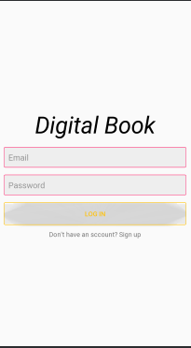
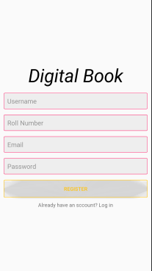
LOGIN PAGE

Slide 9

Get Started

Slide 10
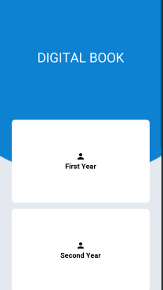
Select Year

Slide 11
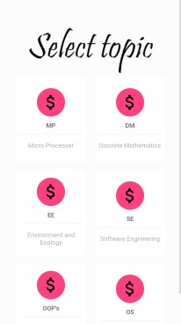
Select Topic

Slide 12
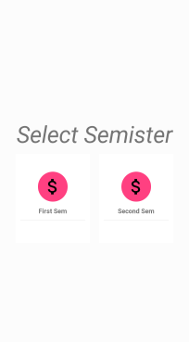
Select Semister

Slide 13

Files

Slide 14
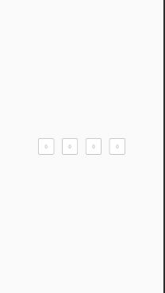
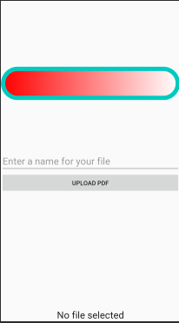
File Uploading
Select course:
Password
Name of file

Slide 15
PROJECT STAGES
STEP 2
STEP 1
STEP 3
Venus has a beautiful name and is the second planet from the Sun
Despite being red, Mars is a cold place, not hot. It’s full of iron oxide dust
Saturn is a gas giant, composed mostly of hydrogen and helium

Slide 16
OUR TIMELINE
WEEK 1
WEEK 3
BETA
RELEASE
FINAL
VERSION
WEEK 2
WEEK 4
Improvements
Increased traffic
Focus group
Progress review

Slide 17


IDEA SPONSORS
LMAS

Slide 18
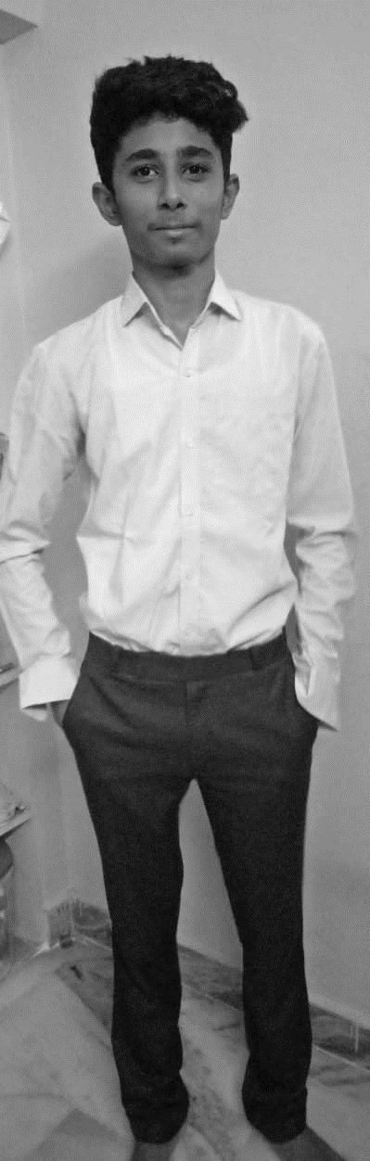
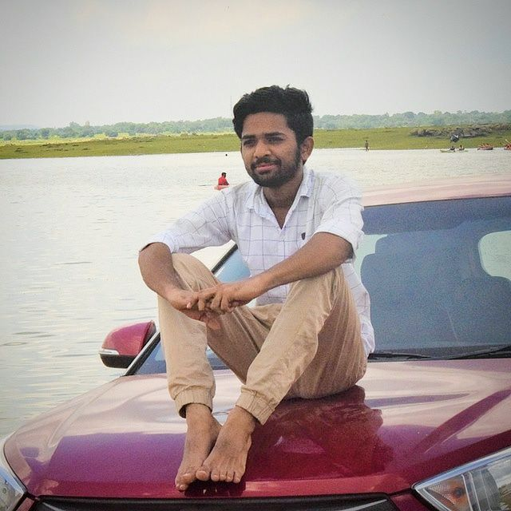
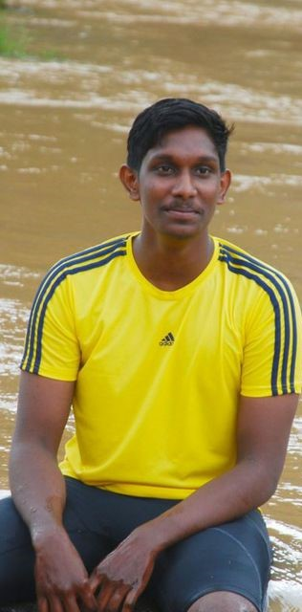
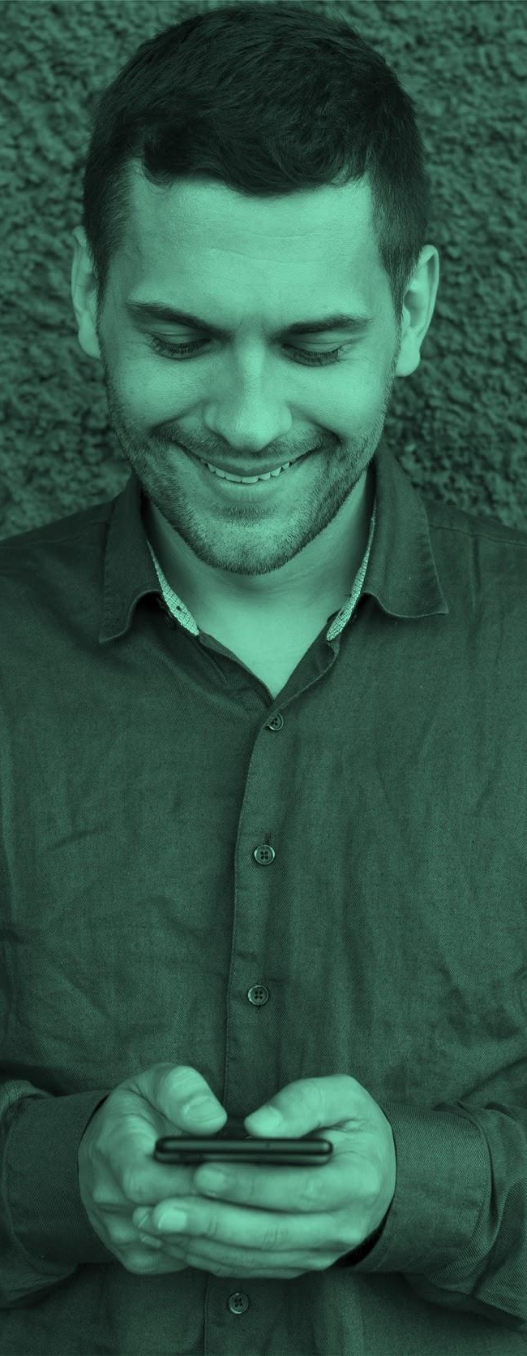

THE TEAM
YASWANTH.P
SAI PRAKASH REDDY .K
ARAVIND KUMAR.V
You can replace the image on the screen with your own
You can replace the image on the screen with your own
You can replace the image on the screen with your own

Slide 19
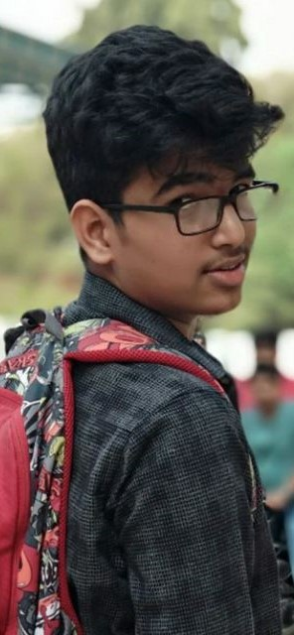
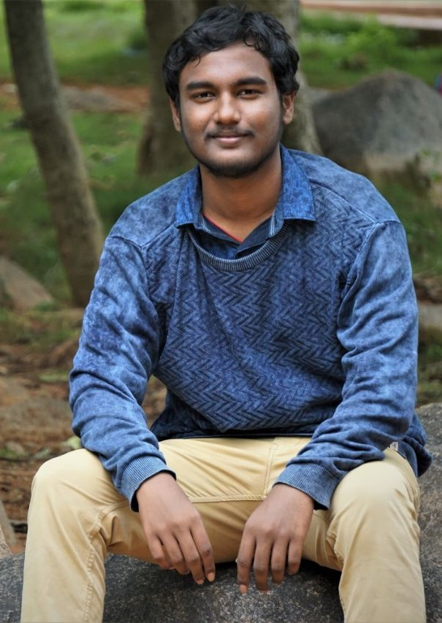

THE TEAM
SAI GANESH
MANISH.K.V
You can replace the image on the screen with your own
You can replace the image on the screen with your own

Slide 20
THANKS!
Does anyone have any question?
30lmas09@gmail.com
Lmas.c1.biz

