Slide 1
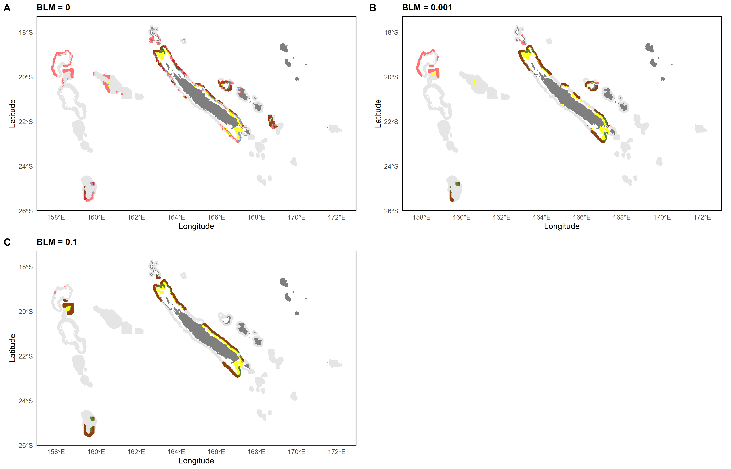
0 – 200m
0 – 200m & 200 – 400m
0 – 200m & 400 – 600m
200 – 400m
400 – 600m
All layers
200 – 400m & 400 – 600m

Slide 2
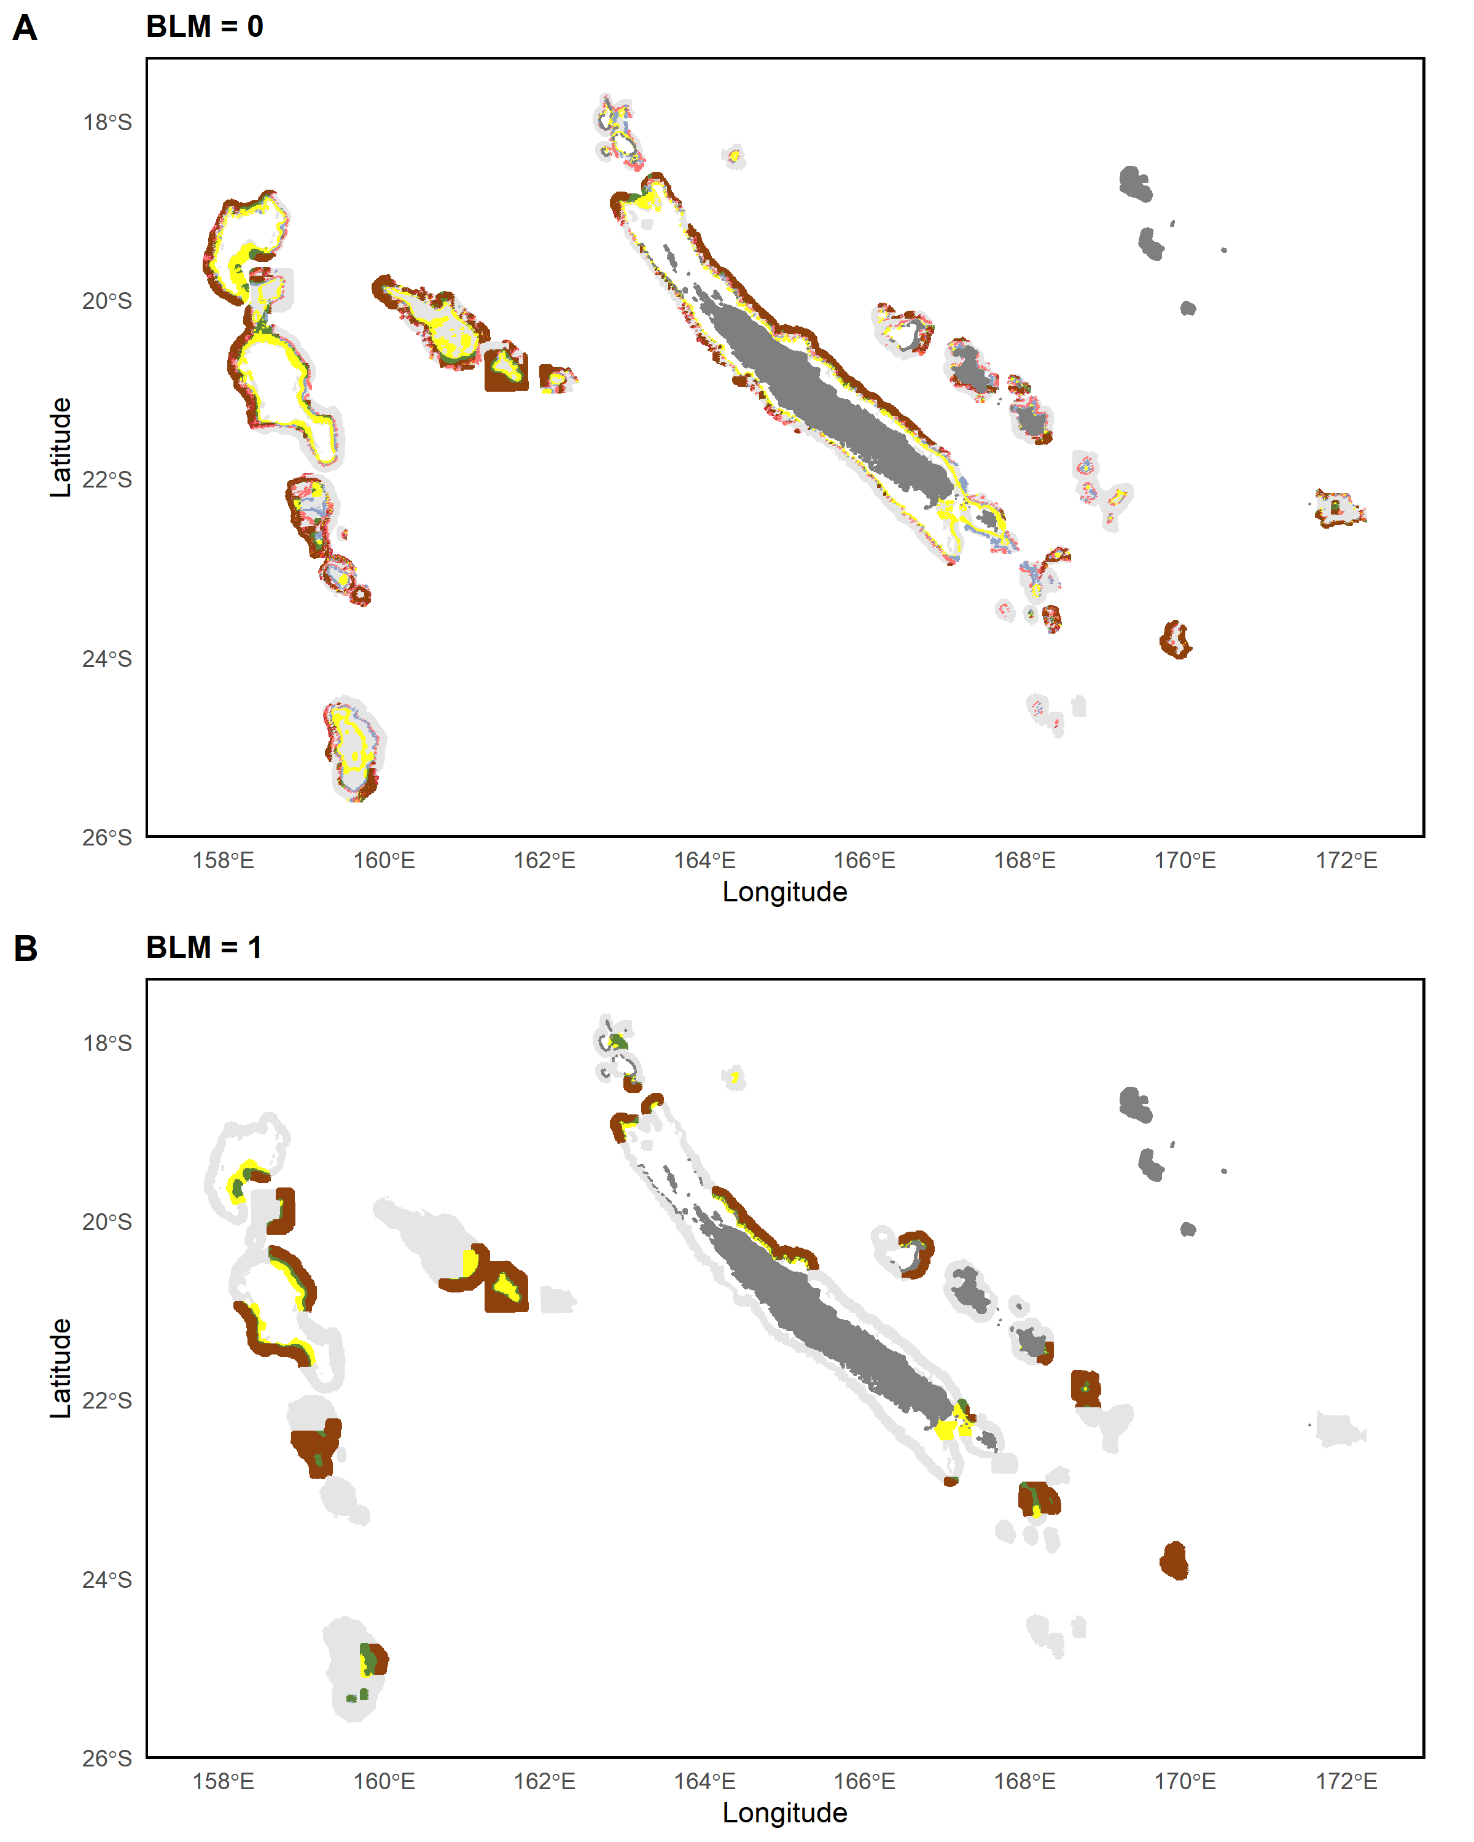
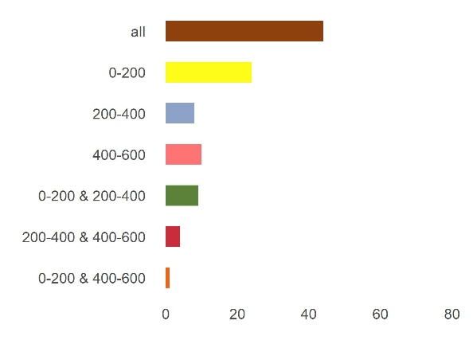
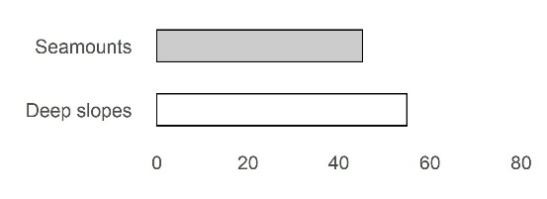
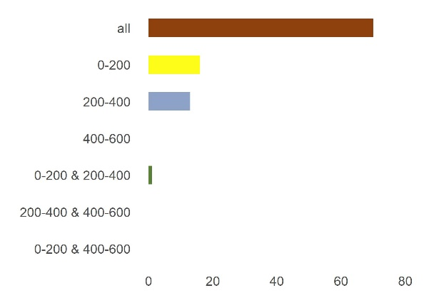
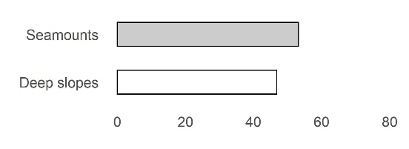
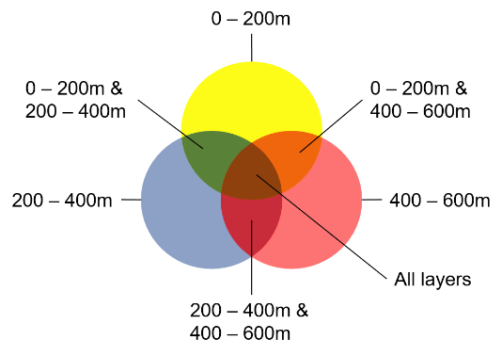

Slide 3
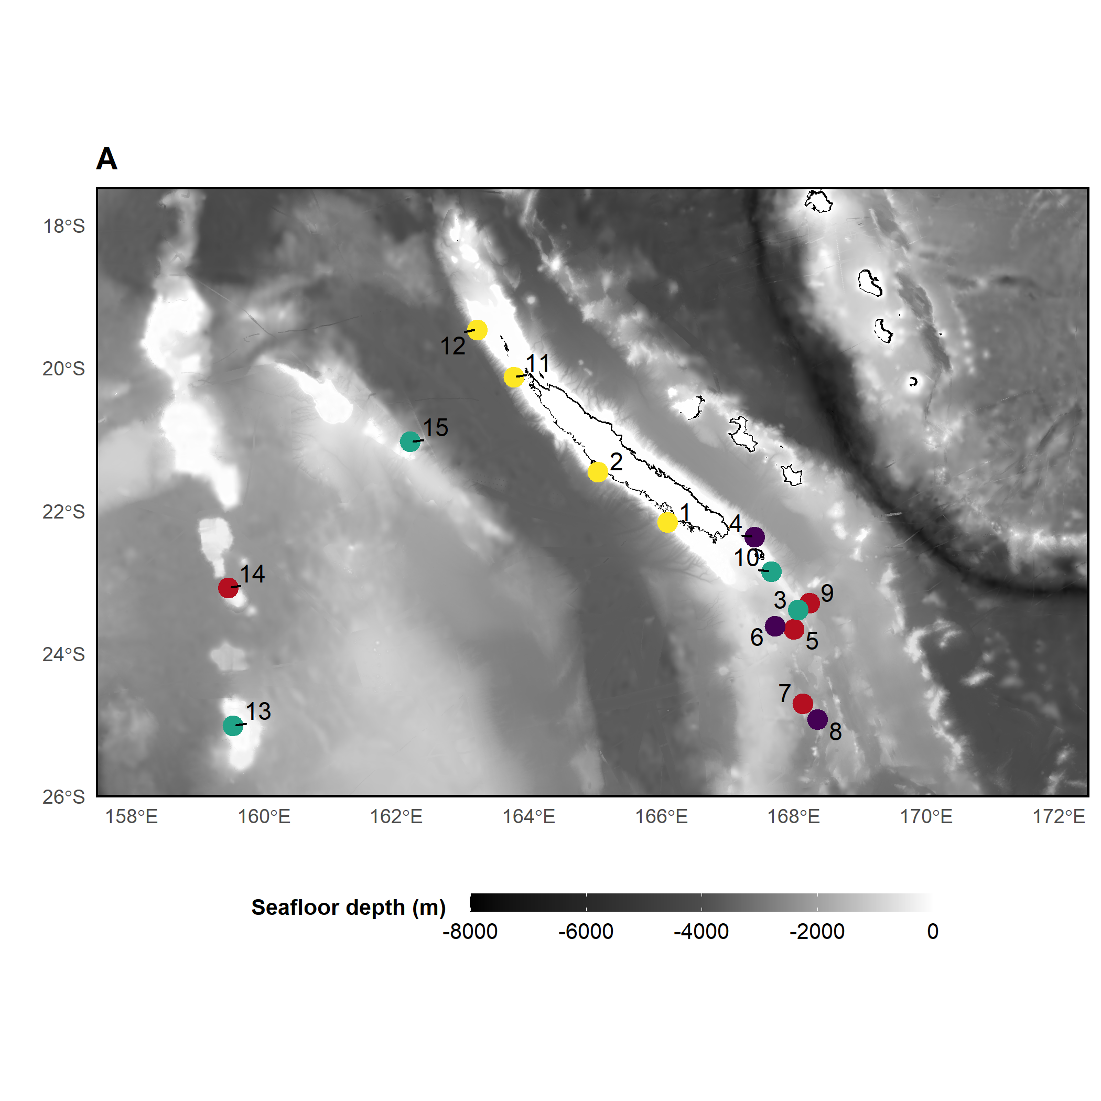
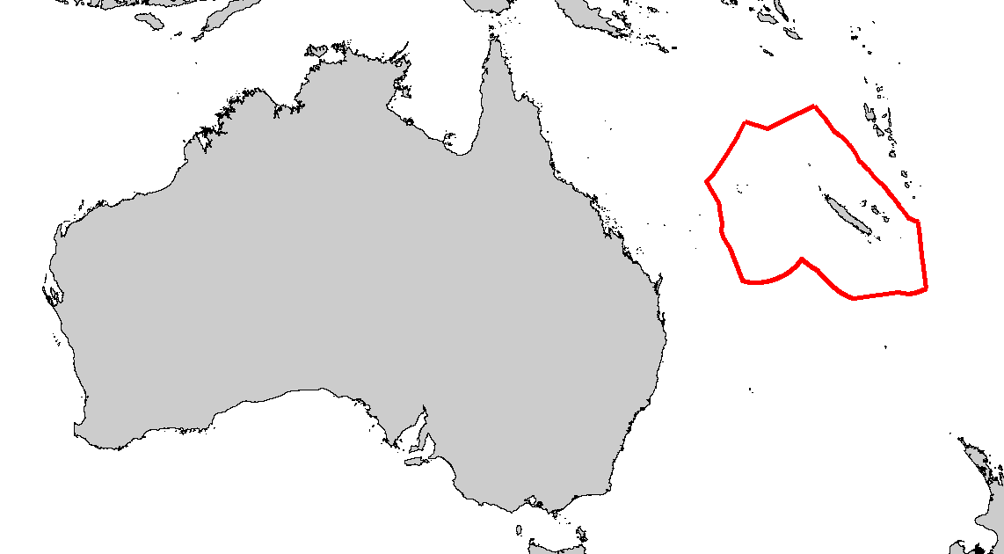
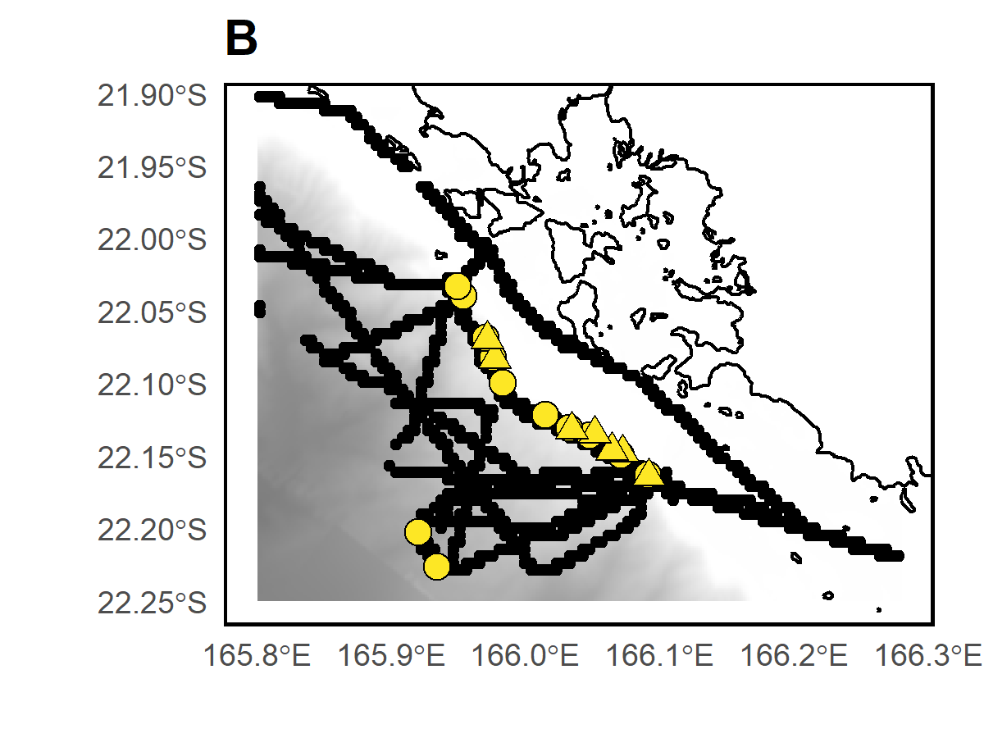
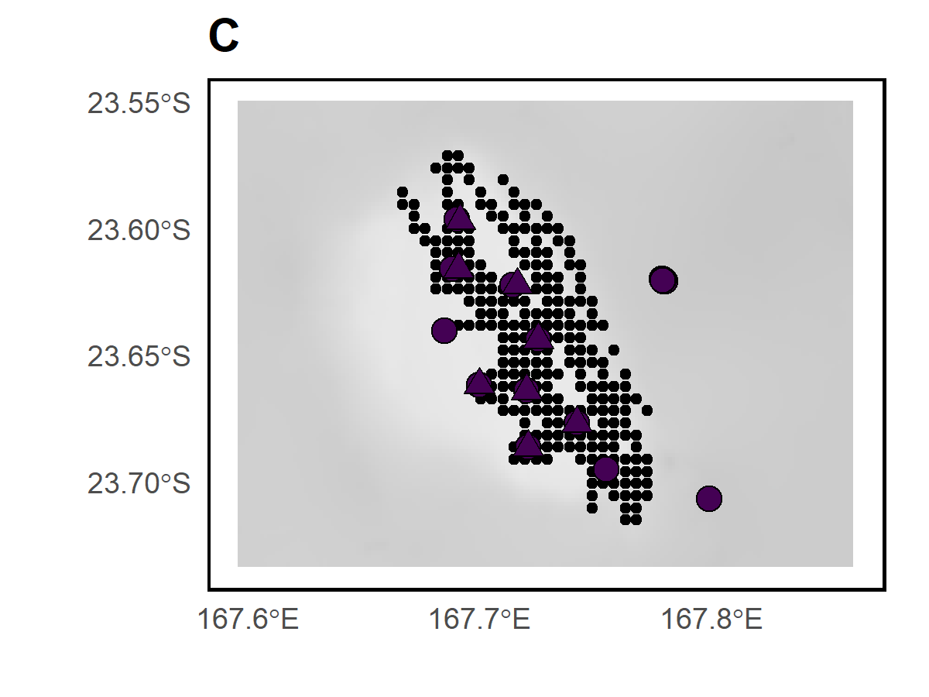
D’Entrecasteaux
Chesterfield
Habitat
Deep slope
Bellona
Seamount ~50m
Seamount ~250m
Nouméa
Seamount ~500m
Sample type
BRUVS samples
eDNA samples
Acoustic recordings

Slide 4
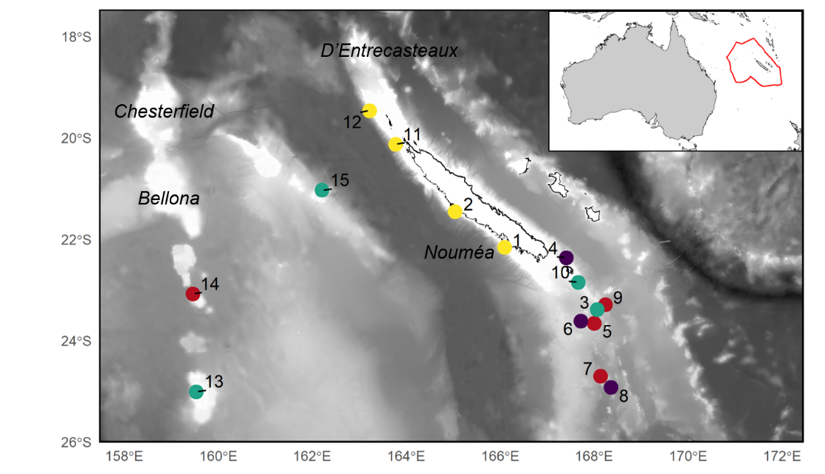

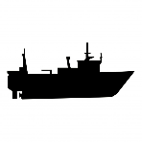


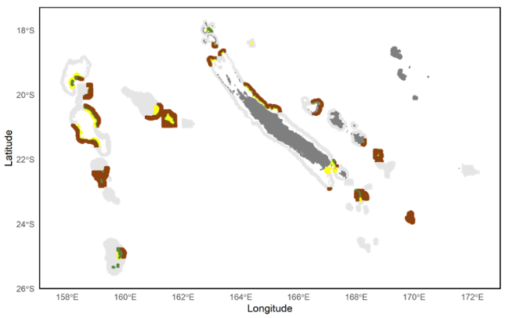
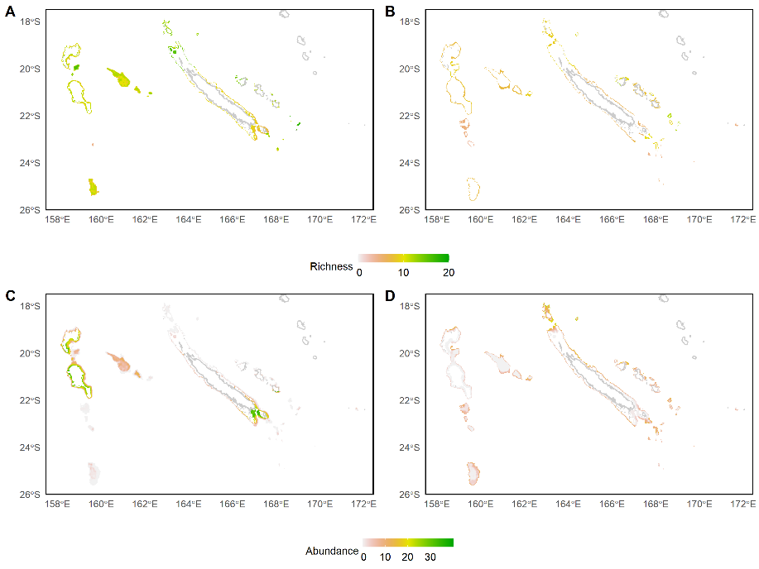


1
Sampling seamounts, deep slopes and pelagic areas with BRUVS, eDNA and echosounder
Benthic species richness, abundance, biomass (BRUVS)
eDNA benthic and pelagic MOTU richness
Benthic and pelagic acoustic biomass
Abundance of most occurrent species (BRUVS)
eDNA read abundance of most occurrent MOTUs
Fairway ridge
Lord Howe ridge
Loyaulty island ridge
Norfolk ridge
2
Modelling with BRTs
Modelling with GJAMs
4
3
Prediction of each integrated metric in 3 depth layers
(0-200, 200-400, 400-600)
Prediction of individual species and MOTUs in 3 depth layers
(0-200, 200-400, 400-600)
3D conservation planning to protect 30% of each metric

