Slide 1
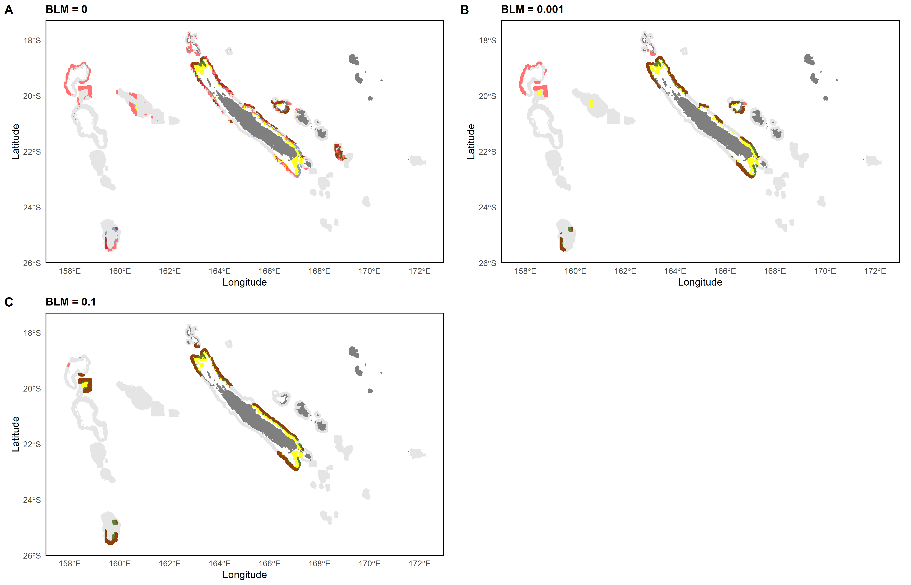
0 – 200m
0 – 200m & 200 – 400m
0 – 200m & 400 – 600m
200 – 400m
400 – 600m
All layers
200 – 400m & 400 – 600m

Slide 2
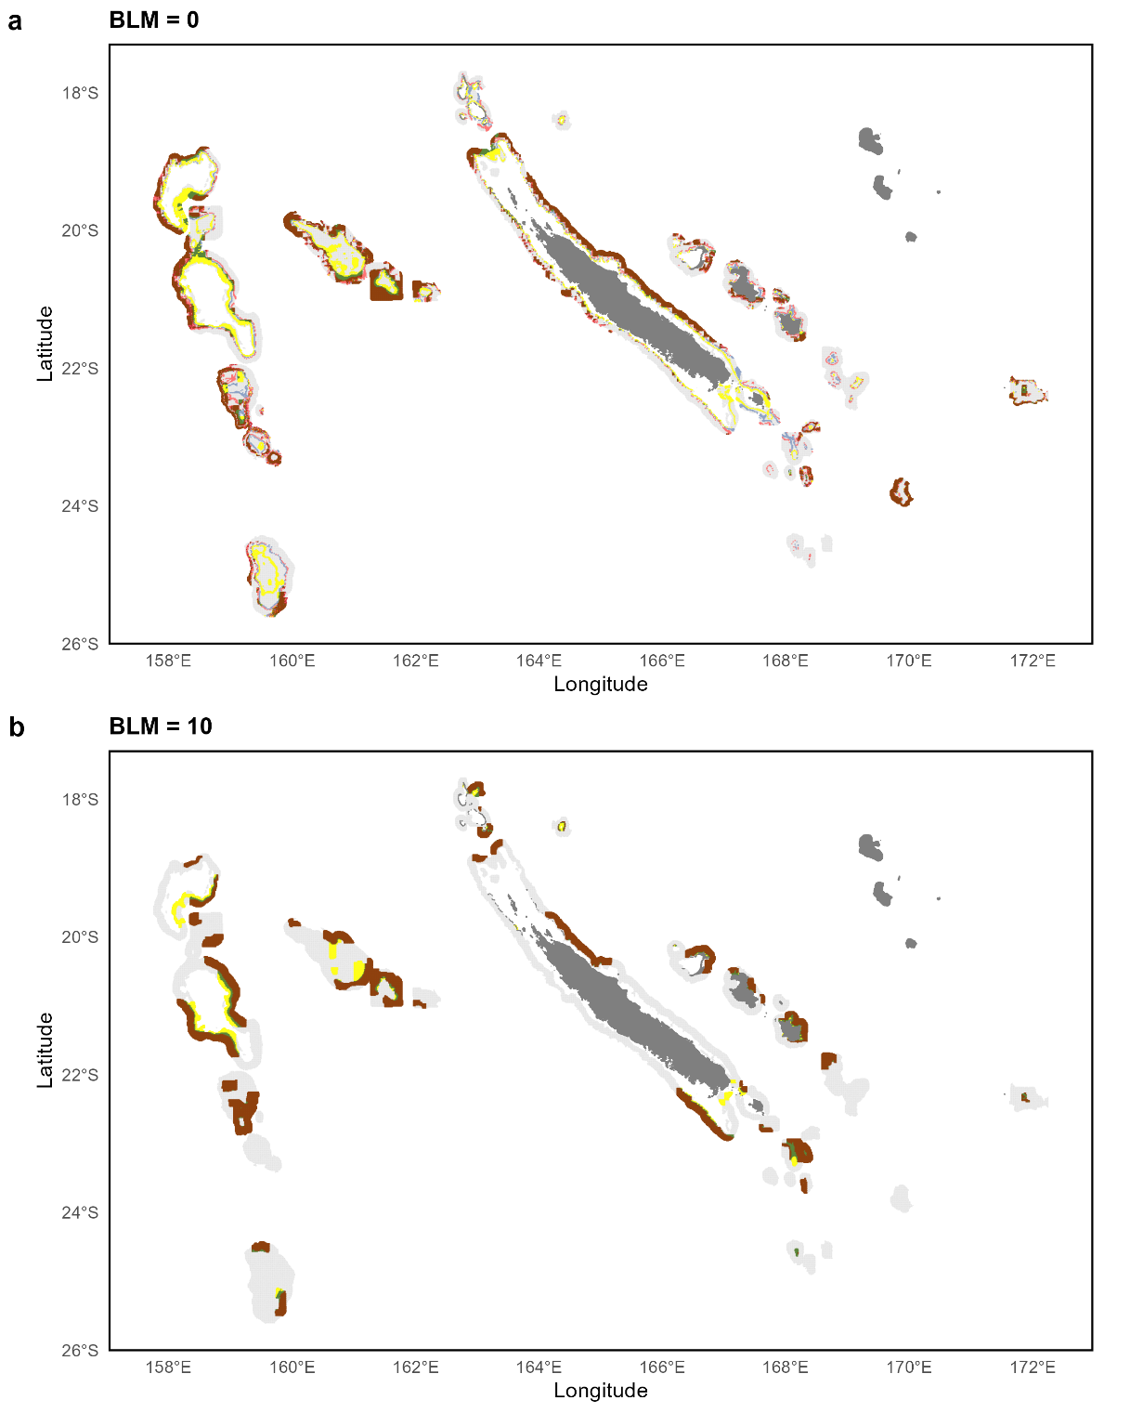
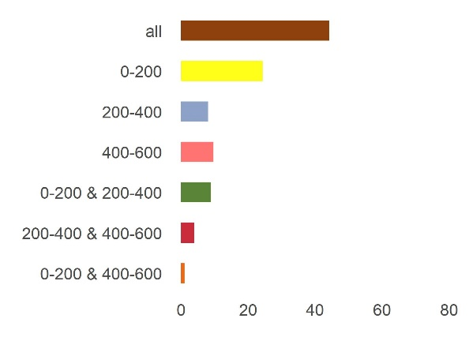
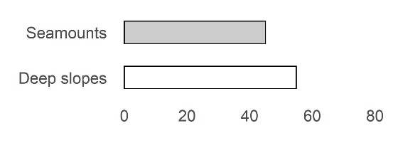
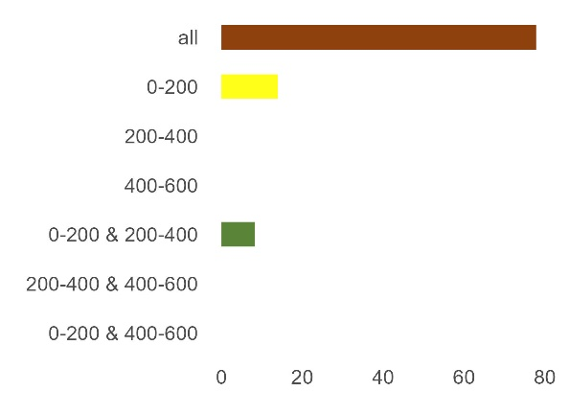
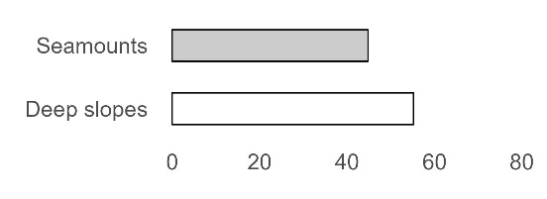
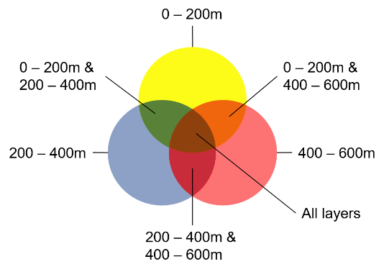
Percentage
Percentage

Slide 3
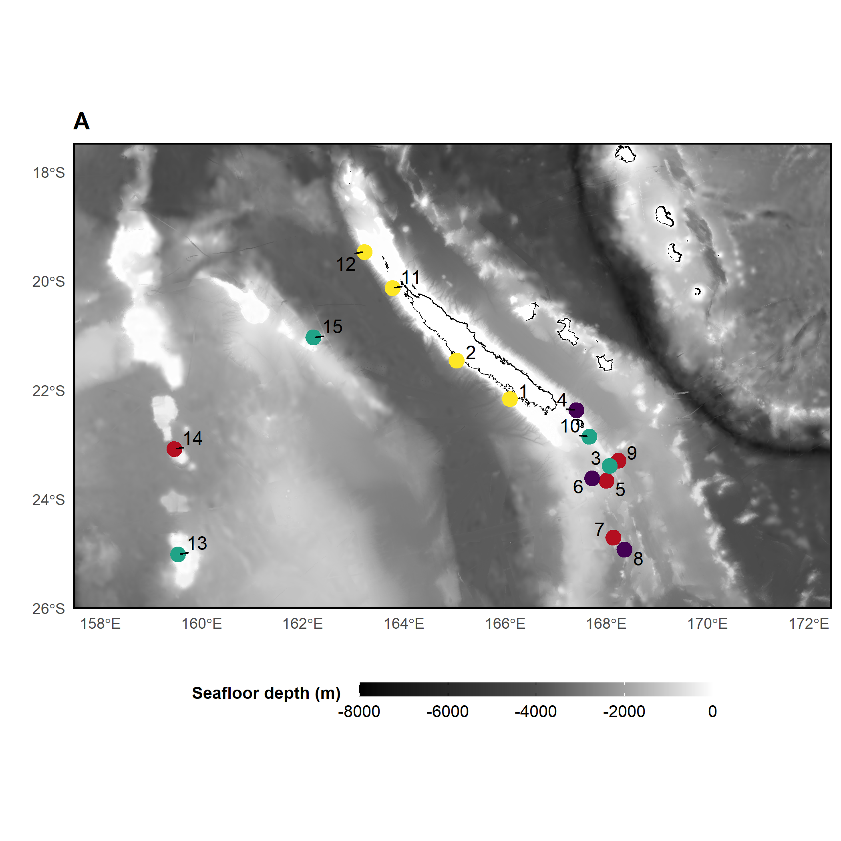
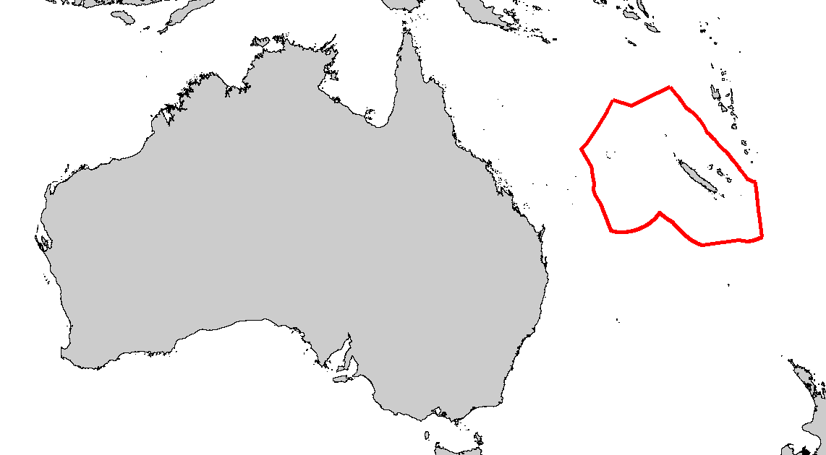
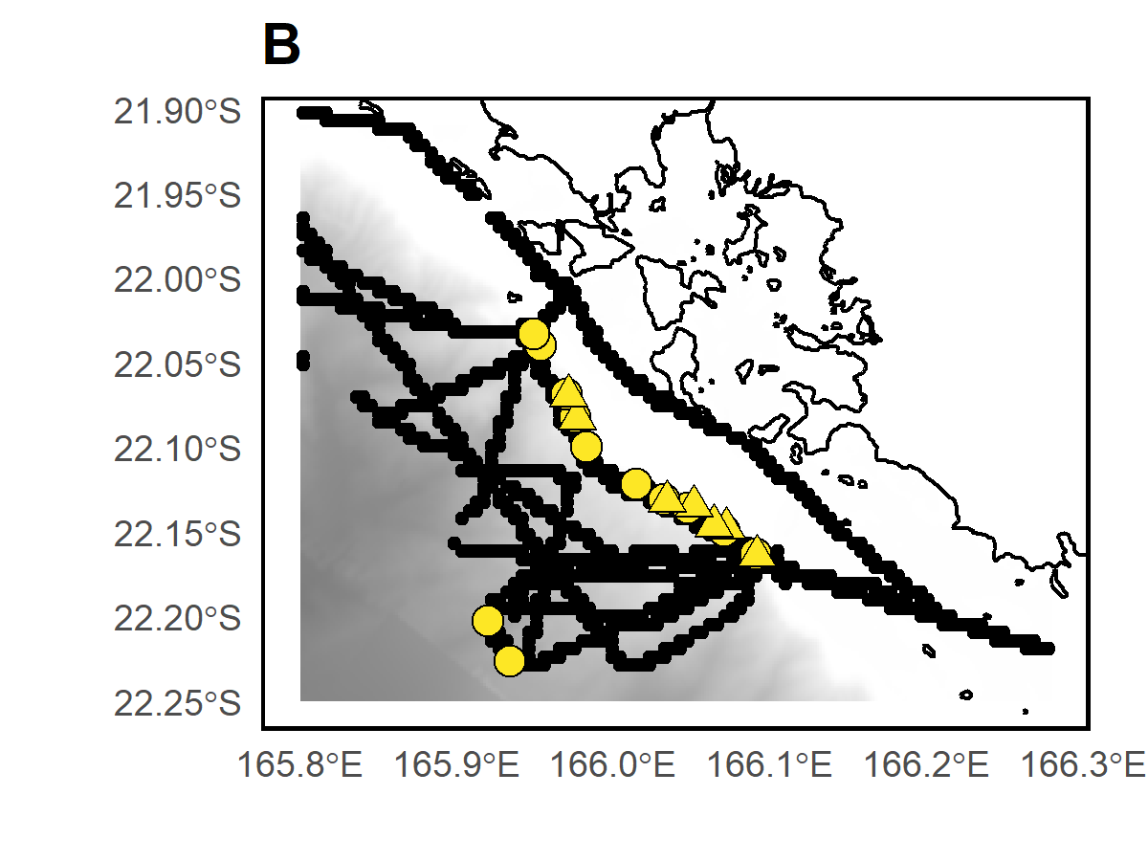
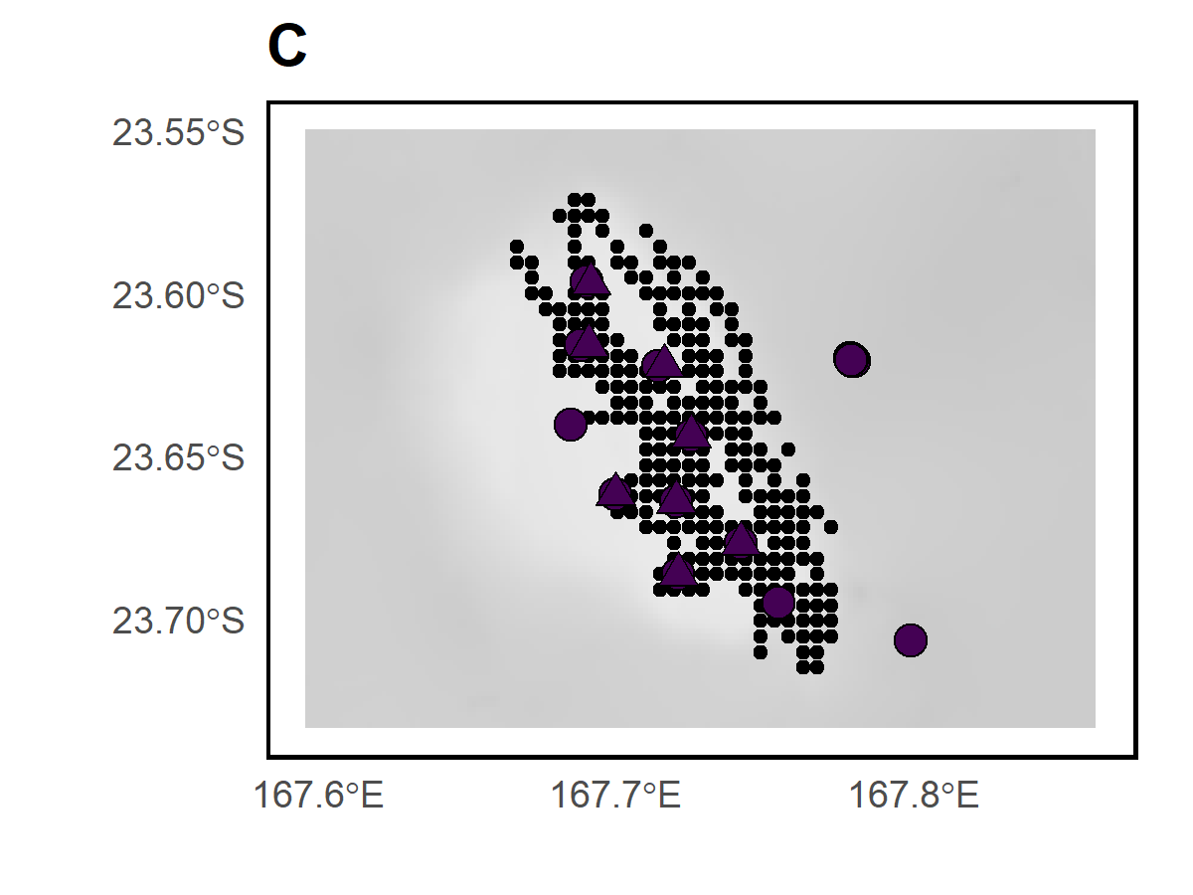
D’Entrecasteaux
Chesterfield
Habitat
Deep slope
Bellona
Seamount ~50m
Seamount ~250m
Nouméa
Seamount ~500m
Sample type
BRUVS samples
eDNA samples
Acoustic recordings

Slide 4
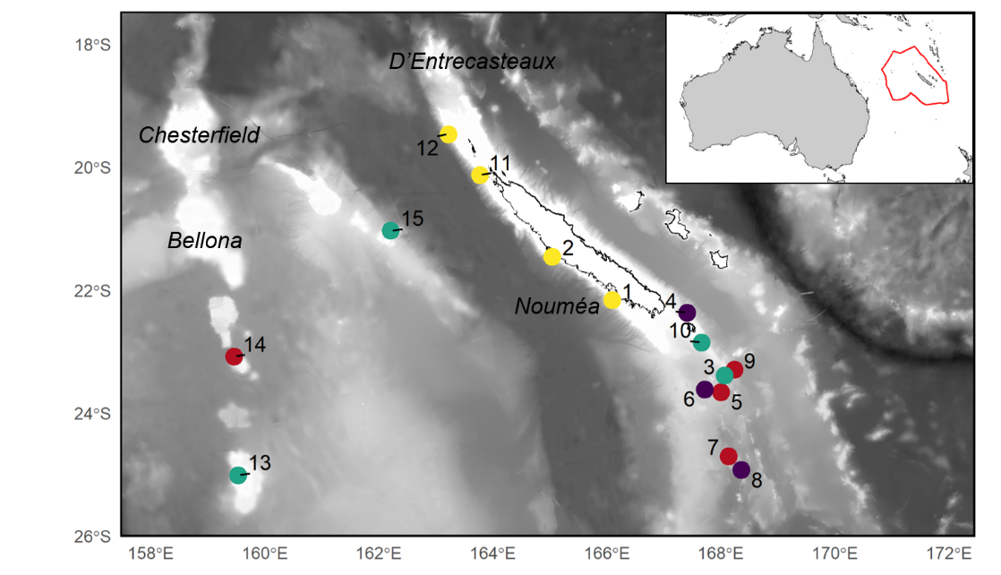

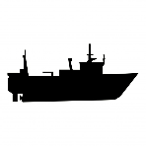


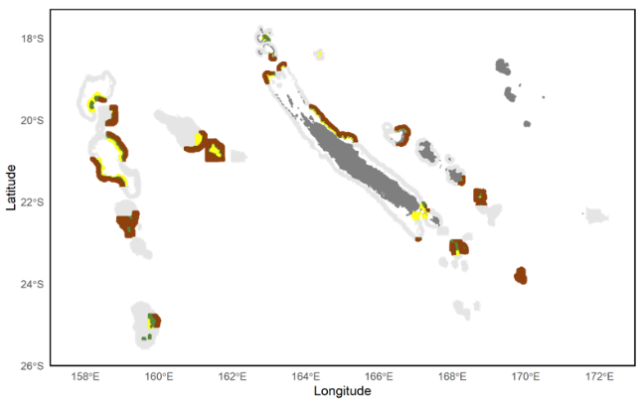
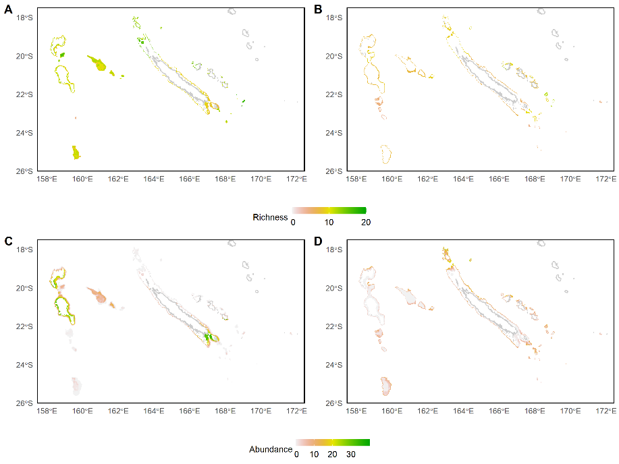


1
Sampling seamounts, deep slopes and pelagic areas with BRUVS, eDNA and echosounder
Benthic species richness, abundance, biomass (BRUVS)
eDNA benthic and pelagic MOTU richness
Benthic and pelagic acoustic biomass
Abundance of most occurrent species (BRUVS)
eDNA read abundance of most occurrent MOTUs
Fairway ridge
Lord Howe ridge
Loyaulty island ridge
Norfolk ridge
2
Modeling with BRTs
Modeling with GJAMs
Prediction of each integrated metric in 3 depth layers
(0-200, 200-400, 400-600)
Prediction of individual species and MOTUs in 3 depth layers
(0-200, 200-400, 400-600)
4
3D conservation planning with various metric targets
3
Select solution protecting 30% of area

Slide 5
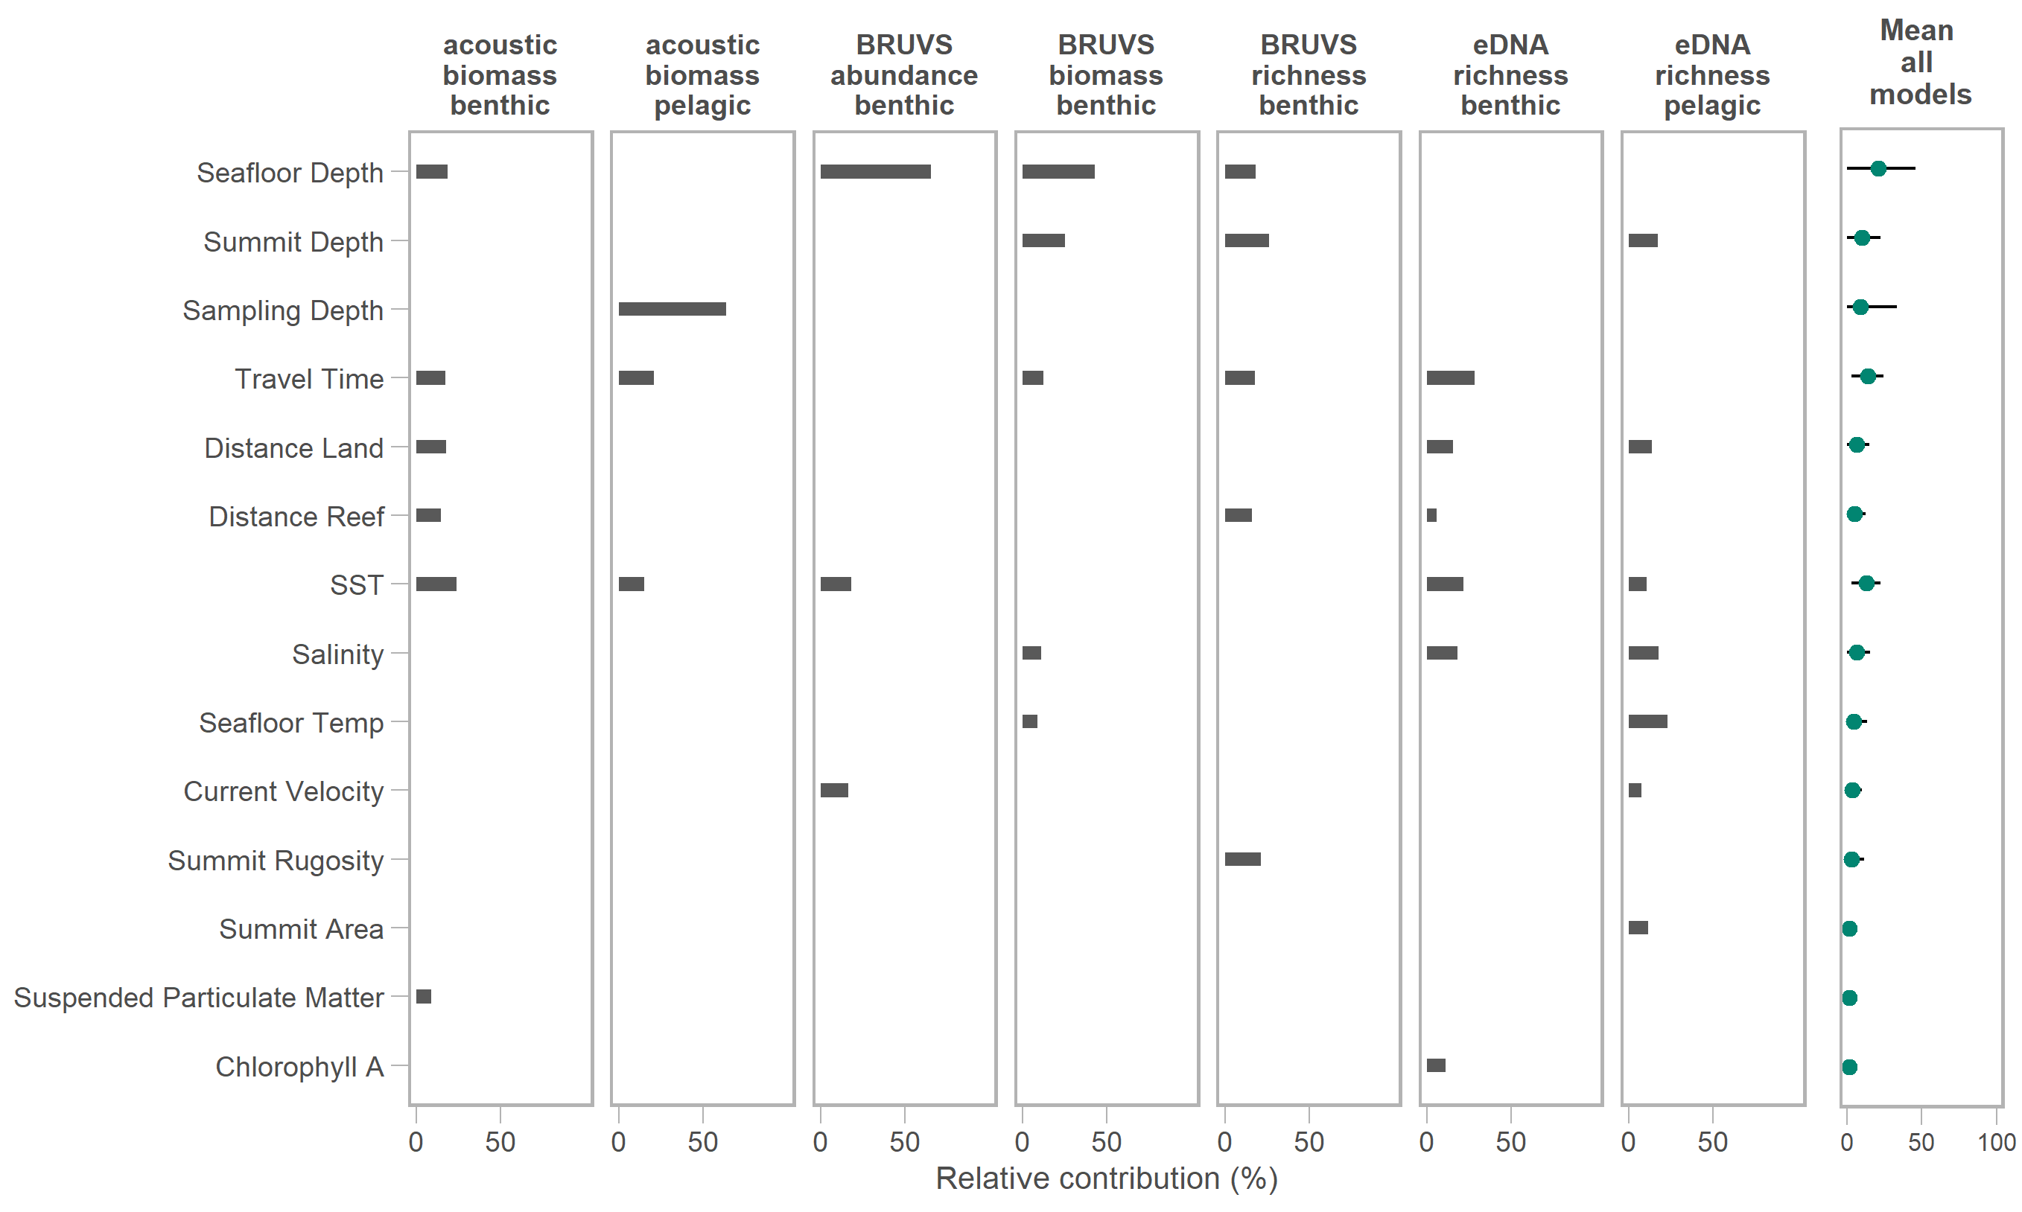
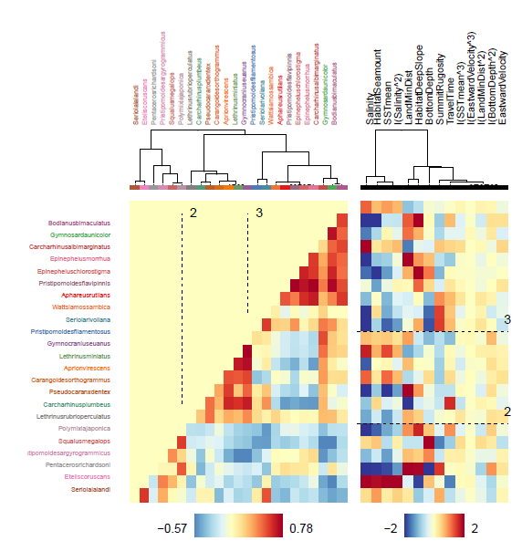
a
S. lalandi
E. coruscans
P. richardsoni
P. argyrogrammicus
S. megalops
P. japonica
L. rubrioperculatus
C. plumbeus
P. dentex
C. orthogrammus
A. virescens
L. miniatus
G. euanus
P. filamentosus
S. rivoliana
W. mossambica
A. rutilans
P. flavipinnis
E. chlorostigma
E. morrhua
C. albimarginatus
G. unicolor
B. bimaculatus
Salinity
Seamount
Mean SST
Salinity²
Distance Land
Deep Slope
Bottom Depth
Summit Rugosity
Travel Time
Mean SST³
Eastward Velocity³
Distance Land²
Bottom Depth²
Eastward Velocity
b
Bodianus bimaculatus
Gymnosarda unicolor
Carcharhinus albimarginatus
Epinephelus morrhua
Epinephelus chlorostigma
Pristipomoides flavipinnis
Aphareus rutilans
Wattsia mossambica
Seriola rivoliana
Pristipomoides filamentosus
Gymnocranius euanus
Lethrinus miniatus
Aprion virescens
Carangoides orthogrammus
Pseudocaranx dentex
Carcharhinus plumbeus
Lethrinus rubrioperculatus
Polymixia japonica
Squalus megalops
Pristipomoides argyrogrammicus
Pentaceros richardsoni
Etelis coruscans
Seriola lalandi

Slide 6
Distance to Reef
Summit Rugosity²
Habitat: Deep slope
Mean SST²
Suspended Particulate Matter
Bottom depth
Salinity
Bottom depth²
Northern velocity
Travel Time
Suspended Particulate Matter²
Northern velocity^3
Summit Rugosity
Salinity
SST mean
Habitat: Seamount
MOTU
Predictors
Myctophidae
Naso
Diaphus
Beryx
Clupeocephala
Percomorphaceae
Myctophiformes
Scomberomorus
Eupercaria
Parupeneus
Percomorphaceae
Diogenichthys
Diogenichthys
Percomorphaceae
Parupeneus
Eupercaria
Scomberomorus
Myctophiformes
Percomorphaceae
Clupeocephala
Beryx
Diaphus
Naso
Myctophidae
MOTU
Correlation
Correlation

Slide 7
Salinity
SST mean
Distance to Reef
Salinity²
Habitat: Seamount
Summit Area
Northward velocity
Summit rugosity
Travel time
Habitat: Deep slope
Summit rugosity²
Eastward velocity
Seafloor temperature²
Sampling depth
Northward velocity²
Bottom depth
Suspended particulate matter
Seafloor temperature
MOTU
Predictors
Diaphus
Percomorphaceae
Scomberomorus
Lutjanus
Tylosurus
Myctophidae
Lethrinus
Percomorphaceae
Thunnus
Sardina pilchardus
Sardina pilchardus
Thunnus
Percomorphaceae
Lethrinus
Myctophidae
Tylosurus
Lutjanus
Scomberomorus
Percomorphaceae
Diaphus
MOTU
Correlation
Correlation

