Slide 1
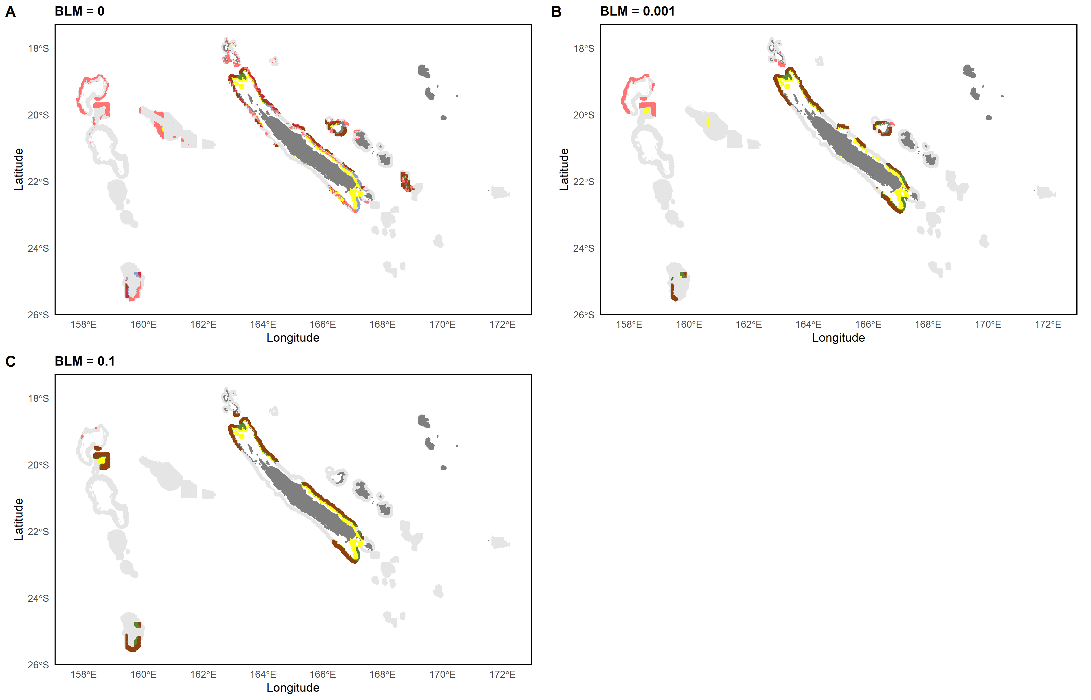
0 – 200m
0 – 200m & 200 – 400m
0 – 200m & 400 – 600m
200 – 400m
400 – 600m
All layers
200 – 400m & 400 – 600m

