Slide 1
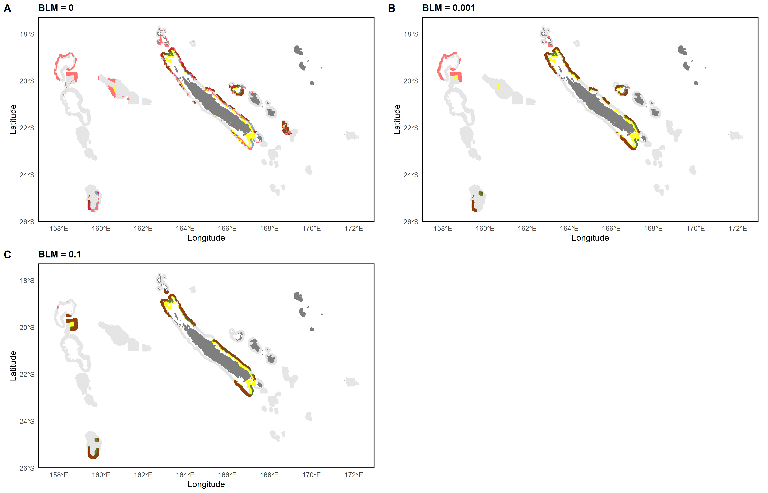
0 – 200m
0 – 200m & 200 – 400m
0 – 200m & 400 – 600m
200 – 400m
400 – 600m
All layers
200 – 400m & 400 – 600m

Slide 2
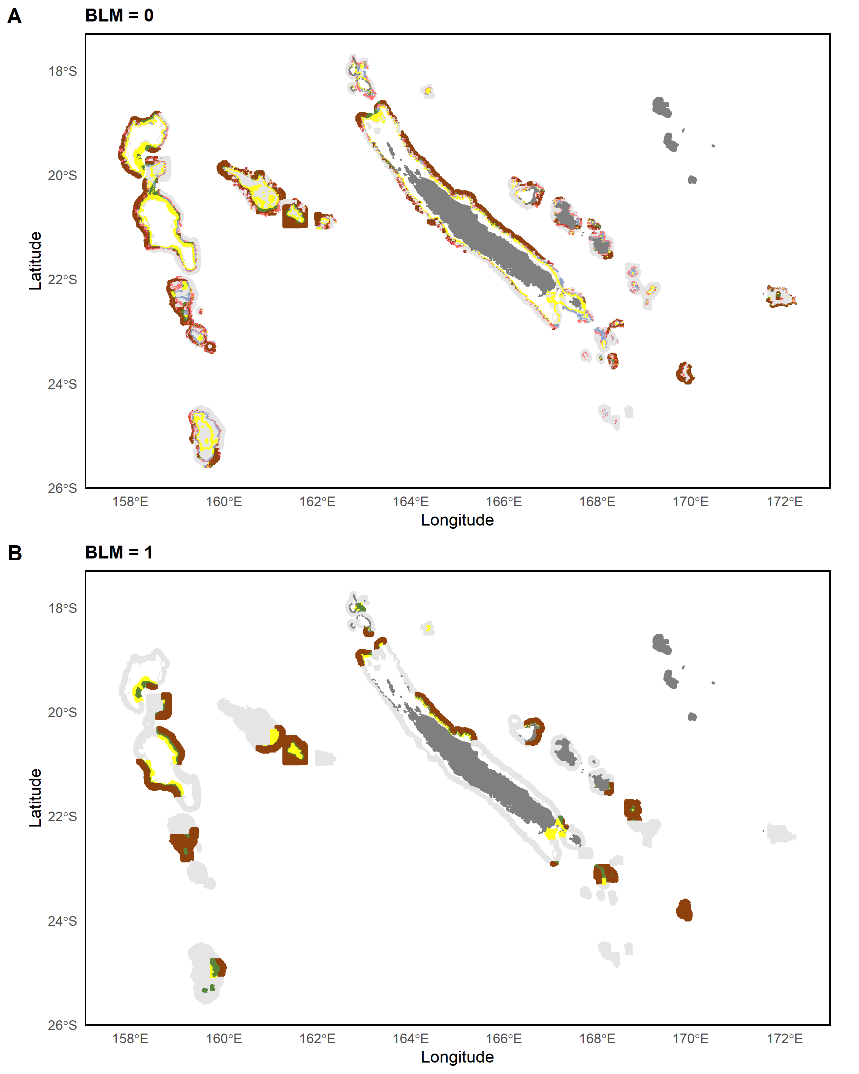
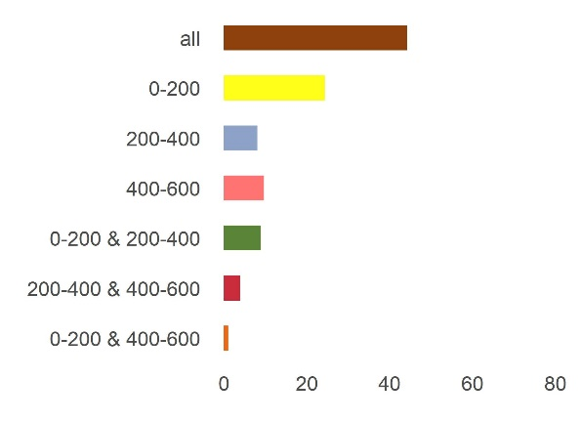
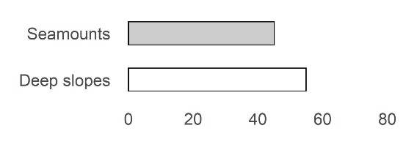
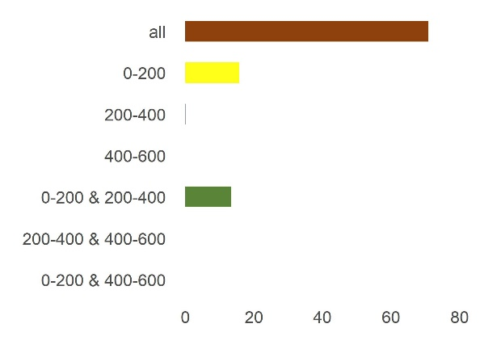
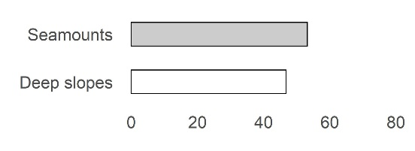
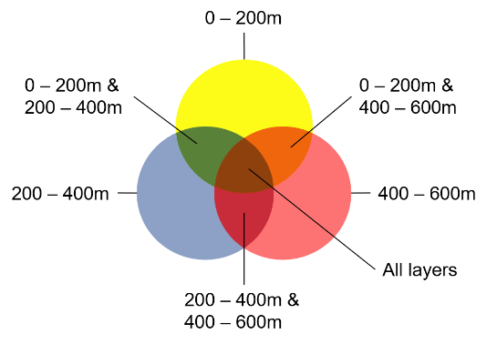
Percentage
Percentage

Slide 3
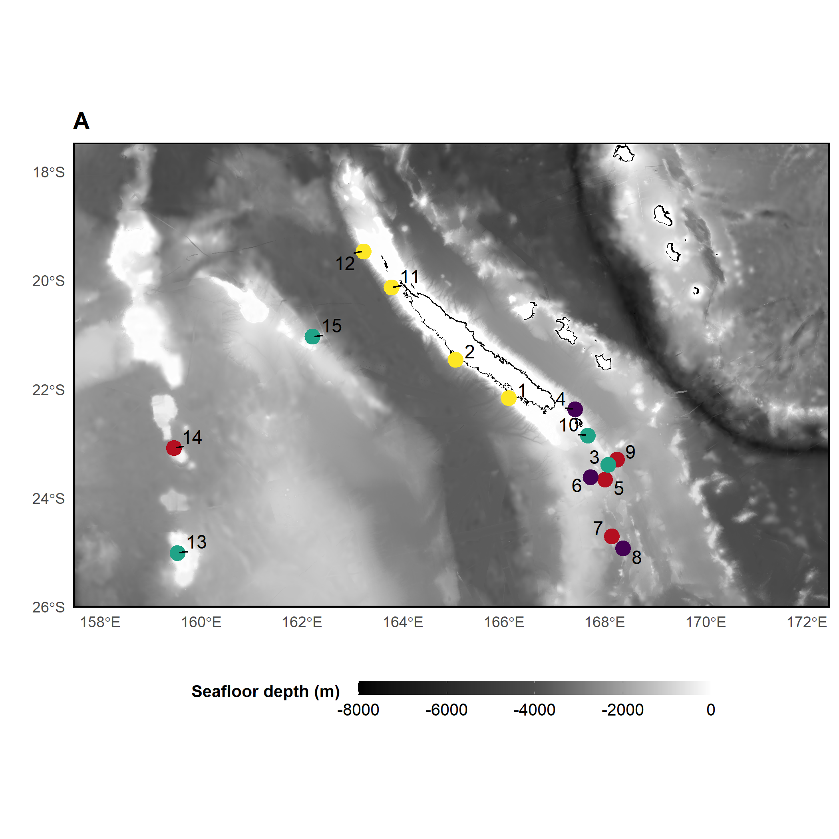
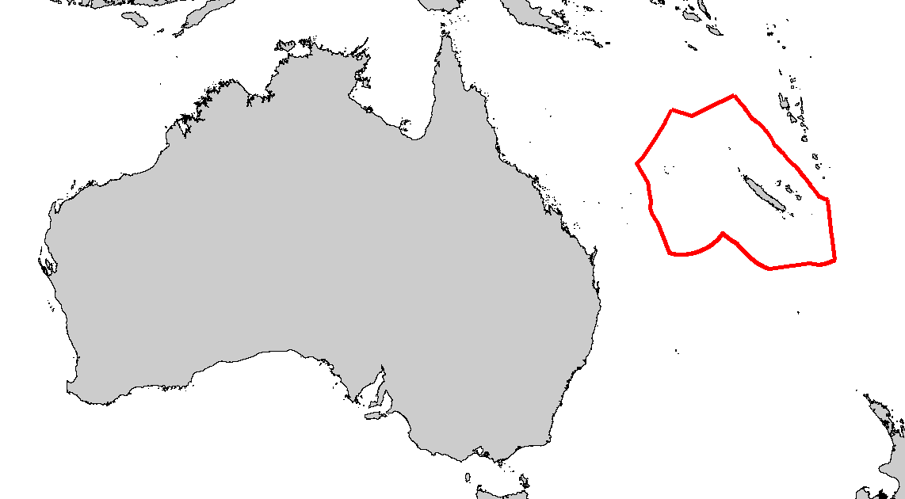
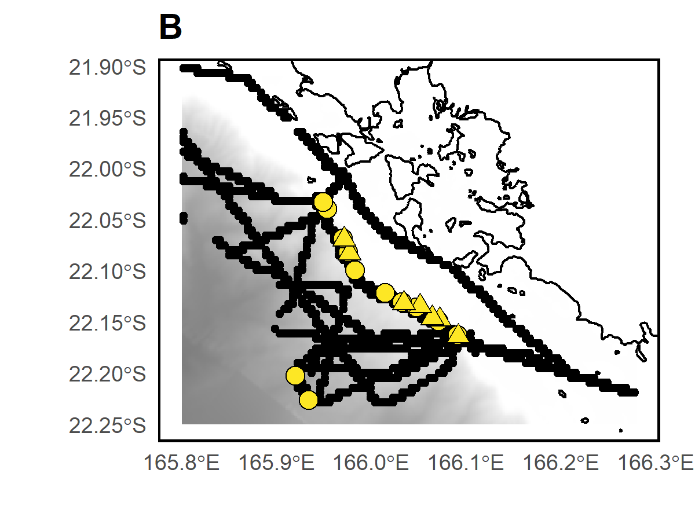
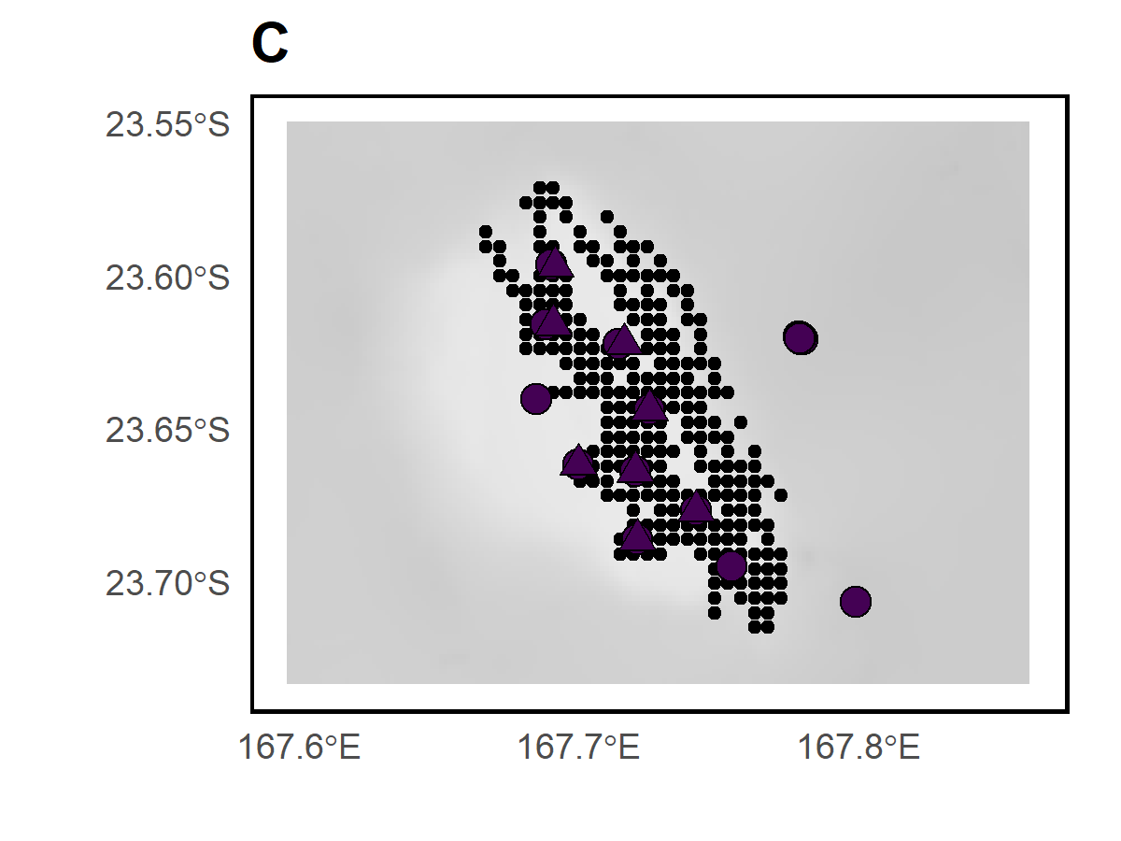
D’Entrecasteaux
Chesterfield
Habitat
Deep slope
Bellona
Seamount ~50m
Seamount ~250m
Nouméa
Seamount ~500m
Sample type
BRUVS samples
eDNA samples
Acoustic recordings

Slide 4
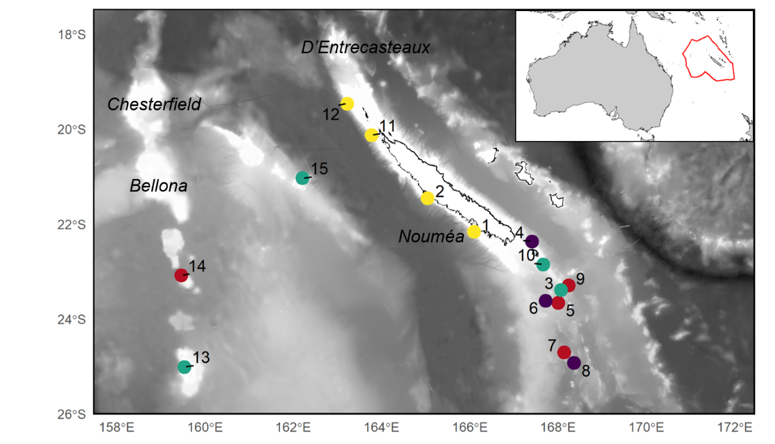

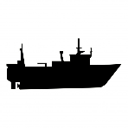


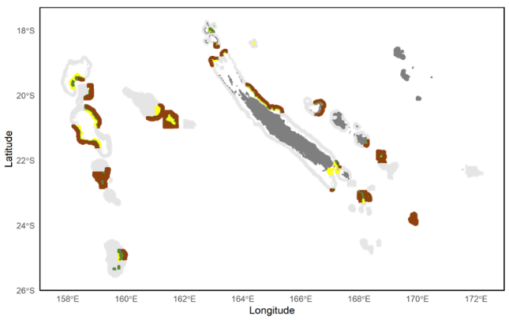
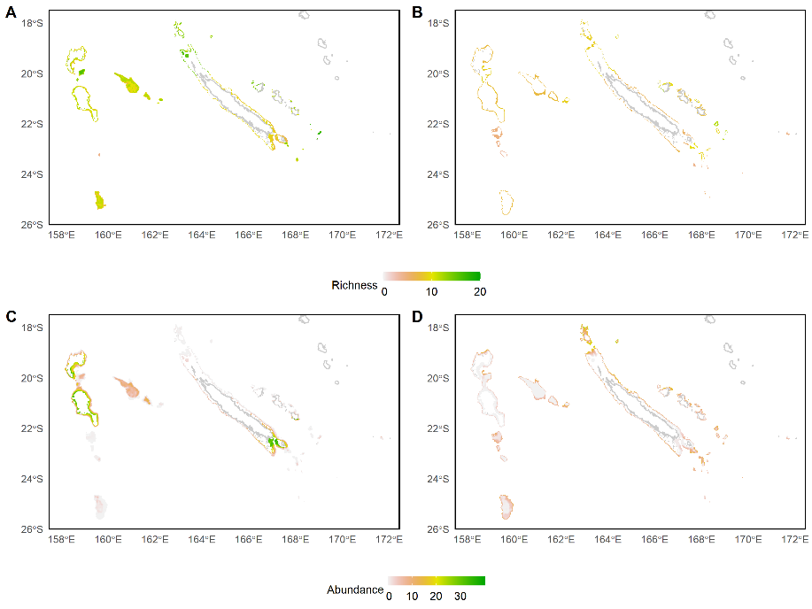


1
Sampling seamounts, deep slopes and pelagic areas with BRUVS, eDNA and echosounder
Benthic species richness, abundance, biomass (BRUVS)
eDNA benthic and pelagic MOTU richness
Benthic and pelagic acoustic biomass
Abundance of most occurrent species (BRUVS)
eDNA read abundance of most occurrent MOTUs
Fairway ridge
Lord Howe ridge
Loyaulty island ridge
Norfolk ridge
2
Modelling with BRTs
Modelling with GJAMs
Prediction of each integrated metric in 3 depth layers
(0-200, 200-400, 400-600)
Prediction of individual species and MOTUs in 3 depth layers
(0-200, 200-400, 400-600)
4
3D conservation planning with various metric targets
3
Select solution protecting 30% of area

Slide 5
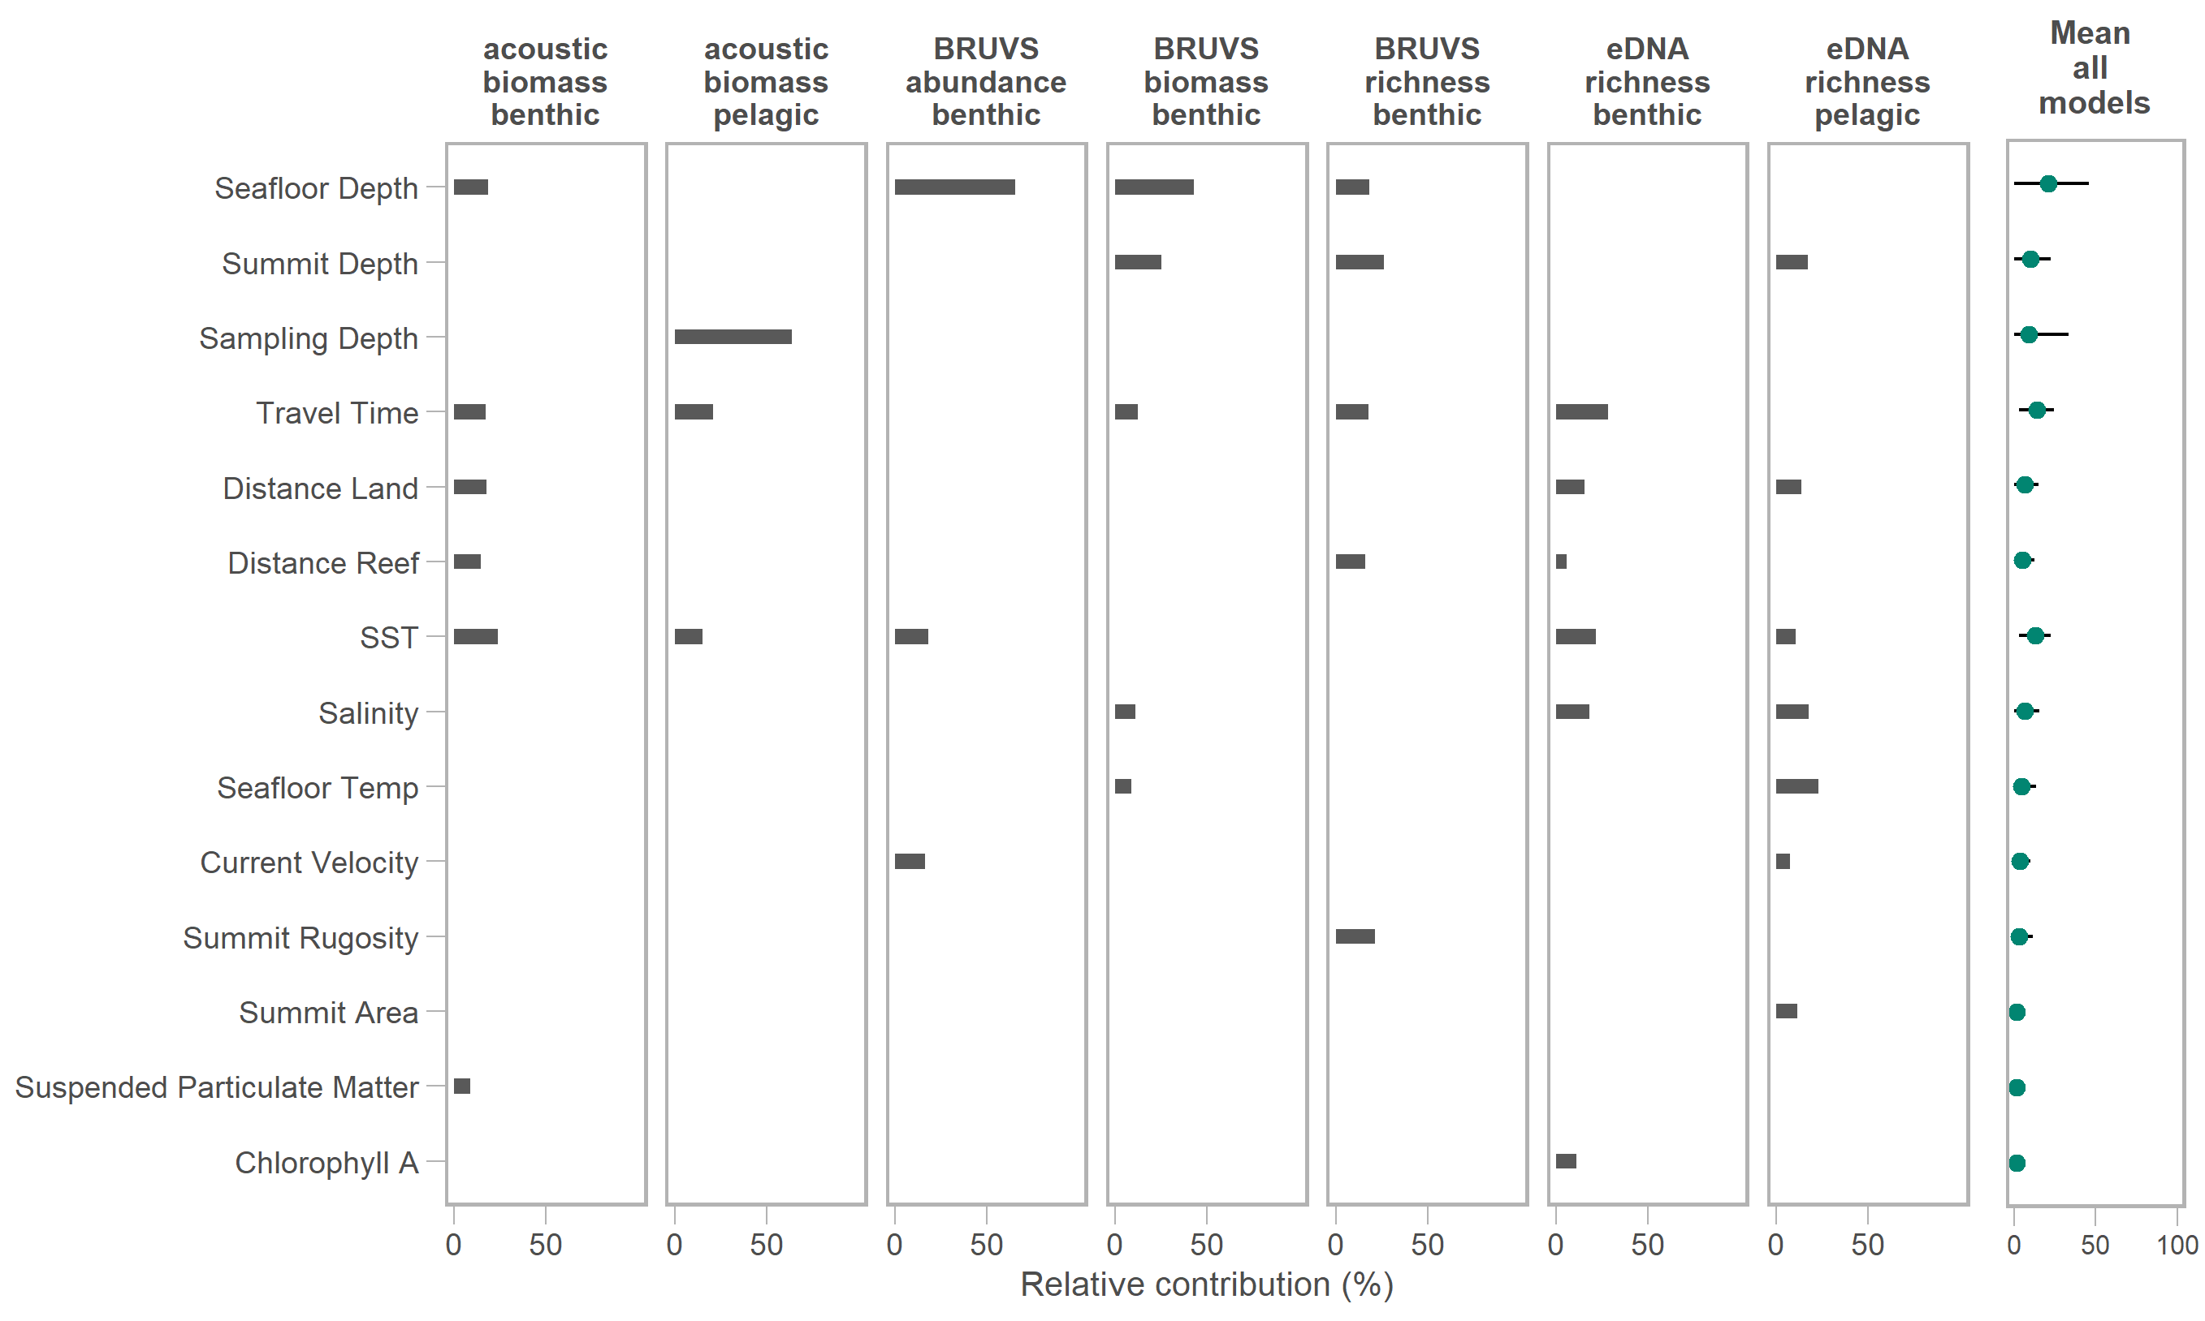
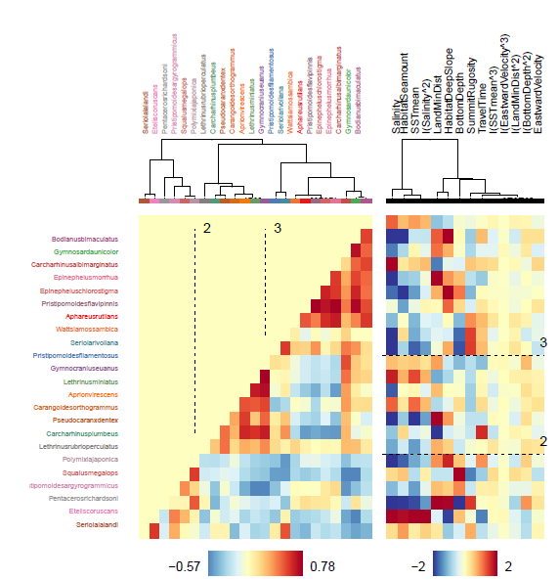
A
S. lalandi
E. coruscans
P. richardsoni
P. argyrogrammicus
S. megalops
P. japonica
L. rubrioperculatus
C. plumbeus
P. dentex
C. orthogrammus
A. virescens
L. miniatus
G. euanus
P. filamentosus
S. rivoliana
W. mossambica
A. rutilans
P. flavipinnis
E. chlorostigma
E. morrhua
C. albimarginatus
G. unicolor
B. bimaculatus
Salinity
Seamount
Mean SST
Salinity²
Distance Land
Deep Slope
Bottom Depth
Summit Rugosity
Travel Time
Mean SST³
Eastward Velocity³
Distance Land²
Bottom Depth²
Eastward Velocity
B
Bodianus bimaculatus
Gymnosarda unicolor
Carcharhinus albimarginatus
Epinephelus morrhua
Epinephelus chlorostigma
Pristipomoides flavipinnis
Aphareus rutilans
Wattsia mossambica
Seriola rivoliana
Pristipomoides filamentosus
Gymnocranius euanus
Lethrinus miniatus
Aprion virescens
Carangoides orthogrammus
Pseudocaranx dentex
Carcharhinus plumbeus
Lethrinus rubrioperculatus
Polymixia japonica
Squalus megalops
Pristipomoides argyrogrammicus
Pentaceros richardsoni
Etelis coruscans
Seriola lalandi

