Slide 1
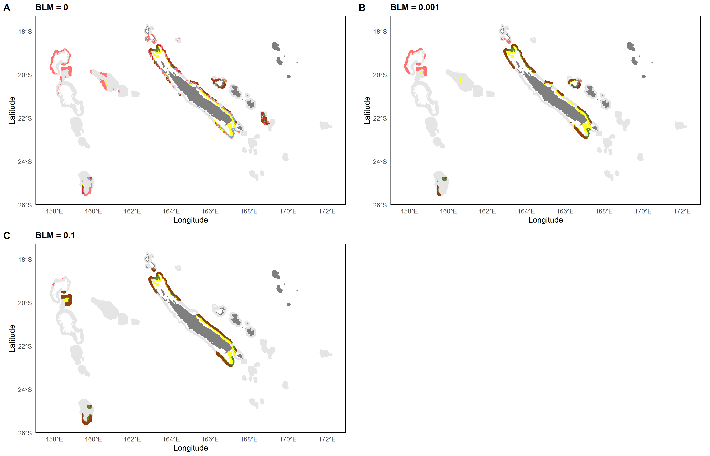
0 – 200m
0 – 200m & 200 – 400m
0 – 200m & 400 – 600m
200 – 400m
400 – 600m
All layers
200 – 400m & 400 – 600m

Slide 2
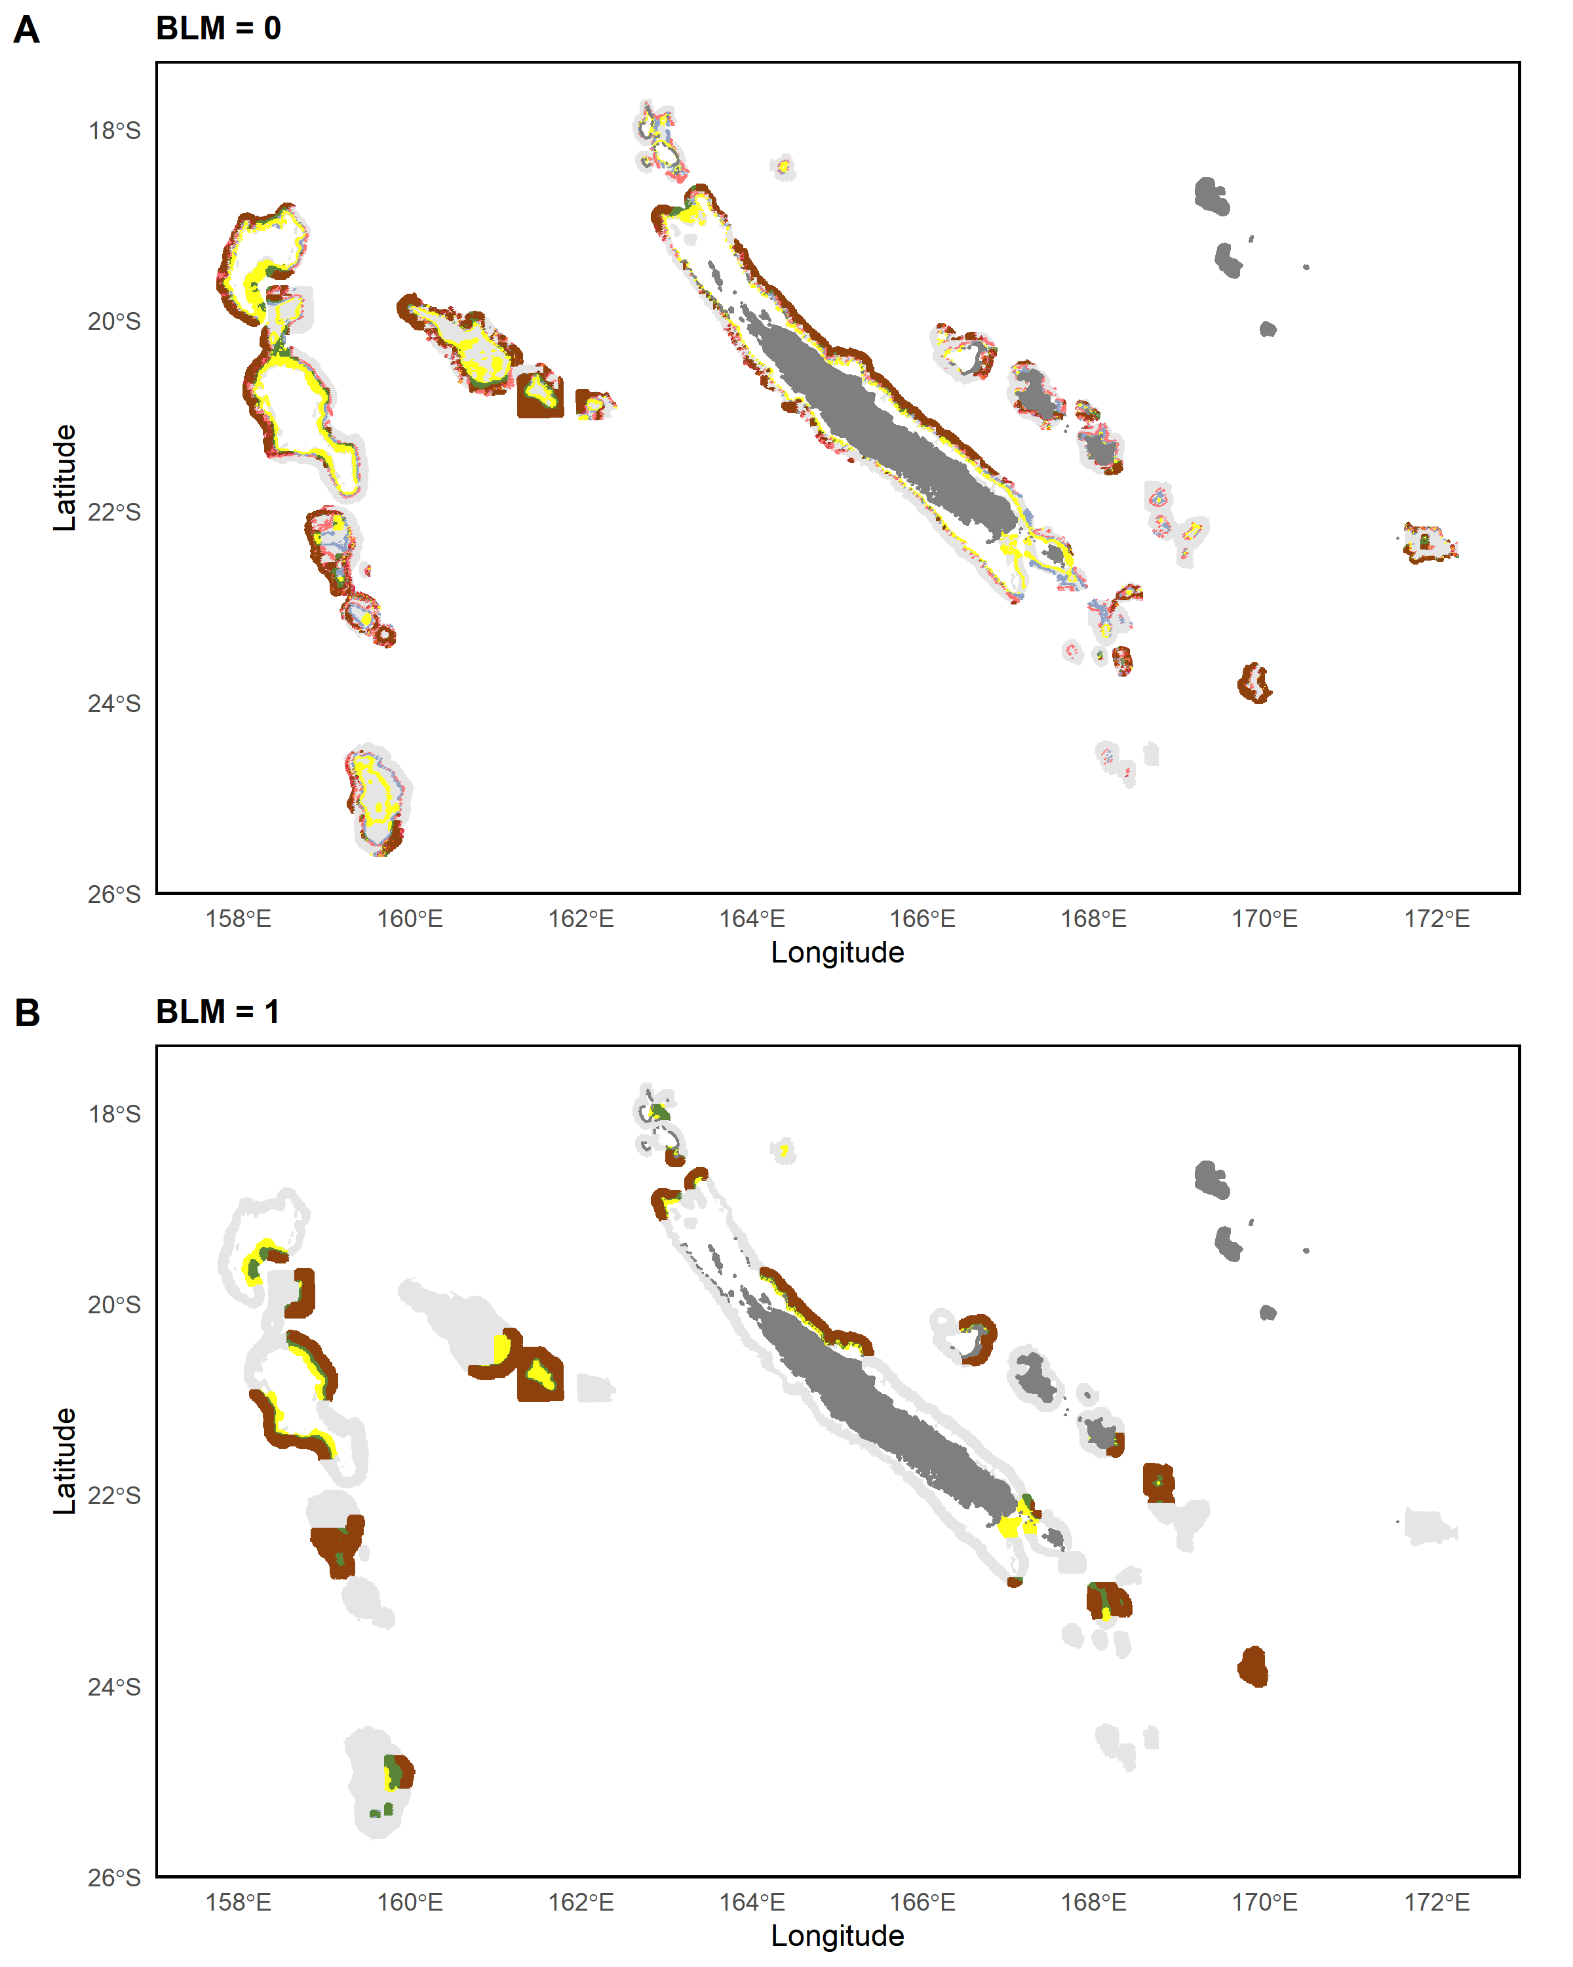
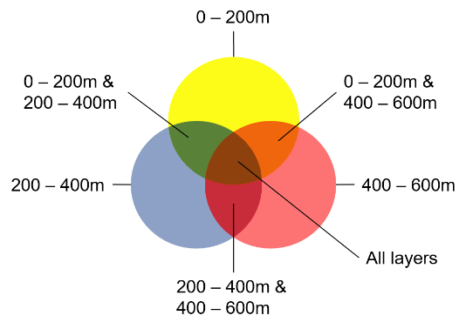

Slide 3
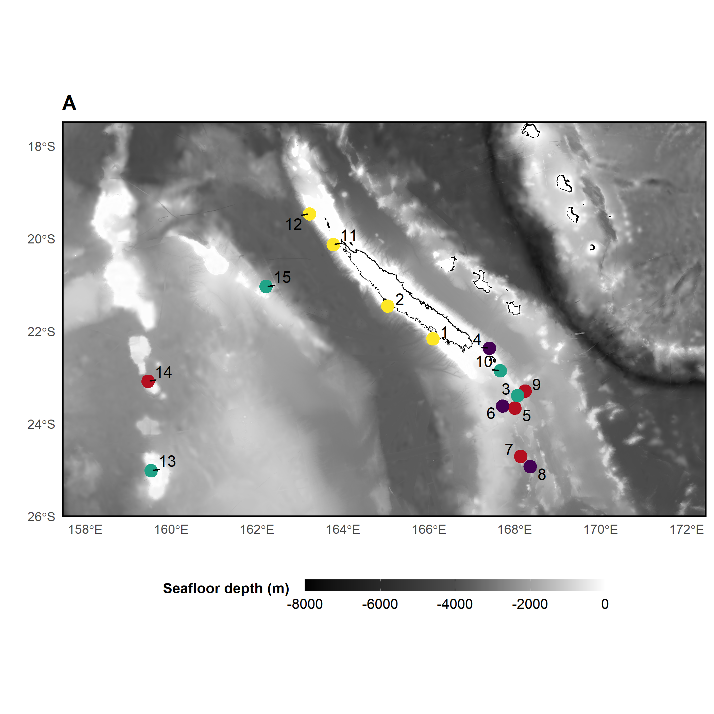
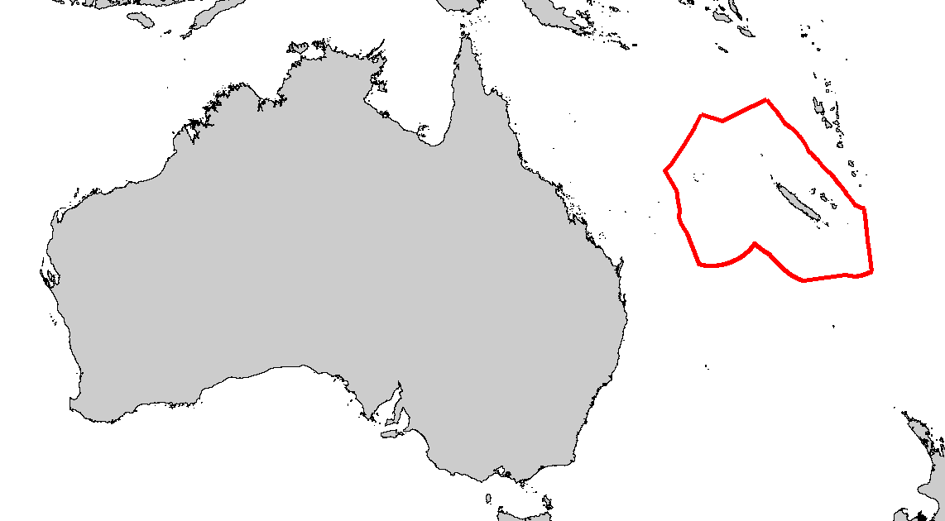
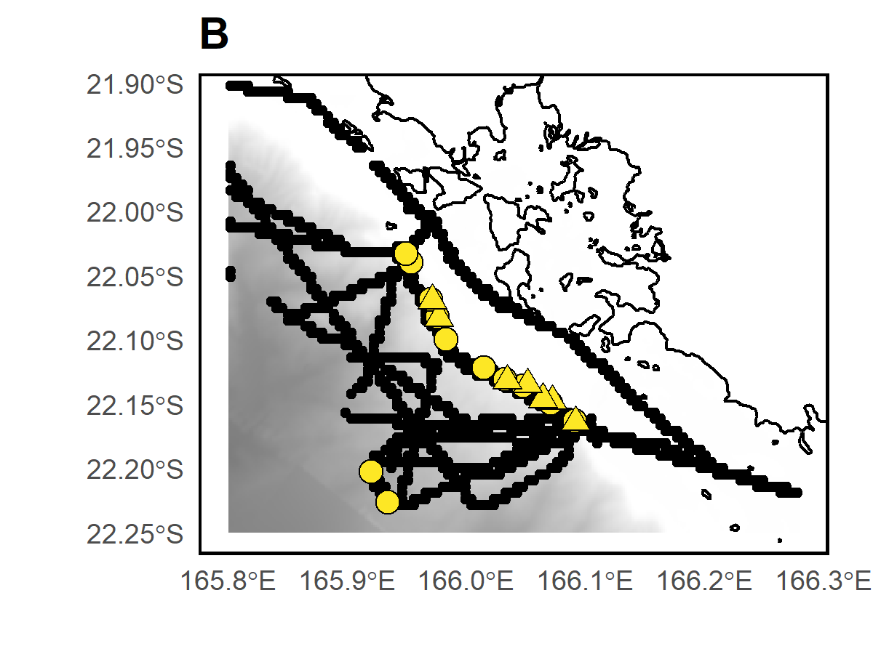
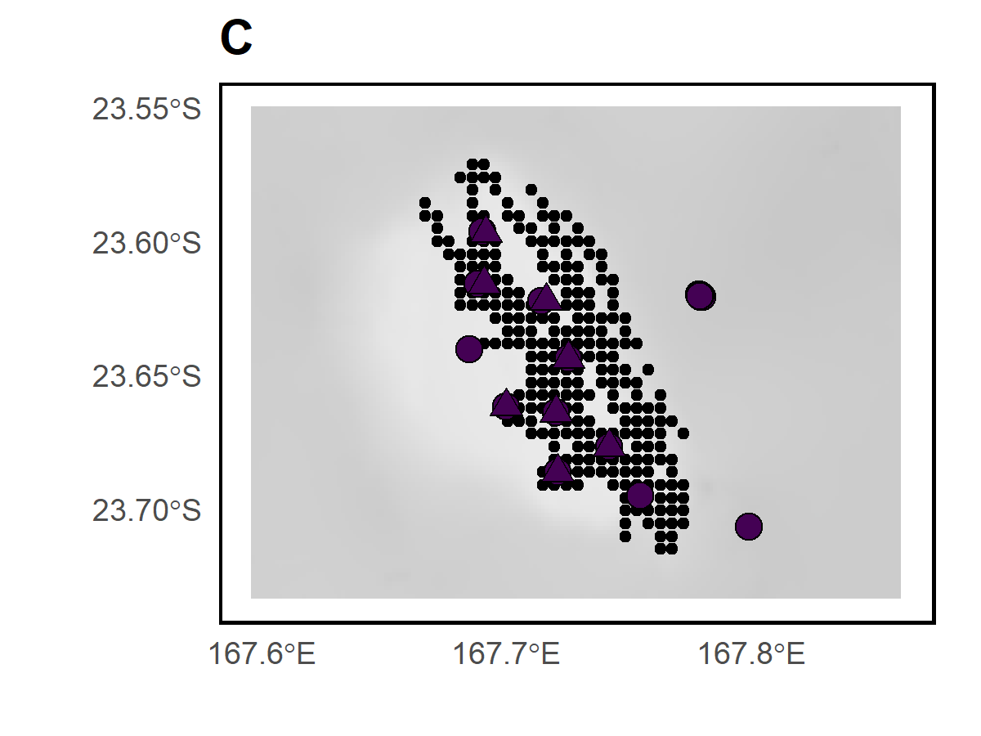
D’Entrecasteaux
Chesterfield
Bellona
Nouméa
Deep slope
Seamount ~250m
BRUVS samples
Acoustic recordings
Seamount ~50m
Seamount ~500m
eDNA samples

Slide 4
D’Entrecasteaux
Chesterfield
Habitat
Deep slope
Bellona
Seamount ~50m
Seamount ~250m
Nouméa
Seamount ~500m
Sample type
BRUVS samples
eDNA samples
Acoustic recordings

