Slide 1
Edge Converter
Project Review
Group G4
Alen Sejdini, Eli Bates, Luka Mavrin, Marita Kresić, Mariana Šeparović

Slide 2
Outline
Overview of the System (UML Diagrams)
Abstracted Input – Creating the XML Parser + Parsing (UML Class and Sequence Diagram)
Abstracted Output – Creating the DDL Generator + Rendering the DDL script (UML Class and Sequence Diagram)
Static Code Analysis Report (SonarQube Screenshots Explained)
List of What is Missing
Part of the Solution We Are Most Proud of
What Could Have Been Done Better?

Slide 3
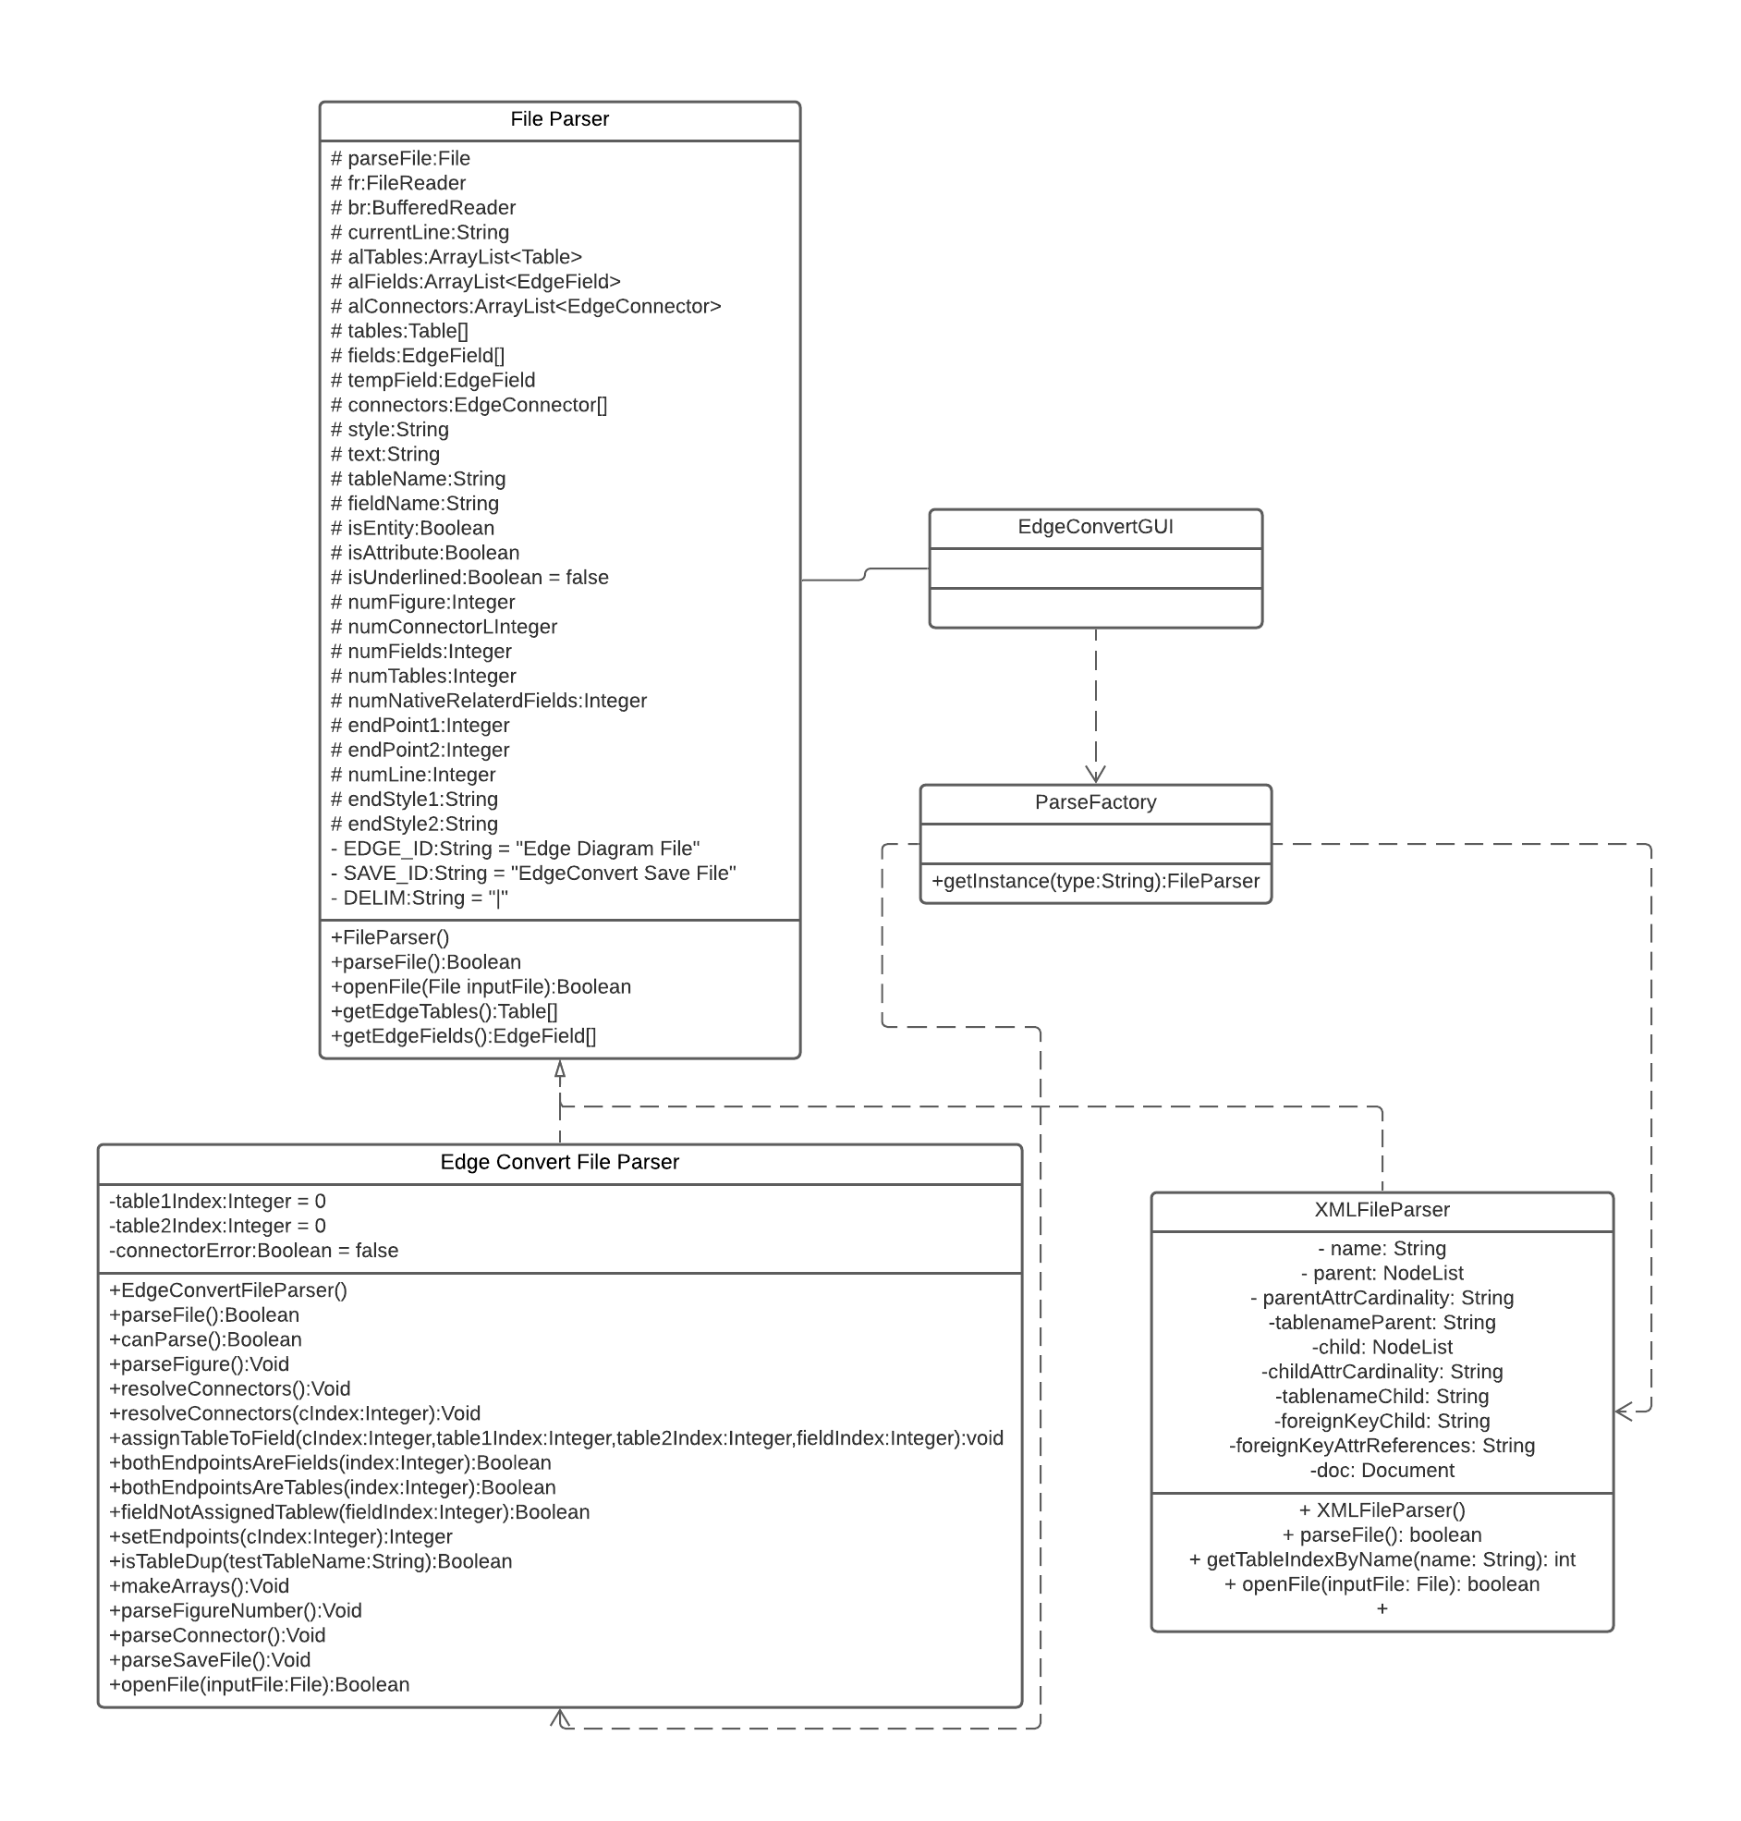
Abstracted Input
UML Class Diagram

Slide 4
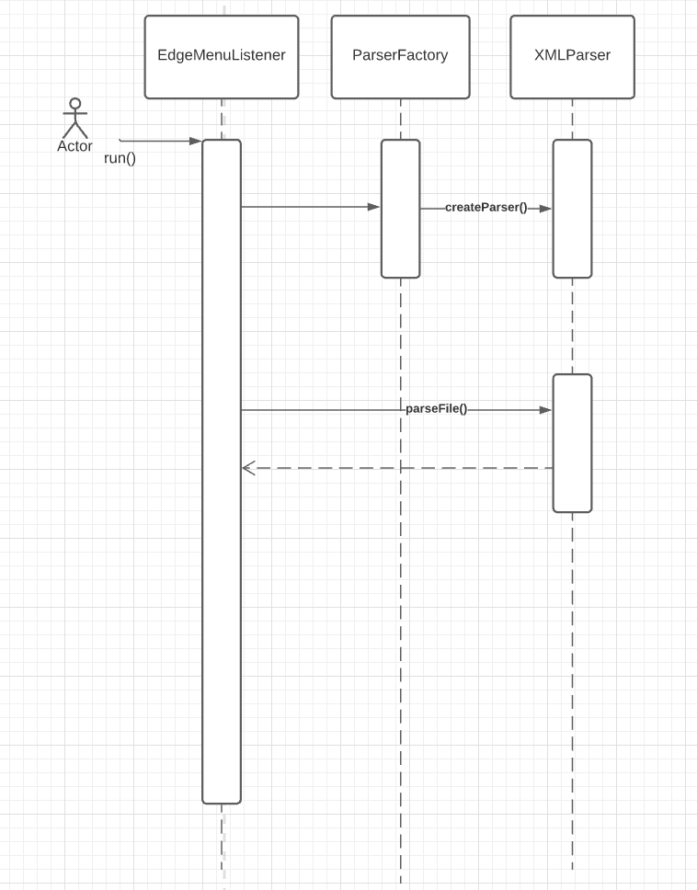
Abstracted Input
Sequence Class Diagram

Slide 5
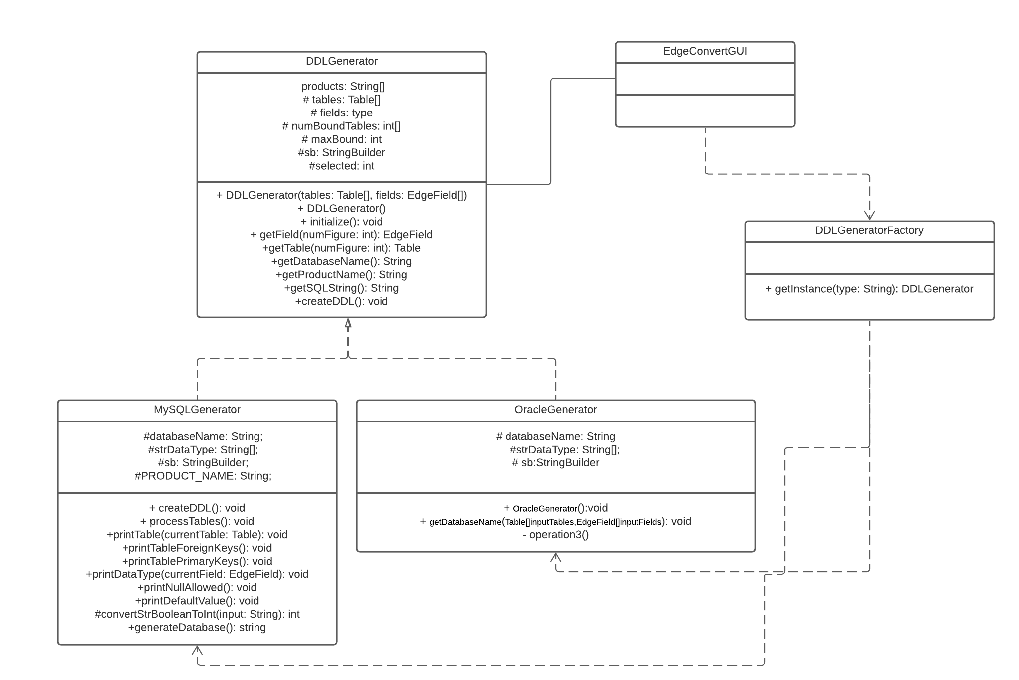
Abstracted Output
UML Class
Diagram

Slide 6
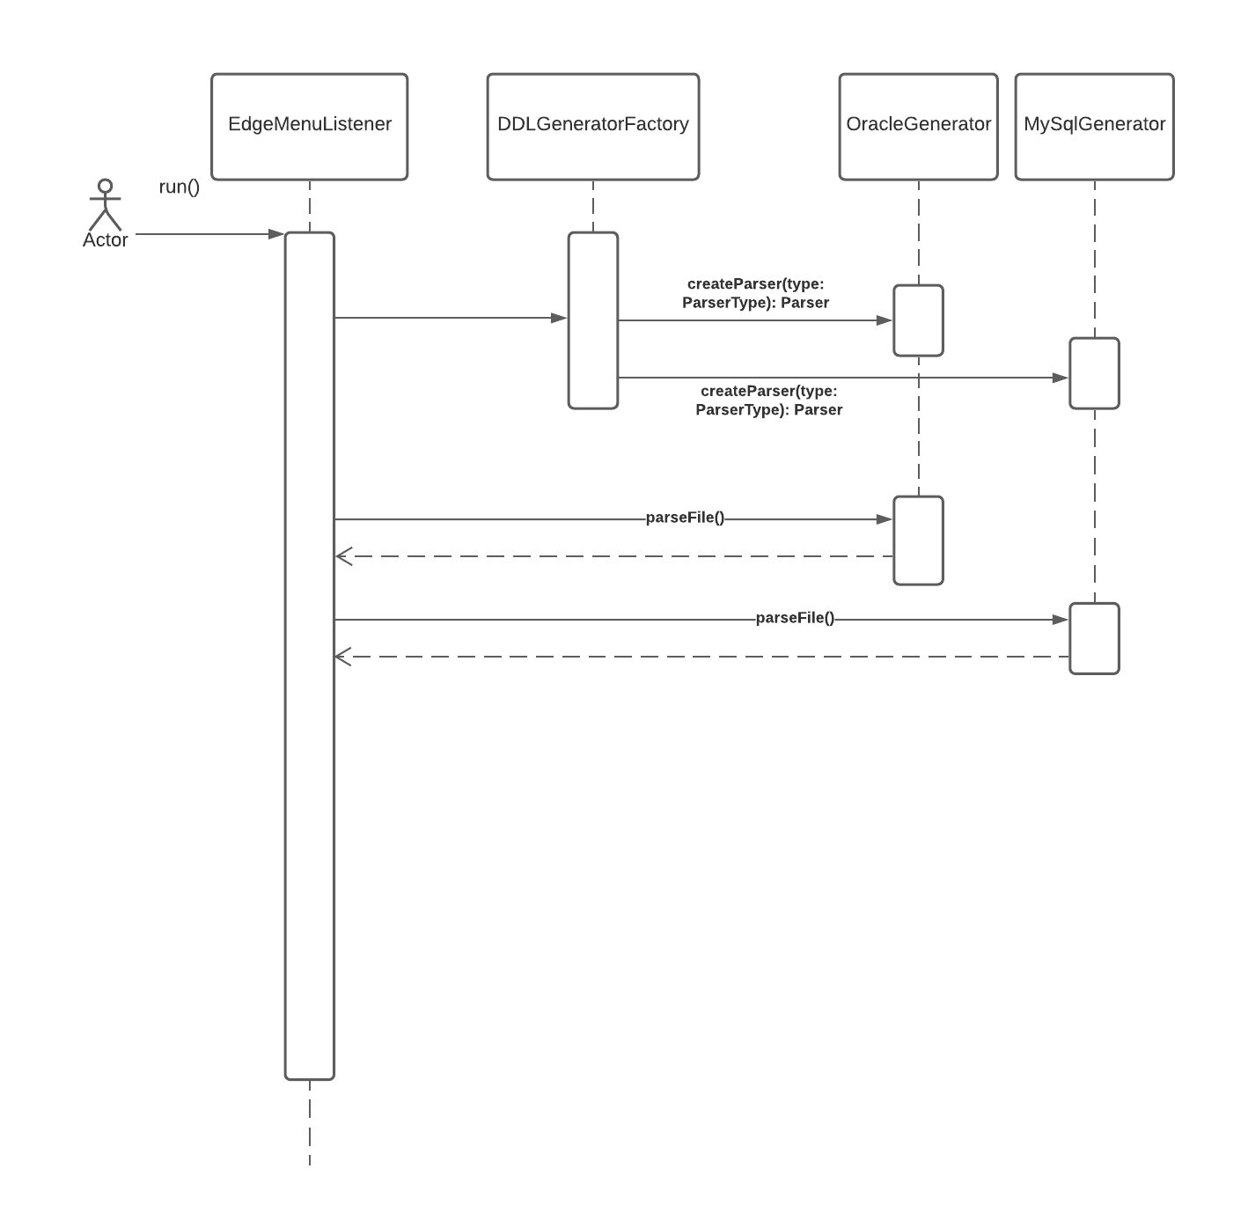
Abstracted Output
Sequence Diagram

Slide 7
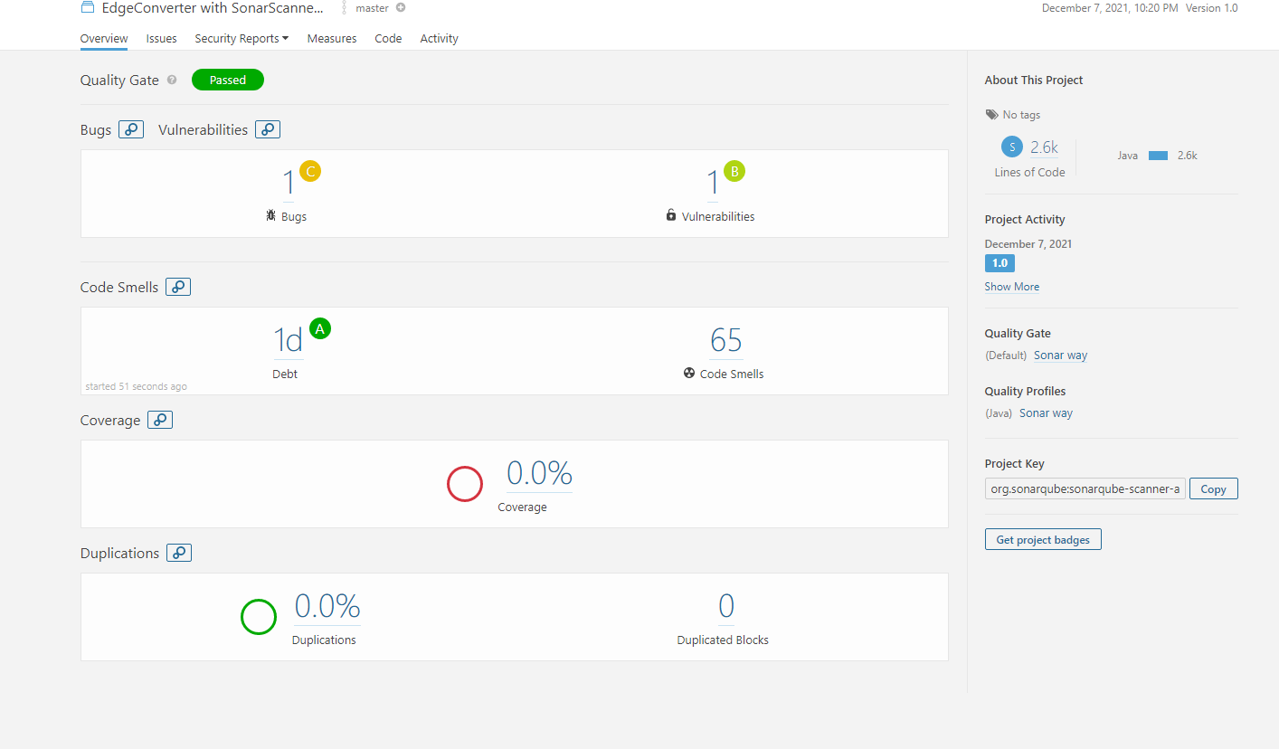
Static Code Analysis

Slide 8
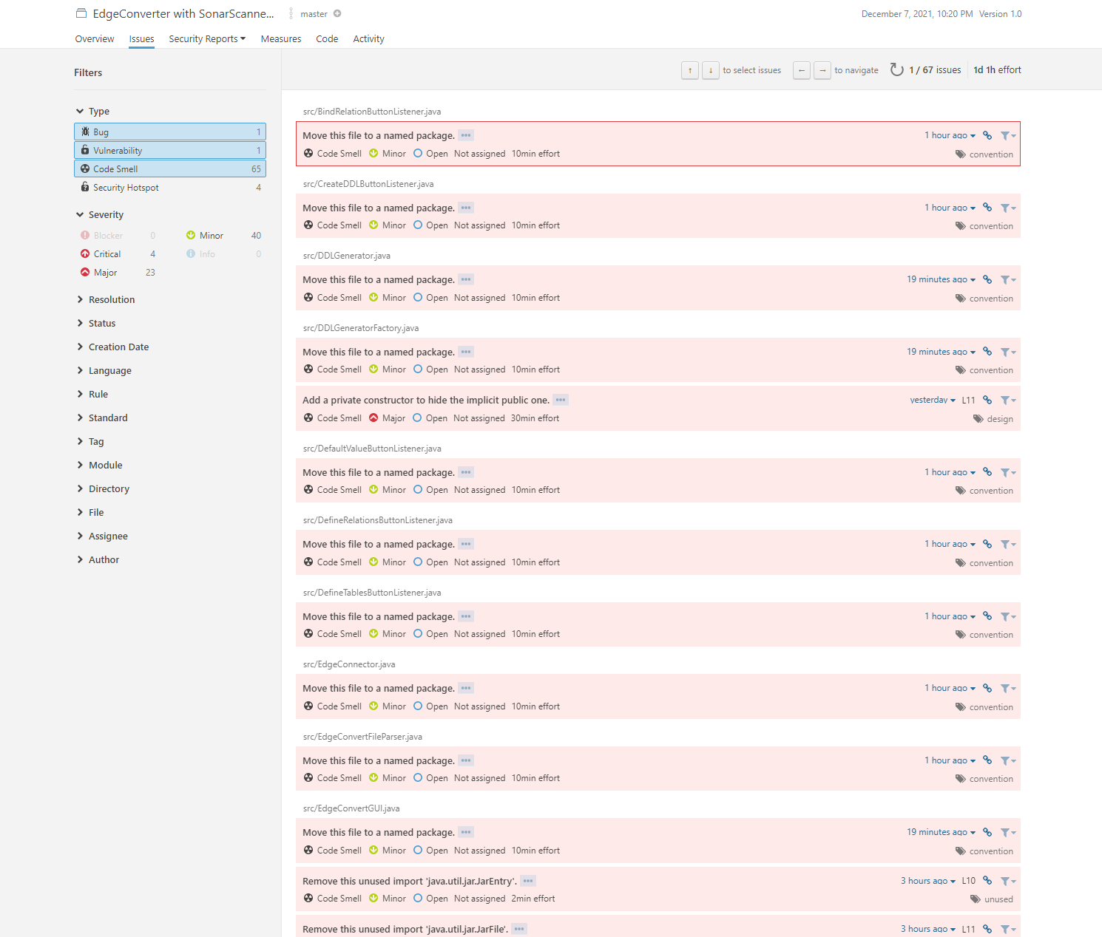

Slide 9
What's Missing ?
We were unsuccessful in getting the XML relations to parse and therefore we could not fully load the data.
Because of this, also the generate DDL was not working because the relations were not set up correctly.

Slide 10
What Are We Most Proud Of?
Coming together in the heat of the moment to meet our goals.
Fixing the DDL Generator after a catastrophic event due to GIT misuses.you
Strong team spiRIT

Slide 11
What Could Have Been Done Better?
The code could have been refactored better
Naming and organization of the branches
Organization and task management during sprints

