Slide 1
Lecture 6
Network Models of Cities
6.2 A First Model: The Amorphous Settlement Model and Urban Scaling
IUS 3.2.2
©Luís M. A. Bettencourt 2024

Slide 2
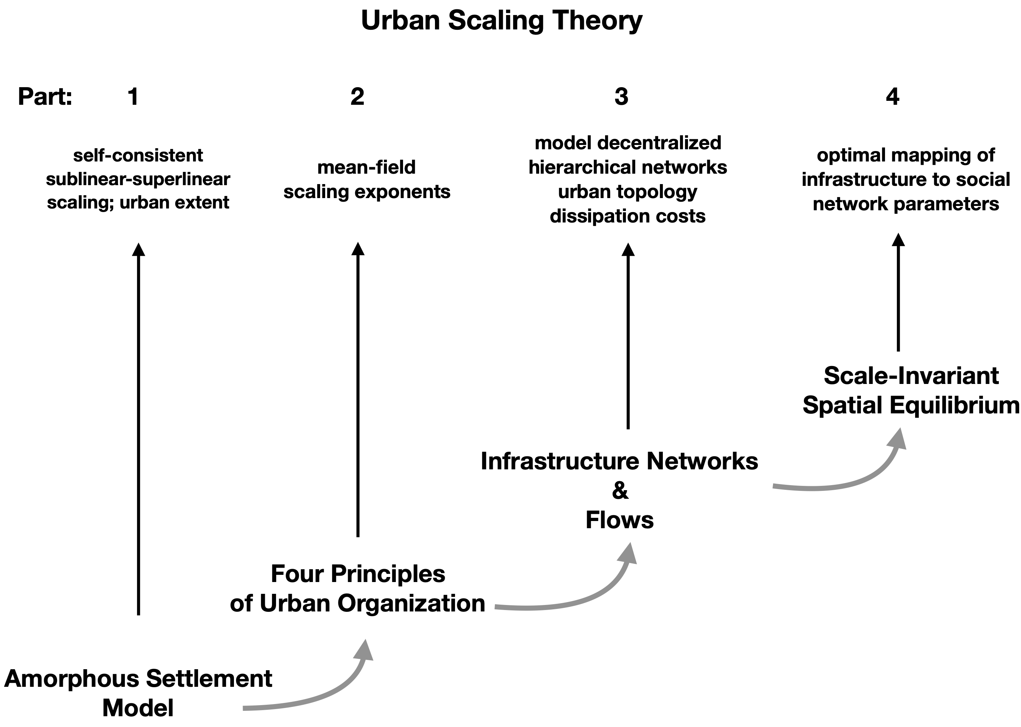

IUS Figure 3.5
Notes:
This module develops the simplest model for deriving scaling: it is simple because it has no spatial structure (no explicit infrastructure). It nevertheless applies to simple real settlements in terms of size or sophistication.

Slide 3
credit: bondyalu.blogspot.com

Slide 4




R = Radius
Capilco
Aztec Rural Village
Notes:
The gold shapes are actual houses in an Aztec settlement. We can characterize the size of the settlement by enclosing it in a circle and measuring its radius. Note that this does not mean that there is circular symmetry, it is just a characterization of size.

Slide 5
Notes:
Why is it not smaller?

Slide 6
Notes:
Or more spread out?

Slide 7
$$A^{3/2}=\frac{\sqrt{π}G}{c_{T_{0}}}N$$
$$G\frac{N}{A}=c_{T_{0}}(\frac{A}{π})^{1/2}$$
For Circle:
$$A=πR^{2}$$
$$G\frac{N}{A}$$
= benefit ~ cost =
$$c_{T_{0}}R=\frac{c_{T_{0}}}{\sqrt{π}}A^{\frac{1}{2}}$$
social interactions
movement
Notes:
We can make up a simple model by equating the (assumed positive) benefits of social contacts to the cost of moving around to realize them. The benefits are proportional to the chance of meeting people which goes like the total population N, divided by the Area (i.e. the density) time a number G, which measures that benefit of each interaction. The cost is simply proportional to the typical distance traveled, which is R.

Slide 8
This gets us two good things:
$$A(N)={\left(\frac{\sqrt{π}G}{c_{T_{0}}}\right)}^{\frac{2}{3}}N^{\frac{2}{3}}$$
$$1-δ=\frac{2}{3}$$
“City” Area:
sublinear
Total
Socioeconomic
Outputs:
$$Y(N)=G\frac{N^{2}}{A}={\left(\frac{G^{\frac{1}{2}}c_{T_{0}}}{\sqrt{π}}\right)}^{\frac{2}{3}}N^{\frac{4}{3}}$$
$$1+δ=\frac{4}{3}$$
superlinear
Note also different $G,c_{T_{0}}$ dependences
$$δ=\frac{1}{3}$$
Results in:
too big !
quality of interactions
transportation costs
c. f. income in economic models models
Notes:
Equating the cost to benefit, we can solve for the area as a function of the population, and also the total number of realized interactions (and their products). We obtain the superlinear-sublinear pattern of scaling we have seen ! The only snag is that delta =1/3 is a bit too large (recall it was more like 1/6). So we will need to work a bit harder to put in infrastructure and see if we can get to a more realistic number.

Slide 9
To get closer to the right answer need:
A better model of social interactions over built space
To understand the general characteristics of urban built spaces
To better compute costs of transportation and land rents (better than in economics)
To understand fundamental constraints on human interactions
Notes:
We also need to make an argument why the number of social contacts per capita can increase, even if human time and effort must remain limited. We now turn to that problem, before we deal with infrastructure.

