Slide 1
Introduction to Urban Sciences
Lecture 1
1.0 Syllabus, Lecture Themes and Objectives
©Luís M. A. Bettencourt 2024

Slide 2
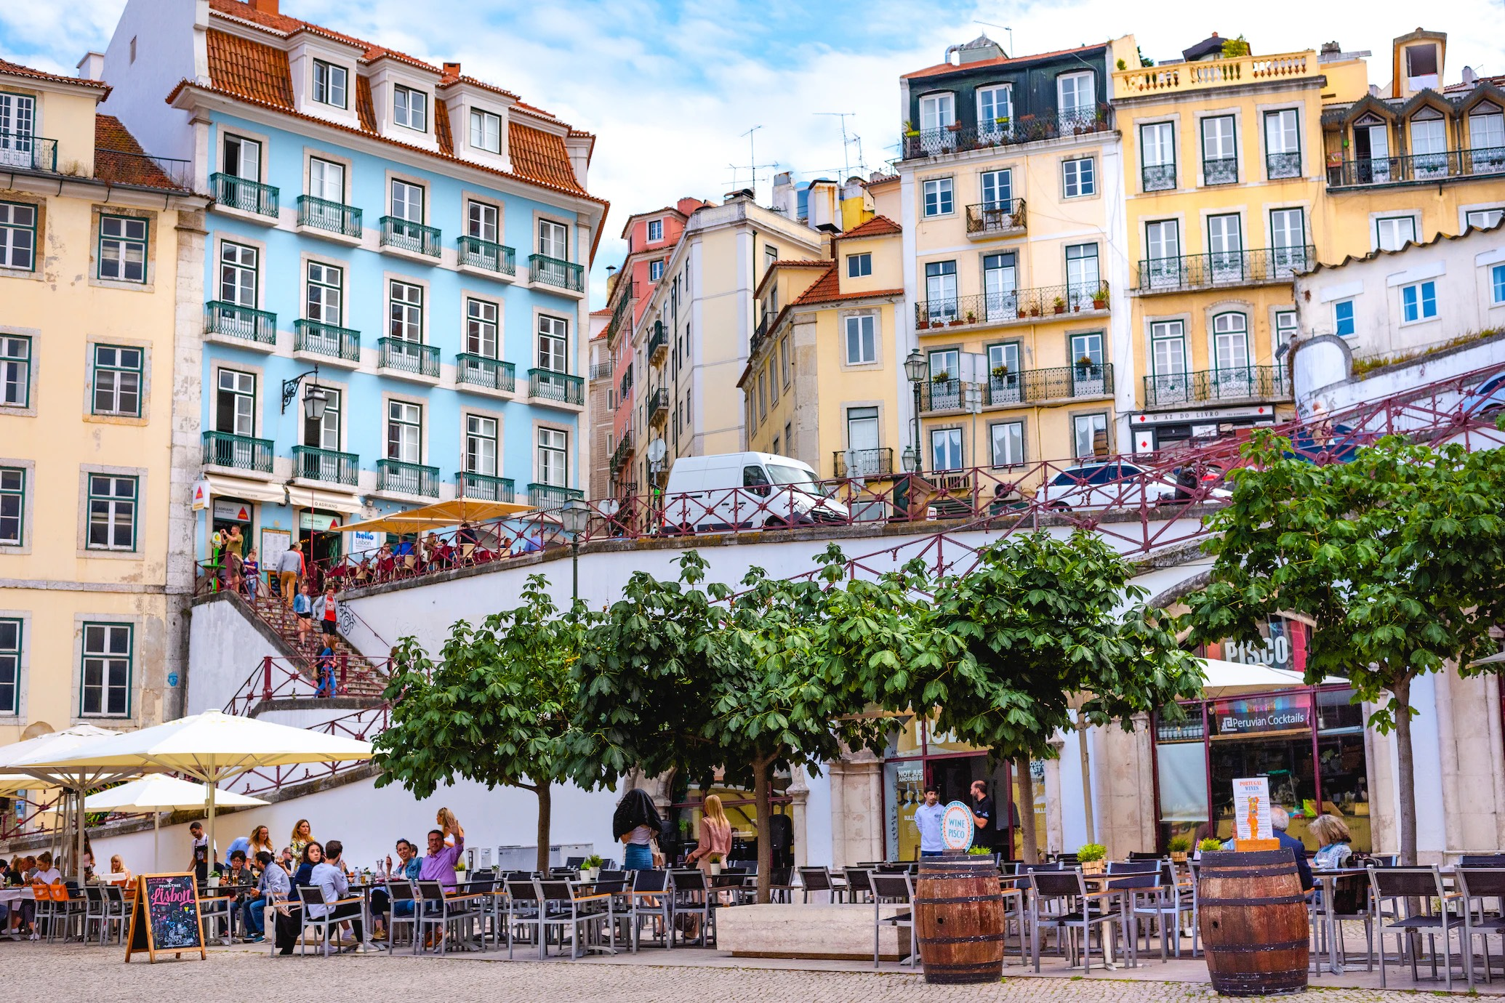
Where are we?
Credit: Paulo Evangelista
Notes:
The idea is to discuss how cities vary, and reflect their own history, context etc, but also have many essential common elements: people, streets, buildings, public spaces, social live, information (signs, names), … This is Lisbon, where I grew up.

Slide 3
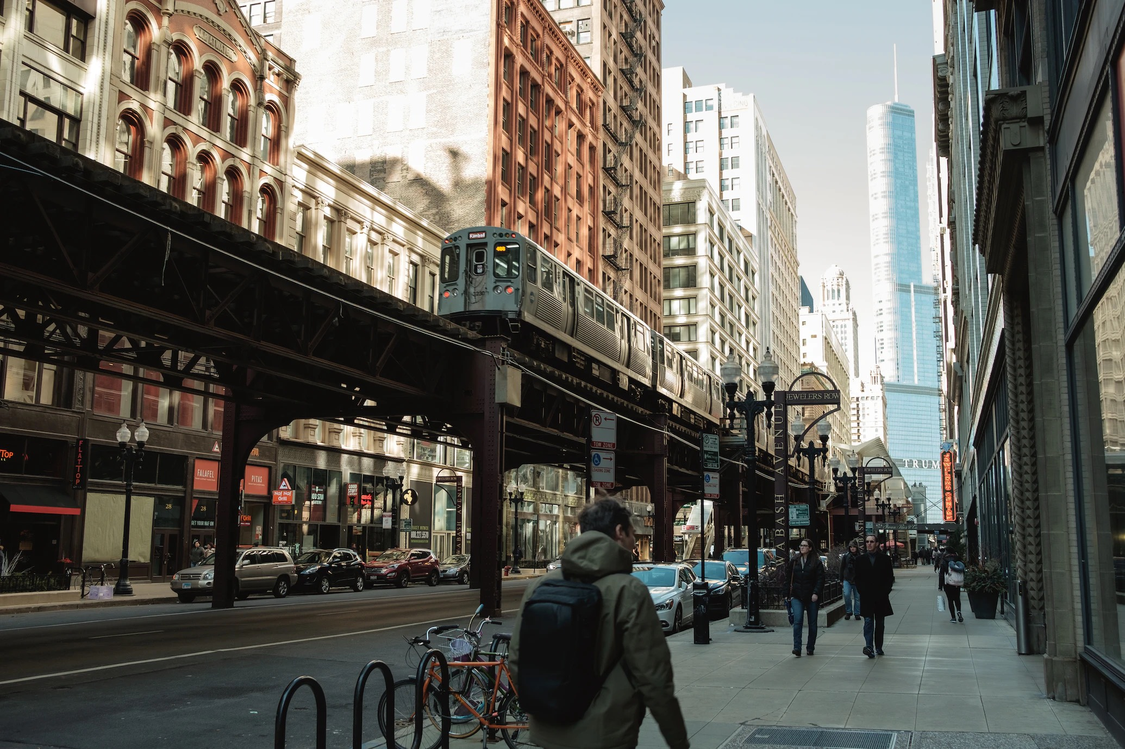
Where are we?
Credit: Johannes Krupinski
Notes:
This is Chicago, where the lectures were, so easy. The L-train (L=elevated) is a local giveaway.

Slide 4
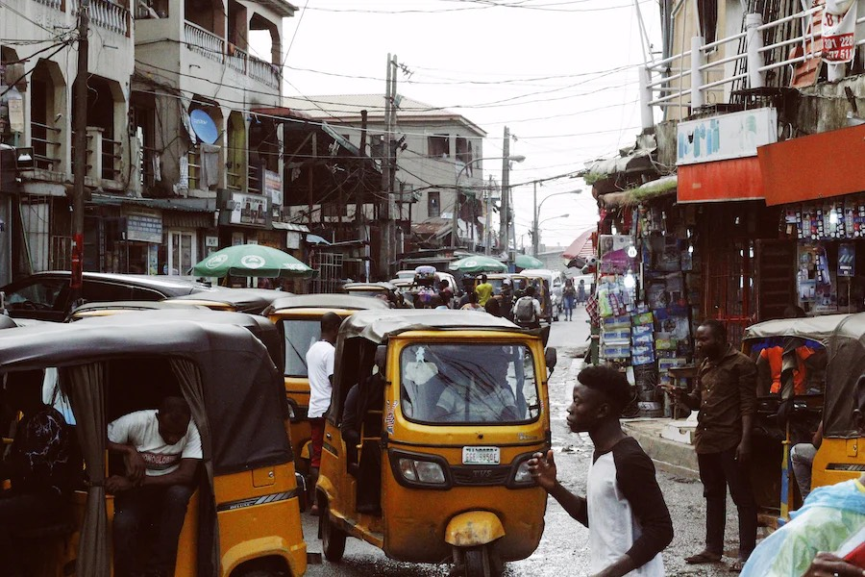
Where are we?
Credit: Muhammadtaha Ibrahim Ma'aji
Notes:
This is Lagos, Nigeria, which is projected to become the largest city in the world by the end of the century, with maybe 80 million people. Much will change …

Slide 5
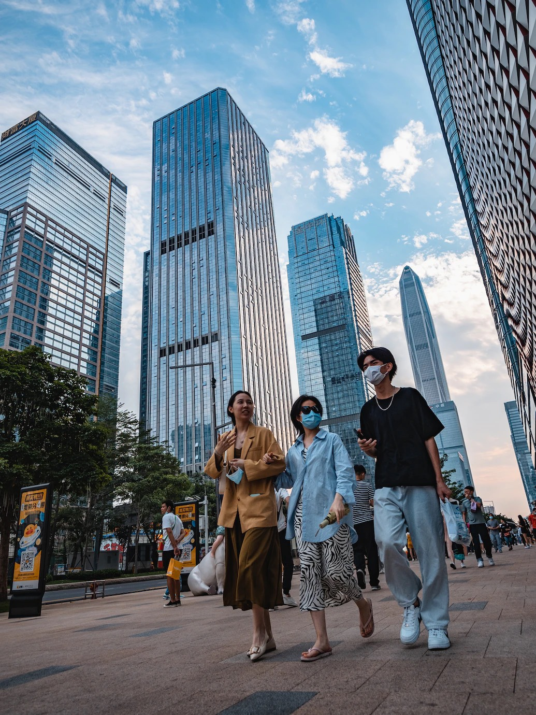
Where are we?
Credit: Joshua Fernandez
Notes:
This is Shenzhen in China, one of the richest cities in China and one of the most high tech… also in terms of ambitions towards sustainability.

Slide 6
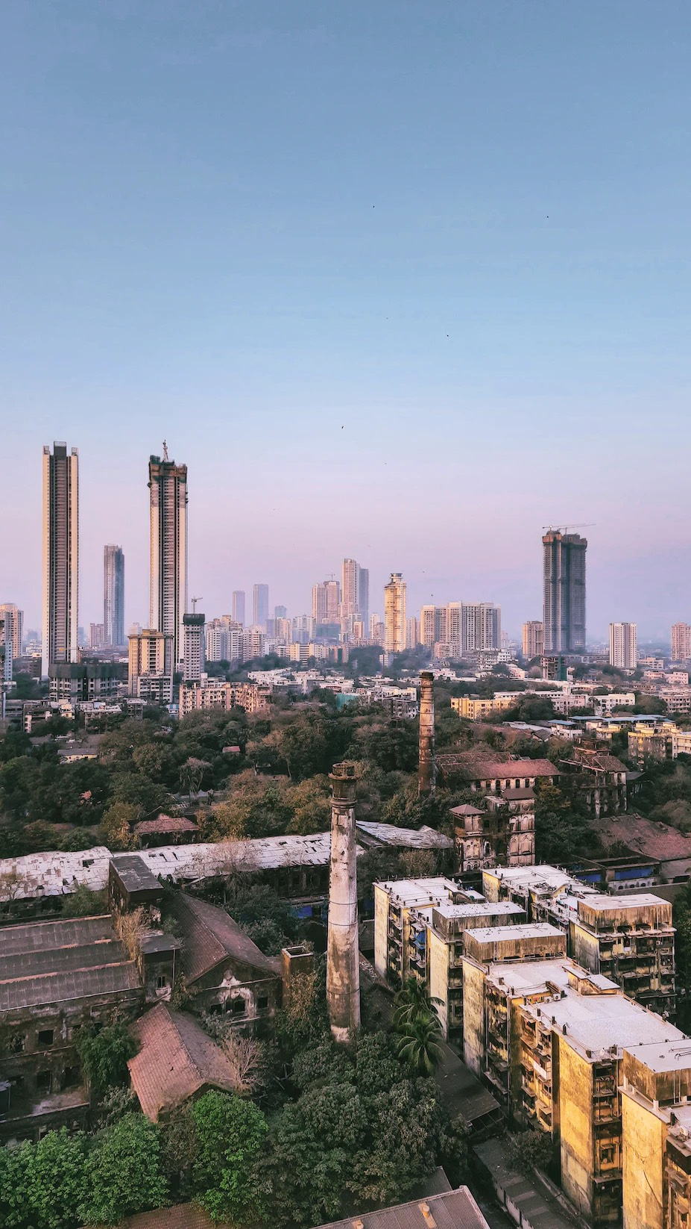
Where are we?
Credit: Harsh Kondekar
Notes:
This is Mumbai, India. With its skyline just coming up, but also with some post-industrial abandonment in some of its central areas, despite strong growth in the largest urban area. Projected to reach something like 50 million people by the second half of the century.

Slide 7
Life in cities is extremely diverse, but it is nevertheless predictable in many ways
We will build a fundamental understanding (and predictive models) of cities
around the world
rich and poor
stagnant and developing
throughout history
into the future
This is possible because there are general principles that explain what cities are and how they change
It is from this general analytical framework that we can also understand particular places and histories
Urban Science is dedicated to discovering, modeling and applying such principles

Slide 8
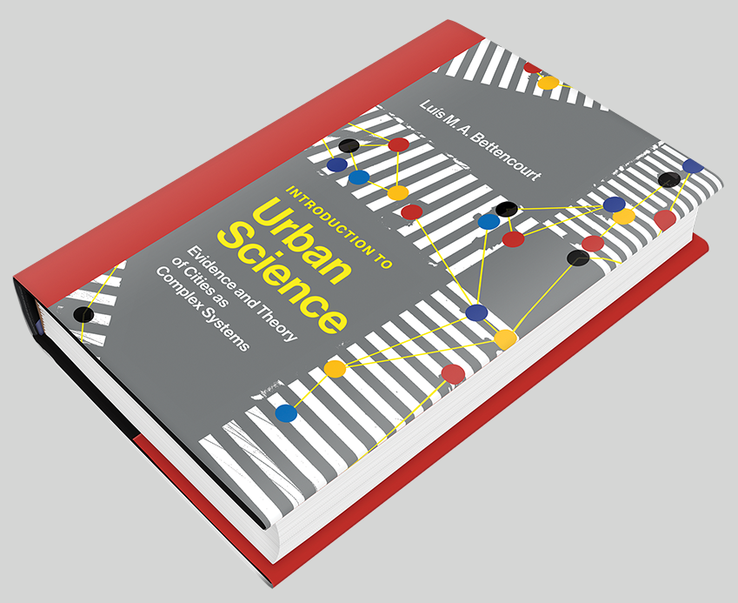
Summary
This course is a grand tour of conceptual frameworks, general phenomena, emerging data and policy applications that define a growing scientific, integrated understanding of cities and urbanization.
I hope this course will give you a new perspective of why we live in cities and why urban environments are so important, despite their challenges, to achieving all the difficult things we do in human societies. Above all I hope you learn to read cities in new ways and are able to imagine (and help plan) better futures out of the processes we will study.
Themes include: worldwide urbanization and the challenge of sustainability, classical models from geography, economics and sociology, cities as complex networks and what they predict, variation and statistics of urban quantities, measuring and understanding diversity and productivity, neighborhoods and human development, cities in history and the origins of settlements, the structure and dynamics of systems of cities big and small (such as the US), the origins of (economic) growth and change, the emergence of institutions and their functional roles in connected, interdependent societies.
‘Textbook’:
Introduction to Urban Science (MIT Press 2021)
Notes:
The course follows the book, with approximately two lectures per Chapter. The book has a lot more detail, including background and references.

Slide 9
Introduction to Urban Sciences
Objectives
To provide students with
A deep, interdisciplinary knowledge of urban phenomena from a scientific perspective;
A new framework and capacity to conceive systemic approaches and solutions to urban challenges;
An introduction to urban evidence, data and (mathematical) methods;
An appreciation of the unique and critical role of cities in human societies and in processes of massive change and development.

Slide 10
Grading and Logistics
Weekly assignments:
9 assignments in total (no final exam)
Each assignment typically has a choice of qualitative versus quantitative tasks
Qualitative rely on reading a book chapter or paper, discuss and generalize
Quantitative involve data and coding in python and/or mathematical analysis
One week to complete, submission on canvas.
late submission: -1 point after missing the deadline -0.5 for every additional week.
Class participation
TA and office hours
TA: Jordan Kemp (PhD, Physics), office hours TBD
Luis Bettencourt. Thursdays 2:30-3:30pm
zoom link: Pass Code: urban or schedule for in-person at Erman 210.

Slide 11
Introductions
- your name & major/minor or interest
- place where you grew up / call home (if you don’t mind sharing).
- what do you hope for from this course?
Notes:
I like to ask students to state what interests them in the class and a place (city?) that they associate with, and then I try to call them to comment on issues we discuss along the course from the perspective of that place.

