Slide 1
Lecture 5
Network Models of Cities
5.1 What are networks? Network Effects and Metcalfe’s Law
IUS 3.2.1
©Luís M. A. Bettencourt 2024

Slide 2
Infrastructure
Education
Government
Key Concepts
Health
Crime
Environment
Network Effects
Scaling Invariance
Innovation
evidence on cities
Where we are going:
Cities are Socioeconomic Networks
embedded in (built) Space-Time
Generalize
Agglomeration Economies
Urban Economics
Centrifugal+Centripetal Market Forces
e.g. Core-periphery model
Notes:
The concept of network effects, generalizes the earlier concepts of agglomeration effects, which were more around economic quantities and spoke of density rather than explicitly about interactions. It is this concept that drives the idea of cities as networks and will derive scaling relations.

Slide 3
Network models of cities
What is a Network? Network Effects!
Basic Concepts:
Notes:
A very brief introduction to networks follows.

Slide 4

Social Network
A simplified scheme of who interacts with whom
Notes:
Everyone is familiar with social networks between people…

Slide 5
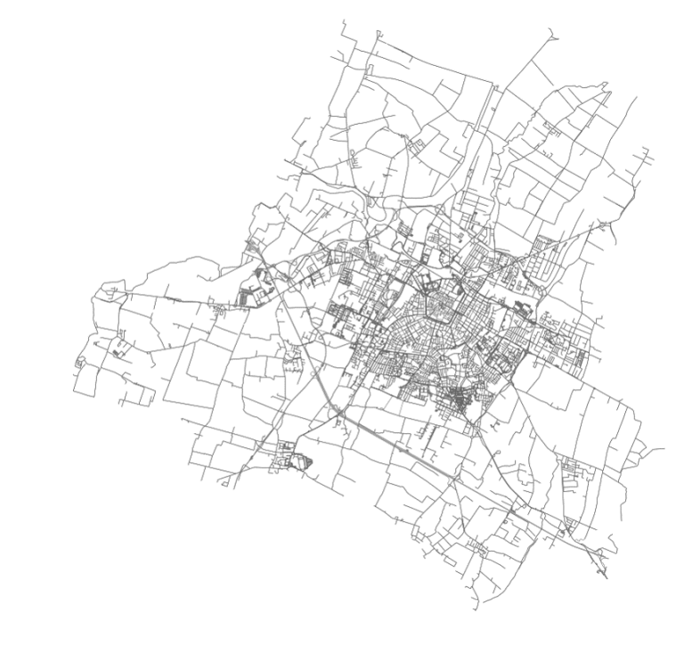
A physical network, abstracted
credit: Geoff Boeing
python software: OSMnx
Modena, Italy
Notes:
But there are also - clearly - networks of infrastructure, such as streets and roads.

Slide 6
A network is a “graph”
5
$$F_{ij}=\left(\begin{matrix}0 & 0 & 0 & 1 & 0 & 0 \\ 0 & 0 & 0 & 1 & 0 & 0 \\ 0 & 0 & 0 & 1 & 0 & 1 \\ 1 & 1 & 1 & 0 & 1 & 0 \\ 0 & 0 & 0 & 1 & 0 & 1 \\ 0 & 0 & 1 & 0 & 1 & 0\end{matrix}\right)$$
6
4
2
representation
3
1
“Adjacency Matrix”
Notes:
Network as a graph and its matrix representation. Can count degree of a node by counting 1s in rows or columns…

Slide 7
Some Basic Network Concepts:
Degree of a Node:
5
$$F_{ij}=\left(\begin{matrix}0 & 0 & 0 & 1 & 0 & 0 \\ 0 & 0 & 0 & 1 & 0 & 0 \\ 0 & 0 & 0 & 1 & 0 & 1 \\ 1 & 1 & 1 & 0 & 1 & 0 \\ 0 & 0 & 0 & 1 & 0 & 1 \\ 0 & 0 & 1 & 0 & 1 & 0\end{matrix}\right)$$
6
4
2
3
1
Node 4 has degree 4
Node 5 has degree 2
Node 6 has degree 2 …

Slide 8
Some Basic Network Concepts:
How many possible unique connections (all to all)?
5
6 nodes:
6
Node 1 connects to 2,3,4,5,6 = 5 connections
4
Node 2 connects to 3,4,5,6 = 4 connections
2
Node 3 connects to 4,5,6 = 3 connections
3
Node 4 connects to 5,6 = 2 connections
1
Node 5 connects to 6 = 1 connections
=15 connections
$$\frac{N(N-1)}{2}$$
For a graph with N nodes there can be:
Graph Connectivity ~ N² Number of Nodes

Slide 9
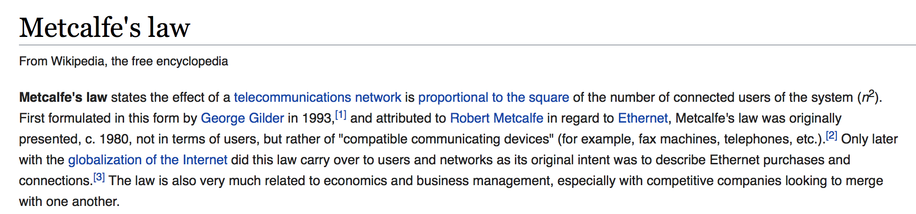
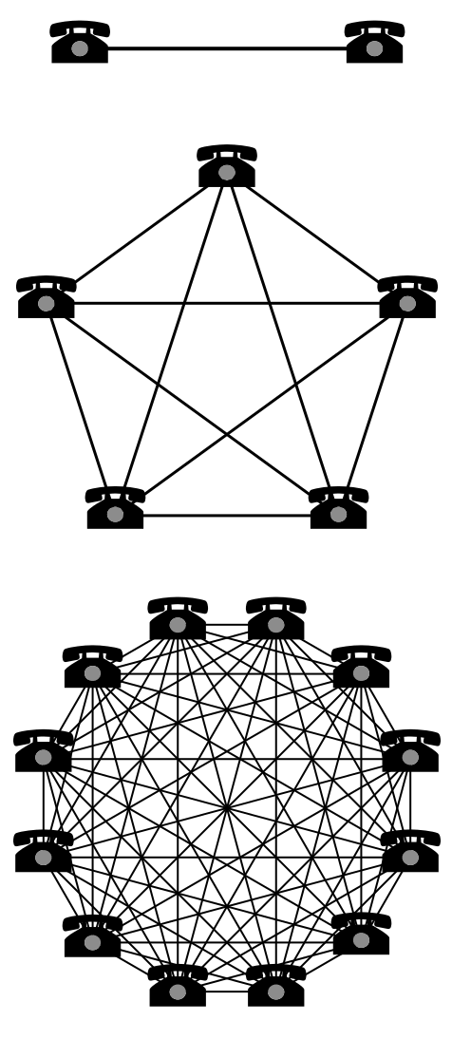
Some Basic Network Concepts:
Notes:
Metcalf’s law is the simplest law of network effects.

Slide 10
Some Basic Network Concepts:
Network Effects
The “value” of a network is proportional to the number of connections, not nodes
Connections grow faster than proportionally to the number of nodes
$$Y∼N^{β_{M}}β_{M}=2$$
Metcalfe
Can this happen for cities? How can it not !
Notes:
It is a particular case of a superlinear (scaling larger than 1) scaling law with exponent =2. It is the maximum exponent if networks are made up of binary connections (not hyper graphs).
Could something like this happen to the social networks of cities ? YES !

