Slide 1
Lecture 4
How to think about Cities: Economic Models
4.1 Models of Urban Economics
IUS 2.2.3 + 2.2.5
©Luís M. A. Bettencourt 2024

Slide 2
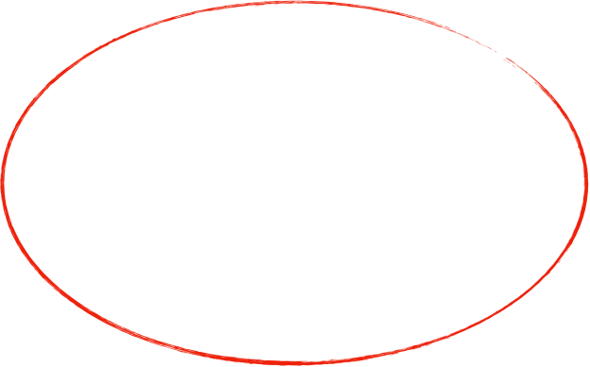
Economics Models about Cities
Urban Economics
Economic Geography
Monocentric City
Core-Periphery Model
Remember Alonso
tries to explain
how land rents and transportation costs
shape the city internally
how sector concentration, trade and transportation costs
vary between spatial regions
different scales: city versus regions (rural areas + cities)

Slide 3
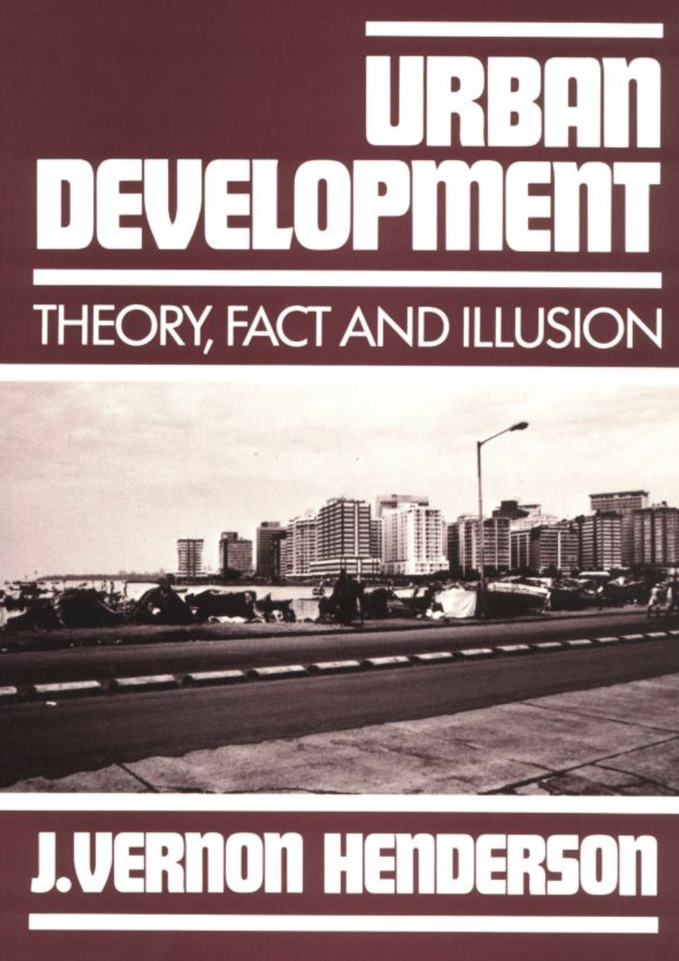
Models of Urban Economics
1991
Notes:
These are now models of urban economics, first some general arguments and then a proper model.

Slide 4
Urban Economics
dis-economies of scale
IUS 2.2.3
Utility
agglomeration economies
Marshall
Maximum Utility
‘diseconomies’ of size
congestion
crime
pollution
housing
…
Minimum Utility
Ideal Population
Population
Henderson 1974, 1988
But cities come in wide range of population sizes!! [“Zipf’s law”]
City size limits are certainly not absolute

Slide 5
Urban Economics
(modeling the city)
IUS 2.2.3
Utility
urban hierarchy? or city “typologies”?
textile
city
financial
city
Ideal Population
textiles
Ideal Population
finance
Population
Henderson 1974, 1988
Criticism: “Black box”, too many assumptions, get what you put in

Slide 6
Urban Economics and the Internal Structure of Cities
IUS 2.2.5
(optional Reading) Brueckner (1987) The structure of urban equilibria

Slide 7



Alonso Model of the Monocentric city
Central Market for Labor
Warning: 2 averages (time and population) !
Extent of City is determined by Budget Constraint
city boundary
Idea: each person has a budget:
$$R_{max}$$
$$y=c_{r}(R)+c_{T}(R)$$
net income
(from work at CBD)
commuting costs
(home work)
$$R$$
land rent expense
(at home)
CBD
At CBD:
$$c_{T}(R=0)=0$$
minimum commuting costs
$$c_{r}(R=0)=c_{r_{max}}$$
maximum rent
$$y=c_{r_{max}}$$
rural areas surround city
At the city boundary:
$$c_{T}(R=R_{max})=c_{T_{max}}$$
maximum c. costs
$$c_{T}(R)=c_{T_{0}}R,c_{T_{0}}=\frac{c_{T_{max}}}{R_{max}}$$
cost/time/distance travelled
minimum rent
$$c_{r}(R=R_{max})=c_{r_{rural}}=c_{r_{min}}$$
$$c_{r}(R)=y-c_{T}(R)$$
$$y=c_{r_{min}}+c_{T_{max}}$$
Notes:
The von Thunen model was then ported (via Burgess’s ideas) to a city. Instead of a central market for produce, it becomes a central market for labor !

Slide 8
Start with Alonso Model
1. Consumer behavior
floor area
budget constraint:
$$y-c_{T_{0}}R=c+p_{f}(R)a_{f}.$$
consumption
of goods
price of land
Maximize Utility:
$$\max_{a_{f}}U(c,a_{f})=U_{max}$$
$$c=y-c_{T_{0}}R-p_{f}(R)a_{f}.$$
other consumption
land “consumption”
$$U[c(a_{f}),a_{f}]$$
$$\frac{dU}{dc}\frac{dc}{da_{f}}+\frac{dU}{da_{f}}=0→p_{f}=\frac{dU/da_{f}}{dU/dc}$$
maximizing sets price of housing
in both variables
land rents (in units of goods’ prices)
$$a_{f}$$
Notes:
Note that the new ingredient is that people receive utility from “land consumption”, i.e. people are assumed to like to have larger homes. Notice that the budget constraint does a lot of the work of the model. The Utility function does not have to be known explicitly.

Slide 9
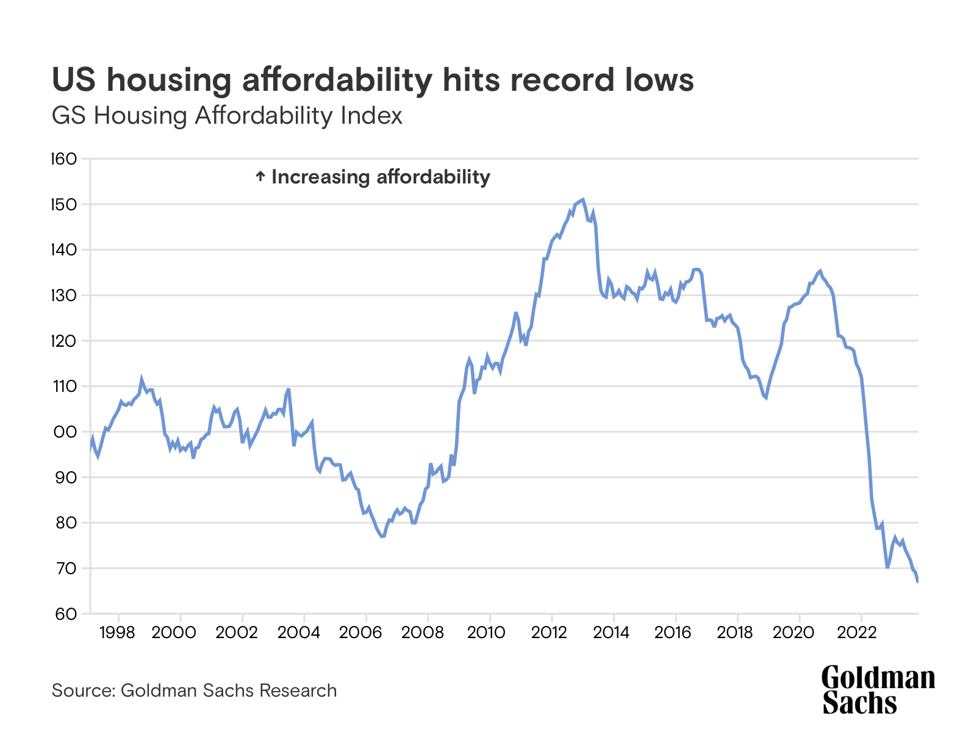
$$\frac{y}{p_{f}a_{f}}$$
Measured as income and
mortgage payment/month
https://www.goldmansachs.com/insights/articles/us-mortgage-rates-are-forecast-to-stay-above-7-percent

Slide 10
how do land rents depend on distance from city center?
$$c=y-c_{T_{0}}R-p_{f}(R)a_{f}.$$
$$\frac{dU}{dR}=\frac{dU}{dc}(-c_{T_{0}}-\frac{dp_{f}}{dR}a_{f}-p_{f}\frac{da_{f}}{dR})+\frac{dU}{da_{f}}\frac{da_{f}}{dR}=0$$
You can take all kinds of variations of utility…
cancel
$$a_{f}\frac{dp_{f}}{dR}=-c_{T_{0}}→\frac{dp_{f}}{dR}=-\frac{c_{T_{0}}}{a_{f}}<0.$$
so rents go down with distance to CBD
$$\frac{da_{f}}{dR}=\frac{da_{f}}{dp_{f}}\frac{dp_{f}}{dR}>0.$$
so the amount of land consumed increases with distance
Conclusion: Suburbs have cheaper, bigger houses
second derivative is convex
$$U[c(a_{f}),a_{f}]$$
$$\frac{d^{2}U}{da_{f}^{2}}<0$$
$$a_{f}$$

Slide 11
Repeat the same reasoning to get:
Because of fixed budget: more money in transportation is less in rent!
land rents…
decrease with
transportation costs
utility decreases with land rents
increase with income
$$\frac{dp_{f}}{dy}=\frac{1}{a_{f}}>0,\frac{dp_{f}}{dc_{T_{0}}}=-\frac{R}{a_{f}}<0,\frac{dU}{dp_{f}}=-a_{f}\frac{dU}{dc}<0.$$
house size…
Varies in the opposite direction to $p_{f}$
$$\frac{da_{f}}{dy}=\frac{da_{f}}{dp_{f}}\frac{1}{a_{f}}<0,\frac{da_{f}}{dc_{T_{0}}}=-\frac{da_{f}}{dp_{f}}\frac{R}{a_{f}}>0,\frac{dU}{da_{f}}=-a_{f}\frac{dU}{dc}\frac{dp_{f}}{da_{f}}>0.$$
decreases with income
increases with
transportation costs
utility increases with bigger housing
recall that:
$$\frac{dU}{dc}>0,\frac{d^{2}U}{da_{f}^{2}}<0→\frac{da_{f}}{dp_{f}}<0$$
This gives a bunch of qualitative expectations for the structure of the city
Quantitative expectations require a particular Utility !

Slide 12
2. Housing Producers behavior
land developers
Production Function
$$A_{H}(a_{l},K_{P})$$
= area of housing developed
area of land input
capital
$$A_{H}(a_{l},K_{P})$$
decreasing returns
to capital
Developer’s Profits and Free Entry condition:
$$K_{P}$$
$$a_{H}=\frac{A_{H}}{a_{l}},K_{P_{l}}=\frac{K_{P}}{a_{l}}$$
$$p_{f}A_{H}-a_{l}p_{l}-K_{P}p_{K}=0→a_{l}(p_{f}a_{H}-p_{l}-p_{K}K_{P_{l}})=0$$
building density
capital density
area of housing per area of land
amount of capital per area of land
“building height”
Notes:
Land developers are assumed to make no profit… This is a standard assumption in econ models, but it is clearly untrue.

Slide 13
3. Housing Producers behavior
How does the price of land and intensity of development depend on distance from center?
Maximizing Developer’s Profit + “Zero Profit” condition
$$K_{P_{l}}=\frac{p_{f}}{p_{K}}a_{H}-\frac{p_{l}}{p_{K}},\frac{da_{H}}{dK_{P_{l}}}=\frac{p_{K}}{p_{f}}$$
from maximizing profits
from zero profit condition
optimal amount of capital of building, or price for land
optimal amount of capital invested / land area
How do these vary with distance to CBD? Recall that $p_{f}$ depends on all the other variables:
$$\frac{dp_{l}}{dϕ}=a_{H}\frac{dp_{f}}{dϕ};\frac{dK_{P_{l}}}{dϕ}=-\frac{\frac{da_{H}}{dK_{P_{l}}}}{\frac{d^{2}a_{H}}{dK_{P_{l}}^{2}}}\frac{1}{p_{f}}\frac{dp_{f}}{dϕ},ϕ=y,c_{T_{0}},R,U$$
$$>0$$
land prices and capital density increase proportionally to rents payed
decrease with R (distance to CBD)

Slide 14
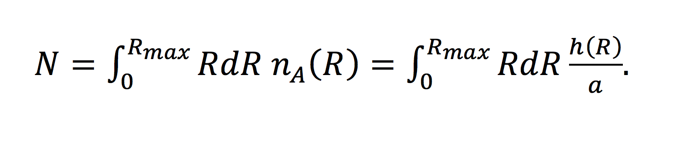
How about population density?
$$n_{A}=\frac{N}{A}∼\frac{a_{H}}{a_{f}}$$
$$A=a_{l},N=\frac{A_{H}}{a_{f}}=a_{l}\frac{a_{H}}{a_{f}}$$
Population Density
because
$$\frac{dn_{A}}{dϕ}=\frac{1}{a_{f}}\frac{da_{H}}{dK_{P_{l}}}\frac{dK_{P_{l}}}{dϕ}-\frac{a_{H}}{a_{f}^{2}}\frac{da_{f}}{dϕ}∼\frac{dp_{f}}{dϕ}$$
density decreases with distance to CBD
Global Constraints on Population and City Area
$$\frac{a_{H}(R)}{a_{f}}$$
$$p_{l}(R_{max},y,c_{T_{0}},U)=p_{l_{r}}$$
population
city area:
$$A=πR_{max}^{2}$$
rent at city’s edge=rent for agriculture
$$\frac{dA}{dN}>0,\frac{dU}{dN}<0,\frac{dp_{f}}{dN}>0,\frac{da_{f}}{dN}<0,\frac{dK_{P_{l}}}{dN}>0,\frac{dn_{A}}{dN}>0.$$
How about the extent of the city?
$$\frac{dA}{dp_{l_{r}}}<0,\frac{dA}{dy}>0,\frac{dA}{dc_{T_{0}}}<0.$$
city area increases with population, decreases with agricultural rents or transportation costs

Slide 15
And if we work a bit harder we recover Alonso’s result
cost of housing/person at city’s edge
income
$$R_{max}=\frac{y-p_{l_{r}}\frac{a_{f}}{a_{H}}}{c_{T_{0}}}$$
size of the city (radius)
transportation costs / length travelled
Notes:
This recovers the Alonso model result for the extent of the city.

Slide 16
Models of Urban Economics
Reasonable outcomes from desire for consuming housing + transportation costs
Many variants and elaborations.
- no time
- just a bit of space (radial, mono centric)
- no social structure
Features and limitations:
representative agents (no heterogeneity): same utility, same income, …
maximize same utility (via maximizing consumption) within the same budget constraint
no inequality, no diversity…
firms maximize profits, but profits are zero
free entry condition
all firms are the same, make no profit
spatial equilibrium
no change over time
no change or development, no knowledge
Equilibrium market with a fixed budget and a utility maximizing agents

